Slide 1
Rotating Wi-Fi Antennas
Estimation and Adaptive
Orientation Optimization
Signal models, algorithms, and deployment scenarios
Notes:
Source: AoA_Estimation_Rotating_WiFi_Antenna_MUSIC_ESPRIT_SAGE.md, Parts I–III.
Proposed models and controller designs. No measured gains are claimed.
Diagrams are conceptual system/algorithm schematics, not measured results. Formulas retain their LaTeX source in image descriptions and in tmp/slides_detailed/equations.json.

Slide 2
Rotation Platform
Follow the strongest path.
Poparization optimization (follow the client ),cross polarization ratio missmatch
Notes:
Source: AoA_Estimation_Rotating_WiFi_Antenna_MUSIC_ESPRIT_SAGE.md, Parts I–III.
Proposed models and controller designs. No measured gains are claimed.
Diagrams are conceptual system/algorithm schematics, not measured results. Formulas retain their LaTeX source in image descriptions and in tmp/slides_detailed/equations.json.

Slide 3
System overview
Labeled uplink CSI
and service metrics
Laptop
Phone
I. Estimate paths
II. Select orientation
AP + rotating antenna
TV
III. Adapt over time
Camera
One shared orientation per data interval. Multiple paths may belong to one client.
2
Notes:
Source: AoA_Estimation_Rotating_WiFi_Antenna_MUSIC_ESPRIT_SAGE.md, 1.1, 2.1.1, 3.1.
Diagrams are conceptual system/algorithm schematics, not measured results. Formulas retain their LaTeX source in image descriptions and in tmp/slides_detailed/equations.json.

Slide 4
Reading the mathematical notation
Notation | Meaning | Units / shape
Bold symbols | Lower case: vector; upper case: matrix | Shape stated locally
Hat / bar | Estimate / normalized vector; d̂ and b̂ denote unit axes | Context-dependent
★, arg max | Selected optimizer / argument giving the largest objective | Same type as argument
T / H / † superscript | Transpose / conjugate transpose / Moore–Penrose pseudoinverse | Matrix operations
|z|, ‖x‖₂, ‖X‖F | Magnitude / Euclidean vector norm / Frobenius matrix norm | Input units
Σ, exp, log | Sum / exponential / natural log of a dimensionless argument | operation
arg(z), eig(Ψ) | Complex phase of z / eigenvalues of Ψ | rad / complex
⊗, j, ≈ | Kronecker product / imaginary unit / approximation | j² = −1
Angles appear in degrees for actuator settings. Trigonometric and complex-phase calculations use radians.
3
Notes:
Source: AoA_Estimation_Rotating_WiFi_Antenna_MUSIC_ESPRIT_SAGE.md, 1.7, 2.1, 3.1.

Slide 5

I. 1-D rotation geometry
z
Client
β: commanded tilt ψ: arrival angle ρ: phase-center offset
arrival ψ
β = 0°…180° with 5° spacing: 37 samples.
Phase-center displacement creates a synthetic aperture.
Dipole gain peaks broadside to its axis.
β
x
The actuator controls β. The estimator infers arrival ψ. These angles serve different roles.
4
Notes:
Source: AoA_Estimation_Rotating_WiFi_Antenna_MUSIC_ESPRIT_SAGE.md, 1.3.1, 2.1.1, 2.2.1.
The in-plane model does not exactly represent arbitrary out-of-plane paths. The complex gain g includes calibrated pattern phase.
Diagrams are conceptual system/algorithm schematics, not measured results. Formulas retain their LaTeX source in image descriptions and in tmp/slides_detailed/equations.json.

Slide 6
I. 1-D geometry notation
Notation | Meaning | Units / shape
βk, β, Δ | Tilt at sample k / candidate tilt / angular sampling step | degrees; Δ = 5°
k, K | Sample index and total orientation count | k = 0…36; K = 37
ψ, ξ | In-plane arrival angle; ξ is generic arrival direction | degrees / radians
d̂(β), x–z plane | Unit antenna-axis vector; scan plane in the coordinate frame | 3 × 1; unitless
ρ, p(β) | Distance from pivot to phase center; phase-center position | m; p is 3 × 1
λ, g(β − ψ) | Wavelength; calibrated complex field response | m; relative field gain
ak(ψ), a(ψ) | Response at sample k; response vector across all K positions | complex; K × 1
j, 2πρ cos(β−ψ)/λ | Imaginary unit; geometry-induced phase term | dimensionless phase
The simple in-plane model assumes paths lie in the scan plane. Out-of-plane paths require the full geometry.
5
Notes:
Source: AoA_Estimation_Rotating_WiFi_Antenna_MUSIC_ESPRIT_SAGE.md, 1.3.1, 2.2.1.

Slide 7
I. 2-D pan–tilt geometry
z
phase center
γ: pan α: polar tilt ξ = (θ, φ): source direction
p = ρ b̂
Control q = (γ, α): pan and polar tilt.
Search joint arrival (θ, φ), plus delay if used.
Use reachable states and avoid redundant pole samples.
α
x
γ
y
Pan–tilt supports a joint spatial search. Two independent 1-D peaks do not define a paired AoA.
6
Notes:
Source: AoA_Estimation_Rotating_WiFi_Antenna_MUSIC_ESPRIT_SAGE.md, 1.4.1–1.4.4, 2.3.1.
α and θ are polar angles from +z. The control range does not imply an upper-hemisphere source prior. Full source sphere is allowed unless scene knowledge restricts it.
Diagrams are conceptual system/algorithm schematics, not measured results. Formulas retain their LaTeX source in image descriptions and in tmp/slides_detailed/equations.json.

Slide 8
I. 2-D geometry notation
Notation | Meaning | Units / shape
q = (γ, α) | Commanded pan–tilt orientation of the antenna | actuator state
γ, α | Pan around +z; polar tilt measured down from +z | γ: [0°,360°); α: [0°,90°]
ξ = (θ, φ) | Arrival direction: source polar angle and azimuth | θ: [0°,180°]; φ: [0°,360°)
b̂(q), u(ξ) | Unit antenna-axis vector; unit vector toward arriving path | 3 × 1 each; unitless
μ = b̂T u | Cosine of angle between axis and arrival direction | unitless; [−1,1]
χ = arccos μ | Axis-to-arrival angle that controls an ideal dipole pattern | radians / degrees
gn(q;ξ), an(q;ξ) | Calibrated complex field gain; complete response on tone n | complex relative response
ρ, λn, p(q) | Phase-center radius; tone wavelength; position ρb̂(q) | m
α and θ are polar angles, not elevation above the horizontal. Elevation equals 90° minus polar angle.
7
Notes:
Source: AoA_Estimation_Rotating_WiFi_Antenna_MUSIC_ESPRIT_SAGE.md, 1.4.1, 2.1.1, 2.3.1.

Slide 9
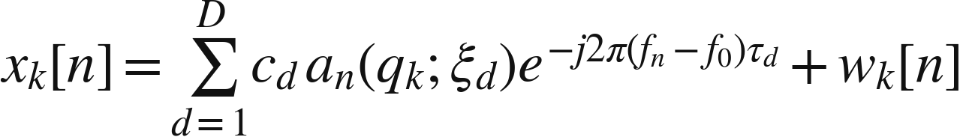
I. CSI and signal model
k: orientation n: subcarrier d: path ξ: arrival direction τ: path delay
Known client pilots
CSI at orientations
Phase + gain correction
Combine only measurements within a valid coherence window.
A reference CSI ratio needs calibration before predicting absolute power.
8
Notes:
Source: AoA_Estimation_Rotating_WiFi_Antenna_MUSIC_ESPRIT_SAGE.md, 1.2.2–1.2.3, 1.5, 2.1.1–2.1.2.
Diagrams are conceptual system/algorithm schematics, not measured results. Formulas retain their LaTeX source in image descriptions and in tmp/slides_detailed/equations.json.

Slide 10
I. Measurement notation
Notation | Meaning | Units / shape
i, d, Di | Client index; propagation-path index; path count of client i | client count ≠ path count
k, n, m | Orientation, subcarrier and valid snapshot/sweep indices | discrete indices
K, L, M | Counts of positions, valid subcarriers and snapshots | positive integers
fn, f0, Δf, λn | Tone frequency, reference frequency, spacing, wavelength | Hz, Hz, Hz, m
ξi,d, τi,d | Arrival direction and delay of path d from client i | angle(s), s
ci,d, xk[n], wk[n] | Complex path gain, calibrated CSI sample and additive noise | consistent channel units
x, A, c, w | Single-tone stacked CSI, manifold, path gains and noise | K×1; K×D; D×1; K×1
X, B | Multi-tone data and full response matrix for gain fitting | KL×M; KL×D
At one tone, absorb the relative delay phase into its gain. Full-frequency B retains each tone’s explicit delay phase.
9
Notes:
Source: AoA_Estimation_Rotating_WiFi_Antenna_MUSIC_ESPRIT_SAGE.md, 1.2.2, 1.3.2, 2.1.2.

Slide 11
I. Acquisition and calibration
INPUT: scan states, client IDs, calibration, timing budget
for each scan state:
move, settle, and record the actual actuator state
sound identified clients and retain tone/time metadata
correct receiver gain, timing offset, and phase drift
revisit a reference state to test consistency
if coherent measurement window is valid:
build compatible snapshots for MUSIC or SAGE
else:
use magnitude likelihood or direct performance probes
OUTPUT: calibrated observations plus validity flags
A stable nonzero reference supports relative phase. Its frequency response and gain still need calibration.
10
Notes:
Source: AoA_Estimation_Rotating_WiFi_Antenna_MUSIC_ESPRIT_SAGE.md, 1.2.3, 1.5, 2.1.1, 2.1.4–2.1.5.

Slide 12
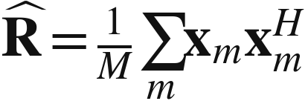
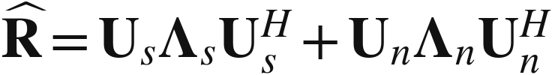
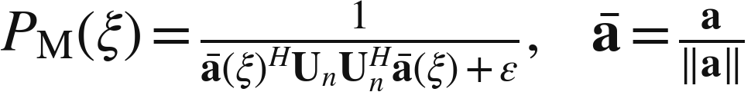
I. MUSIC estimation
Valid snapshots
Covariance + eigenvectors
R̂: covariance Us / Un: signal / noise eigenvectors
Λs / Λn: eigenvalues ε: numerical floor
Search normalized spectrum
Noise-subspace orthogonality
Separated direction peaks
Normalize the manifold, select supported path count D,
and recover complex gains after locating peaks.
11
Notes:
Source: AoA_Estimation_Rotating_WiFi_Antenna_MUSIC_ESPRIT_SAGE.md, 1.3.2–1.3.3, 2.1.4.
Use common-frequency full-rank covariance or the justified wideband construction on the next slide. Repeating identical coherent multipath snapshots does not restore rank. MUSIC peak heights are not calibrated path powers.
Diagrams are conceptual system/algorithm schematics, not measured results. Formulas retain their LaTeX source in image descriptions and in tmp/slides_detailed/equations.json.

Slide 13
I. MUSIC subspace notation
Notation | Meaning | Units / shape
xₘ, M | Compatible synthetic snapshot; number of such snapshots | K×1; count
R̂ | Sample covariance of stacked measurements | K × K; Hermitian
D, Us, Un | Supported path count; signal and noise eigenvector bases | K×D; K×(K−D)
Λs, Λn | Diagonal matrices of signal/noise eigenvalues | D×D; (K−D)×(K−D)
a(ξ), ā(ξ) | Calibrated steering vector; a divided by its norm | K × 1; ‖ā‖₂ = 1
PM(ξ), ε | Normalized MUSIC score; positive numerical floor | relative score; unitless
H, aH Un UnH a | Conjugate transpose; energy projected into noise space | scalar ≥ 0
Peak directions, Ĉ | Estimated directions; gains fitted jointly after peak search | angles; D × M
For angle-delay MUSIC, replace K by KQ and a by bQ. Pseudo-spectrum heights are not physical path powers.
12
Notes:
Source: AoA_Estimation_Rotating_WiFi_Antenna_MUSIC_ESPRIT_SAGE.md, 1.3.2–1.3.3, 2.1.4.

Slide 14
I. MUSIC_FIT pseudocode
MUSIC_FIT(client_CSI):
calibrate CSI and preserve client identity
if angular snapshots have valid full rank:
build angular covariance
else:
validate tones and aperture approximation
form overlapping Q-tone windows
build angle-delay covariance; check rank
extract noise subspace; search normalized peaks
fit complex gains jointly to original CSI
validate on held-out data; return fit or UNRELIABLE
The fallback uses bQ(ξ,τ) = vQ(τ) ⊗ a0(ξ), with S = L − Q + 1 ≥ D and D < KQ.
13
Notes:
Source: AoA_Estimation_Rotating_WiFi_Antenna_MUSIC_ESPRIT_SAGE.md, 2.1.4.
Frequency smoothing assumes equally spaced valid tones and an approximately frequency-flat aperture response. Distinct delays modulo 1/Δf, enough offsets, independent columns and nonzero gains are necessary for the stated rank restoration. Equal delays are not decorrelated by this construction alone. Fit gains by QR/SVD least squares and check held-out residuals.
Diagrams are conceptual system/algorithm schematics, not measured results. Formulas retain their LaTeX source in image descriptions and in tmp/slides_detailed/equations.json.

Slide 15

I. Frequency-smoothed MUSIC
Notation | Meaning | Units / shape
Q, L, S | Tones/window, usable tones, and shifted windows S = L−Q+1 | counts
b, zᵢ,b,m | Window start offset; stacked Q-tone observation | b = 0…S−1; KQ×1
vQ(τ), bQ(ξ,τ) | Delay progression and joint angle-delay manifold | Q×1; KQ×1
Δf, τ, a0, ⊗ | Tone spacing, path delay, reference manifold, Kronecker product | Hz; s; K×1; operation
Requires valid uniform tones and a nearly frequency-flat aperture. Equal path delays are not decorrelated this way.
14
Notes:
Source: AoA_Estimation_Rotating_WiFi_Antenna_MUSIC_ESPRIT_SAGE.md, 2.1.4.
Distinct delays modulo 1/Δf, S≥D, independent response columns, nonzero gains and D<KQ support rank restoration. Search delay over an interval shorter than 1/Δf. This is a conditional construction, not a general covariance repair.

Slide 16



I. ESPRIT in beamspace
Calibrated circular manifold
Validated phase-mode transform
Es: transformed signal subspace
J1 / J2: selection matrices Ψ: invariance operator
Overlapping virtual subarrays
No spectral grid search after a valid transform.
Verify invariance and conditioning for the actual geometry.
Eigenvalue angle readout
15
Notes:
Source: AoA_Estimation_Rotating_WiFi_Antenna_MUSIC_ESPRIT_SAGE.md, 1.3.4, 1.4.4, 1.6.
The source proposes a phase-mode approximation. A partial 180° arc and a measured pattern do not automatically yield exact full-circle UCA invariance. The final angle map depends on the validated transform.
Diagrams are conceptual system/algorithm schematics, not measured results. Formulas retain their LaTeX source in image descriptions and in tmp/slides_detailed/equations.json.

Slide 17
I. ESPRIT steps and notation
Notation | Meaning | Units / shape
Es | Signal-subspace basis after the validated mode transform | V × D
J1, J2 | Matrices selecting two overlapping virtual subarrays | R × V each
Ψ | Operator mapping one selected subspace to the other | D × D
V, R, †, eig, arg | Mode count, selected rows, pseudoinverse, eigenvalues, phase | defined locally
validate beamspace transform and response conditioning
form Es; solve Psi = pinv(J1 * Es) * (J2 * Es)
map eigenvalue phases to angles using the calibrated convention
validate reconstructed responses; reject an unreliable transform
A partial rotating arc does not automatically satisfy full-circle UCA invariance. Validate the approximation.
16
Notes:
Source: AoA_Estimation_Rotating_WiFi_Antenna_MUSIC_ESPRIT_SAGE.md, 1.3.4, 1.4.4.

Slide 18
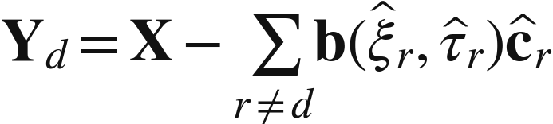
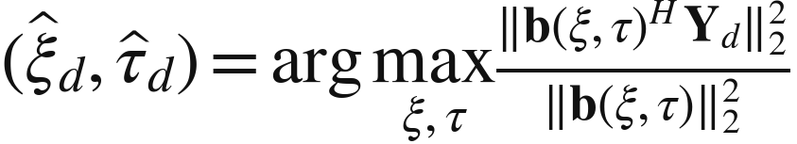
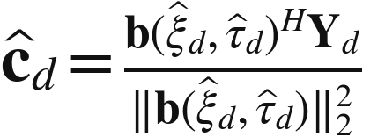
I. SAGE update equations
1. Remove other paths
2. Search angle + delay
3. Update complex gain
X: stacked CSI Yd: observation with other paths removed
b: path response across positions and tones cd: gains across snapshots
Use exact calibrated responses. Accepted improving updates reduce residual error, but can reach a local optimum.
17
Notes:
Source: AoA_Estimation_Rotating_WiFi_Antenna_MUSIC_ESPRIT_SAGE.md, 1.3.5, 1.4.4, 2.1.5.
X stacks all orientation/tone observations and sweeps. b includes the exact calibrated frequency response and delay phase. The concentrated update assumes white noise after whitening. SAGE needs identifiable data, although it does not require full-rank source covariance.
Diagrams are conceptual system/algorithm schematics, not measured results. Formulas retain their LaTeX source in image descriptions and in tmp/slides_detailed/equations.json.

Slide 19
I. SAGE notation and dimensions
Notation | Meaning | Units / shape
X, K, L, M | Stacked calibrated CSI; counts of orientations, tones, snapshots | X: KL × M
d, r, D | Updated path, other-path index, total fitted path count | 1…D
b(ξ,τ) | Full path response across every position/tone sample | KL × 1
cd, ĉd | True / fitted complex gain across snapshots for path d | 1 × M row vector
Yd | X with all fitted paths except d subtracted | KL × M
ξ, τ | Arrival direction and delay searched in each path update | 1-D/2-D angle(s); s
bH Yd, ‖bH Yd‖₂² | Matched residual projection; sum of squared magnitudes | 1 × M; scalar
‖b‖₂², arg max | Response energy normalization; maximizing angle/delay | scalar; parameter pair
Interpretation: isolate one path, optimize its parameters, update its gain, then repeat for the remaining paths.
18
Notes:
Source: AoA_Estimation_Rotating_WiFi_Antenna_MUSIC_ESPRIT_SAGE.md, 2.1.5.

Slide 20
I. SAGE_FIT pseudocode
SAGE_FIT(client_CSI):
calibrate, stack X, and whiten if necessary
choose bounded path count D
initialize paths from matched filtering or MUSIC
for each initialization:
repeat until convergence or iteration limit:
for d = 1,...,D:
Yd = X minus every other fitted path
search angle/delay; include current estimate
refit gain; accept only residual improvement
evaluate held-out reconstruction error
return best reliable fit, otherwise UNRELIABLE
Both 1-D and 2-D use this loop. Only the calibrated manifold and angle search domain change.
19
Notes:
Source: AoA_Estimation_Rotating_WiFi_Antenna_MUSIC_ESPRIT_SAGE.md, 2.1.5.
Use bounded path-count selection, multiple starts, current-parameter candidates and held-out fit selection. Directly substituting magnitudes into this complex likelihood is invalid.
Diagrams are conceptual system/algorithm schematics, not measured results. Formulas retain their LaTeX source in image descriptions and in tmp/slides_detailed/equations.json.

Slide 21
I. Estimator inputs and outputs
Method | Contract | Reliability check
MUSIC | Input: valid full-rank covariance and matching manifold. Output: directions or angle-delay peaks, followed by gain fitting. | Rank and held-out fit
ESPRIT | Input: validated shift-invariant beamspace and signal basis. Output: angles from eigenvalues, with calibrated mapping. | Transform error
SAGE | Input: stacked CSI, calibrated response, path count and seeds. Output: path angles, delays and gains. | Residual and held-out fit
Reject poor fits instead of forcing a confident orientation decision.
When coherent estimation fails, compare measured service performance directly.
20
Notes:
Source: AoA_Estimation_Rotating_WiFi_Antenna_MUSIC_ESPRIT_SAGE.md, 1.6, 2.1.4–2.1.5.

Slide 22
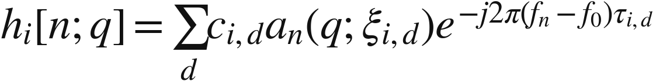
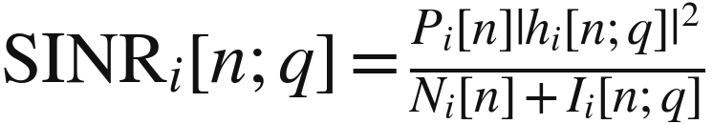
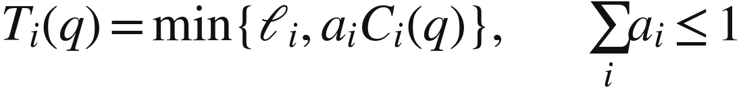
II. Channel to goodput
Calibrated CSI
Coherent channel
SINR + rate model
h: complex channel P / N / I: transmit / noise / interference power
ℓ: offered load a: airtime share C: allocated-airtime payload rate
Delivered goodput
Add complex paths before computing power.
Keep offered load and airtime policy consistent during comparison.
21
Notes:
Source: AoA_Estimation_Rotating_WiFi_Antenna_MUSIC_ESPRIT_SAGE.md, 2.1.2–2.1.5.
c contains propagation phase at f0 and excludes transmit power. C is payload rate per second allocated to a link; T is load-capped delivered rate under shared airtime. The baseline optimizes uplink reception. Downlink requires corresponding validation.
Diagrams are conceptual system/algorithm schematics, not measured results. Formulas retain their LaTeX source in image descriptions and in tmp/slides_detailed/equations.json.

Slide 23
II. Channel and rate notation
Notation | Meaning | Units / shape
hi[n;q] | Complex channel of client i, tone n, orientation q | complex channel gain
Pi[n], Ni[n], Ii[n;q] | Transmit, noise and interference power on the same tone | W; same bandwidth basis
SINRi[n;q] | Signal power divided by noise plus interference | linear, not dB
Ci(q) | Successful payload rate per second allocated to client i | bit/s of allocated airtime
ai, ℓi | Usable-data airtime share; offered traffic rate | [0,1]; bit/s
Ti(q) | Load-capped delivered goodput: min{ℓi, ai Ci(q)} | bit/s of data interval
Jsum(q), q★ | Sum of client goodputs; optimizer over feasible candidates | bit/s; actuator state
Q1, Q2, Q | Feasible tilt, pan–tilt, and generic candidate sets | sets of actuator states
Averaged dB values and sums of isolated full-airtime link rates cannot be inserted directly into these formulas.
22
Notes:
Source: AoA_Estimation_Rotating_WiFi_Antenna_MUSIC_ESPRIT_SAGE.md, 2.1.1–2.1.3.

Slide 24
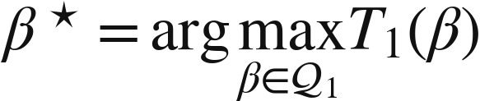
II. 1-D: one source
Reflector
Q1: feasible tilt grid β★: selected tilt T1: client-1 goodput
Fit the client’s multipath channel, then score every feasible tilt.
Use goodput or a declared SINR objective. A dominant AoA is only an input.
Probe finalists and the current tilt before committing.
Client 1
Shared AP orientation
Direct + reflected paths
23
Notes:
Source: AoA_Estimation_Rotating_WiFi_Antenna_MUSIC_ESPRIT_SAGE.md, 2.2.1–2.2.2.
Each reflected path belongs to the same source. Dipole gain is generally broadside, so pointing the axis toward a source is not the optimizer.
Diagrams are conceptual system/algorithm schematics, not measured results. Formulas retain their LaTeX source in image descriptions and in tmp/slides_detailed/equations.json.

Slide 25
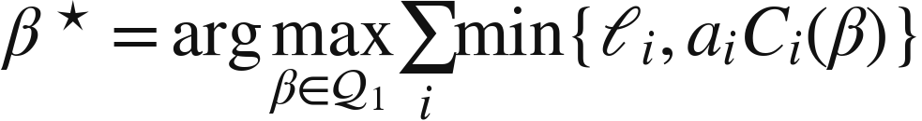
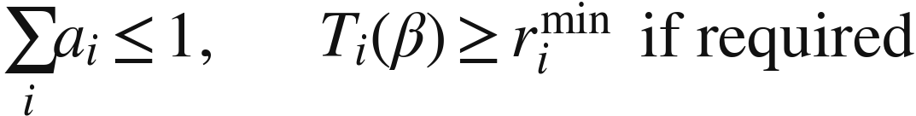
II. 1-D: multiple sources
i: client index ℓi: offered load ai: airtime share rmin: minimum rate
Fit each labeled client separately. Sum delivered rates after load and airtime limits.
One common tilt serves all clients. Equal fixed airtime is a reproducible baseline.
Pure sum-goodput can sacrifice a weak client. Add explicit minimum service if required.
Client 1
Client 2
Shared AP orientation
Client 3
24
Notes:
Source: AoA_Estimation_Rotating_WiFi_Antenna_MUSIC_ESPRIT_SAGE.md, 2.2.3.
Do not sum isolated full-airtime link rates or count multipath components as clients.
Diagrams are conceptual system/algorithm schematics, not measured results. Formulas retain their LaTeX source in image descriptions and in tmp/slides_detailed/equations.json.

Slide 26
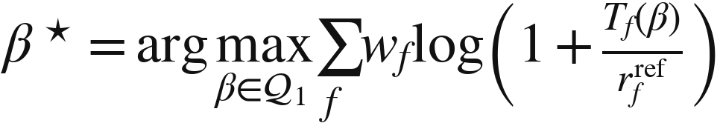
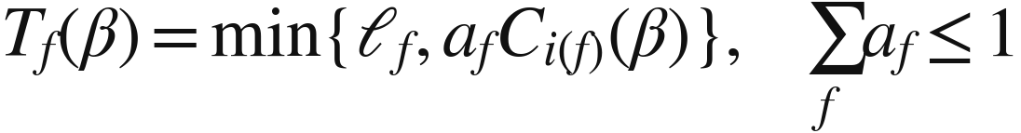
II. 1-D: service priorities
Add IOT Range– Coverage area other than Throughput
f: service index i(f): client carrying f wf: weight rref: reference rate
Policy supplies service weights, loads and flow-to-client mapping.
Concave utility reduces the reward for improving already-fast services.
Check critical rates and measured delay. Weights alone do not guarantee QoS.
Call / gaming
Video call
Shared AP orientation
Streaming
25
Notes:
Source: AoA_Estimation_Rotating_WiFi_Antenna_MUSIC_ESPRIT_SAGE.md, 2.2.4.
r_ref is a positive reference rate. Services on the same device share one spatial channel and available airtime. No numerical weights are presented as standardized WMM weights.
Diagrams are conceptual system/algorithm schematics, not measured results. Formulas retain their LaTeX source in image descriptions and in tmp/slides_detailed/equations.json.

Slide 27
II. Service-priority notation
Notation | Meaning | Units / shape
f, i(f) | Logical service/flow index; client that carries that service | indices
wf | Policy-defined relative priority weight | unitless; ≥ 0
af, ℓf | Service airtime share and offered demand | [0,1]; bit/s
Tf(q) | Delivered service rate sharing client i(f)’s channel | bit/s
rfref, log(1 + Tf/rfref) | Positive reference rate; concave utility with diminishing returns | bit/s; unitless utility
rfmin, Fcritical | Required minimum service rate; set of active critical services | bit/s; set
Σf af ≤ 1 | All services together share the same data-time budget | unitless constraint
J(q), constraints | Utility ranks candidates; explicit rate/delay checks impose feasibility | depends on chosen utility
Client index i differs from service index f. Several services on one client share one spatial channel.
26
Notes:
Source: AoA_Estimation_Rotating_WiFi_Antenna_MUSIC_ESPRIT_SAGE.md, 2.2.4, 2.3.4.

Slide 28
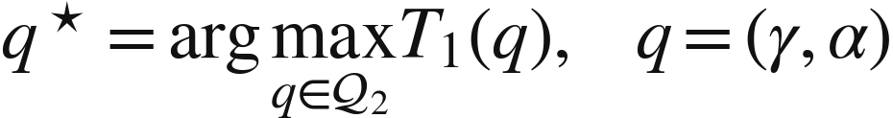
II. 2-D: one source
Q2: reachable pan–tilt states q★: selected state T1: client-1 goodput
pan γ / tilt α
Search feasible pan–tilt pairs using the joint calibrated response.
For a known dominant path, local active probes can reduce acquisition cost.
Use wider scans when multipath, uncertainty or a distant mode defeats local search.
Moving client
Shared AP orientation
27
Notes:
Source: AoA_Estimation_Rotating_WiFi_Antenna_MUSIC_ESPRIT_SAGE.md, 1.4.3, 2.3.1–2.3.2.
The schematic illustrates client motion; a dipole does not use its axis as a peak-gain beam. Active local search is conditional on valid response behavior, not a guaranteed small-sample AoA estimator.
Diagrams are conceptual system/algorithm schematics, not measured results. Formulas retain their LaTeX source in image descriptions and in tmp/slides_detailed/equations.json.

Slide 29
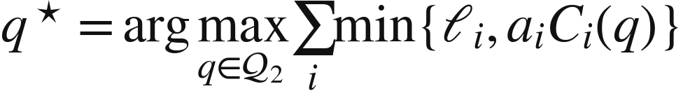
II. 2-D: multiple sources
q = (γ, α): shared pan–tilt state Ti: delivered rate of client i
Upper / lower spatial directions
Fit all client channels on the same geometry, then score each reachable pair.
Use an equal-area or coarse-to-fine grid to control scan cost.
Probe separated candidates because distant multipath maxima may compete.
Client 1
Client 2
Shared AP orientation
Client 3
28
Notes:
Source: AoA_Estimation_Rotating_WiFi_Antenna_MUSIC_ESPRIT_SAGE.md, 2.3.1, 2.3.3.
Upper-hemisphere mechanical control does not restrict source arrival directions to the upper hemisphere. Avoid redundant azimuth states at the pole only when the calibrated hardware response makes them equivalent.
Diagrams are conceptual system/algorithm schematics, not measured results. Formulas retain their LaTeX source in image descriptions and in tmp/slides_detailed/equations.json.

Slide 30
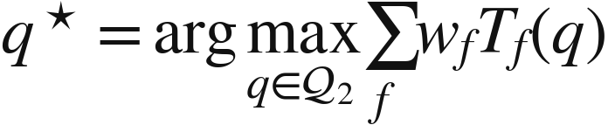
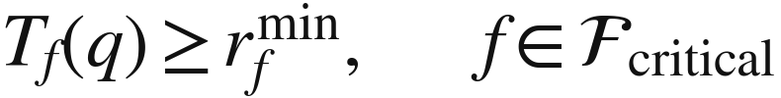
II. 2-D: service priorities
f: service wf: weight Fcritical: required-service set
Upper / lower spatial directions
Optimize weighted service delivery under one common pan–tilt state.
A newly urgent service can change the best state even when channels stay fixed.
Rescore valid models, verify delay/rate constraints, and report infeasibility if necessary.
Call / gaming
Video call
Shared AP orientation
Streaming
29
Notes:
Source: AoA_Estimation_Rotating_WiFi_Antenna_MUSIC_ESPRIT_SAGE.md, 2.3.4.
Weighted-goodput and concave utility are alternative objectives, both available in either geometry. A strict service guarantee requires explicit constraints and a feasibility policy.
Diagrams are conceptual system/algorithm schematics, not measured results. Formulas retain their LaTeX source in image descriptions and in tmp/slides_detailed/equations.json.

Slide 31
II. Worked airtime example
Illustrative assumptions: two saturated clients, equal airtime a1 = a2 = 0.5.
Candidate A has C = (100, 20) Mb/s. Candidate B has C = (65, 50) Mb/s.
Candidate | T1 (Mb/s) | T2 (Mb/s) | T1 + T2 | T1 + 4T2
A | 50 | 10 | 60 | 90
B | 32.5 | 25 | 57.5 | 132.5
Sum-goodput chooses A. Giving client 2 weight 4 chooses B.
If client 2 requires at least 20 Mb/s, A is infeasible and B meets that rate.
Assumed numbers demonstrate the objective only. They are not measured Wi-Fi performance.
30
Notes:
Source: AoA_Estimation_Rotating_WiFi_Antenna_MUSIC_ESPRIT_SAGE.md, 2.1.3, 2.2.3–2.2.4.
Authored illustrative arithmetic: A: T=(0.5×100,0.5×20)=(50,10), sum=60, weighted=50+4×10=90. B: T=(32.5,25), sum=57.5, weighted=32.5+4×25=132.5. Both use identical saturated demand and airtime. Numerical rates are hypothetical.

Slide 32
II. Selection pseudocode
SELECT_AND_VERIFY(models, Q, objective, q0):
candidates = Q plus incumbent q0
if models are reliable:
predict coherent channels and service utility
shortlist separated high-score states; refine
else: use a budgeted direct-probe candidate grid
probe candidates and q0 under the same policy
reject invalid comparisons; check service constraints
choose best verified feasible candidate
move only for confirmed gain or feasibility recovery
confirm, hold, and record measured service outcomes
Best predicted grid point and best verified candidate are limited claims, not a continuous global optimum.
31
Notes:
Source: AoA_Estimation_Rotating_WiFi_Antenna_MUSIC_ESPRIT_SAGE.md, 2.1.6, 2.4.
Diagrams are conceptual system/algorithm schematics, not measured results. Formulas retain their LaTeX source in image descriptions and in tmp/slides_detailed/equations.json.

Slide 33
II. Selection contract
Notation | Meaning | Units / shape
models | Per-client fitted paths, calibration and reliability diagnostics | Input
Q, q0 | Reachable candidate grid and current orientation | Input
objective / context | Loads, weights, airtime policy and service constraints | Input; fixed for comparison
shortlist | Several separated predicted winners plus the incumbent | Intermediate
verified metrics | Comparable direct service measurements, with uncertainty | Evidence
q★, status | Chosen candidate, measured scores, feasible/unreliable/unchanged status | Output
backup and logs | Recently checked fallback and all search/movement time | Recovery and evaluation
Use a direct probe grid if models fail. Keep “unknown comparison,” “poor performance,” and “infeasible” distinct.
32
Notes:
Source: AoA_Estimation_Rotating_WiFi_Antenna_MUSIC_ESPRIT_SAGE.md, 2.1.6, 2.4.

Slide 34
III. A: periodic full scans
Full scan + verify
Hold and serve
Next scheduled scan
PERIODIC_CONTROLLER(P_full):
serve until next fixed scheduled start
snapshot traffic and service context
scan all configured states; insert reference revisits
fit MUSIC/SAGE if coherent data remain valid
select and verify finalists, or use direct measurements
commit and confirm; record all search and movement cost
advance to next future start on the fixed schedule
Trade-off: shorter periods improve responsiveness but consume more service time and mechanical travel.
33
Notes:
Source: AoA_Estimation_Rotating_WiFi_Antenna_MUSIC_ESPRIT_SAGE.md, 3.2.
Keep the original fixed schedule and advance to the next future start if a scan takes too long. Full scans still require valid comparable measurements.
Diagrams are conceptual system/algorithm schematics, not measured results. Formulas retain their LaTeX source in image descriptions and in tmp/slides_detailed/equations.json.

Slide 35
III. Timing and control parameters
Notation | Meaning | Units / shape
t, Pfull | Physical time; fixed interval between scheduled full-scan starts | s
Wmeas | Duration of a settled performance measurement window | s
Wbeh | Behavior observation window used for usage learning | s; often longer
minimum dwell / cooldown | Time held before ordinary new motion/search is allowed | s
local radius and step | Search neighborhood bound and probe spacing | angle / axis distance
global-check interval | Independent timer for distant-state exploration | s
rolling search budget | Limit on accumulated probing, motion and interruption | time / travel budget
model age / validity | Freshness plus prediction-reliability conditions for reuse | timestamp + diagnostics
Tune from measured settling time, rate adaptation, score variance and coherence. No universal period is assumed.
34
Notes:
Source: AoA_Estimation_Rotating_WiFi_Antenna_MUSIC_ESPRIT_SAGE.md, 3.1.2, 3.2.1, 3.5.2.

Slide 36
III. B: local + global search
Monitor persistent, comparable degradation rather than isolated noisy samples.
Probe neighbors first and bound local search time.
Reserve independent global coverage. Escalate when local repair or models fail.
Global check
Current
Local probes
A remote orientation can improve while the current one stays unchanged. Degradation triggers alone will miss it.
35
Notes:
Source: AoA_Estimation_Rotating_WiFi_Antenna_MUSIC_ESPRIT_SAGE.md, 3.3.1–3.3.5.
The diagram is a search schematic, not an empirical objective surface. Global checks must continue independently of degradation at the incumbent.
Diagrams are conceptual system/algorithm schematics, not measured results. Formulas retain their LaTeX source in image descriptions and in tmp/slides_detailed/equations.json.

Slide 37
III. Local-search decision steps
LOCAL_SEARCH(q0, step, bounds, budgets):
best = q0
while time and comparison budgets remain:
form reachable neighbors; wrap pan and respect limits
compare each neighbor using paired measurements
if accepted: commit, confirm, and recenter at new best
elif comparison is inconclusive: repeat or return UNCERTAIN
else: check 2-D diagonals when useful; reduce step
stop at actuator resolution, adequacy, or budget limit
return best and explicit stopping status
1-D neighbors: β ± step. 2-D: pan/tilt perturbations, with physical-axis neighbors near a pole.
36
Notes:
Source: AoA_Estimation_Rotating_WiFi_Antenna_MUSIC_ESPRIT_SAGE.md, 3.3.2–3.3.3.
Trigger only after persistent comparable degradation. Freeze the accepted baseline during suspected deterioration or search. Local success may justify bounded step expansion; a valid unsuccessful poll supports contraction. Inconclusive observations do not establish a local optimum. q0 is the incumbent supplied to this subroutine.

Slide 38
III. B: controller pseudocode
EVENT_CONTROLLER():
initialize by full scan; store backups and coverage queue
while active:
monitor valid service metrics and current context
if severe failure: run budgeted recovery
elif only policy changed: rescore valid models; verify
elif sustained degradation: local search; widen if needed
if independent global timer is due:
probe coverage states and diverse archive candidates
refresh MUSIC/SAGE only from sufficient valid new data
confirm changes; reset baseline only after valid settling
log outcomes; enforce cooldown and rolling search budget
If global checks are deferred, retain their coverage debt. Invalid observations are not zero-capacity measurements.
37
Notes:
Source: AoA_Estimation_Rotating_WiFi_Antenna_MUSIC_ESPRIT_SAGE.md, 3.3.6, 3.4.
Diagrams are conceptual system/algorithm schematics, not measured results. Formulas retain their LaTeX source in image descriptions and in tmp/slides_detailed/equations.json.

Slide 39
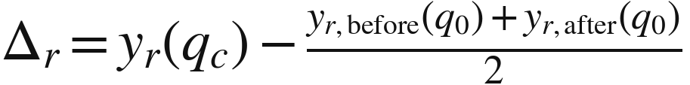

III. Paired verification
Incumbent q₀
Candidate qc
Incumbent q₀
before
candidate
after
Δ̄: average measured improvement uΔ: uncertainty allowance δswitch: minimum useful gain
Reject brackets with excessive drift, missing clients or a changed policy.
Require service feasibility. Confirm the move and revalidate any rollback state.
38
Notes:
Source: AoA_Estimation_Rotating_WiFi_Antenna_MUSIC_ESPRIT_SAGE.md, 3.1.2–3.1.4.
The displayed average assumes equally spaced observation centers. Otherwise interpolate incumbent performance at the candidate time. Correlated packets are not independent uncertainty samples. Restore feasibility under an explicit policy even when aggregate utility decreases.
Diagrams are conceptual system/algorithm schematics, not measured results. Formulas retain their LaTeX source in image descriptions and in tmp/slides_detailed/equations.json.

Slide 40
III. Paired-probe notation
Notation | Meaning | Units / shape
q0, qc, r | Current orientation, candidate orientation, bracket repetition | states; index
yr(q) | Finite-window measured utility at orientation q | objective units
Δr, Δ̄ | Candidate gain for one bracket; average across valid brackets | same units as utility
uΔ, δswitch | Empirical uncertainty allowance; useful-gain threshold | same units as utility
Illustrative bracket (Mb/s): current before = 50, candidate = 55, current after = 46.
Interpolated current = (50 + 46)/2 = 48, so candidate gain Δ = 7 Mb/s.
With uΔ = 2 and δswitch = 3, the gain test passes: 7 − 2 > 3.
Acceptance still requires a valid bracket and service feasibility. These example values are hypothetical.
39
Notes:
Source: AoA_Estimation_Rotating_WiFi_Antenna_MUSIC_ESPRIT_SAGE.md, 3.1.2–3.1.3.

Slide 41
III. C: recurring usage
Weekday evening
Weekend daytime
Living room streaming
Phone active
Work / browsing
Camera may stay active
Forecast a distribution of activity, demand, and spatial state
Use current observations to correct the seasonal prior. Multiple rooms and services can be active together.
40
Notes:
Source: AoA_Estimation_Rotating_WiFi_Antenna_MUSIC_ESPRIT_SAGE.md, 3.6.2–3.7.2.
Household contexts shown here are illustrative hypotheses to learn, not assumptions imposed on every home. Device class alone does not determine traffic demand or criticality.
Diagrams are conceptual system/algorithm schematics, not measured results. Formulas retain their LaTeX source in image descriptions and in tmp/slides_detailed/equations.json.

Slide 42
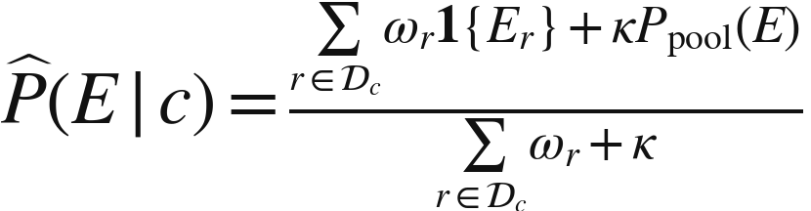

III. C: seasonal learning
E: activity event c: calendar context κ: pooling strength ωr: recency weight
Group observations by time band and weekday/weekend. Pool sparse contexts.
Learn joint activity and demand uncertainty, not just an average traffic vector.
Keep behavior forecasts separate from current orientation-response estimates.
Cold start or changed routines: lower confidence and continue Scheme B.
41
Notes:
Source: AoA_Estimation_Rotating_WiFi_Antenna_MUSIC_ESPRIT_SAGE.md, 3.7.3–3.7.5.
The formula uses recency weights and shrinkage κ to a broader pooled activity profile. Session/day grouping avoids overstated support from correlated windows. One weekend is weak evidence for a recurring weekly pattern.
Diagrams are conceptual system/algorithm schematics, not measured results. Formulas retain their LaTeX source in image descriptions and in tmp/slides_detailed/equations.json.

Slide 43
III. Seasonal-profile notation
Notation | Meaning | Units / shape
E, Er, 1{Er} | Activity event; event in record r; indicator equal to 1 if observed | event; 0 or 1
c, Dc | Calendar/context bin; valid comparable records in that bin | label; set of records
P̂(E|c), Ppool(E) | Estimated context probability and broader pooled probability | [0,1]
κ | Pooling strength, expressed as prior effective observation weight | ≥ 0; weight units
ωr, te, tr | Recency weight, current decision time, past observation time | unitless; time
Tmemory | Decay time scale controlling how fast older records lose weight | same time unit as te − tr
e, Af,e, Zi,e, Λf,e | Behavior window; activity flag; spatial state; offered active rate | index; binary; label; bit/s
R, unknown | Available spatial labels/clusters and explicit missing-state value | set; categorical state
Here c is a context bin. In the channel equations, c is a complex path gain. These meanings are unrelated.
42
Notes:
Source: AoA_Estimation_Rotating_WiFi_Antenna_MUSIC_ESPRIT_SAGE.md, 3.7.1–3.7.5.

Slide 44
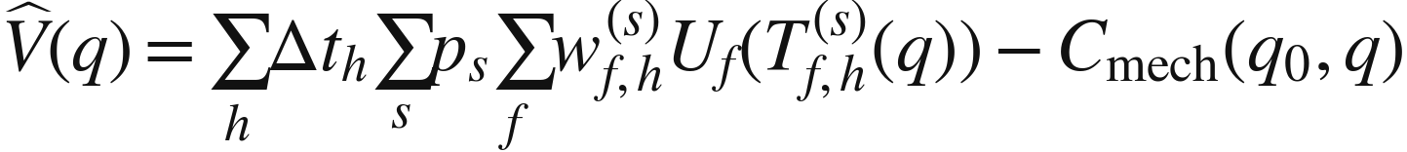

III. C: predictive objective
h: future interval s: forecast scenario ps: scenario probability
V̂: expected horizon utility uV: uncertainty allowance δpredict: required gain
Score likely joint scenarios over a short horizon, including holding the incumbent.
Include probe interruption and movement cost once. Revalidate candidate response.
Require net benefit beyond uncertainty while protecting current critical services.
Urgent live recovery overrides predictive proposals. Replan after new observations.
43
Notes:
Source: AoA_Estimation_Rotating_WiFi_Antenna_MUSIC_ESPRIT_SAGE.md, 3.8.1–3.8.3.
T_f,h^(s) already accounts for service interruption via usable airtime. Do not subtract the same loss twice. Mechanical penalties must use compatible utility units, or be handled only through budgets. Evaluate joint scenarios before averaging nonlinear utility. The predictive gate differs from requiring an immediate measured gain: a safe advance move may temporarily reduce present utility while improving horizon utility.
Diagrams are conceptual system/algorithm schematics, not measured results. Formulas retain their LaTeX source in image descriptions and in tmp/slides_detailed/equations.json.

Slide 45
III. Horizon-utility notation
Notation | Meaning | Units / shape
h, H, Δth | Future interval index, number of intervals, interval duration | 0…H−1; count; s
s, S, ps | Joint forecast scenario index/count and scenario probability | 1…S; Σs ps = 1
wf,h(s), Tf,h(s)(q) | Policy weight and delivered service rate in scenario s, interval h | unitless; bit/s
Uf(T) | Chosen utility: T or log(1 + T/rfref) | bit/s or unitless
V̂(q) | Expected utility integrated over the prediction horizon | bits or utility-seconds
Cmech(q0,q) | Mechanical wear/energy penalty converted into objective units | same units as V̂
uV(q), δpredict | Forecast/response uncertainty allowance and required net-gain margin | same units as V̂
q0, q, q★ | Incumbent, proposed candidate, and selected feasible orientation | actuator states
H here is a horizon length. A superscript H in matrix formulas means conjugate transpose.
44
Notes:
Source: AoA_Estimation_Rotating_WiFi_Antenna_MUSIC_ESPRIT_SAGE.md, 3.8.1–3.8.2.

Slide 46
III. Forecasted service terms
For each scenario and future interval:
delivered rate = activity × min{offered demand, usable fraction × airtime × link rate}
Notation | Meaning | Units / shape
Af,h(s) | Predicted service activity flag | 0 or 1
Λf,h(s) | Offered rate when active | bit/s
ζh(q0,q) | Usable fraction after planned probe, motion and settling | [0,1]
af,h(s) | Share of usable data airtime given to service f | [0,1]; total ≤ 1
Ci(f),h(s)(q) | Response-model payload rate for client carrying service f | bit/s of allocated airtime
This rate approximation needs queue evolution when backlog carries across intervals. Count lost airtime only once.
45
Notes:
Source: AoA_Estimation_Rotating_WiFi_Antenna_MUSIC_ESPRIT_SAGE.md, 3.8.1.

Slide 47
III. C: predictive pseudocode
PREDICTIVE_CONTROLLER():
update models from newly completed observations
if urgent current-service failure: return Scheme B recovery
if forecast or response support is weak: return Scheme B
forecast joint activity, demand, and spatial scenarios
build incumbent + contextual + global coverage candidates
score horizon utility after interruption and movement cost
if conservative net-gain margin passes:
probe proposal within shared budget
check present-service guards and forecast validity
commit, confirm, and retain recovery options
continue global checks; log forecasts and actual outcomes
First use prediction to rank probes. Enable advance moves only after validating forecast and response quality.
46
Notes:
Source: AoA_Estimation_Rotating_WiFi_Antenna_MUSIC_ESPRIT_SAGE.md, 3.8.6.
Update models exactly once per completed record. Do not coherently pool CSI from incompatible times. Reuse Scheme B recovery, global coverage and a shared movement budget.
Diagrams are conceptual system/algorithm schematics, not measured results. Formulas retain their LaTeX source in image descriptions and in tmp/slides_detailed/equations.json.

Slide 48
III. Predictive acceptance gates
Behavior support: the context has enough independent history and calibrated uncertainty.
Response support: fresh channel/probe evidence supports the candidate’s predicted service rates.
Current-service guard: active critical rates and delay requirements remain satisfied.
Future-value gate: expected horizon gain exceeds uncertainty and the configured margin.
Execution guard: one actuator controller enforces the shared budget, confirmation and recovery.
A useful advance move can have a temporary noncritical loss. It needs explicit permission from the control policy.
47
Notes:
Source: AoA_Estimation_Rotating_WiFi_Antenna_MUSIC_ESPRIT_SAGE.md, 3.8.2–3.8.6.
“Permission from the control policy” means a configured system constraint, not a requirement for human approval on each movement. If temporary current loss is disallowed, use prediction only to prioritize probes or wait for ordinary acceptance. Never treat absent or unobserved future clients as already validated response measurements.

Slide 49
III. Controller architecture
History + calendar
Usage forecast
Candidate planner
Fresh CSI / probes
Response model
Service guards
Shared search budget
Live service monitor
Scheme B recovery
Single actuator + verify
Measured outcomes update both the response archive and behavioral history. Current-service recovery has priority.
48
Notes:
Source: AoA_Estimation_Rotating_WiFi_Antenna_MUSIC_ESPRIT_SAGE.md, 3.8.4–3.8.5.
One actuator controller arbitrates all changes. Current severe service failures have precedence. Forecast-driven probes share the ordinary exploration budget. Independent global coverage remains active even when a learned pattern is confident.
Diagrams are conceptual system/algorithm schematics, not measured results. Formulas retain their LaTeX source in image descriptions and in tmp/slides_detailed/equations.json.

Slide 50
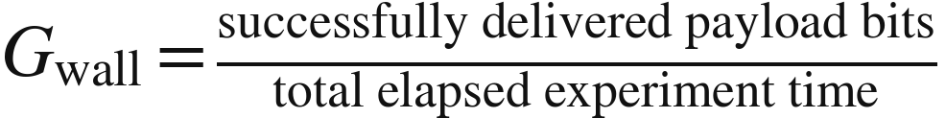
III. Evaluation and rollout
Test static scenes, gradual motion, abrupt blockage, remote improvements and policy changes.
Compare A/B baselines, prediction for probe ranking, and guarded proactive control.
Report per-service goodput, latency/violations, recovery time, probe cost and mechanical travel.
Validate on later time periods, including cold start, unfamiliar devices and changed routines.
Deployment: validate estimation and static selection, establish A/B baselines, then add learning incrementally.
49
Notes:
Source: AoA_Estimation_Rotating_WiFi_Antenna_MUSIC_ESPRIT_SAGE.md, 2.4, 3.5.3–3.5.4, 3.9.
Compare matched elapsed-time and movement/exploration budgets. Include several controlled trials and uncertainty. Chronological held-out evaluation prevents session leakage. Deterministic historical logs cannot identify unsupported counterfactual outcomes.
Diagrams are conceptual system/algorithm schematics, not measured results. Formulas retain their LaTeX source in image descriptions and in tmp/slides_detailed/equations.json.

Slide 51
Reference: Part I symbols
Notation | Meaning | Units / shape
β, γ, α; ψ, θ, φ | Control tilt/pan/polar tilt; in-plane or polar/azimuth arrival angles | geometry
q, ξ; d̂, b̂, u | Control state, arrival direction; unit axis and arrival vectors | geometry
ρ, p, λn, μ, χ | Phase-center radius/position, wavelength, axis-direction cosine/angle | geometry
K, L, M, D; k,n,m,d | Position, tone, snapshot, path counts and their indices | sampling
x, X, w; A, B; c | CSI, noise, response matrices and complex path gains | signal model
R̂, Us, Un, Λs, Λn, PM, ε | Covariance, subspaces, eigenvalues, MUSIC score, numerical floor | MUSIC
Q, S, vQ, bQ; J1,J2,Es,Ψ | Frequency windows/manifolds; virtual selectors, subspace, operator | MUSIC / ESPRIT
Yd, b, cd; ξd,τd | Path-isolated observation, full response, gain row, angle and delay | SAGE
Detailed tables beside each method give dimensions and assumptions. fn, f0 and Δf are frequencies in Hz.
50
Notes:
Source: AoA_Estimation_Rotating_WiFi_Antenna_MUSIC_ESPRIT_SAGE.md, Part I, 2.1.4–2.1.5.

Slide 52
Reference: Part II symbols
Notation | Meaning | Units / shape
i, f, i(f) | Client index, service index, and service-to-client mapping | indices
h, P, N, I, SINR | Channel, transmit/noise/interference power, linear signal-quality ratio | link model
C, a, ℓ, T | Allocated-airtime rate, airtime share, offered load, delivered rate | service model
Q1, Q2, q0, q★ | Candidate sets, incumbent and selected orientation | optimization
Jsum, J, w | Sum-goodput, chosen objective, and policy weight | objective
rref, rmin, Fcritical | Utility normalization rate, minimum rate, constrained service set | requirements
goodput, Mb/s | Nonduplicate delivered payload rate; 10⁶ payload bits per second | reported unit
models, shortlist, status | Reliable source-labeled fits, finalists, explicit decision outcome | algorithm interface
a is a steering response when indexed by scan/tone and direction; ai or af is an airtime fraction.
51
Notes:
Source: AoA_Estimation_Rotating_WiFi_Antenna_MUSIC_ESPRIT_SAGE.md, Part II.

Slide 53
Reference: Part III symbols
Notation | Meaning | Units / shape
t, Pfull, Wmeas, Wbeh | Physical time, full-scan period, score window, behavior window | time
yr, Δr, Δ̄, uΔ, δswitch | Probe score, gain, average gain, uncertainty and switch threshold | current utility units
E, c, Dc, Ppool, κ, ωr | Activity event, context, records, pooled prior, shrinkage, recency | seasonal profile
te, tr, Tmemory; A, Z, Λ | Decision/record/decay times; activity, spatial state, demand | learning state
h,H,Δth; s,S,ps | Horizon index/count/duration; scenario index/count/probability | forecast
ζ, a, C, T, w, U | Usable fraction, airtime, link rate, delivered rate, weight, utility | predicted service
V̂, Cmech, uV, δpredict | Horizon value, mechanical cost, uncertainty, required benefit | compatible utility units
Gwall | Delivered payload bits divided by total elapsed experiment time | bit/s
S counts smoothing windows or forecast scenarios. b is a window offset in MUSIC and a response vector in SAGE.
52
Notes:
Source: AoA_Estimation_Rotating_WiFi_Antenna_MUSIC_ESPRIT_SAGE.md, Part III.

