Slide 1
Презентация на тему “Достопримечательность Москвы”

Slide 2
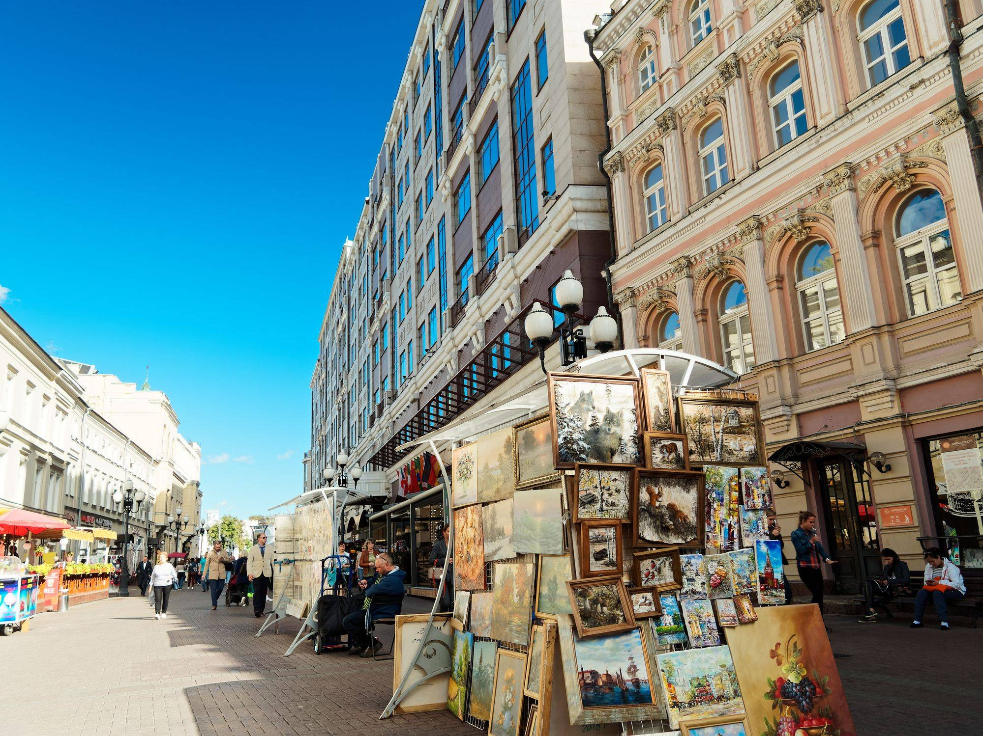
Arbat Street
Arbat is one of the oldest streets in Moscow. Today, the Arbat is as important a Moscow landmark as Red Square, the Bolshoi Theater or St. Basil's Cathedral. Since 1986, the street has been completely pedestrian. Every house on this pedestrian street has a rich history and famous residents. Pushkin lived on the Arbat right after the wedding, Mayakovsky and Yesenin read their poems here.There is also the famous "Tsoi" wall, on which fans of the creativity of the " Kino" group leave their messages. There are always a lot of street musicians, artists, dancers and other artists on the Arbat. Here you can find various tourist attractions, cafes and restaurants, souvenir shops. Arbat is often called the Old One, because there is a parallel street — New Arbat, which is famous for its "book houses".

Slide 3
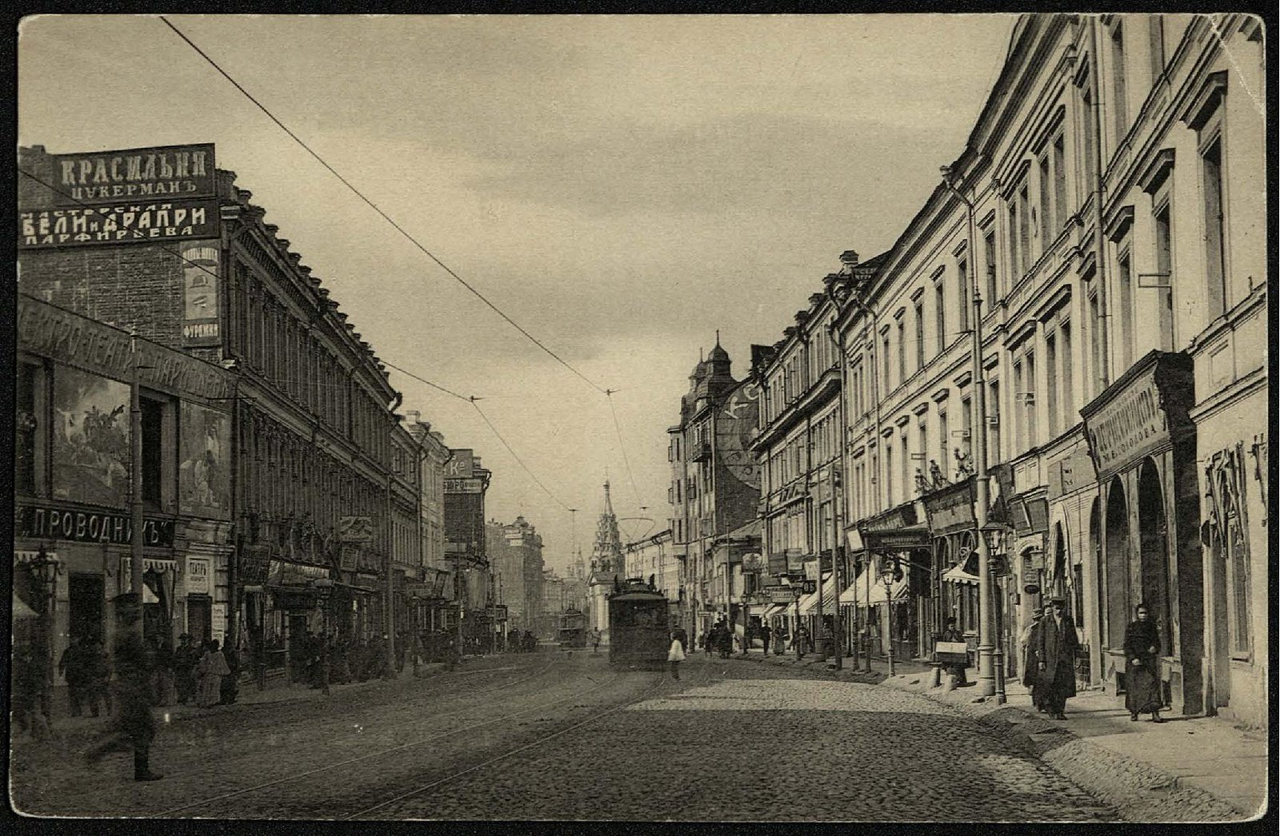
History
By the beginning of the XX century, many people already knew about the central Moscow street. Arbat was especially loved for its sweet wine and delicious soft pies, which were talked about almost at every step.In Soviet times, the white color of buildings changed to gray. All the buildings were adjusted to the same height, round lanterns were installed. People reacted differently to such changes. For example, Bulat Okudzhava, a well-known composer, reacted very negatively to the transformation of the street and said that Arbat was ofonarelle. In 1908, a tram began to run along the street, and in 1952 the building of the Ministry of Foreign Affairs was erected.

Slide 4
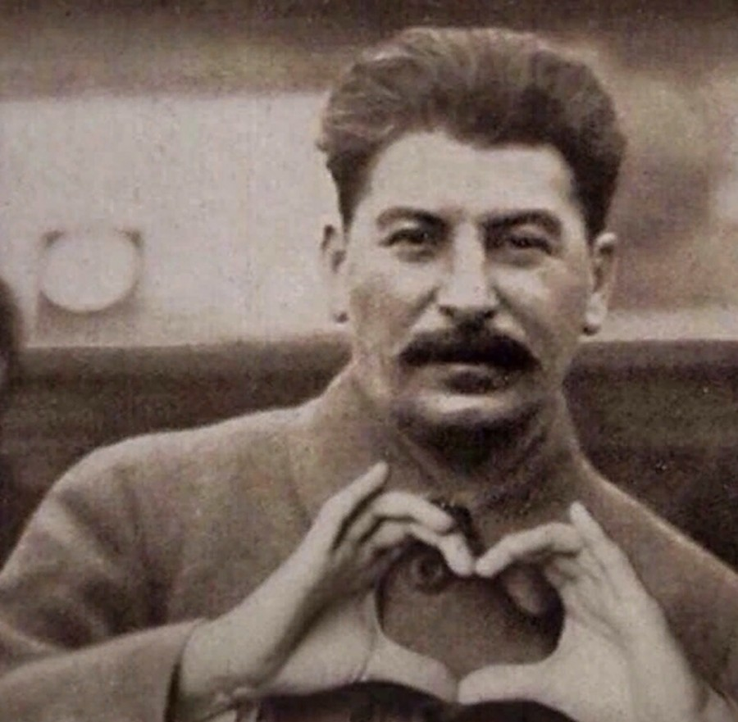
Changing the Arbat
In the period of the thirties, fifties of the last century, the Arbat was called the “Georgian military road” due to the fact that I.V. Stalin liked to go to his dacha. At the same time, stompers appeared - NKVD workers who control order and security on the street during Stalin's journey from the Kremlin to Kuntsevo. In winter, from a long stay in the cold, they stamped their feet so as not to freeze, because of this they were called that. Tram tracks, dense urban development ran along the Arbat - all this interfered with the comfortable passage of the cars of the political leader of all peoples. Therefore, it was decided to build a track and place it along Arbat Street. The name was given to Kalinin Avenue

Slide 5
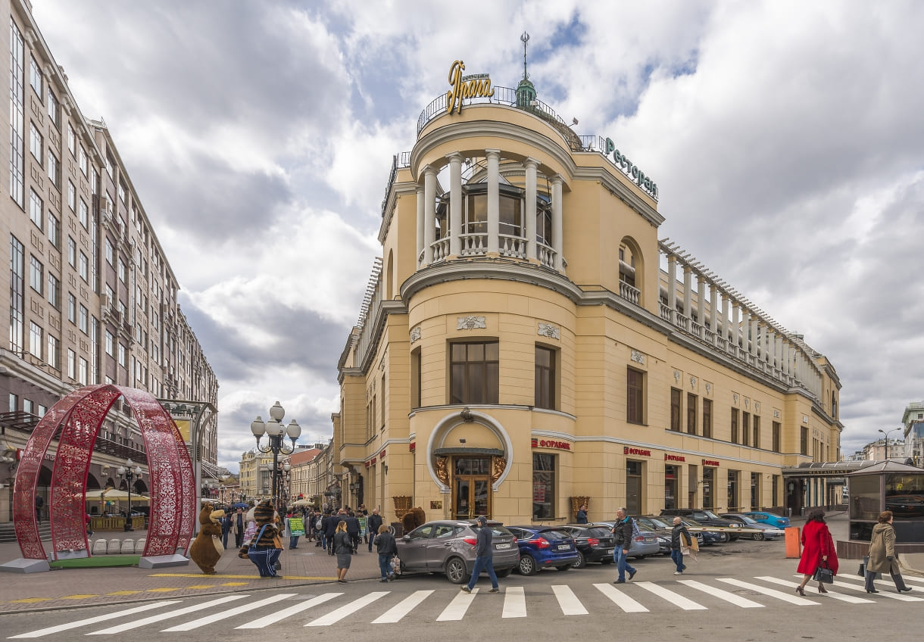
Where to go on the Arbat
The Old Arbat begins with "Prague". The restaurant has its own history, worthy of a movie.. Of the visitors, there were only cabmen who distorted the name in the manner familiar to them — "Braga".But at the beginning of the XX century, the building was completely rebuilt: a large, solid restaurant wedged into the Arbat corner. Celebrities have reached out here. Alexander Blok, Andrey Bely, Ilya Repin, Anton Chekhov, Vladimir Gilyarovsky, Fyodor Chaliapin were considered regulars. In the Soviet years, "Prague" became one of the best restaurants in the country, which many dreamed of getting into.
Interesting fact: the recipe for the Prague cake was invented here. It was developed by the head of the confectionery shop. So dessert has nothing to do with the Czech Republic.

Slide 6
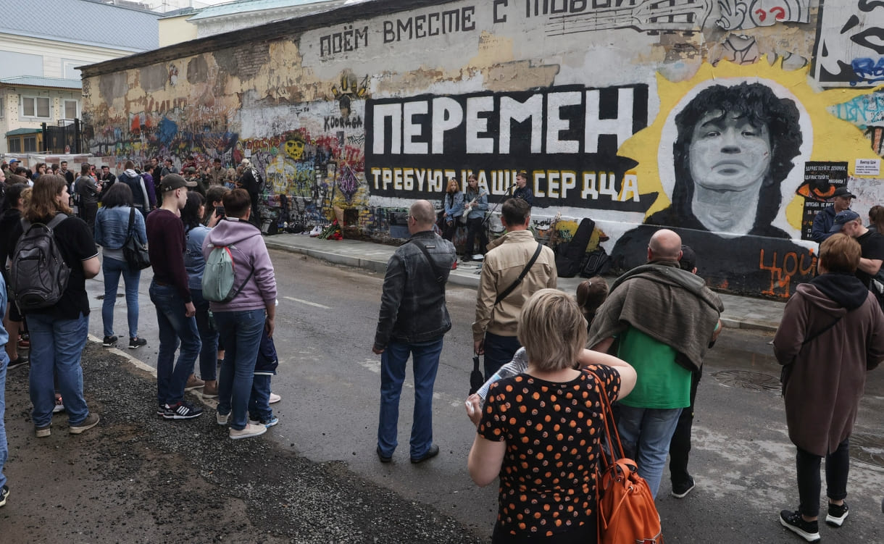
Where to go on the Arbat
Since the 1990s, the Old Arbat has become a place of memory for Viktor Tsoi. It is here that you can see the most popular memorial of those that have ever been created in honor of the iconic musician.Tsoi's wall appeared immediately after the news of the death of the leader of the Kino group. Fans came here and just wrote what they had in their hearts (this is how the famous inscription "Choi is alive" appeared), left drawings, wrote poems. Public utilities tried to paint over the wall several times, but in the end, people's love won: now it is one of the key attractions of the Old Arbat. Officially!
An interesting fact: The Arbat in Moscow and then set the fashion. Other cities of our country and CIS countries also have their own "Choi walls".

Slide 7
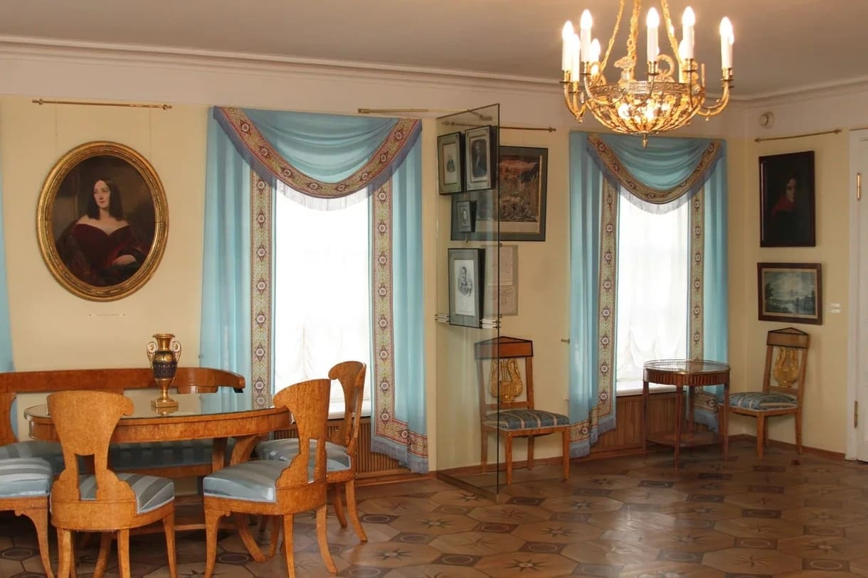
Where to go on the Arbat
This ancient mansion is the main symbol of Pushkin's Moscow and the only surviving house in which Pushkin lived in the capital, his real Moscow address.The building itself is an architectural monument of the early XIX century, but the most interesting, of course, is inside. In the halls of the two-story mansion there are many objects directly related to the Russian poet. The collection was collected bit by bit, but now it forms a single whole and allows you not just to see, but to feel that era.
Interesting fact: Pushkin lived in five rooms on the second floor. He rented these premises and came here shortly before his wedding in 1831. It was here that the poet arranged a bachelor party, saying goodbye to his bachelor life. He also brought his wife Natalia Goncharova here.

Slide 8
Conclusion
Old Arbat is a street that deserves a separate walk and opens up a lot of interesting things about Moscow. The sights of Arbat, as if alive, tell their own story. This is one of those places on the city map where you should definitely come with local guides who know hundreds of interesting facts about the back streets and houses of this street and can surprise even Muscovites.
Thank you for your attention

