Slide 1

Sequence-Based Classification of Regulatory DNA Elements
A comparative study of 1D-CNN and SVM for classifying genomic sequences into Enhancers, Promoters, and Intergenic regions using nucleotide sequence only.
Presenters: Omri Schlesinger, Nadav Idelson

Slide 2

The Challenge
Biological Complexity
Computational Goal
Non‑TATA promoters dominate and are marked by broad CpG regions and motifs (Sp1, NRF‑1). Enhancers show high heterogeneity and spatial flexibility.
Classify sequences into Enhancer / Promoter / Intergenic from raw nucleotides, capturing both local composition and long-range motif context.

Slide 3
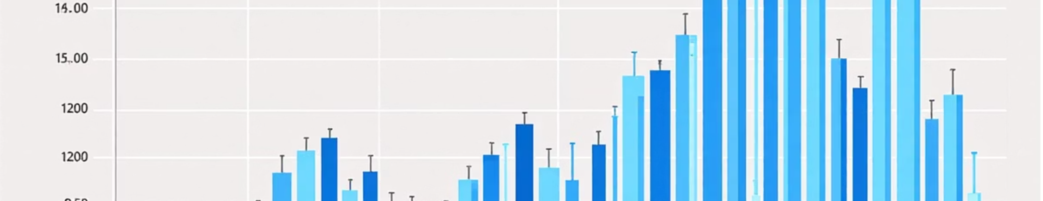
Dataset & Preprocessing
We balanced the dataset via targeted downsampling from 234,783 sequences to 108,393 total (36,131 per class). Split: 70% train / 15% validation / 15% test.
Fixed-length sequences: post-pad to 452 bp using 'N' (covers ~95% of sequences). Encoding: one-hot (A,C,G,T,N) for deep models; k-mer counts for SVM.

Slide 4

Baseline: k-mer SVM
Representation: CountVectorizer extracting k‑mer frequencies (Bag‑of‑Words). Limited to local composition; no explicit positional context.
Hyperparameter search with Optuna. Selected configuration: k=5, C ≈ 0.001.

Slide 5
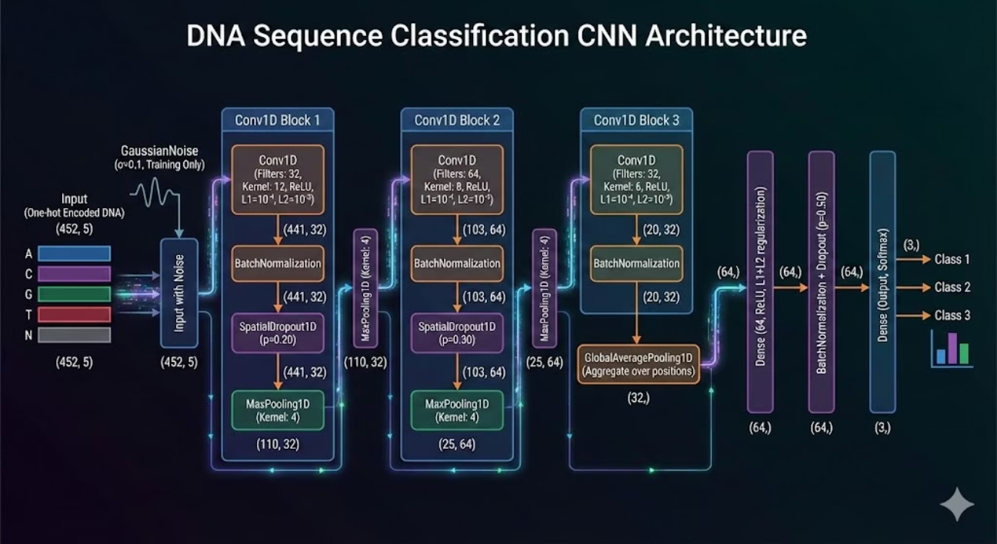
1D-CNN: Biology‑aware Architecture
Input
One‑hot encoding (5 channels: A,C,G,T,N).
Convolutional Hierarchy
Three conv blocks with kernel sizes 12, 8, 6 bp to emulate PWM scanning and capture motif interactions at multiple scales.
Aggregation & Invariance
Global Average Pooling reduces sensitivity to absolute position and padding artifacts.
Biological Augmentation
Reverse complement augmentation with 50% probability during training to avoid strand bias and increase data diversity.

Slide 6
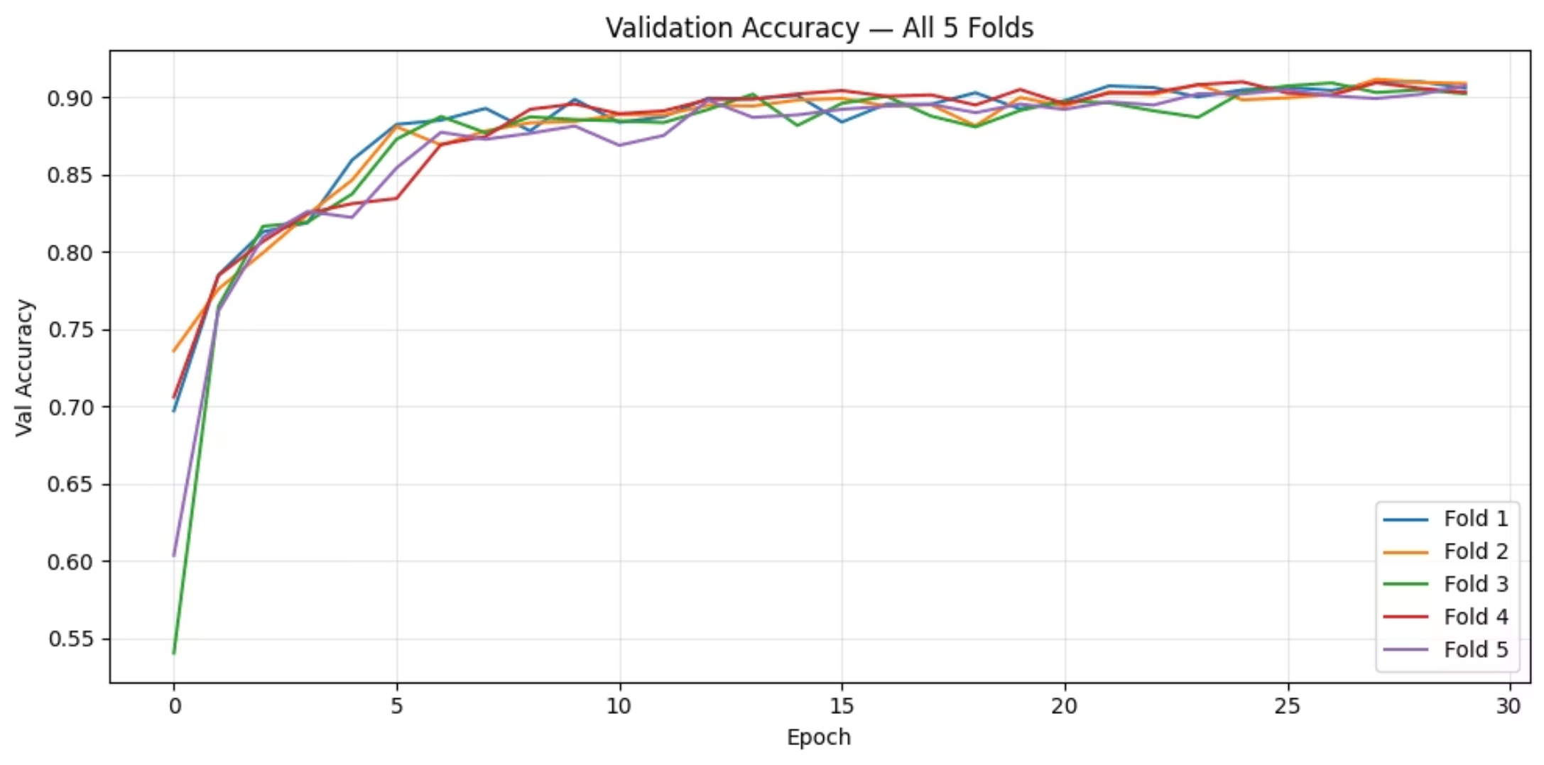
Training Protocol & Regularization
5‑fold stratified CV for robustness (observed SD ≈ 0.002). Early stopping and ReduceLROnPlateau used for learning control.
Spatial Dropout (20–30%)
L1 + L2 weight regularization
Batch Normalization between conv layers
Gaussian noise on input channel

Slide 7
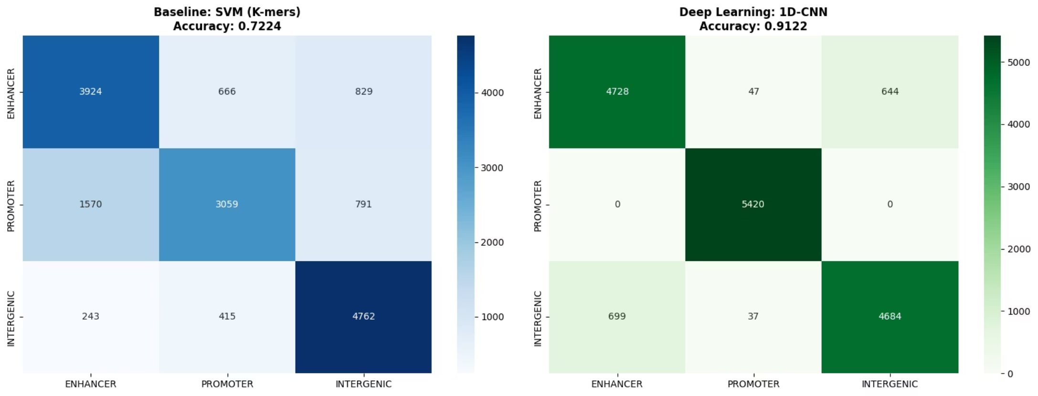
Results — Model Comparison
1D‑CNN outperforms SVM: relative accuracy improvement +26.28%.
Interpretation: CNN captures spatial motif syntax (e.g., CpG islands, motif co-occurrence) beyond k‑mer frequency statistics.
SVM
1D‑CNN
Accuracy: 72.24%
Accuracy: 91.22% — Promoter recall = 1.000 (perfect identification of promoter signatures).

Slide 8
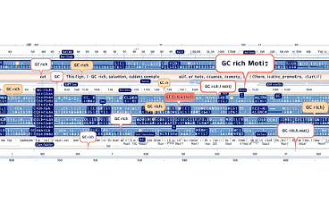

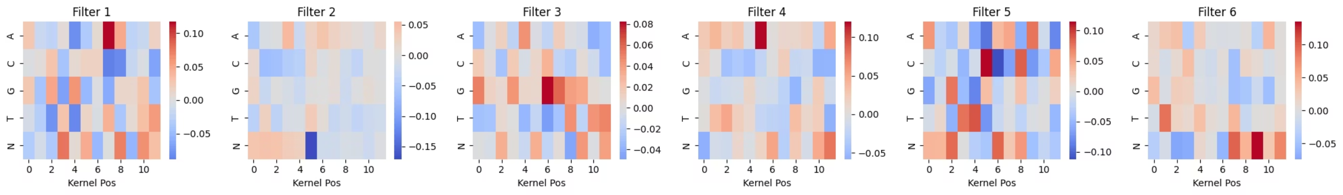
Model Interpretability
Saliency Maps
Filter Visualizations
Gradient-based maps consistently highlight GC-rich stretches and motif clusters correlated with promoter decisions.
First-layer filters produce PWMs similar to known motifs (Sp1, ETS), indicating biologically meaningful feature learning.

Slide 9
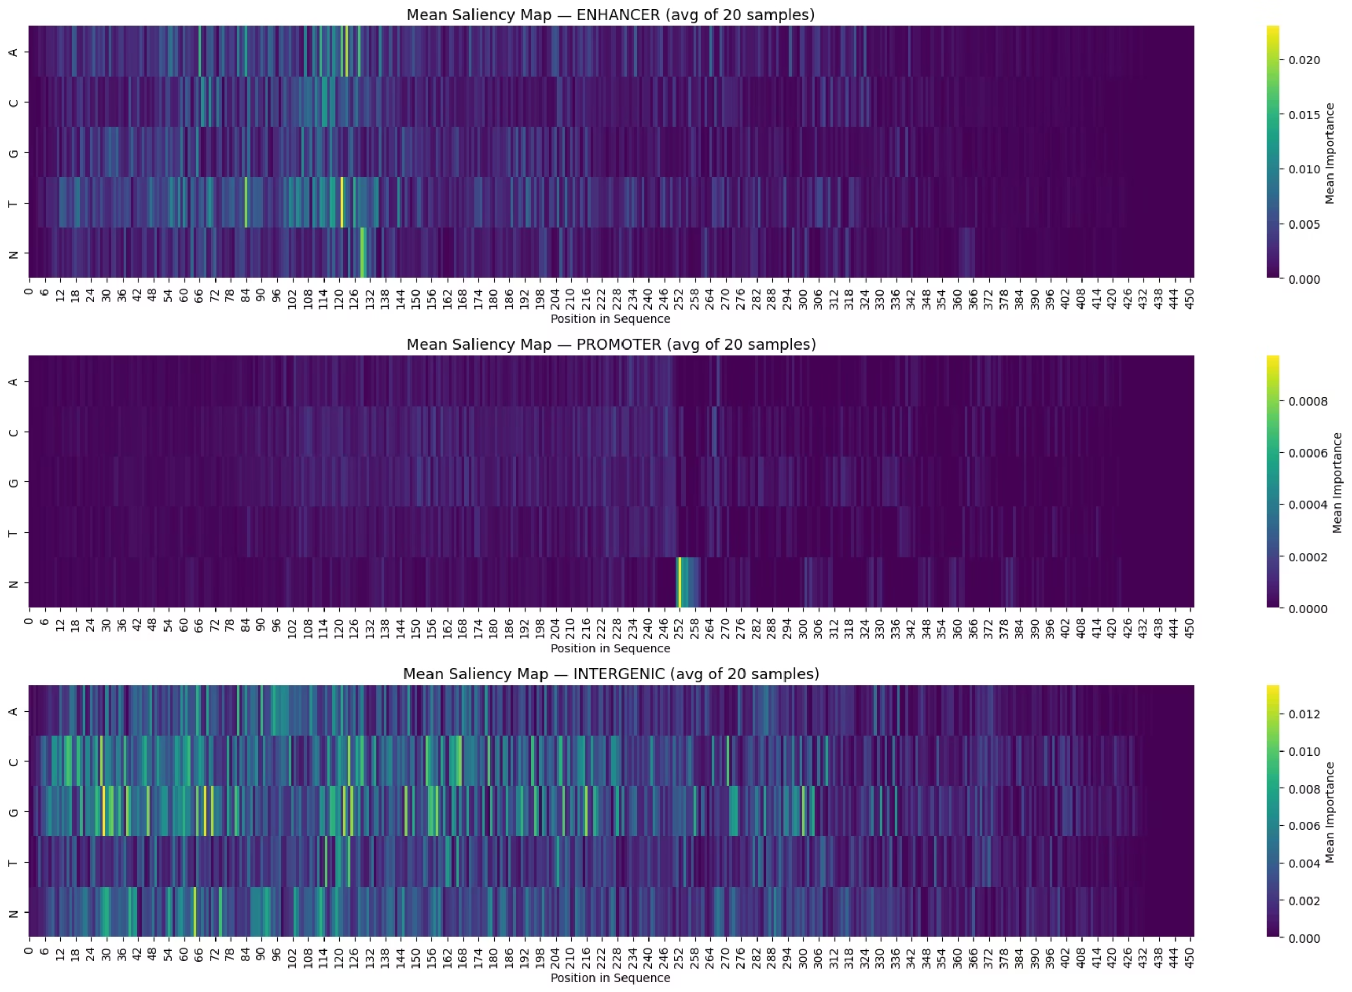

Slide 10

Conclusions
Location‑sensitive hierarchical representations (1D‑CNN) significantly outperform k‑mer SVM for regulatory element classification.
Biologically motivated design choices (kernel sizes, RC augmentation) and rigorous regularization produce strong generalization.
Interpretability analyses confirm learned features correspond to known biological motifs and CpG signals.

