Slide 1
CSN-221 Project
RISC-R
GUIDED BY: PROFESSOR SATISH KUMAR PEDDOJU
Aditya Rai -19114004 Gagan Sharma-19114032 Gajanan Gitte-19114033
Raghav Somani-19114068 Shlok Goyal-19114078 Gaurav Wasnik-19114090
BTech CSE 2nd year, IIT ROORKEE

Slide 2
The Project Outline

Slide 3
ISA

Slide 4
Instructions supported by Processor
Instructions without immediates
Instructions with immediate
Halt, load, store, mov, jump, jz, jc, nop, add, sub, mul, div, cmp, and, or, not,
loadi, movi, jumpi, jzi, jci, addi, subi, andi, ori, muli, divi, cmpi

Slide 5
R Format
31 .. 27 | 26 .. 22 | 21 .. 17 | 16 .. 1 | 0 .. 0
Opcode | Source | Destination | Immediate | Immediate bit
I Format
31 .. 27 | 26 .. 22 | 21 .. 17 | 16 .. 12 | 11 .. 1 | 0 .. 0
Opcode | Source1 | Destination | Source2 | Empty | Immediate bit
J Format
31 .. 27 | 26 .. 22 | 21 .. 17 | 16 .. 12 | 11 .. 1 | 0 .. 0
Opcode | Empty | Empty | Source | Empty | 0
31 .. 27 | 26 .. 22 | 21 .. 17 | 16 .. 1 | 0 .. 0
Opcode | Source | Empty | Immediate | 1

Slide 6
Assembler

Slide 7
Functioning of assembler
To run programs on the processor, first assemble the memory image.
python assembler.py inputfilename [outputfilename]
Load the memory image inside Logism by right clicking on the RAM module and selecting Load Image...
The programs are loaded at starting address 0x0000
Each instruction in the assembly language takes up one memory word of 32-bit.

Slide 8
CPU Design and Instruction execution

Slide 9
CPU Design
The whole CPU is hardwired design with Von Neumann architecture.
The RAM is 256KB in size with 16-Bit address bus and 32-Bit word length.
There are 32 general purpose registers with 32-Bit word length.
The CPU uses 16-Bit immediate.
Each assembly instruction is executed in 5 stages separately.
Instruction is fetched automatically at the start of the simulation and halts at the end of the program.
An assembler is written based on Python which translates assembly instructions to machine language (in hexadecimal).

Slide 10
5 stages of execution
Instruction Fetch stage (IF) : fetch next instruction
Operand Fetch stage (OF) : decode the instruction and fetch operands
Execution stage (EX) : execute ALU operations and generate results
Memory Access unit (MA) : Access memory for load and store operations
Register Write Stage (RW) : Writeback to the register if needed

Slide 11
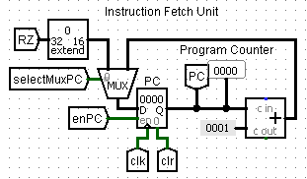
Instruction Fetch Unit

Slide 12
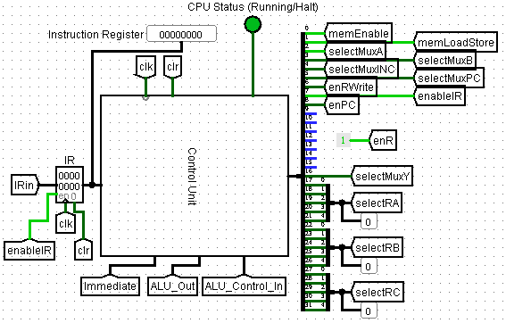
Control Unit Signals

Slide 13
Control Signal | Function
memEnable | Memory access is allowed-1 Otherwise-0
memLoadStore | Store instruction-0 Otherwise-1
selectMuxA | Fetch next instruction-1 Load/Store instruction-0
selectMuxB | 2nd operand is immediate-1 2nd operand is register-0
selectMuxINC | Allow incrementing PC-1 Otherwise-0
selectMuxPC | Next instruction-1 Jump instruction taken-0

Slide 14
Control Signal | Function
enRWrite | Enable Register write-back-1 Otherwise-0
enableIR | Allow update of IR-1 Otherwise-0
enPC | Allow update of PC-1 Otherwise-0
enR | Enable temporary result to update to be later stored in a register-1
selectMuxY | store load result in a register-1 Store aluResult in a register-0
selectRA | Select bits for 1st operand-5 bits
selectRB | Select bits for 2nd operand-5 bits

Slide 15
Control Signal | Function
selectRC | Select bits for destination-5 bits
Immediate | Calculated immediate-32 bits
ALU_Out | Values of C (greaterThan) and Z (equalTo) flags-2bits
ALU_Control_In | Contains information about aluOp and if comparing flags are required or not-8 bits

Slide 16
Control Unit
The control unit input consists of 3 things:
Clock
Instruction Register
Flags
And output are Control Signals within the processor.

Slide 17
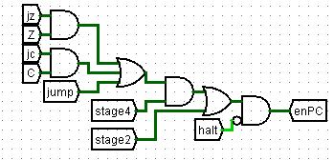
enPC Control Signal
The control signal generated here is enPC

Slide 18
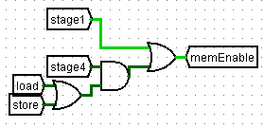

memEnable and memLoadStore
memEnable and memLoadStore control signals are generated as shown in the diagram with the required inputs.

Slide 19
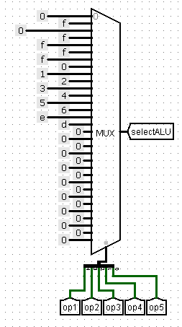
selectALU and ALU_Control_In Signal
4 bit wide wires present to communicate across the CU and the ALU, which is passed on into the MUX of ALU to choose the desired operation result/output.

Slide 20
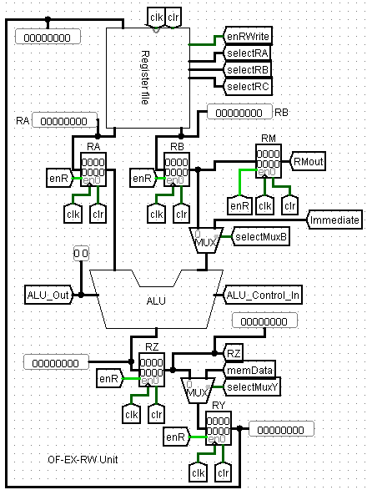
OF-EX-MA-RW stage

Slide 21
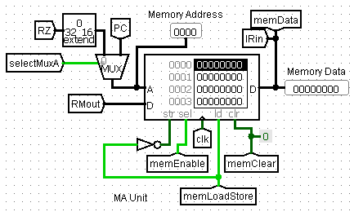
MA Unit

Slide 22
Arithmetic and Logic Unit (ALU)

Slide 23
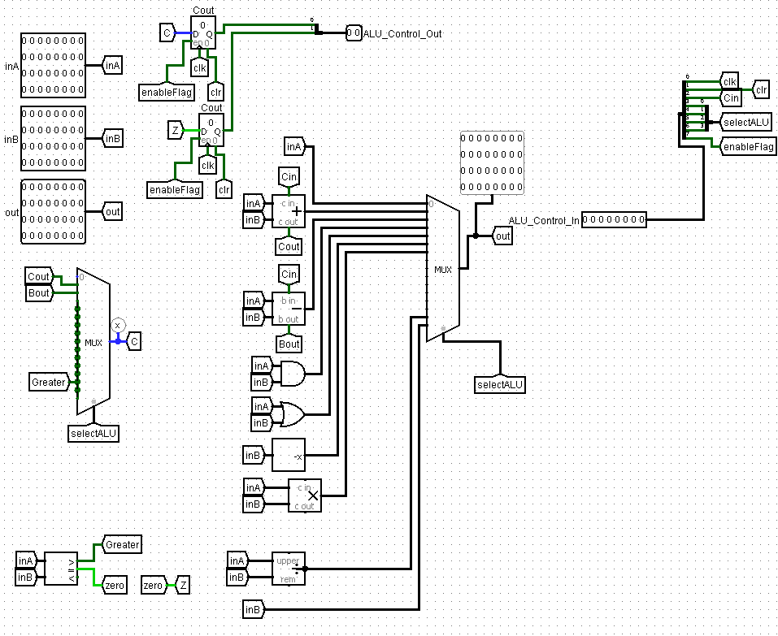

Slide 24
Registers Name | Size | Function
enableFlag | 1 | Check whether ALU operation or not
selectALU | 4 | Operation type
Cin | 1 | Input carry bit
Cout | 1 | Output carry bit
Clk | 1 | Clock signal
Clr | 1 | Reset or not
ALU_Control_in | 8 | Combination of above registers
C, Z | 1, 1 | Storing the result of logical operation

Slide 25
Assembly Language Commands
Add, Subtract, And, Or, Multiply, Divide :-
op [destination] [source1] [source2]
opi [destination] [source1] Immediate Value
Not :-
not [destination] [source]
Compare :-
op [source1] [source2]
opi [source1] Immediate Value

Slide 26
Operations supported by ALU
Operation | Opcode
Addition | 1000 + I
Subtraction | 1001 + I
Multiplication | 1101 + I
Division | 1110 + I
AND | 1010 + I
NOT | 1100 + I
Compare | 1111 + I
Where, I stand for Immediate bit.

Slide 27
The Register File

Slide 28
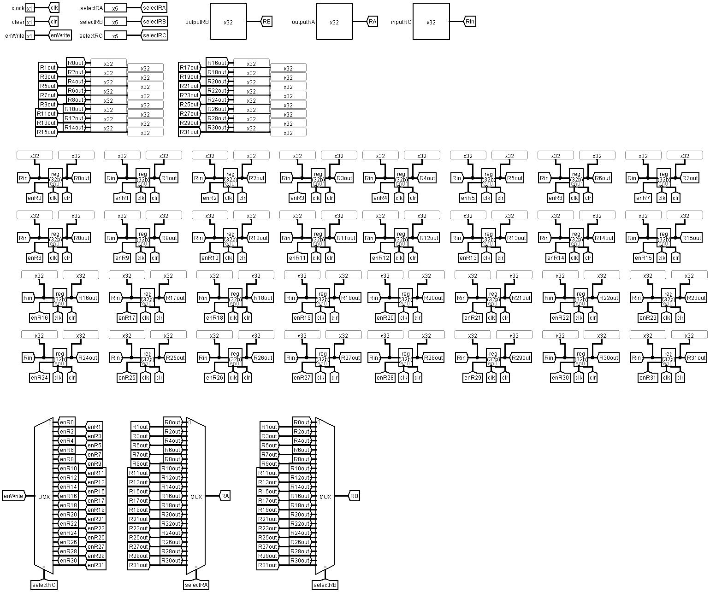
The Register File
Input / Output
The Registers
Input / Output

Slide 29
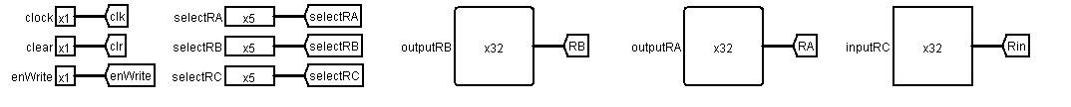
Input / Output

Slide 30
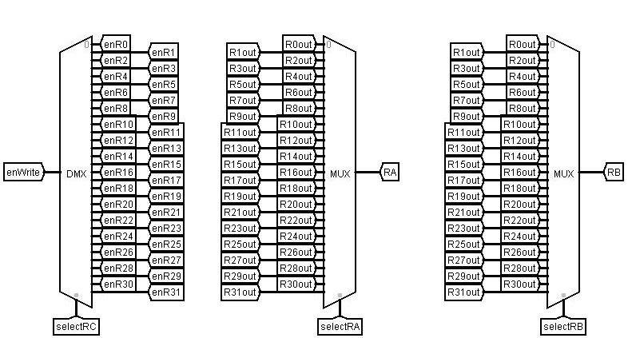
Input / Output

Slide 31
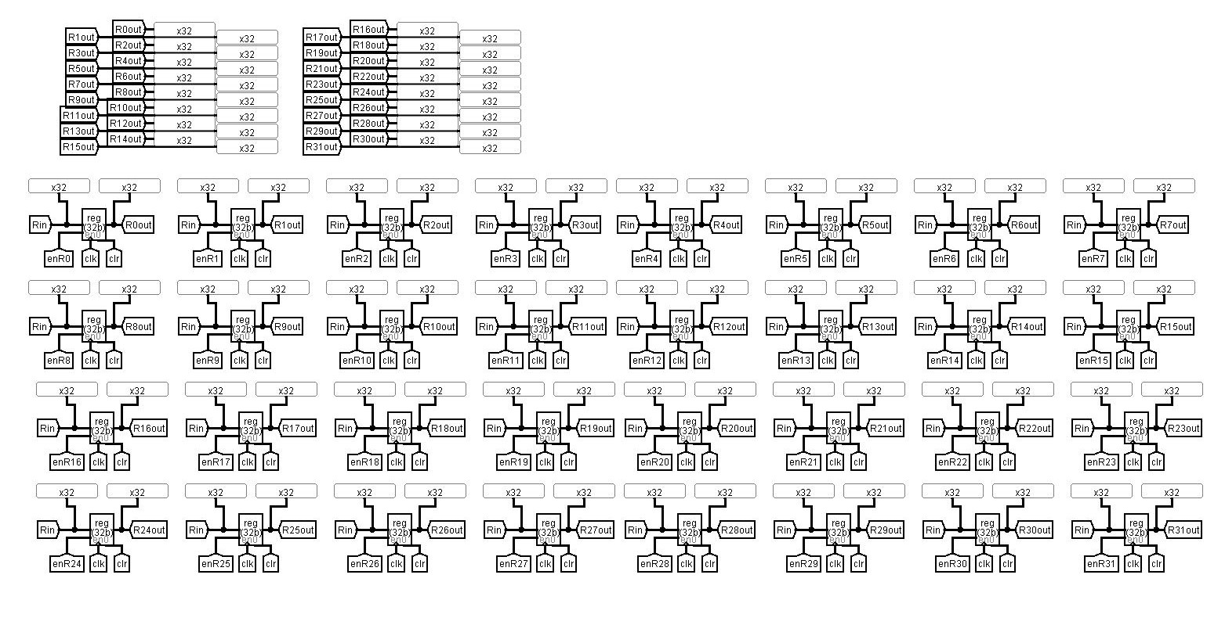
The Registers

Slide 32
The Register File

Slide 33
The Control Unit

Slide 34
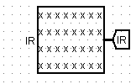
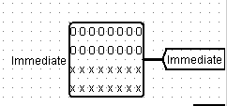
Instruction Register
Control Unit: The Brain of the Processor which instructs various components with control signals.
Instruction Register:
The instructions are fetched from the instruction register saved
in the ISA format.
This IR is attached to the RAM part or the disc memory
the user loads.

Slide 35
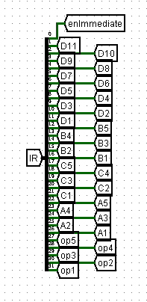
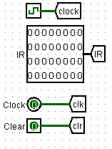
Some important parts of the Control Unit

Slide 36
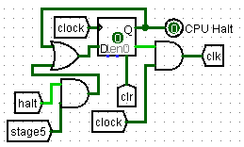
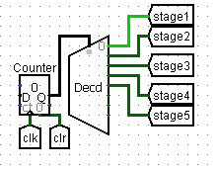
Clock, Clear, IR and Flip Flops
Clock, clear, and Flip Flops are integral to the Control Unit.
We used a D Flip Flop triggered by Negative Falling Edge:
Reduce Active Power Consumption
Data-Lockout Issue
Multi-Transition Problem
This D Flip Flop acts as a counter for 5 stage execution.

Slide 37
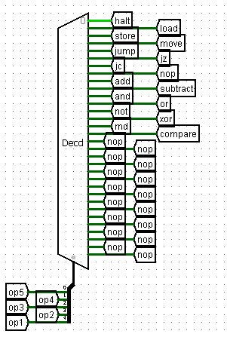
Decoder
Decoder:
The IR contains the Operation Codes or OpCodes.
The OpCodes are them passed into a decoder and
suitable control signals are sent to the ALU for
calculation.
The signals are of 16 types with 2 variants each:
With and without immediate operand.

Slide 38
SOFTWARE, TESTING AND UI

Slide 39
Features of the Platform
One-touch-away windows software
4 themes for smooth user interaction
Easy to use and super user friendly
Designed using batch-file scripting
Uses Logisim for the simulation of the processor circuit

Slide 40
The Platform: Recipe
Ingredients: Uses some very basic scripting commands like: start, conditionals, echo, a lot of goto-workflow and the iexpress by windows. It is a terminal user interactive software.
Testing/ Tasting: We came across with an innovation with this project. Previously, testing on logisim was a manual process. Now, it is almost automatic.

Slide 41
Testing the Platform and Tasting the Soup
Innovation: Logisim provides a logging feature along with the its ‘poke-a-wire’ functionality. If the states of the register file are properly documented, we can find the errors in the program, if any.
The RISC-R Software comes with some basic test cases for given example programs.

Slide 42
THANK YOU!

