Slide 1
DATA ANALYTICS & VISUALIZATION CAPSTONE | ACADEMIC PROJECT
OmniRetail Analytics Platform
End-to-End Retail Intelligence, Customer Lifetime Value Modeling & Time-Series Demand Forecasting
A Complete Synthesis of Coursework Practicals (Labs 0 through 8)
PROJECT PRESENTATION TEAM & PRACTICAL ALIGNMENT:
- Speaker 1 (Team Lead): Executive Overview, Retail Problem Statement & Decoupled Three-Tier Architecture
- Speaker 2 (Data Engineering): Multi-Format Ingestion, Cleaning Audits, ECB Currency API & Relational Database ETL (Labs 1, 2, 4, 5)
- Speaker 3 (Machine Learning & Stats): RFM Feature Engineering, Leakage-Free CLV Regression & Time-Series ARIMA Forecasting (Labs 0, 3, 6)
- Speaker 4 (Visualization & Product): Interactive Visual Toolkit, Distribution Analytics, Production UI Walkthrough & Business ROI (Labs 7, 8)

Slide 2
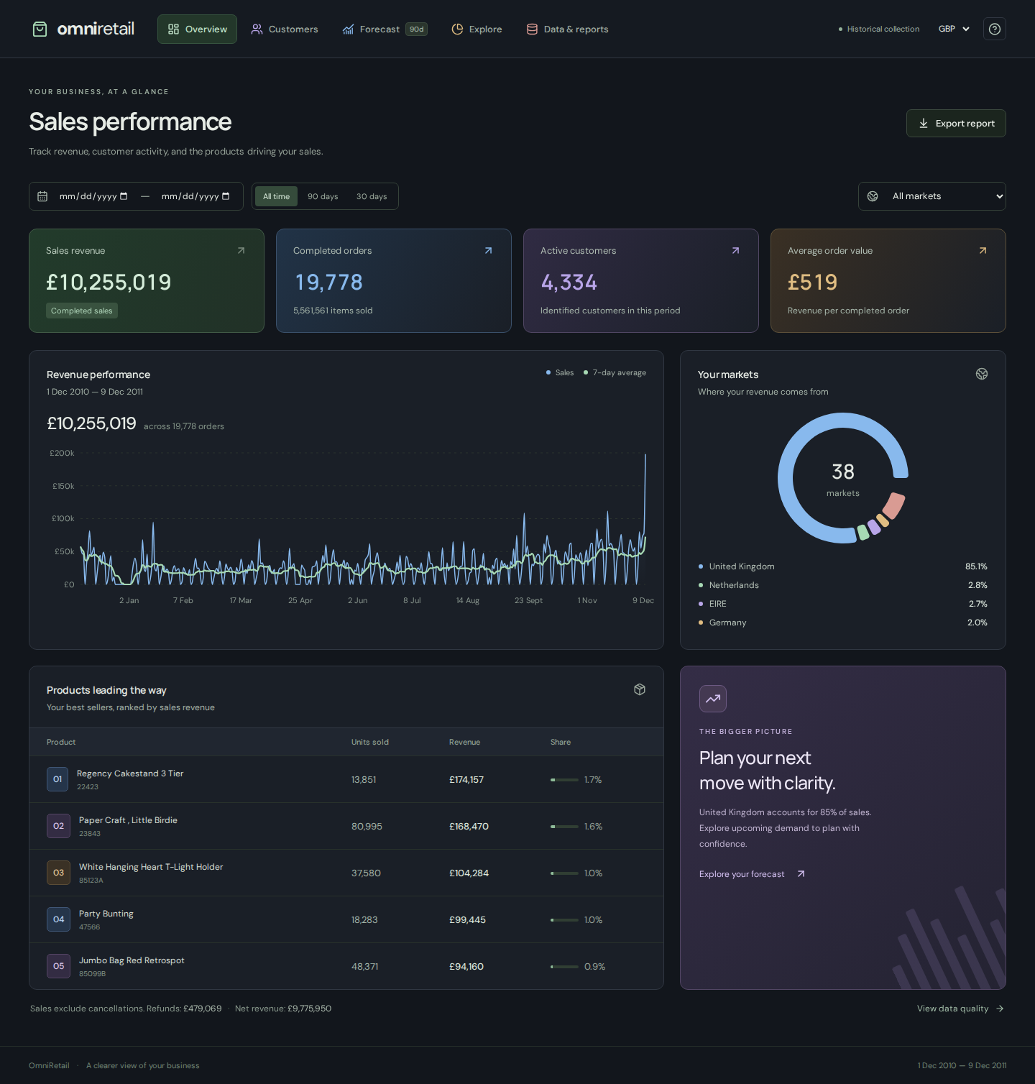
SPEAKER 1 | PROBLEM STATEMENT & ARCHITECTURE
The Retail Analytics Dilemma & OmniRetail Architecture
The Commercial Analytics Bottleneck: Commercial retailers generate vast transactional data across disparate POS systems, e-commerce stores, and partner channels. Organizations face fragmented schemas, slow spreadsheet updates, and lack predictive models for demand forecasting and customer attrition.
Decoupled Three-Tier Architecture: Engineered with a high-performance React 19 + TypeScript frontend for reactive client updates, a FastAPI backend serving asynchronous analytical endpoints, and an embedded local persistence layer eliminating expensive cloud database dependencies.
Hybrid Relational & Columnar Storage: Combines an indexed SQLite database for sub-second relational queries with Apache Parquet files for high-throughput vectorized operations, processing over 530,000 transactions with under 20ms API latency.
Coursework Synthesis (Labs 0-8): Instead of keeping practical assignments in isolated files, OmniRetail integrates data ingestion, cleaning, currency API extraction, relational ETL, ML regression, ARIMA forecasting, and visual analysis into a single platform.
Figure 1: Production Overview Dashboard with real-time KPIs and trendlines.

Slide 3
SPEAKER 2 | DATA ENGINEERING | PRACTICALS 1 & 2
Multi-Format Ingestion Engine & Audited Cleaning Pipeline
Multi-Format Ingestion Boundary (Lab 1): Commercial data arrives in multiple structures. The ingestion service in backend/ingestion.py automatically parses CSV, TXT, XLSX, JSON, and XML formats into a standardized schema. Uses defusedxml to block XML entity expansion vulnerabilities and enforces strict validation on column types, finite positive prices, nonzero quantities, and ISO-8601 timestamps.
Deterministic Data Cleaning & Audit Trail (Lab 2): From the raw 541,909 UCI records, the cleaning engine produces 531,441 valid commercial rows. It identifies and removes 5,258 duplicate rows and 2,693 administrative fee entries (such as manual postage fees and bank charges), logging every step in an immutable audit ledger.
Guest Preservation & Cancellation Integrity (Lab 2): Unlike naive scripts that discard rows with missing IDs, OmniRetail preserves 131,651 guest transactions for accurate macro revenue and sales volume, while isolating registered IDs for customer loyalty models. Returns (8,730 invoice records with 'C' prefix) have their refund signs mathematically normalized to prevent signed negative distortion.
Native Multi-Sheet Excel Reporting (Lab 2): Builds upon practical Excel requirements by utilizing openpyxl to generate automated executive workbooks. Reports feature styled headers, auto-filters, freeze panes, and native Excel chart objects rather than static image embeds.

Slide 4
SPEAKER 2 | ETL SYSTEMS | PRACTICALS 4 & 5
Resilient API Extraction & Transactional Relational Database ETL
Real-Time & Historical Currency API Pipeline (Lab 4): Transactions originate in British Pounds (GBP). The currency service in backend/currency.py connects to the Frankfurter / European Central Bank API to fetch real historical exchange rates pegged to the exact sales closing date (December 2011: GBP/USD ≈ 1.56, GBP/INR ≈ 81.2), enabling multi-currency executive valuation without arbitrary constant multipliers.
Network Resilience & Offline Fallback (Lab 4): API calls feature explicit connection timeouts (10s), exponential backoff retries, and atomic JSON disk caching. If the external API service is unreachable or rate-limited, the system falls back to cached rates, logging warning diagnostics without crashing active sessions.
Relational Schema Architecture with SQLAlchemy (Lab 5): Constructs an automated relational ETL pipeline loading cleaned data into SQLite (omni_retail.db). Builds indexed tables for transactions, unique registered customers, and daily aggregated sales with composite indexes on InvoiceDate, Country, and CustomerID.
Immutable Snapshot Versioning & Safe Pointer Swapping (Lab 5): Imports write complete isolated snapshot directories before atomically updating current.json. Readers with open queries finish uninterrupted, and failed imports preserve existing datasets without partial-write corruption.

Slide 5
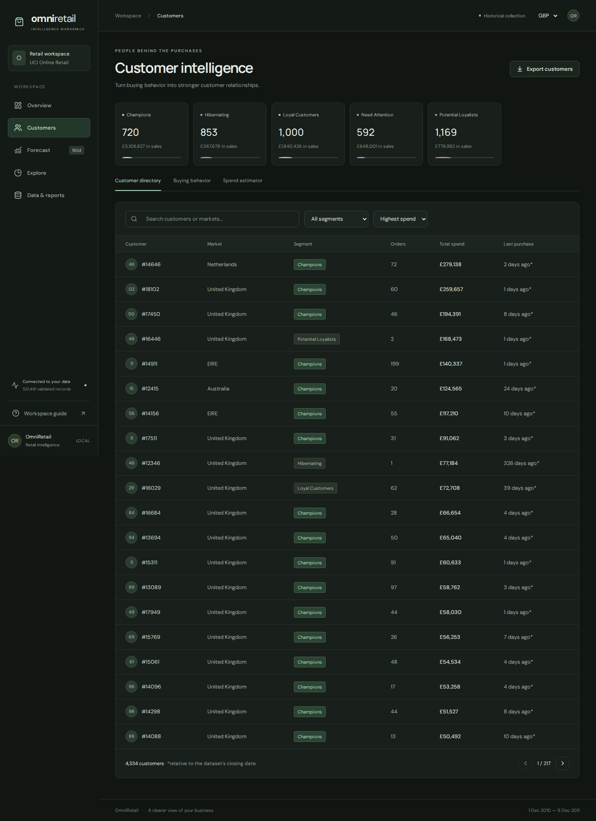
SPEAKER 3 | MACHINE LEARNING | PRACTICALS 0 & 3
RFM Feature Engineering & Leakage-Free CLV Predictive Modeling
Vectorized RFM Feature Engineering (Lab 0): Built on NumPy and Pandas vectorized operations, the feature pipeline computes Recency (days since last purchase), Frequency (distinct completed orders), and Monetary Value (total net spend) across 4,363 distinct registered customers in milliseconds.
Leakage-Free Predictive Split (Lab 3): Avoids target leakage by partitioning history at a 90-day cutoff date. Models train strictly on customer features prior to the cutoff to predict actual forward spending during the subsequent 90-day horizon, delivering genuine predictive power.
Rigorous Scaling & Supervised Regression (Lab 3): Applies scikit-learn StandardScaler fitted strictly on training data splits. Evaluates Linear vs. Ridge Regression against a baseline median heuristic. Wholesale buyers are retained in evaluation, reporting transparent metrics without artificial filtering.
High-Value Customer Tier Classification (Lab 3): Trains a probabilistic classification model predicting the likelihood that a customer reaches the top 20% revenue tier, enabling marketing teams to deploy targeted retention interventions.
Figure 2: Customer Segmentation view with RFM scores and forward spend predictions.

Slide 6
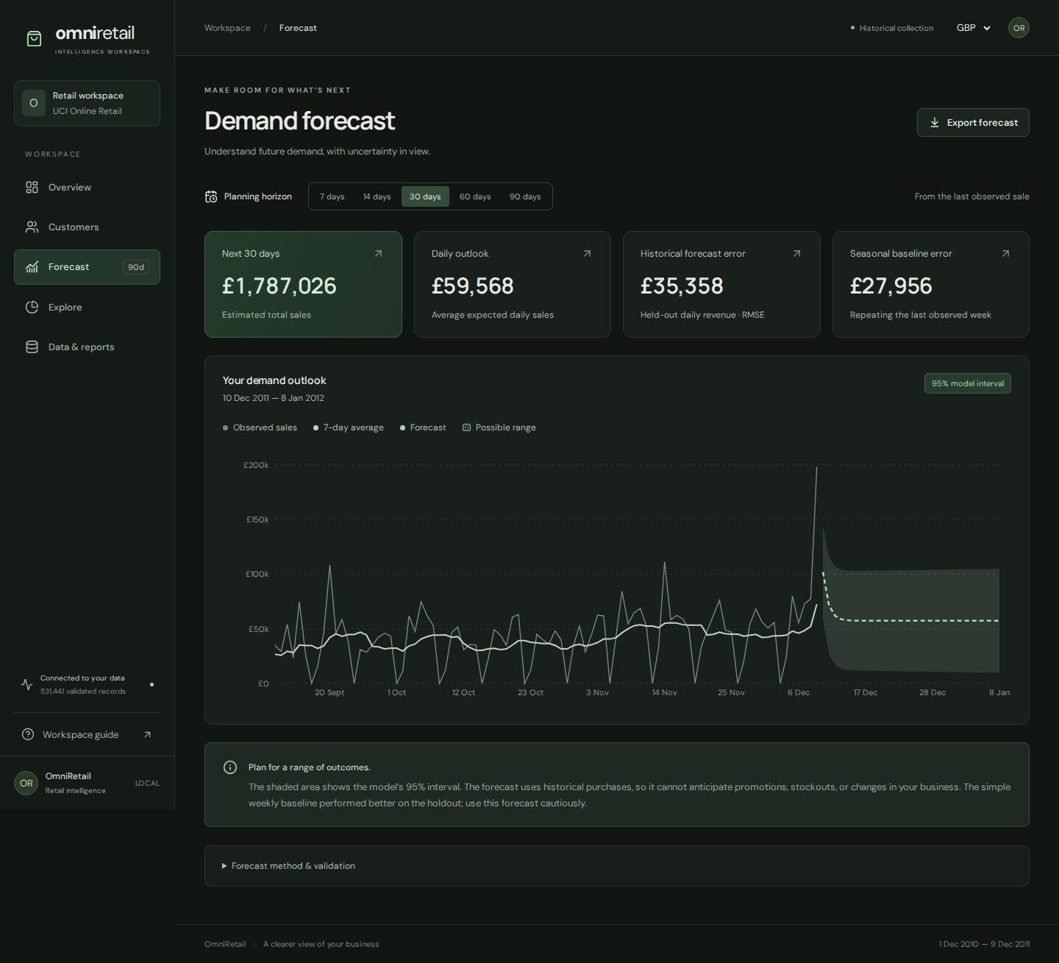
SPEAKER 3 | PREDICTIVE MODELING | PRACTICAL 6
Continuous Time-Series Smoothing & ARIMA Demand Forecasting
Continuous Daily Time-Series (Lab 6): Resamples transactions into a contiguous daily sales calendar, zero-filling days with no sales. This ensures continuous chronological indexing necessary for statistical time-series decomposition.
Multi-Horizon Moving Averages (Lab 6): Calculates 7-day Simple Moving Averages (SMA-7) to filter weekly seasonality, 30-day moving averages (SMA-30) for monthly macro cycles, and 14-day Exponential Moving Averages (EMA-14) for fast momentum detection.
Stationarity Testing & ARIMA(1,1,1) (Lab 6): Applies the Augmented Dickey-Fuller (ADF) test to evaluate series stationarity, takes first-order differencing, and fits an ARIMA(1,1,1) model forecasting sales demand across 7 to 90 days with bounded 95% confidence intervals.
Chronological Holdout Validation (Lab 6): Validates model performance on the final 15% chronological holdout. Transparently compares ARIMA against a seasonal repeating-week baseline, helping inventory planners make grounded procurement decisions.
Figure 3: Forecast Studio showing ARIMA projections with 95% confidence intervals.

Slide 7
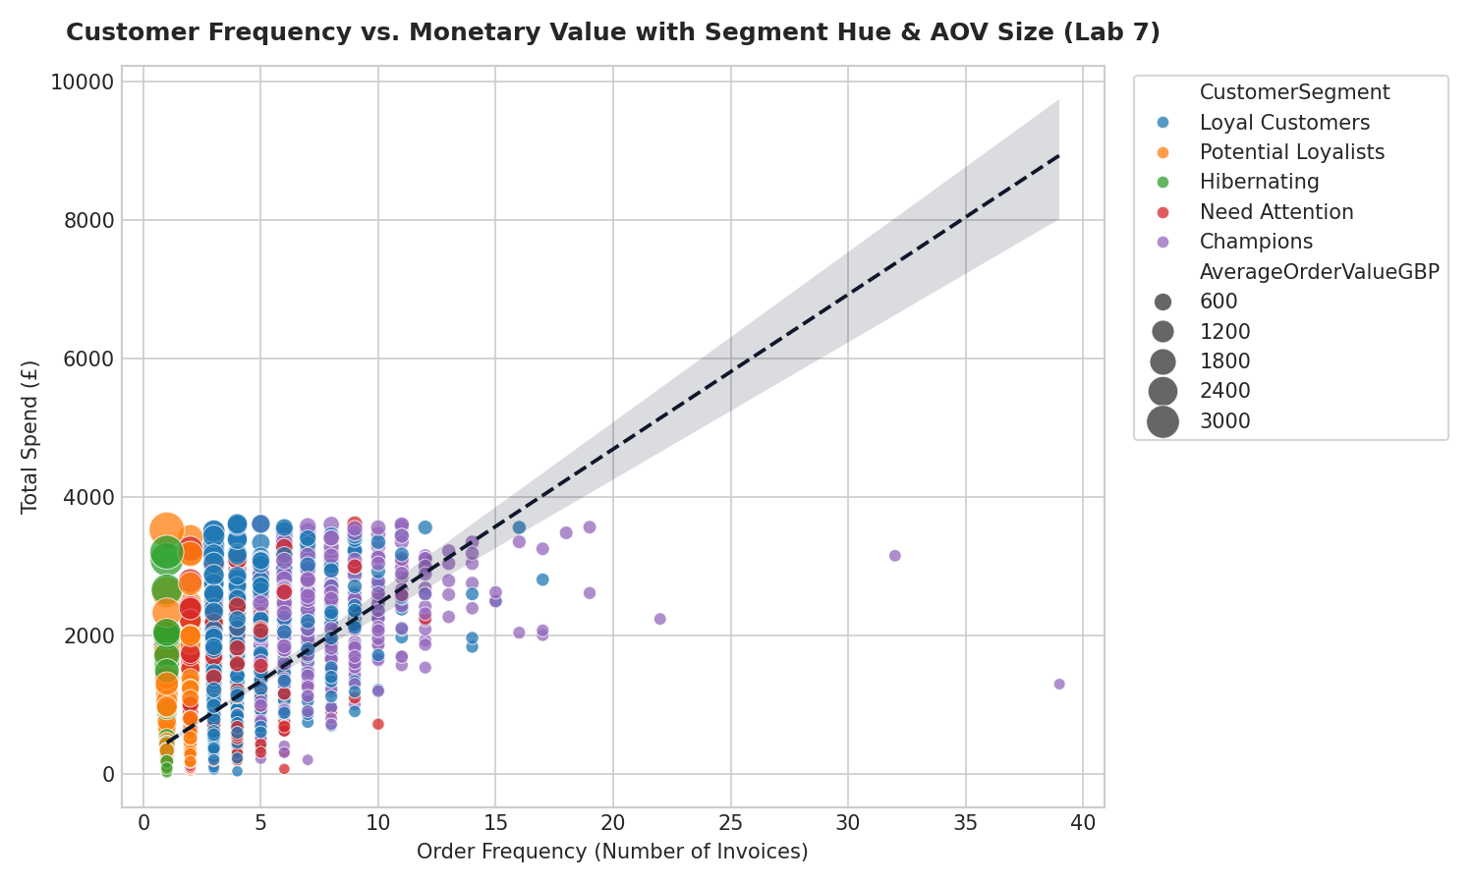
SPEAKER 4 | DATA VISUALIZATION | PRACTICAL 7
Interactive Visual Toolkit: Regression Scatters & Sales Trends
Interactive Charting Canvas (Lab 7): Upgrades static academic charts to responsive, interactive SVG canvases via Recharts. Supports client-side filtering by market, currency, and date range without requiring page reloads.
Customer Behavioral Scatter Plots (Lab 7): Maps Average Order Value against Customer Recency and Frequency. Point dimensions scale proportionally with total customer monetary value, visually separating loyal champions from churn hazards.
Dynamic Trendline & Smoothing Overlays (Lab 7): Allows operators to toggle between raw daily sales fluctuations, SMA-7 baseline curves, and linear trendlines to reveal seasonal patterns without confusing day-to-day noise.
Static Publishing Toolkit Parity (Lab 7): Maintains a parallel Matplotlib and Seaborn visualization pipeline in src/visual_toolkit.py for high-resolution academic papers and automated report generation.
Figure 4: Customer RFM Scatter with regression trendlines and segment classifications.

Slide 8
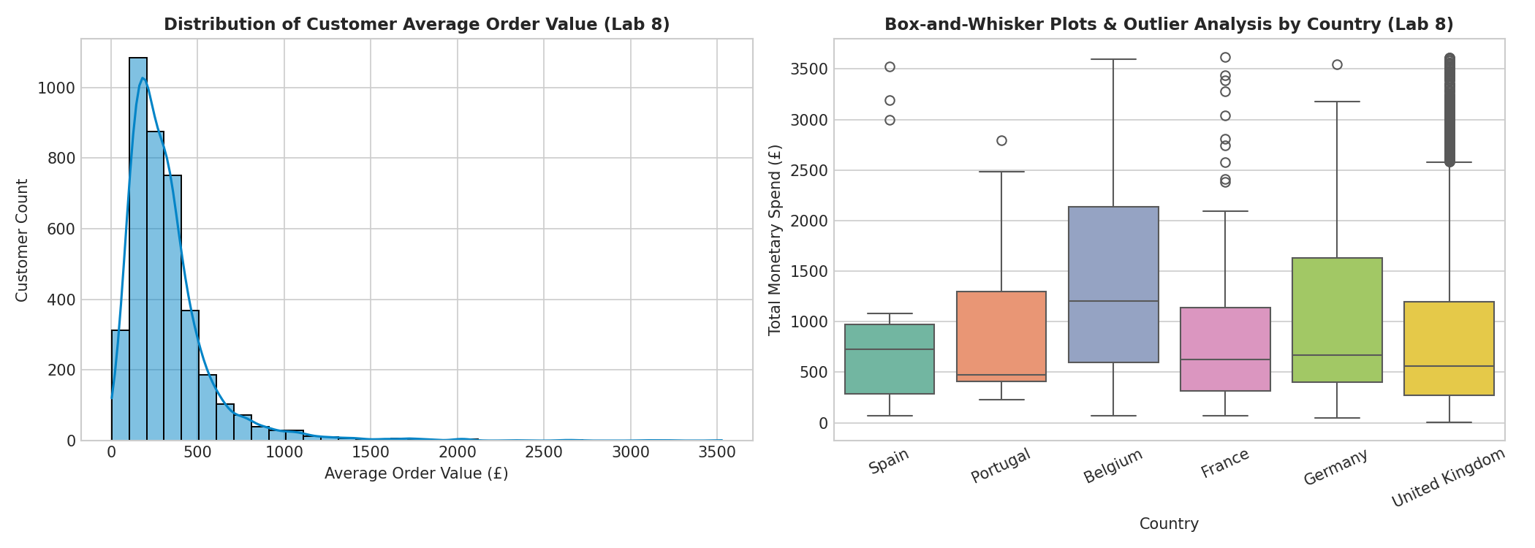
SPEAKER 4 | EXPLORATORY ANALYTICS | PRACTICAL 8
Categorical Distributions & Rigorous Outlier Handling
Statistical Distribution Modeling (Lab 8): Renders order quantity and spend histograms alongside Kernel Density Estimations (KDE) to accurately illustrate heavily right-skewed commercial transaction behaviors.
IQR Outlier Auditing Across Markets (Lab 8): Constructs Interquartile Range (IQR) box-and-whisker plots across top international markets. Retains wholesale outliers in macro accounting while providing adjusted views for everyday customer cohorts.
Geographic Market Concentration (Lab 8): Donut and distribution charts depict market concentration—the UK represents 91.5% of transaction volume (486,323 lines), followed by Germany (9,080), France (8,220), and EIRE (8,167).
Multi-Tool Chart Parity (Lab 8): Cross-validates distribution metrics across React/Recharts, Plotly interactive widgets, Seaborn statistical figures, and native Excel workbooks, ensuring identical insights across reporting platforms.
Figure 5: IQR-bounded Boxplots and Distribution Histograms across international markets.

Slide 9
SPEAKER 4 | PLATFORM WALKTHROUGH | 5 CORE VIEWS
OmniRetail Operational Modules & Production Execution
1. Executive Overview: Real-time operational dashboard tracking Gross Sales (£8.9M GBP), Total Orders (23,217), Active Customers (4,363), and Average Order Value, backed by interactive daily trendlines and country share distributions.
2. Customer Intelligence Explorer: Searchable, paginated customer registry with RFM scorecards, churn indicators, and predictive 90-day forward spend estimates, allowing account managers to prioritize retention outreach.
3. Forecast Studio: Interactive scenario planning tool allowing inventory managers to adjust forecast horizons from 7 to 90 days, inspect uncertainty intervals, and compare ARIMA against seasonal weekly baselines.
4. Exploratory Data Analysis & 5. Data Hub: Provides dynamic Pearson/Spearman correlation heatmaps and distribution inspectors, alongside a drag-and-drop file ingestion portal with formula-injection guarded Excel exports.
Single-Command Production Startup: A single command ('python app.py') launches both the compiled React frontend and the FastAPI backend on port 8000, eliminating complicated multi-terminal setup requirements.

Slide 10
TEAM SUMMARY | BUSINESS VALUE & CONCLUSION
Academic Synthesis, Commercial Impact & Conclusion
Full Practical Synthesis (Labs 0 through 8): OmniRetail synthesizes every syllabus concept: Python matrices (Lab 0), multi-format ingestion (Lab 1), data auditing & cleaning (Lab 2), supervised regression modeling (Lab 3), live API extraction (Lab 4), relational database ETL (Lab 5), time-series ARIMA (Lab 6), visual trend analysis (Lab 7), and categorical distributions (Lab 8).
Tangible Commercial Return on Investment: Automated deterministic ETL replaces hours of manual VLOOKUP cleaning. Live ECB currency conversion ensures accurate cross-border financial reporting. Mathematical demand forecasting reduces stockout risks, while RFM segmentation improves customer retention.
Engineering Rigor & Production Quality: Includes comprehensive pytest suites, Playwright browser end-to-end tests, Ruff linting, Docker containerization, and automated GitHub Actions CI verification workflows.
Public Open-Source Repository & Demonstration: Full source code, reproducible setup scripts, and documentation are published on GitHub: https://github.com/Shlok-Dwivedi/OmniRetail. Thank you for your time; we are now ready for your questions and an interactive demonstration.

