Slide 1
Intelligent Pathfinding using A* Algorithm
Artificial Intelligence • College Project Presented by: Shlok Sagar (25BAI10567)

Slide 2
Introduction to AI
• AI simulates HUMAN INTELLIGENCE in machines.
• Key goal: Enable machines to LEARN, REASON, and PROBLEM-SOLVE.
• Pathfinding is a fundamental AI problem (finding the best route).
• Used in everyday tech from GPS to video games.

Slide 3
What are Search Algorithms?
• A systematic way to SEARCH through a problem space.
• State Space: All possible positions or configurations.
• Goal: Find a sequence of actions from START state to GOAL state.
• Efficiency is measured by Time and Memory complexity.

Slide 4
Uninformed vs Informed Search
Uninformed (Blind Search)
• No knowledge of the goal location.
• Explores all directions equally.
• Examples: BFS, DFS.
Informed (Heuristic Search)
• Uses 'Hints' to reach the goal.
• Focuses on the most promising path.
• Example: A* Algorithm.

Slide 5
Introduction to A* Algorithm
• Pronounced as 'A-Star'.
• It is both OPTIMAL (finds shortest path) and COMPLETE (finds path if it exists).
• Combines features of Dijkstra’s and Greedy Best-First Search.
• Widely used because it is more EFFICIENT than blind search.

Slide 6
The A* Formula
f(n) = g(n) + h(n)
• g(n): Actual cost from START to current node n.
• h(n): HEURISTIC - Estimated cost from current node n to GOAL.
• f(n): TOTAL ESTIMATED COST of the path through node n.

Slide 7
The Heuristic Function (h(n))
• Manhattan Distance: Used for 4-directional grids (L-shaped movement).
• Formula: |x1 - x2| + |y1 - y2|
• Euclidean Distance: Used for any-angle movement (direct 'as the crow flies').
• A 'Good' heuristic never overestimates the cost (Admissible).

Slide 8
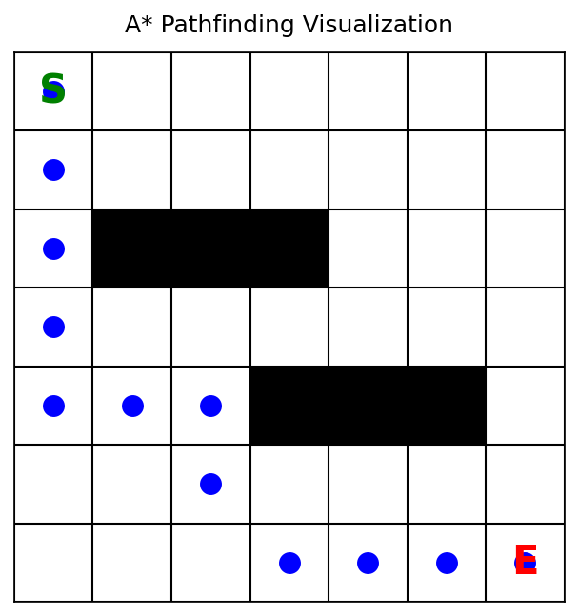
Step-by-Step Working
1. Maintain two lists: OPEN (nodes to visit) and CLOSED (visited).
2. Start by adding the START node to OPEN.
3. Pick node with LOWEST f(n) from OPEN.
4. Check its neighbors: calculate their g, h, f.
5. Update neighbor costs if a better path is found.
6. Repeat until GOAL is reached.

Slide 9
Implementation Overview
• Language: Python is preferred for its library support.
• Data Structures: Priority Queue (Heap) for managing the OPEN list.
• Grid Representation: 2D Array or Graph Nodes.
• Visualization: Pygame or Matplotlib to draw the search live.

Slide 10
Comparison: A* vs BFS
 | Breadth-First Search (BFS) | A* Algorithm
Intelligence | Blind search (Uninformed) | Heuristic-based (Informed)
Speed | Slow (explores all paths) | Fast (directed towards goal)

Slide 11
Real-World Applications
• Video Games: NPCs moving around obstacles.
• Google Maps: Finding shortest traffic-aware routes.
• Robotics: Autonomous vacuum cleaners navigating rooms.
• Network Routing: Sending data packets via best nodes.

Slide 12
Conclusion & Learning Outcomes
• A* is the 'Gold Standard' for pathfinding.
• It balances EFFICIENCY (speed) and ACCURACY (path length).
• Understanding h(n) is key to solving complex AI searches.
• Project demonstrated how mathematical logic can guide machine movement.

