Slide 1
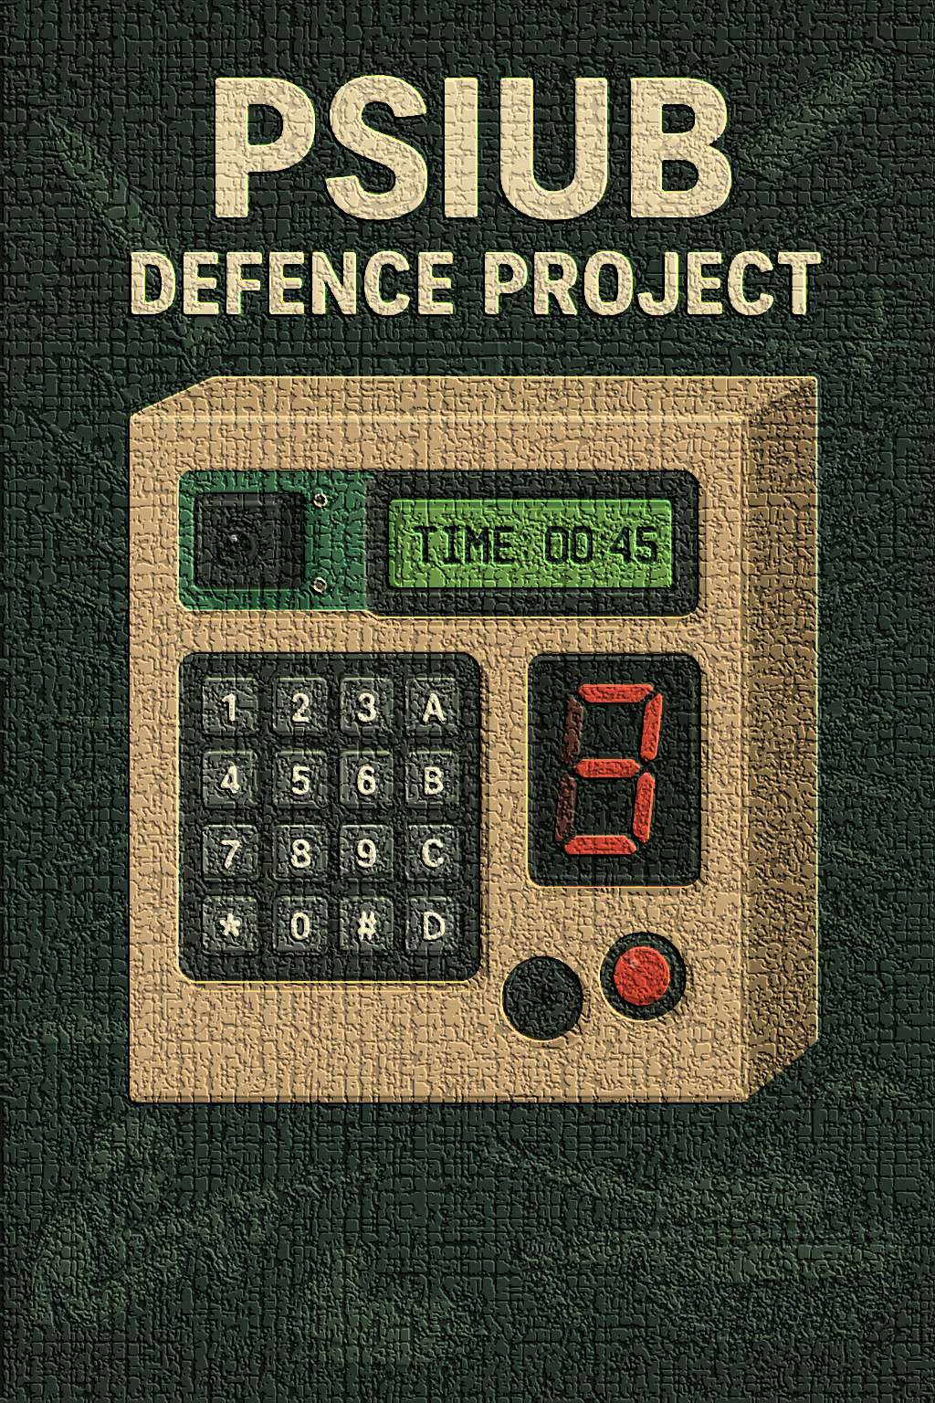
PSIUB
Perimeter Surveillance Interface Unit with Buzzer
–By shlok.

Slide 2
Problem Statement
Increasing security threats to sensitive installations.
Need for a low-cost, portable, and efficient intrusion detection solution.
Defence requirement: quick deployment in the field.

Slide 3
Objective
Detect unauthorized entry using IR sensors.
Provide instant visual & audio alerts.
Show countdown timer for breach time tracking.
Enable secure code entry via keypad to disarm.

Slide 4
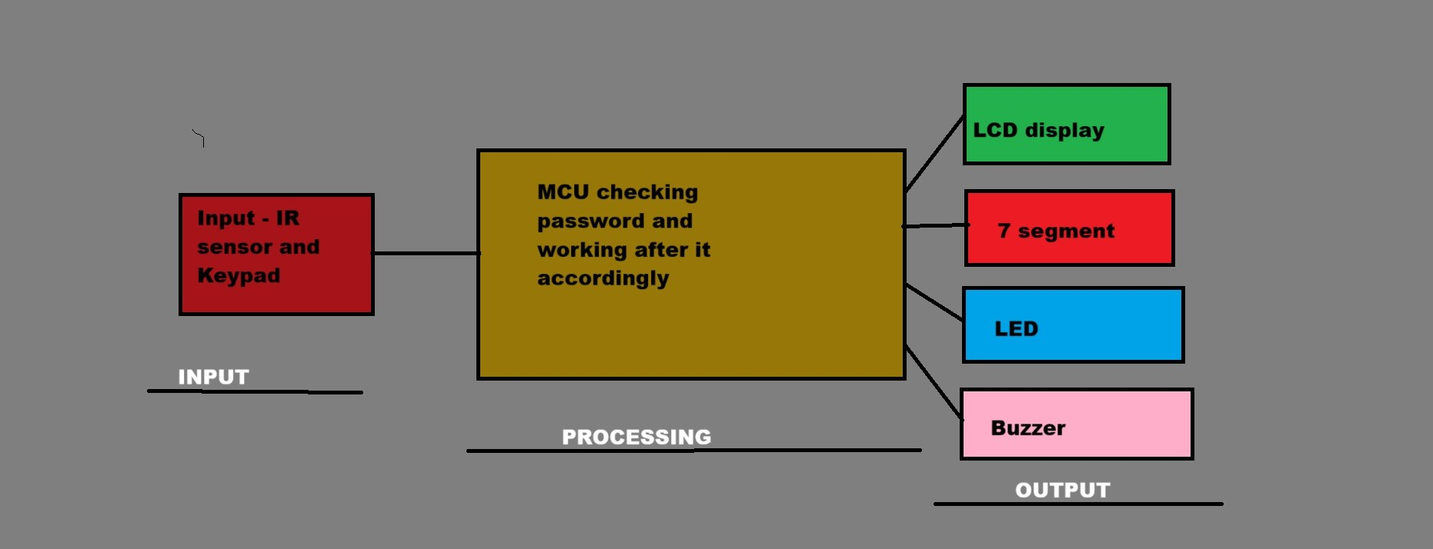
BLOCK DIAGRAM

Slide 5
Hardware Components
IR Sensor – Motion/intrusion detection { in simulation switch is representing the sensor to create interrupt}
Keypad – Code input for disarm/authentication
LCD – Timer & system status display
LED – Visual breach alert
Buzzer – Audible alarm
7-Segment Display – Single-digit status/count display
8051 MCU – Core processing unit

Slide 6

FLOWCHART
Start ↓
Initialize LCD, Ports, and Variables ↓
Display "ENTER pass -" on LCD ↓
Configure External Interrupt 0 (EX0) ↓
Configure Timer0 (Mode 1) for 1-second count ↓
Enable Global Interrupts (EA) ↓
Wait for Password Entry ↳ Key Press?
No → Stay in loop
Yes → Store in entered[] and show on LCD ↓
If 3 digits entered ↳ Compare with Corrpass
Match → Show "Access Granted", set passd = 1
Mismatch → Show "Wrong Pass!", reset POS ↓
After Access Granted → Enter Main Loop

Slide 7
Main Loop Checks:
If ckfg==1 (set by Timer0 ISR) → Update LCD with current Time (hh:mm:ss) → Reset ckfg=0
If sevsegfg==1 (set by EX0 ISR) → Increment sevsegg → Display on 7-segment (dnseg() function) → Reset sevsegfg=0
Other non-blocking tasks can be placed here ↓
Repeat Forever
Interrupt Routines:
Timer0 ISR:
Increment seconds, minutes, hours.
If limits reached, reset and carry over.
Set ckfg=1 to notify main loop.
External Interrupt 0 ISR:
Set sevsegfg=1 to notify main loop.
Toggle LED.

Slide 8
New Approach learnt during this project -
My Old Logic did -
Blocking loops (keypad, 7-seg, delays) → MCU stuck, events missed.
New Event-Driven Logic
Timers → periodic tasks (clock, LEDs).
Interrupts → instant reactions (buttons, sensors).
Flags → communicate between ISR & main loop.
How It Works
Timer ISR updates flags → main loop acts.
Interrupt ISR sets flags → main loop responds.
Main loop never blocked, MCU free for other tasks.
Benefits
Non-blocking, responsive, efficient, scalable.
Hardware vs Simulation
Hardware: Real events & precise timers.
Simulation: Adjusted logic, same principles.

Slide 9
Applications
Border post security.
Ammunition storage monitoring.
Military camp perimeter security.
Sensitive room access control.
Disaster relief temporary shelter protection.
Advantages
Fast deployment in the field.
Cost-effective compared to industrial security systems.
User-friendly with clear display and simple controls.
Reliable for critical defence scenarios.

Slide 10
Conclusion & Future Scope
Successfully developed a compact intrusion alert system.
Scope: integrate GSM module, wireless sensor nodes, solar power.
Can be adapted for civilian and defence use.
THANK YOU
Visit our GitHub profile from website to see its files and codes

