Slide 1
An Application for secure email exchange: encryption- decryption with Blowfish, key delivery with McEliece cryptosystem + EC DSA signature
NAME ID
SHAHAR BERENSON 208608414
SHLOMI FRIDMAN 318187002
OMER GOLDSTEIN 205906258
Notes:
Model flow and model architecturte

Slide 2



Members
Shlomi Fridman
Omer Goldstein
Shahar Berenson

Slide 3
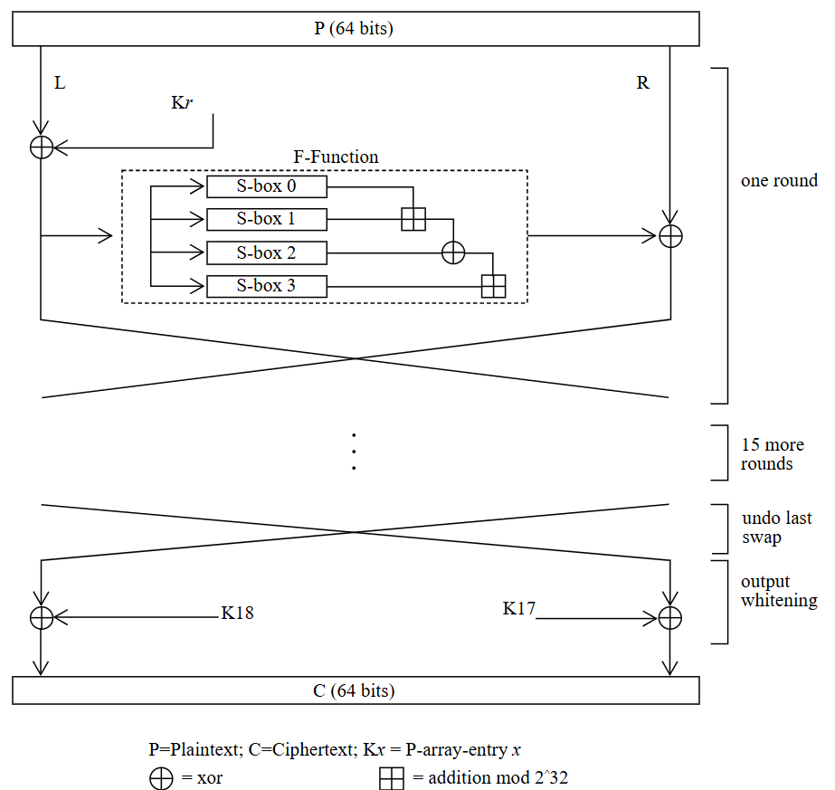
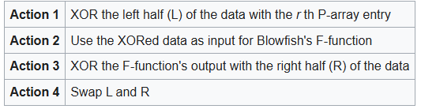
How the cipher works - Blowfish
Symmetric Feistel Iterative Cipher
64-bits block size
32-448-bits key-length
Blowfish's key schedule starts by initializing the P-array and S-boxes
16 rounds with 4 actions listed below
final round - skip action 4
decryption is the same as encryption with reverse order of keys

Slide 4
Blowfish - Key Expansion (1)
The key is used in a process called key expansion, where it initializes:
18-entry P-array (P[0] to P[17])
Four 256-entry S-boxes (S[0] to S[3])
These structures are used throughout the encryption process and must be unique for each key.
Key Expansion Steps:
Initialize the P-array and S-boxes with hex digits of pi (a known constant).
XOR the P-array entries with the key:
The key bytes are cyclically XORed with each 32-bit entry of the P-array.
If the key is shorter than needed, it wraps around.

Slide 5
Blowfish - Key Expansion (2)
Re-encrypt all-zero blocks:
A 64-bit block of all zeros is encrypted using the current state of the P-array and S-boxes.
The output is used to replace the first two entries of the P-array.
This process repeats:
The output of each encryption is used to update the next two entries of the P-array and then all entries of the S-boxes.
This makes Blowfish key-dependent: the final subkeys depend on the key and the internal encryption function.

Slide 6
Text Example of Blowfish
Plain Text: “Hello World”
Encrypted Text: Ҙˮ⑿ݢ♈ሳᾑ⊡ᢉ⒛໽ரῢᝣ

Slide 7
Attacks on Blowfish (1)
Related-Key Attack
This attack exploits predictable relationships between keys to weaken encryption. Impact: Effective only on reduced-round (up to 4 rounds) versions of Blowfish. Not a practical threat to the full 16-round cipher Mitigation: Use strong, randomly generated, and unrelated keys to prevent exploitation through key similarity.
Weak Key Classes
Certain poorly chosen keys can result in weak S-boxes, reducing the security of encryption. Impact: Low impact if keys are generated securely. Easily avoidable with proper key management. Mitigation: Avoid predictable or structured keys by generating keys with a cryptographically secure random number generator.
Birthday Attack
Due to Blowfish’s 64-bit block size, block collisions can occur after encrypting about 34 GB of data. Impact: Moderate impact. Practical for large datasets; makes Blowfish unsuitable for encrypting large volumes with the same key. Mitigation: Limit data encrypted under the same key or switch to a cipher with a larger block size like AES to avoid block collisions.
Differential Cryptanalysis
Analyzes how input differences affect output to deduce information about the key. Impact: Breaks up to 14-round versions; the full 16-round cipher remains unbroken. Mostly theoretical for full Blowfish. Mitigation: Always use the full 16-round version of Blowfish to prevent exposure to known reduced-round attacks.

Slide 8
Attacks on Blowfish (2)
Truncated & Impossible Differential Attacks
Variants of differential cryptanalysis that use partial or impossible output differences. Impact: Limited to reduced-round Blowfish (up to 6 rounds). Not effective on the full cipher. Mitigation: Ensure full-round usage and avoid experimental or reduced versions of Blowfish.
Slow Key Schedule / Side-Channel Risks
Blowfish's complex key setup can leak timing information if not implemented securely. Impact: Low to moderate. Can be a risk in insecure implementations, but not a flaw in the algorithm itself. Mitigation: Use constant-time cryptographic implementations and audited libraries to avoid timing-based side-channel leaks.
Brute Force Attack
Attempts every possible key until the correct one is found. Impact: Ineffective with full-length keys (up to 448 bits). Very low risk when strong keys are used. Mitigation: Use long, high-entropy keys (ideally 448 bits) and protect key material with secure key derivation functions.

Slide 9
Blowfish - General Explanation
Blowfish is a symmetric-key block cipher developed in 1993 by Bruce Schneier
Designed as a fast, free alternative to DES
Operates on 64-bit blocks of data
Supports variable-length keys: from 32 to 448 bits
Based on a Feistel network structure with 16 rounds
Public domain — no patents or license restrictions
Notes:
Decryption: Going Backwards
If you have the same key, you can run the process in reverse to get back the original message.
This is like unlocking the scrambled message with the correct password.

Slide 10
Blowfish - Steps Breakdown
1. Key Expansion
Input key is expanded into 18 32-bit subkeys (P-array) and 4 S-boxes with 256 entries each
Uses repeated encryption of a zero block to initialize the P-array and S-boxes
2. Encryption (Feistel Network) For a 64-bit input block X = L ∥ R: For each round i = 1 to 16:
L = L ⊕ P_{i}
R = F(L) ⊕ R
Swap L and R
After 16 rounds:
Swap L and R one last time
Final operations:
R = R ⊕ P₁₇
L = L ⊕ P₁₈
Output: L ∥ R
→
Notes:
Decryption: Going Backwards
If you have the same key, you can run the process in reverse to get back the original message.
This is like unlocking the scrambled message with the correct password.

Slide 11
Blowfish - Steps Breakdown
3. The F-function
Takes 32-bit input
Divides it into 4 bytes: a, b, c, d
Computes: F(x) = ((S₁[a] + S₂[b]) ⊕ S₃[c]) + S₄[d]
Notes:
Decryption: Going Backwards
If you have the same key, you can run the process in reverse to get back the original message.
This is like unlocking the scrambled message with the correct password.

Slide 12
Blowfish - Efficiency and Speed
Efficiency
Designed for fast encryption on 32-bit CPUs
Key setup is computationally expensive, but encryption/decryption is fast
Ideal for applications with frequent reuse of a fixed key
Complexity
Encryption: 16 rounds of Feistel structure
Each round involves XOR, addition, and table lookups
Time complexity: O(1) per block once key is expanded
Key schedule complexity: O(448) due to key-dependent S-boxes
Notes:
Decryption: Going Backwards
If you have the same key, you can run the process in reverse to get back the original message.
This is like unlocking the scrambled message with the correct password.

Slide 13
Text Example of Blowfish
Plain Text: “Hello World”
Encrypted Text: Ҙˮ⑿ݢ♈ሳᾑ⊡ᢉ⒛໽ரῢᝣ

Slide 14
Blowfish - Example
Assume:
Key = "abcdefgh"
L = 0x01234567
R = 0x89ABCDEF
P_{1_intial} = 0x243F6A88
P_{2_intial} = 0x85A308D3
Encryption:
XOR key into P-array
P₁ = 0x243F6A88 ⊕ 0x61626364 = 0x457D09EC
P₂ = 0x85A308D3 ⊕ 0x65666768 = 0xE0C56FBB
Notes:
Decryption: Going Backwards
If you have the same key, you can run the process in reverse to get back the original message.
This is like unlocking the scrambled message with the correct password.

Slide 15
Blowfish - Example
2. Round 1:
L = L ⊕ P₁ L = 0x01234567 ⊕ 0x457D09EC = 0x44414C8B
Compute F(L)
S₁[0x44] + S₂[0x41] 0x4B7A70E9 + 0xB5B32944 = 0x0105FAA2D (overflow → keep lower 32 bits) = 0x105FAA2D
0x105FAA2D ⊕ S₃[0x4C] 0x105FAA2D ⊕ 0xDB75092E = 0xCF0AA3A3
0xCF0AA3A3 + S₄[0x8B] 0xCF0AA3A3 + 0x726003CA = 0x441AA76D(modulo 2³²) So: F(L) = 0x441AA76D
Notes:
Decryption: Going Backwards
If you have the same key, you can run the process in reverse to get back the original message.
This is like unlocking the scrambled message with the correct password.

Slide 16
Blowfish - Example
2. Round 1:
3. R = R ⊕ F(L) R = 0x89ABCDEF ⊕ 0x441AA76D = 0xCDB16482
4. Swap New L = 0xCD B1 64 82 New R = 0x44 41 4C 8B
3. Decryption:
L = L ⊕ P₁₇
Compute F(L)
R = R ⊕ F(L)
Swap
Notes:
Decryption: Going Backwards
If you have the same key, you can run the process in reverse to get back the original message.
This is like unlocking the scrambled message with the correct password.

Slide 17
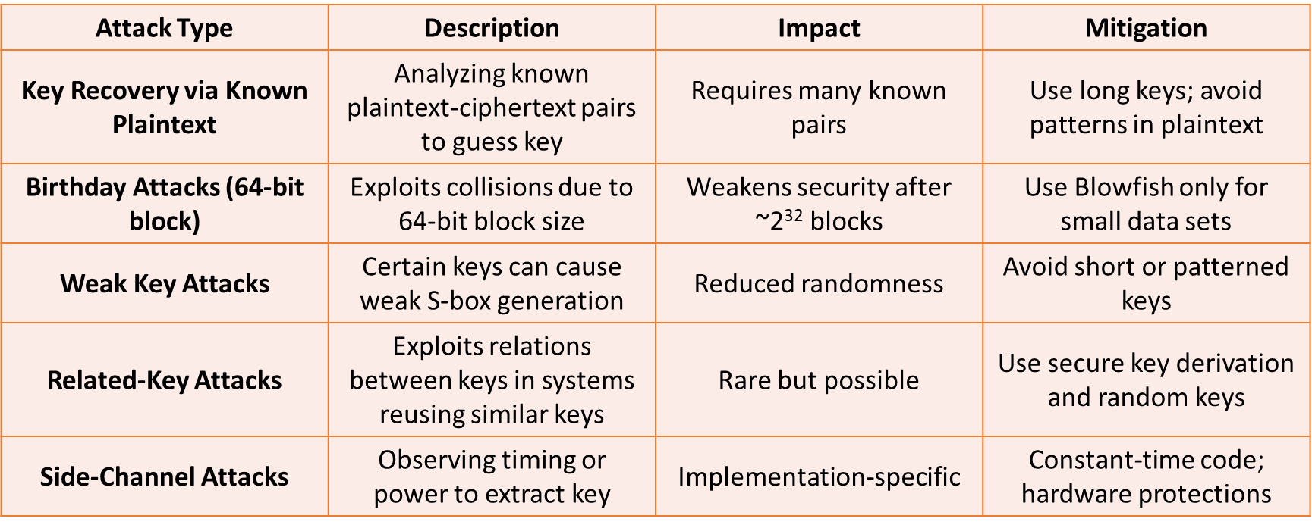
Blowfish - Attack Methods
Notes:
Decryption: Going Backwards
If you have the same key, you can run the process in reverse to get back the original message.
This is like unlocking the scrambled message with the correct password.

Slide 18
McEliece - General Explanation + Core Idea
General Explanation
Public-key encryption scheme based on error-correcting codes
Utilizes Goppa codes for encryption/decryption
Key advantage: Secure against quantum computer attacks
Originally overlooked due to large key size
Core Idea
Encrypts messages by adding noise (errors) to codewords
Only the private key holder can correct the errors and recover the original message
Based on hardness of decoding a general linear code – an NP-hard problem
Notes:
Decryption: Going Backwards
If you have the same key, you can run the process in reverse to get back the original message.
This is like unlocking the scrambled message with the correct password.

Slide 19
McEliece - Steps Breakdown
1. Key Generation
Choose a binary Goppa code with known decoding algorithm
Generate:
Private Key: (Goppa code, decoding algorithm)
Public Key: Generator matrix G' = S × G × P
S: Random invertible matrix (scrambler)
P: Permutation matrix
2. Encryption
Message m: binary vector
Ciphertext c = m ⋅ G′ + e
e: Random error vector of fixed weight
Notes:
Decryption: Going Backwards
If you have the same key, you can run the process in reverse to get back the original message.
This is like unlocking the scrambled message with the correct password.

Slide 20
McEliece - Steps Breakdown
3. Decryption
Undo permutation and scrambling:
Compute cP⁻¹
Use private decoding algorithm to correct errors
Recover m from decoded codeword using S⁻¹
Notes:
Decryption: Going Backwards
If you have the same key, you can run the process in reverse to get back the original message.
This is like unlocking the scrambled message with the correct password.

Slide 21
McEliece - Efficiency and Speed
Efficiency
Encryption/Decryption is fast, especially compared to RSA or ECC
Efficient decoding due to structured Goppa codes
Small encryption time even for large data
Trade-off
Large public key size: ~100 KB to several MB depending on parameters
Storage and transmission can be an issue for constrained environments
Computational Complexity
Based on NP-hard problem: decoding a general linear code
Not efficiently solvable even with quantum computers
Efficient for legitimate users due to special structure of Goppa code
Notes:
Decryption: Going Backwards
If you have the same key, you can run the process in reverse to get back the original message.
This is like unlocking the scrambled message with the correct password.

Slide 22
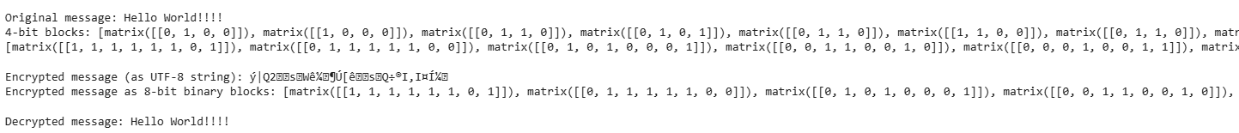
Example Text of McEliece
Plain Text: Hello World!!!!!
Encrypted Text: ý|Q2sWê¼¶Ú[êsQ÷®I,I¤Í¼

Slide 23
McEliece - Example
Assume:
Public key matrix G′: 3×6
Message m=[1,0,1]
Random error e=[0,0,0,1,0,0]
Encryption:
Compute c=m × G′ + e
Result: Ciphertext c=[1,1,0,1,0,1]
Decryption:
Use private key to decode the noisy codeword
Correct the error and recover original message m
Notes:
Decryption: Going Backwards
If you have the same key, you can run the process in reverse to get back the original message.
This is like unlocking the scrambled message with the correct password.

Slide 24
ECDSA - General Explanation
ECDSA = Digital signature scheme based on elliptic curve cryptography (ECC)
Provides authentication, data integrity, and non-repudiation
Security relies on the Elliptic Curve Discrete Logarithm Problem (ECDLP)
Widely used in TLS, cryptocurrencies (e.g., Bitcoin, Ethereum), digital certificates
Notes:
Decryption: Going Backwards
If you have the same key, you can run the process in reverse to get back the original message.
This is like unlocking the scrambled message with the correct password.

Slide 25
ECDSA - Steps Breakdown
Key Generation
Select an elliptic curve E over a finite field F_{p}
Choose private key d∈[1,n−1]d
Compute public key Q = d ⋅ G, where G is the base point
Signing a Message
Hash message mmm to get h=HASH(m)
Choose random k∈[1,n−1]
Compute point (x₁,y₁) = k ⋅ G , set r = x₁ mod n
Compute s = k⁻¹(h + dr)mod n
Signature = (r,s)
Notes:
Decryption: Going Backwards
If you have the same key, you can run the process in reverse to get back the original message.
This is like unlocking the scrambled message with the correct password.

Slide 26
ECDSA - Steps Breakdown
Verifying a Signature
Compute h=HASH(m)
Compute w= s⁻¹ mod n
Compute u₁ = h ⋅ w mod n
Compute (x₂,y₂) = u₁ ⋅ G + u₂⋅Q
Valid if r ≡ x₂ mod n
Notes:
Decryption: Going Backwards
If you have the same key, you can run the process in reverse to get back the original message.
This is like unlocking the scrambled message with the correct password.

Slide 27
ECDSA - Efficiency and Speed
Efficiency
More secure per-bit than RSA
Shorter key sizes = faster operations and lower bandwidth
256-bit ECC ~ 3072-bit RSA security
Ideal for mobile, embedded, and blockchain systems
Complexity
Based on scalar multiplication: O(log⁡ n) field operations
Signing: one scalar multiplication
Verifying: two scalar multiplications + addition
Notes:
Decryption: Going Backwards
If you have the same key, you can run the process in reverse to get back the original message.
This is like unlocking the scrambled message with the correct password.

Slide 28
Example Text of EC-DSA
Plain Text: Hello World!!

Slide 29
ECDSA - Example
Assume:
Base point G, order n = 19
Private key d = 7
Public key Q = 7G
Message: “Hi”, hashed to h = 10
Random k = 3
Signature:
kG=(x,y) ⇒ r = x mod 19 = 4
s = k⁻¹(h + d ⋅ r) mod 19 = 3⁻¹(10 + 7 ⋅ 4) mod 19 = 0
Verification:
Compute w = s⁻¹ mod n, then verify with point additions
Notes:
Decryption: Going Backwards
If you have the same key, you can run the process in reverse to get back the original message.
This is like unlocking the scrambled message with the correct password.

Slide 30
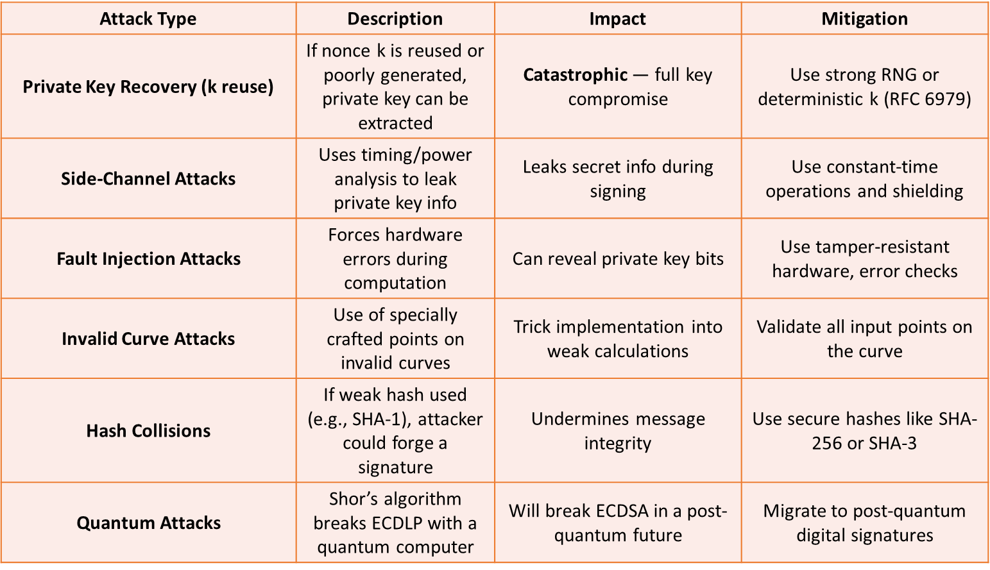
ECDSA - Attack Methods
Notes:
Decryption: Going Backwards
If you have the same key, you can run the process in reverse to get back the original message.
This is like unlocking the scrambled message with the correct password.

Slide 31
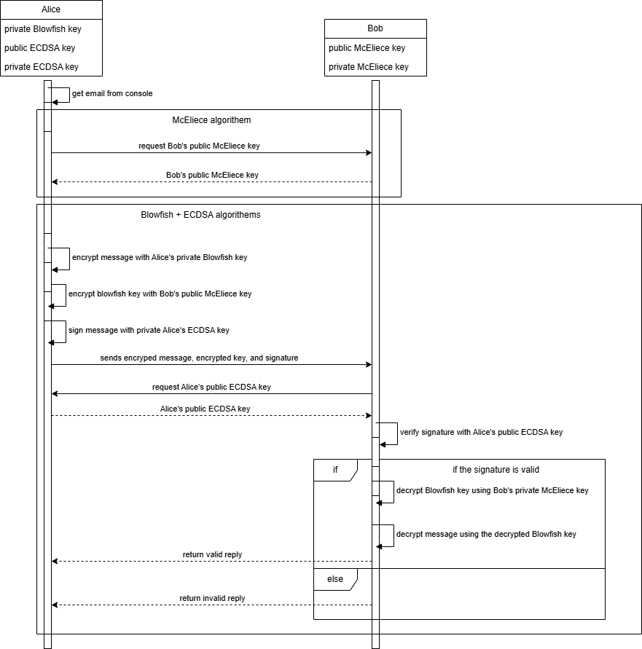
General Schema
Secure email exchange system using:
Blowfish for symmetric encryption of the email contents
McEliece cryptosystem for secure delivery of the symmetric key
EC-DSA for digital signatures (authenticity + integrity)

Slide 32
Secure Email Exchange –Step-by-Step
Pre-Setup
Key Generation:
Sender (Alice) generates an ECDSA key pair (private and public) for signing.
Receiver (Bob) generates a McEliece key pair (private and public) for asymmetric encryption.
Public Key Exchange:
Bob securely shares his McEliece public key with Alice.
Alice securely shares her ECDSA public key with Bob (or includes it in the message).
Notes:
Blowfish is a symmetric block cipher that encrypts data in 64-bit blocks using a variable-length key (32 to 448 bits).
Commonly used for fast, lightweight encryption.
Operates in several modes (e.g., ECB, CBC). For email messages, CBC is more secure.
Encryption and decryption use the same key, which must be shared securely.

Slide 33
Secure Email Exchange –Step-by-Step
Sender (Alice) Prepares and Sends the Email
Generate symmetric key (K):
Alice generates a random symmetric key for Blowfish.
Encrypt the message with Blowfish:
EncryptedMessage = Blowfish_Encrypt(plaintext, K)
Encrypt the symmetric key with McEliece:
EncryptedKey = McEliece_Encrypt(K, Bob_McEliece_PublicKey)
Create a digital signature with ECDSA
:Alice signs EncryptedMessage || EncryptedKey using her ECDSA private key.
Signature = ECDSA_Sign(EncryptedMessage || EncryptedKey, Alice_ECDSA_PrivateKey)
Send email package:
Alice sends to Bob:
Notes:
Blowfish is a symmetric block cipher that encrypts data in 64-bit blocks using a variable-length key (32 to 448 bits).
Commonly used for fast, lightweight encryption.
Operates in several modes (e.g., ECB, CBC). For email messages, CBC is more secure.
Encryption and decryption use the same key, which must be shared securely.

Slide 34
Secure Email Exchange –Step-by-Step
Receiver (Bob) Processes the Email
Get Alice’s ECDSA Public Key:
If Bob doesn’t already have it, he extracts Alice’s ECDSA public key from the message and verifies its authenticity.
Verify the signature:
Bob verifies the signature using Alice’s ECDSA public key.
If verification fails → reject the message.
Decrypt the symmetric key:
Bob uses his McEliece private key to decrypt EncryptedKey and recover symmetric key K.
Decrypt the message:
Bob decrypts EncryptedMessage using Blowfish and the symmetric key K.
Notes:
Blowfish is a symmetric block cipher that encrypts data in 64-bit blocks using a variable-length key (32 to 448 bits).
Commonly used for fast, lightweight encryption.
Operates in several modes (e.g., ECB, CBC). For email messages, CBC is more secure.
Encryption and decryption use the same key, which must be shared securely.

Slide 35
How the cipher works
Asymmetric Key Delivery – McEliece
Asymmetric encryption for key delivery
Based on error-correcting codes (Goppa codes)
Public key used to encrypt Blowfish key
Private key used by recipient to recover Blowfish key
Resistant to quantum attacks (unlike RSA)
Notes:
McEliece is a public-key cryptosystem based on error-correcting codes, not number theory — it's considered quantum-resistant.
Used to encrypt the symmetric Blowfish key, so it can be sent securely.
Only the recipient (Bob) can decrypt it using his private McEliece key.

Slide 36
Original Text
Example plaintext message: “Project X status: Launch delayed until Q3.”
Message is unprotected in its current form Needs:
Encryption for confidentiality
Digital signature for authenticity
Processed next using Blowfish, McEliece, and ECDSA
Notes:
The original message is a plaintext string representing the content of an email. In real-world applications, this could be a subject line, a short paragraph, or any piece of text. For demonstration purposes, we use a simple text message to show how it is processed through encryption, key delivery, and digital signing.
The message must be encrypted to ensure confidentiality, and should be digitally signed to guarantee authenticity and integrity.
Waiting for script

Slide 37
Encrypted Text
Message encrypted using Blowfish cipher
Uses a randomly generated symmetric key
Output is ciphertext: unreadable without the correct key
Appears as random data (e.g., hexadecimal or base64)
Blowfish key will be securely sent using McEliece
Protects message confidentiality in transit
Notes:
Once the plaintext message is encrypted using the Blowfish symmetric cipher, the result is a non-readable block of ciphertext. This ciphertext appears as a random string of characters and symbols — not meaningful to anyone without the key.
Encryption is done using a randomly generated Blowfish key, and the same key must later be used to decrypt the message. Since symmetric keys cannot be shared openly, the Blowfish key is encrypted using the McEliece public-key system.
This step ensures that even if someone intercepts the message, they cannot understand it without the Blowfish key — and they can't access the key unless they can break McEliece encryption (which is considered quantum-safe).

Slide 38
How to decipher with the key
Receiver (Bob) receives:
Encrypted message (ciphertext)
Encrypted Blowfish key
Digital signature
Sender’s public ECDSA key
Step 1: Decrypt Blowfish key
Use McEliece private key to recover the symmetric Blowfish key
Step 2: Decrypt the message
Use the recovered Blowfish key to decrypt the message
Step 3: Verify the signature
Use sender’s public ECDSA key to confirm message authenticity
Message is only accepted if signature is valid
Notes:
To decipher the message, the receiver (Bob) performs three critical steps:
Recover the Blowfish key Using his private McEliece key, Bob decrypts the encrypted Blowfish key that was sent by Alice. Only Bob can perform this decryption, because only he possesses the correct private key.
Decrypt the message With the recovered Blowfish key, Bob decrypts the ciphertext. Blowfish is symmetric, so the same key used for encryption is now used for decryption.
Verify the signature Before trusting the decrypted content, Bob verifies the digital signature using Alice’s public ECDSA key. This ensures that:
The message truly came from Alice (authenticity)
The message has not been altered (integrity)
Only if the signature is valid does Bob consider the message trustworthy.

Slide 39
Digital Signature
Ensures the message came from the claimed sender
Confirms the message hasn’t been altered
Signature is created with sender’s private key
Verified using sender’s public key
Applied to the encrypted message, not the plaintext
Notes:
Digital signatures are used in our system to make sure that:
The message truly came from the sender (Alice)
The encrypted message has not been tampered with
The signature is added after encryption, and verified before decryption, using public-key cryptography. Details of how the signing works will be covered in the next slide: “How ECDSA Works.”

Slide 40
Digital Signature
Based on elliptic curve cryptography
Uses a private key to create a signature
Uses the corresponding public key to verify it
Two main steps:
Signing: Hash the message + generate signature using private key
Verification: Use public key to verify that signature matches hash
If matched: signature is valid → message is authentic
If mismatch: reject message → possible tampering
Notes:
ECDSA (Elliptic Curve Digital Signature Algorithm) is a digital signature scheme based on the mathematics of elliptic curves.
Step 1: Signing (by Alice)
Alice hashes the encrypted message (e.g., with SHA-256)
She uses her private key and the hash to generate a digital signature — typically a pair of numbers (r, s)
She sends the encrypted message, the signature (r, s), and her public key
Step 2: Verification (by Bob)
Bob receives the signature and message
He also hashes the received message
Using Alice’s public key, he verifies if the signature corresponds to that hash
If it matches, Bob knows:
The message really came from Alice (authenticity)
The message was not altered in transit (integrity)
Why elliptic curves?
Strong security with smaller keys (e.g., 256-bit ECC key ≈ 3072-bit RSA key)

Slide 41
Hash Function

