Slide 1
An Application for secure email exchange: encryption- decryption with Blowfish, key delivery with McEliece cryptosystem + EC DSA signature
NAME ID
SHAHAR BERENSON 208608414
SHLOMI FRIDMAN 318187002
OMER GOLDSTEIN 205906258
Notes:
Model flow and model architecture

Slide 2



Members
Shlomi Fridman
Omer Goldstein
Shahar Berenson

Slide 3
Blowfish - General Explanation
Blowfish is a symmetric-key block cipher developed in 1993 by Bruce Schneier
Designed as a fast, free alternative to DES
Operates on 64-bit blocks of data
Supports variable-length keys: from 32 to 448 bits
Based on a Feistel network structure with 16 rounds
Public domain — no patents or license restrictions
Notes:
Decryption: Going Backwards
If you have the same key, you can run the process in reverse to get back the original message.
This is like unlocking the scrambled message with the correct password.

Slide 4
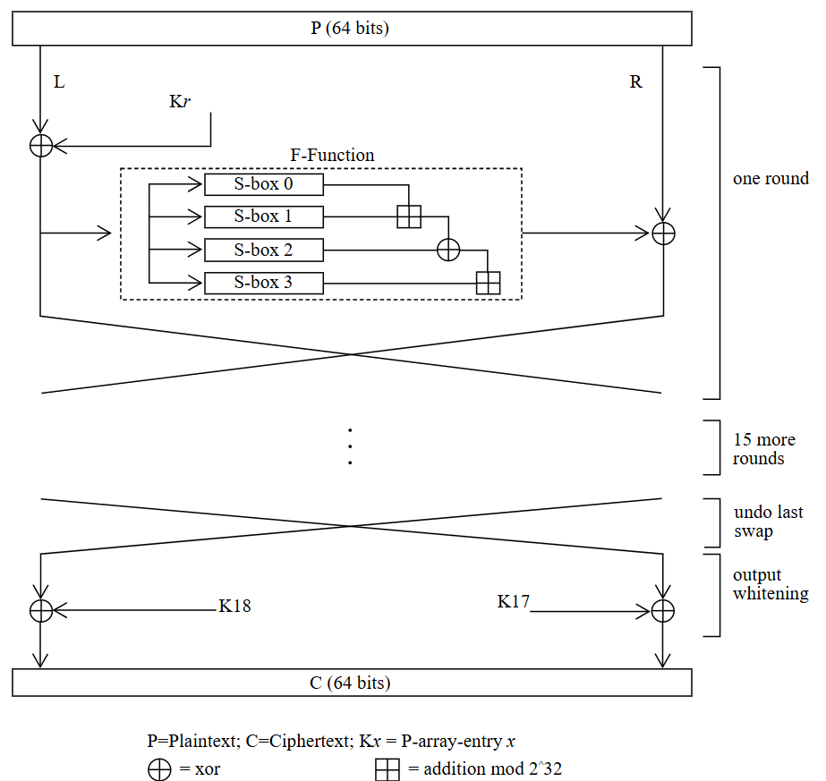
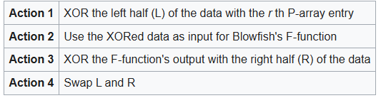
How the cipher works - Blowfish
Symmetric Feistel Iterative Cipher
64-bits block size
32-448-bits key-length
Blowfish's key schedule starts by initializing the P-array and S-boxes
16 rounds with 4 actions listed below
final round - skip action 4
decryption is the same as encryption with reverse order of keys

Slide 5
Blowfish - Steps Breakdown
1. Key Expansion
Input key is expanded into 18 32-bit subkeys (P-array) and 4 S-boxes with 256 entries each
Uses repeated encryption of a zero block to initialize the P-array and S-boxes
2. Encryption (Feistel Network) For a 64-bit input block X = L ∥ R: For each round i = 1 to 16:
L = L ⊕ P_{i}
R = F(L) ⊕ R
Swap L and R
After 16 rounds:
Swap L and R one last time
Final operations:
R = R ⊕ P₁₇
L = L ⊕ P₁₈
Output: L ∥ R
→
Notes:
Decryption: Going Backwards
If you have the same key, you can run the process in reverse to get back the original message.
This is like unlocking the scrambled message with the correct password.

Slide 6
Blowfish - Steps Breakdown
3. The F-function
Takes 32-bit input
Divides it into 4 bytes: a, b, c, d
Computes: F(x) = ((S₁[a] + S₂[b]) ⊕ S₃[c]) + S₄[d]
Notes:
Decryption: Going Backwards
If you have the same key, you can run the process in reverse to get back the original message.
This is like unlocking the scrambled message with the correct password.

Slide 7
Blowfish - Efficiency and Speed
Efficiency
Designed for fast encryption on 32-bit CPUs
Key setup is computationally expensive, but encryption/decryption is fast
Ideal for applications with frequent reuse of a fixed key
Complexity
Encryption: 16 rounds of Feistel structure
Each round involves XOR, addition, and table lookups
Time complexity: O(1) per block once key is expanded
Key schedule complexity: O(448) due to key-dependent S-boxes
Notes:
Decryption: Going Backwards
If you have the same key, you can run the process in reverse to get back the original message.
This is like unlocking the scrambled message with the correct password.

Slide 8
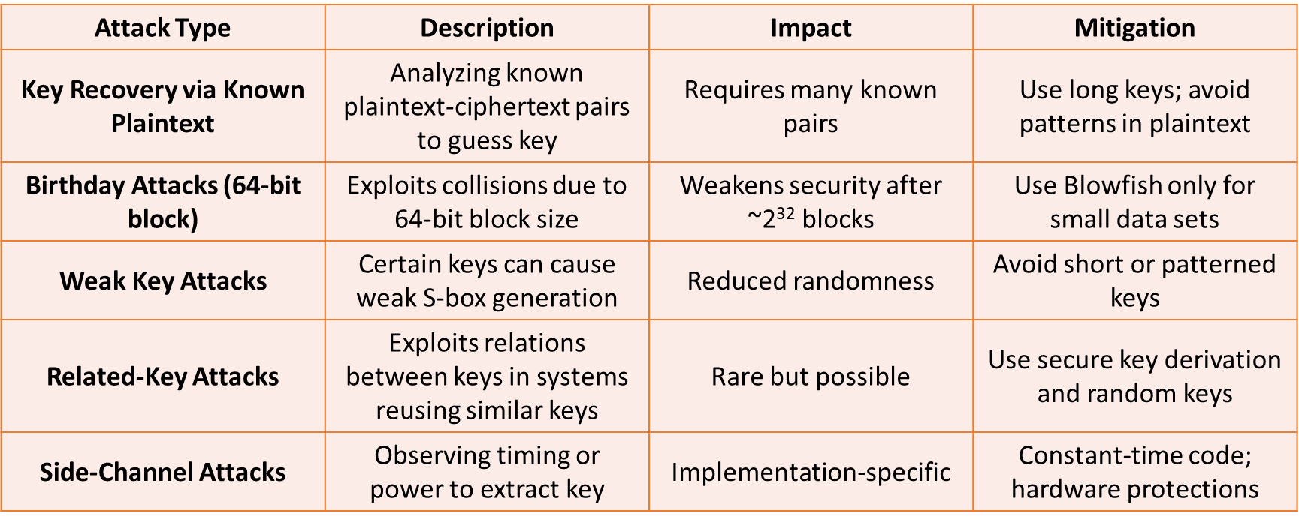
Blowfish - Attack Methods
Notes:
Decryption: Going Backwards
If you have the same key, you can run the process in reverse to get back the original message.
This is like unlocking the scrambled message with the correct password.

Slide 9
Blowfish - Example
Assume:
Key = "abcdefgh"
L = 0x01234567
R = 0x89ABCDEF
P_{1_intial} = 0x243F6A88
P_{2_intial} = 0x85A308D3
Encryption:
XOR key into P-array
P₁ = 0x243F6A88 ⊕ 0x61626364 = 0x457D09EC
P₂ = 0x85A308D3 ⊕ 0x65666768 = 0xE0C56FBB
Notes:
Decryption: Going Backwards
If you have the same key, you can run the process in reverse to get back the original message.
This is like unlocking the scrambled message with the correct password.

Slide 10
Blowfish - Example
2. Round 1:
L = L ⊕ P₁ L = 0x01234567 ⊕ 0x457D09EC = 0x44414C8B
Compute F(L)
S₁[0x44] + S₂[0x41] 0x4B7A70E9 + 0xB5B32944 = 0x0105FAA2D (overflow → keep lower 32 bits) = 0x105FAA2D
0x105FAA2D ⊕ S₃[0x4C] 0x105FAA2D ⊕ 0xDB75092E = 0xCF0AA3A3
0xCF0AA3A3 + S₄[0x8B] 0xCF0AA3A3 + 0x726003CA = 0x441AA76D(modulo 2³²) So: F(L) = 0x441AA76D
Notes:
Decryption: Going Backwards
If you have the same key, you can run the process in reverse to get back the original message.
This is like unlocking the scrambled message with the correct password.

Slide 11
Blowfish - Example
2. Round 1:
3. R = R ⊕ F(L) R = 0x89ABCDEF ⊕ 0x441AA76D = 0xCDB16482
4. Swap New L = 0xCD B1 64 82 New R = 0x44 41 4C 8B
Decryption:
L = L ⊕ P₁₇
Compute F(L)
R = R ⊕ F(L)
Swap
Notes:
Decryption: Going Backwards
If you have the same key, you can run the process in reverse to get back the original message.
This is like unlocking the scrambled message with the correct password.

Slide 12
Text Example of Blowfish
Plain Text: “Hello World!”
Encrypted Text: Ҙˮ⑿ݢ♈ሳᾑ⊡ᢉ⒛໽ரῢᝣ

Slide 13
McEliece - General Explanation + Core Idea
General Explanation
Public-key encryption scheme based on error-correcting codes
Utilizes Goppa codes for encryption/decryption
Key advantage: Secure against quantum computer attacks
Originally overlooked due to large key size
Core Idea
Encrypts messages by adding noise (errors) to codewords
Only the private key holder can correct the errors and recover the original message
Based on hardness of decoding a general linear code – an NP-hard problem
Notes:
ביטחון קוונטי: McEliece נחשבת לבטוחה גם כנגד מחשבים קוונטיים, כי היא מתבססת על בעיה מתמטית קשה: פענוח קוד עם שגיאות – בעיה שאין לה פתרון יעיל גם באמצעות מחשב קוונטי.
קודי Goppa: סוג של קוד לתיקון שגיאות עם מבנה אלגברי מיוחד, שמאפשר פענוח מהיר כאשר המפתח הפרטי ידוע.
הוספת רעש: בזמן ההצפנה מוסיפים שגיאות אקראיות לקוד, מה שהופך את ההודעה לבלתי קריאה עבור מי שאין לו את המפתח.
בעיה קשה מתמטית: פענוח קוד ליניארי כללי זו בעיה מאוד קשה חישובית (NP-hard), ולכן קשה מאוד לשבירה גם עם מחשבים חזקים במיוחד.

Slide 14
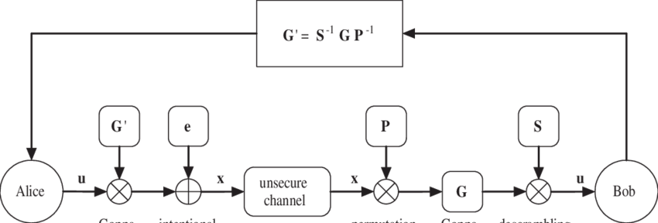
McEliece - Steps Breakdown
1. Key Generation
Choose a binary Goppa code with known decoding algorithm
Generate:
Private Key: (Goppa code, decoding algorithm)
Public Key: Generator matrix G' = S × G × P
S: Random invertible matrix (scrambler)
P: Permutation matrix
2. Encryption
Message m: binary vector
Ciphertext c = m ⋅ G′ + e
e: Random error vector of fixed weight
Notes:
מסתירים את המבנה של הקוד המקורי על ידי שיבוש (S) ופרמוטציה (P) כדי שיהיה קשה לזהות שמדובר בקוד Goppa.
המפתח הציבורי נראה אקראי – אבל מי שמחזיק את המפתח הפרטי יודע איך להפוך את הפעולות האלה.
מכפילים את ההודעה במטריצה הציבורית, ואז מוסיפים שגיאות.
מתקבל ciphertext שנראה רועש, אך בר-פענוח רק למי שיש את המפתח הפרטי.

Slide 15
McEliece - Steps Breakdown
3. Decryption
Undo permutation and scrambling:
Compute cP⁻¹
Use private decoding algorithm to correct errors
Recover m from decoded codeword using S⁻¹
Notes:
משתמשים במפתח הפרטי כדי להפוך את השיבוש והפרמוטציה.
מתקנים את השגיאות שנוספו באמצעות הפענוח היעיל של קוד Goppa.
מחזירים את ההודעה המקורית.

Slide 16
McEliece - Efficiency and Speed
Efficiency
Encryption/Decryption is fast, especially compared to RSA or ECC
Efficient decoding due to structured Goppa codes
Small encryption time even for large data
Trade-off
Large public key size: ~100 KB to several MB depending on parameters
Storage and transmission can be an issue for constrained environments
Computational Complexity
Based on NP-hard problem: decoding a general linear code
Not efficiently solvable even with quantum computers
Efficient for legitimate users due to special structure of Goppa code
Notes:
החיסרון המרכזי הוא גודל המפתח, אך בתמורה מקבלים מהירות וביטחון גבוה.
בזכות מבנה הקוד, מי שמחזיק במפתח יכול לפענח במהירות.

Slide 17
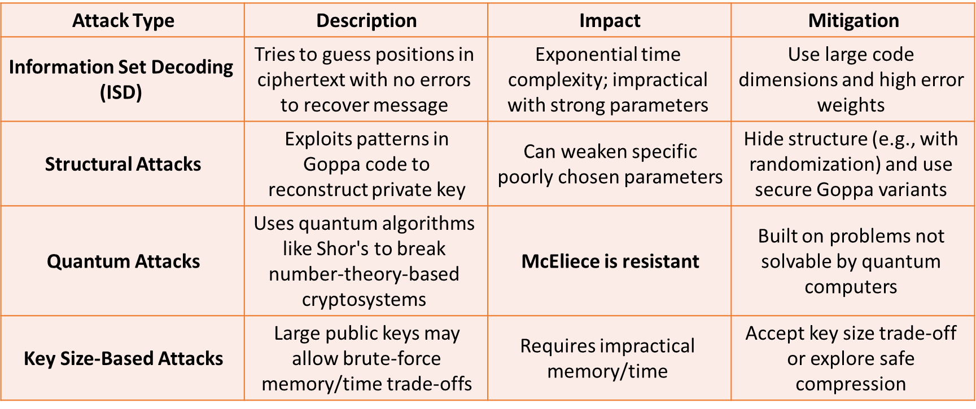
McEliece - Attack Methods
Notes:
Information-set decoding: מנסה לנחש את החלקים שלא הושפעו משגיאות – אבל מאוד איטית כאשר הפרמטרים חזקים.
תקיפות מבניות: מנסות לחשוף את קוד ה-Goppa מתוך המפתח הציבורי. לכן משתמשים בפרמטרים שמקשים על כך.

Slide 18
McEliece - Example
Assume:
Public key matrix G′: 3×6
Message m=[1,0,1]
Random error e=[0,0,0,1,0,0]
Encryption:
Compute c=m × G′ + e
Result: Ciphertext c=[1,1,0,1,0,1]
Decryption:
Use private key to decode the noisy codeword
Correct the error and recover original message m
Notes:
דוגמה קטנה שמראה איך הודעה באורך 3 הופכת לקוד באורך 6 עם שגיאה אחת.
רק מי שעם המפתח הפרטי יכול לשחזר את ההודעה המקורית.

Slide 19
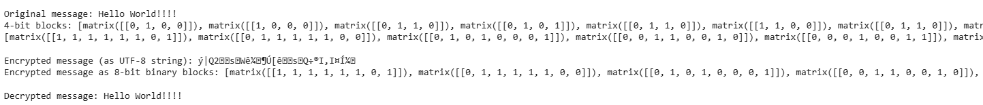
Example Text of McEliece
Plain Text: Hello World!!!!!
Encrypted Text: ý|Q2sWê¼¶Ú[êsQ÷®I,I¤Í¼
Notes:
מראה תוצאה אמיתית של הצפנה: הטקסט נראה כמו רעש אקראי.
בלי המפתח הפרטי, אי אפשר להבין או לשחזר את ההודעה המקורית.

Slide 20
ECDSA - General Explanation
ECDSA - Elliptic Curve Digital Signature Algorithm
Digital signature scheme based on elliptic curve cryptography (ECC)
Provides authentication, data integrity, and non-repudiation
Security relies on the Elliptic Curve Discrete Logarithm Problem (ECDLP)
Widely used in TLS, cryptocurrencies (e.g., Bitcoin, Ethereum), digital certificates
Notes:
Decryption: Going Backwards
If you have the same key, you can run the process in reverse to get back the original message.
This is like unlocking the scrambled message with the correct password.

Slide 21
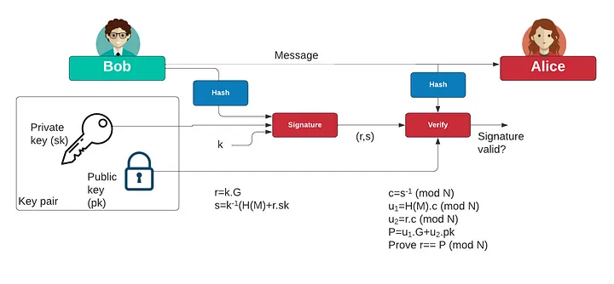
ECDSA - Steps Breakdown
Key Generation
Select an elliptic curve E over a finite field F_{p}
Choose private key d∈[1,n−1]d
Compute public key Q = d ⋅ G, where G is the base point
Signing a Message
Hash message m to get h=HASH(m)
Choose random k∈[1,n−1]
Compute point (x₁,y₁) = k ⋅ G , set r = x₁ mod n
Compute s = k⁻¹(h + dr)mod n
Signature = (r,s)
Notes:
Decryption: Going Backwards
If you have the same key, you can run the process in reverse to get back the original message.
This is like unlocking the scrambled message with the correct password.

Slide 22
ECDSA - Steps Breakdown
Verifying a Signature
Compute z = HASH(m)
Compute w = s⁻¹ mod n
Compute u₁ = z ⋅ w mod n
Compute u₂ = r ⋅ w mod n
Compute (x₂,y₂) = u₁ ⋅ G + u₂⋅Q
Valid if r ≡ x₂ mod n
Notes:
Decryption: Going Backwards
If you have the same key, you can run the process in reverse to get back the original message.
This is like unlocking the scrambled message with the correct password.
Q - public key

Slide 23
ECDSA - Efficiency and Speed
Efficiency
More secure per-bit than RSA
Shorter key sizes = faster operations and lower bandwidth
256-bit ECC ~ 3072-bit RSA security
Ideal for mobile, embedded, and blockchain systems
Complexity
Based on scalar multiplication: O(log⁡ n) field operations
Signing: one scalar multiplication
Verifying: two scalar multiplications + addition
Notes:
Decryption: Going Backwards
If you have the same key, you can run the process in reverse to get back the original message.
This is like unlocking the scrambled message with the correct password.

Slide 24
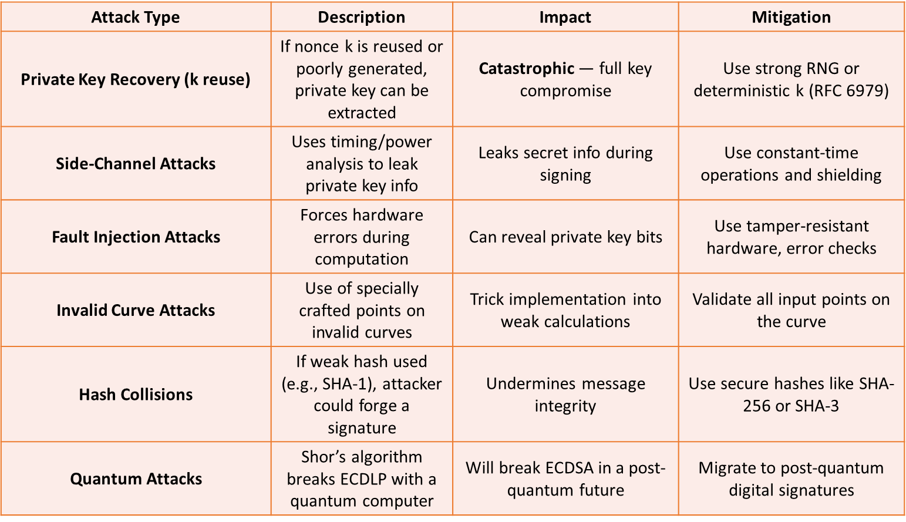
ECDSA - Attack Methods
Notes:
Decryption: Going Backwards
If you have the same key, you can run the process in reverse to get back the original message.
This is like unlocking the scrambled message with the correct password.
# 2010, hackers exploited a flaw in Sony’s implementation of ECDSA, Sony used a static random number (k) in the signature process, allowing attackers to extract the private key. This led to the system being fully jailbroken, enabling unauthorized software and piracy.

Slide 25
ECDSA - Signature Example
Assume:
Base point G, order n = 19
Private key d = 7
Public key Q = 7G
Message: “Hi”, hashed to h = 10
Random k = 2
Signature:
kG=(x,y) ⇒ r = x mod 19 = 5
s = k⁻¹(h + d ⋅ r) mod 19 = 2⁻¹(10 + 7 ⋅ 5) mod 19 = 13
Signature = (r=5, s=13)

Slide 26
ECDSA - Verification Example
Assume:
Base point G, order n = 19
Public key Q = 7G
Signature = (r=5, s=13)
Verification:
h = hash(msg) = 10
w = s⁻¹ mod n = 3
u_1 = h * w mod n = 30 mod 19 = 11
u_2 = r * w mod n = 15 mod 19 = 15
(x_2, y_2) = u_1 * G + u_2 * Q = … = (5, y)
x_2 == r
Verified Successfully!

Slide 27
Example Text of EC-DSA
Plain Text: Hello World!!

Slide 28
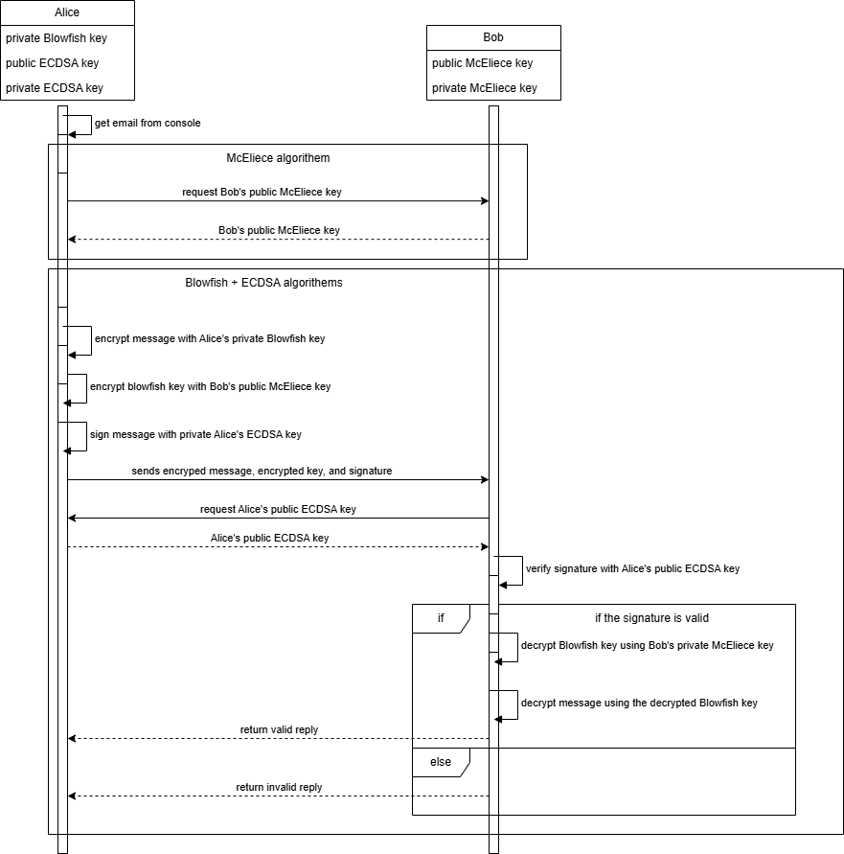
General Schema
Secure email exchange system using:
Blowfish for symmetric encryption of the email contents
McEliece cryptosystem for secure delivery of the symmetric key
EC-DSA for digital signatures (authenticity + integrity)

