Slide 1
An Application for secure email exchange: encryption- decryption with Blowfish, key delivery with McEliece cryptosystem + EC DSA signature
Name ID
Shahar Berenson 208608414
Shlomi Fridman 318187002
Omer Goldstein 205906258
Notes:
Model flow and model architecturte

Slide 2



Members
Shlomi Fridman
Omer Goldstein
Shahar Berenson

Slide 3
How the cipher works - Blowfish
1. The Message is Chopped
Blowfish takes your message and splits it into 8-byte blocks (like cutting a letter into equal pieces).
2. Each Block is Encrypted Separately
It encrypts each block one by one using a secret key.
3. It Uses Many Rounds of Scrambling
For each block, it goes through 16 rounds:
It does a mix of math (adding, XOR), swaps halves, and uses something called subkeys to control the process.
These rounds make the output look completely random—even if the input is just a simple word.
4. The Secret Key Changes Everything
The same message with a different key gives a completely different result.
Without the key, it's nearly impossible to figure out what the original message was.
Notes:
Decryption: Going Backwards
If you have the same key, you can run the process in reverse to get back the original message.
This is like unlocking the scrambled message with the correct password.

Slide 4
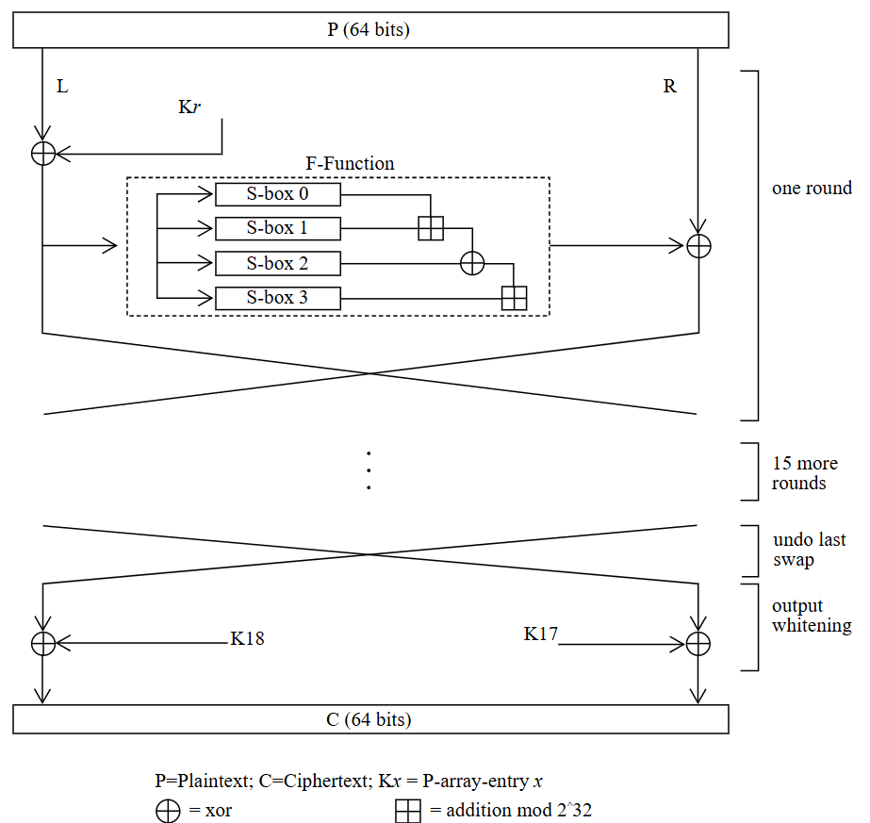
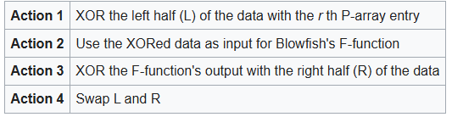
How the cipher works - Blowfish
64-bits block size
448-bits key-length

Slide 5
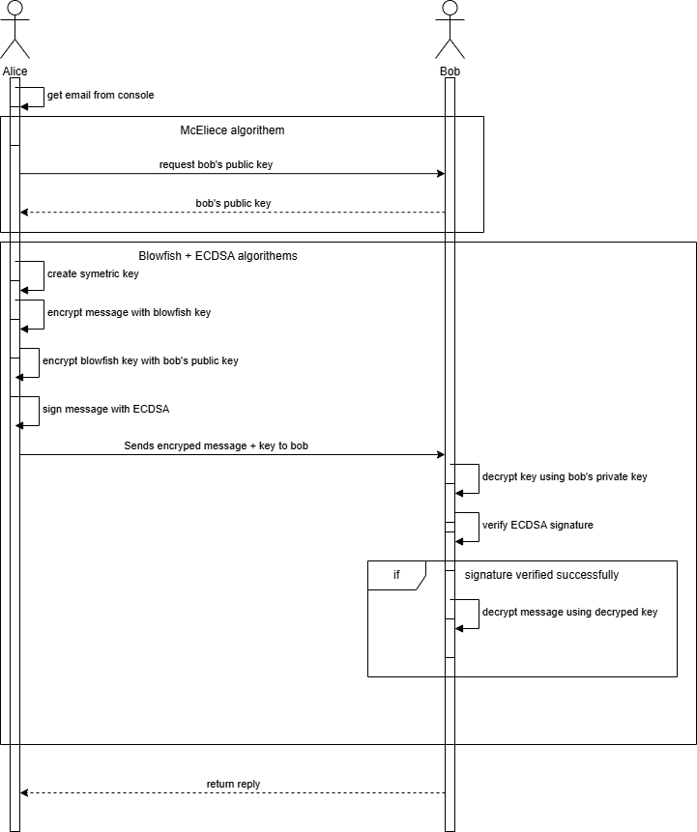
General Schema
Secure email exchange system using:
Blowfish for symmetric encryption of the email contents
McEliece cryptosystem for secure delivery of the symmetric key
EC-DSA for digital signatures (authenticity + integrity)

Slide 6
General Schema
Legend:
Actors:
A – Alice B - Bob
M – Message C – Ciphered Message E – Encrypt D – Decrypt V - Verify
K_bf = Blowfish Key
Enc_K = Encrypted Key
A
B
(public_ECDSA_Alice, private_ECDSA_Alice)
(public_ECDSA_Bob, private_ECDSA_Bob)
(public_McEliece_Alice, private_McEliece_Alice)
(public_McEliece_Bob, private_McEliece_Bob)
M
{C,Enc_K, Sig, Public_ECDSA_Alice}
public_McEliece_Bob
E_{Blowfish_key}(M) = C
H' = Hash(C || Enc_K)
Verify_{ECDSA}(Public_ECDSA_Alice, Signature, H')
E_{McEliece}(k_bf) = Enc_K
Valid
Else
H = Hash_{ECDSA}(C || Enc_K)
Reject
D_{McE}(Private_McE_Bob, Enc_K) = K_bf
D_{Blowfish}(K_bf, C) = M
Sig = ECDSA_Sign(Private_ECDSA_Alice, H)
{C,Enc_K, Sig, Public_ECDSA_Alice}

Slide 7
Secure Email Exchange –Step-by-Step
Pre-Setup
Key Generation:
Sender (Alice) generates an ECDSA key pair (private and public) for signing.
Receiver (Bob) generates a McEliece key pair (private and public) for asymmetric encryption.
Public Key Exchange:
Bob securely shares his McEliece public key with Alice.
Alice securely shares her ECDSA public key with Bob (or includes it in the message).
Notes:
Blowfish is a symmetric block cipher that encrypts data in 64-bit blocks using a variable-length key (32 to 448 bits).
Commonly used for fast, lightweight encryption.
Operates in several modes (e.g., ECB, CBC). For email messages, CBC is more secure.
Encryption and decryption use the same key, which must be shared securely.

Slide 8
Secure Email Exchange –Step-by-Step
Sender (Alice) Prepares and Sends the Email
Generate symmetric key (K):
Alice generates a random symmetric key for Blowfish.
Encrypt the message with Blowfish:
EncryptedMessage = Blowfish_Encrypt(plaintext, K)
Encrypt the symmetric key with McEliece:
EncryptedKey = McEliece_Encrypt(K, Bob_McEliece_PublicKey)
Create a digital signature with ECDSA
:Alice signs EncryptedMessage || EncryptedKey using her ECDSA private key.
Signature = ECDSA_Sign(EncryptedMessage || EncryptedKey, Alice_ECDSA_PrivateKey)
Send email package:
Alice sends to Bob:
Notes:
Blowfish is a symmetric block cipher that encrypts data in 64-bit blocks using a variable-length key (32 to 448 bits).
Commonly used for fast, lightweight encryption.
Operates in several modes (e.g., ECB, CBC). For email messages, CBC is more secure.
Encryption and decryption use the same key, which must be shared securely.

Slide 9
Secure Email Exchange –Step-by-Step
Receiver (Bob) Processes the Email
Get Alice’s ECDSA Public Key:
If Bob doesn’t already have it, he extracts Alice’s ECDSA public key from the message and verifies its authenticity.
Verify the signature:
Bob verifies the signature using Alice’s ECDSA public key.
If verification fails → reject the message.
Decrypt the symmetric key:
Bob uses his McEliece private key to decrypt EncryptedKey and recover symmetric key K.
Decrypt the message:
Bob decrypts EncryptedMessage using Blowfish and the symmetric key K.
Notes:
Blowfish is a symmetric block cipher that encrypts data in 64-bit blocks using a variable-length key (32 to 448 bits).
Commonly used for fast, lightweight encryption.
Operates in several modes (e.g., ECB, CBC). For email messages, CBC is more secure.
Encryption and decryption use the same key, which must be shared securely.

Slide 10
BUFFER

Slide 11
Attacks
Step | Method Used | Potential Attacks | Mitigation Strategies
1 | Key Generation (ECDSA, McEliece) | - Predictable keys (poor RNG)- Compromised device- Reuse of keys | - Use CSPRNG- Generate keys on secure, isolated devices- Rotate keys periodically
2 | Public Key Distribution | - Man-in-the-middle (key spoofing)- Fake key injection- Key tampering | - Use digital certificates or fingerprint validation- Exchange keys via secure channels
3 | Symmetric Key Generation (Blowfish key) | - Predictable/randomly guessable key- Reuse of key across messages | - Use strong entropy source (CSPRNG)- Always generate a fresh key per session/message
4 | Symmetric Encryption (Blowfish) | - Chosen plaintext/ciphertext attack (if using ECB)- Key reuse- Padding oracle | - Use CBC/CFB mode with IVs- Never reuse keys- Use authenticated encryption modes
5 | McEliece Encryption (for symmetric key) | - Public key spoofing- Weak parameters- Ciphertext manipulation | - Verify public key authenticity- Use strong, NIST-approved parameters
6 | ECDSA Signature | - Signature forgery (ECDSA nonce reuse)- Private key leakage- Replay attacks | - Use unique nonces per signature (secure library)- Protect private keys- Timestamp messages

Slide 12
Attacks
Step | Method Used | Potential Attacks | Mitigation Strategies
7 | Email Transmission | - Tampering in transit- Eavesdropping (metadata exposure)- Message dropping | - Use TLS for email transport- Rely on message authentication via signature
8 | Public Key Extraction (ECDSA) | - Key spoofing- Trust on first use (TOFU) issues- Replay of outdated keys | - Validate key from known/trusted directory or fingerprint- Include key versioning
9 | Signature Verification | - Accepting forged signatures- Skipping verification- Signature mismatch not detected | - Always verify against a trusted public key- Validate signature over complete data
10 | McEliece Decryption | - Side-channel attacks- Key compromise- Invalid ciphertext causing failure | - Use constant-time decryption- Secure key storage- Validate inputs before decrypting
11 | Blowfish Decryption | - Padding oracle attack- Ciphertext tampering- Side-channel attack | - Use authenticated encryption (e.g., HMAC + encrypt)- Input validation

Slide 13
How the cipher works
Asymmetric Key Delivery – McEliece
Asymmetric encryption for key delivery
Based on error-correcting codes (Goppa codes)
Public key used to encrypt Blowfish key
Private key used by recipient to recover Blowfish key
Resistant to quantum attacks (unlike RSA)
Notes:
McEliece is a public-key cryptosystem based on error-correcting codes, not number theory — it's considered quantum-resistant.
Used to encrypt the symmetric Blowfish key, so it can be sent securely.
Only the recipient (Bob) can decrypt it using his private McEliece key.

Slide 14
Original Text
Example plaintext message: “Project X status: Launch delayed until Q3.”
Message is unprotected in its current form Needs:
Encryption for confidentiality
Digital signature for authenticity
Processed next using Blowfish, McEliece, and ECDSA
Notes:
The original message is a plaintext string representing the content of an email. In real-world applications, this could be a subject line, a short paragraph, or any piece of text. For demonstration purposes, we use a simple text message to show how it is processed through encryption, key delivery, and digital signing.
The message must be encrypted to ensure confidentiality, and should be digitally signed to guarantee authenticity and integrity.
Waiting for script

Slide 15
Encrypted Text
Message encrypted using Blowfish cipher
Uses a randomly generated symmetric key
Output is ciphertext: unreadable without the correct key
Appears as random data (e.g., hexadecimal or base64)
Blowfish key will be securely sent using McEliece
Protects message confidentiality in transit
Notes:
Once the plaintext message is encrypted using the Blowfish symmetric cipher, the result is a non-readable block of ciphertext. This ciphertext appears as a random string of characters and symbols — not meaningful to anyone without the key.
Encryption is done using a randomly generated Blowfish key, and the same key must later be used to decrypt the message. Since symmetric keys cannot be shared openly, the Blowfish key is encrypted using the McEliece public-key system.
This step ensures that even if someone intercepts the message, they cannot understand it without the Blowfish key — and they can't access the key unless they can break McEliece encryption (which is considered quantum-safe).

Slide 16
How to decipher with the key
Receiver (Bob) receives:
Encrypted message (ciphertext)
Encrypted Blowfish key
Digital signature
Sender’s public ECDSA key
Step 1: Decrypt Blowfish key
Use McEliece private key to recover the symmetric Blowfish key
Step 2: Decrypt the message
Use the recovered Blowfish key to decrypt the message
Step 3: Verify the signature
Use sender’s public ECDSA key to confirm message authenticity
Message is only accepted if signature is valid
Notes:
To decipher the message, the receiver (Bob) performs three critical steps:
Recover the Blowfish key Using his private McEliece key, Bob decrypts the encrypted Blowfish key that was sent by Alice. Only Bob can perform this decryption, because only he possesses the correct private key.
Decrypt the message With the recovered Blowfish key, Bob decrypts the ciphertext. Blowfish is symmetric, so the same key used for encryption is now used for decryption.
Verify the signature Before trusting the decrypted content, Bob verifies the digital signature using Alice’s public ECDSA key. This ensures that:
The message truly came from Alice (authenticity)
The message has not been altered (integrity)
Only if the signature is valid does Bob consider the message trustworthy.

Slide 17
Digital Signature
Bullet Points (for slide content)
Ensures the message came from the claimed sender
Confirms the message hasn’t been altered
Signature is created with sender’s private key
Verified using sender’s public key
Applied to the encrypted message, not the plaintext
Notes:
Digital signatures are used in our system to make sure that:
The message truly came from the sender (Alice)
The encrypted message has not been tampered with
The signature is added after encryption, and verified before decryption, using public-key cryptography. Details of how the signing works will be covered in the next slide: “How ECDSA Works.”

Slide 18
Digital Signature
Based on elliptic curve cryptography
Uses a private key to create a signature
Uses the corresponding public key to verify it
Two main steps:
Signing: Hash the message + generate signature using private key
Verification: Use public key to verify that signature matches hash
If matched: signature is valid → message is authentic
If mismatch: reject message → possible tampering
Notes:
ECDSA (Elliptic Curve Digital Signature Algorithm) is a digital signature scheme based on the mathematics of elliptic curves.
Step 1: Signing (by Alice)
Alice hashes the encrypted message (e.g., with SHA-256)
She uses her private key and the hash to generate a digital signature — typically a pair of numbers (r, s)
She sends the encrypted message, the signature (r, s), and her public key
Step 2: Verification (by Bob)
Bob receives the signature and message
He also hashes the received message
Using Alice’s public key, he verifies if the signature corresponds to that hash
If it matches, Bob knows:
The message really came from Alice (authenticity)
The message was not altered in transit (integrity)
Why elliptic curves?
Strong security with smaller keys (e.g., 256-bit ECC key ≈ 3072-bit RSA key)

Slide 19
Hash Function

