Slide 1
מעבדת התקפה
הראל ברגר
Partly based on Amir Hertzberg’s slides, BIU

Slide 2

Off path
Any examples?

Slide 3
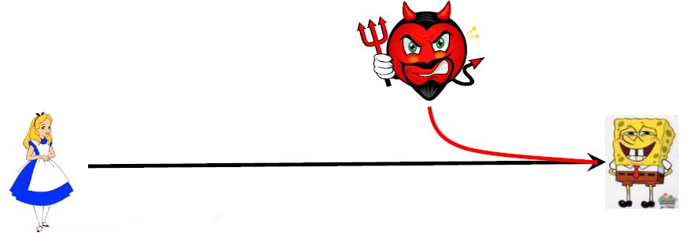
Attacker models
Off-path Attacker, Aka: spoofing, blind.
Can inject…
Goals include ‘poisoning’: trick client into contacting attacker instead of site.
ISPs should prevent: ‘ingress filter’, but many don’t.

Slide 4
Off path
DNS poisoning
DNS off path lab
Upload the report to the assignment box.

