Slide 1
Computational Biomathematics
Coding Lab 2 (90 min)
Lesson 10
Lecture
The individual group tasks
Outlook: “Win Stay – Lose Shift”

Slide 2
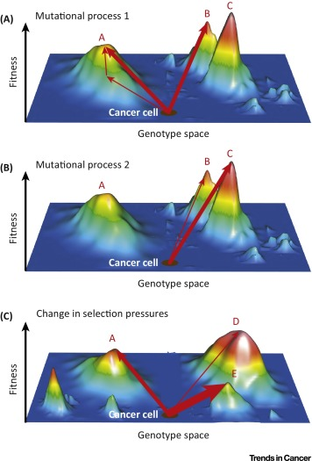
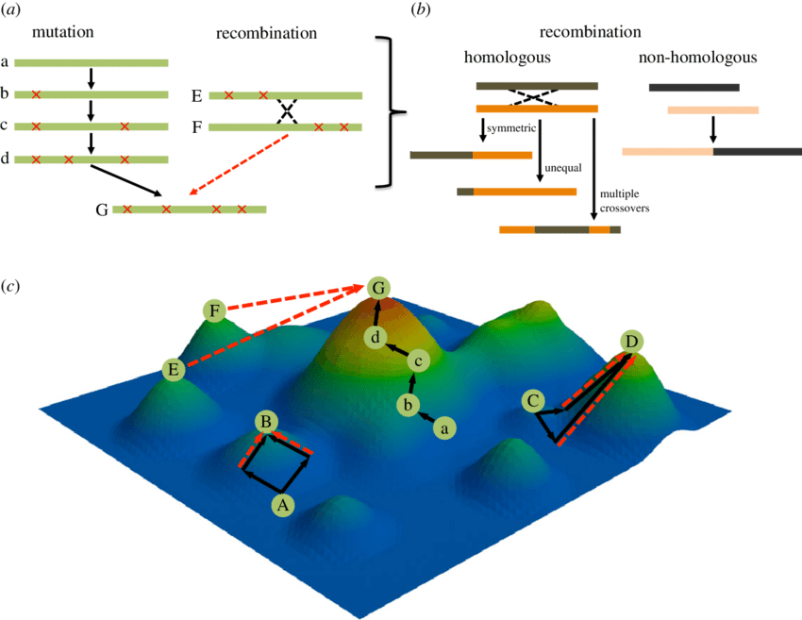
Genetic algorithms adapt the biological processes of selection, mutation, and recombination to optimize a target functional (1/ 2)

Slide 3
Genetic algorithms adapt the biological processes of selection, mutation, and recombination to optimize a target functional (2/ 2)
Initialize Population
1
1
0
1
0
1
0
0
0
1
1
1
Generate new Population
Calculate
Fitness
1
1
1
1
0
1
1
1
1
1
1
1
children
Mutation
1
1
1
1
0
0
1
1
1
1
1
1
parents
Criteria Met?
No
1
1
1
1
0
0
1
1
1
1
1
1
children
Crossover/ Recombination
3
1
1
1
1
1
0
1
0
1
1
1
1
1
1
1
parents
Yes
2
1
0
1
2
1
1
0
Best-Fit
Population
1
1
0
1
0
1
1
1
1
1
1
1
children
0
0
0
0
Selection
1
1
0
1
0
1
0
0
0
1
1
1
parents
7/4 < criterion

Slide 4
Genetic Algorithms Lab: Group Tasks
Evolution of a Trait
General Instruction (for all groups):
All groups implement a genetic algorithm with the following components:
Initialize population
Evaluate fitness
Selection (e.g., survival tournament)
Crossover (recombination)
Mutation (variation)
Iterate over generations
Your goal is not only to run the algorithm, but to:
design a good prompt,
understand the biology behind the model, and
interpret the results.
Fitting a Population Model
Evolution of Antibiotic Resistance
Evolution of Cooperation Strategies
A genetic algorithm is not just a computational trick; it is a simplified model of evolution acting on traits, parameters, or strategies.

Slide 5
Genetic Algorithms Lab: Common Implementation Guidance (for all groups)
Minimal Structure:
Important Advice:
Before using AI: define your model clearly
When using AI: ask for
modular code
simple implementation
comments
After using AI: verify
fitness function
mutation
selection
population = initialize_population()
for generation in range(T):
fitness = evaluate(population)
selected = selection(population, fitness)
offspring = crossover(selected)
population = mutate(offspring)
Visualization (required):
best fitness over time
average fitness over time

Slide 6
Genetic Algorithms Lab: Link to Lab 1
Lab 1 | Lab 2
local rules | global optimization
spatial dynamics | evolution in abstract space
emergence | selection

Slide 7
Topics
The Individual Group Tasks
Outlook: “Win Stay – Lose Shift”
A
Evolution of a Trait
C
Evolution of Antibiotic Resistance
B
Fitting a Population Model
D
Evolution of Cooperation Strategies

Slide 8
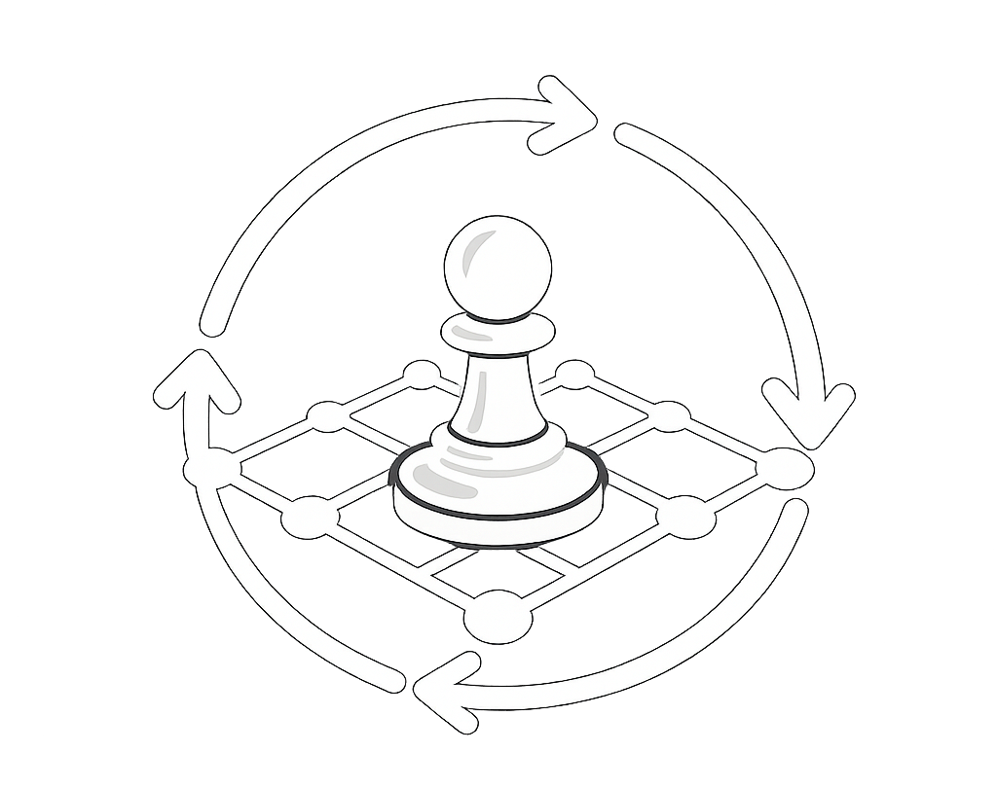
Group A: Evolution of a Trait (Size vs. Survival) – 1/ 2
A
Model:
Define fitness as: f(x) = x⋅(1-x)
Interpretation:
small x: low reproduction
large x: high cost
optimal intermediate value emerges
Task:
Your genetic algorithm (GA) should:
evolve a population of x-values
find the optimal trait value
Evolution of a Trait (Size vs. Survival)
Study a population of organisms where individuals differ in the trait body size x ∈ [0,1]
Biological assumption:
Larger size increases reproductive success
But large size also comes with a survival cost
Discuss the trade-off.
Representation:
Every individual is represented by a number x ∈ [0,1]
Option: float or binary encoding
Experiment:
Vary: mutation rate and/ or population size
Observe:
convergence speed
variability

Slide 9
Group A: Evolution of a Trait (Size vs. Survival) – 2/ 2
AI Prompt Task:
Design a prompt that includes:
trait definition
fitness function
GA steps
visualization (best x over time)
Reflection:
What trait value emerges?
Why does it make biological sense?

Slide 10
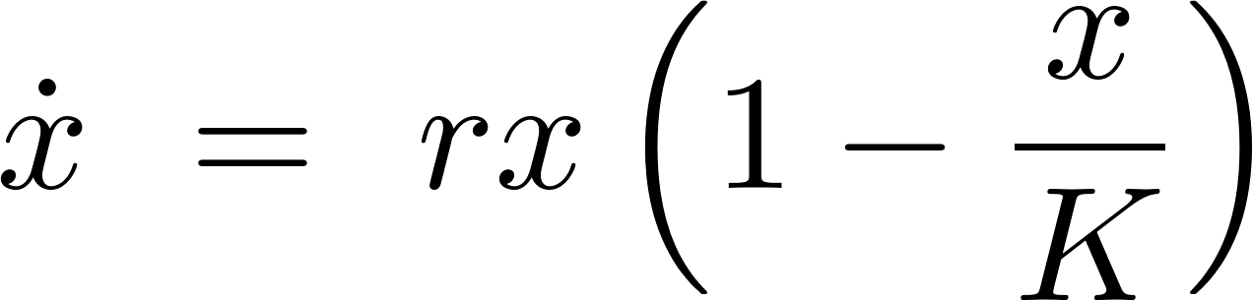
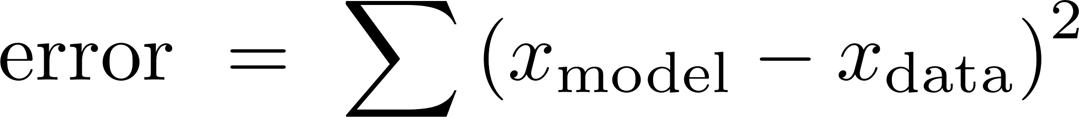
Group B: Fitting a Population Model (Logistic Growth) – 1/ 2
B
Model:
Define
You are given data (you can simulate or approximate).
Task:
Use a genetic algorithm (GA) to estimate:
r (growth rate)
K (carrying capacity)
Fitting a Population Model (Logistic Growth)
You observe a biological population over time.
You suspect it follows logistic growth, but parameters are unknown.
Representation & Fitness:
Every individual is represented by a pair (r, K)
Minimize the error
Experiment:
Vary: mutation strength and/ or population size
Observe:
convergence speed
variability

Slide 11
Group B: Fitting a Population Model (Logistic Growth) – 2/ 2
AI Prompt Task:
Design a prompt that includes:
parameter estimation goal
simulation of logistic model
error computation
visualization (fit vs data)
Reflection:
Does the GA recover reasonable parameters?
What happens if mutation is too high?

Slide 12
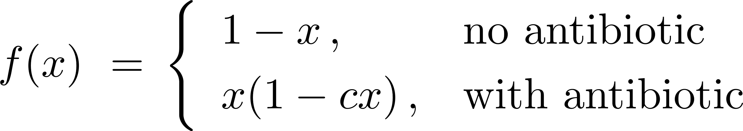
Group C: Evolution of Antibiotic Resistance – 1/ 2
C
Model:
Use a fitness function defined as
where c > 0 is the cost of resistance
Task:
Simulate evolution under:
environment without antibiotic
environment with antibiotic
Evolution of Antibiotic Resistance
You observe a bacterial population evolves under antibiotic pressure
Each bacterium has a resistance level x ∈ [0,1]
Consider the biological trade-off between higher resistance and lower growth rate
Representation:
Every individual has a resistance level x
Experiment:
Compare the evolution in both environments

Slide 13
Group C: Evolution of Antibiotic Resistance – 2/ 2
AI Prompt Task:
Design a prompt that includes:
environmental dependence
two scenarios
comparison of outcomes
Reflection:
Why does resistance increase?
What is the cost of resistance?
Remark on the fitness function:
The fitness under antibiotics has two competing effects:
x: benefit (survival under antibiotic)
(1-cx): cost (reduced growth)
So:
small x: low resistance → vulnerable
large x: high resistance → costly
optimal x∗: balance between both

Slide 14
Group D: Evolution of Cooperation Strategies – 1/ 2
D
Model:
ach individual has a probability of cooperation p ∈ [0,1]
Fitness: payoff from repeated interactions
Task:
Use your genetic algorithm (GA) to evolve the cooperation strategies
Evolution of Cooperation Strategies
Individuals repeatedly interact using a simple rule:
cooperate or
defect
Strategies evolve based on success.
Representation:
Every individual has a strategy parameter p
Experiment:
Vary:
mutation rate
interaction noise

Slide 15
Group D: Evolution of Cooperation Strategies – 2/ 2
AI Prompt Task:
Design a prompt that includes:
interaction rule
fitness from interactions
evolution via GA
Reflection:
Does cooperation emerge?
Under what conditions?
Remark :
Use one number p per individual and expected payoffs; do not build a complex game model

Slide 16
Roadmap
Time | Topic
0 – 15 min | Introduction GA loop & interpretation (selection = survival, crossover = recombination, mutation = variation) Project overview & roadmap
15 – 40 min | Architecture & Prompt Design (no AI yet) Each group defines representation: bitstring? real values? fitness function parameters: population size, mutation rate, crossover rate, … outputs: best fitness over time Each group must write Prompt v1 (basic) Prompt v2 (improved) including GA steps, modular structure, and visualization

Slide 17
Roadmap
Time | Topic
40 – 60 min | AI Coding & Running Task: run prompt, get code, execute, debug
60 – 75 min | Exploration Each group varies: mutation rate, population size, selection pressure Task: Observe convergence speed, stability, and randomness
75 – 90 min | Final Mini-Presentation (3-4 min per group) Each group presents: Biological problem Representation Best prompt Result One insight

Slide 18
Topics
The Individual Group Tasks
Outlook: “Win Stay – Lose Shift”

Slide 19
Win Stay – Lose Shift: An elementary Learning Rule for Normal Form Games
Aspirations
Interaction & Decision Rules
Generic Algorithm
At each round each agent interacts with all other agents according to the iterated Prisoner’s scheme:
The payoff from the interaction is added to the agent’s resource level
With a certain update probability each agent evaluates the performance of their strategy:
Each agent has an aspiration w.r.t. to the outcome of an interaction. Depending on the strategy the agent may change their strategy
With a certain evaluation probability, the resource levels of all agents are evaluated after a round, and the non-fit strategies are sorted out
This is done by means of a generic algorithm, as described on the right-hand side
Tournament Selection:
Two agents are randomly chosen, and their average payoffs are compared.
That with the higher value is added to the pool of agents for further reproduction
Crossover:
The agents exchange each coordinate of their strategy vector with a certain probability
Mutation:
Each coordinate of the strategy vector is subject to a point mutation with a certain probability
3, 3 | 0, 5
5, 0 | 1, 1
we assume additive utility
evaluation probability
strategy vector
update probability
aspiration level
resource level

Slide 20
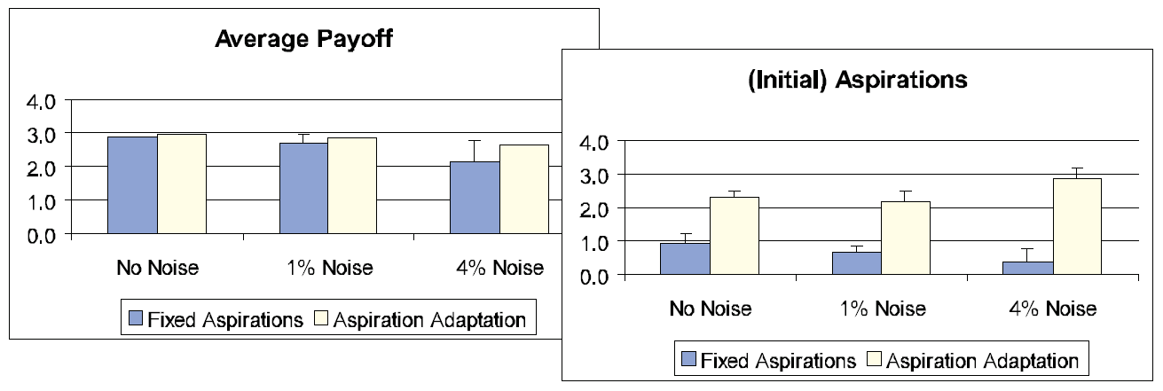
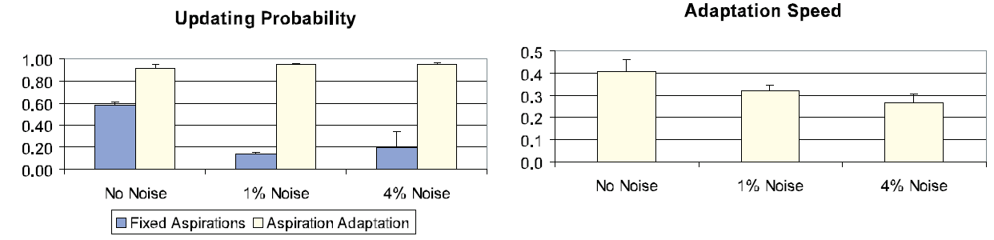
Win Stay – Lose Shift: An elementary Learning Rule for Normal Form Games
Strategies with a fixed aspiration level
The average payoffs and (initial) aspiration levels for different noise levels. The average is taken over the whole population, over all generations and the simulation runs. The height of the bars gives the average; the height of the T’s is the standard deviation of the averages in the simulation runs.
Strategies that adapt their aspiration level with a certain speed of adaption
The average updating probabilities and adaption rates for different noise levels.
Fixed strategies:
Cooperation dominates but decreases with increasing noise level
Updating probabilities decrease with increasing noise level
Adapting strategies:
“winners” in terms of resource accumulation
Updating probabilities increase with increasing noise level, this is balanced with an decreased speed of adaption

Slide 21
Computational Biomathematics
florian.rupp@kiu.edu.ge

