Slide 1
Computational Biomathematics
Coding Lab 3 (90 min)
Lesson 14
Lecture
The individual group tasks

Slide 2
Overall Design Principle
Diffusion vs. Reaction Balance
All groups use the same base model, a simple 2-species reaction–diffusion system. Hence, the task is not to derive the model, instead it is about
exploring the parameter space,
interpretation of the results, and
prompt design.
Common Core Model (for all groups):
From Noise to Pattern
Parameter Sensitivity
# u, v are 2D arrays
u_next = u + (Du * laplacian(u) + f(u,v)) * dt
v_next = v + (Dv * laplacian(v) + g(u,v)) * dt
def laplacian(Z):
return (
-4*Z
+ np.roll(Z, (1,0), (0,1))
+ np.roll(Z, (-1,0), (0,1))
+ np.roll(Z, (0,1), (0,1))
+ np.roll(Z, (0,-1), (0,1))
)
Biological Interpretation

Slide 3
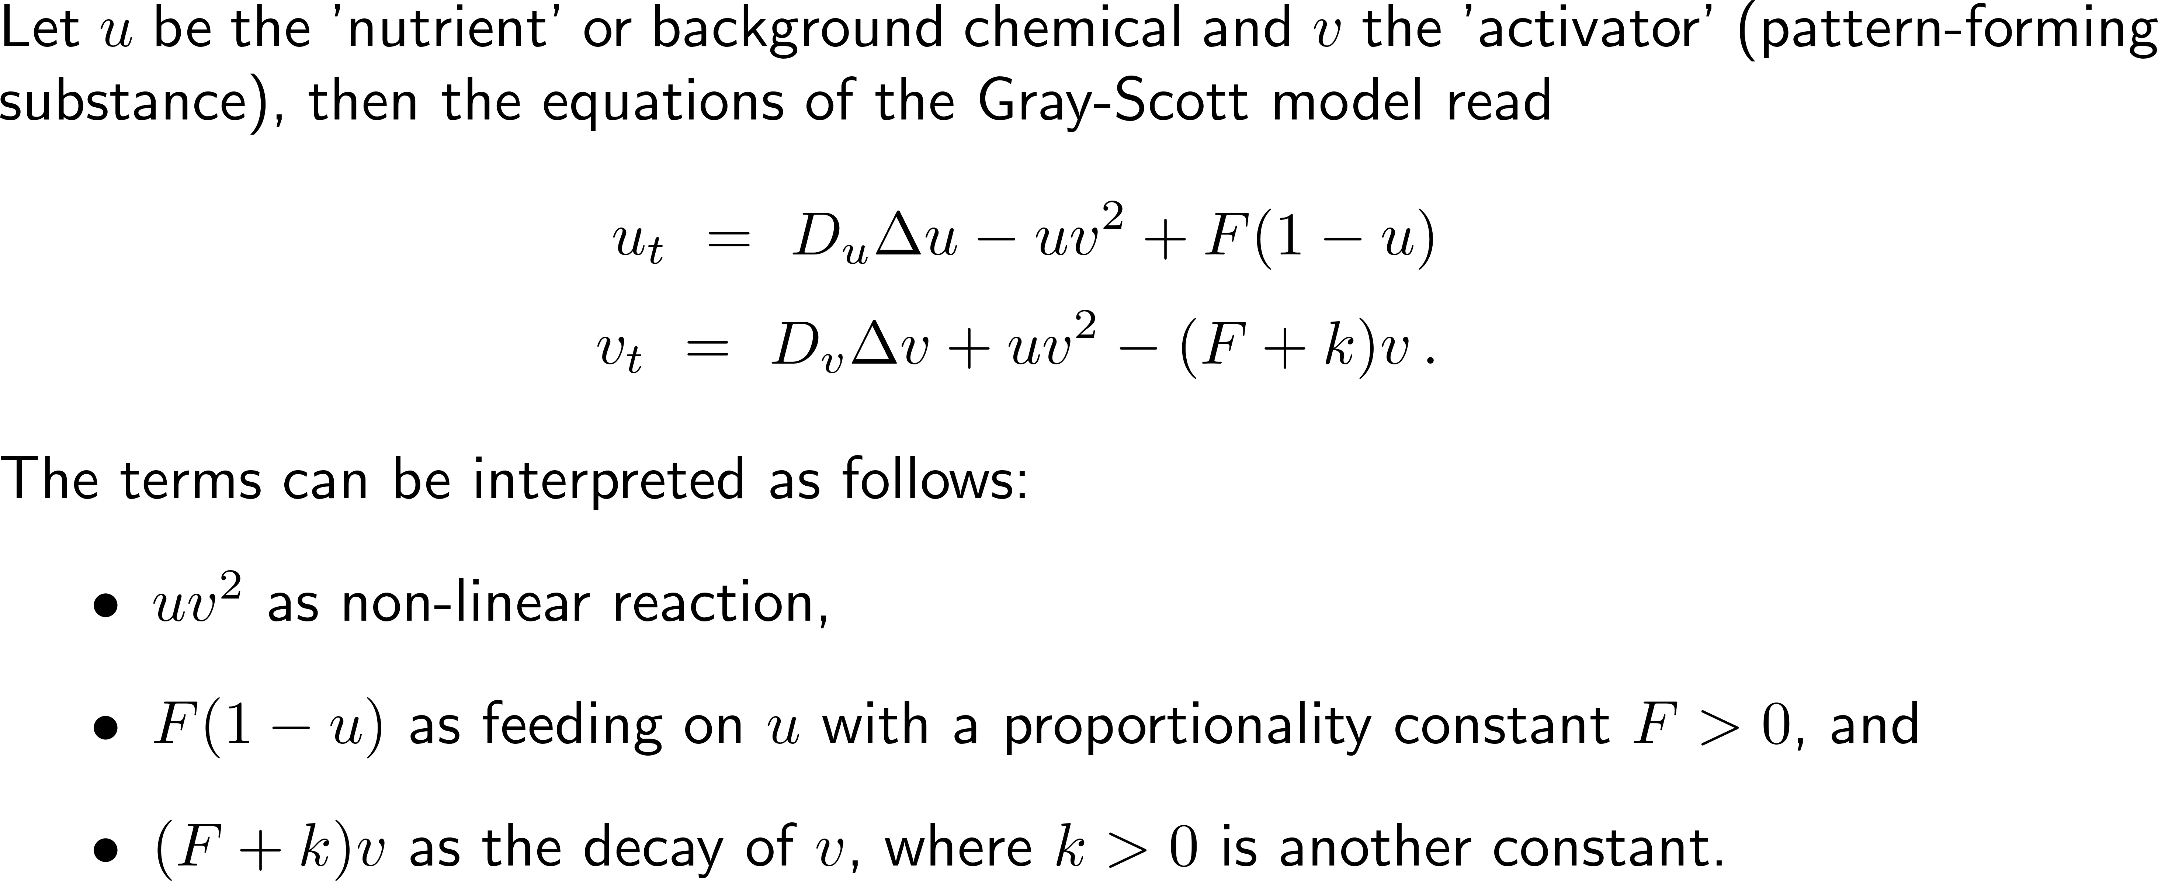
For the lab, we are using the Gray-Scott model for reaction-diffusion system (1/ 2)

Slide 4
For the lab, we are using the Gray-Scott model for reaction-diffusion system (2/ 2)
Discrete update (what is to be implemented):
Good default parameters: Initial conditions (important!):
What you will see:
spots, stripes, and labyrinth patterns
u = u + (Du * laplacian(u) - u * v**2 + F * (1 - u)) * dt
v = v + (Dv * laplacian(v) + u * v**2 - (F + k) * v) * dt
Du = 0.16
Dv = 0.08
F = 0.035
k = 0.065
dt = 1.0
N = 100
u = np.ones((N, N))
v = np.zeros((N, N))
# small disturbance in center
u[40:60, 40:60] = 0.5
v[40:60, 40:60] = 0.25

Slide 5
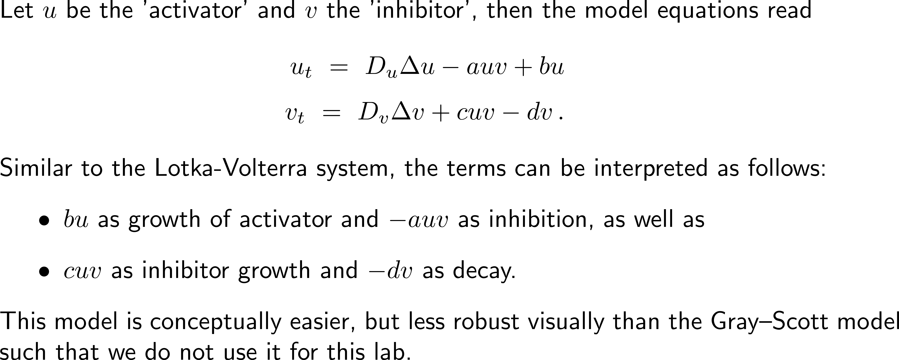
Another model is the mathematically more transparent activator-inhibitor system (toy model)

Slide 6
Topics
The individual group tasks
A
Diffusion vs. Reaction Balance
C
Parameter Sensitivity
B
From Noise to Pattern
D
Biological Interpretation

Slide 7
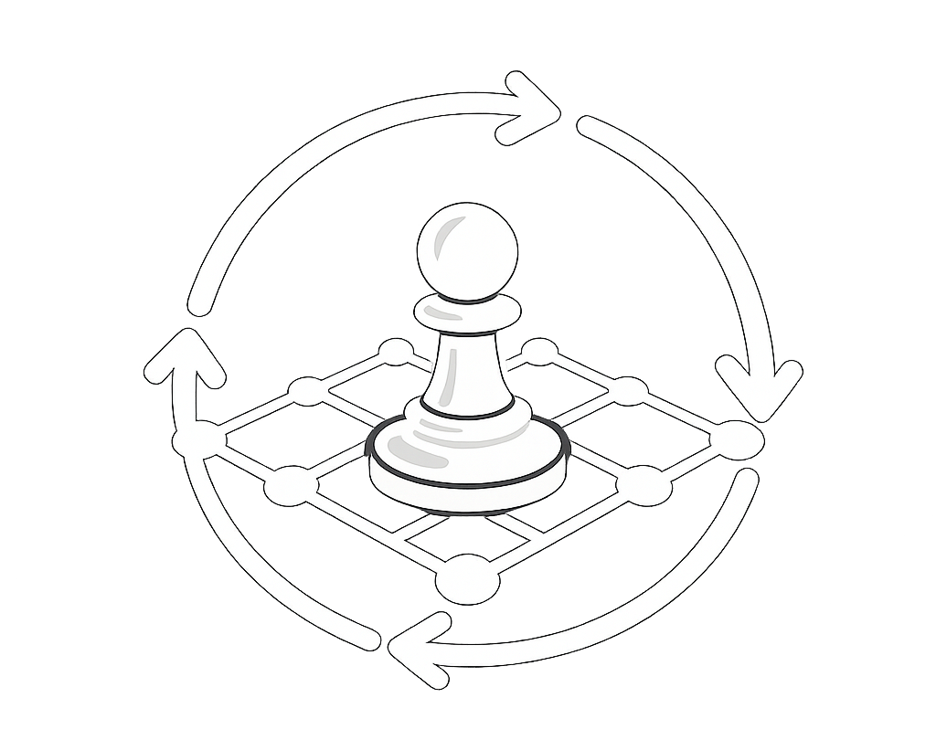
Group A: Diffusion vs. Reaction Balance
A
Task:
Explore how patterns change when the diffusion rates D_{u} and D_{v} vary.
What to do:
run simulation with:
D_{u} ≪ D_{v}
D_{u} ≈ D_{v}
​compare patterns: spots, stripes or homogeneous
Diffusion vs. Reaction Balance
You study how two chemicals interact and diffuse in tissue.
Biological idea:
one activates,
one inhibits.
Patterns emerge from balance.
Learning goal:
Pattern formation depends critically on different diffusion speeds.
Experiment:
Ask AI to:
implement reaction-diffusion system
allow parameter changes
visualize evolution

Slide 8
Group B: From Noise to Pattern
B
Task:
Investigate how initial conditions affect patterns
What to do:
Compare:
random noise
single localized perturbation
structured initial condition
From Noise to Pattern
Real biological systems start from small random fluctuations.
Patterns emerge from noise.
Learning goal:
Patterns do not need pre-patterns; they can self-organize.
Experiment:
Prompt focus
emphasize initialization
reproducibility (random seed)

Slide 9
Group C: Parameter Sensitivity (Biological Robustness)
C
Task:
Vary reaction parameters
What to do:
run several parameter sets
classify outcomes
stable pattern
oscillation
no pattern
Parameter Sensitivity (Biological Robustness)
Biological systems must be robust, i.e., small parameter changes should not destroy patterns completely.
Learning goal:
Biological pattern formation occurs only in specific parameter regimes.
Experiment:
Prompt focus:
parameter sweeps
multiple runs
visualization grid

Slide 10
Group D: Biological Interpretation (Morphogenesis)
D
Tasks:
run the simulation of the reaction-diffusion system
interpret patterns biologically
What to do:
generate patterns
describe: stripes vs. spots
density connect to real organisms
Biological Interpretation (Morphogenesis)
You interpret patterns as:
animal skin (zebra, leopard)
chemical morphogens
developmental biology
Learning goal:
Mathematical models help to explain real biological structures.
Experiment:
Prompt focus:
visualization quality
parameter tuning for pattern types

Slide 11
Roadmap
Time | Topic
0 – 15 min | Introduction Project overview & roadmap
15 – 40 min | Architecture & Prompt Design (no AI yet) Each group defines their program architecture best suited for their project Each group must write Prompt v1 (basic) Prompt v2 (improved) including GA steps, modular structure, and visualization
40 – 60 min | AI Coding & Running Task: run prompt, get code, execute, debug
60 – 75 min | Exploration Each group varies the parameters as suggested in their task and observe the outcomes

Slide 12
Roadmap
Time | Topic
75 – 90 min | Final Mini-Presentation (3-4 min per group) Each group presents: What they varied What pattern emerged Best prompt Biological interpretation

Slide 13
Computational Biomathematics
florian.rupp@kiu.edu.ge

