Slide 1
Computational Biomathematics
Introduction & The Wa-Tor World
Lesson 1
Lecture
Course overview
The water planet Wa-Tor
Verification & validation
Strategy evolution on Wa-Tor

Slide 2
The aim of our course is to combine modelling, analysis, and simulation by focusing on biological phenomena
Biology
Mathematics
Conceptual Model
analysis
Mathematical Model
Computer Science
(AI-enhanced Coding)
modelling
Computerized Model
Markov Chains
simplified description
analysis &
checking of model
quality
simulation
Dynamical Systems
Game Theory
Machine Learning
Scientific Computing

Slide 3
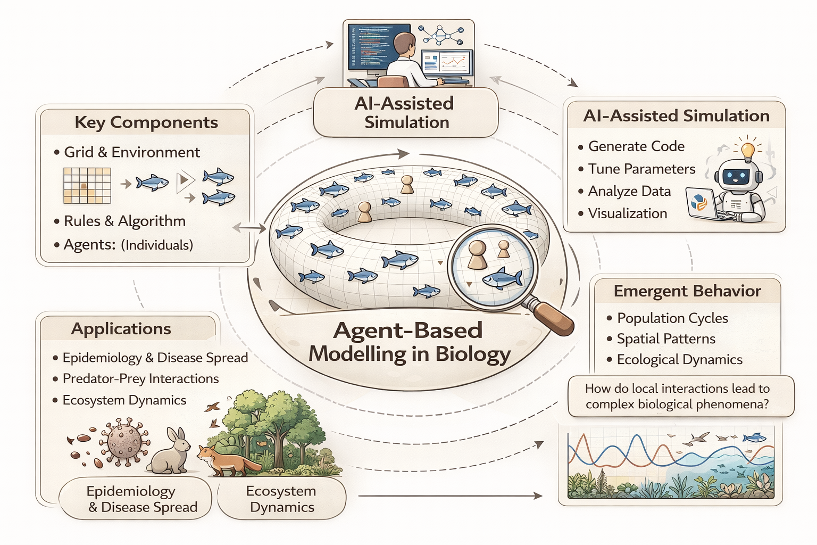
For the most part, we will be using Agent Based Modeling (ABM) to base our considerations on first principles
Many of the scenarios and models we will discuss assume the use of first principles and that these first principles are acting on individuals or whole populations.
By this the individuals or populations become agents that act according to specific rules.
These rules can be rather explicit, was we will see in the upcoming Wa-Tor dynamics, such that they describe very detailed movement and life-choices and interactions of each involved individual agent.
They can also be rather general, as we will see in ODE/ PDE dynamics, such that they describe average tendencies and overall behavioral frames.
image generated
with ChatGPT

Slide 4
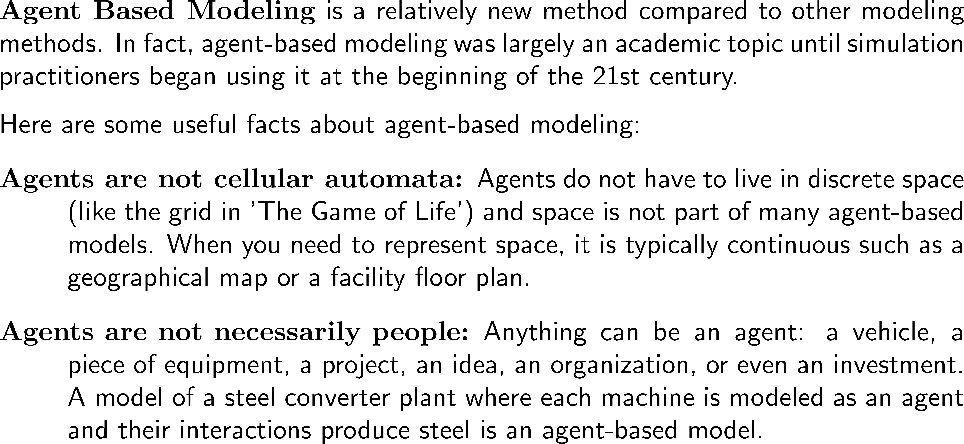
What is Agent Based Modeling? (1/ 2)

Slide 5
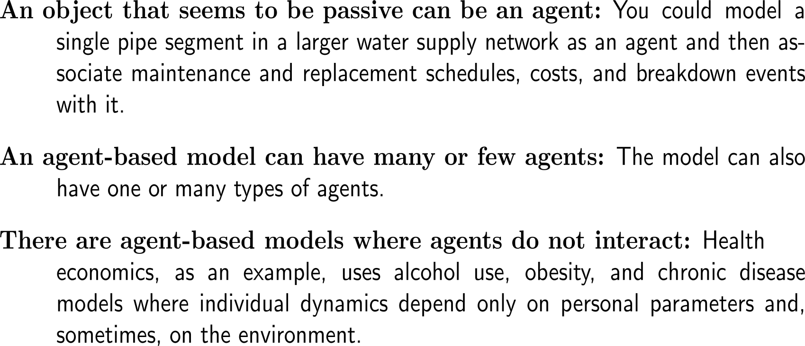
What is Agent Based Modeling? (2/ 2)

Slide 6
Topics
Course Overview
The Water Planet Wa-Tor
Verification & Validation
Strategy Evolution on Wa-Tor

Slide 7
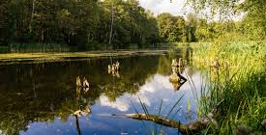
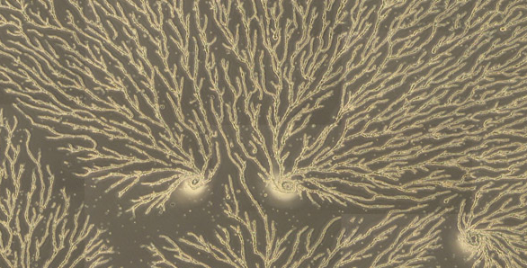
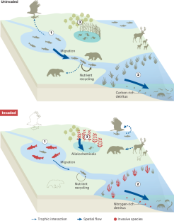
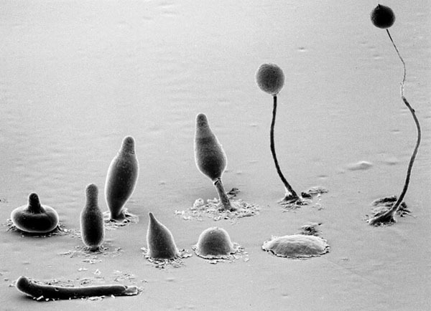
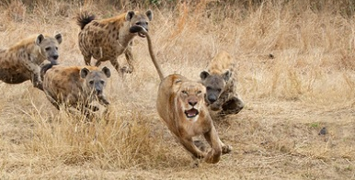
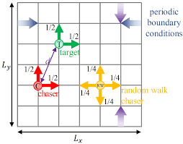
Agent-Based Modeling & Simulation in Biology
Evolution & Cell Differentiation
Flocking, Chase & Escape

Slide 8
The course roadmap (1/ 2)
April 2026
Mo | Tu | We | Th | Fr | Sa | Su
 |  | 1 | 2 | 3 | 4 | 5
6 | 7 | 8 | 9 | 10 | 11 | 12
13 | 14 | 15 | 16 | 17 | 18 | 19
20 | 21 | 22 | 23 | 24 | 25 | 26
27 | 28 | 29 | 30
Day | Topic
Monday: 13:35 – 15:05 | Introduction & the Wa-Tor world
Tuesday: 13:35 – 15:05 | Rejuvenating forests & Markov-chains
Wednesday: 11:50 – 13:20 & 13:35 – 15:05 | Mobile heterogeneous ecosystems Applications of multi-agent ecosystem modeling & simulation
Thursday: 11:50 – 13:20 & 13:35 – 15:05 | Coding lab – pt. 1 Coding lab – pt. 2
Friday: 8:30 – 10:00 10:10 – 11:40 | The evolution of cooperation Ritualistic battels
Week 1
May 206
Mo | Tu | We | Th | Fr | Sa | Su
 |  |  |  | 1 | 2 | 3
4 | 5 | 6 | 7 | 8 | 9 | 10
11 | 12 | 13 | 14 | 15 | 16 | 17
18 | 19 | 20 | 21 | 22 | 23 | 24
25 | 26 | 27 | 28 | 29 | 30 | 31

Slide 9
The course roadmap (2/ 2)
April 2026
Mo | Tu | We | Th | Fr | Sa | Su
 |  | 1 | 2 | 3 | 4 | 5
6 | 7 | 8 | 9 | 10 | 11 | 12
13 | 14 | 15 | 16 | 17 | 18 | 19
20 | 21 | 22 | 23 | 24 | 25 | 26
27 | 28 | 29 | 30
Day | Topic
Monday: 13:35 – 15:05 | The secret life of slime molds: aggregation
Tuesday: 13:35 – 15:05 | The secret life of slime molds: pattern formation
Wednesday: 13:35 – 15:05 | Flocking: The Vicsek model
Thursday: 11:50 – 13:20 & 13:35 – 15:05 | Coding lab – pt. 1 Coding lab – pt. 2
Friday: 11:50 – 13:20 & 13:35 – 15:05 | Swarms of locusts & introduction to chase & escape Intermediate result presentation
Week 2
May 206
Mo | Tu | We | Th | Fr | Sa | Su
 |  |  |  | 1 | 2 | 3
4 | 5 | 6 | 7 | 8 | 9 | 10
11 | 12 | 13 | 14 | 15 | 16 | 17
18 | 19 | 20 | 21 | 22 | 23 | 24
25 | 26 | 27 | 28 | 29 | 30 | 31
Later
Final Presentation
we need to find a well-suiting date

Slide 10
Grading: Group projects with peer contribution monitoring (details later)
Grading
Necessary Parts of the Presentations
Components:
Group project (3-4 students per team)
Individual deviation from group grade according to peer contribution
Intermediate result presentation (seeing that you are on track): 30% of the grade
at the end of the course (Friday 2nd week)
criteria: well-defined problem and solution approach, first results
Final presentation (= report): 70% of the grade
about 3 weeks after the end of the course
criteria: clear presentation and comprehensive results
Your presentation should be clearly structured highlighting your completed work:
Problem
Statement
(Situation/ Complication)
Your Solution
Approach
(Solution)
Peer
Contribution
List of Completed Activities
Activity Details/
Results
Activity Details
Activity Details
Activity Details
Conclusion &
Outlook
Consider and carry-out several ways to solve the problem by different mathematical approaches

Slide 11
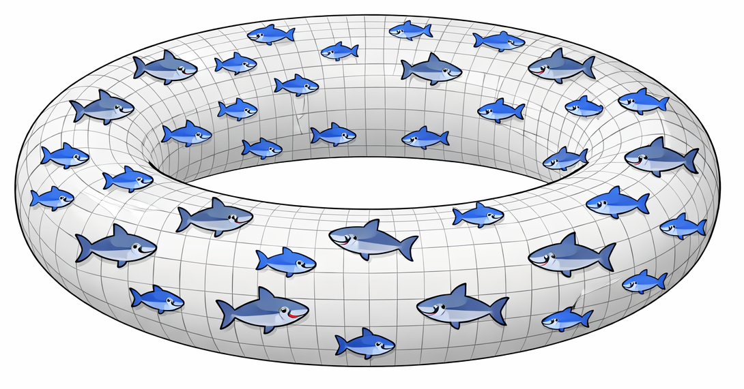
Topics
Course Overview
The Water Planet Wa-Tor
Verification & Validation
Strategy Evolution on Wa-Tor
image generated
with ChatGPT

Slide 12
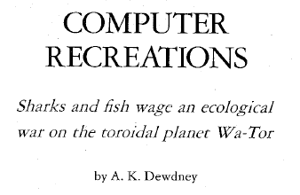
One of the best known agent-based predator-prey models is the Wa-Tor population dynamics simulation
One of the best known agent-based predator-prey models is the Wa-Tor population dynamics simulation proposed by Alexander K. Dewdney (1941 – 2024) in his 1984 article
“Sharks and fish wage an ecological war on the toroidal planet Wa-Tor”.
The Wa-Tor simulation has three possible results,
either both species get extinct,
or sharks disappear,
or a dynamic balance between sharks and fish gets established (where total numbers of the species vary, though none gets extinct).
image generated
with ChatGPT

Slide 13
The conceptual model we are starting from describes the rather simple Wa-Tor ecosystem
Conceptual Model
The Wa-Tor ecosystem:
Space: regular toroidal lattice with a fixed number of cells (i.e., upper and lower boundary as well as left and right boundary are identified)
The lattice cells have 8 neighbors
Two species: fish and shark
Each member of a species occupies a lattice cell and can move to another unoccupied lattice cell (north, east, south, or west)
Shark can move to a lattice cell occupied by a fish and eat this fish (the fish then vanishes from the lattice)
Fish and shark reproduce such that new members of each species are “born” at unoccupied neighboring lattice cells
Fish and shark have a certain life-time
north-west
north
north-east
west
east
south-west
south
south-east
Computerized Model

Slide 14
From there we progress iteratively following George Polya‘s comprehensive framework for problem solving
Polya‘s Problem Solving Circle
Main Program
Goal: Preform computer-based simulations to understand the Wa-Tor ecosystem.
Data Structures
(gird, fish, shark)
Initialization
1. Understand the Problem
2. Plan
Update Rules
Iteration
Movement Rules
(fish, shark)
Strategies
(shark)
Interaction Rules
(fish, shark)
4. Look Back
(plausibility & validation)
3. Execute (AI-enhanced coding)
Post-
Processing
Vizualization
(iteration-dependent plots, videos)

Slide 15
It is generally recommended to segment a problem and then start the solution process from the “easy” questions to the “hard” ones
Segmentation of the Problem
Start the Solution From Outside-In for Each Part
Part A
Part A
Part E
Part E
Part B
Part B
Part D
Part D
Part C
Part C
challenging
unsloved
challenging
hard
hard
normal
sloved
normal

Slide 16
The required code will be generated AI-enhanced and in a sequential way to validate the implementation easily
1. Understand the Problem
Preparing the execution of the plan:
We are dividing the coding into two phases:
Phase 1: Movement on the toroidal lattice (and essential visualizations)
Phase2: Interaction dynamics (inter- and intra species)
We will design the code in a clear modular way (i.e., using sub-programs) to be able to check parts separately and later include additional modules
The code will be produced in Python. Please, install Thonny a simple Python Integrated Development Environment (IDE) for beginners: https://thonny.org/
We will make use of the ChatOn AI for the generation of Python code: https://chat.chaton.ai/
We use AI to successively build-up the code by means of several steps forward
This means that we need to put ourselves in the shoes of an architect who knows what to do and then guides the AI towards success
2. Plan
3. Execute
4. Look Back

Slide 17
Implementation: 0) Be specific when addressing AI
https://aimaker.substack.com/p/the-10-step-system-prompt-structure-guide-anthropic-claude
Like in real-world situations when meeting a stranger, you need to be specific and outline clearly what you want:
Specifications
Illustration
I'm [your role/ situation] working on [specific project/ goal].
My audience/ stakeholders are [who they are and what they need].
This task needs to [primary objective] while [secondary objectives].
Success looks like [specific outcome description].
Be Clear and Concise:
Define your purpose clearly before writing. Use simple, direct language and keep sentences short to ensure the message is easily understood (stick to the point).
Be Concrete and Specific:
Use solid facts and data rather than vague generalizations to ensure the AI understands exactly what is meant.
Be Correct and Coherent:
Use accurate information and grammar.
State your sentences logically including all relevant points.
Structure Your Message:
Organize your thoughts logically.
Use the TOWER approach: Think, Organize, Write, Edit, and Rewrite.
Be Complete:
Include all necessary information.
These include also what you intend to do with the result and your criteria to accepting a result.
Avoid Jargon and Ambiguity:
Simplify complex ideas and avoid technical jargon that may confuse or lead to ambiguity in interpretation.

Slide 18
Topics
Course Overview
The Water Planet Wa-Tor
Phase 1: Movement on the Lattice
Phase 2: Interactions
Verification & Validation
Strategy Evolution on Wa-Tor
image generated
with ChatGPT

Slide 19
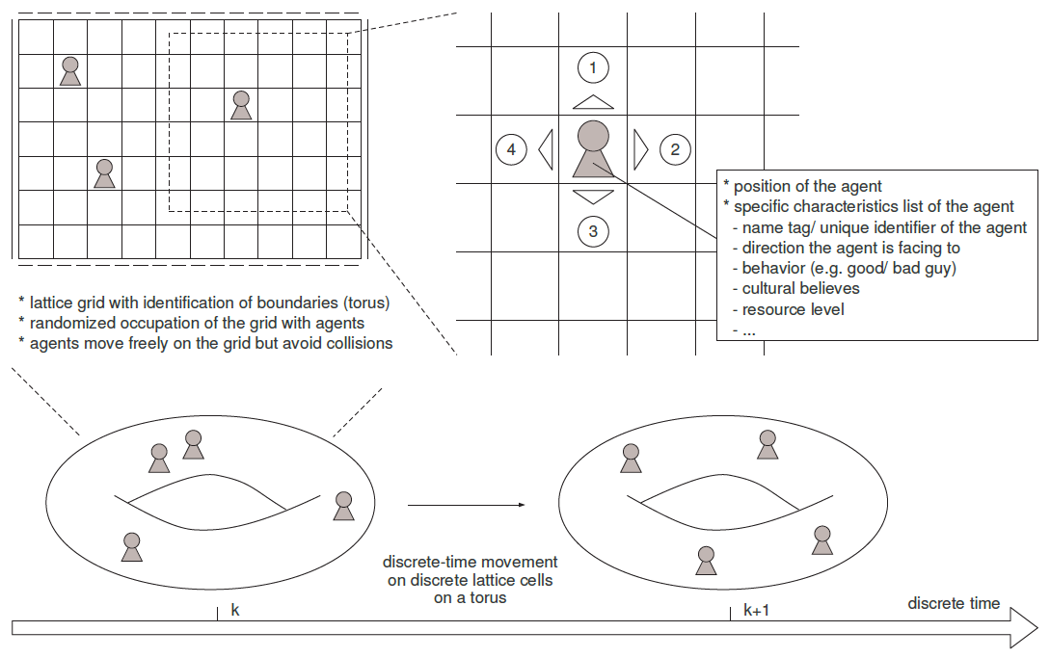
For our simulation of the shark-fish dynamics on Wa-To let us assume a general agent-based set-up
A system consisting of interacting individuals, each with his own characteristics (e.g., cultural values, race, resources), can be simulated using a discrete dynamical system where space, time, and the states of the system are all discrete and have the following properties:
Space is represented by a regular two-dimensional toroidal lattice.
Each site, or cell, in the lattice is in a given state at a given instant of time. The states of lattice sites can be integers, reals, symbols, or strings, as well as tuplets (lists) with elements of any type.
The system evolves over a succession of time steps. The values of all of the sites in the lattice are updated synchronously in each time step.
A site’s value is updated using a set of rules which takes the values of the site and other sites into account.

Slide 20
A possible data structure for representing the agents and their movement are arrays that contain the agents’ individual attributes
We assume that each agent (here fish or shark) is described by a list
e.g. { x, y, type, direction, age }
containing these quantities:
the x- and y-coordinates where the agent is located on the lattice
the type of agent (either 1 for fish or 2 for shark)
the direction the agent is facing, indicated by 1 (north/ up), 2 (east/ right), 3 (south/ down), and 4 (west/ left)
the values 1, 2, 3, and 4 are initially chosen randomly with equal probability; during the time steps the agent moves one cell in the direction of the direction
the age of the agent
this list set equal to zero at the initiation and updated by one for each time step the agent lives)
For each time step, we run through the agent lists and perform an (asynchronous) update
asynchronous
update
(x, y, type, direction, age)

Slide 21
Next, we formulate the domain and movement rules …
The Domain
Movement Rules
A system of interacting fish and a shark populations, each with their own characteristics is to be simulated where space, time, and the states of the system are all discrete and have the following properties:
Space is represented by a regular two-dimensional N x N toroidal lattice with cells described by (i, j) where i, j = 1, …, N (identification of lower and upper as well as right and left boundaries).
Each cell of the lattice is quadratic and has 8 direct neighbors (north/ up, east/ right, south/ down, west/ left, north-east, south-east, south-west, and north-west).
We assume that each agent (here fish or shark) is described by the list
{ x, y, type, direction, age }
as defined previously. I.e., the lattice occupation is stored in this form.
As given in the definition of the agent list, at the beginning a number NF of fish and NS of shark is placed randomly on the lattice cells (equal probability of placement; should a cell be occupied already, then another cell is chosen randomly).
The system evolves over a succession of at most T time steps.
The values of N, T, NF, and NF are inputs for the computer program.
At each time step both fish and shark move either 1 = north/ up, 2 = east/ right, 3 = south/ down, or 4 = west/ left as indicated by their direction variable. If the target cell under this direction is occupied then the agent moves to an unoccupied neighbor cell (north, east, south, or west) with equal probability amongst the unoccupied cells.
Fish cannot move to cells already occupied by other fish or shark. If no movement is possible the fish remains at the current cell.
Sharks cannot move to cells already occupied by another shark. If no movement is possible the shark remains at the current cell.
If a shark moves on a cell occupied by a fish a collision happens (we discuss this later). For now, we treat this case such that the shark cannot move to such a cell. If no movement is possible the shark remains at the current cell.
Note that the lattice is toroidal such that up-movement from a cell (i, N) leads to the cell (i, 1), right-movement from a cell (N, j) leads to the cell (1, j), down-movement from a cell (i, 1) leads to the cell (i, N), and left-movement of a cell (1, j) to the cell (N, j).
Wa-Tor Scheme

Slide 22
… together with the visualization demands
Visualization Demands
Remarks:
The resulting Python code will give the initial distribution of the two populations and their movement on the grid.
For now, both the fish and the shark are not interacting and are not
The simulations should be visualized by means of either a .mp4 movie (or animated gif) and a plot of the total number of fish and the total numbers of each of shark sub-populations over time from 0 to T (all populations in the same plot for each simulation).
The movie should show the movement of the fish and shark populations on the lattice (square, no toroidal representation needed). It would be great if here the fish and sharks are represented by little fish and shark icons.
Visualizations must be clear and provide all necessary information, like legends and labels of the coordinate axis.
Wa-Tor Scheme
AI Remarks:
Giving all this information at once seems to bee too much for AI assistant coding
We need to break down and have a conversation with the AI to reach our goal
At each step reflect if the generated output matches expectations, i.e., that graphical results are acceptable.

Slide 23
Implementation: 1) AI-enhanced coding of the movement only Wa-Tor al
Prompt
Generate main routine and sub-routines in different files
Generate initialization sub-routine
Generate visualization of fish and shark on the lattice
Prompt
Prompt
Refinement of the results such that expectations are matched
Provision of own ideas to AI to overcome challenges
Prompt
Start completely new by focusing on even smaller parts of the problem and then continue to build on them
Prompt
Update main routine and sub-routines to incorporate movement
Generate time stepping
Generate animation of fish and shark on the lattice
Prompt
Reuse already existing sub-routines as starting point for further developments

Slide 24
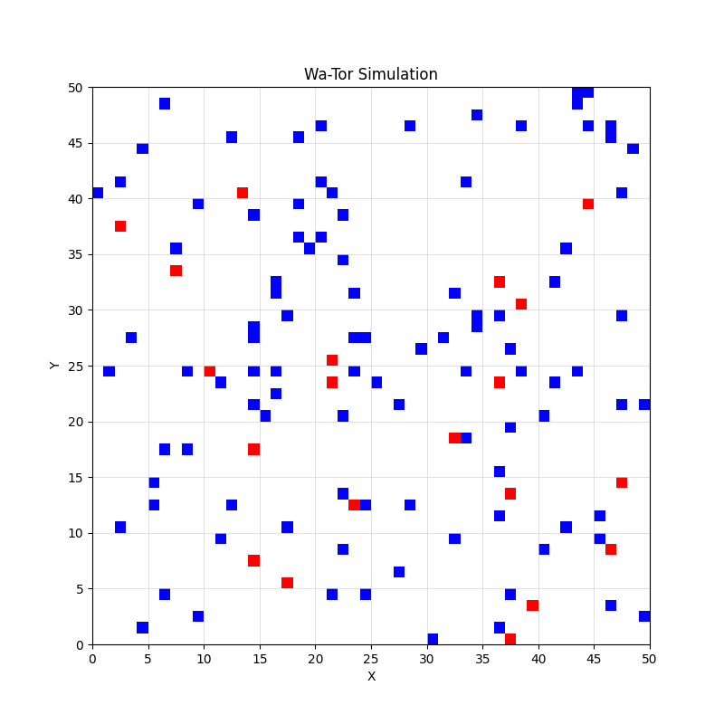
Implementation: 2a) The AI code – 1/ 1
Initialization
01_WaTor.py (main routine)
random seed
global settings and parameter
call of sub-routines
P01a_initialization.py (sub-routine)
initial distribution of the NF fish and the NS shark on the N×N lattice
P01v_lattice_plot.py (sub-routine)
plot of the distribution of fish and shark populations on the lattice
# File: 01_WaTor.py
# Simulation parameters
N = 50 # Size of the lattice
NF = 100 # Initial number of fish
NS = 20 # Initial number of sharks

Slide 25
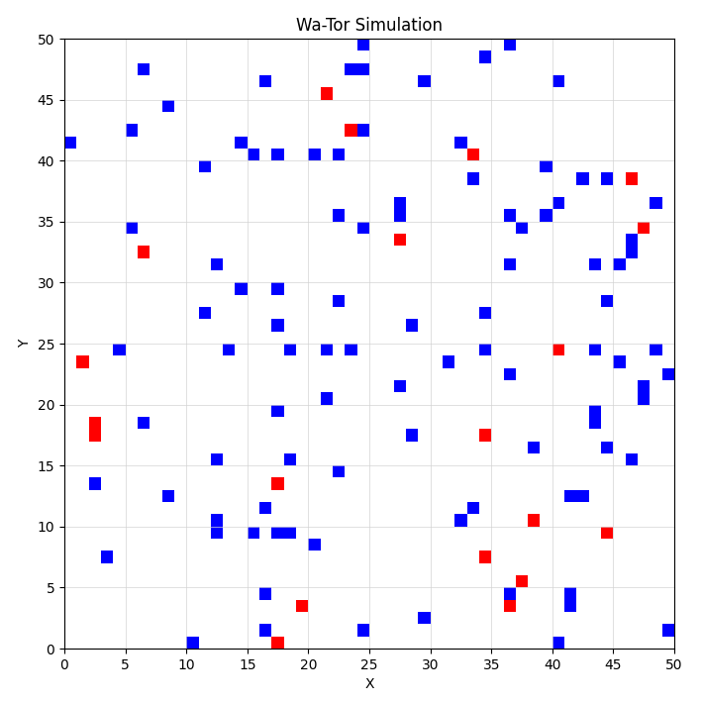
Implementation: 2a) The AI code – 1/ 2
Iterations
02_WaTor.py (main routine)
random seed
global settings and parameter
settings and parameter for the movement rules
call of sub-routines
iteration loop for the movement
P01a_initialization.py (sub-routine)
initial distribution of the NF fish and the NS shark on the N×N lattice
update
update
P01m_movement (sub-routine)
Implementation of the movement rules and update of the populations
new
P01v_lattice_video.py (sub-routine)
animation of the distribution of fish and shark populations on the lattice
update
included in P01v_lattice_video.py
Plot of the total fish and shark numbers over time
# File: 01_WaTor.py
# Simulation parameters
N = 50 # Size of the lattice
T = 20 # Maximum number of time steps
NF = 100 # Initial number of fish
NS = 20 # Initial number of sharks
new

Slide 26
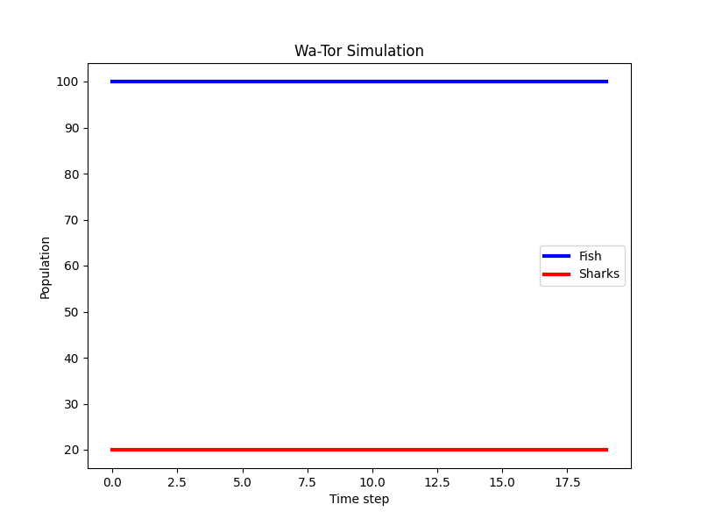
Implementation: 3) Results from ChatOn AI: movement only
Movement on the Toroidal Grid
# File: 01_WaTor.py
# Simulation parameters
N = 100 # Size of the lattice
T = 20 # Maximum number of time steps
NF = 100 # Initial number of fish
NS = 20 # Initial number of sharks
Time Evolution of the Population Numbers

Slide 27
Topics
Course Overview
The Water Planet Wa-Tor
Phase 1: Movement on the Lattice
Phase 2: Interactions
Qualification & Verfication
Strategy Evolution on Wa-Tor
image generated
with ChatGPT

Slide 28
Finally, we state the (intra- and inter-species) interaction rules …
Fish Rules
Shark Rules
Every fish has an age that is increased by one after each move.
If the age is larger than a “fish breeding time” then a new fish is “born” (with zero age) on an unoccupied neighboring cell, and the age of the fish is set back to zero.
If there is more than one unoccupied neighboring cell, then the place for the new fish is equally likely for all unoccupied neighboring cell and selected at random.
If all eight direct neighbor cells are occupied, the fish moves on until it either gets eaten by a shark or is positioned at a cell with at least one unoccupied neighboring cell.
Every shark has an age that is increased by one after each move.
At a collision between a shark and a fish the shark eats the fish, then the “shark starving time” is set to zero and the fish is canceled from the simulation.
If a shark does not find a fish after a certain amount of time (shark starving time), then it is canceled from the simulation.
If the age of a shark is equal or larger than a “shark breeding time” then a new shark is “born” (with zero age and zero starve time) according to the same rules as for fish.
Wa-Tor Scheme (1st version)

Slide 29
… as well as further simulations demands
Simulation Demands
Remarks:
The interaction rules augment the already implemented movement rules.
I.e., mainly the movement sub-routine needs to be updated.
Fist a shark step is executed with movement including feeding (removal of the fish) and breeding.
Then a fish step is executed with movement and breeding.
This finalizes the computerized model, and we can then observer how well simulations fit with the conceptual model or other models that are even closer the reality.
A modular design is needed to later exchange rules by other rules.
Simulations will be conducted such that a unique seed is required for the random number generator that is used, e.g., for the initial random population of the toroidal lattice.
For the simulations there is the need to easily vary the number N of the lattice dimension, the maximal number of time steps T as well as the initial numbers NF of fish and NS of shark, respectively.
Later, a further shark sub-populations will be introduced such that the evolutionary fitness of different shark rules can be tested (e.g., direct movement towards fish in a two-cell radius as a hunting strategy).
Wa-Tor Scheme

Slide 30
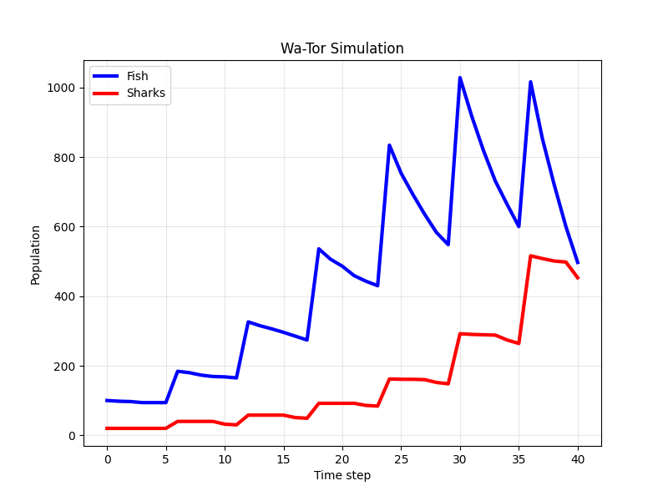
Implementation: 8) Results from ChatOn AI: movement and interaction
Movement on the Toroidal Grid (sim01)
# File: 01_WaTor.py
# Simulation parameters
N = 50 # Size of the lattice
T = 40 # Maximum number of time steps
NF = 100 # Initial number of fish
NS = 20 # Initial number of sharks
FISH_BREEDING_TIME = 5 # Time steps for fish to breed
SHARK_BREEDING_TIME = 5 # Time steps for sharks to breed
SHARK_STARVATION_TIME = 10 # Time steps for sharks to starve
Time Evolution of the Population Numbers

Slide 31
Topics
Course Overview
The Water Planet Wa-Tor
Verification & Validation
Strategy Evolution on Wa-Tor

Slide 32
At this stage we are already at the “Computerized Model” and have made several steps of the modeling process at once
Qualification & Verification
Reality:
Interaction Dynamics of Fish and Shark
Conceptual model:
Only these two species
No boundary effects (toroidal domain)
Birth, movement, and predation events
Computerized model:
Agent-based model
Translation of the conceptual discrete space and discrete time conceptual model
Reality
Conceptual Model
Computerized Model

Slide 33
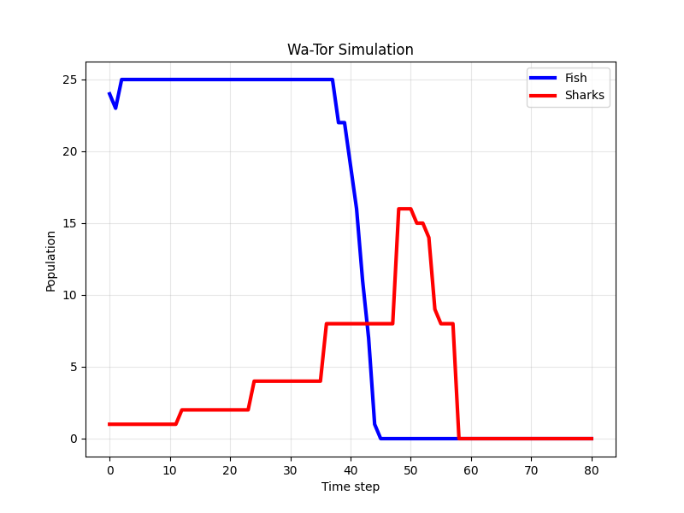
Simulation: Invasion & Complete Extinction
Gedanken Experiment
Simulation (sim02)
Assume that Wa-Tor is completely occupied by fish. As they do not die and cannot breed (due to a lack of free cells) the fish population will remain at its size for all times. This is an example of a steady state or equilibrium (all fish equilibrium).
This equilibrium is in general not stable against invasion: Let us replace one fish with a shark, then the shark immediately starts to feed on the fish whose population begins to decline.
After some time, the shark breeds such that the predation pressure on the fish population increases. The following dynamics then depends on the spatial dynamics.
N = 5 # Size of the lattice
T = 80 # Maximum number of time steps
NF = 24 # Initial number of fish
NS = 1 # Initial number of sharks
FISH_BREEDING_TIME = 1 # Time steps for fish to breed
SHARK_BREEDING_TIME = 11 # Time steps for sharks to breed
SHARK_STARVATION_TIME = 10 # Time steps for sharks to starve

Slide 34
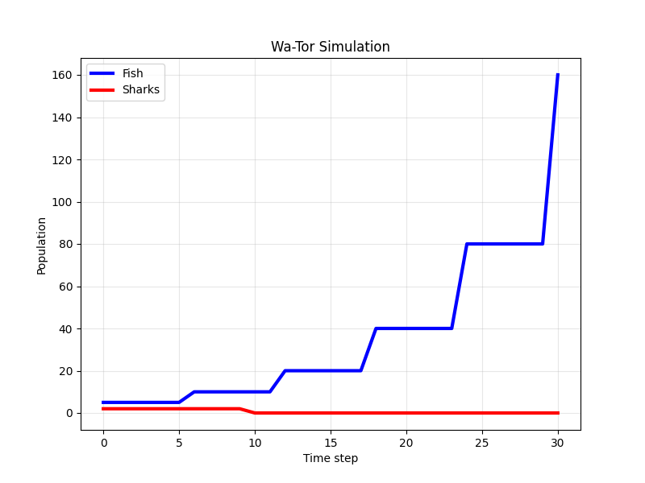
Simulation: Shark Extinction
Gedanken Experiment
Simulation (sim03)
In a larger Wa-Tor ocean with only few fish it may be rather hard for the shark to find their prey such that they may get extinct, and the fish population can take over.
N = 50 # Size of the lattice
T = 50 # Maximum number of time steps
NF = 5 # Initial number of fish
NS = 2 # Initial number of sharks
FISH_BREEDING_TIME = 5 # Time steps for fish to breed
SHARK_BREEDING_TIME = 11 # Time steps for sharks to breed
SHARK_STARVATION_TIME = 10 # Time steps for sharks to starve

Slide 35
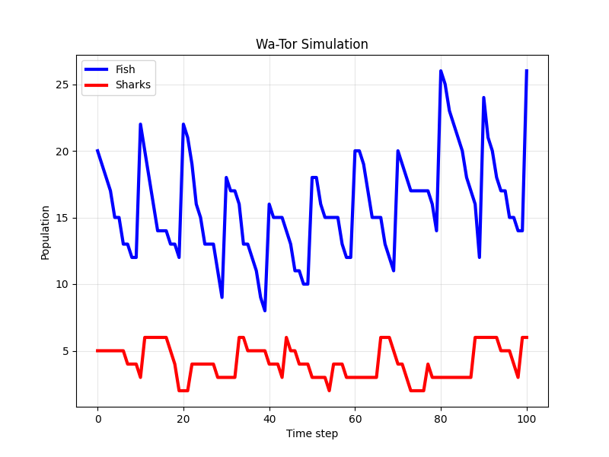
Simulation: Co-Existence
Gedanken Experiment
Simulation (sim04)
If the population numbers as well as the breeding and starvation parameters are in some balance, we expect coexistence of the two species for a considerable amount of time.
Remark:
Long-time coexistence or the existence of a mixed-species equilibrium may be very hard to justify rigorously in the agent-based model.
For such kinds of questions mathematical models are better suited; e.g., for fish-shark dynamics there is the Lotka-Volterra model.
N = 10 # Size of the lattice
T = 100 # Maximum number of time steps
NF = 20 # Initial number of fish
NS = 5 # Initial number of sharks
FISH_BREEDING_TIME = 9 # Time steps for fish to breed
SHARK_BREEDING_TIME = 10 # Time steps for sharks to breed
SHARK_STARVATION_TIME = 6 # Time steps for sharks to starve

Slide 36
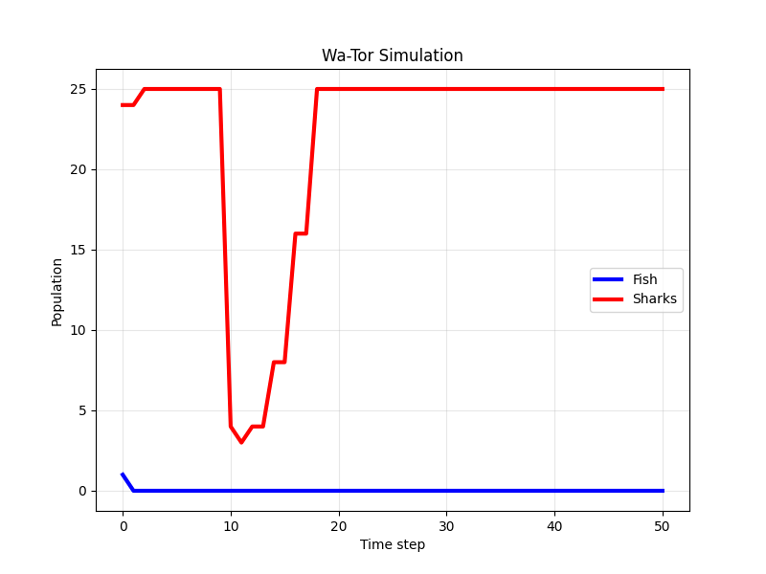
Simulation: Wrong Model Behavior? (1/ 2)
Gedanken Experiment
Simulation (sim05)
With biological intuition it makes sense that if Wa-Tor is completely occupied by sharks despite one cell inhabited by a fish.
This setting cannot be invaded by the fish population (which will be immediately consumed). Though, due to the lack of prey the sharks will get extinct eventually.
We see that due to the birth events, that produce new shark with an initial starve time zero, we get an increasing amount of shark that multiply before starving (based on the lack of fish).
N = 5 # Size of the lattice
T = 50 # Maximum number of time steps
NF = 1 # Initial number of fish
NS = 24 # Initial number of sharks
FISH_BREEDING_TIME = 5 # Time steps for fish to breed
SHARK_BREEDING_TIME = 1 # Time steps for sharks to breed
SHARK_STARVATION_TIME = 10 # Time steps for sharks to starve

Slide 37
Simulation: Wrong Model Behavior? (2/ 2)
Validation
We observe an incongruency between reality and model results.
Hence, something may be wrong with the way we built our model, and we should revise it.
In our modelling, we neglected the reason why shark feed on fish: they require resources to survive.
So, let’s augment the rules for sharks in this sense.
Reality
We see that due to the birth events, that produce new shark with an initial starve time zero, we get an increasing amount of shark that multiply before starving (based on the lack of fish).
Model Results

Slide 38
As a second version of Wa-Tor we assume a different breeding behavior of shark to see if that helps to get rid of wrong model behavior
Version 1 Fish Rules
Updated Shark Rules (Resource Level)
Every fish has an age that is increased by one after each move.
If the age is larger than a “fish breeding time” then a new fish is “born” (with zero age) on an unoccupied neighboring cell, and the age of the fish is set back to zero.
If there is more than one unoccupied neighboring cell, then the place for the new fish is equally likely for all unoccupied neighboring cell and selected at random.
If all of the eight direct neighbor cells are occupied, the fish moves on until it either gets eaten by a shark or is positioned at a cell with at least one unoccupied neighboring cell.
As before, every shark has an age that is increased by one after each move.
At an encounter between a shark and a fish the shark eats the fish, then the resource level of the shark is increased by the resource level of the fish, the ’shark starve time’ is set to zero, and the fish is canceled from the simulation.
We assume that the resource level of a fish corresponds to its age value.
For every move without an encounter with a fish the resource level of the shark is decreased by one.
As before, if a shark does not find a fish after a certain amount of time (shark starving time), then it is canceled from the simulation.
If the age of a shark is equal or larger than a ’shark breeding time’ and its resource level is larger than a threshold (breeding energy) then a new shark is ’born’ (with zero age and zero starve time) according to the same rules as for fish.
The resource level of the ’parent’ shark is as equally distributed between the parent and child shark as possible.
Wa-Tor Scheme (2nd version)
Version 1 Shark Rules
Every shark has an age that is increased by one after each move.
At a collision between a shark and a fish the shark eats the fish, then the “shark starve time” is set to zero and the fish is canceled from the simulation.
If a shark does not find a fish after a certain amount of time (shark starving time), then it is canceled from the simulation.
If the age of a shark is equal or larger than a 'shark breeding time' then a new shark is “born” (with zero age and zero starve time) according to the same rules as for fish.

Slide 39
Implementation: Wa-Tor Scheme (2nd version)
Iterations
Key changes:
Sharks now have 6 elements: (x, y, direction, age, starve_time, resource_level)
When shark eats fish: resource_level += fish_age, starve_time = 0
When shark moves without eating: resource_level -= 1
Shark dies if: starve_time >= shark_starving_time OR resource_level < 0
Shark breeds if: age >= shark_breeding_time AND resource_level > breeding_energy
Resource splitting: parent gets resource_level // 2, child gets the remainder
04_WaTor.py (main routine)
random seed
global settings and parameter
settings and parameter for the interaction rules
call of sub-routines
iteration loop for the movement
P04a_initialization.py (sub-routine)
initial distribution of the NF fish and the NS shark on the N×N lattice
update
update
P04m_interaction (sub-routine)
Implementation of the movement rules and update of the populations
update
P04v_lattice_video.py (sub-routine)
animation of the distribution of fish and shark populations on the lattice
update
included in P01v_lattice_video.py
Plot of the total fish and shark numbers over time

Slide 40
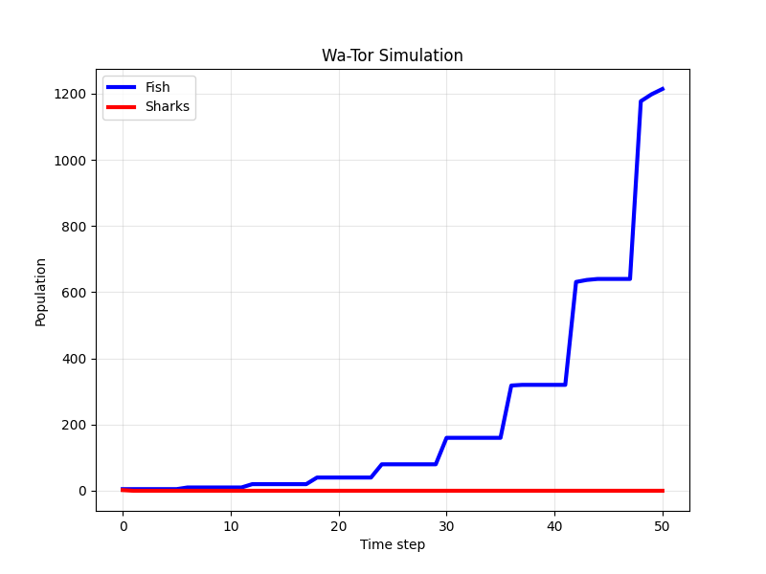
Simulation: Wa-Tor Version 2 (1/ 2)
Simulation: Invasion & Complete Extinction
Simulation: Shark Extinction
2sim02.png
2sim03.png
N = 5 # Size of the lattice
T = 80 # Maximum number of time steps
NF = 24 # Initial number of fish
NS = 1 # Initial number of sharks
FISH_BREEDING_TIME = 1 # Time steps for fish to breed
SHARK_BREEDING_TIME = 11 # Time steps for sharks to breed
SHARK_STARVATION_TIME = 10 # Time steps for sharks to starve
SHARK_BREEDING_ENERGY = 11 # Minimum resource level to breed
N = 50 # Size of the lattice
T = 50 # Maximum number of time steps
NF = 5 # Initial number of fish
NS = 2 # Initial number of sharks
FISH_BREEDING_TIME = 5 # Time steps for fish to breed
SHARK_BREEDING_TIME = 11 # Time steps for sharks to breed
SHARK_STARVATION_TIME = 10 # Time steps for sharks to starve
SHARK_BREEDING_ENERGY = 11 # Minimum resource level to breed

Slide 41
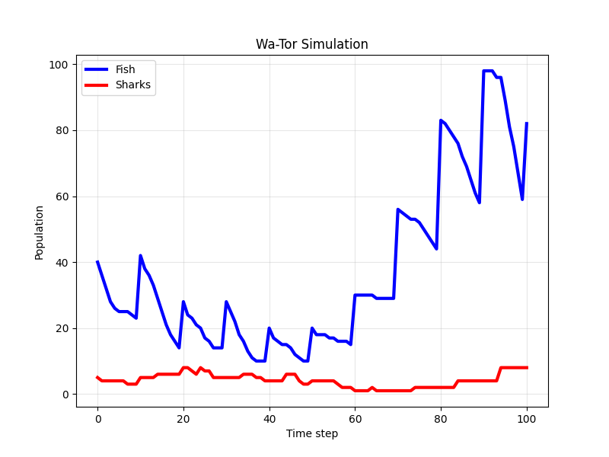
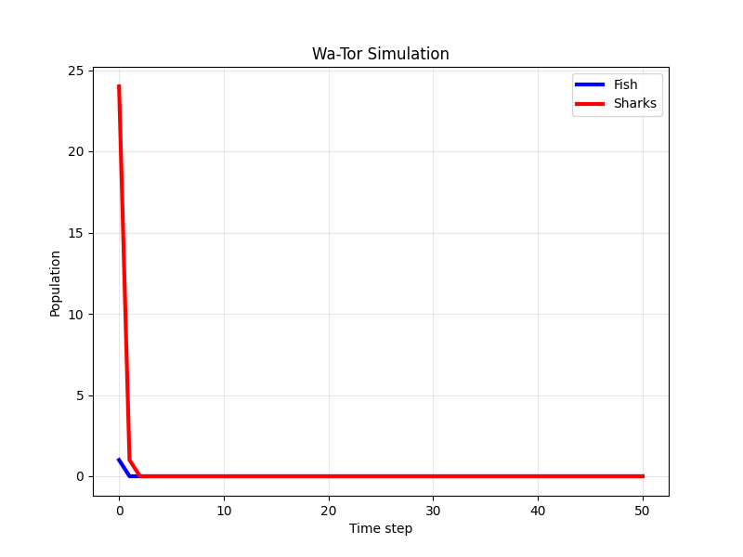
Simulation: Wa-Tor Version 2 (2/ 2)
Simulation: Co-Existence
Simulation: Wrong Model Behavior?
2sim04.png
2sim05.png
N = 10 # Size of the lattice
T = 100 # Maximum number of time steps
NF = 40 # Initial number of fish
NS = 5 # Initial number of sharks
FISH_BREEDING_TIME = 9 # Time steps for fish to breed
SHARK_BREEDING_TIME = 9 # Time steps for sharks to breed
SHARK_STARVATION_TIME = 6 # Time steps for sharks to starve
SHARK_BREEDING_ENERGY = 2 # Minimum resource level to breed
N = 5 # Size of the lattice
T = 50 # Maximum number of time steps
NF = 1 # Initial number of fish
NS = 24 # Initial number of sharks
FISH_BREEDING_TIME = 5 # Time steps for fish to breed
SHARK_BREEDING_TIME = 1 # Time steps for sharks to breed
SHARK_STARVATION_TIME = 10 # Time steps for sharks to starve
SHARK_BREEDING_ENERGY = 2 # Minimum resource level to breed

Slide 42
Topics
Course Overview
The Water Planet Wa-Tor
Verification & Validation
Strategy Evolution on Wa-Tor

Slide 43
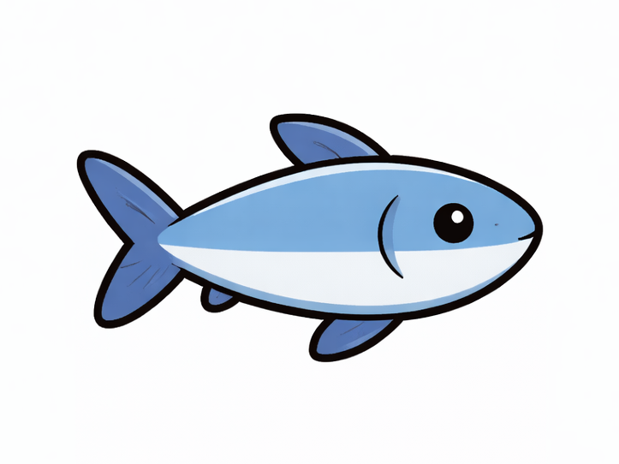
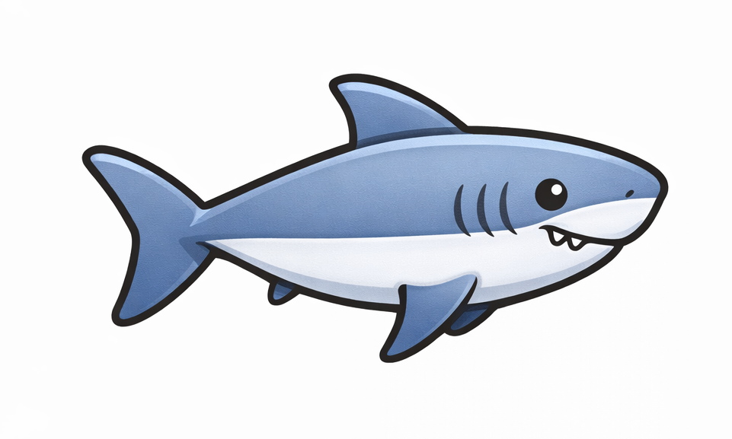
Next, we can add further species to the ecosystem, like “hunter sharks” that use a more aggressive feeding strategy
Next, we introduce a new hunter shark species which
moves and breeds like a shark, but
searches for prey before each movement step and then occupies a fish cell if amongst its direct 8 neighbors.
Thus, the new hunter shark rule are:
Before each move survey the 8 direct neighbors around the hunter shark position.
If one of them is occupied by a fish, then go to the first such cell found (i.e., position and age update) and eat the fish (i.e., fish vanishes from the lattice, starving time is set to zero, and breeding energy is updated by the age of the fish). The direction value is kept unchanged.
If none of the 8 direct neighbors is occupied, then continue with a shark move along the given direction.
movement direction
hunting space
image generated
with ChatGPT

Slide 44
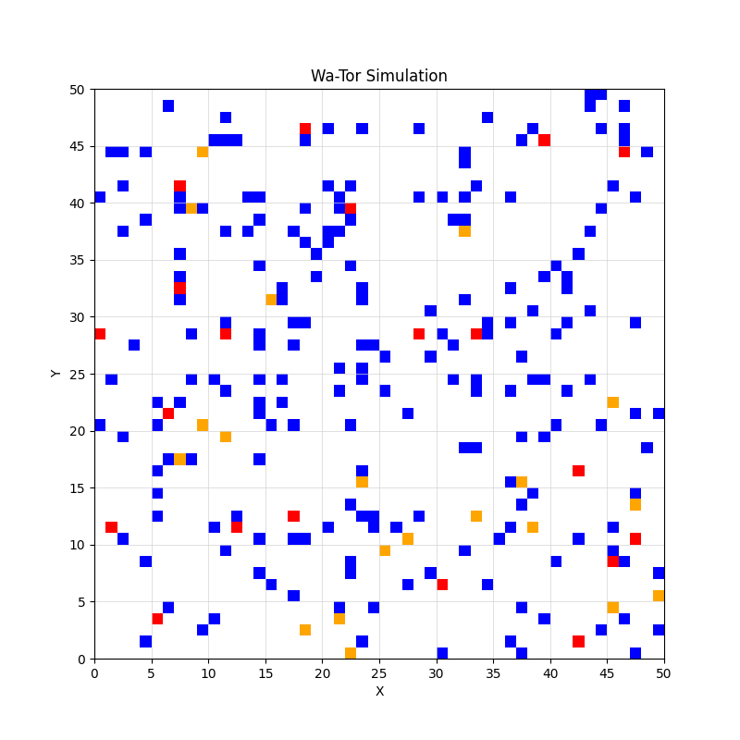
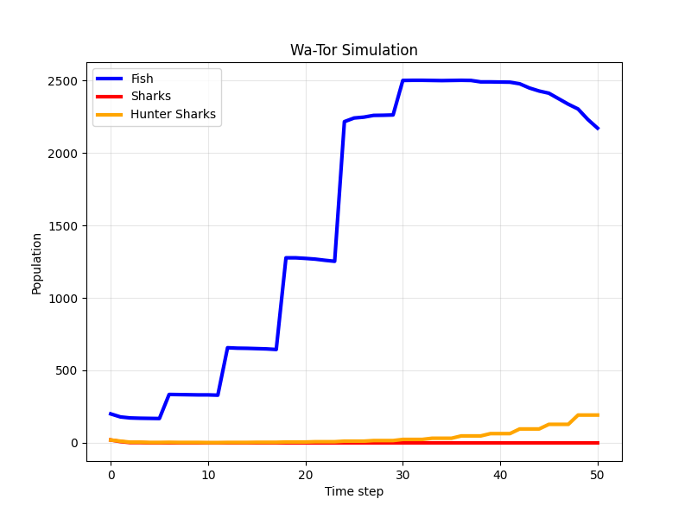
Simulation: 1st run
Initial Lattice Occupation
Time Evolution
3sim01a.png
3sim01b.png
N = 50 # Size of the lattice
T = 50 # Maximum number of time steps
NF = 200 # Initial number of fish
NS = 20 # Initial number of sharks
NH = 20 # Initial number of hunter sharks
FISH_BREEDING_TIME = 5 # Time steps for fish to breed
SHARK_BREEDING_TIME = 5 # Time steps for sharks to breed
HUNTER_BREEDING_TIME = 5 # Time steps for hunter sharks to breed
SHARK_STARVATION_TIME = 10 # Time steps for sharks to starve
HUNTER_STARVATION_TIME = 10 # Time steps for sharks to starve
BREEDING_ENERGY = 5 # Minimum resource level to breed

Slide 45
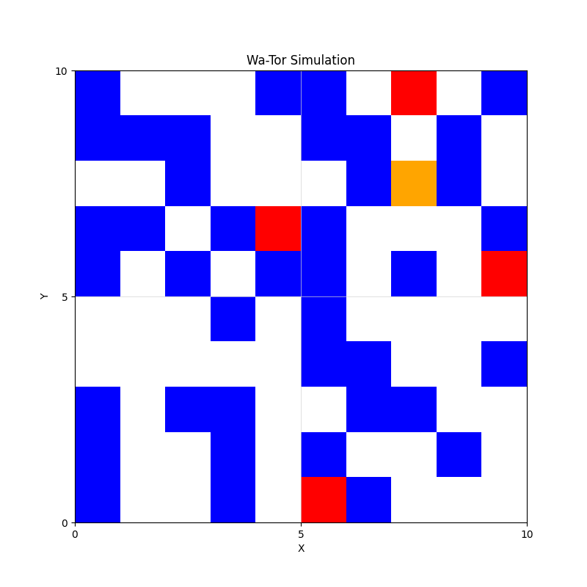
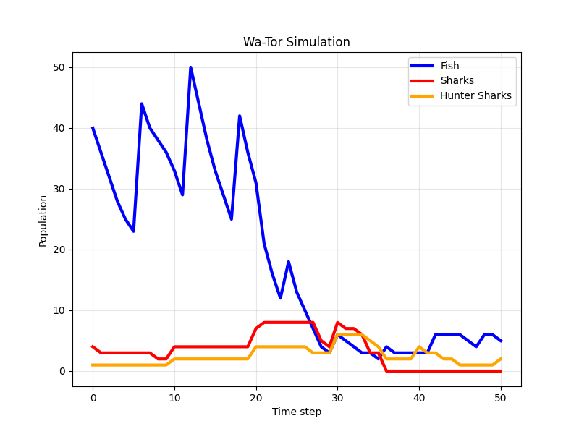
Simulation: 2nd run
Initial Lattice Occupation
Time Evolution
3sim02a.png
3sim02b.png
N = 10 # Size of the lattice
T = 50 # Maximum number of time steps
NF = 40 # Initial number of fish
NS = 4 # Initial number of sharks
NH = 1 # Initial number of hunter sharks
FISH_BREEDING_TIME = 5 # Time steps for fish to breed
SHARK_BREEDING_TIME = 9 # Time steps for sharks to breed
HUNTER_BREEDING_TIME = 9 # Time steps for hunter sharks to breed
SHARK_STARVATION_TIME = 6 # Time steps for sharks to starve
HUNTER_STARVATION_TIME = 6 # Time steps for sharks to starve
BREEDING_ENERGY = 2 # Minimum resource level to breed

Slide 46
Finally, let’s add a sanctuary for the fish population where it cannot fall prey to the shark
We introduce a sanctuary for the fish population
where it cannot fall prey to neither of the shark sub-populations (safe harbor),
and can thus proliferate and from there continue occupying the whole of Wa-Tor (breeding center).
The sanctuary is located at the center of the lattice and, in this case, has the size ½ N × ½ N.
fish sanctuary

Slide 47
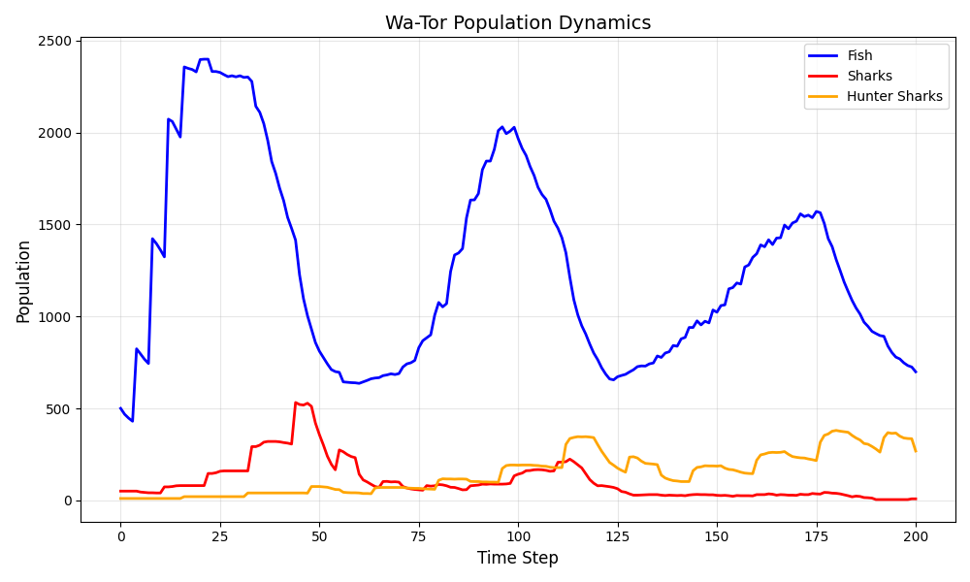
Simulation: 2nd run
Movement on the Toroidal Grid (sim06)
Time Evolution
N = 50 # Size of the lattice
T = 200 # Maximum number of time steps
NF = 500 # Initial number of fish
NS = 50 # Initial number of sharks
NH = 10 # Initial number of hunter sharks
FISH_BREEDING_TIME = 3 # Time steps for fish to breed
SHARK_BREEDING_TIME = 10 # Time steps for sharks to breed
HUNTER_BREEDING_TIME = 15 # Time steps for hunter sharks to breed
SHARK_STARVATION_TIME = 5 # Time steps for sharks to starve
HUNTER_STARVATION_TIME = 8 # Time steps for sharks to starve
BREEDING_ENERGY = 10 # Minimum resource level to breed

Slide 48
Computational Biomathematics
florian.rupp@kiu.edu.ge

