Slide 1
Computational Biomathematics
Rejuvenating Forests & Markov-Chains
Lesson 2
Lecture
Administration: details about the group project
Forest rejuvenation dynamics
Markovian description of the forest dynamics

Slide 2
Topics
Administration: Details About the Group Project
Forest Rejuvenation Dynamics
Markovian Description of the Forest Dynamics

Slide 3
Grading is based on group projects (3-4 students) that will combine “literature work” with own modeling and simulation (1/ 2)
For the assessment I would like to combine your own research interests with traditional assessment methods:
Research means that you are interested in a topic and want to inquire how it is working in its very core
Therefore:
you will have access to large number of topics in social science simulation
you will get a substantial amount of freedom to steer your project
Assessment means that you are in a somewhat save environment where you can apply those methods and tools that were discussed during the course
Therefore:
you will have to tweak the “research part” such that it boils down both to the framework of the lecture and your available time budget
you are requested to use only those methods and tools you know
Please keep in mind, that the projects should be fun for you and lead to some nice results, you are not expected to give a comprehensive answer to any real-world problem

Slide 4

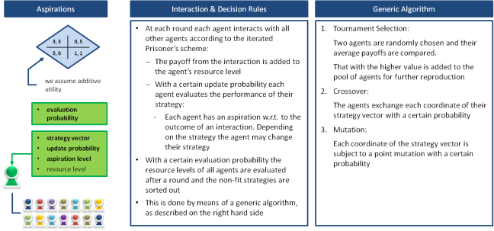
Grading is based on group projects that will combine “literature work” with own modeling and simulation (2a/ 2)
Topic Selection
Research Question
Modeling
Simulating
Writing
Communication
Get my approval for your project such that we can negotiate the amount of work and fix expectations
Boil the article down to an interesting sub-problem (e.g., that arises in the article’s discussion section):
Description of the situation
Modeling approach (agent interactions, additional believe landscapes, etc.)
Keep time and scope restrictions in mind
Use the “Journal of Artificial Societies and Social Simulation” as a source for ideas
http://jasss.soc.surrey.ac.uk/JASSS.html
http://jasss.soc.surrey.ac.uk/index_by_issue.html

Slide 5
Grading is based on group projects that will combine “literature work” with own modeling and simulation (2b/ 2)
Topic Selection
Research Question
Modeling
Simulating
Writing
Communication
Key idea of AI-enhanced coding:
AI can help produce code faster, but scientific quality still depends on biological understanding, mathematical reasoning, and careful validation.
AI needs to be integrated responsibly:
Never submit AI-generated code you do not understand.
Always verify whether the equations in the code match the mathematical model.
Always test units, dimensions, and parameter meanings.
Always compare numerical output with biological expectations.
Use AI for structure, debugging, and explanation, not for replacing reasoning.
Document where AI was used.

Slide 6
Grading: Group projects with peer contribution monitoring
Grading
Necessary Parts of the Presentations
Components:
Group project (3-4 students per team)
Individual deviation from group grade according to peer contribution
Intermediate result presentation (seeing that you are on track): 30% of the grade
at the end of the course (Friday 2nd week)
criteria: well-defined problem and solution approach, first results
Final presentation (= report): 70% of the grade
about 3 weeks after the end of the course
criteria: clear presentation and comprehensive results
Your presentation should be clearly structured highlighting your completed work:
Problem
Statement
(Situation/ Complication)
Your Solution
Approach
(Solution)
Peer
Contribution
List of Completed Activities
Activity Details/
Results
Activity Details
Activity Details
Activity Details
Conclusion &
Outlook
Consider and carry-out several ways to solve the problem by different mathematical approaches

Slide 7
Your presentation should be clearly structured highlighting your completed work and that you are in-time and in-scope
Problem
Statement
(Situation/ Complication)
Your Solution
Approach
(Solution)
Peer
Contribution
Titlepage
Roadmap
List of Completed Activities
Activity Details/
Results
Keep in mind:
15 min presentation
5 min for questions and answers
You can embed LaTeX into PowerPoint e.g., via “IguanaTex”
Slides should be self-explanatory
Be precise
Activity Details
Activity Details
Activity Details
Next Steps
Consider and carry-out several ways to solve the problem by different mathematical approaches

Slide 8
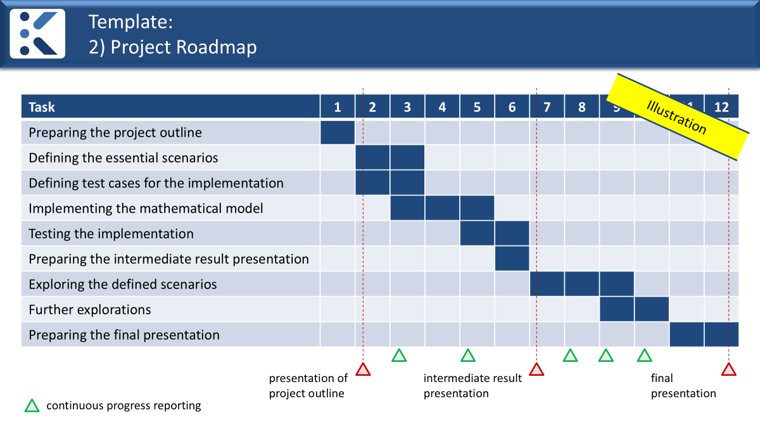
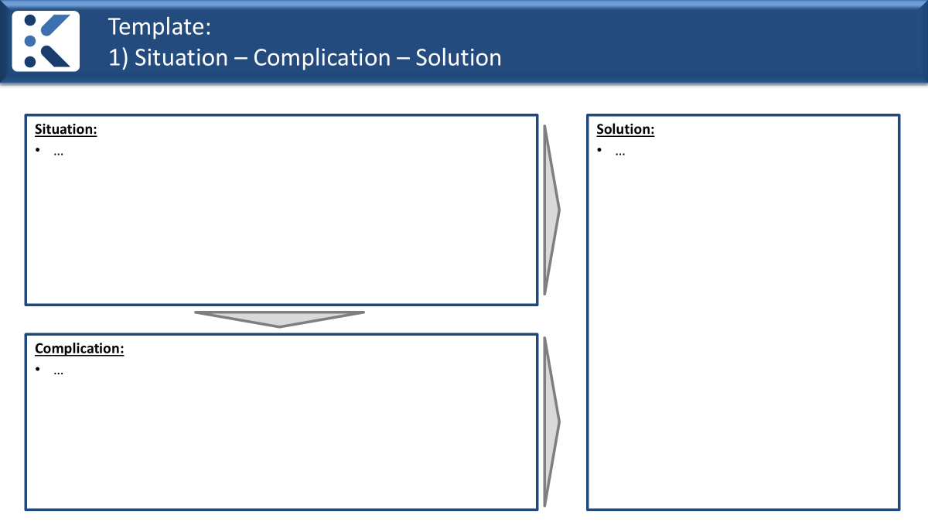
Remarks: Slide contents (1a/ 2)
<title of your project>
Intermediate Results Presentation
<names of project team>
WCU logo
The timeframe up to the final presentation:
Titlepage
Roadmap
Problem Statement:
Consider and carry-out several ways to solve the problem by different mathematical approaches:
Besides your approach, state alternative approaches (at least two) how the problem under consideration can be solved as well
Summarize, whether (where and how) these approaches were already used (literature research)
Briefly discuss the pros and cons of the approaches
Reason, why your solutions approach is better suited
Problem
Statement
(Situation/ Complication)
Describe your solution approach clearly and transparently
Shortly illustrate the benefits of this approach
Your Solution
Approach
(Solution)

Slide 9
Remarks: Slide contents (1b/ 2)
Situation:
…
Solution:
…
Illustration
Complication:
…
Consider and carry-out several ways to solve the problem by different mathematical approaches

Slide 10
Remarks: Slide contents (1c/ 2)
Task | 1 | 2 | 3 | 4 | 5 | 6 | 7 | 8 | 9 | 10 | 11 | 12
Preparing the project outline
Defining the essential scenarios
Defining test cases for the implementation
Implementing the mathematical model
Testing the implementation
Preparing the intermediate result presentation
Exploring the defined scenarios
Further explorations
Preparing the final presentation
Illustration
intermediate result presentation
final presentation

Slide 11
Remarks: Slide contents (2/ 2)
Peer Contribution:
Give a “peer contribution” evaluation stating how everyone in the group has indeed contributed to the results; e.g., in form of a table:
For the “peer contribution”, keep the honor code of the university and academic honesty in mind.
Peer
Contribution
name of team member | contribution relative to the other team members
 | not significant | - 20% | equal | + 20% | did everything

Slide 12
Topics
Administration: Details About the Group Project
Forest Rejuvenation Dynamics
Markovian Description of the Forest Dynamics

Slide 13
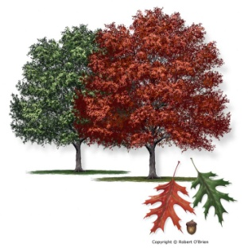
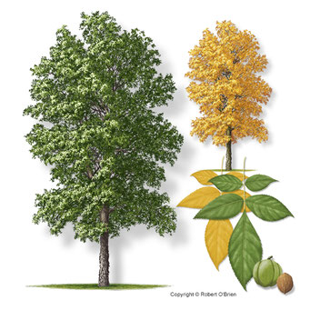
Example: A forest consisting of two tree species
Example:
We consider a simplified forest comprising red oak RO and hickory HI. We assume that the life spans of the two trees are similar.
In each generation,
red oak may be replaced by itself or by hickory, and
hickory may be replaced by itself or red oak.
For example, suppose that when
a red oak tree dies, it is equally likely to be replaced by hickory or red oak, and that when
a hickory tree dies; it has probability 0.74 of being replaced by red oak and 0.26 of being replaced by hickory.
red oak
hickory

Slide 14
As starting point of the AI-enhanced coding, we take this information and generate a prompt (1/ 3)
1. Understand the Problem
Task:
Write a modular and extensible Python project for simulating a stochastic forest model on an N x N lattice with initially two species: red oak (RO) and hickory (HI).
Biological rules:
Each lattice cell contains one tree.
State space: RO or HI.
Time is discrete, with T steps.
Update rule for each cell:
RO -> RO with probability 0.50
RO -> HI with probability 0.50
HI -> RO with probability 0.74
HI -> HI with probability 0.26
Software design requirements:
Split the code into separate files for initialization, dynamics, visualization, and execution.
The code must be written so that these modules can later be replaced independently.
Use functions rather than hard-coded script logic.
Use NumPy arrays for the lattice.
Use matplotlib for visualization.
Include docstrings and concise comments.
Keep the code readable for university students who are not familiar with coding.
2. Plan
3. Execute
4. Look Back

Slide 15
As starting point of the AI-enhanced coding, we take this information and generate a prompt (2/ 3)
1. Understand the Problem
Project structure:
“forest.py”: main entry point that contains the model parameters and configuration, seed for the random number generator, as well as the call of the required time stepping routines
“initialization.py”: functions to generate the initial lattice
“dynamics.py”: functions for one simulation step and full simulation
“visualization.py”: functions for lattice plotting, time-series plotting, and optional animation
forest.py
parameters
seed
2. Plan
initialization.py
3. Execute
dynamics.py
4. Look Back
visualization.py
Remark: for purposes, where there a several model parameters and configuration that are not varied, it makes sense to have them in a separate file, e.g., “parameters.py”.

Slide 16
As starting point of the AI-enhanced coding, we take this information and generate a prompt (3/ 3)
1. Understand the Problem
Output requirements:
Show the lattice evolution with RO as red and HI as green cells.
Plot the number of RO and HI trees over time.
Store the lattice state history so that animations or later analysis are possible.
Store the initial and the final state of the lattice in separate .png files.
Give the initial percentage of RO and HI as well as the final percentage.
Make it easy to replace the update rule later, for example with neighborhood-dependent dynamics.
Please provide:
full code for each file,
a short explanation of the program structure,
brief instructions for execution, as well as
a design that is simple, modular, and suitable for teaching.
2. Plan
3. Execute
Such a specification prompt can also be generated with the support of AI.
E.g., take the word description in the example and apply an LLM to design a prompt that lets AI write a modular python program with the given requirements. (Augment this prompt if necessary.)
4. Look Back

Slide 17
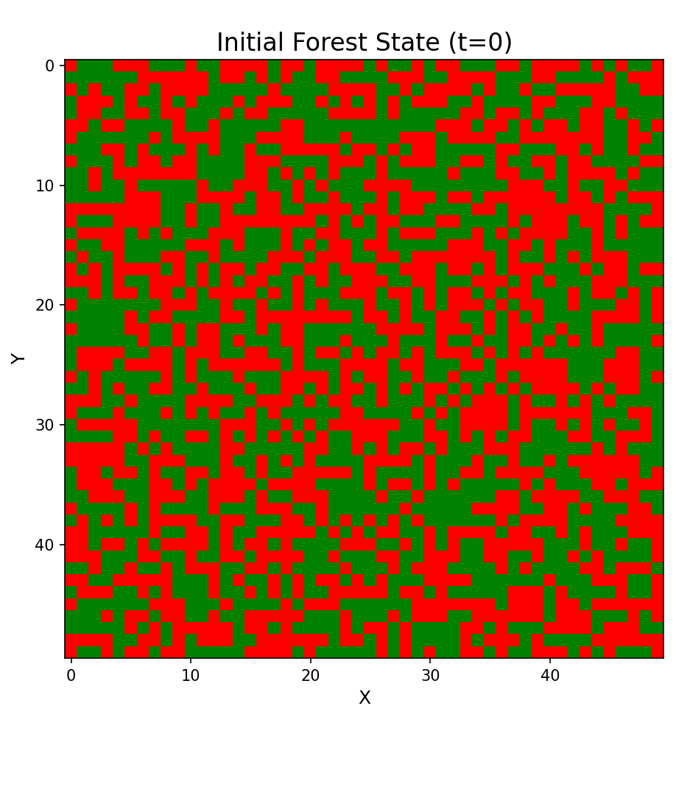
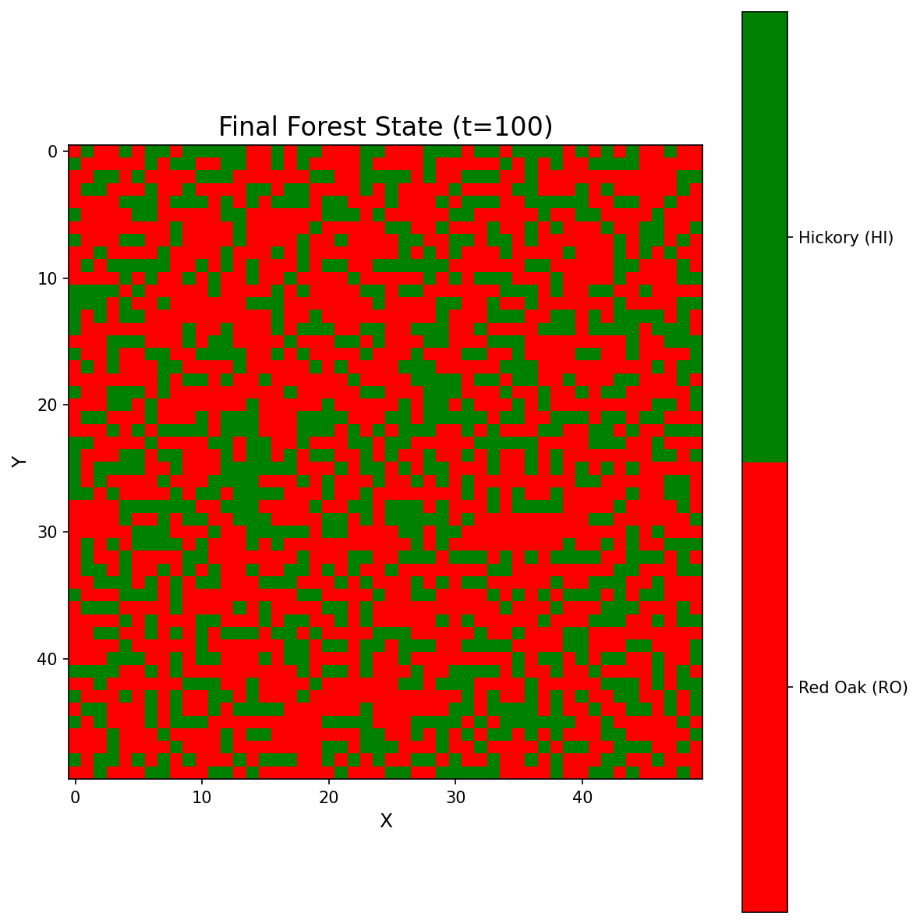
Results: Time evolution for the forest with two tree species (1/ 2)
============================================STOCHASTIC FOREST MODEL SIMULATION
============================================Lattice size: 50 x 50
Time steps: 100
Random seed: 42
Initial P(RO): 0.5
Transition rules:
RO -> RO: 0.50
RO -> HI: 0.50
HI -> RO: 0.74
HI -> HI: 0.26
============================================SIMULATION STATISTICS
============================================Total cells: 2500
Initial state:
Red Oak (RO): 1238 trees (49.52%)
Hickory (HI): 1262 trees (50.48%)
Final state:
Red Oak (RO): 1540 trees (61.60%)
Hickory (HI): 960 trees (38.40%)
Change:
Red Oak (RO): +302 trees (+12.08%)
Hickory (HI): -302 trees (-12.08%)
============================================

Slide 18
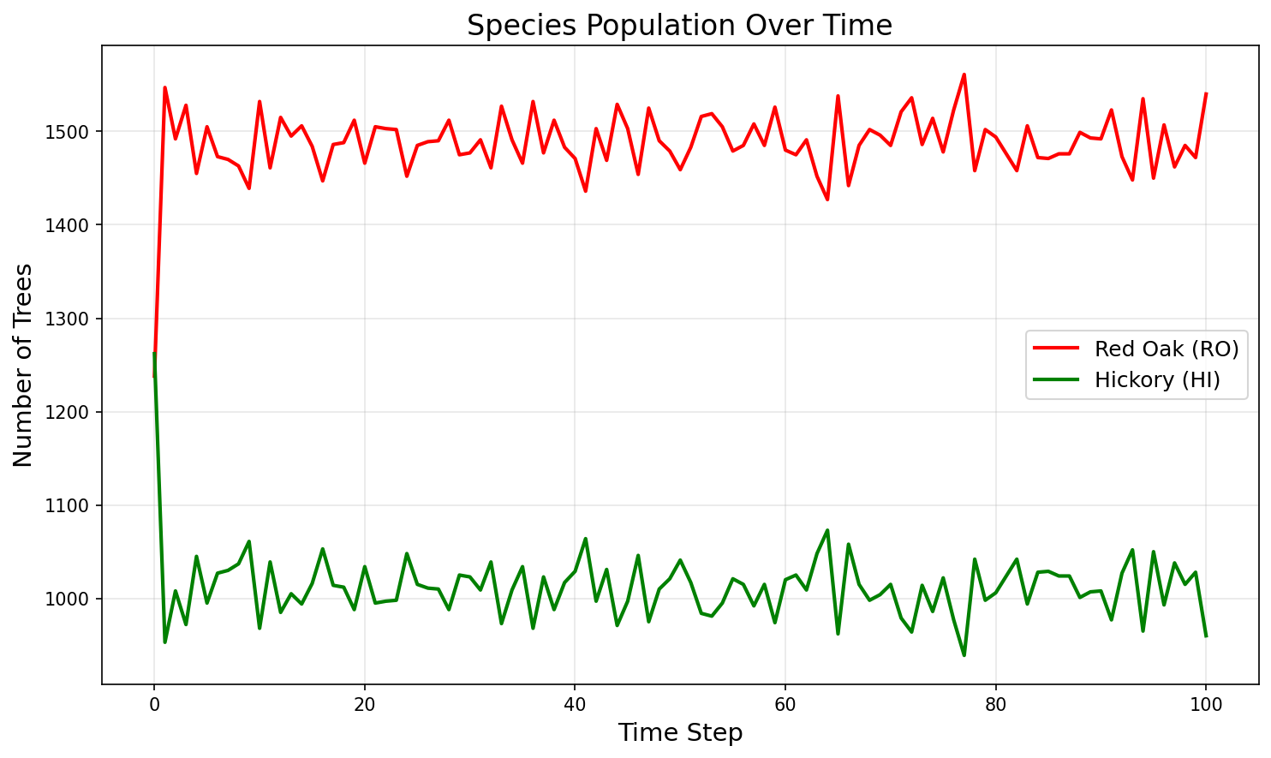
Results: Time evolution for the forest with two tree species (2/ 2)
Animation (100 steps)
Time series
Approx. long-time average:
RO ≈ 1500 (60 %) and HI ≈ 1000 (40 %)

Slide 19
Example [cont.]: Mixing/ invasion of previously separated pure plantations
HI
Example [cont.]:
We next include the spatial surrounding of the trees in the replacement mechanism and assume two separate pure plantations to simulate mixing between the plantations (or invasion of tree types into the pure plantations of the other type).
Thus, let’s continue with the previous setting, but assume some changes:
Each tree hast 8 neighbors (north, north-east, east, south-east, south, south-west, west, north-west)
A RO tree is always replaced by a RO tree if all its 8 neighbors are RO, and it is replaced equally likely by a RO or a HI tree if at least one of its 8 neighbors is a HI tree.
A HI tree is always replaced by a HI tree if all its 8 neighbors are HI, and it is replaced with a 74% chance by a RO and a 26% chance by a HI tree if at least one of its 8 neighbors is a RO tree.
Initially the NxN lattice is divided such that the lower Nx(N/2) part is occupied by RO trees only and the upper Nx(N/2) part is occupied by HI trees only.
RO

Slide 20
We again start with the prompt for the AI coding
Task: Update the existing modular Python lattice simulation project to include spatially dependent replacement rules based on the 8-cell Moore neighborhood (fixed boundary conditions).
Important:
Modify the existing files instead of creating a completely new project.
Preserve the modular design with separate files for initialization, dynamics, visualization, and execution.
Model:
The lattice is N x N and each site contains either:
RO = red oak
HI = hickory
Initial state:
upper half of the lattice: HI only
lower half of the lattice: RO only
Neighborhood:
Each cell has 8 neighbors (Moore neighborhood).
Update rules for one time step:
If the current cell is RO:
if all 8 neighbors are RO, the new state is RO with probability 1
otherwise, the new state is:
RO with probability 0.50
HI with probability 0.50
If the current cell is HI:
if all 8 neighbors are HI, the new state is HI with probability 1
otherwise, the new state is:
RO with probability 0.74
HI with probability 0.26
Technical requirements:
Update “initialization.py” to generate the two-plantation initial lattice.
Update “dynamics.py” to:
compute the Moore neighborhood of each cell
apply the new replacement rule
perform synchronous updating of the whole lattice
Document the chosen boundary condition clearly.
Keep “visualization.py” able to:
display the lattice over time with RO in red and HI in green
plot the number of RO and HI cells versus time
Keep parameters such as N, T, random seed, and probabilities easy to change.
Use readable, well-commented code for teaching purposes.
Return the full updated code file by file.
Briefly explain which functions were added or modified.
Document the changes
When asking AI to modify a scientific program, one should not only describe the new biology but also specify which software structure must be preserved.
Otherwise, the AI may solve the mathematical problem but destroy the program design.

Slide 21
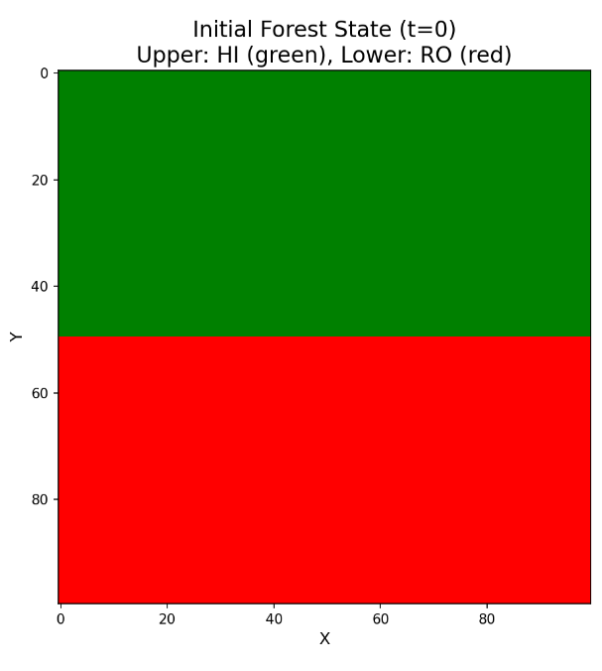
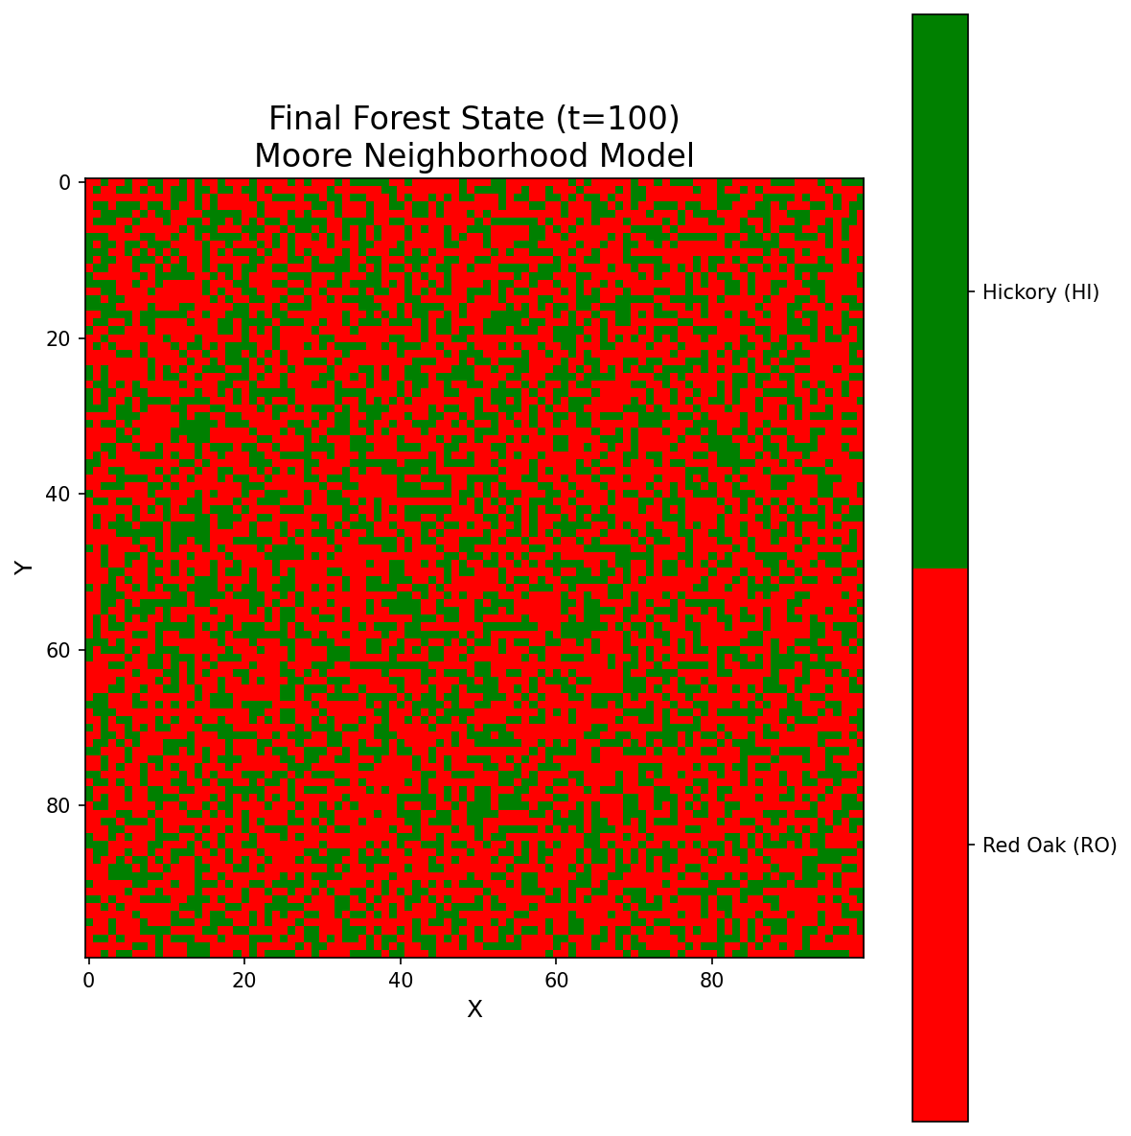
Results: Time evolution for the forest mixing example (1/ 2)
============================================STOCHASTIC FOREST MODEL SIMULATION
============================================Lattice size: 100 x 100
Time steps: 200
Random seed: 42
Boundary condition: torus topology
Neighborhood: Moore (8 cells)
Initial condition: Two-plantation setup
Upper half (rows 0-49): Hickory (HI) only
Lower half (rows 50-99): Red Oak (RO) only
============================================SIMULATION STATISTICS
============================================Total cells: 10000
Initial state:
Red Oak (RO): 5000 trees (50.00%)
Hickory (HI): 5000 trees (50.00%)
Final state:
Red Oak (RO): 5975 trees (59.75%)
Hickory (HI): 4025 trees (40.25%)
Change:
Red Oak (RO): +975 trees ( +9.75%)
Hickory (HI): -975 trees ( -9.75%)
============================================

Slide 22
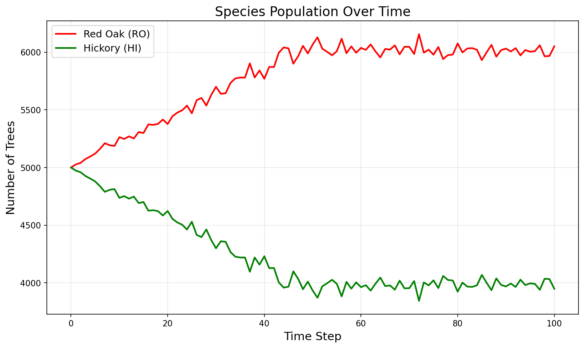
Results: Time evolution for the forest mixing example (2/ 2)
Animation (200 steps)
Time series

Slide 23
Topics
Administration: Details About the Group Project
Forest Rejuvenation Dynamics
Markovian Description of the Forest Dynamics

Slide 24
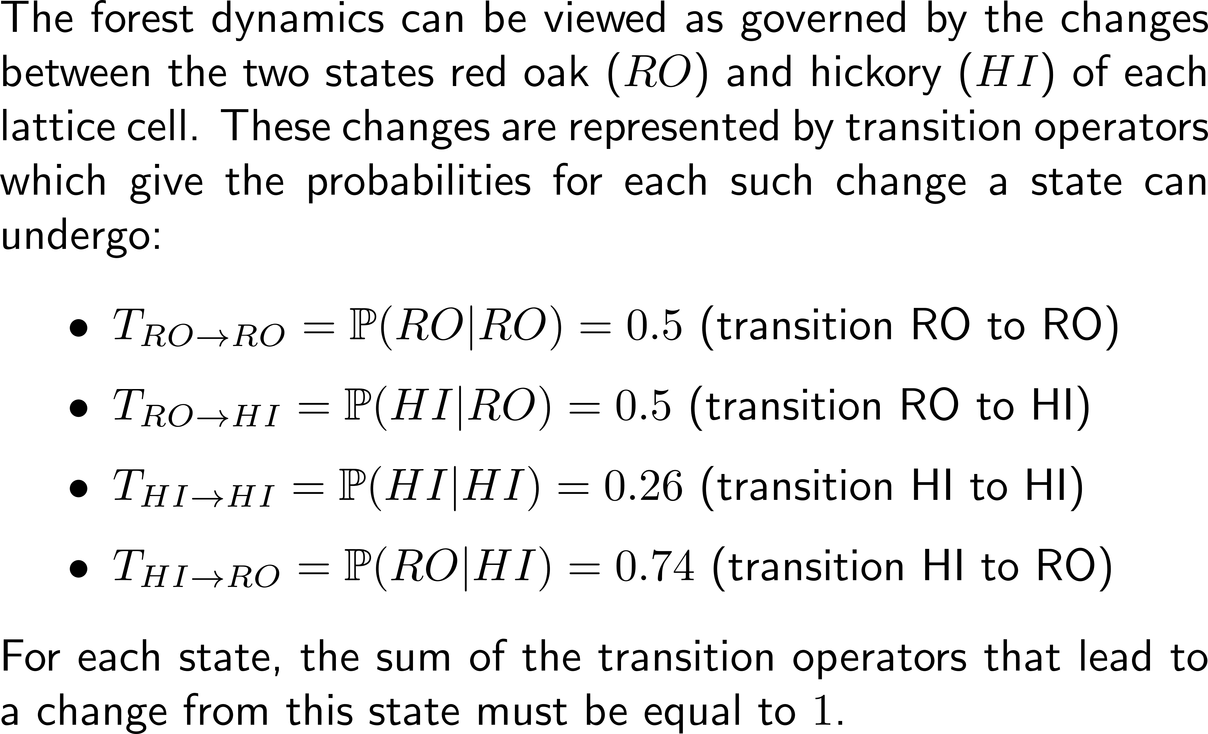




The forest dynamics are governed by changes of the states of the lattice cells …
state space per lattice cell
RO
HI
lattice space

Slide 25
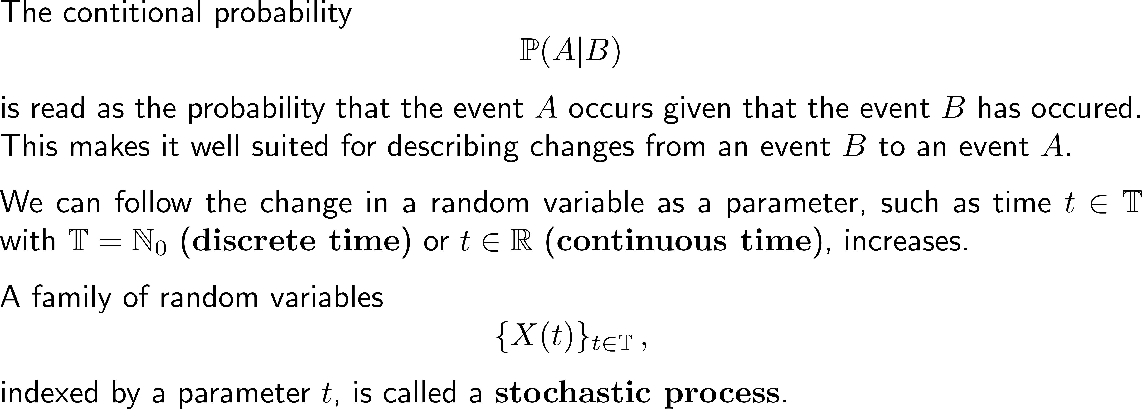
… such that w.r.t. to time evolution a stochastic process gets established

Slide 26
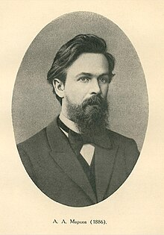
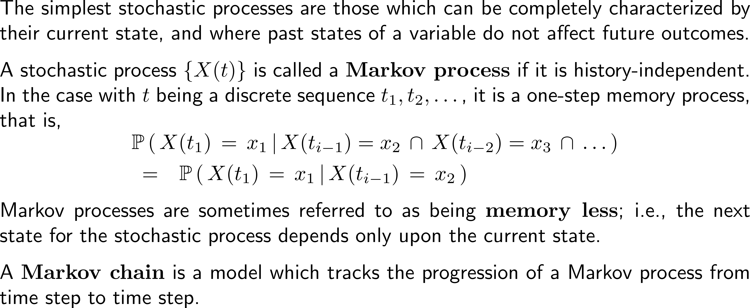
One way to describe such changes of states is by virtue of Markov processes
Andrey Andreyevich Markov
(1856 – 1922)

Slide 27
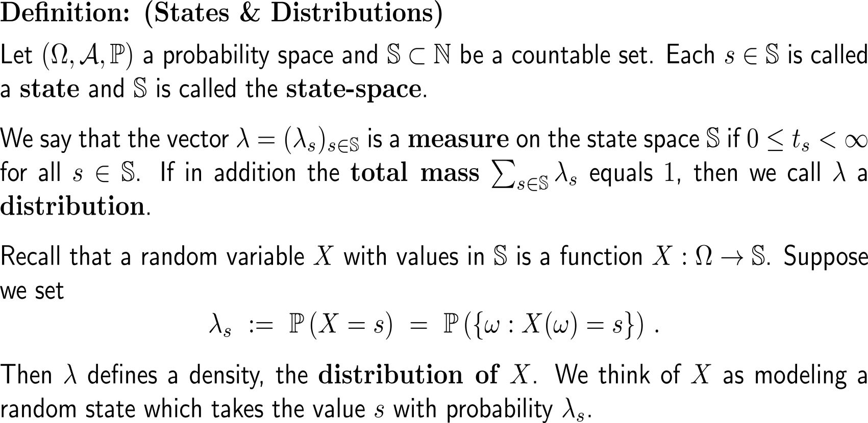
Definition: States & Distributions (1/ 2)

Slide 28
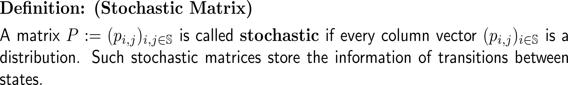
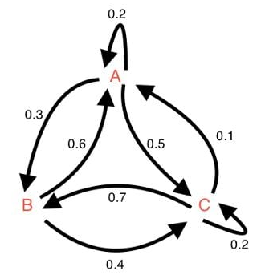
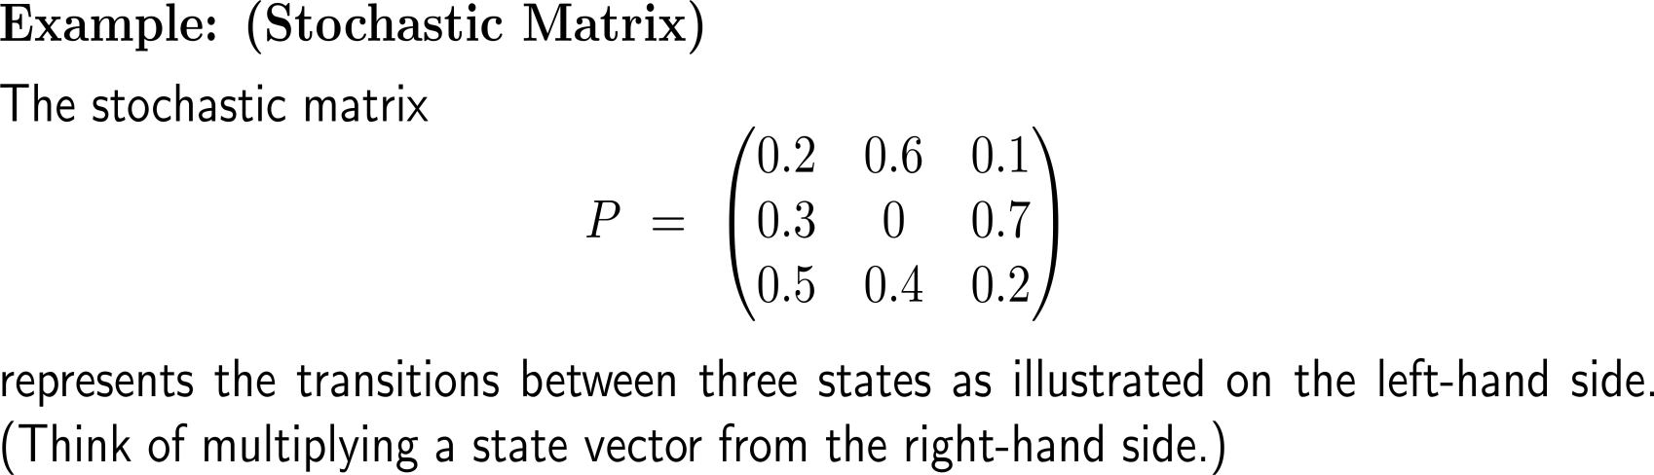
Definition: States & Distributions (2/ 2)

Slide 29
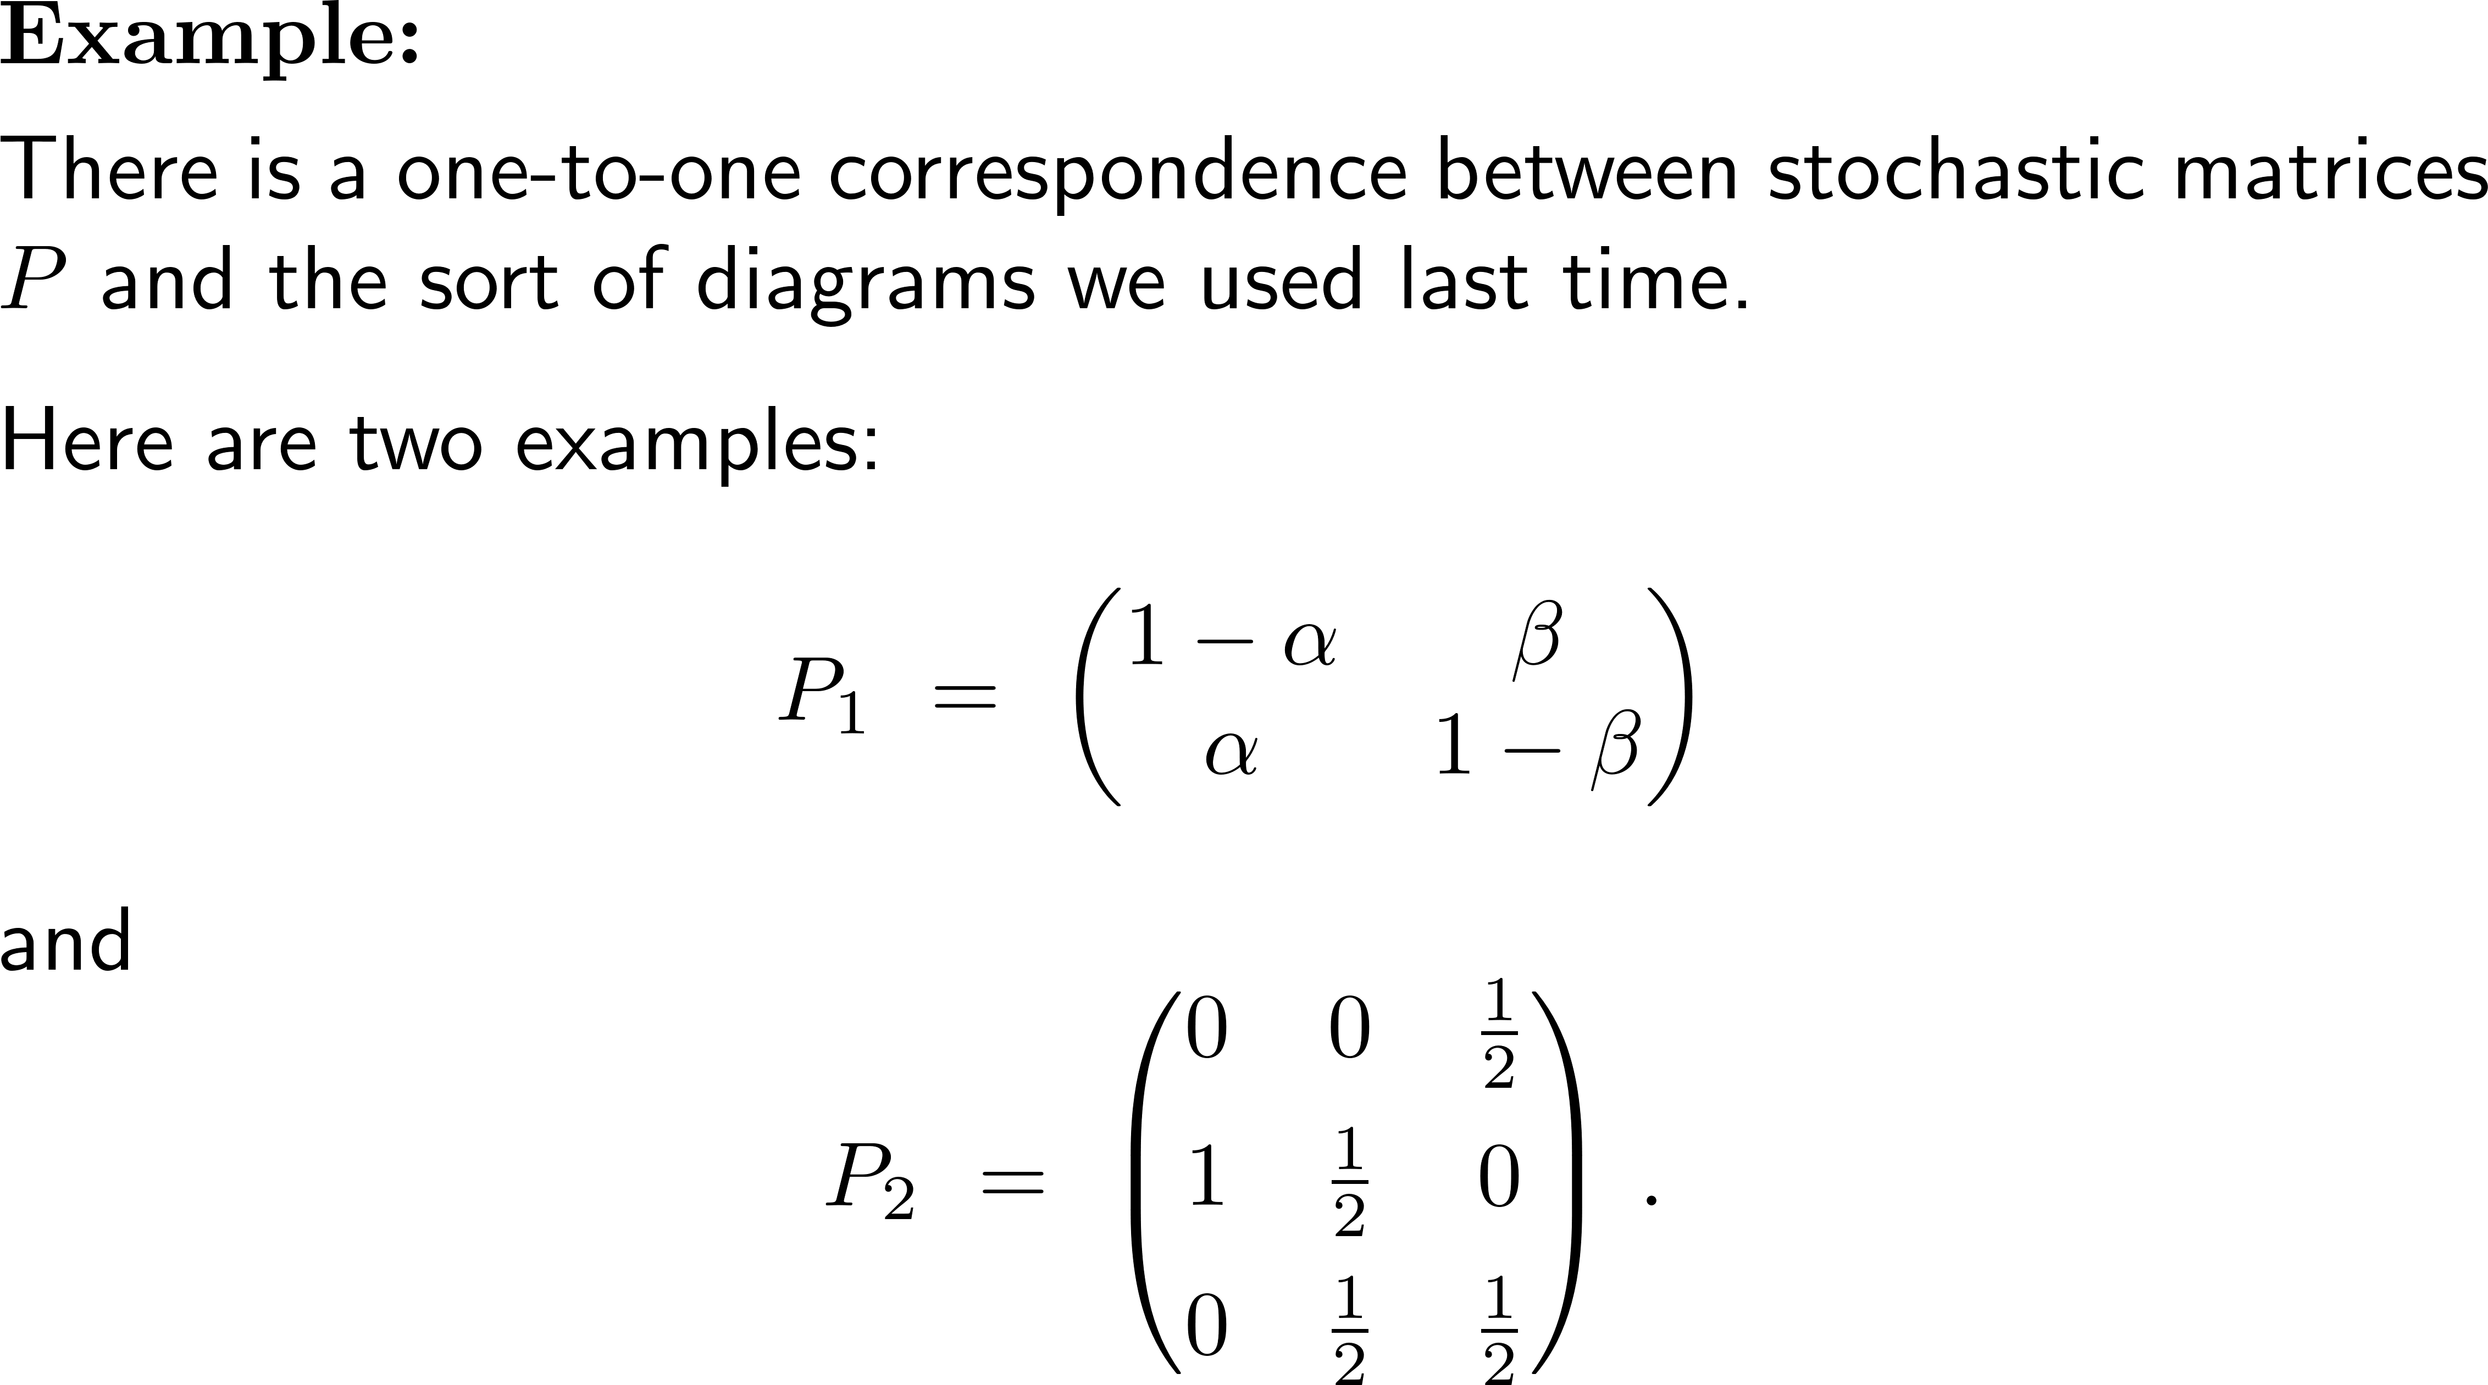
Example: Diagrams and stochastic matrices
1
α
1
2
β
2
1
0.5
1
3
0.5
2

Slide 30
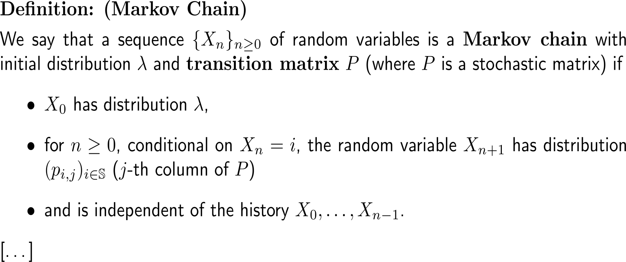
Definition: Markov Chain (1/ 2)

Slide 31
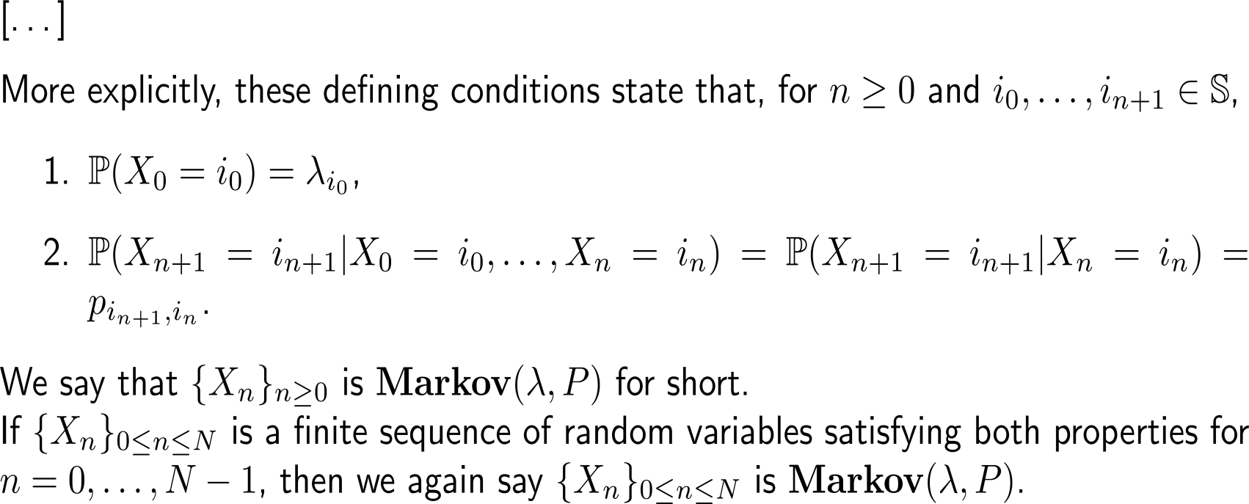
Definition: Markov Chain (2/ 2)

Slide 32
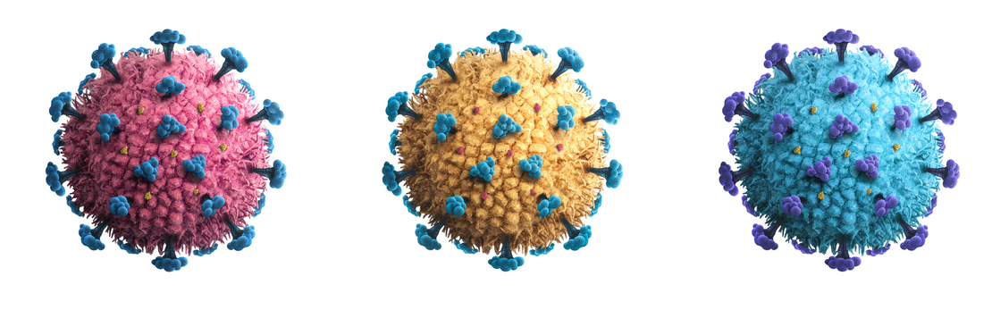
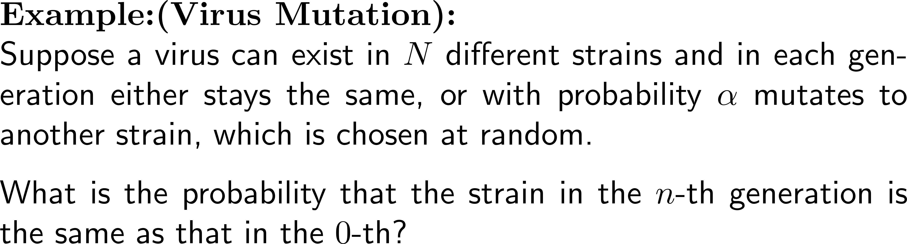


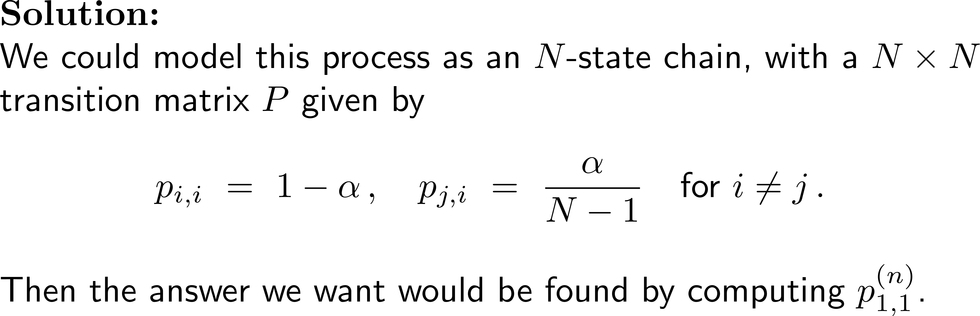
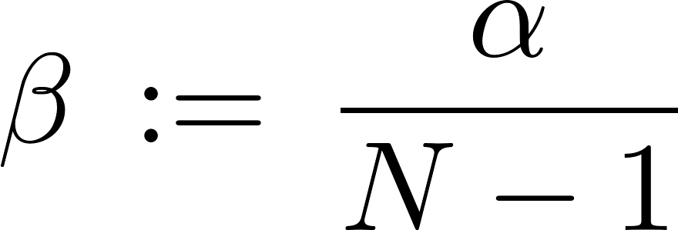
Example: Virus mutation
J.D. Ahlers, I.M. Belyakov (2010): Lessons learned from natural infection: focusing on the design of protective T cell vaccines for HIV/ AIDS, Trends in Immunology, Volume 31, Issue 3, pp. 120–130

Slide 33
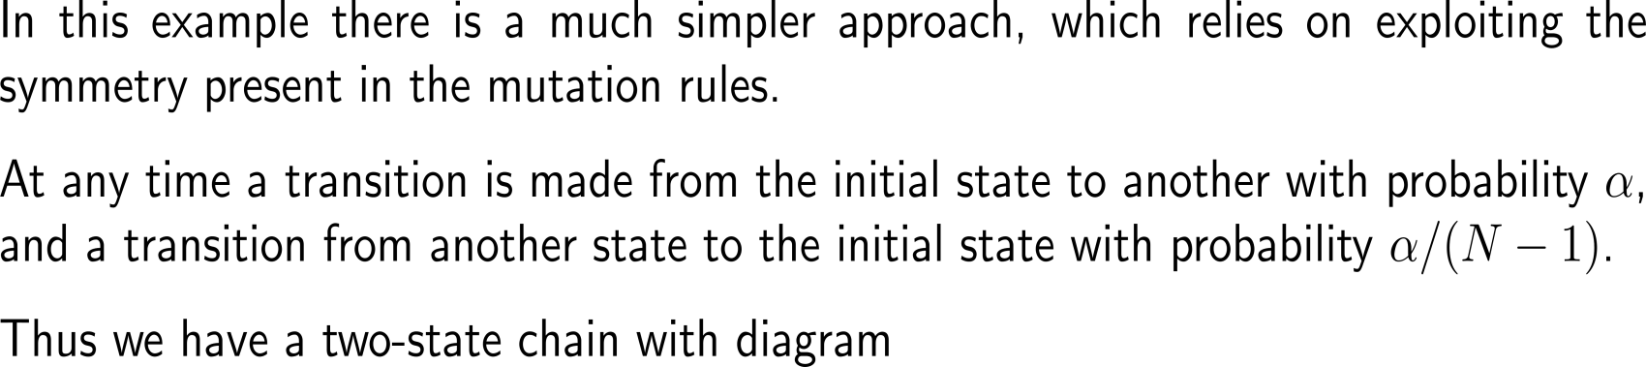
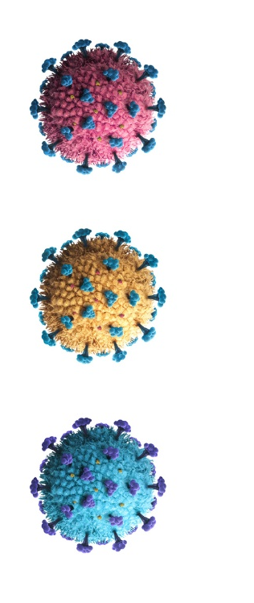

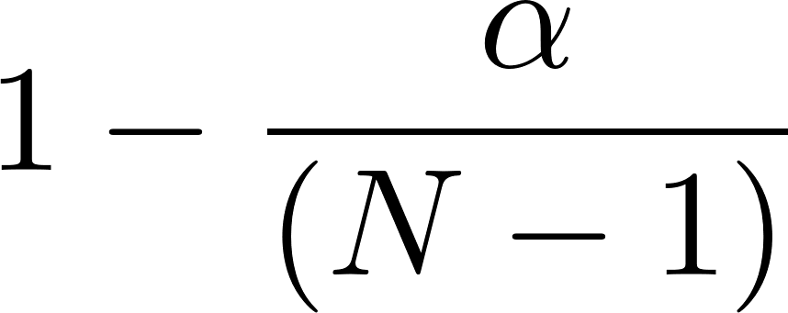
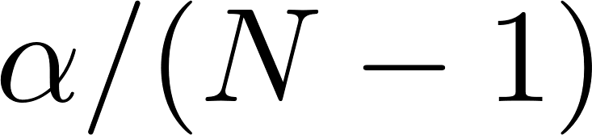
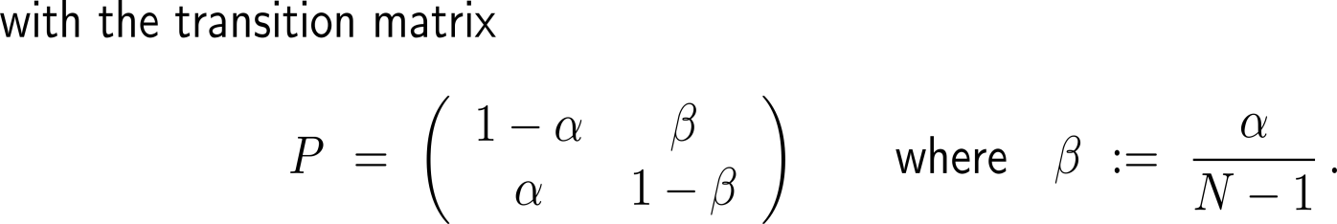
Example: Virus mutation
initial
other

Slide 34
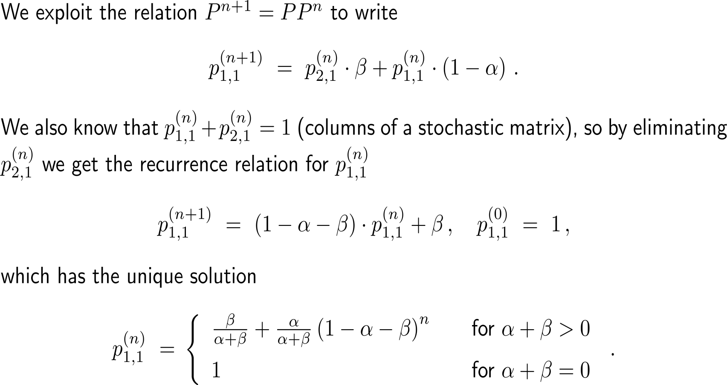
Example: Virus mutation

Slide 35
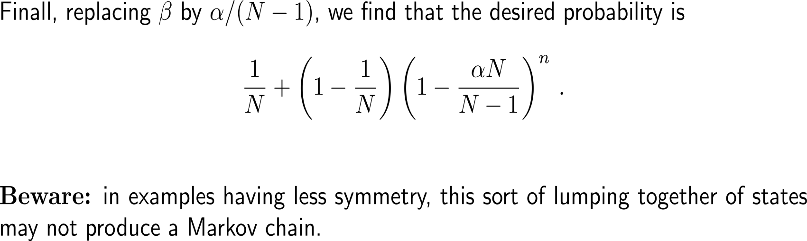
Example: Virus mutation

Slide 36
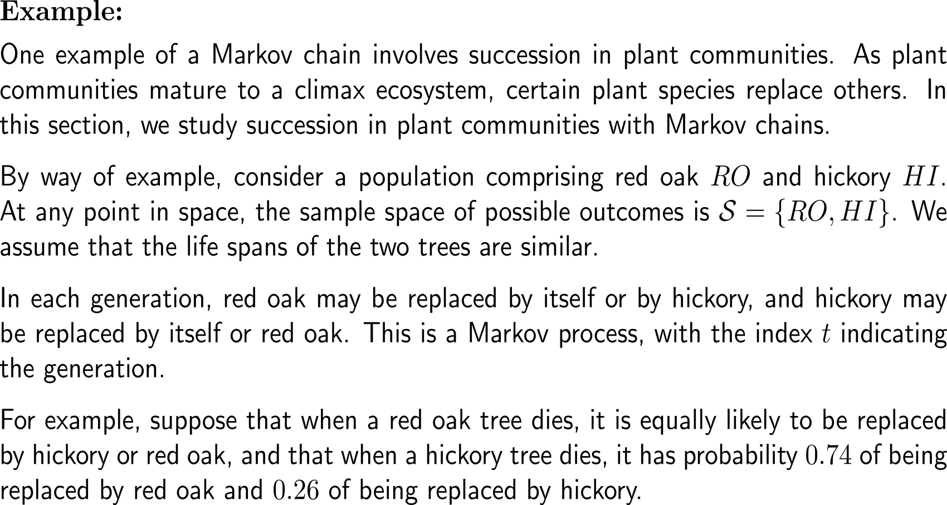
Example [continued]: Markov chain for a forest consisting of two tree species
red oak
hickory

Slide 37
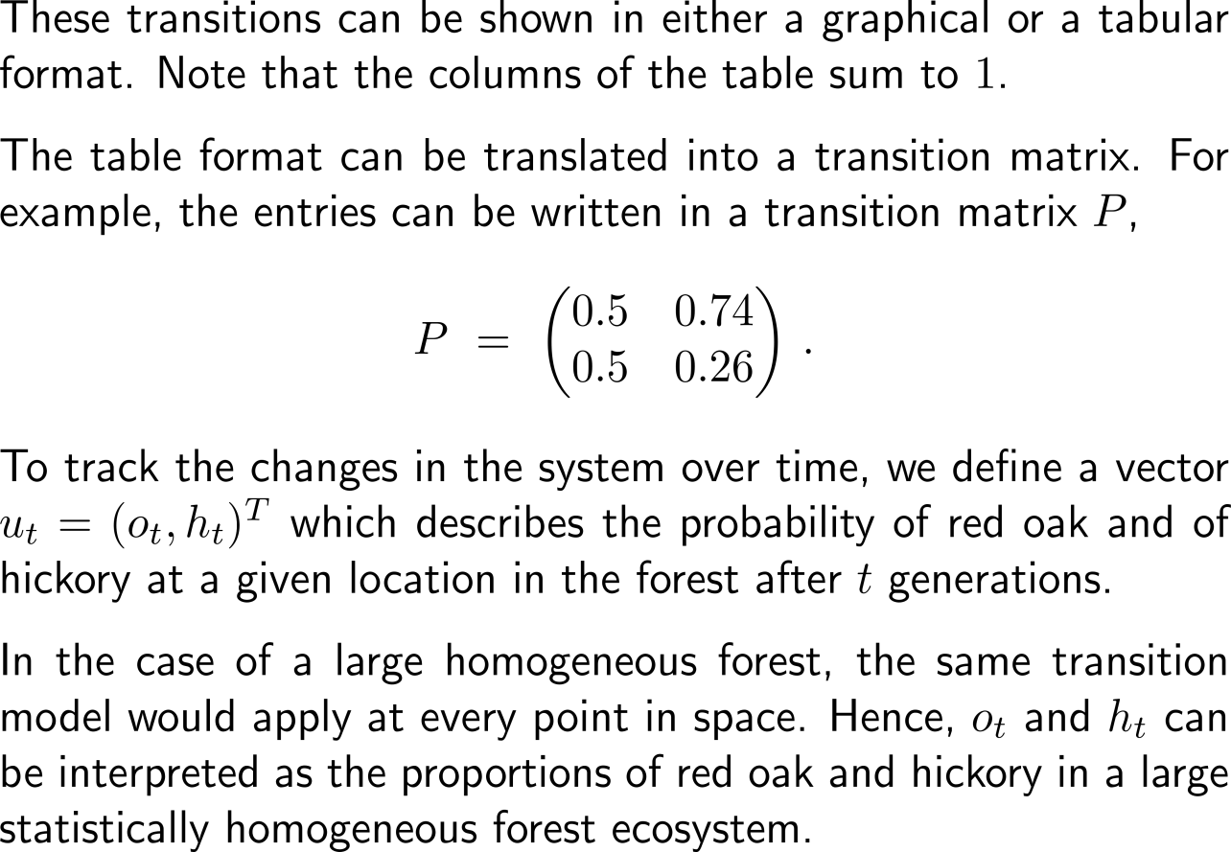
Example: Markov chain for a forest consisting of two tree species
Transitions between red oak and hickory vegetation:
RO
HI
 | Canopy
% Samplings | Red oak | Hickory
Red oak | 0.5 | 0.74
Hickory | 0.5 | 0.26

Slide 38
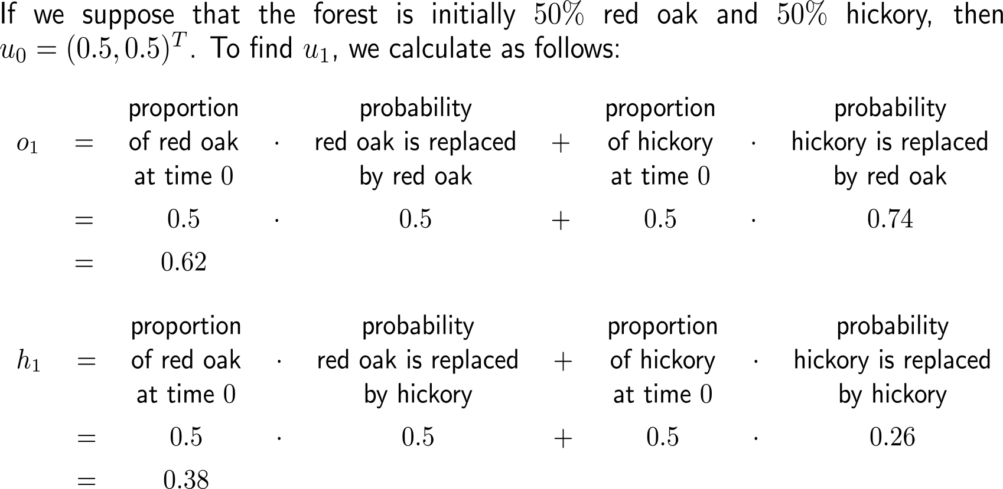
Example: Markov chain for a forest consisting of two tree species

Slide 39
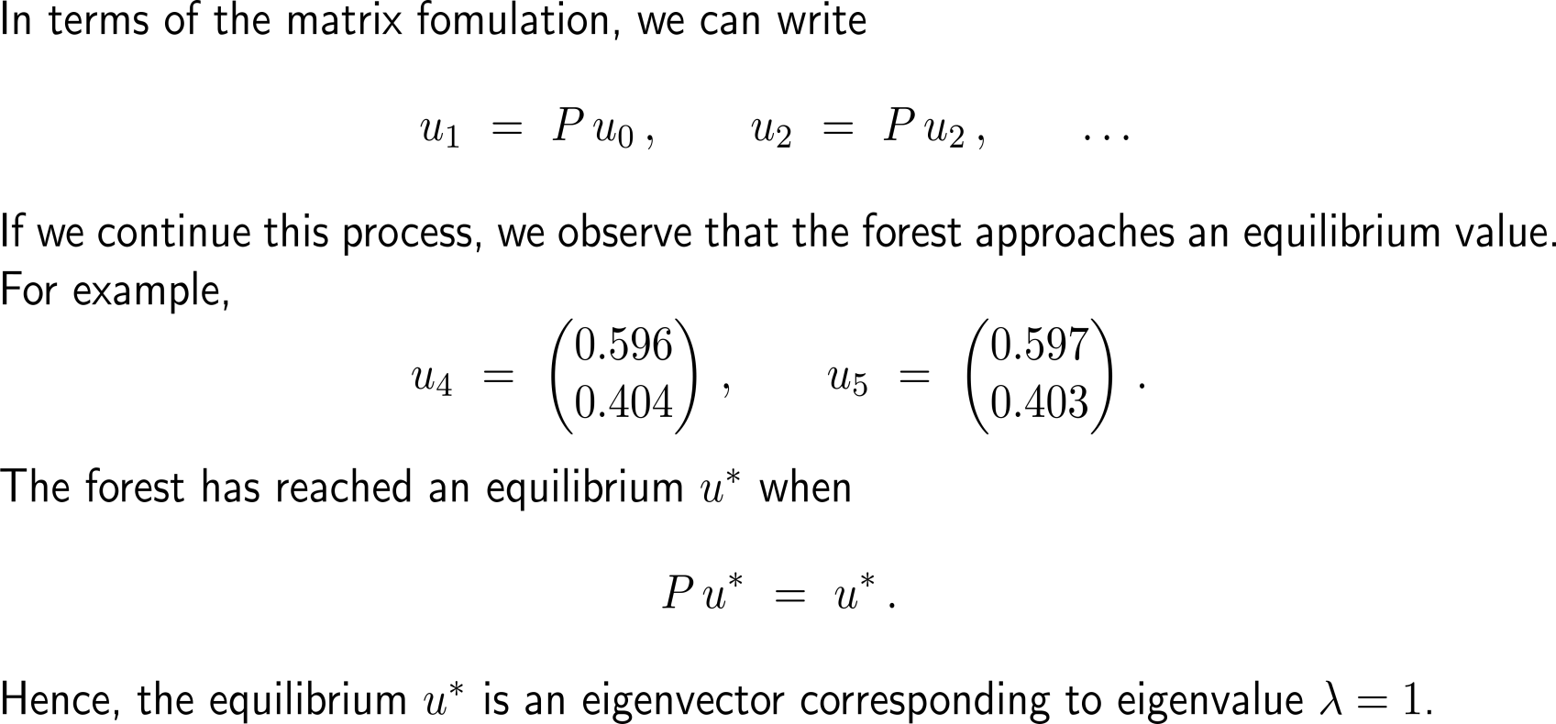
Example: Markov chain for a forest consisting of two tree species

Slide 40
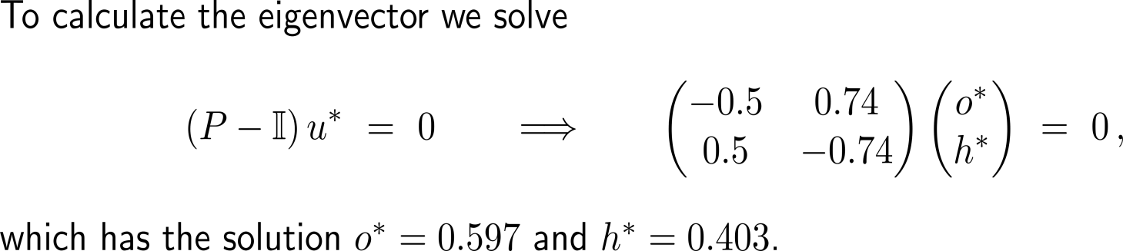
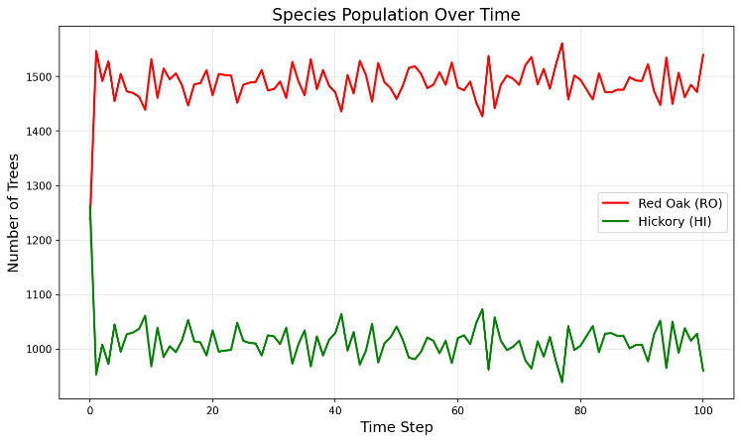
Example: Markov chain for a forest consisting of two tree species
Recall:
Our simulations gave the approximate long-time average of
RO ≈ 1500 (60 %) and HI ≈ 1000 (40 %)

Slide 41
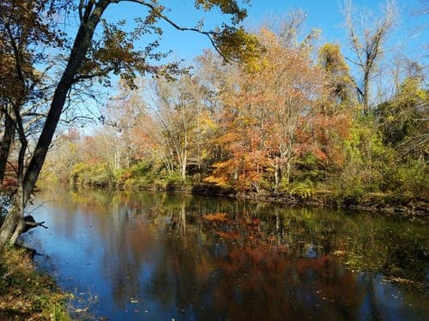
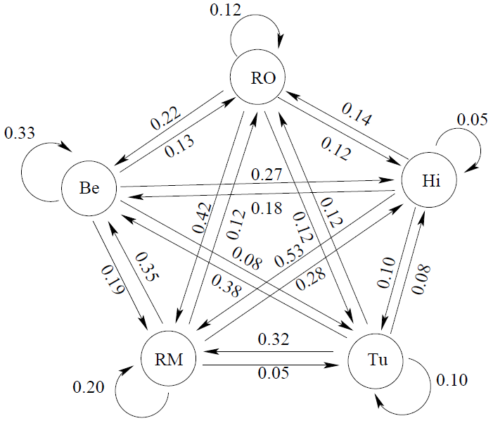
Of course, in a real forest there are more than just two tree species (1/ 2)
In his 1975 article H.S. Horn studied the woods in New Jersey and was able to empirically obtain the replacement probabilities between the 11 key tree species therein.
Based on Horn’s studies, the following table^{*)} provides probabilities for the replacement of existing trees by others:
 | RO | HI | TU | RM | BE
Red oak (RO) | 0.12 | 0.14 | 0.12 | 0.12 | 0.13
Hickory (HI) | 0.12 | 0.05 | 0.08 | 0.28 | 0.27
Tulip tree (TU) | 0.12 | 0.10 | 0.10 | 0.05 | 0.08
Red maple (RM) | 0.42 | 0.53 | 0.32 | 0.20 | 0.19
Beech (BE) | 0.22 | 0.18 | 0.38 | 0.35 | 0.33
^{*)} taken from G. de Vries et al. (2006): A Course in Mathematical Biology, SIAM

Slide 42
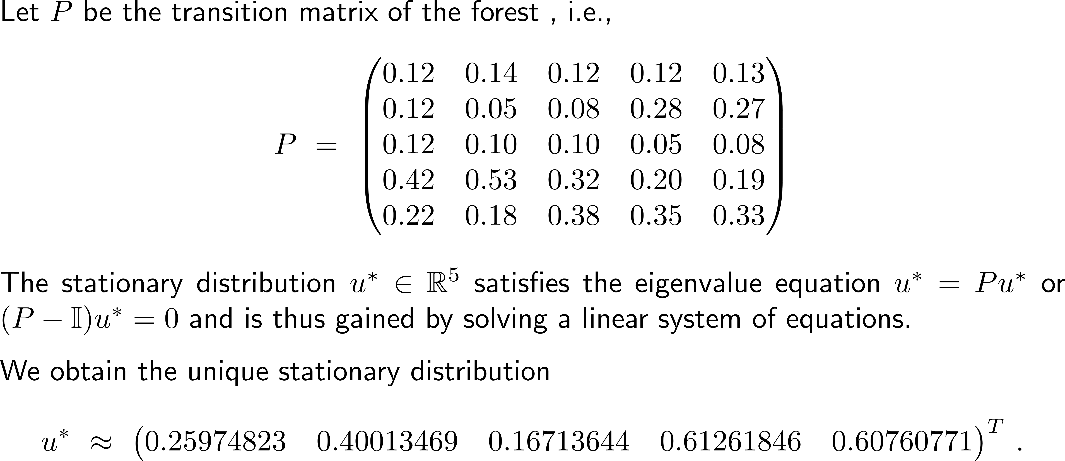
Of course, in a real forest there are more than just two tree species (2/ 2)

Slide 43
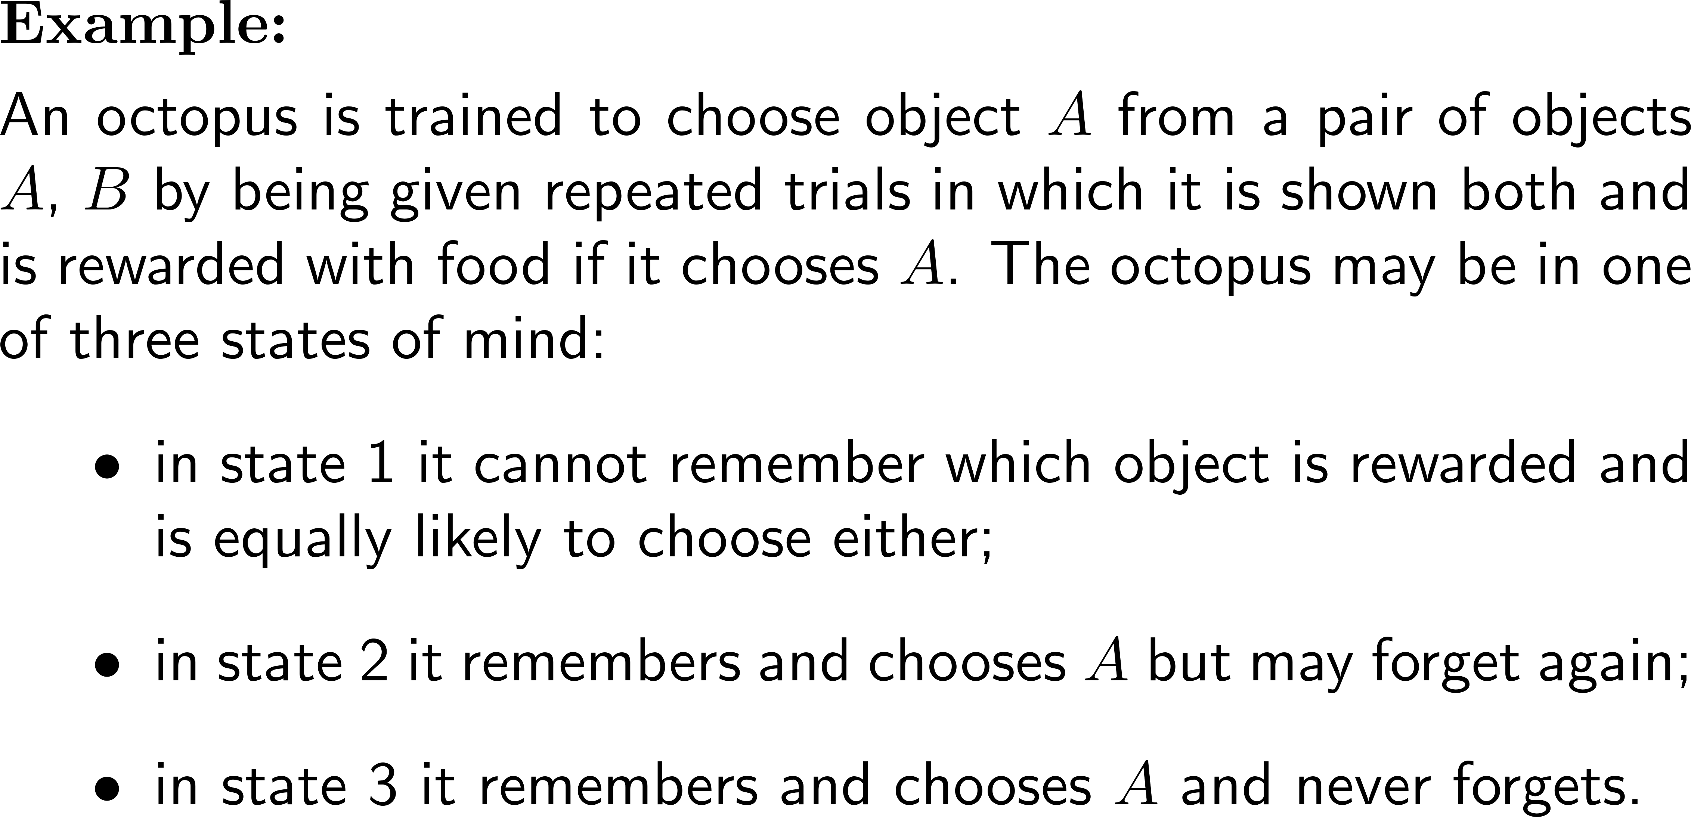
Example: Training of an octopus

Slide 44
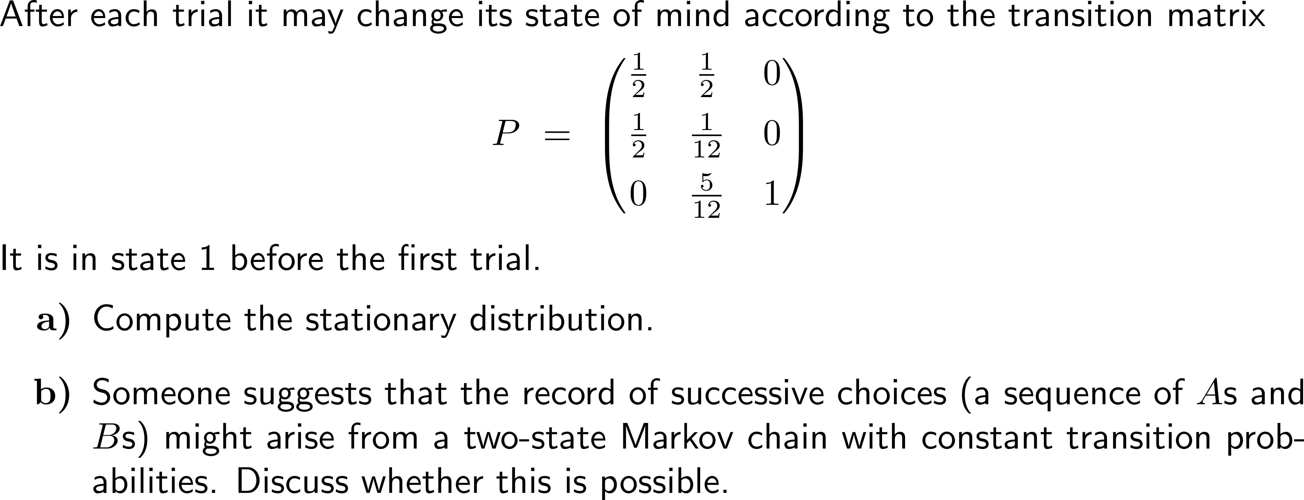
Example: Training of an octopus

Slide 45
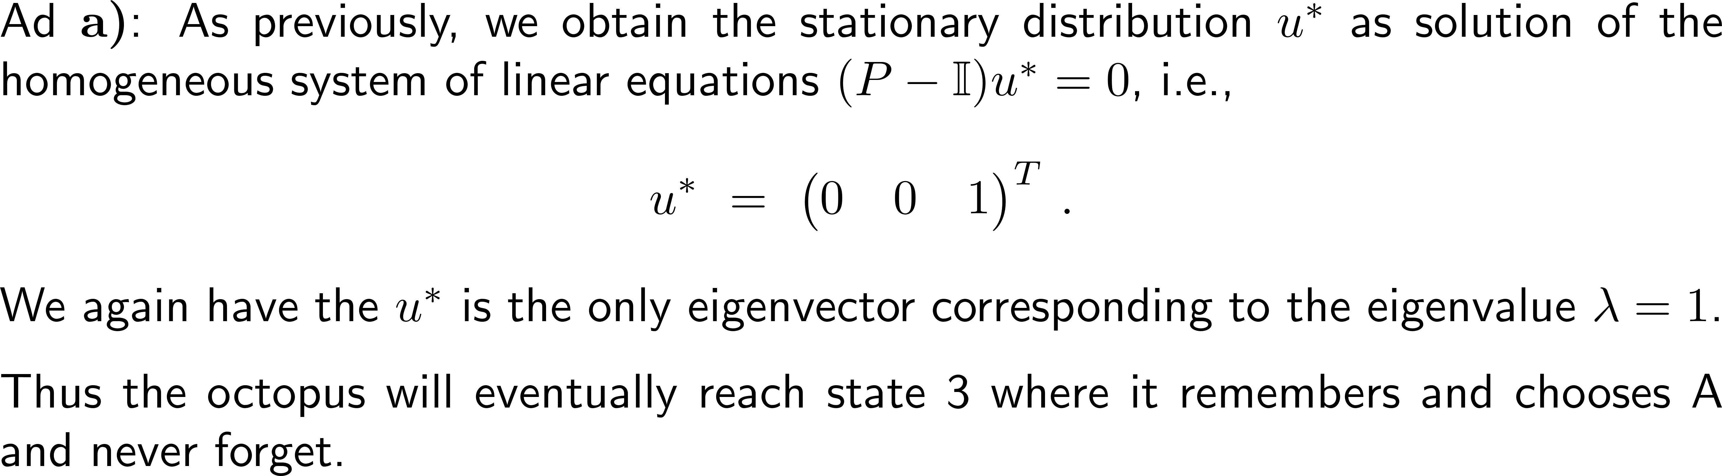
Example: Training of an octopus

Slide 46
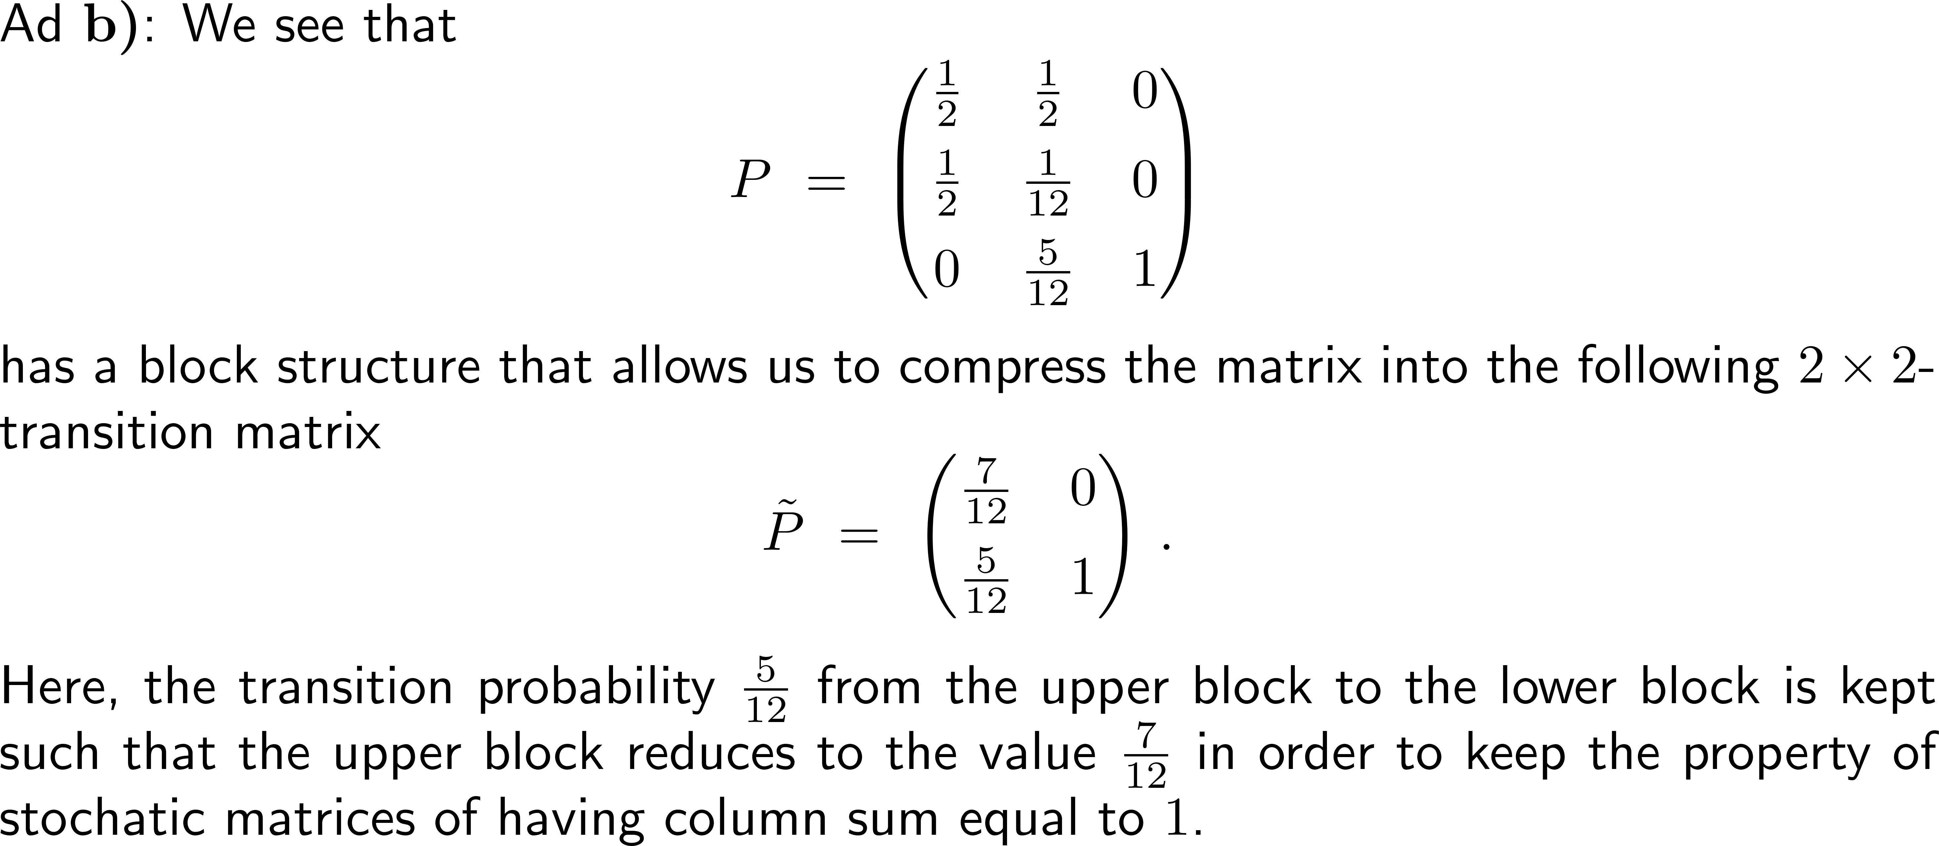
Example: Training of an octopus

Slide 47
Computational Biomathematics
florian.rupp@kiu.edu.ge

