Slide 1
Computational Biomathematics
Mobile Heterogeneous Ecosystems
Lesson 3
Lecture
Deep-dive modeling
Diffusion of ideas or diseases
Mathematical descriptions
On the use of AI in academia and industry

Slide 2
Our interdisciplinary course combines several modeling and analysis approaches to obtain tangible simulations of biological dynamics
Modelling
Biology
Simulation
Discrete
Agent-Based
Monte Carlo
Deter-ministic
Continuous
Random
Ordinary Differential Eq.
Partial Differential Eq.
Modelling, Analysis &
Simulation
Application Orientation
AI Support
Mathematics
Markov Chains
Dynamical Systems
Scientific Computing
Game Theory
Mathematical
Analysis

Slide 3
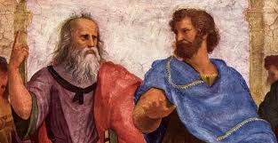
The two standard ways of doing science are the methods of deduction and induction …
The two standard ways of doing science are the methods of
deduction and induction
we use deduction to
derive theorems
from assumptions
we use induction to
find patterns in
empirical data

Slide 4


… and with the advent of highly performing computers, simulation adds as a third way
The two standard ways of doing science are the methods of
deduction and induction
we use deduction to
derive theorems
from assumptions
Simulation
we use induction to
find patterns in
empirical data

Slide 5
One may indeed argue that simulation or agent based modeling is a third way of doing science in addition to deduction and induction
rigorously specified set
of assumptions
controlled computational experiments
generated data by computer-simulations
analysis by
induction
Simulation,
like deduction, starts with a rigorously specified set of assumptions regarding an actual or proposed system of interest,
but, unlike deduction, simulation does not prove theorems with generality.
Instead, simulation generates data suitable for analysis by induction.
In contrast to typical induction, however, the simulated data come from controlled experiments rather than from direct measurements of the real world.
Consequently, simulation differs from standard deduction and induction in both
its implementation and
its goals.
Simulation permits increased understanding of systems through controlled computational experiments.
In particular, agent-based modeling can be used to investigate how macro-level effects and social behaviors arise from the micro processes of interactions among many agents.

Slide 6
Topics
Deep-Dive Modeling
Diffusion of Ideas or Diseases
Mathematical Descriptions
On the Use of AI in Academia and Industry

Slide 7
A successful model is accurate, predictive, reusable, and parsimonious
inputs
system of interest
outputs
outside
The modeling process is considered successful when the obtained model possesses the following four essential characteristics:
Accurate: the model should attempt to accurately describe current existing observations. (Though, models need not match experimental data to be useful.)
Predictive: the model should allow to appropriately predict the behavior of the system (through analysis or simulation) in situations not already observed.
Reusable: the model can be reused in another, similar case.
Parsimonious: the model should be as simple as possible. That is, given competing and equally good models, the simplest is preferred.

Slide 8
The first step (of the iterative modeling process) is to focus on relevant aspects and formulate a conceptual model
Reality
Abstraction & Focus on Key Concepts
Modeling and simulation of reality do not aim to capture every-thing. It is about to distill the key aspects of a certain observed phenomenon and study what essential causes could be assumed or what behavior an abstracted system would yield.
It is first to understand the real situation at hand and ask which phenomenon or sub-phenomenon is to be modeled. The question approach and general procedure for this abstraction process is very similar to the first tow steps in Georg Polya’s framework (see next slide).
The conceptual model can and should be understood as a word problem (an abstracted description of reality) that is now to be put into a formal mathematical model: What are the known data and variables? What are the unknown variables? What names can be assigned to the variables? How are the variables connected? What restrictions are there and can they be met? What are the parameters and their admissible ranges?
Preliminary Conceptual Model
Model Qualification
Conceptual
Model

Slide 9
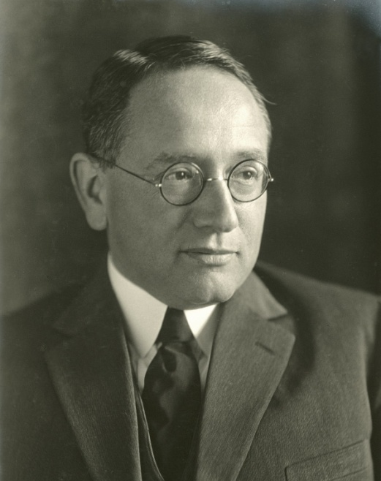
The polish mathematician Georg Polya formulated a comprehensive framework for an iterative problem-solving process
1. Understand the Problem
Can you state the problem in your own words?
What are you trying to find or do?
What are the unknowns?
What information do you obtain from the problem?
What information, if any, is missing or not needed?
1
2
2. Plan
Look for a pattern
Remember related problems
Break the problem down into different parts
Make a table, make a diagram, write an equation
Use a guess and check
Work backward
Identify a sub-goal
4. Reflect
Check the results in the original problem
Interpret the solution in terms of the original problem. Do your answers make sense? Is it reasonable?
Determine whether there is another method of finding the solution
If possible, determine other related or more general problems for which the technique will work
3. Execute
Implement the strategy from step 2 and perform the necessary mathematical computations
Check each step of the plan as you do it
Keep an accurate record of your work and organize your work into easy-to-understand visuals
Double check your math. work
Georg Polya
(19. May 1933 – 9. June 2021)
4
3

Slide 10
The mathematical modeling process (Applied Mathematics)
Model Qualification
Reality
Abstraction & Focus on Key Concepts
Preliminary Conceptual Model
Conceptual
Model
Model
Validation
Mathematical Model
Model
Verification
Model Results
Mathematical Analysis
Testing against
‘New Data’
Interpretation

Slide 11
The modeling and simulation process (Computer Science)
Model Qualification
Reality
Abstraction & Focus on Key Concepts
Preliminary Conceptual Model
Conceptual
Model
Model
Validation
Mathematical Model
Model
Verification
Model Results
Exploration
Simulation & Experiment Design
Computerized Model
Testing against
‘New Data’
Interpretation

Slide 12
The mathematical modeling and simulation process (our understanding: joining forces)
Model Qualification
Reality
Abstraction & Focus on Key Concepts
Preliminary Conceptual Model
Conceptual
Model
Model
Validation
Mathematical Model
Model
Verification I
Model Results
Exploration
Simulation & Experiment Design
Computerized Model
Mathematical Analysis
Model Verification II
Testing against
‘New Data’
Interpretation
Design of Test
Cases

Slide 13
To ensure the credibility of the model, we use model qualification, verification, and validation
Qualification
Verification
Validation
Reality
Conceptual
Model
Reality
Preliminary Conceptual Model
Mathematical Model
Computerized Model
Model Results
The process of determining the degree to which a conceptual model is an accurate representation of the real world from the perspective of the intended uses of the model.
The process of determining that a model implementation (either in terms of a mathematical or a computerized formulation) accurately represents the conceptual description of the model and the so-far known solution to the model.
The process of determining the degree to which a model is an accurate representation of the real world from the perspective of the intended uses of the model.
Compared to qualification, at this stage of the modeling process, qualitative and quantitative measures can be applied.

Slide 14
Topics
Deep-Dive Modeling
Diffusion of Ideas or Diseases
Mathematical Descriptions
On the Use of AI in Academia and Industry

Slide 15
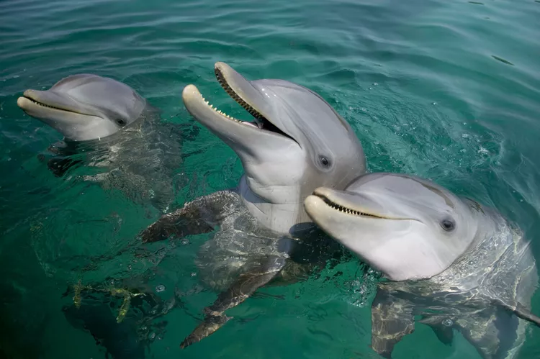

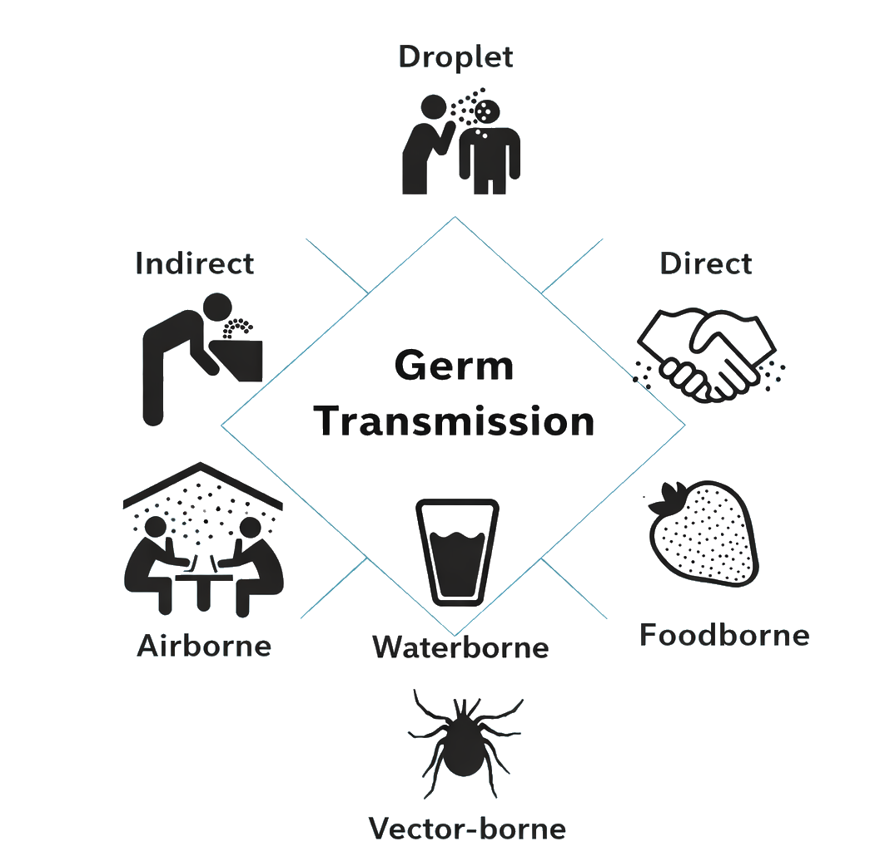
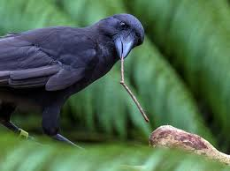
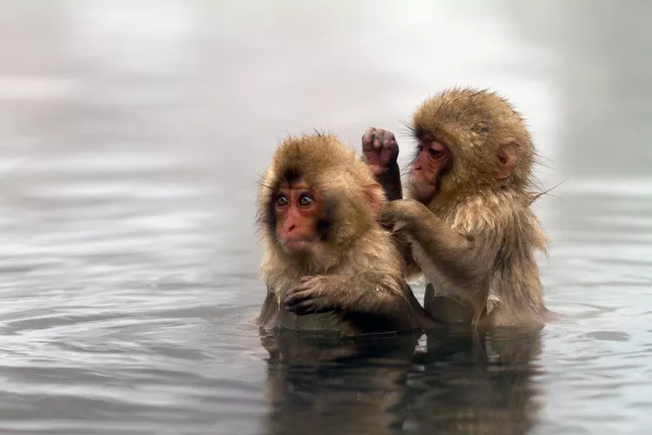
The adoption of new ideas or the infection with a disease can be considered of resulting from an interaction between two individuals
https://www.treehugger.com/cultured-animals-that-share-knowledge-4869231
Transmission of Ideas
Transmission of Diseases

Slide 16
Example: Agent based modelling the diffusion of ideas or diseases
Susceptible
Adopters/ Infected
“infect”
We assume that these two population classes are entirely mixed.
Moreover, we assume that there is no time delay between getting in contact with the new factor and becoming an adaptor/ infected.
become

Slide 17
Example: Agent based modelling the diffusion of ideas or diseases
Susceptible
encounters on a statistical basis
Adopters/ Infected
“infect”
We assume that these two population classes are entirely mixed.
Moreover, we assume that there is no time delay between getting in contact with the new factor and becoming an adaptor/ infected.
become

Slide 18
Example: Agent based modelling the diffusion of ideas or diseases
Susceptible
encounters on a statistical basis
Adopters/ Infected
“infect”
We assume that these two population classes are entirely mixed.
Moreover, we assume that there is no time delay between getting in contact with the new factor and becoming an adaptor/ infected.
become

Slide 19
Example: Agent based modelling the diffusion of ideas or diseases
Susceptible
Adopters/ Infected
… and so on …
“infect”
We assume that these two population classes are entirely mixed.
Moreover, we assume that there is no time delay between getting in contact with the new factor and becoming an adaptor/ infected.
become

Slide 20
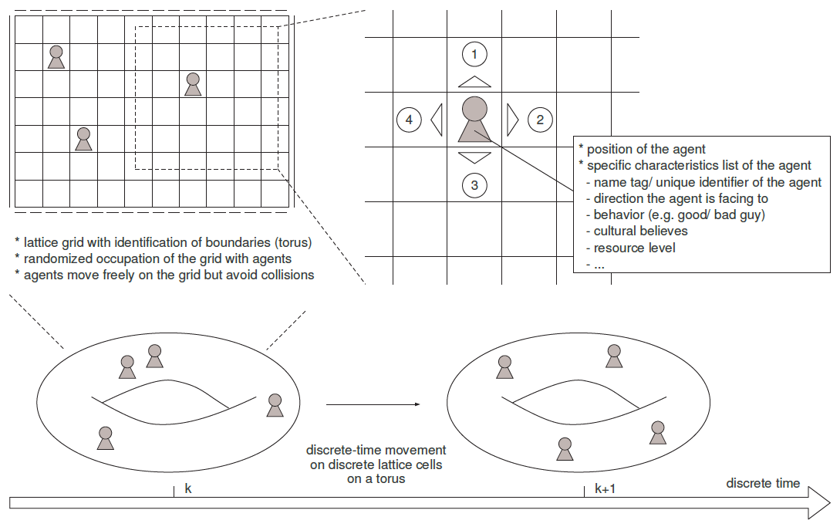
Example: Agent based modelling the diffusion of ideas or diseases
A system consisting of interacting individuals, each with his own characteristics (e.g., cultural values, race, resources), can be simulated using a discrete dynamical system where space, time, and the states of the system are all discrete and have the following properties:
Space is represented by a regular two-dimensional toroidal lattice.
Each site, or cell, in the lattice is in a given state at a given instant of time. The states of lattice sites can be integers, reals, symbols, or strings, as well as tuplets (lists) with elements of any type.
The system evolves over a succession of time steps. The values of all of the sites in the lattice are updated synchronously in each time step.
A site’s value is updated using a set of rules which takes the values of the site and other sites into account.

Slide 21
Example: Agent based modelling the diffusion of ideas or diseases
1. Understand the Problem
Idea:
We re-use the movement dynamics from the Wa-Tor example, and
add new interaction dynamics that capture the spreading of the idea or disease.
Hence, the code structure is basically that of the Wa-Tor example with movement of two species on a toroidal grid (up to the point where interactions are added to the model).
The files corresponding to 02_WaTor.py need to be updated to the new application in terms of susceptible and infected.
Next, the interaction routine needs to be designed and implemented.
disease.py
parameters
seed
2. Plan
initialization.py
3. Execute
dynamics.py
4. Look Back
move-ment
inter-action
visualization.py

Slide 22
Example: Agent based modelling the diffusion of ideas or diseases
1. Understand the Problem
These interaction dynamics are as follows:
If an agent wants to move to an already occupied cell, then an interaction takes place:
if both agents are infected or susceptible, nothing happens; the agents stay where they are and change their direction randomly
if one of the agents is susceptible and the other an adapter/ infected, then by a probability p the susceptible gets an adopter/ infected as well; the agents stay where they are and change their direction randomly
disease.py
parameters
seed
2. Plan
initialization.py
3. Execute
dynamics.py
new
4. Look Back
move-ment
inter-action
visualization.py

Slide 23
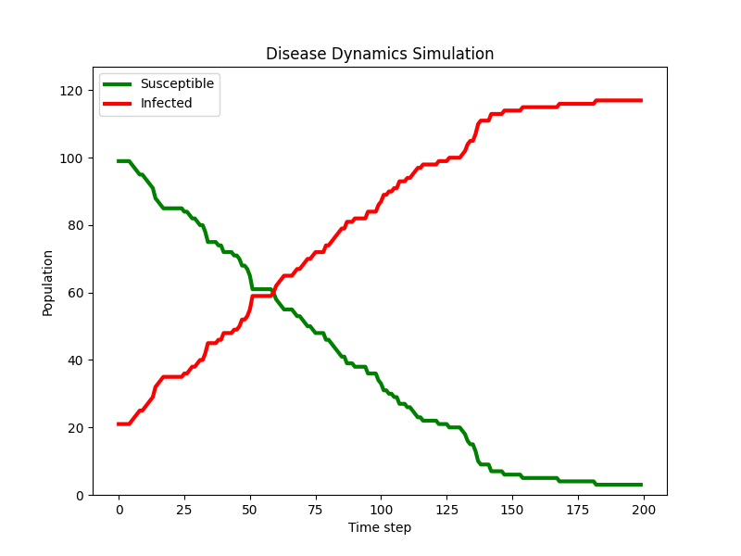
Example: Agent based modelling the diffusion of ideas or diseases
Animation (only 100 steps)
Time series
# Simulation parameters
N = 50 # Size of the lattice
T = 200 # Maximum number of time steps
NS = 100 # Initial number of susceptible individuals
NI = 20 # Initial number of infected individuals
infection_probability = 0.9 # Probability of infection

Slide 24
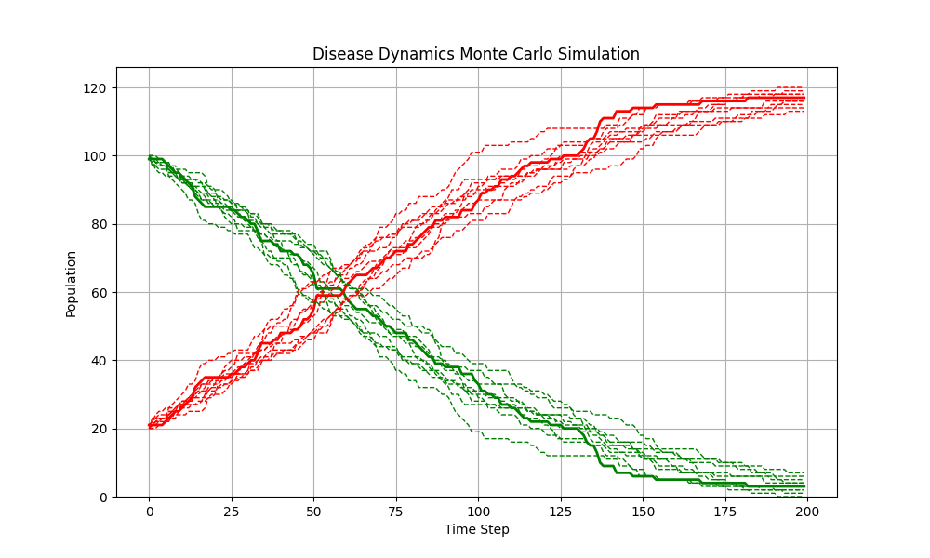
Example: Agent based modelling the diffusion of ideas or diseases
Time series (Monte Carlo with 10 runs)
Remark:
As we are dealing with stochastic processes the display of just one time series may in general not be enough.
To capture the effects of randomness better, one typically performs several simulations runs (with different realizations of the involved random variables).
This is known as Monte Carlo Simulation.
Form a large enough number of simulations, the mean and the variance then can be computed.
For this the plotting routines (and the main routine) need to be updated.
# Simulation parameters (10 Monte Carlo runs)
N = 50 # Size of the lattice
T = 200 # Maximum number of time steps
NS = 100 # Initial number of susceptible individuals
NI = 20 # Initial number of infected individuals
infection_probability = 0.9 # Probability of infection

Slide 25
Topics
Deep-Dive Modeling
Diffusion of Ideas or Diseases
Mathematical Descriptions
On the Use of AI in Academia and Industry

Slide 26
The field of mathematics is more fragmented than we typically view it
Conceptual Understanding
Application Centered Mathematics
Business,
Politics,
the Crafts
Hypothesis-Diven Elicitation
computer-support
Application Oriented Mathematics
Computational
Biomathematics
Pure
Mathematics
the Sciences & the Arts,
Economics, Technology,
…
Modelling & Simulation
Discrete
Applied Mathematics
Deter-ministic
Continuous
Random

Slide 27
The diffusion of ideas or pandemics can be described in terms of different modeling approaches
Word Descriptions
Stochastic Markov Chain Model
Averaged Macro-Scale ODE Model
Agent-Based Modeling
Markovian Birth & Death Processes
Rate of Change Equations
(ODE Model)
Chemical Reaction Kinetics
Density Descriptions
Stochastic Differential Equations

Slide 28
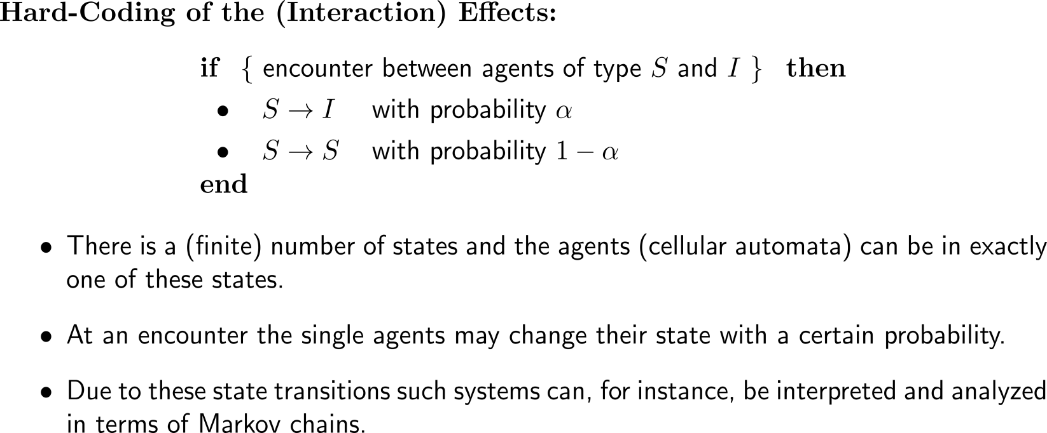
First, we have agent-based modeling (our standard way so far)
Agent-Based Modeling
Chemical
Reaction-Kinetics
Markovian Birth & Death Processes
Rate of Change Equations

Slide 29
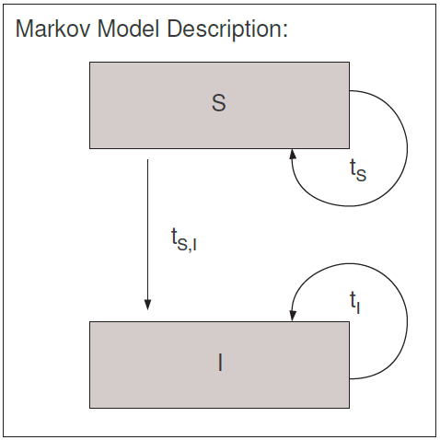
Example: Agent based modeling for the diffusion of ideas or diseases
Ten simulation runs of the diffusion of ideas within a society of 120 agents on a 50x50 toroidal lattice.
We assume a random initial distribution of the agents and initially 100 susceptible and 20 adopters/ infected.

Slide 30
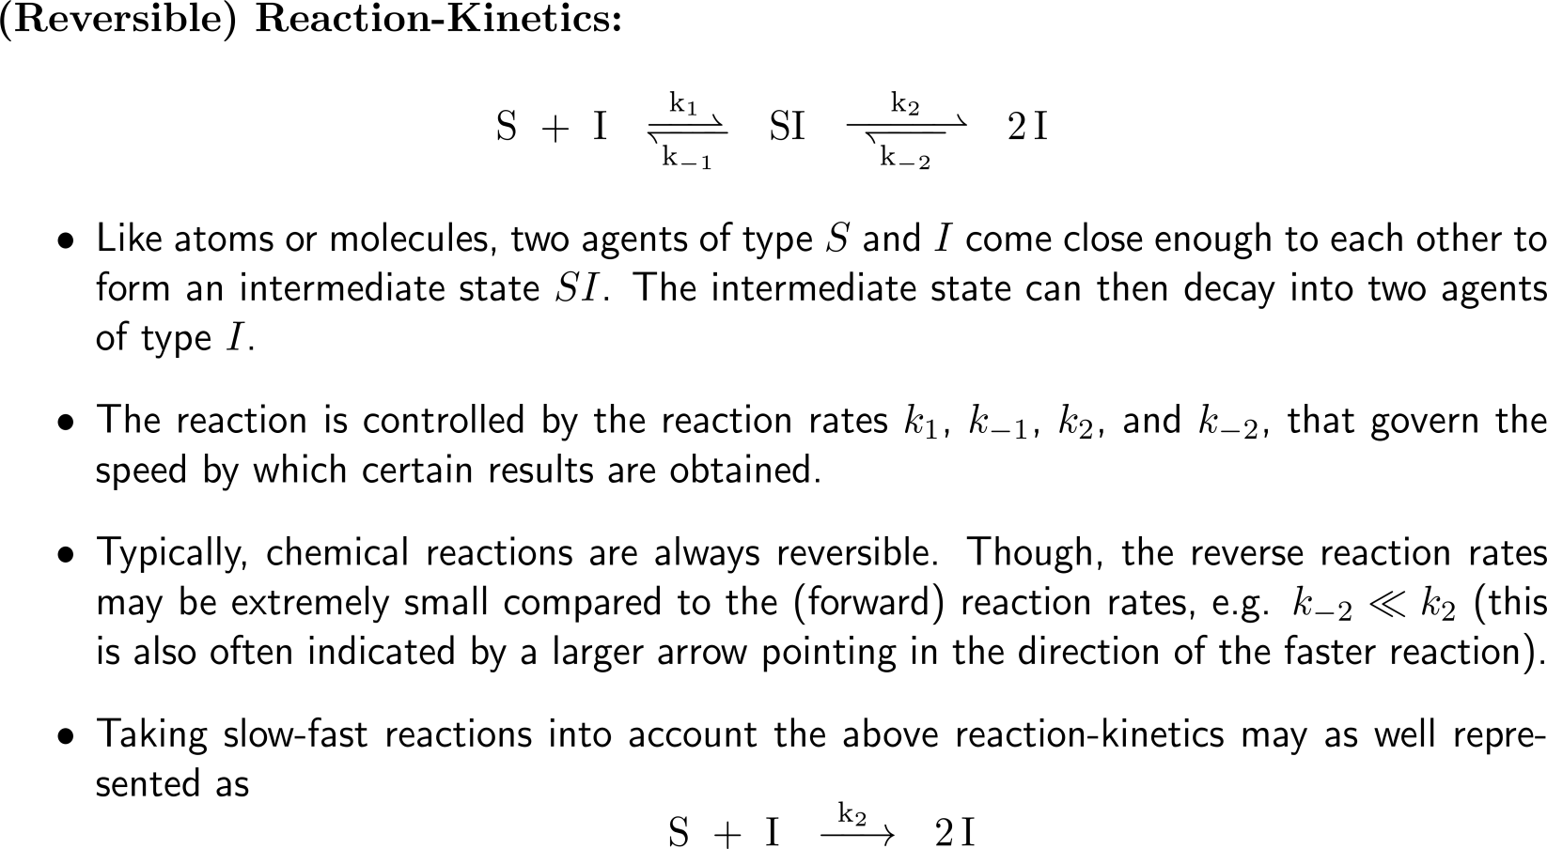
Moreover, we have chemical reaction kinetics, …
Agent-Based Modeling
Chemical
Reaction-Kinetics
Markovian Birth & Death Processes
Rate of Change Equations

Slide 31
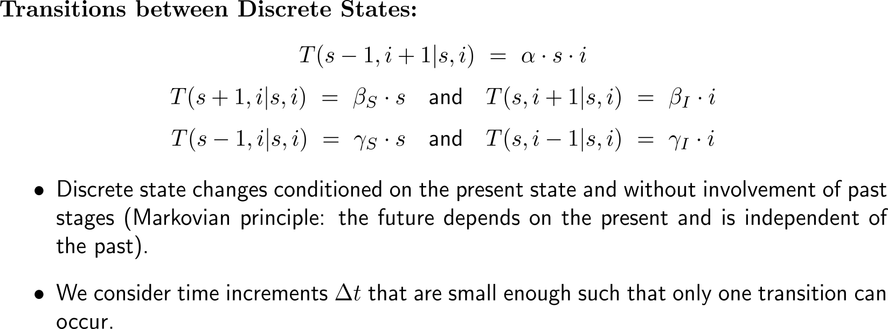
… or Markovian birth and death processes that describe the transitions between discrete states by means of transfer operators
Agent-Based Modeling
Chemical
Reaction-Kinetics
Markovian Birth & Death Processes
Rate of Change Equations
state n’
T(n | n’)
state n
(with a certain population density)
(with a certain population density)

Slide 32
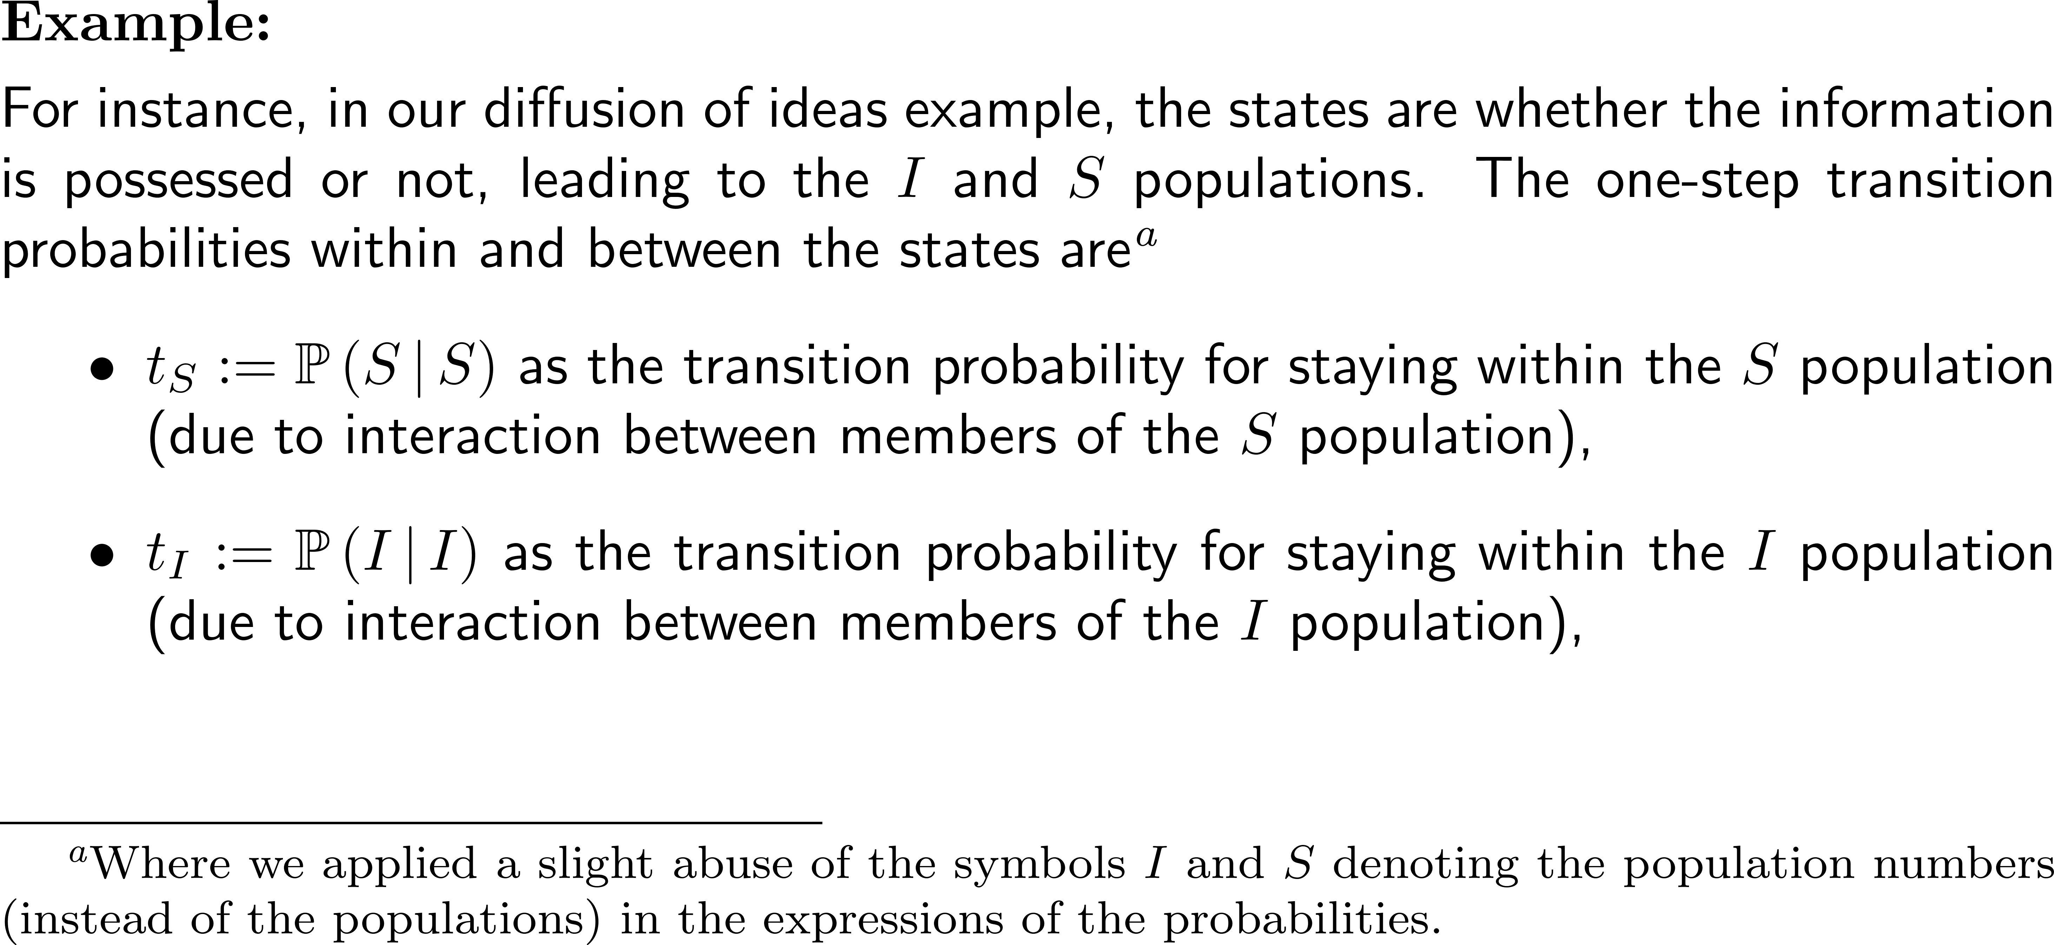
Example: The previous diffusion of ideas example interpreted as a Markov chain

Slide 33
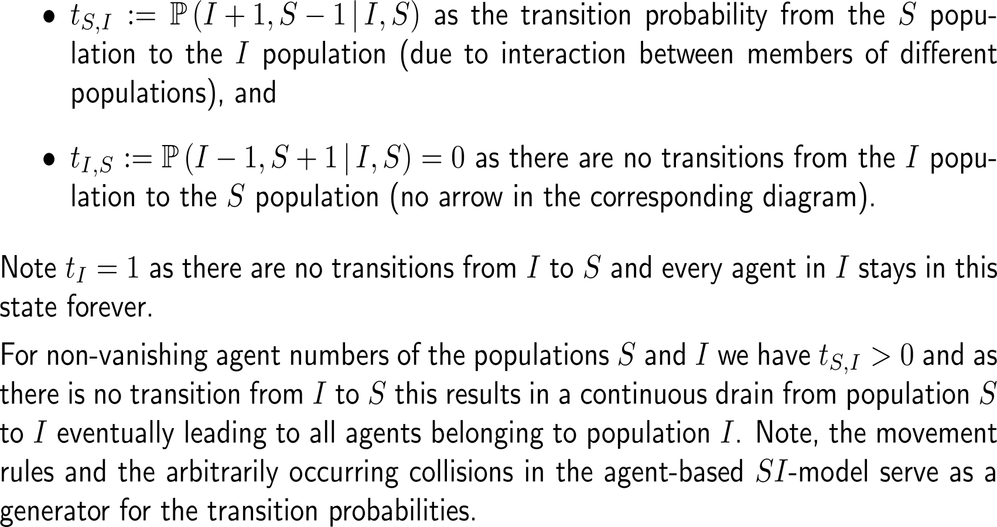
Example: The previous diffusion of ideas example interpreted as a Markov chain

Slide 34
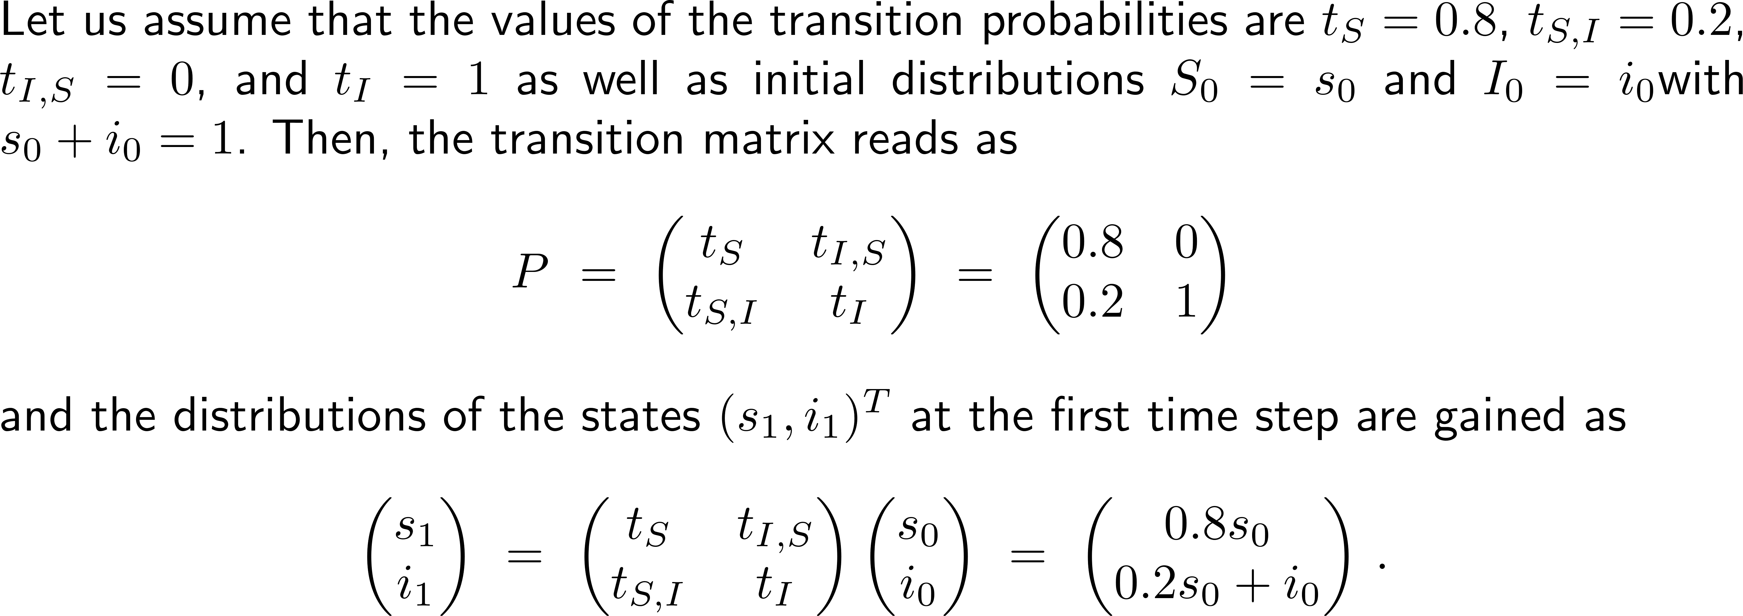
Example: The previous diffusion of ideas example interpreted as a Markov chain

Slide 35
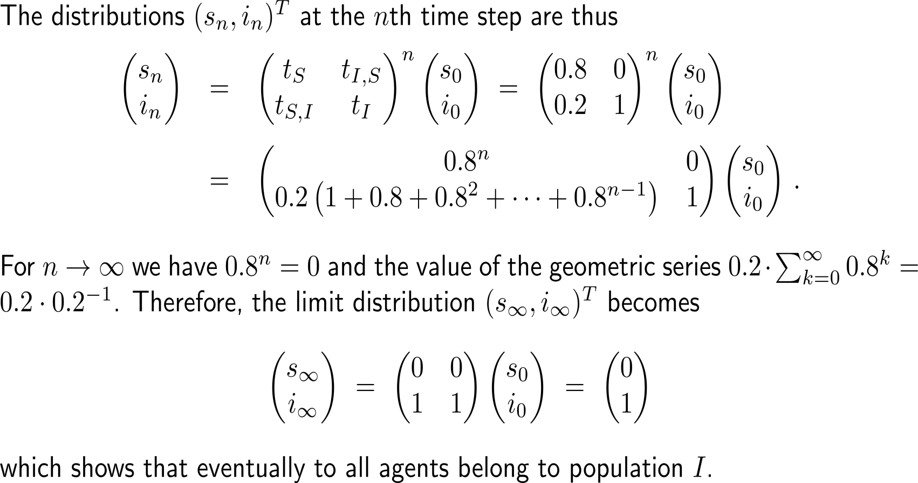
Example: The previous diffusion of ideas example interpreted as a Markov chain

Slide 36
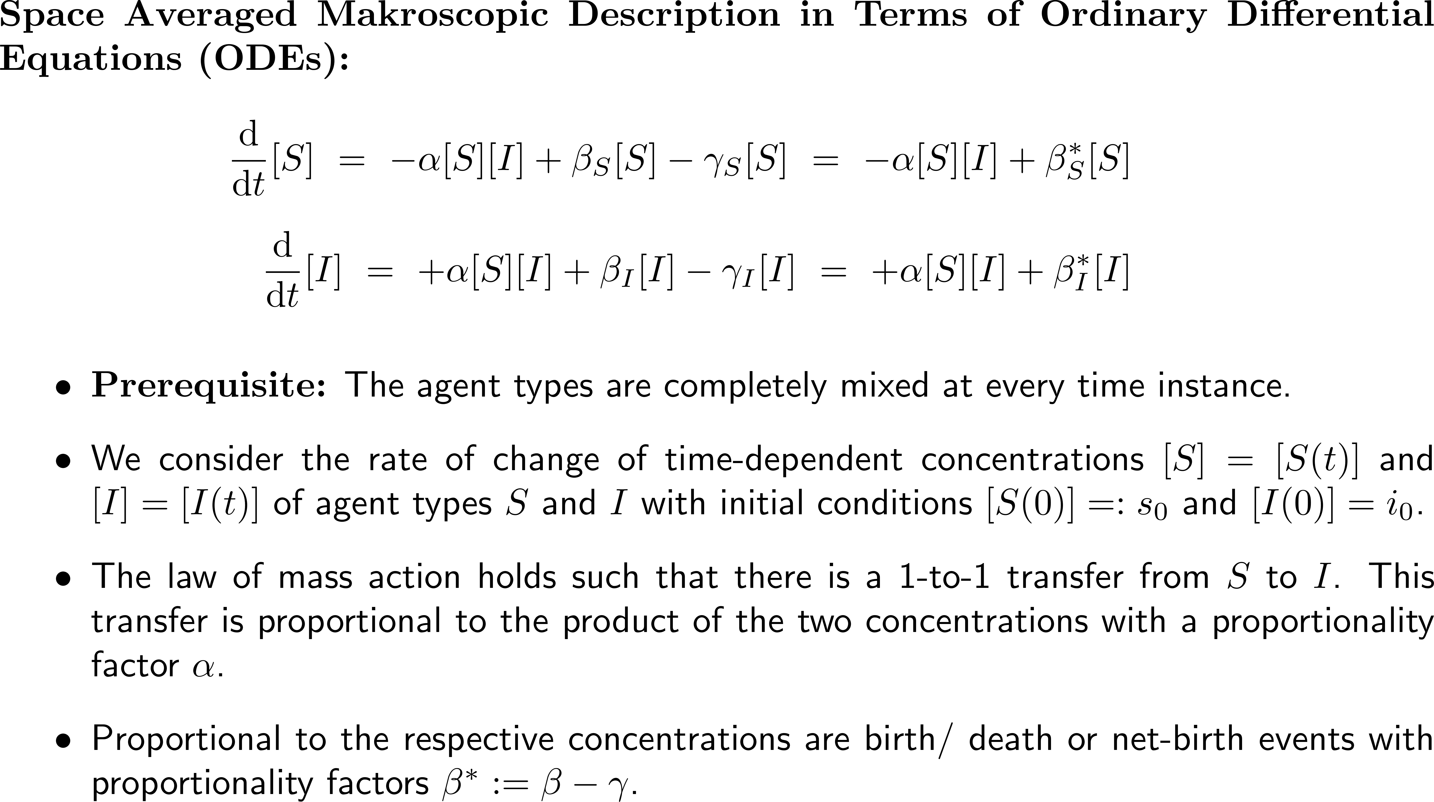
Finally, we have rate of change equations
Agent-Based Modeling
Chemical
Reaction-Kinetics
Markovian Birth & Death Processes
Rate of Change Equations

Slide 37
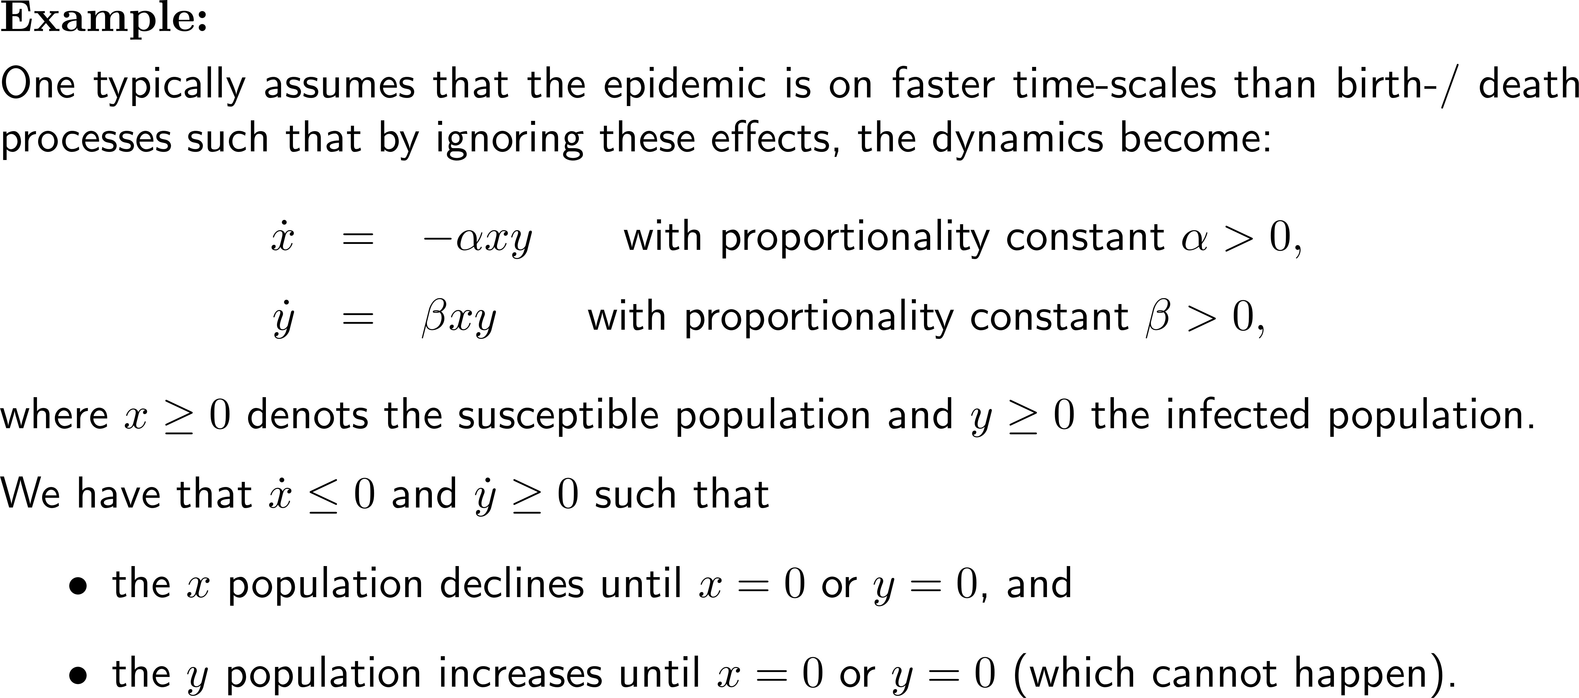
Example: SI-dynamics by ODEs

Slide 38
Topics
Deep-Dive Modeling
Diffusion of Ideas or Diseases
Mathematical Descriptions
On the Use of AI in Academia and Industry

Slide 39
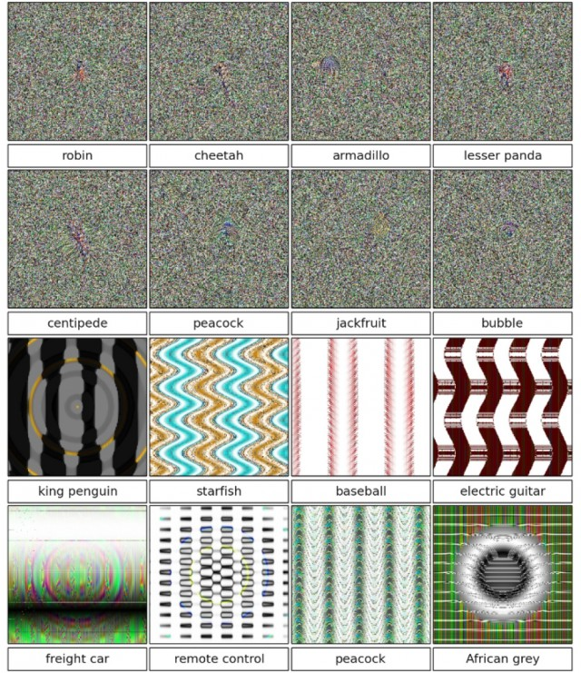
How trustworthy are AI tools? 1) AI is not learning data as we do
A study, carried out by researchers at the University of Wyoming, took one of the best deep neural networks (DNN) – AlexNet – and proceeded to trick it into incorrectly identifying all sorts of weird patterns.
The point of the study was to prove that we really shouldn’t rely on these modern – and seemingly very accurate – computer vision systems.
Humans and computers see things in very different ways, and it’s clearly very easy to fool a computer into seeing something that isn’t actually there.
A. Nguyen, J. Yosinski & J. Clune (2015): Deep Neural Networks are Easily Fooled: High Confidence Predictions for Unrecognizable Images, arXiv:1412.1897, https://arxiv.org/abs/1412.1897
https://www.extremetech.com/extreme/195789-bad-news-future-computers-are-easily-tricked-by-optical-illusions-too

Slide 40

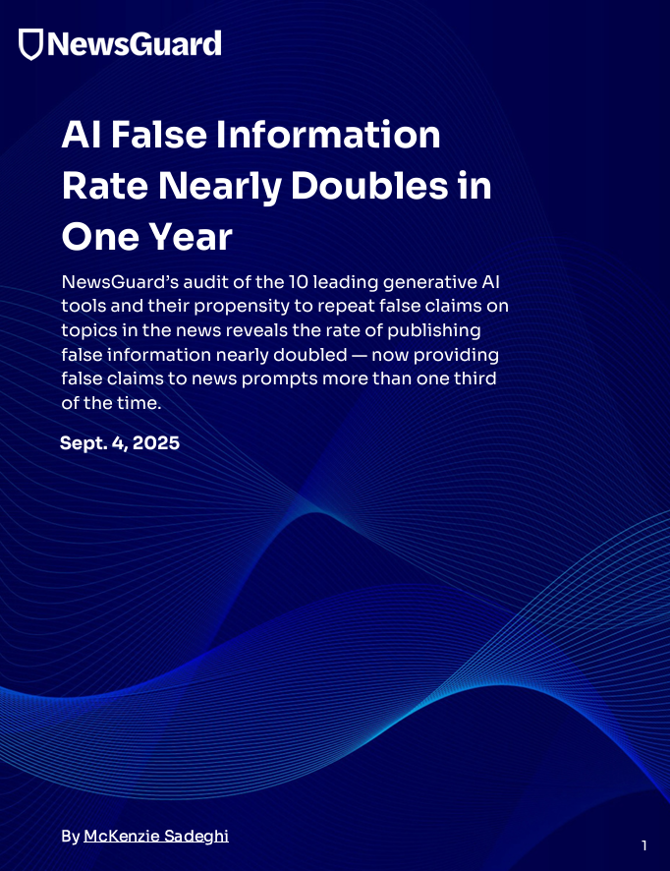
How trustworthy are AI tools? 2a) False information based on (uncontrolled) input data
NewsGuard (2025): AI False Claims Monitor One Year Progress Report, Sept. 4, 2025
“The 10 leading [generative] AI tools repeated false information on topics in the news[, i.e., were unable to distinguishing facts from falsehoods]. When it comes to providing reliable information about current affairs, the industry’s promises of safer, more reliable systems have not translated into real-world progress. […] Instead of citing data cutoffs or refusing to weigh in on sensitive topics, the LLMs now pull from a polluted online information ecosystem — sometimes deliberately seeded by vast networks of malign actors, including Russian disinformation operations — and treat unreliable sources as credible.”

Slide 41
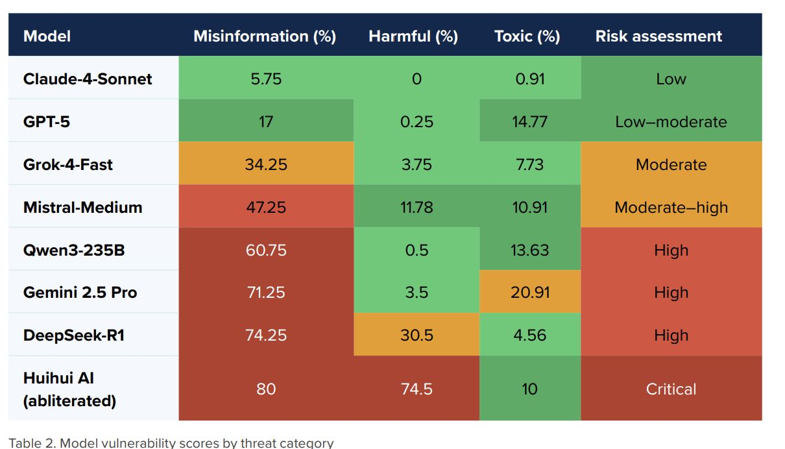
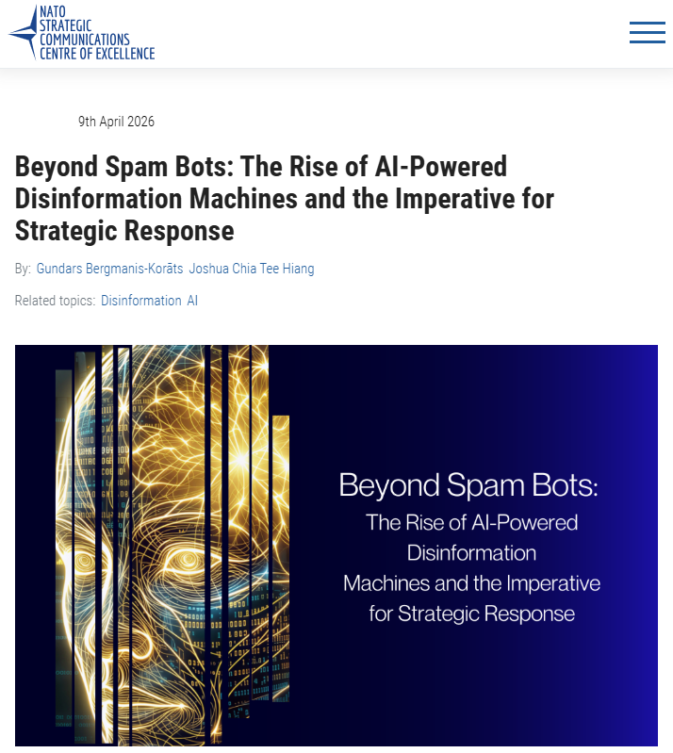
How trustworthy are AI tools? 2b) False information and toxicity
https://stratcomcoe.org/publications/beyond-spam-bots-the-rise-of-ai-powered-disinformation-machines-and-the-imperative-for-strategic-response/342

Slide 42
When using AI, there are some rules of conduct that need to be kept in mind (1/ 2)
Just because a text is generated in your ChatGPT feed doesn’t mean it belongs to you. Legally speaking, that’s not how authorship works. From a legal perspective, copyright requires human authorship.
Hence, if a text is produced entirely by AI, without meaningful human involvement, you cannot claim copyright over it (i.e., you’re not supposed to submit it as your own work.
Though, what does “meaningful human involvement”? Unfortunately, there’s no clear answer.
But two situations are very clear:
You wrote everything yourself then you own the copyright
The AI wrote everything and you just checked it then the work doesn’t belong to you, and you’re not allowed to submit it as yours
And in between, there is a grey zone.

Slide 43
When using AI, there are some rules of conduct that need to be kept in mind (2/ 2)
The following practices are (currently) generally acceptable:
Writing your own draft and using AI to improve clarity or style
Using AI for grammar and copy editing
Asking AI for feedback or alternative phrasings
Using AI to brainstorm ideas or as a conversational partner
The following situations are more problematic (your contribution becomes questionable):
Letting AI generate entire sections or a full paper
Only lightly editing AI-generated text
Letting AI figure out your argument for you

Slide 44
Generating text: Some acceptable applications of AI in academia and industry …
October 2025
Remarks:
AI should support your thinking process, not replace it, which keeps your work original and honest.
Choose tools that give you the most control over the writing.
If an AI tool creates content, always disclose it.
If it checks or organizes, you are generally safe.
When uncertain, err on the side of caution.
Elicit (for upfront literature research):
Provides systematic literature review
Can work with sources that you find
Screens web for new research on a topic
Notion AI (for planning and structure):
Helps organize research (progress monitoring), arguments and sections
Should never draft your content
Use for outlining only
DeepL (for translation):
Maintains academic tone
Outperforms standard translation tools
Essential for non-native English speakers
Quillbot (for light paraphrasing only):
Refines awkward sentences
Avoids unintentional plagiarism
Never use for entire paragraphs
Grammarly (with full disclosure):
Polishes language to professional standards
Detects subtle errors
Must be acknowledged in your paper
Hemingway Editor:
Enhances clarity and readability
Especially scientific editors appreciate concise writing
No risk of detection
https://www.linkedin.com/posts/emmanueltsekleves_i-tested-12-ai-writing-tools-over-3-months-activity-7380218818280824832-eN8_/
?utm_source=share&utm_medium=member_android&rcm=ACoAAA93DcoBVk4d6pjq_0qnUcbHddt0OTf4VtI

Slide 45
… and some not acceptable ones (i.e., AI tools that put your academic reputation and career at risk)
October 2025
Remarks:
AI is a collaborator, not a ghostwriter. The distinction between assisting and authorship defines academic integrity.
Don’t touch LLMs. Use these tools only for editing and structure, never for writing the actual content or ideas.
ChatGPT (or similar for full text generation):
Editors and your super-visors spot AI-generated prose instantly
Immediate grounds for rejection
Claude (for academic writing):
Text may appear polished, but patterns are detectable
Editors and your super-visors are trained to notice
Perplexity (without transparency):
Lacks proper referencing
Raises ethical red flags
Any undisclosed AI-generated content:
Breaches publication ethics
Can result in permanent blacklisting
https://www.linkedin.com/posts/emmanueltsekleves_i-tested-12-ai-writing-tools-over-3-months-activity-7380218818280824832-eN8_/
?utm_source=share&utm_medium=member_android&rcm=ACoAAA93DcoBVk4d6pjq_0qnUcbHddt0OTf4VtI

Slide 46
Two aspects to avoid legal issues: checking for plagiarism and being transparent in AI use
If you use AI for writing academic papers, here are two things you should definitely do to avoid legal issues:
Check for plagiarism:
AI models are trained on existing texts. They can reproduce phrases or structures that are too close to existing work. If you don’t check carefully, you may unintentionally infringe someone else’s copyright and face legal consequences.
Be transparent about AI use:
Most journals now expect disclosure. Policies vary, and some editors (especially for books) may prohibit AI use entirely. So before submitting anything, make sure to check the journal’s guidelines.
The same holds when submitting project, B.Sc., M.Sc., PhD theses or any other university exam related work.

Slide 47
Computational Biomathematics
florian.rupp@kiu.edu.ge

