Slide 1
Computational Biomathematics
Applications of Multi-Agent Ecosystem Modeling & Simulation
Lesson 4 (part 1)
Lecture
Loss of alpha-predators
Effects of invasive species
A trisexual nematode
Tobacco plant & insect dynamics

Slide 2
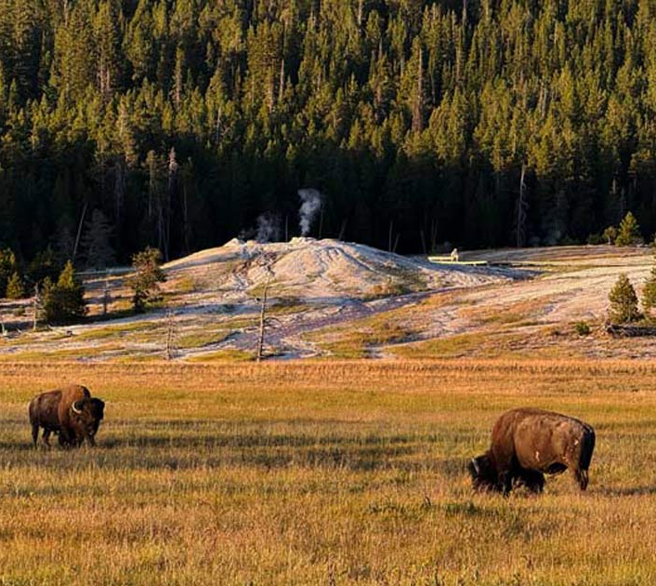
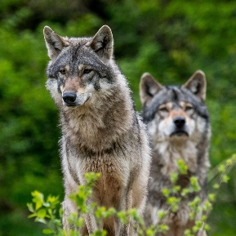
Topics
Loss of Alpha-Predators
Effects of Invasive Species
A Trisexual Nematode
Tobacco Plant & Insect Dynamics
Yellowstone National Park

Slide 3
How wolves became gardeners
https://herofortheplanet.org/wolf-coexistence/explore/yellowstone-without-wolves/
By the mid-1900’s (grey) wolves had been nearly eliminated from Yellowstone National Park. In 1995, the park moved forward with a plan to reintroduce wolves to the area.
Biologists assumed that the new wolve population would of course affect the food chain and lead to impacts on the total number of prey species.
What they observed was even more interesting: groves and other collections of trees and bushes started to emerge, and forests expanded boundaries while the percentage of grassland declined a bit. This transformation seemed to bring the park back to a state before seeing wolves as unwanted animals and hunting them by purpose.
The park concluded that wolves kept large herbivores, like bison, from grassing too long at one spot and hence suppressing the growth of larger bushes and trees. The bison started to move around the park more to avoid being to close to wolves.
Yellowstone National Park

Slide 4
The conceptual model: Multi-agent design (1/ 3)
1. Understand the Problem
Movement Rules: We assume that
there are two species interacting: wolves (W) and bison (B),
the geography is represented by a toroidal lattice with two distinct cell types: grass land (G) and forest (F),
bison moves only in and between grassland cells, whereas wolves can move in and between all two cell types,
movement is, if only permitted, north, east, south, or west, and
generally, at most one wolf or at most one bison can occupy a permitted cell, if at one time step there are more than one individual are occupying a cell then this needs to be resolved before the next time step.
2. Plan
3. Execute
grass land
4. Look Back
forest

Slide 5
The conceptual model: Multi-agent design (2a/ 3)
1. Understand the Problem
Interaction Rules: We assume that
wolves are not actively hunting bison (due to easier prey available), though, they randomly move between cells every k^{th} time step and thus induce bison movement.
wolves do not move on a cell that is occupied by another wolve, if all neighboring cells are occupied by wolves no movement is conducted.
if a wolf enters a cell occupied by bison, all bison will randomly move toward other cells that are not occupied by any wolf.
grassland cells have 10 stages: 0 – 9 pure grassland and 10 emerging forest, the grassland states are affected by the occupation of bison (see table). 0 is the least possible state (overgrazing) and 10 the maximal possible state.
Change of Grassland Cell Stage (from one time step to the next)
Change | Criterion
-2 | bison within the cell
+1 | no bison within one cell
2. Plan
3. Execute
4. Look Back

Slide 6
The conceptual model: Multi-agent design (2b/ 3)
1. Understand the Problem
[cont.]
stage 10 grassland cells can become forest cells (see table).
bison move according to grassland rules:
bison do not move on a cell already occupied by a wolve
bison move to better grassing grounds if the grassland cell they occupy has stage less than 4, i.e., to those neighboring grassland cells with stages higher than or equal to 4.
if there is no such cell in their neighborhood then they move to the next best permitted cell and if all permitted cells have the same stage as the one they occupy then the move by random to any one of the permitted neighboring cells.
Forest Conversion (ecological memory)
stage increases/ decreases deterministically, and conversion only after staying at stage 10 for m = 20 consecutive steps.
2. Plan
3. Execute
4. Look Back

Slide 7
The conceptual model: Multi-agent design (2c/ 3)
1. Understand the Problem
[cont.]
Bison move according to social rules:
if at the end of a time step a cell is occupied by more than one bison, then a random asynchronous movement to neighboring permitted cells is started (the last bison stays at the cell):
priority is given to bison moving to unoccupied permitted neighboring cells,
if these do not exist then bison move to that neighboring cell that is occupied by the least number of other bison (break ties randomly)
Bison Movement Prioritization
Wolve escape Grassland rules (better feeding conditions) Social rules (keep number of bison at one per cell)
2. Plan
3. Execute
4. Look Back

Slide 8
The conceptual model: Multi-agent design (3/ 3)
1. Understand the Problem
Update/ Time-Evolution Rules:
Random initialization of NB bison and NW wolves (such that permitted cells are occupied only).
During each simulation time step:
count current occupancy
move wolves only if current time step is a multiple of k
detect cells where wolves and bison coincide and force bison escape from wolf-occupied cells
asynchronously move remaining bison according to better grassland rule and social rule
update grassland stages from local bison pressure and convert eligible stage-5 grassland to forest
record metrics and optionally render
Bison Movement
candidate cells are von Neumann neighbors that are grassland score each candidate by number of bison already there move to one of the highest-scoring candidates break ties randomly
2. Plan
3. Execute
Bison Escape
for each bison in a wolf-occupied cell, search neighboring grassland cells without wolves if several exist, choose randomly if none exist, stay put
4. Look Back

Slide 9
To support AI-assisted coding, we use a very modular program structure
setup.py
Yellowstone/
script that automatically creates all the folders and files (correct names, but empty)
main.py
config/
README.md
__init__.py
requirenments.txt
initialization.py
visualization/
config.py
model/
__init__.py
analysis/
movement.py
plot.py
__init__.py
interactions.py
animation.py
__init__.py
grid.py
update_rules.py
metrics.py
environment.py
tests/
simulation.py
monte_carlo.py
agents.py

Slide 10
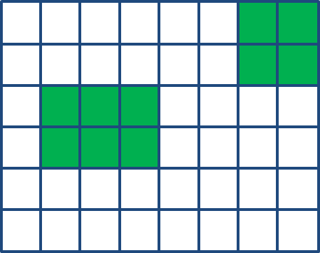
Here, the single files contain the information necessary to simulate the Yellowstone model (1/ 2)
main.py
config/config.py
config/initialization.py
model/grid.py
model/environment.py
Main file
supported by
README.md
requirenments.txt
Stores:
grid size nx, ny
bison & wolve numbers wolf movement period k
overgrazing threshold values
random seed
simulation length
visualization interval
Stores:
initial pattern of forest cells
initial grassland stage values
Handles the toroidal lattice:
wrap-around indexing (toroidal movement)
neighborhood queries
valid movement targets
helper functions, like
wrap_position or
get_von_neumann_ neigbours
Stores habitat and vegetation state:
cell type: “grass” or “forest”
grassland stage
logic for converting grassland to forest
counting occupancy per cell
model/agents.py
model/movement.py
model/interactions.py
model/update_rules.py
Defines the agent classes:
Bison
Wolf
Each agent should at least store:
id
cell number where it is
a simple move history for diagnostics
Pure movement logic:
bison movement rules
wolf movement rules
selecting candidate cells
random tie-breaking
Implements cross-species effects:
check whether wolves occupy a bison cell
bison escape
ensure escape targets are wolf-free
bison attraction toward bison-rich cells
Updates environment after movement:
count bison per grassland cell
apply stage change:
-1 if more than 20 bison,
0 if 1-20 bison, and
+1 if 0 bison
clamp grassland stage to [0,5]
convert stage-5 grassland to forest under the condition from your model interpretation

Slide 11
Here, the single files contain the information necessary to simulate the Yellowstone model (2/ 2)
model/simulation.py
visualization/plot.py
vis…/animation.py
analysis/metrics.py
Central orchestrator:
initialize environment and agents
run time loop
call movement, interactions, updates
collect statistics
Static plots:
habitat map
grassland-stage heatmap
bison density map
wolf positions
Animation of the system over time.
Computes time series such as:
total number of forest cells
mean grassland stage
number of overgrazed cells
mean bison cluster size
number of wolf-bison encounters
spatial dispersion index of bison
ana…/monte_carlo.py
Monte Carlo simulation runs for different numbers of wolves to get their impact
Minimal Parameter Set:
NX = 40
NY = 40
N_BISON = 250
N_WOLVES = 8
WOLF_MOVE_PERIOD = 4
N_STEPS = 300
INITIAL_GRASS_STAGE = 3
STAGE5_TO_FOREST_DELAY = 3
RANDOM_SEED = 42
Experiments:
wolves act as ecosystem engineers by changing bison space use,
not necessarily by directly killing them
No wolves vs. wolves: Does forest recover more with wolves being present?
Different wolf movement periods: How much disturbance is needed to prevent overgrazing?
Low vs high bison numbers: Is there a threshold where vegetation collapses?
Strong vs. weak bison sociality: Does tighter herding worsen overgrazing?
Different forest-conversion rules: How sensitive is reforestation to ecological memory?

Slide 12
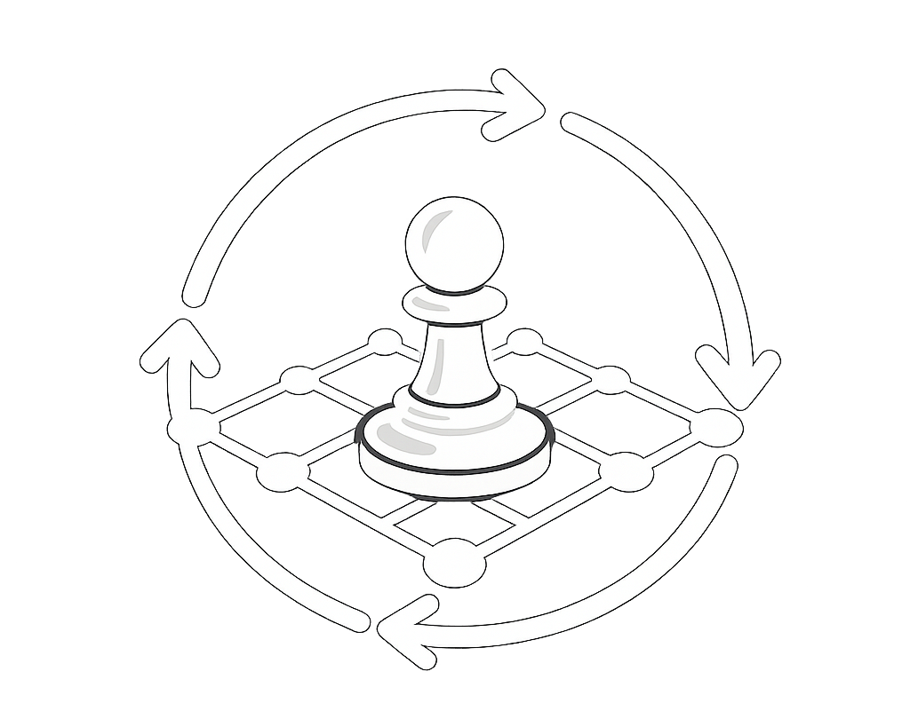
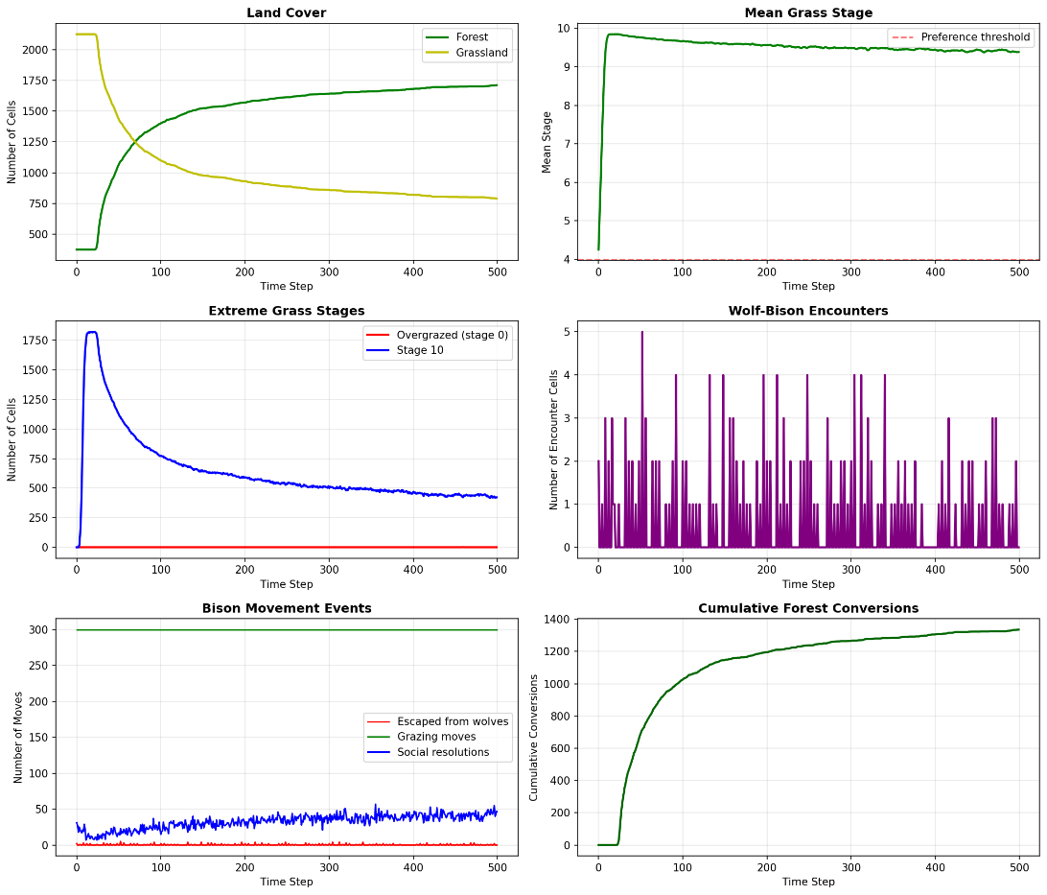
Simulation 1: Animation of the dynamics – 1/ 2
NX = 50 # Grid width
NY = 50 # Grid height
N_BISON = 300
N_WOLVES = 15
WOLF_MOVE_PERIOD = 1
# Wolves move every k steps
N_STEPS = 5#500
RANDOM_SEED = 42
CELL_TYPE_GRASS = "grass"
CELL_TYPE_FOREST = "forest"
INITIAL_FOREST_FRACTION = 0.15 INITIAL_GRASS_STAGE_MEAN = 4.0 INITIAL_GRASS_STAGE_STD = 1.0
MIN_GRASS_STAGE = 0 MAX_GRASS_STAGE = 10
GRASS_PREFERENCE_THRESHOLD = 4
GRASS_CHANGE_GRAZING = -2
GRASS_CHANGE_RECOVERY = +1
STAGE10_THRESHOLD = 20 WOLF_DETECTION_RANGE = 0
MAX_WOLVES_PER_CELL = 1
MAX_BISON_PER_CELL = 1
Wolve-Bison Dynamics

Slide 13
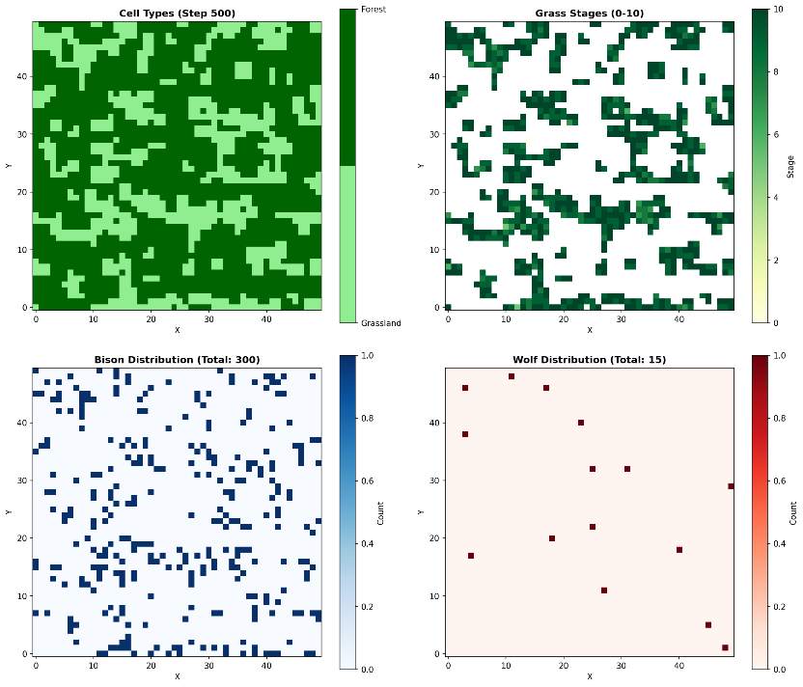
Simulation 1: Animation of the dynamics – 2/ 2
final stage

Slide 14
Simulation 2: The wolf effect – increasing percentage of forest
Number of Wolves | Final Forest Cells | Wolf-Bison Encounter
0 | 1124.3 ± 16.7 | 0.0 ± 0.0
5 | 1132.4 ± 14.7 | 165.5 ± 24.2
10 | 1132.8 ± 16.6 | 345.2 ± 31.7
15 | 1139.5 ± 18.1 | 510.8 ± 37.6
20 | 1142.7 ± 18.9 | 684.4 ± 36.5
30 | 1146.2 ± 16.6 | 1028.2 ± 45.9
Monte Carlo Simulation
50 runs for each number of wolves
number of forest cells & wolf-bison encounters recorded after 300 simulation steps per run
empirical mean ± standard deviation are given
some slight positive correlation is visible between the number of wolves and the amount of forest cells

Slide 15
Topics
Loss of Alpha-Predators
Effects of Invasive Species
A Trisexual Nematode
Tobacco Plant & Insect Dynamics

Slide 16
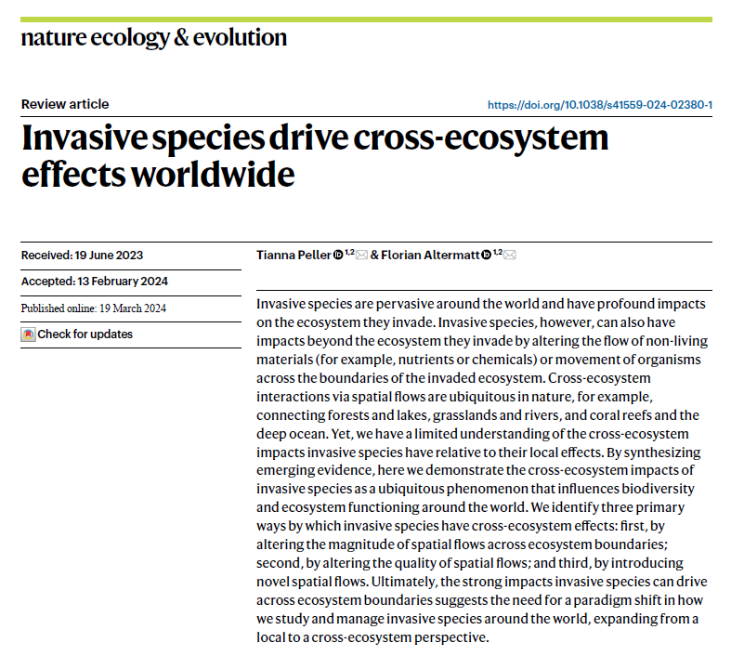
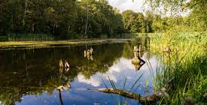
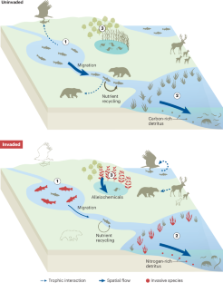
Based on [Peller & Altermatt, 2024] we are simulating the effects of invasive species on ecosystems (1/ 2)
T. Peller & F. Altermatt (2024): Invasive species drive cross-ecosystem effects worldwide, Nature Ecology & Evolution, 8 (6), pp. 1087–1097
DOI: 10.1038/s41559-024-02380-1

Slide 17
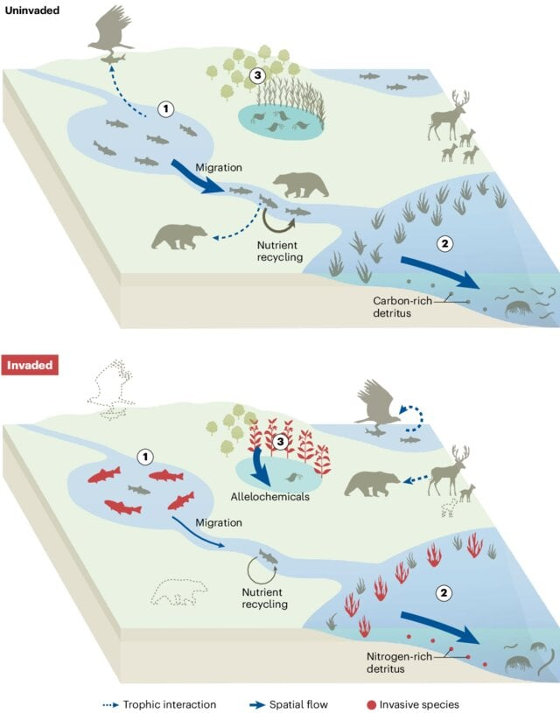
Based on [Peller & Alermatt, 2024] we are simulating the effects of invasive species on ecosystems (2a/ 2)
Invasive species drive cross-ecosystem effects by altering flows of non-living materials and the movement of organisms across ecosystem boundaries.
Invasive species (red) drive cross-ecosystem effects by altering flows of non-living materials and the movement of organisms across ecosystem boundaries (for example, aquatic-terrestrial).
For instance:
① Invasive lake trout feed on native trout, decreasing their abundance and interrupting their migration from lakes to rivers, which reduces the contribution of native trout to river nutrient cycles and eliminates a key prey source for bears.
This has cascading impacts through the terrestrial food web by causing bears to feed primarily on alternative prey sources, such as juvenile elk.

Slide 18
Based on [Peller & Alermatt, 2024] we are simulating the effects of invasive species on ecosystems (2b/ 2)
Lake trout invasion further has spatially cascading effects on distant lakes: birds that fed on native trout prior to lake trout invasion shift their feeding activities to lakes with sufficient prey availability.
② The displacement of native kelp forests by invasive green macroalgae alters the quality of macroalgal detritus exported from coastal ecosystems to deeper ocean ecosystems, where imported detritus is a key food source. This change in quality of imported detritus affects the abundance and diversity of macrofaunal species.
③ Invasive terrestrial plants displacing native forest plants affect foodweb dynamics in ponds by introducing novel allelochemicals to forests that leach and flow into ponds, where they decrease the growth rate of zooplankton.

Slide 19
Scenario ①: Invasion of lake trout and change of food webs
1. Understand the Problem
Movement Rules: We assume that
there are six species interacting: native trout (NT), invasive trout (IT), bear (B), native trout predatory birds (P), and elk (E),
the geography is represented by a toroidal lattice with three distinct cell types: lake (L), river (R), and grass land (G),
native trout moves only in and between lake and river cells, invasive trout only in and between lake cells, bears only in and between grassland and river cells, elk only in and between grassland cells, and trout predatory birds can move in and between all three cell types, and
movement is, if not permitted, north, east, south, or west.
2. Plan
3. Execute
grass land
4. Look Back
lake
river

Slide 20
Scenario ①: Invasion of lake trout and change of food webs
1. Understand the Problem
Occupation Rules: We assume that more than one member of any species can occupy a cell.
Interaction Rules: We assume that
each predator-prey encounter is successful for the predator by a certain hunter probability
within lakes native trout is preyed upon by invasive trout and predatory birds
within in rivers native trout is preyed upon by bears
within grassland elks are preyed upon by bears
the hunting probability of a bear on native trout is much higher than on elk
Resource Rules: We assume that
species are born proportional to the total amount of the species
species have a specific age limit
native and invasive trout have a species-specific total number limit (carrying capacity of the ecosystem)
each predatory bird needs to feed at least on one native trout every 10th time step
each bear needs to feed at least on one native trout every 5th time step or one elk every 10th time step
2. Plan
3. Execute
4. Look Back

Slide 21
To support AI-assisted coding, we use a very modular program structure
setup.py
inv_species/
script that automatically creates all the folders and files (correct names, but empty)
main.py
core/
initializer.py
config/
agents/
output/
utils/
movement.py
config.py
base_agent.py
metrics.py
rng_utils.py
interactions.py
native_trout.py
visualizer.py
torus.py
reproduction.py
invasive_trout.py
animation.py
validaton.py
mortality.py
environment/
bear.py
reporter.py
carying_capacity.py
habitat.py
bird.py
scheduler.py
tests/
lattice.py
elk.py
simulation.py

Slide 22
Here, the single files contain the information necessary to simulate the invasive species model (1/ 2)
main.py
config/config.py
environment/habitat.py
environment/lattice.py
Main file
supported by
README.md
requirenments.txt
Contains all model parameters:
grid size
number of time steps
habitat layout
initial population sizes
movement probabilities
hunting probabilities
age limits
starvation thresholds
birth rates
carrying capacities
random seed
visualization settings
Defines habitat constants:
lake = 0
river = 1
grassland = 2
Creates the toroidal habitat grid and provides helpers:
wrap positions on torus
get habitat at (x, y)
neighborhood lookup
optional habitat map generator
agents/base_agent.py
core/movement.py
core/reproduction.py
core/simulation.py
Common fields:
id
species
x, y
age
alive
steps_since_last_meal_ native_trout
steps_since_last_meal_ elk
Handles movement according to habitat permissions.
Creates newborn agents.
Main simulation class holding:
habitat grid
list of agents
current time step
statistics
Each species class defines:
allowed habitats
max age
reproduction rate
movement style
hunger constraints if any
core/interactions.py
core/mortality.py
Handles predator-prey encounters.
Removes agents due to predation, age, or starvation.

Slide 23
Here, the single files contain the information necessary to simulate the invasive species model (2/ 2)
core/carrying_capacity.py
output/metrics.py
We want these tendencies:
IT: seek native trout in the lake
NT: if invasive trout are nearby in the lake, move toward river cells
P: strongly seek lake cells containing native trout, and stay near the lake
B: first seek native trout in river cells; if river trout become scarce, seek elk in grassland
E: just remain in grassland
Hence, our program need directed movement
Creates newborn agents.
Tracks:
total counts by species
births/ deaths by species
number of predation events
spatial occupancy summaries
output/animation.py
Animated lattice over time.
output/visualizer.py
utils/validation.py
Static plots:
habitat map
population time series
snapshots of species positions
Checks for debugging:
valid habitat indices
valid agent positions
agents only on permitted habitats
no negative counts

Slide 24
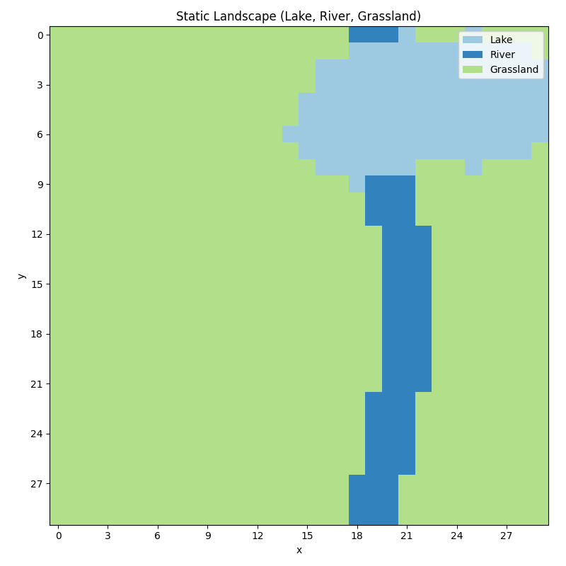
Simulation 1: Ecosystem without invasive trout
GRID_WIDTH = 30, GRID_HEIGHT = 30
TIME_STEPS = 100
RANDOM_SEED = 42
NT: 60, B: 8, P: 12, E: 30
P_on_NT: 0.60, # birds on native trout in lake
B_on_NT: 0.75, # bears on native trout in river
B_on_E: 0.25 # bears on elk in grassland
# Species-specific maximum ages
NT: 40, B: 60, P: 45, E: 50
# Per-step birth probabilities
NT: 0.08, B: 0.03, P: 0.04, E: 0.05
# Total carrying capacities
NT: 140, E: 120
# Feeding constraints
BIRD_STARVE_AFTER = 12
BEAR_STARVE_NT_AFTER = 7
BEAR_STARVE_E_AFTER = 12
# Movement / sensing
SENSING_RADIUS = 3
Ecosystem without Invasive Trout

Slide 25
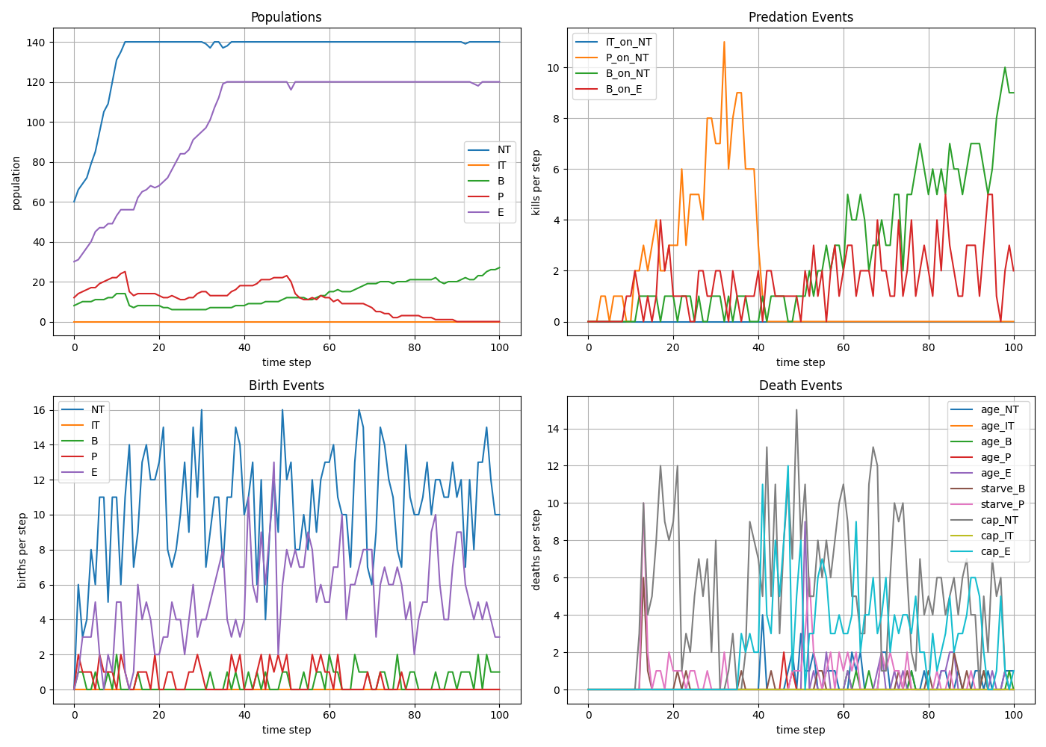
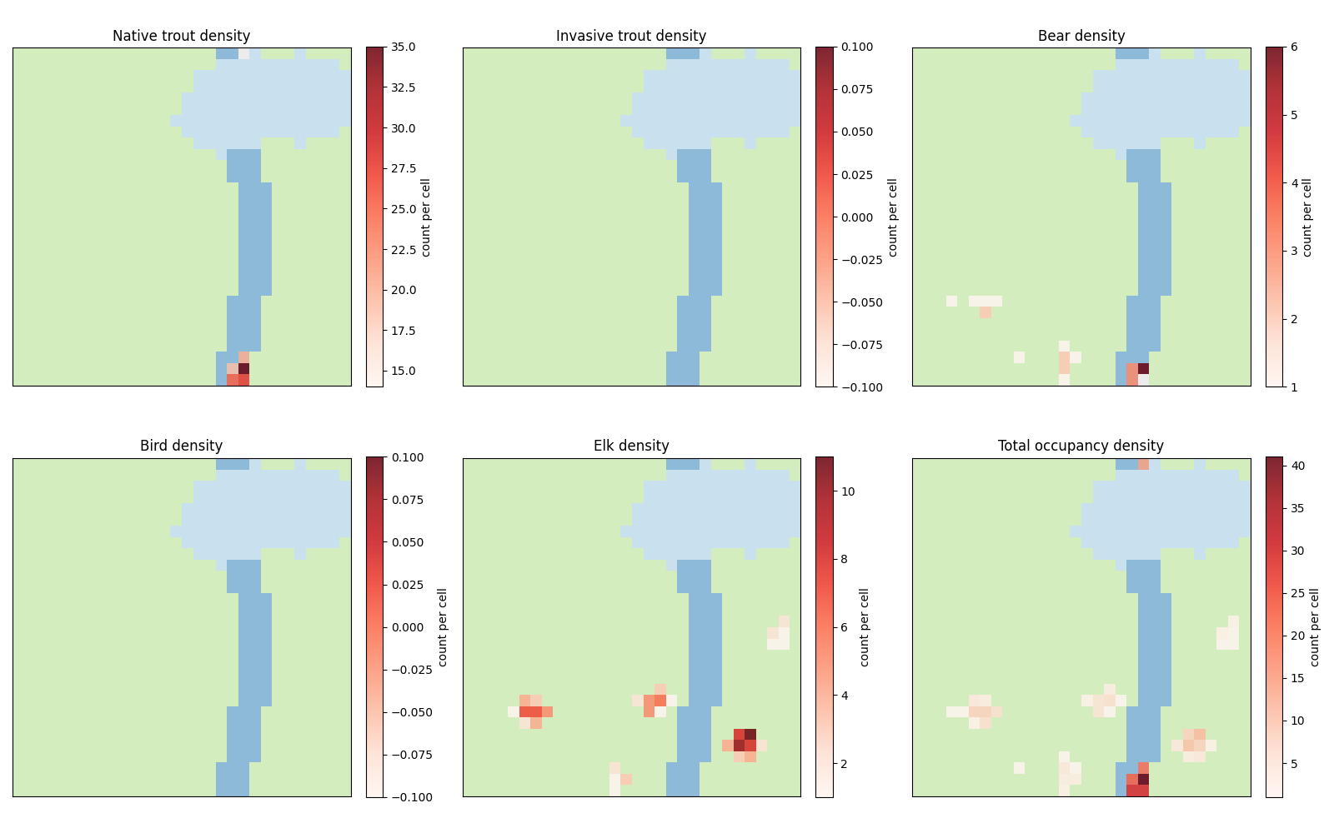
Simulation 1: Ecosystem without invasive trout

Slide 26
Simulation 1: Ecosystem without invasive trout

Slide 27
Simulation 2: Ecosystem with invasive trout
GRID_WIDTH = 30, GRID_HEIGHT = 30
TIME_STEPS = 100
RANDOM_SEED = 42
NT: 60, IT: 18, B: 8, P: 12, E: 30
IT_on_NT: 0.45, # invasive trout on native trout in lake
P_on_NT: 0.60, # birds on native trout in lake
B_on_NT: 0.75, # bears on native trout in river
B_on_E: 0.25 # bears on elk in grassland
# Species-specific maximum ages
NT: 40, IT: 35, B: 60, P: 45, E: 50
# Per-step birth probabilities
NT: 0.08, IT: 0.06, B: 0.03, P: 0.04, E: 0.05
# Total carrying capacities
NT: 140, IT: 90, E: 120
# Feeding constraints
BIRD_STARVE_AFTER = 12
BEAR_STARVE_NT_AFTER = 7
BEAR_STARVE_E_AFTER = 12
# Movement / sensing
SENSING_RADIUS = 3
Ecosystem with Invasive Trout

Slide 28
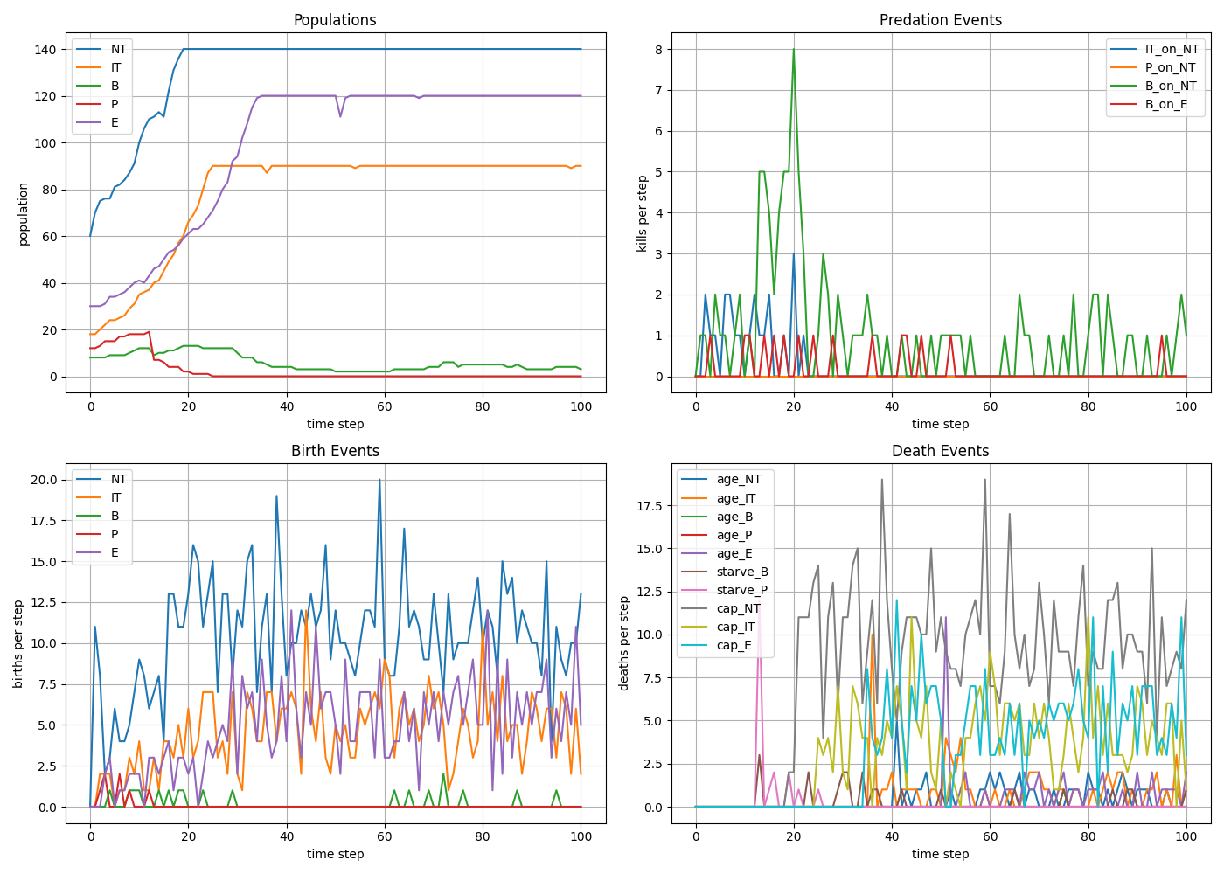
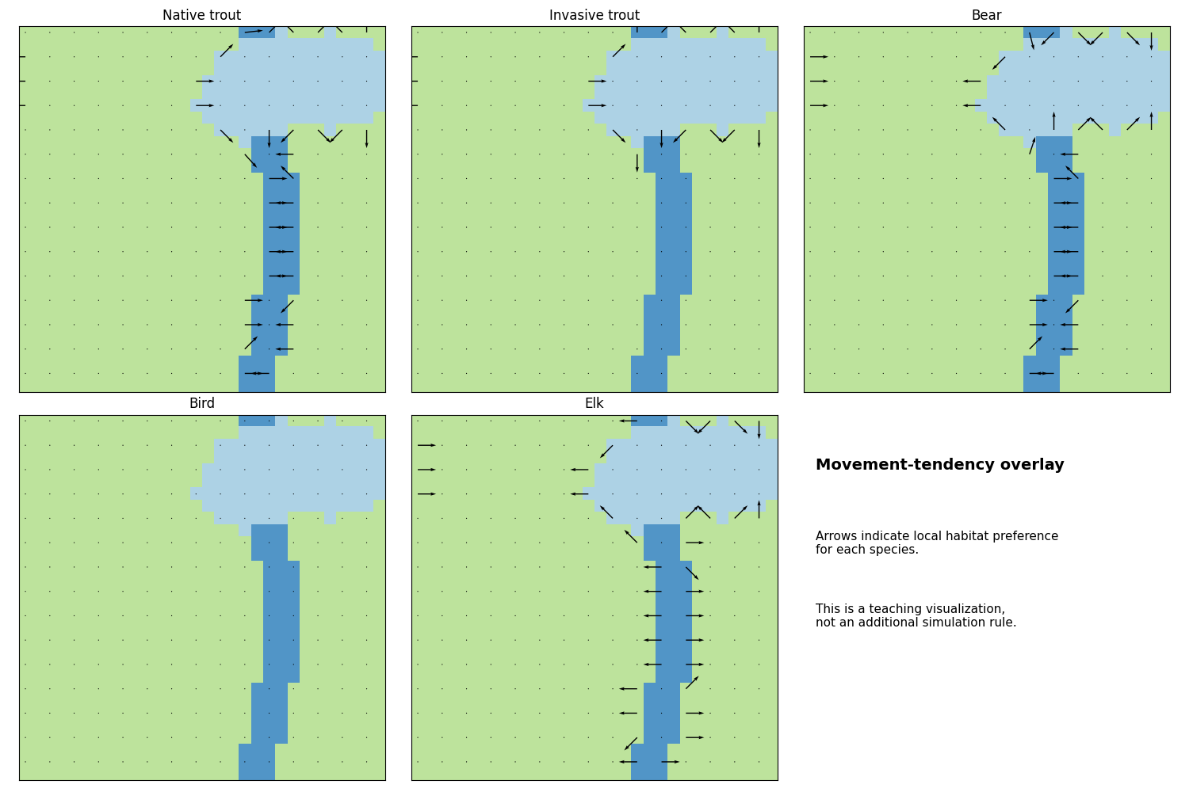
Simulation 2: Ecosystem with invasive trout

Slide 29
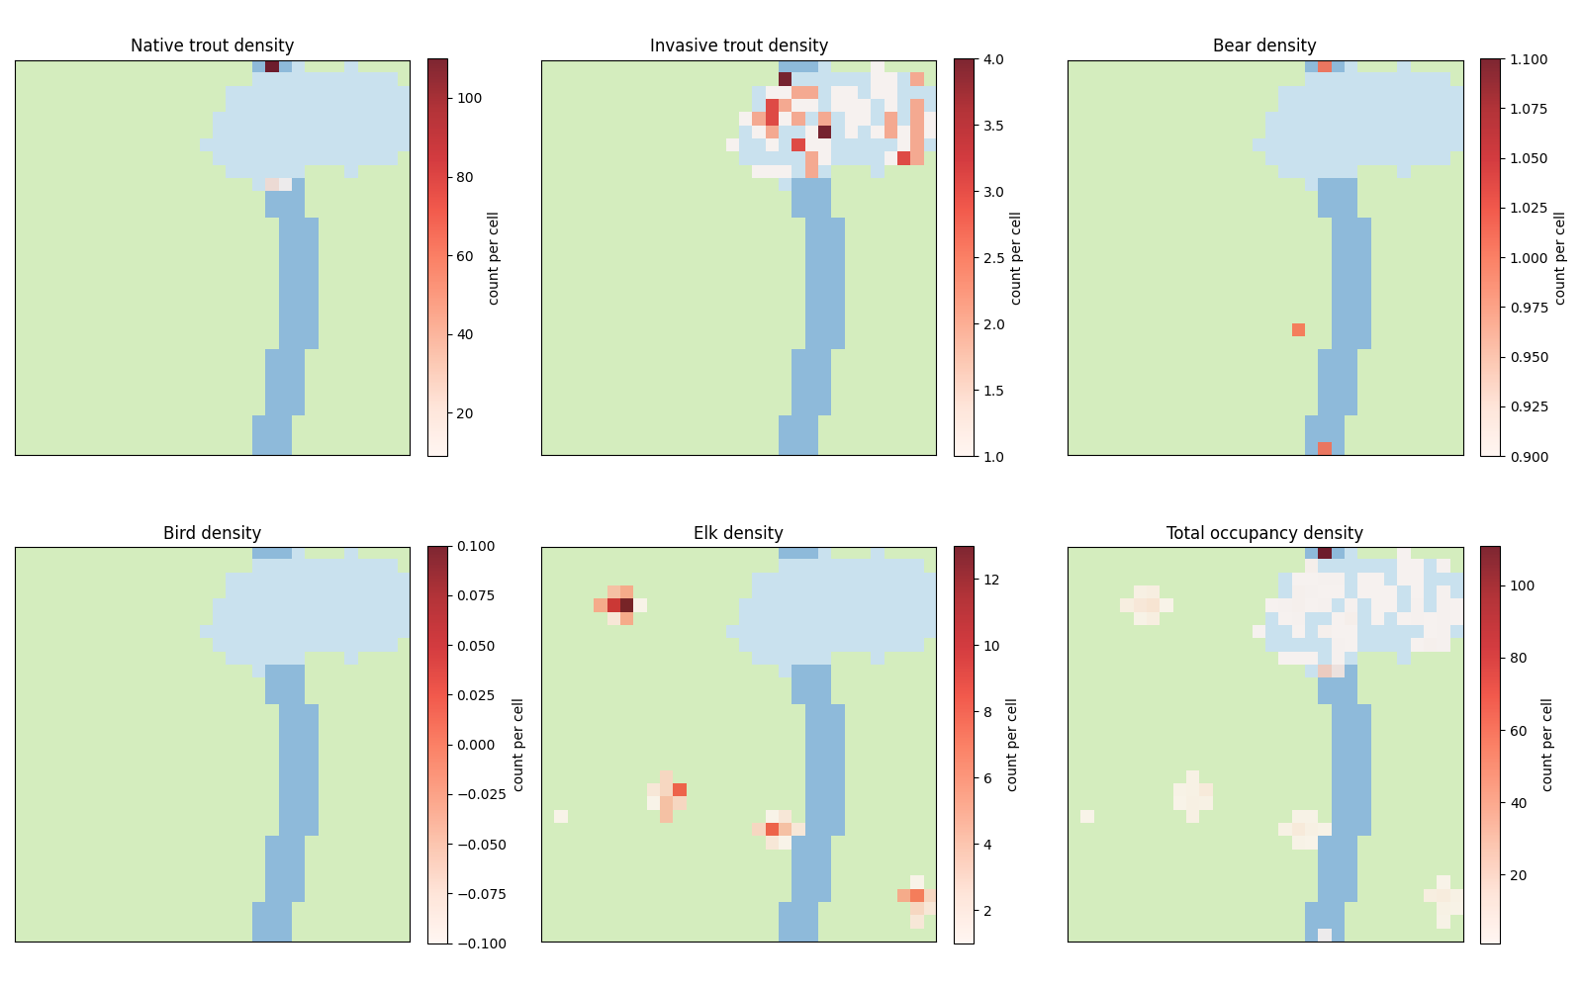
Simulation 2: Ecosystem with invasive trout

Slide 30
Computational Biomathematics
florian.rupp@kiu.edu.ge

