Slide 1
Computational Biomathematics
Coding Lab 1 (2x 90 min)
Lessons 5 & 6
Coding Lab
Overview
Structure of the lab

Slide 2
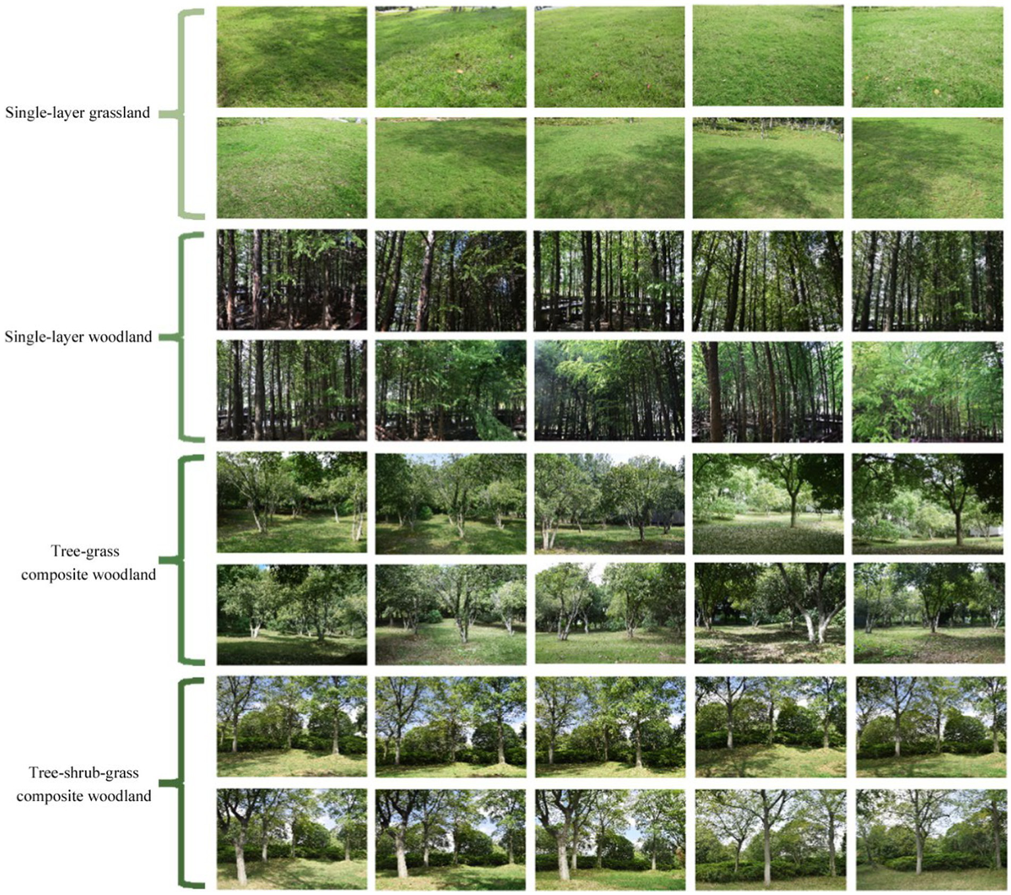
In this lab, we are discussing three cases: 1) Vegetation competition on a lattice
Vegetation Competition on a Lattice
Idea:
Each cell is occupied by grass/ shrub/ tree or empty / occupied
Rules:
local competition (neighbors determine survival)
colonization probabilities
disturbance (fire, drought)
Why it’s good:
direct extension of the forest example
easy to implement
rich spatial patterns (patches, fronts)

Slide 3
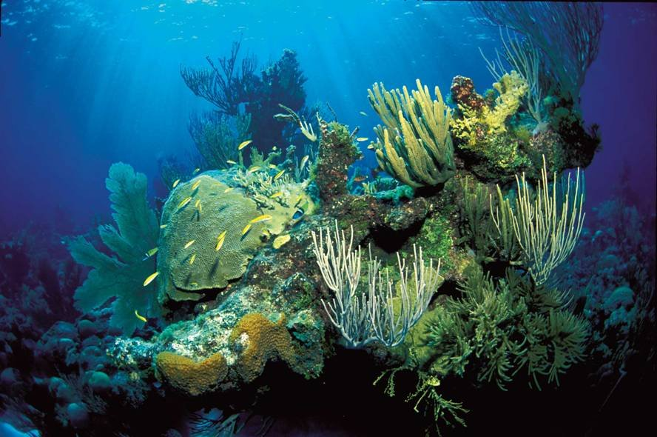
In this lab, we are discussing three cases: 2) Coral reef/ sessile species competition
Coral Reef/ Sessile Species Competition
Idea:
Each cell is in one of the following states: coral, algae, or empty
Rules:
coral grows slowly but is stable
algae spreads quickly
disturbances (bleaching)
Why it’s good:
very clear ecological interpretation
strong spatial effects
connects to climate topics

Slide 4
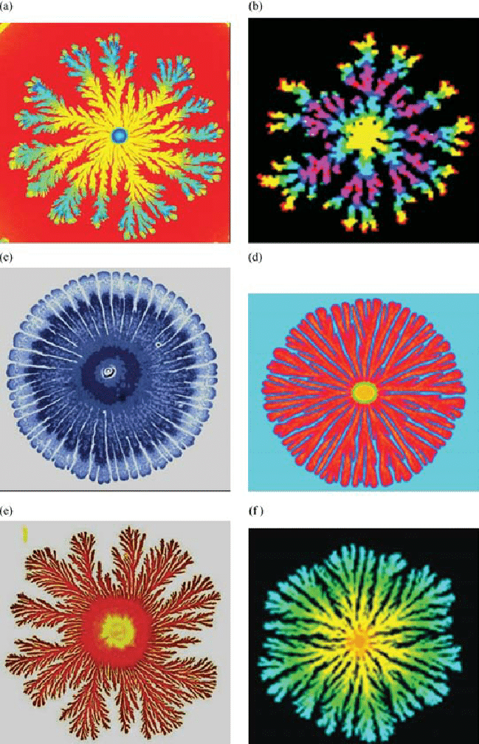
In this lab, we are discussing three cases: 3) Bacterial colony growth (with diffusion-like spreading)
Bacterial Colony Growth (with diffusion-like spreading)
Idea:
cells reproduce and spread locally
nutrient availability affects growth
Why it’s good:
local movement rules
branching patterns
link to diffusion/ PDEs
Many biological systems can be understood as local interaction rules on space. The complexity we observe in nature often emerges from very simple rules applied repeatedly.

Slide 5
Topics
Overview
Structure of the Lab

Slide 6
The central goals of this lab are to simulate biological systems and to learn how to use AI responsibly and effectively for scientific simulations
A central goal of this lab is not only to simulate biological systems, but also to learn how to use AI responsibly and effectively for scientific simulations. We will practice the following workflow:
Biological idea → mathematical/ computational structure
→ program architecture
→ AI prompt design
→ code review and refinement
After completing this lab, you should be able to
explain how local biological rules can generate global patterns,
implement simple lattice-based biological simulations in Python,
design a modular program architecture,
formulate clear prompts for AI-assisted coding,
critically evaluate AI-generated code.

Slide 7
AI can generate code quickly, but scientific quality depends on whether you provide a precise model description and a clear software structure
General Setup: We represent space as an N × N lattice. Each cell contains a biological state, for example, empty, grass, tree, coral, algae, or bacteria.
We use Python together with:
import numpy as np
import matplotlib.pyplot as plt
Why Prompt Design Matters? When using AI for coding, it is tempting to immediately ask
“Write me Python code for this model:”
However, in scientific programming this is often a poor strategy. Before asking AI to generate code, you should first think about
What biological states exist?
What are the local update rules?
What should be visualized?
Which parts of the program should be easy to replace later?
Which files or functions are needed

Slide 8
For all three models, a modular structure is recommended
Recommended Program Architecture:
For all three models, use a modular structure such as:
main.py – runs the simulation
initialization.py – creates the initial grid –
dynamics.py – contains the update rules
visualization.py – plotting and animation
parameters.py – parameters such as N, T, probabilities, …
Before writing any prompt, sketch the architecture of your program on paper. For each file, write down:
its purpose,
the functions it should contain, as well as
which inputs and outputs these functions should have.

Slide 9
Topics
Overview
Structure of the Lab
High-level structure:
Session 1: building foundations (architecture & first AI interaction)
Session 2: deepening (second model, comparison & reflection)
Final 30 min: presentations across groups

Slide 10
Roadmap A) Session 1: building foundations – 1/ 3
Session 1: building foundations (architecture & first AI interaction)
Time | Topic
0 – 15 min | Introduction: Overview & Lab Structure Key messages “We are not learning Python. We are learning how to structure models.” “AI is a coding assistant, not a scientist.” “Good prompts = clear thinking.” You have seen: 1 weak vs 1 strong prompt (very helpful anchor) modular structure (just conceptually)
15 – 25 min | Group Formation & Task Assignment Different task per each group such that there is natural diversity for presentations later

Slide 11
Roadmap A) Session 1: building foundations – 2/ 3
Time | Topic
25 – 50 min | Phase 1: Architecture thinking (no AI yet) – this is the most important thinking phase Task: definition of states, update rules, parameters, outputs, and file structure give this in writing Guiding questions: “Where would you put this function?” “What should be changeable?” “What is your state space?”
50 – 70 min | Phase 2: Prompt design (still no AI yet) Task: write a first prompt improve it by considering structure, precision, modularity, and visualization requirements

Slide 12
Roadmap A) Session 1: building foundations – 3/ 3
Time | Topic
70 – 90 min | Phase 3: First AI interaction Task: run prompt get code try to run it Likely issues (use AI for debugging): small errors plotting problems confusion about arrays

Slide 13
Roadmap B) Session 2: deepening & presentation – 1/ 2
Session 2: deepening (second model, comparison & reflection)
Time | Topic
0 – 10 min | Quick Recap Task: “What worked?” “What didn’t?”
10 – 45 min | Phase 4: Improve & extend Task: improve prompt and refine code choose one of the following add parameter study improve visualization
extend rule (e.g., neighbor influence strength)
compare two parameter settings

Slide 14
Roadmap B) Session 2: deepening & presentation – 2/ 2
Time | Topic
45 – 60 min | Phase 5: Prepare presentation Prepare the following content to be ready for presentation: Biological model (1–2 min) Architecture (files/ modules) Best prompt One challenge the group faced One insight about AI usage One simulation result
60 – 90 min | Presentations (approx. 5 min per group plus Q & A) After each presentation should briefly highlight (i) good prompt features, (ii) good modular design, and (iii) interesting biological behavior.

Slide 15
Computational Biomathematics
florian.rupp@kiu.edu.ge

