Slide 1
Computational Biomathematics
The Evolution of Cooperation
Lesson 7
Lecture
The Prisoner’s Dilemma
The iterated Prisoner’s Dilemma
Nash equilibria
Nash equilibria in the Chicken Game

Slide 2
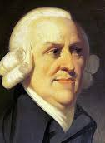
Smith argues that our actions are a result of our need to be both “lovable and praiseworthy” in the eyes of the “impartial spectator”
economy
agent
rational choice
optimal
judgment of the
impartial spectator
desires
actions
According to Adam Smith (1723 – 1790), human actions are primarily determined by an internal tension between passions (desires/ emotions) and the moral constraints of an “impartial spectator” (independent, neutral observer) within the mind. In his “Theory of Moral Sentiments” he states that actions are moderated by sympathy—our ability to put ourselves in another's place—to achieve social harmony.

Slide 3
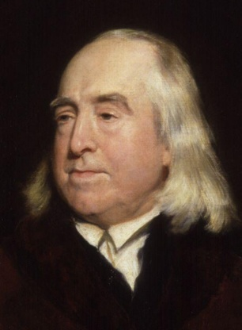
The rational choice happens due to a self-optimization of the agents, i.e., due to utility (= “happiness”) maximization
economy
agent
rational choice
desires
preferences
actions
utilities
= happiness
The principle of utility judges any action to be right by the tendency it appears to have to augment or diminish the happiness of the party whose interests are in question … if that party by the community the happiness of the community, if a particular individual, the happiness of that individual.
(Jeremy Bentham, 1748 – 1832)

Slide 4
In Game Theory we put ourselves into the shoes of the other self-optimizing player and evaluate the use/ utility of an event/ outcome for them
Which strategy should the row-player (red) choose?
complete
information
strategy
1
strategy
2
strategy
…
rational choice
preferences
actions
strategy
1
outcome
1, 1
outcome
1, 2
…
strategy
2
outcome
2, 1
outcome
2, 2
…
The column player (blue) will act in a way that is best for them.
strategy
…
…
…
…
The row player (red) must optimize themselves regarding the actions/ strategies played by blue.

Slide 5
Agenda
The Prisoner’s Dilemma
The Iterated Prisoner’s Dilemma
Nash Equilibria
Nash Equilibria in the Chicken Game

Slide 6
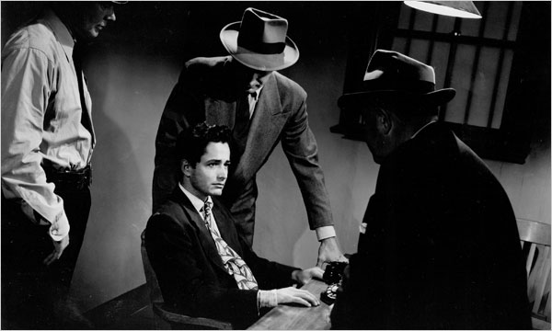
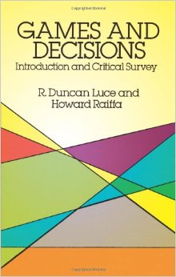
The prisoner’s dilemma [D.R. Luce & H. Raiffa (1957): Games and Decisions, p. 95, New York: Wiley]
Two suspects (called A and B) are taken into custody and separated. The district attorney is certain that they are guilty of a certain crime, but he does not have adequate evidence to convict them at trail. He points out to each prisoner that each has two alternatives:
to confess the crime the police is sure they have done,
or not to confess.
If they both do not confess, then the district attorney states he will book them on some very minor trumped-up charge such as petty larceny and illegal possession of a weapon, and they will both receive a a minor punishment (of say 2 years in prison)
If they both confess they will be prosecuted (and go to jail for 10 years).
Finally, if one confesses and the other does not, then the confessor will receive lenient treatment for turning state’s evidence whereas the latter will get “the book” slapped at him (which means, the confessor gets a penalty of just one year in jail, whereas the other one is sent there for 20 years).

Slide 7
From the event matrix of the prisoner’s dilemma …
Each of the two suspects has two strategies: not confess and confess
This leads to four different events depending on which strategy is chosen:
(not confess, not confess): both two years in prison
(not confess, confess): 20 years in prison for A, and 1 year in prison for B
(confess, not confess): 1 year in prison for A, and 20 years in prison for B
(confess, confess): both ten years in prison
We thus obtain the following event matrix:
player A B | not confess | confess
not confess | (2, 2) | (20, 1)
confess | (1, 20) | (10, 10)
the event matrix:
numbers are the years in prison
as claimed by the district attorney

Slide 8
… to come the payoff matrix that considers the individual preferences of each player
In order to describe the decision problem completely, we require to know which utilities the players A and B assign to the different outcomes. It seems adequate to assume that both suspects value an imprisonment more the lower in years it is. With an individual ordinal utility function
e° is better than e* ⇒ u_{A, B}(e°) > u_{A, B}(e*)
we thus obtain the following payoff matrix:
the payoff matrix:
numbers are the utilities each
player assigns individually
to the outcomes,
i.e. the numbers represent an
ordinal preference structure.
Only the ordinal structure counts, the exact numbers do not matter.
player A B | not confess | confess
not confess | (2, 2) | (0, 3)
confess | (3, 0) | (1, 1)

Slide 9
Each of the players has a strictly dominant strategy, though the equilibrium in dominant strategies is Pareto-inefficient …
player A B | not confess | confess
not confess | (2, 2) | (0, 3)
confess | (3, 0) | (1, 1)
Assuming rational agents, each player is interested in the maximization of their own payoff (and not in the maximization of a common payoff).
In particular, both players A and B have the strictly dominant strategy to “confess”.
Thus, the solution concept of an equilibrium in dominant strategies describes the result of the prisoner’s dilemma game.
But, this result is inefficient or Pareto-inefficient, as both players could have done better if they both had chosen “not confess” instead of “confess”.
result
(here: inefficient)

Slide 10
… this is in general the characterization of a prisoner’s dilemma situation
player A B | not confess | confess
not confess | (2, 2) | (0, 3)
confess | (3, 0) | (1, 1)
The fundamental structural properties of the prisoner’s dilemma are:
Every player has a strictly dominant strategy, and
The choice of the strictly dominant strategy leads to a result, determined by an equilibrium in dominant strategies, that is inefficient/ Pareto-inefficient from the point of view of the individual player: both players could do better without worsening the situation of the other player.
Note: We are discussing games in their matrix-form, this representation is called normal-form or strategic-form of a game as well.
At a payoff matrix only the ordinal structures count:
player A B | not confess | confess
not confess | (80, 20) | (25, 30)
confess | (150, 10) | (50, 15)

Slide 11
Often, the strategies of the “suspects” are labeled as cooperative and non-cooperative behavior
player A B | cooperate | not cooperate
cooperate | (b, b) | (d, a)
not cooperate | (a, d) | (c, c)
player A B | not confess | confess
not confess | (2, 2) | (0, 3)
confess | (3, 0) | (1, 1)
a > b > c > d
The prisoner’s dilemma is often used as a description of a decision situation that contains a fundamental conflict between individually rational behavior and socially desirable behavior, i.e., collectively rational behavior (which corresponds to an efficient result).
At a one-time interaction cooperative behavior does not materialize as it is dominated by non-cooperative behavior.
The following change of terms takes this generalization of the prisoner’s dilemma into account by switching from “confessing” to “not cooperating”, though without any alternation of the payoffs.

Slide 12
The story of the prisoner’s dilemma often leads to some misconceptions
Let us talk about two common misconceptions of the prisoner’s dilemma:
Does it play a role that the “suspects are […] separated”?
If both players can assume that the district attorney tells both of them the same story, then the separation is indeed not relevant. Moreover, they could even be in the same room and talk to each other and know which strategy the other will choose.
As both players have a strictly dominant strategy, that maximizes their respective individual payoff, they will always play this strategy irrespective of what the other player chooses.
The important thing is that the players are not allowed to go for binding agreements.
The other misconception is that one sometimes thinks that, e.g., player A can decide for him and for player B to “not confess”. Though, it is in the very nature of a game that each player can decide only for themselves and not for the other one.
The players only control their strategies; they do not control the strategies of the other player and thus do not control the result of the game.

Slide 13
Agenda
The Prisoner’s Dilemma
The Iterated Prisoner’s Dilemma
Nash Equilibria
Nash Equilibria in the Chicken Game

Slide 14

How does cooperation evolve in an un-cooperative environment?
Motivation:
Assume a continuous interaction between two players. Under which conditions should the players cooperate and under which conditions should they be selfish?
Evolutionary Perspective:
How can a strategy that is open for cooperation establish itself/ survive in an environment that is mainly un-cooperative?
Which type of strategy can sustain in a complex environment, that consists of a broad spectrum of different and more or less sophisticated strategies?
Due to which circumstances can such a strategy, if it is once established at a group, resist the invasion of a less cooperative strategy?

Slide 15
As an paradigmatically example for common decision situations let us use the Prisoner’s Dilemma, …
 |  | Column Player (c)
 |  | Cooperation | Defection
Row Player (r) | Cooperation | R_{r} = 3, R_{c} = 3 | S_{r} = 0, T_{c} = 5
 | Defection | T_{r}= 5, S_{c} = 0 | P_{r} = 1, P_{c} = 1
Payoffs:
The payoffs are ranked as follows: T > R > P > S
R (reward): reward for mutual cooperation
T (temptation): temptation to defect/ play defection
S (suckers’ payoff): payoff of the trustful
player
P (punishment): punishment for mutual
defection
Fundamental Issue:
Individual rationality leads to an inefficient result for both players.

Slide 16


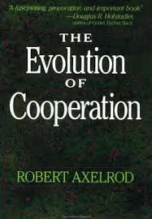
… and apply it multiple times in different/ repeated interactions
R, R | S, T
T, S | P, P
R, R | S, T
T, S | P, P
…
This allows different strategies (that may even take past encounters into account):
Name | Description
ALWAYS C | Always “cooperate”. This strategy is friendly, non retaliatory and conciliatory
ALWAYS D | Always “defecting”
TIT FOR TAT | Every action of the other player is replied at the next encounter with exactly the same response that the other player played at the present encounter. It starts with cooperation. This is a friendly, retaliatory and conciliatory strategy
…
Robert Axelrod
(* 27. Mai 1943)

Slide 17
… and apply it multiple times in different/ repeated interactions
R, R | S, T
T, S | P, P
R, R | S, T
T, S | P, P
…
In the case of the iterated Prisoner‘s Dilemma not only the current payoffs play an essential role but also the future interactions.
Hereby, one assumes that future payoffs play are less prominent for a decision at the present round (human factor, smaller probability of meeting in the future).
This is considered by accumulating the payoffs over time in such a way that the next move/ round is weighted in terms of a fraction w 2 (0, 1] of the previous move. This weight w is called discounting parameter:
A₀ + w A₁ + w² A₂ + w³ A₃ + w⁴ A₄ + …
where A₀, A₁, … are the payoffs at the initial round and in the future.

Slide 18
There is no optimal strategy, …
Theorem:
If the discounting parameter w is sufficiently large, then there is no best strategy independent of the strategy of another player.
Proof:
Assume the other player is playing „ALWAYS D (permanent defection). Hence, if the other player never cooperates, then it is best to always defect as well.
Next, assume on the other hand that another player chooses the strategy “Permanent Retaliation” (i.e. he/ she cooperates until the other player defects for the first time, and then he/ she defects for the rest of the game). In that case, it is obviously best to never defect, provided the temptation T, to defect at the first encounter, is over-compensated by the long-term disadvantage to just always gain the punishment P instead of the reward R. This holds if the discounting parameter w is large enough (w > (T – R)/(T – P)).
Hence, it depends on the strategy of the antagonist, if a player should cooperate or not, even in the first round. If w is sufficiently large, then there consequently is no best strategy (independent of the choice of the strategy of the other player).

Slide 19
… but there is a plethora of possible strategies
Name | Description
ALWAYS C | Always “cooperate”. This strategy is friendly, non retaliatory and conciliatory
ALWAYS D | Always “defecting”
TIT FOR TAT | Every action of the other player is replied at the next encounter with exactly the same response that the other player played at the present encounter. It starts with cooperation. This is a friendly, retaliatory and conciliatory strategy
 | The complete opposite of TIT FOR TAT: This strategy replies every action of the other player with the opposite action. This strategy is not friendly (it starts with defection) and not retaliatory.
JOSS | “Insidious” version of TIT FOR TAT: Starts with cooperation, defects after an defection, though instead of always cooperating this strategy defects by purpose in 10% of all cases after a cooperation
FRIEDMAN | Everlasting retaliation. Friendly strategy, that responds to a defection of the other player with everlasting defection.
NYDEGGER | Starts like TIT FOR TAT. After a while it analyzes the 3 last mutual encounters and acts accordingly.
RANDOM | With a probability of ½ this strategy cooperates or defects, independent of the history of previous mutual encounters.
…

Slide 20
Results from the 1st round of the tournament: “Tit For Tat” is the winner (during the 200 moves each of the15 rules met each other rule 5 times)
For comparison: always defection: 1000 points, always cooperation: 600 points, always mutual defection: 200 points

Slide 21
An example for the repeated encounter of two strategies: TIT FOR TAT and JOSS
moves | 1 – 20 | 11111 | 23232 | 32323 | 23232
moves | 21 – 40 | 32324 | 44444 | 44444 | 44444
moves | 41 – 60 | 44444 | 44444 | 44444 | 44444
moves | 61 – 80 | 44444 | 44444 | 44444 | 44444
moves | 81 – 100 | 44444 | 44444 | 44444 | 44444
moves | 101 – 120 | 44444 | 44444 | 44444 | 44444
moves | 121 – 140 | 44444 | 44444 | 44444 | 44444
moves | 141 – 160 | 44444 | 44444 | 44444 | 44444
moves | 161 – 180 | 44444 | 44444 | 44444 | 44444
moves | 181 – 200 | 44444 | 44444 | 44444 | 44444
Example for a TIT FOR TAT and JOSS encounter:
initially both cooperate;
then JOSS tries to find out how far it can go and defects,
TIT FOR TAT punishes this, JOSS apologizes, a mutual “punishment-apology-cycle” starts
JOSS defects at the 25. move randomly, and
form now on both punish each other mutually (echo-effect).
Points in this example:
TIT FOR TAT: 236
JOSS: 241
1: both cooperate, 2: only TIT FOR TAT cooperates,
3: only JOSS cooperates, 4: both defect
A less “harsh” strategy as TIT FOR TAT would have gained better results with respect to JOSS due to faster pardoning JOSS, and presumably without escalation (e.g. TIT FOR TWO TATS)

Slide 22
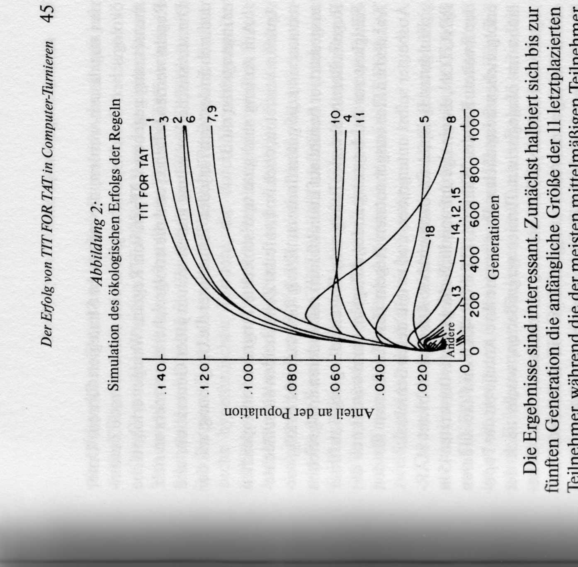
TIT FOR TAT performs very well with respect to other strategies under evolutionary conditions as well (1/ 2)
[Axelrod, 2009], S. 45
The idea at this type of simulation is that the successful strategies are applied with higher probability in the next round, whereas the less successful strategies are applied with a smaller probability.
In the simulation the number of a strategy’s copies (offspring) in the next generation/ round is proportional to its success in the tournament.
E.g., if a strategy has twice as much points in the initial round compared to another strategy, then it will occur in the next round also twice as often.
This process simulates the “survival of the fittest”: A strategy that, on average, is successful in a population at a given distribution of strategies, occupies in the next round a larger share of the environment of the other strategies.

Slide 23
TIT FOR TAT performs very well with respect to other strategies under evolutionary conditions as well (2/ 2)
[Axelrod, 2009], S. 45
Again, TIT FOR TAT is winning, presumably also due to its assertiveness in the first “unfriendly” generations
The friendly rules profit from a continuously increasing friendly environment and can exhaust the potential of cooperation to the fullest
The un-friendly strategy 8 looses its base for successful exploitation due to the extinction of the less successful strategies
Extinction of the less successful strategies during the first generations

Slide 24
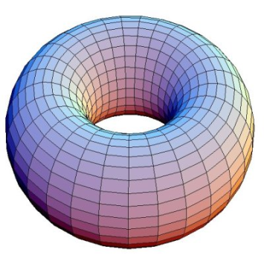
“New” rules for territorial systems on a toroidal plane
Let us now study the iterated prisoner’s dilemma and the evolution of the strategies in a territorial setting.
Our playing field is the surface of a torus, i.e. a rectangle the left and right side and the upper and lower side of which are identified with each other (i.e. glued together in some sense), in order to avoid boundary phenomena.
The decision rules for the adaption of a strategy in a “territory”:
We start with a random distribution of the strategies on the playing field
The rules compete against their direct neighbors (left, right, up, down) as in the common Axelrod tournament and gain points
Then, each field that has a more successful neighbor adapts this strategy and the simulation continuous at stage 2.
The game ends if there are only friendly strategies left that always cooperate mutually (and thus there is no change in the strategies any more).

Slide 25
Example for the final populations in a territorial setting after all conversions have been performed
In the territorial setting the adaption and thus the spread of strategies can occur that are doing “better” with respect to their environment as TIT FOR TAT
6 | 6 | 6 | 1 | 44 | 44 | 44 | 44 | 44 | 6 | 6 | 7 | 7 | 6 | 7 | 6 | 6 | 6
6 | 1 | 31 | 1 | 1 | 44 | 44 | 44 | 44 | 3 | 6 | 3 | 6 | 6 | 6 | 6 | 6 | 6
6 | 6 | 31 | 31 | 1 | 1 | 1 | 1 | 1 | 1 | 3 | 3 | 3 | 52 | 52 | 6 | 6 | 6
6 | 1 | 31 | 31 | 31 | 31 | 31 | 31 | 31 | 31 | 31 | 3 | 3 | 6 | 6 | 6 | 6 | 6
6 | 9 | 31 | 31 | 31 | 31 | 31 | 31 | 31 | 31 | 31 | 31 | 3 | 6 | 6 | 6 | 6 | 6
6 | 31 | 31 | 31 | 31 | 31 | 31 | 31 | 31 | 31 | 31 | 31 | 31 | 6 | 6 | 6 | 6 | 6
6 | 31 | 31 | 6 | 6 | 9 | 31 | 31 | 6 | 9 | 41 | 31 | 31 | 6 | 6 | 31 | 31 | 6
6 | 31 | 31 | 6 | 6 | 9 | 9 | 9 | 6 | 41 | 41 | 31 | 4 | 31 | 31 | 31 | 31 | 6
6 | 31 | 31 | 9 | 9 | 9 | 9 | 9 | 6 | 41 | 41 | 41 | 41 | 31 | 31 | 31 | 31 | 31
6 | 31 | 6 | 9 | 9 | 9 | 6 | 6 | 6 | 41 | 41 | 41 | 17 | 31 | 31 | 31 | 31 | 31
6 | 6 | 9 | 7 | 9 | 9 | 6 | 6 | 6 | 41 | 41 | 41 | 41 | 31 | 31 | 31 | 31 | 7
6 | 6 | 7 | 7 | 7 | 6 | 6 | 6 | 9 | 41 | 41 | 7 | 7 | 7 | 7 | 7 | 7 | 6
6 | 6 | 7 | 7 | 7 | 6 | 6 | 6 | 6 | 41 | 6 | 7 | 7 | 7 | 7 | 7 | 7 | 6
6 | 6 | 7 | 7 | 6 | 6 | 44 | 6 | 6 | 6 | 6 | 7 | 7 | 7 | 7 | 6 | 6 | 6
1: TIT FOR TAT (appears11 times), 31: NYDEGGER (appears 63 times)

Slide 26
Explanation for the success of NYDEGGER
Name | Description
NYDEGGER | Starts like TIT FOR TAT. After a while it analyzes the 3 last mutual encounters and acts accordingly.
Remark:
Even if the average success rate itself is not that excellent, it is a great advantage, in a social system that is based on diffusion by imitation, to be able to achieve some remarkable results.
This is due to the fact that remarkable results lead to numerous conversions.
The performance of NYDEGGER is best studied with respect to its reactions to other strategies:
Like all other surviving strategies, NYDEGGER also never defects as the first one
NYDEGGER is sometimes able to provoke a defecting strategy to such an abundant excuse, that NYDEGGER indeed obtains a higher score as in the case of just mutual cooperation
This abundant excuse happens with 5 of the 24 non-friendly strategies in the tournament
If one of these 5 strategies is a neighbor of NYDEGGER and the other 3 neighbors are friendly rules, then it is likely that NYDEGGER performs better that each of its four neighbors or even better than any of its neighbors’ neighbors.
In that way NYDEGGER is not only able to convert the strategy that apologized but also some or even all of its other neighbors

Slide 27
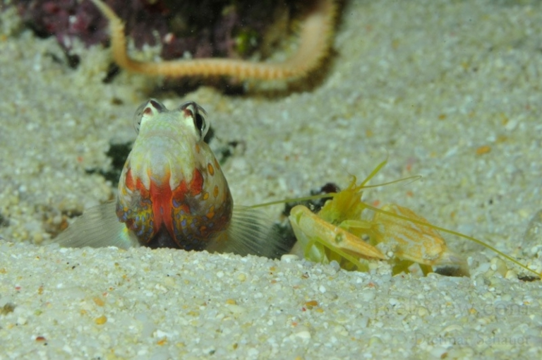
Conclusion: cooperation amongst egoists is possible without a central force of control
Conclusion:
In a world populated by egoists it is possible that mutual cooperation evolves without the interference of a central force of control. The requirement for that is that there is a group of individuals who vouch for reciprocal treatment.
In the computer simulations for the iterated prisoner’s dilemma the easy rule TIT FOR TAT performed remarkably well with respect to other rules
This result is due to the following:
combination of friendly, retaliatory and conciliatory behavior
very easy to spot structure
adequate environment
Under evolutionary conditions TIT FOR TAT did extremely well, too
Depending on the modification of the strategy’s environment and the rules for evolutionary adaption there are better strategies than TIT FOR TAT (territorial systems)

Slide 28
Agenda
The Prisoner’s Dilemma
The Iterated Prisoner’s Dilemma
Nash Equilibria
Nash Equilibria in the Chicken Game

Slide 29
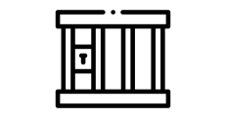
As we already know, the Prisoner’s Dilemma game has one equilibrium in strictly dominant strategies …
player A B | Hawk | Dove
Hawk | (1, 1) | (6, 0)
Dove | (0, 6) | (2, 2)
Definition (Strictly Dominant Strategy):
A pure strategy is said to be “strictly dominant” if the payoffs that a player receives are always strictly better than the payoffs, they receive for all other of their strategies.
“Hawk” is a strictly dominant strategy for player A, as the payoff vector (1, 6) is larger than (0, 2) in each entry:
(1, 6) u (0,2)
Therefore, player A will always choose “hawk” irrespective of what strategy player B chooses.
Due to the symmetry of the game, we have that “hawk” is also a strictly dominant strategy for player B. Hence, both play “hawk” for sure.
The game has the strategy pair (hawk, hawk) as an equilibrium in strictly dominant strategies.
equilibrium in strictly dominant
strategies
Prisoner’s Dilemma payoff matrix

Slide 30
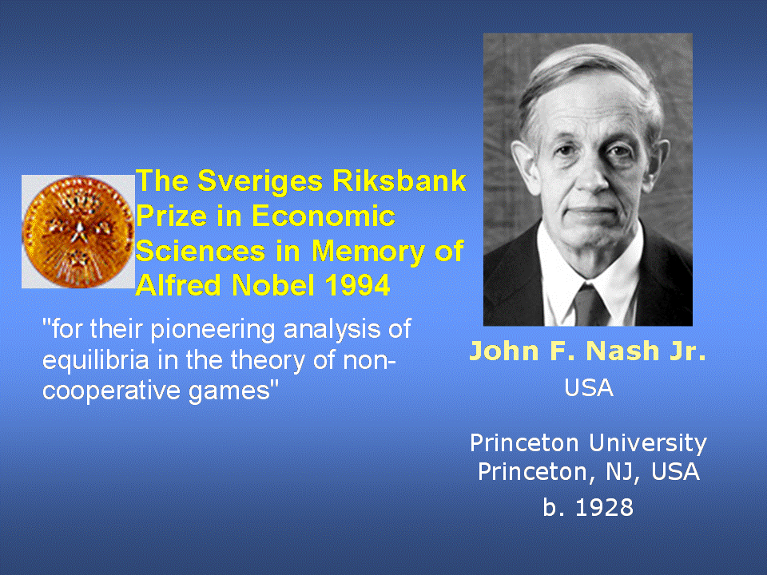
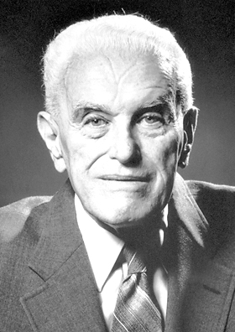
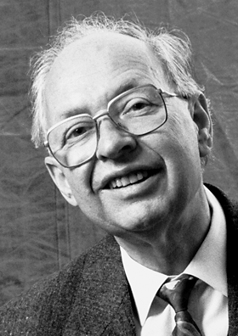
… and this is also a Nash-equilibrium (1/ 2)
In his PhD thesis (1950) Nash showed that
Every game with a finite number of players such that each player has a finite number of (pure) strategies, has at least one equilibrium.
Definition (Nash-equilibrium):
In a non-cooperative game – i.e. a game where the players can not make binding agreements – a Nash-equilibrium is defined as a strategy vector that has the following properties:
no player has an incentive to change their strategy,
given the (equilibrium-)strategy of the other players.
This strategy vector does not need to only contain pure strategies but may also consist of mixed strategies.
John C. Harsanyi
Reinhard Selten

Slide 31
… and this is also a Nash-equilibrium (2/ 2)
player A B | Hawk | Dove
Hawk | (1, 1) | (6, 0)
Dove | (0, 6) | (2, 2)
In the Prisoner’s Dilemma the outcome (hawk, hawk) is such that
no player has an incentive to change their strategy,
given the (equilibrium-)strategy “hawk” of the other player
On the other hand:
at the outcome (hawk, dove), given player A chooses “hawk”, then player B is better of with “hawk” (payoff 1) instead of “dove” (payoff 0)
at the outcome (dove, hawk), given player B chooses “hawk”, then player A is better of with “hawk” (payoff 1) instead of “dove” (payoff 0)
at the outcome (dove, dove),
given player A chooses “dove”, then player B is better of with “hawk” (payoff 6) instead of “dove” (payoff 2)
given player B chooses “dove”, then player A is better of with “hawk” (payoff 6) instead of “dove” (payoff 2)
Nash-equilibrium in pure strategies
Prisoner’s Dilemma payoff matrix

Slide 32
Example: A game with two Nash equilibria in pure strategies
player A B | Hawk | Dove
Hawk | (-1, -1) | (6, 0)
Dove | (0, 6) | (2, 2)
Example:
It is easy to see that the Hawk-Dove game (on the left-hand side) has
no equilibrium in strictly dominant strategies, and
two Nash-equilibria in pure strategies (hawk, dove) and (dove, hawk)
This game is also referred to as the Chicken game.
Nash-equilibrium in pure strategies

Slide 33
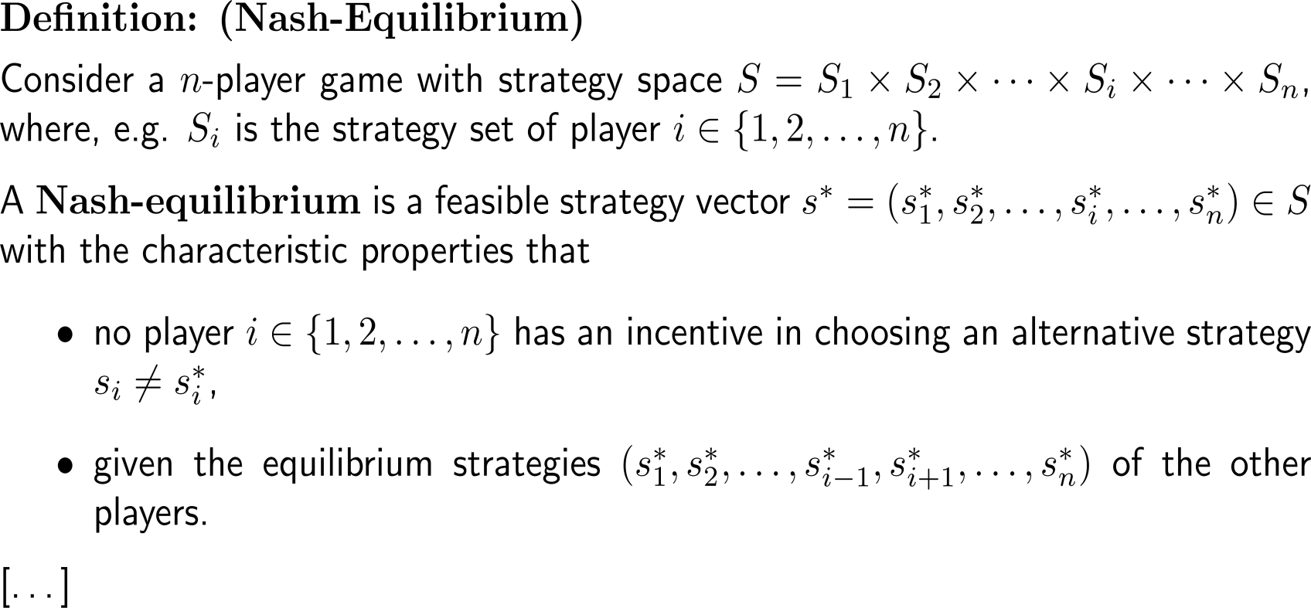
In a Nash-equilibrium no player has an incentive in changing to another strategy given the equilibrium strategy of the other players (2a/ 2)

Slide 34
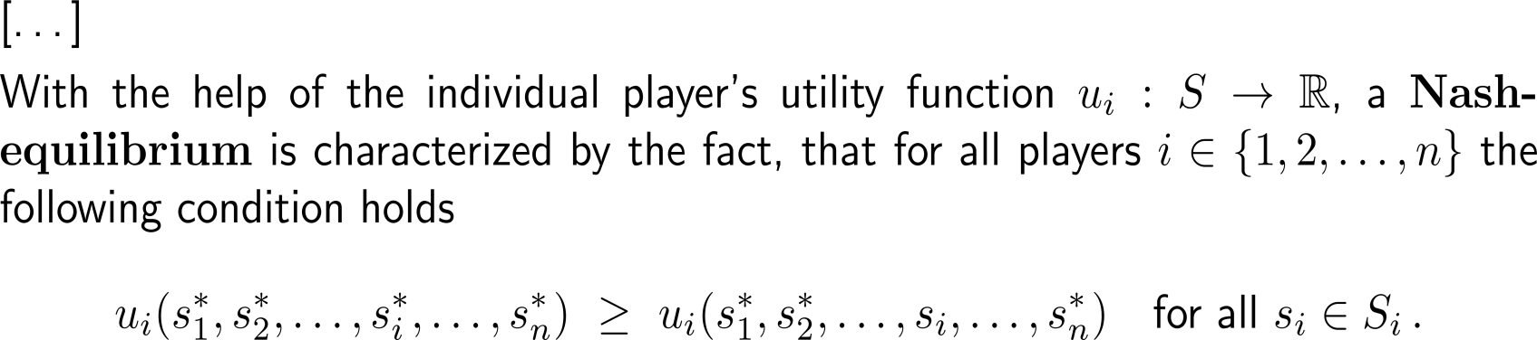
In a Nash-equilibrium no player has an incentive in changing to another strategy given the equilibrium strategy of the other players (2b/ 2)

Slide 35
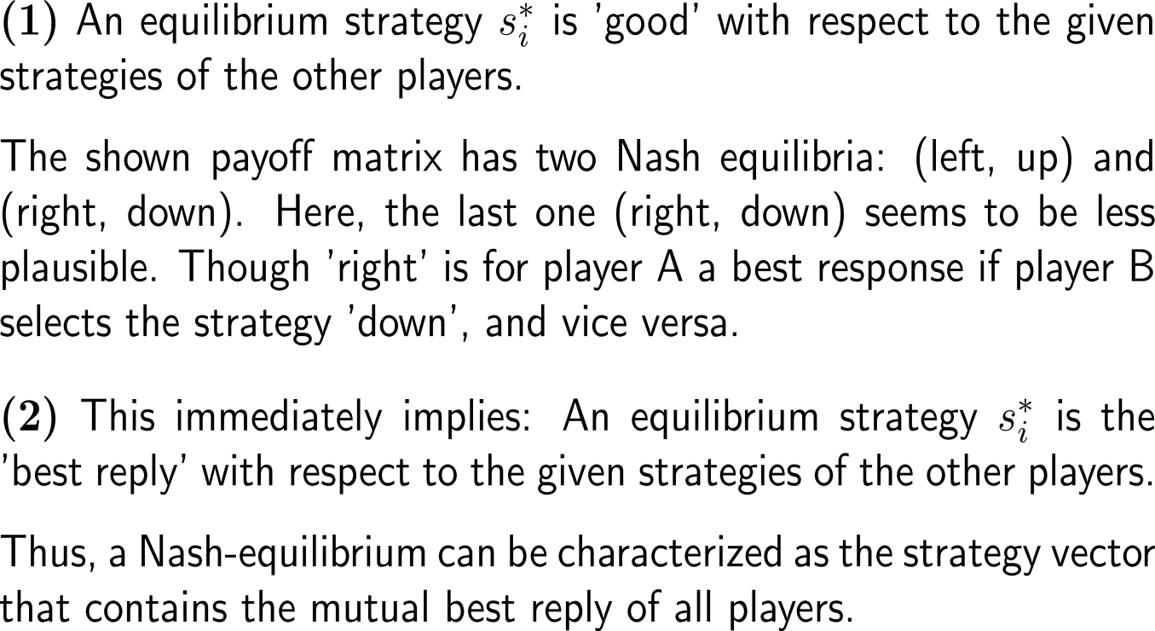
The definition of a Nash-equilibrium immediately implies four consequences (1/ 2)
player A B | up | down
left | (1, 1) | (0, 0)
right | (0, 0) | (0, 0)

Slide 36
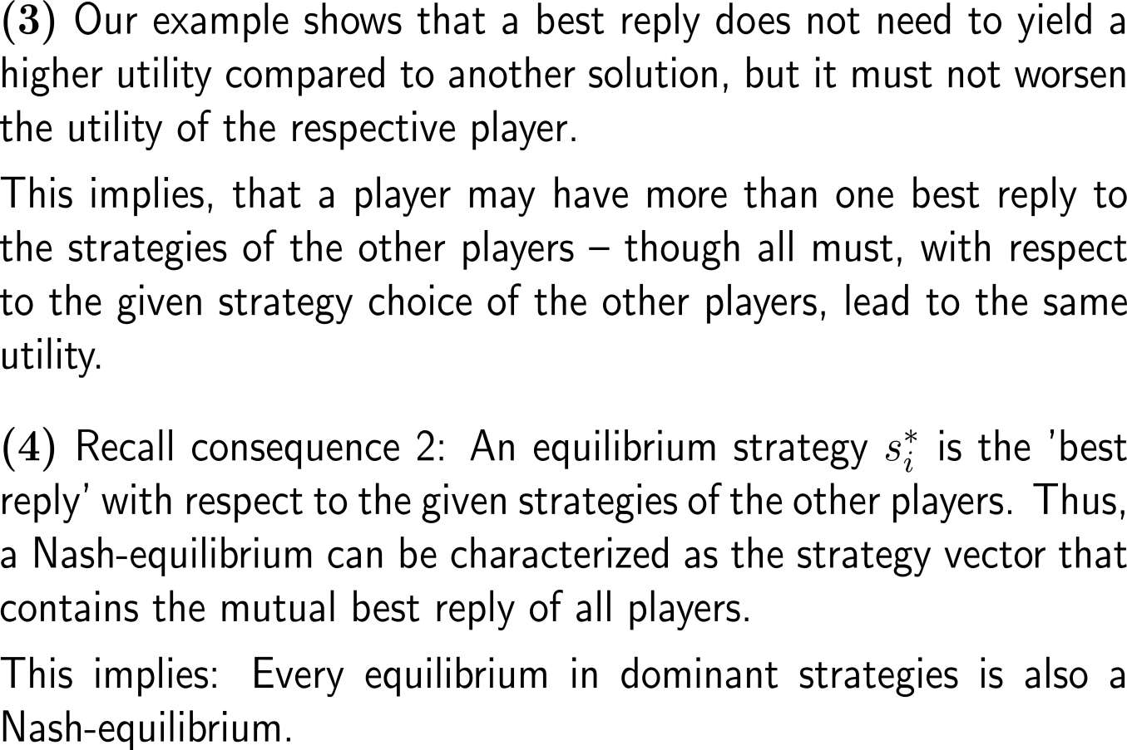
The definition of a Nash-equilibrium immediately implies four consequences (2/ 2)
player A B | up | down
left | (1, 1) | (0, 0)
right | (0, 0) | (0, 0)
equilibrium in strictly dominant strategies
Nash equilibirum

Slide 37
Example: Nash equilibria
player A B | cooperate | not cooperate
cooperate | (3, 5) | (1, 4)
not cooperate | (4, 1) | (2, 2)
Example:
What is the Nash-equilibrium in the given game?
(not cooperate, not cooperate)
(cooperate, cooperate)
(not cooperate, cooperate)
(cooperate, not cooperate)
Which of the following is true?
neither player has a dominant strategy
only player B has a dominant strategy
only player A has a dominant strategy
both players have a dominant strategy
[…]

Slide 38
Example: Nash equilibria
player A B | left | center | right
up | (2, 4) | (2, 2) | (2, 2)
middle | (1, 3) | (3, 1) | (3, 2)
down | (5, 3) | (4, 2) | (4, 4)
How many Nash-equilibria (in pure strategies) does the above game have?
none
1 Nash-equilibrium
2 Nash-equilibria
3 Nash-equilibria

Slide 39
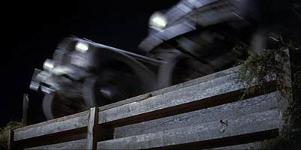
Agenda
The Prisoner’s Dilemma
The Iterated Prisoner’s Dilemma
Nash Equilibria
Nash Equilibria in the Chicken Game

Slide 40
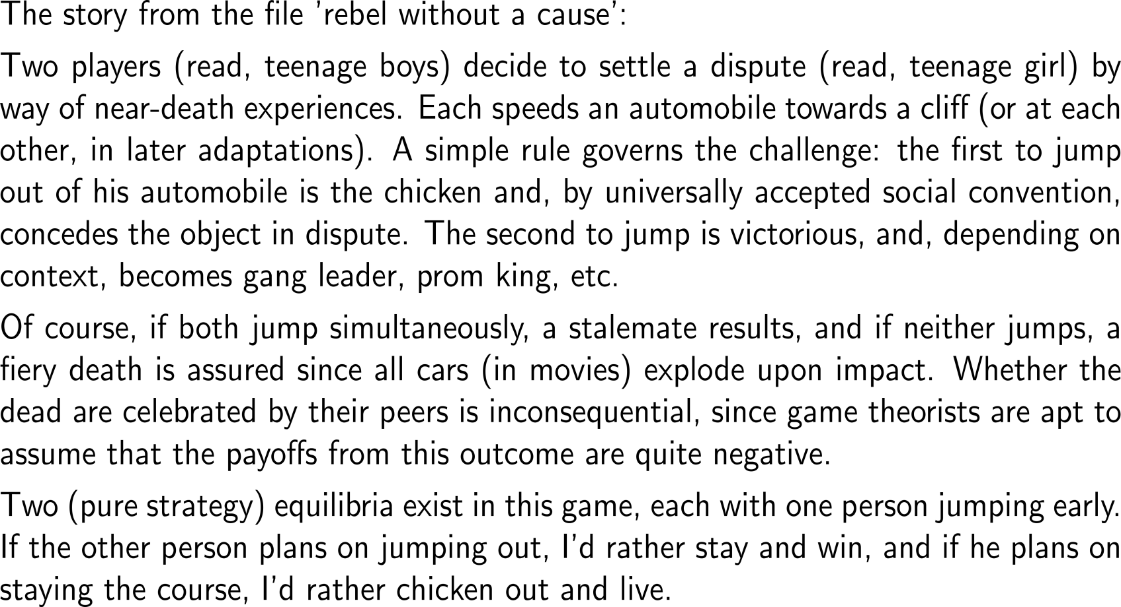
“We are both heading for the cliff, who jumps first, is the Chicken”
video.mp4
(approx. 4 minutes)

Slide 41

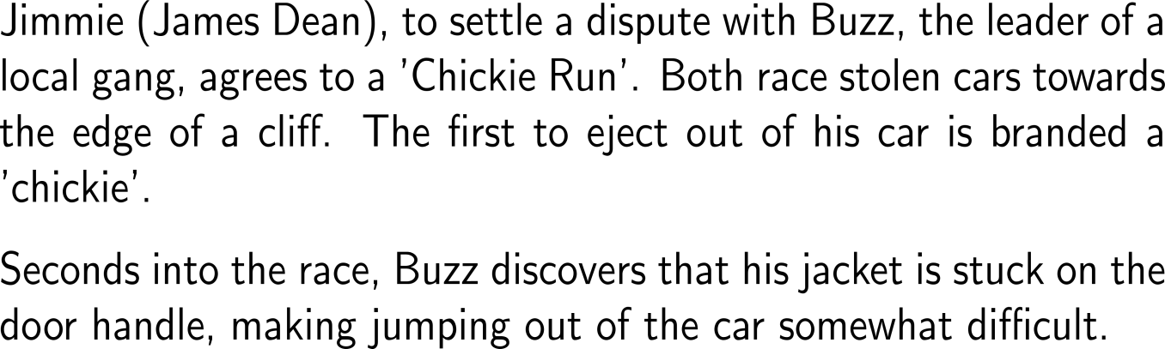

“We are both heading for the cliff, who jumps first, is the Chicken”

Slide 42
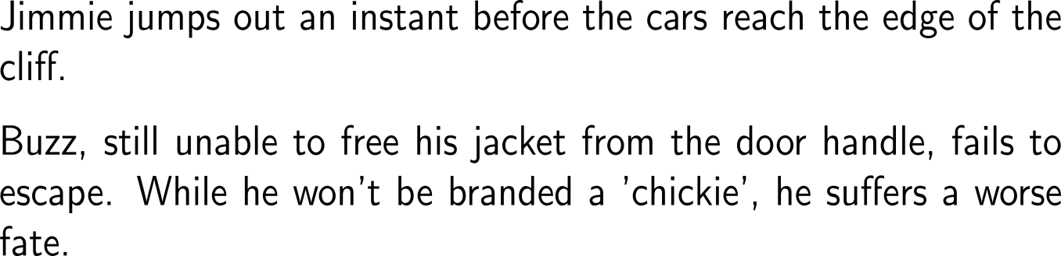

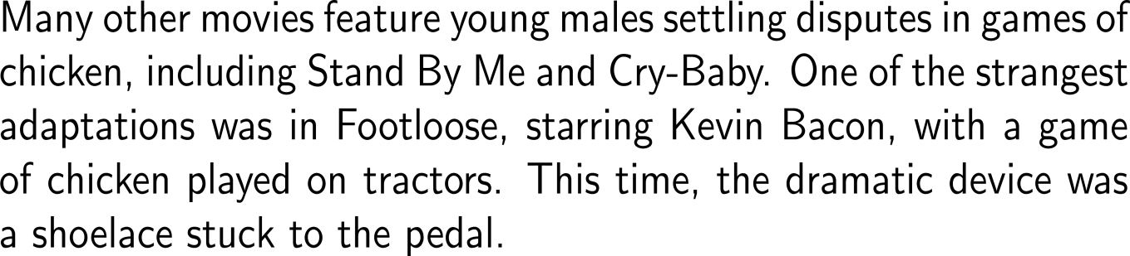
“We are both heading for the cliff, who jumps first, is the Chicken”

Slide 43
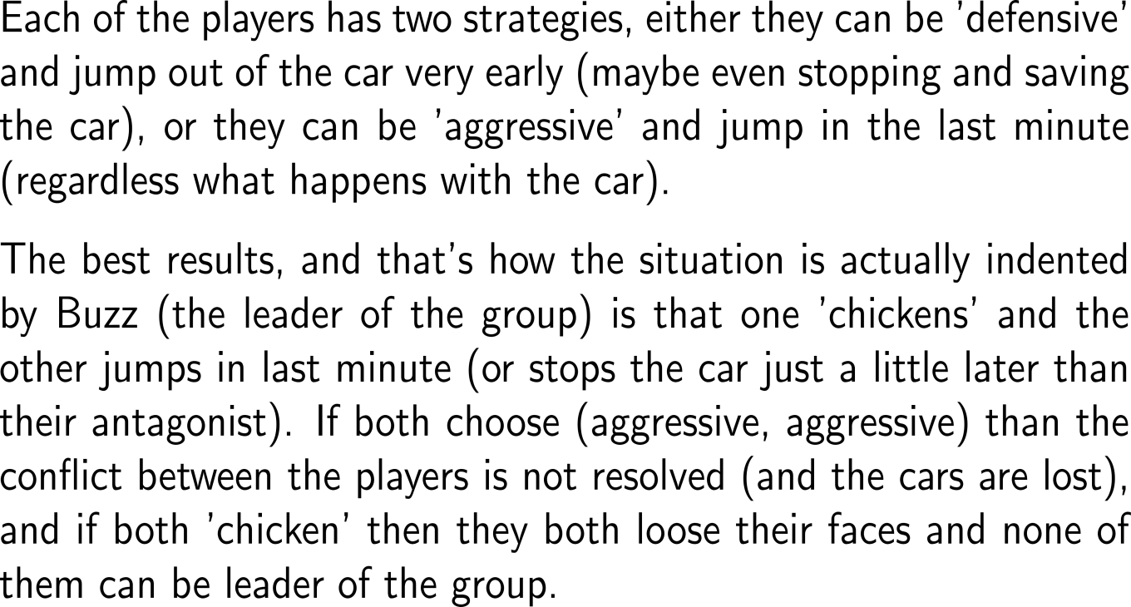
The payoff matrix of the chicken game …
player A B | defensive | aggressive
defensive | (2, 2) | (1, 3)
aggressive | (3, 1) | (0, 0)

Slide 44

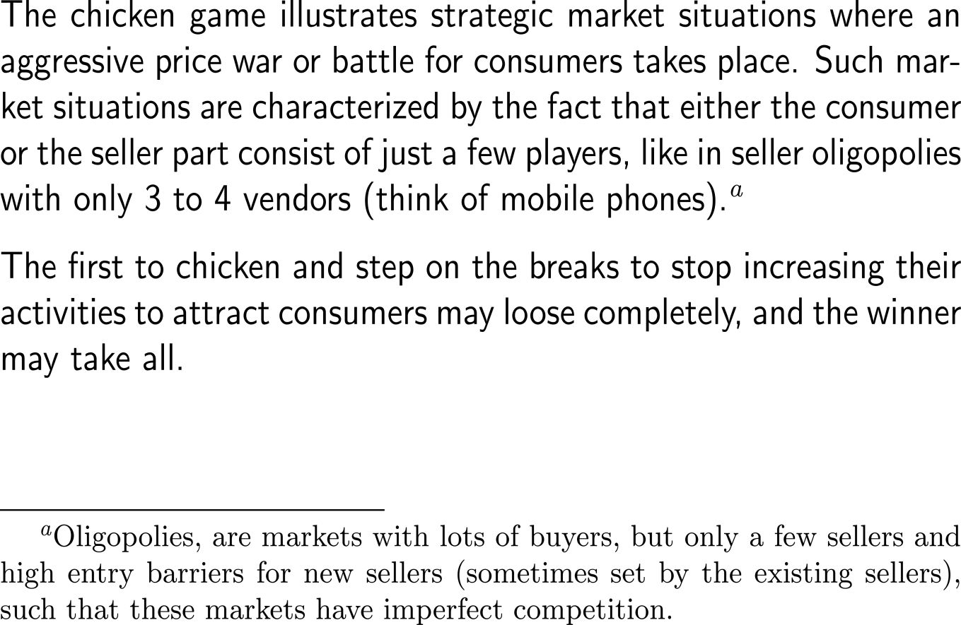
… illustrates strategic market situations in oligopolies
player A B | defensive | aggressive
defensive | (2, 2) | (1, 3)
aggressive | (3, 1) | (0, 0)

Slide 45
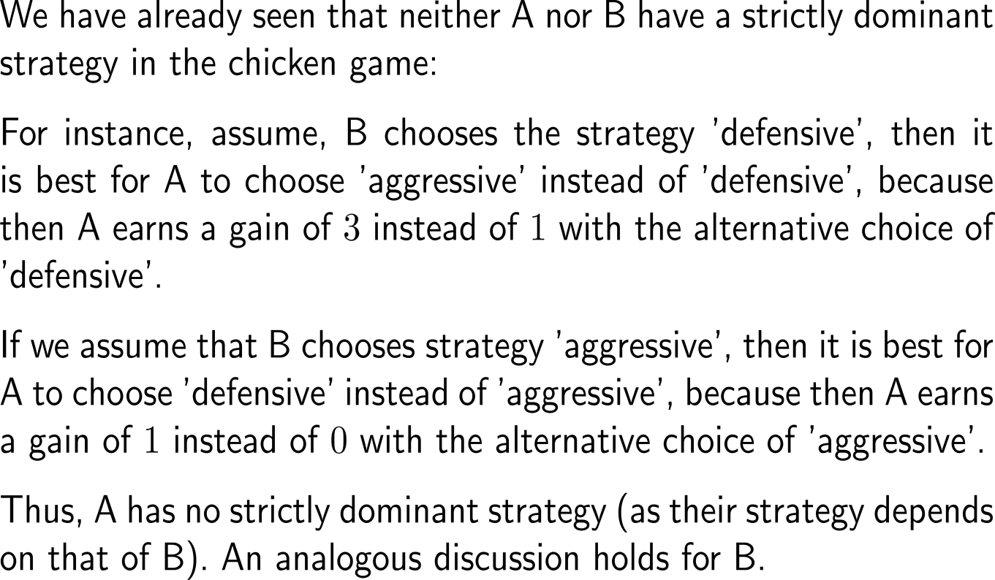
As both players lack a strictly dominant strategy, the chicken game has no equilibrium in dominant strategies …
player A B | defensive | aggressive
defensive | (2, 2) | (1, 3)
aggressive | (3, 1) | (0, 0)

Slide 46
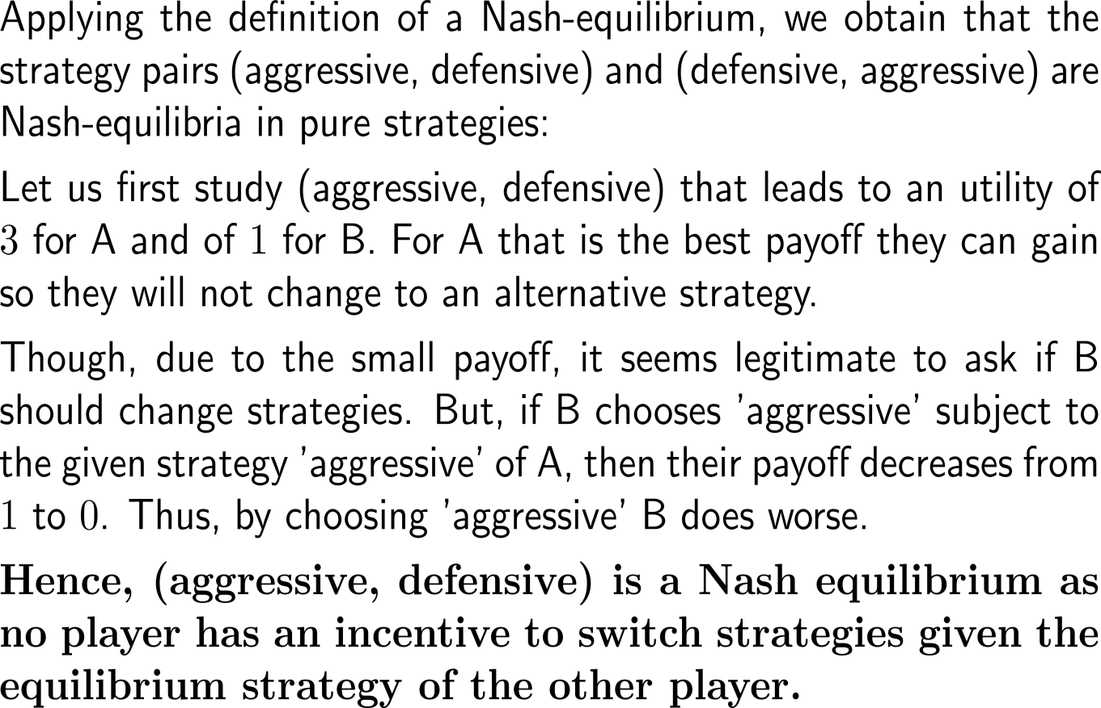
… but it has two Nash equilibria in pure strategies
player A B | defensive | aggressive
defensive | (2, 2) | (1, 3)
aggressive | (3, 1) | (0, 0)

Slide 47
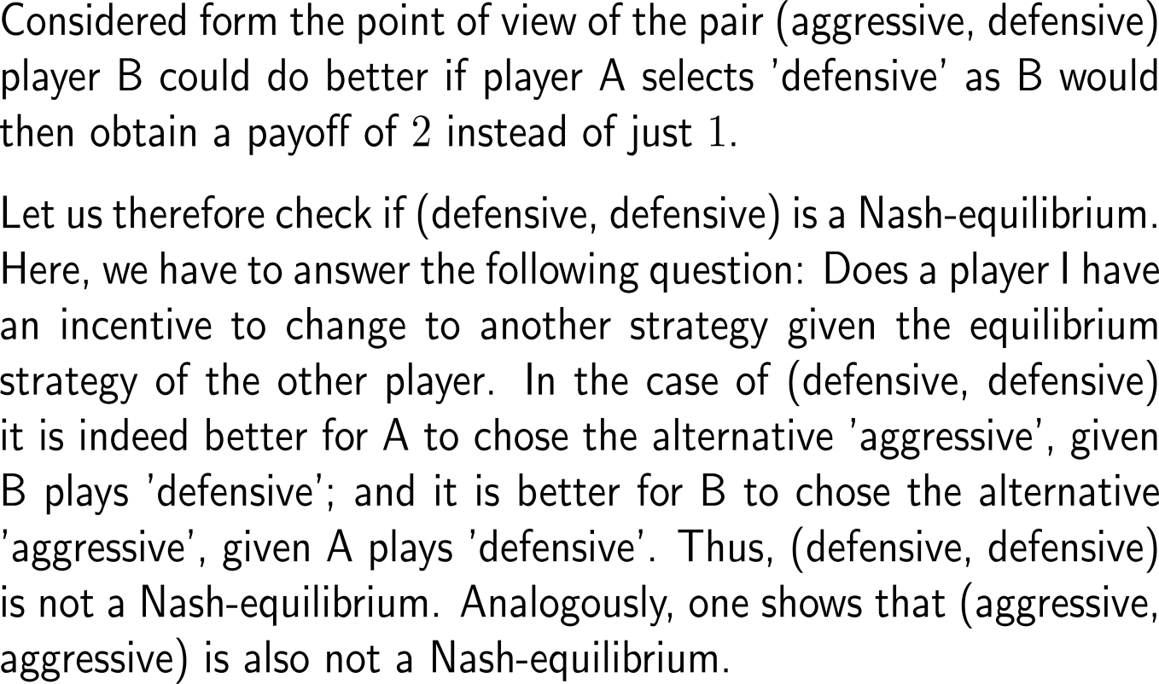
Why are (defensive, defensive) and (aggressive, aggressive) no Nash equilibria?
player A B | defensive | aggressive
defensive | (2, 2) | (1, 3)
aggressive | (3, 1) | (0, 0)

Slide 48
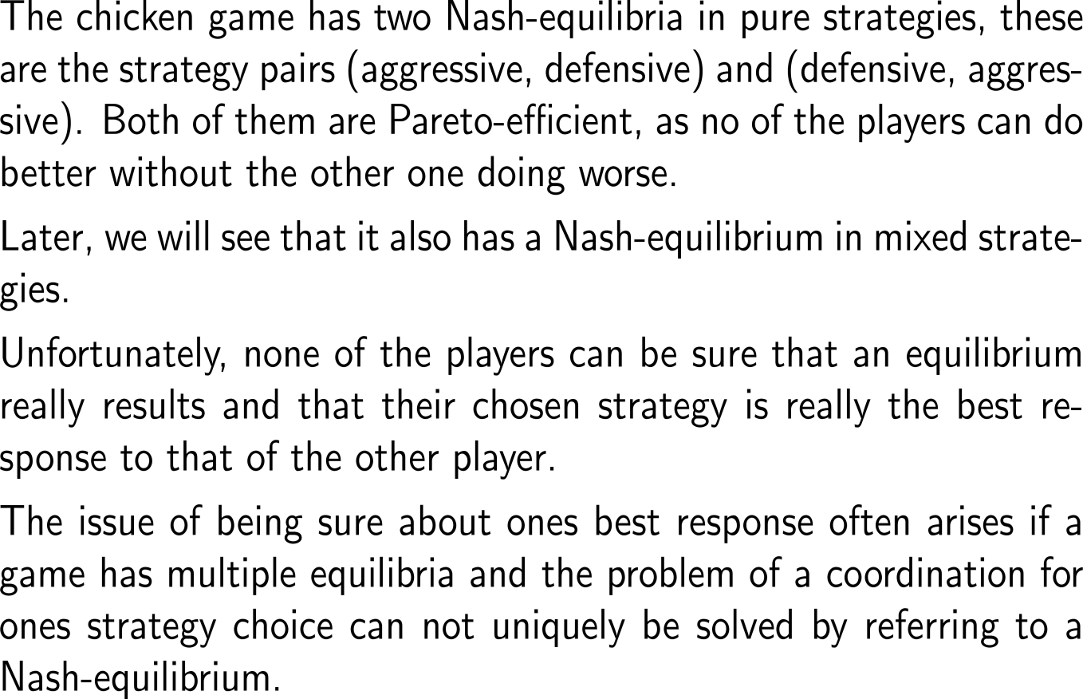
Summary: What does the chicken game tell us so far?
player A B | defensive | aggressive
defensive | (2, 2) | (1, 3)
aggressive | (3, 1) | (0, 0)

Slide 49
What happens when we take “strategic time” into account and consider the Chicken Game as a sequential game? (1/ 2)
player A B | defensive | aggressive
defensive | (2, 2) | (1, 3)
aggressive | (3, 1) | (0, 0)
s₂₂
(0, 0)
2
s₁₂
s₂₁
(3, 1)
A
1
s₂₂
(1, 3)
s₁₁
2
changing the representation of the chicken game from the matrix form to its game tree with the sequential information that player 1 moves first
s₂₁
(2, 2)
B
strategic time/ sequential structure

Slide 50
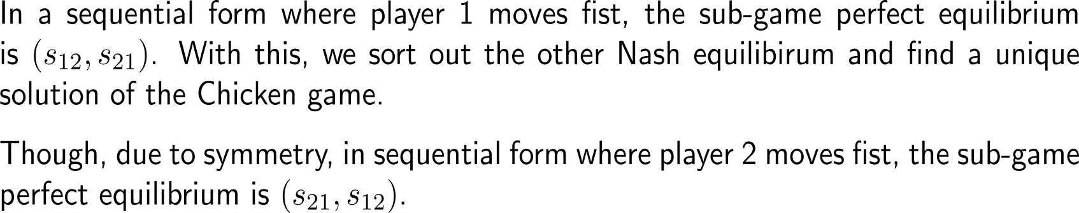
What happens when we take “strategic time” into account and consider the Chicken Game as a sequential game? (2/ 2)
s₂₂
(0, 0)
2
2
(3, 1)
2
(3, 1)
s₁₂
(3, 1)
s₁₂
s₂₁
s₁₂
s₂₁
A
s₂₁
A
A
1
1
1
s₂₂
(1, 3)
s₁₁
s₁₁
2
2
(1, 3)
s₂₁
(2, 2)
s₂₂
B
B

Slide 51
Computational Biomathematics
florian.rupp@kiu.edu.ge

