Slide 1
Computational Biomathematics
Implementation of the Iterated Prisoner’s Dilemma (Replaying Axelrod’s Tournaments)
Lesson 7
Lecture
Setting-up the computerized model
Phase 1: baseline tournament
Phase 2: evolution
Phase 3: environments

Slide 2
The four dimensions of good utilization of AI
1. Understand the Problem
Purpose
clear goals, directions, and requirements
here:
2. Plan
Biology
Methodology
structure and segment complex task, examine intermediate steps
Domain Knowledge
check facts, identify gaps, assess outputs (qualification, validation, verification)
3. Execute
Scientific Computing
KI Competency (Tool Competency)
prompting, iterating, steering context
4. Look Back
Mathematics

Slide 3
Topics
Setting-up the Computerized Model
Phase 1: Baseline Tournament
Phase 2: Evolution
Phase 3: Environments

Slide 4
AI-enhanced coding: 1) Specify computational work in layers
1. Understand the Problem
The simulation of the iterated Prisoner’s Dilemma tournaments is quite a complex endeavor. As you may have already recognized, it does not help much to merely ask AI:
“write me a big program.”
Instead, we must specify computational work in layers:
Rules
Software design requirements
Project structure
Output requirements
File-by-file code generation
This has two advantages:
it teaches computational thinking, and
it teaches good AI prompting practice
2. Plan
Architecture overview:
easy addition of strategies
easy modification of payoff matrices
competition between strategies
evolutionary replacement of weak strategies by more successful ones
small code files, so AI-generated output does not become too large
a design that is simple and modular
3. Execute
4. Look Back

Slide 5
AI-enhanced coding: 2) Program structure
1. Understand the Problem
main.py
seed
config.py
(contains parameters: payoff matrix, number of rounds, number of generations, mutation/copy rules, list of strategies)
utils.py
(small helper functions for formatting and saving outputs)
2. Plan
tournament.py
(runs pairwise encounters and computes scores)
3. Execute
evolution.py
(implements the replacement process: worst strategies decrease, successful ones reproduce)
4. Look Back
base_strategy.py
(abstract interface for all strategies)
individual strategies (one per file)
visualization.py
(implements the visualization of the output statistics, graphs over time)

Slide 6
AI-enhanced coding: 3) Consecutive execution
1. Understand the Problem
Next, we use AI to build a modular Python simulator for the evolution of cooperation. We proceed our AI interaction (execution phase) in two steps:
Step 1: Think about the model before coding
Rules: We ask AI to formulate clear simulation rules for an iterated Prisoner’s Dilemma tournament with evolutionary updating.
Software design requirements: We ask AI to define a simple modular software design with strategy classes, tournament logic, evolution logic, configuration, and execution.
Project structure: We ask AI to propose a file structure with short files and one strategy per file.
Step 2: File-by-file code generation
Successive code generation: We ask AI to generate the files one by one, not all at once, and to keep the design simple and modular.
Output requirements: We ask AI to include rankings, scores, and population changes across generations.
2. Plan
3. Execute
4. Look Back

Slide 7
Step 1: Think about the model before coding a) Rules specification
Prompt A (Rules Specification):
Help me define the rules for a Python simulation of the evolution of cooperation based on the iterated prisoner’s dilemma (Axelrod’s tournament).
Please, formulate the rules clearly and compactly. The simulation should include:
repeated pairwise interactions,
strategies with memory of previous moves,
a configurable payoff matrix,
a tournament among strategies,
an evolutionary update step after each tournament,
multiple generations.
Please provide:
a precise rule set,
a list of configurable parameters,
a short explanation of how the evolutionary replacement should.
AI
refine and specify with detailed information about the iterated Prisoner’s Dilemma
prompt generated with the help pf AI

Slide 8
Example: a) Rules specification
Example:
Participants: Each strategy is represented by an agent that can remember previous moves.
Interactions: Agents engage in repeated pairwise interactions, where each agent plays against every other agent a fixed number of times.
Strategies: Each agent employs a strategy that determines its action (cooperate or defect) based on its memory of previous interactions.
Payoff Matrix: Payoff values are configurable and define the rewards for the actions:
T (temptation to defect)
R (reward for mutual cooperation)
P (punishment for mutual defection)
S (sucker’s payoff)
Example matrix/ payoffs from point of view of the column player:
Tournament Structure: After all pairwise interactions, agents are ranked based on their total payoffs.
Evolutionary Update: The least successful agents are replaced by copies of the most successful agents based on their performance in the tournament.
Generational Cycle: Repeat the tournament and evolutionary update for a specified number of generations.
 | cooperate | defect
cooperate | R | S
defect | T | P

Slide 9
Example: a) Rules specification
Configurable Parameters
Number of Agents: Total agents participating in the simulation.
Number of Iterations: How many times each agent interacts with every other agent.
Payoff Matrix Values: Configurable values for T, R, P, S.
Memory Length: How many previous moves each agent remembers.
Number of Generations: How many times the tournament and evolutionary update will occur.
Selection Pressure: Determines how many of the top-performing agents will reproduce.
Evolutionary Replacement Explanation
Scoring: After each tournament, calculate the total payoff for each agent.
Selection: Rank agents by their total payoffs.
Replacement:
Select a predefined number of the highest-scoring agents.
Replace the lowest-scoring agents in the population with copies of these successful agents.
Optionally, introduce mutations or variations in the strategies of the new agents.
Summary
This simulation framework will allow you to explore the dynamics of cooperation through repeated interactions and evolutionary pressures. By adjusting the parameters, you can investigate various scenarios and the emergence of cooperative behavior among agents.

Slide 10
Step 1: Think about the model before coding b) Software design requirements
Prompt B (Software Design Requirements):
Based on the following simulation idea, please derive suitable software design requirements for a modular Python project.
Simulation idea:
iterated prisoner's dilemma,
multiple strategies,
configurable payoff matrix,
all strategies play against each other,
evolutionary update across generations.
Please provide:
the main software design requirements,
a recommendation for modular decomposition,
the interface that every strategy class should implement,
advice for keeping the code simple and beginner-friendly.
AI
refine and specify with detailed information about the iterated Prisoner’s Dilemma
prompt generated with the help pf AI

Slide 11
Example: b) Software design requirements
Example:
Main Software Design Requirements
Modularity: The code should be divided into well-defined modules to promote reusability and ease of maintenance.
Configurability: The simulation should allow easy modification of key parameters, such as the payoff matrix and the number of agents.
Scalability: The design should accommodate the addition of new strategies without significant changes to existing code.
Performance: The simulation should efficiently handle multiple strategies and interactions without excessive computational overhead.
Documentation: Code should be well-documented with clear comments and a user guide to facilitate understanding for beginners.
Testing: Implement unit tests to ensure the functionality of individual components and overall system integrity.
Recommended Modular Decomposition
Main Module: Handles the overall simulation flow, including initialization, running tournaments, and managing generations.
Strategy Module: Contains different strategy classes implementing various strategies for the prisoner’s dilemma.
Payoff Matrix Module: Manages the configuration and storage of the payoff matrix.
Tournament Module: Responsible for running pairwise interactions between strategies and calculating scores.
Evolution Module: Handles the evolutionary update process, including selection and replacement of strategies.
Utilities Module: Provides helper functions for common tasks (e.g., data handling, logging).

Slide 12
Example: b) Software design requirements
Interface for Strategy Classes
Every strategy class should implement the following interface:
Advice for Keeping the Code Simple and Beginner-Friendly
Use Clear Naming Conventions: Use descriptive names for variables, classes, and functions to clarify their roles and purposes.
Limit Complexity: Keep functions and classes focused on a single responsibility to make them easier to understand and test.
Provide Examples: Include example usage and simple test cases in the documentation to help beginners grasp how to use the code.
Consistent Formatting: Follow a consistent code style (e.g., PEP 8 for Python) to enhance readability.
Encourage Modularity: Promote the use of modules and classes to encapsulate functionality, making it easier for beginners to modify and extend the code.
Comment Generously: Use comments to explain complex sections of code and the rationale behind important design decisions.
class Strategy:
def __init__(self):
pass
def reset(self):
"""
Reset the strategy's state for a new generation or match.
"""
pass
def choose_action(self, history: list) -> str:
"""
Decide the next action based on the history of previous moves.
:param history: List of previous actions (e.g., ['C', 'D', 'C'])
:return: 'C' for cooperate, 'D' for defect
"""
pass
def update_memory(self, opponent_action: str):
"""
Update the strategy's memory based on the opponent's action.
:param opponent_action: The action taken by the opponent ('C' or 'D')
"""
pass

Slide 13
Step 1: Think about the model before coding c) Project structure
Prompt C (Project Structure):
Please propose a clean project structure for a Python teaching project on the evolution of cooperation in an iterated Prisoner’s Dilemma.
Requirements:
code files should not be too large,
strategies should be easy to add later,
payoff rules should be easy to change,
tournament and evolution logic should be separate,
output should be easy to understand.
Please provide:
1. the folder structure,
2. the purpose of each file,
3. the recommended order in which the files should be implemented.
AI
refine and specify with detailed information about the iterated Prisoner’s Dilemma
prompt generated with the help pf AI

Slide 14
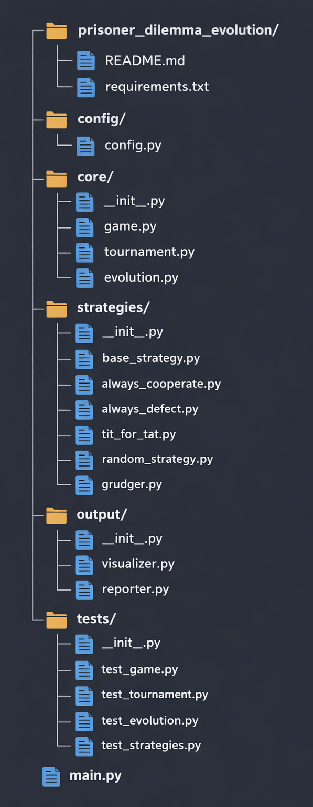
Example: c) Project structure
Example:
1. Folder Structure (see left-hand side)
2. Purpose of Each File
Root Level:
README.md: Project overview, installation instructions, usage examples, and educational goals.
requirements.txt: List of Python dependencies (e.g., matplotlib, numpy).
main.py: Entry point for running the simulation; orchestrates the entire process.
config/
config.py: Stores all configurable parameters (payoff matrix, number of generations, iterations per match, population size, selection pressure).
core/
init.py: Makes the directory a Python package.
game.py: Implements the basic prisoner's dilemma game logic (single interaction, payoff calculation).
tournament.py: Manages round-robin tournaments where all strategies play against each other.
evolution.py: Handles evolutionary updates (selection, reproduction, replacement of strategies).

Slide 15
Example: c) Project structure
strategies/
init.py: Makes the directory a Python package; can include a strategy registry.
base_strategy.py: Defines the abstract base class/interface that all strategies must implement.
always_cooperate.py: Strategy that always cooperates.
always_defect.py: Strategy that always defects.
tit_for_tat.py: Strategy that copies the opponent's last move.
random_strategy.py: Strategy that randomly chooses cooperation or defection.
grudger.py: Strategy that cooperates until the opponent defects, then always defects.
output/
init.py: Makes the directory a Python package.
visualizer.py: Creates graphs and charts (e.g., strategy population over generations, average scores).
reporter.py: Generates text-based reports and summaries of simulation results.

Slide 16
Example: c) Project structure
tests/
init.py: Makes the directory a Python package.
test_game.py: Unit tests for game logic.
test_tournament.py: Unit tests for tournament mechanics.
test_evolution.py: Unit tests for evolutionary updates.
test_strategies.py: Unit tests for individual strategies.
3. Recommended Implementation Order
Phase 1a: Baseline Tournament (Core Game Mechanics)
strategies/base_strategy.py – Create the strategy interface.
strategies/always_cooperate.py – Implement simplest strategy.
strategies/always_defect.py – Implement second simplest strategy.
config/config.py – Define all parameters first.
core/game.py – Implement basic game logic for single interactions.
output/reporter.py – Generate 1st version of a text-based output.
output/visualizer.py – Create 1st version of visualizations.
main.py – Create the 1st version of the main simulation loop (such that a testing of this phase can be conducted).

Slide 17
Example: c) Project structure
Phase 1b: Tournament Logic
strategies/tit_for_tat.py – Add a memory-based strategy.
strategies/random_strategy.py – Add probabilistic strategy.
strategies/grudger.py – Add more complex strategies.
core/tournament.py – Implement round-robin tournament.
output/reporter.py – Generate 2nd version of a text-based output.
output/visualizer.py – Create 2nd version of visualizations.
main.py – Create the 2nd version of the main simulation loop (such that a testing of this phase can be conducted).
tests/test_*.py – Write several unit tests for all modules.
Phase 2: Evolution
core/evolution.py – Implement evolutionary selection and replacement.
output/reporter.py – Generate final version of a text-based output.
output/visualizer.py – Create final version of visualizations.
main.py – Create the final version of the main simulation loop.
tests/test_*.py – Write several unit tests for all modules.
README.md – Complete documentation.
requirements.txt – Finalize dependencies.

Slide 18
Example: c) Project structure
Phase 3: Environments & Testing
Consider harsh environments
Consider noisy interactions
tests/test_*.py – Write unit tests for all modules.
README.md – Complete documentation.
requirements.txt – Finalize dependencies.
Additional Notes
Start Simple: Begin with just two basic strategies to verify the game and tournament logic work correctly.
Incremental Testing: Test each component as you build it before moving to the next phase.
Flexibility: The modular structure allows students to easily add new strategies by creating new files in the strategies/ folder.
Summary
This structure promotes clean separation of concerns, making it easy to understand and modify.

Slide 19
Topics
Setting-up the Computerized Model
Phase 1: Baseline Tournament
Phase 2: Evolution
Phase 3: Environments & Testing

Slide 20
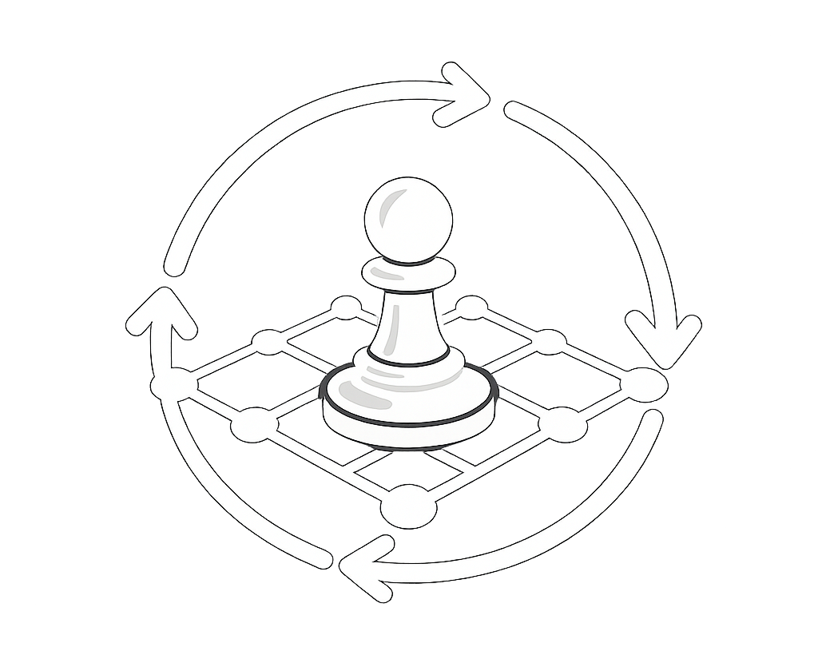
Phase 1 (Baseline Tournament): File-by-file code generation – 1/ 2
Illustration
Phase 1: Baseline Tournament (Core Game Mechanics)
0. generation of the folder structure with empty python files
strategies/base_strategy.py
strategies/always_cooperate.py strategies/always_defect.py
config/config.py
core/game.py
output/reporter.py (1st version)
output/visualizer.py (1st version)
main.py (1st version)
Prompt D1 (base_strategy.py):
Please write the file “base_strategy.py”for a modular Python project on the iterated prisoner's dilemma.
Requirements:
define a base class for all strategies,
include a strategy name,
include a reset() method,
include a choose_action(opponent_history, own_history) method,
keep it simple and suitable for teaching,
use clear comments,
provide only the code for this file.
Baseline Tournament
no evolution yet
just let all strategies play each other
compare scores
Purpose: understand strategic behavior.
prompt generated with the help pf AI
AI

Slide 21
Phase 1 (Baseline Tournament): File-by-file code generation – 2/ 2
Illustration
Illustration
Prompt D2 (simple strategies):
Please write the following files for a modular Python project on the iterated prisoner's dilemma:
always_cooperate.py
always_defect.py
Requirements:
each strategy should inherit from the base strategy class,
each file should contain exactly one strategy,
keep the files short,
use clear comments,
provide the code file by file.
Prompt D3 (config.py):
Please write the file ‘config.py’ for the project.
Requirements:
define the payoff matrix centrally,
define number of rounds per encounter,
define number of generations,
define initial population counts for each strategy,
make it easy to modify parameters,
keep the file short and readable,
provide only the code for this file.
prompt generated with the help pf AI
AI
prompt generated with the help pf AI
AI

Slide 22
Phase 1 (Baseline Tournament): Simulation results
=== MATCH RESULTS ===
AlwaysCooperate vs AlwaysCooperate: 30 - 30
AlwaysCooperate vs AlwaysDefect: 0 - 50
AlwaysCooperate vs TitForTat: 30 - 30
AlwaysCooperate vs RandomStrategy: 24 - 34
AlwaysCooperate vs Grudger: 30 - 30
AlwaysDefect vs AlwaysDefect: 10 - 10
AlwaysDefect vs TitForTat: 14 - 9
AlwaysDefect vs RandomStrategy: 38 - 3
AlwaysDefect vs Grudger: 14 - 9
TitForTat vs TitForTat: 30 - 30
TitForTat vs RandomStrategy: 24 - 24
TitForTat vs Grudger: 30 - 30
RandomStrategy vs RandomStrategy: 36 - 11
RandomStrategy vs Grudger: 11 - 21
Grudger vs Grudger: 30 - 30
Questions
Why does “Always Defect” often score well against naive cooperators?
Why can “Tit for Tat” perform strongly in repeated settings?
How does “Grudger” differ from Tit for Tat?
How does randomness affect tournament outcomes?
Why total score and average score can both be interesting? (see next slide)

Slide 23
Phase 1 (Baseline Tournament): Simulation results
=== SCOREBOARD ===
AlwaysCooperate | total = 144 | avg/match = 24.00 | avg/round = 2.40
AlwaysDefect | total = 136 | avg/match = 22.67 | avg/round = 2.27
TitForTat | total = 153 | avg/match = 25.50 | avg/round = 2.55
RandomStrategy | total = 119 | avg/match = 19.83 | avg/round = 1.98
Grudger | total = 150 | avg/match = 25.00 | avg/round = 2.50
=== RANKING ===
1. TitForTat (total score = 153)
2. Grudger (total score = 150)
3. AlwaysCooperate (total score = 144)
4. AlwaysDefect (total score = 136)
5. RandomStrategy (total score = 119)

Slide 24
Topics
Setting-up the Computerized Model
Phase 1: Baseline Tournament
Phase 2: Evolution
Phase 3: Environments

Slide 25
Phase 2 (1st Evolutionary Replacement): Simulation set-up
Matches are weighted by population sizes (adaptation of the tournament rules) following the idea:
if strategy A has population 20 and strategy B has population 15,
then the encounter A vs B represents 20 * 15 pairings,
for self-play we use n * n.
Ranking is based on average performance per effective match where following the simple replacement rule is implemented (this is not a replicator-like approach):
find strongest strategy,
find weakest strategy,
move some number of individuals from weakest to strongest,
do not reduce below zero.
1st Evolutionary Replacement
weakest loses, strongest gains
over several generations
Purpose: see selection effects.

Slide 26
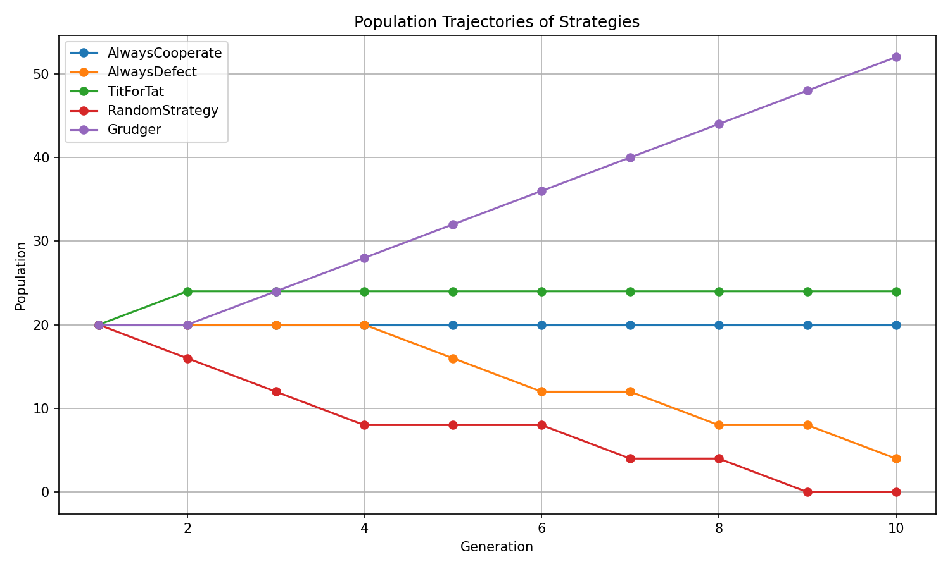
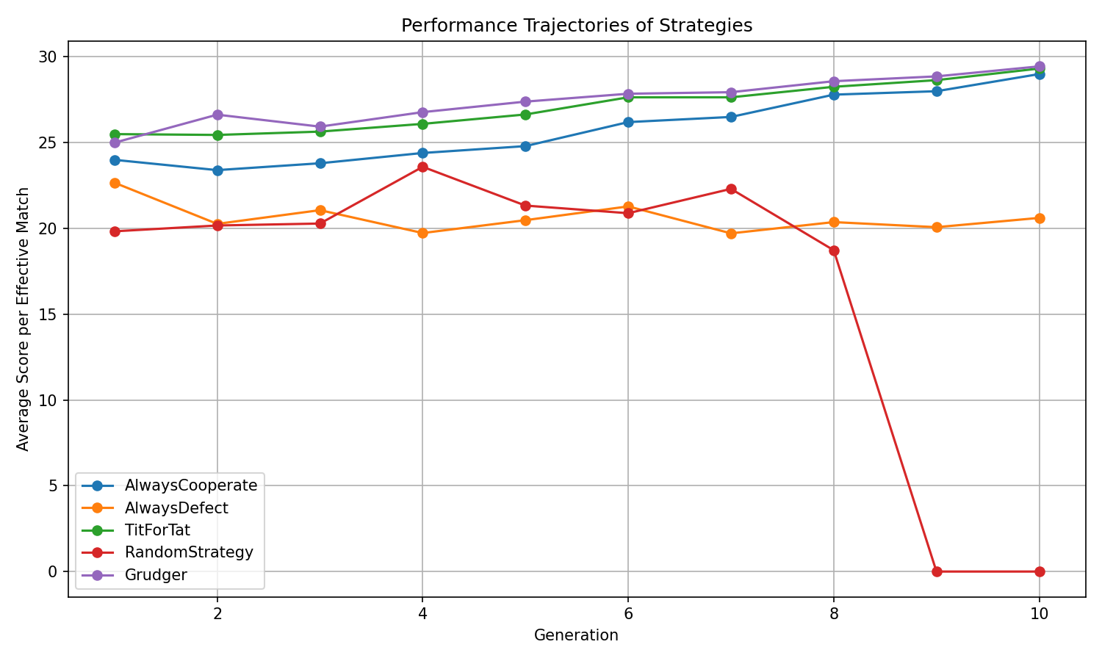
Phase 2 (1st Evolutionary Replacement): Simulation results
A strategy may have high current performance but if its environment changes because populations shifts, its future success may change as well.

Slide 27
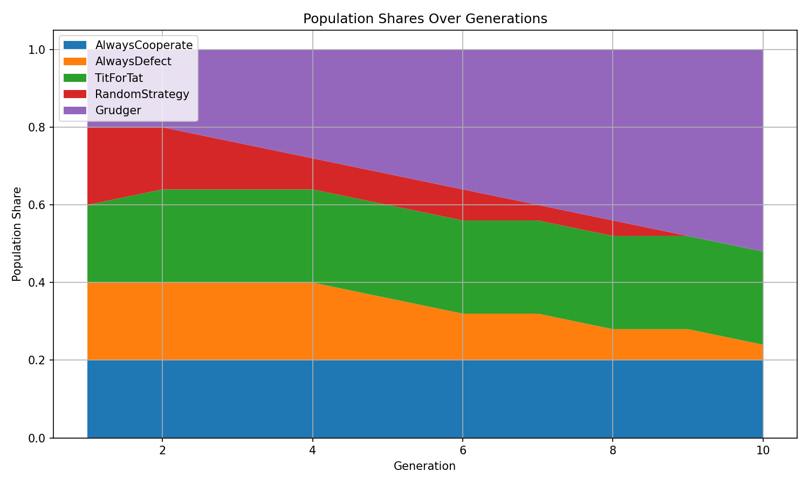
Phase 2 (1st Evolutionary Replacement): Simulation results

Slide 28
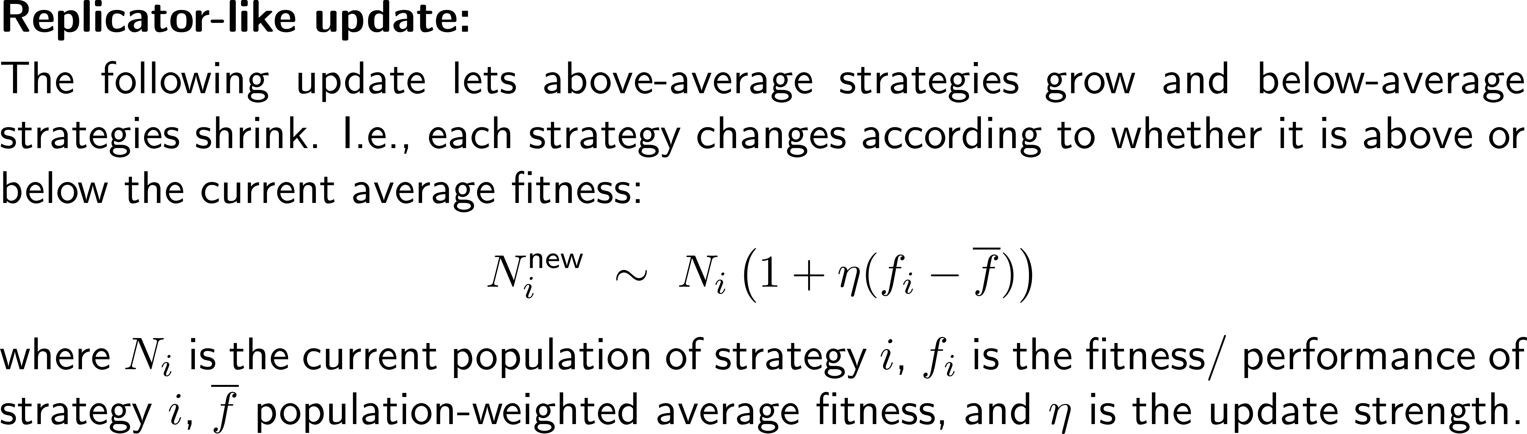
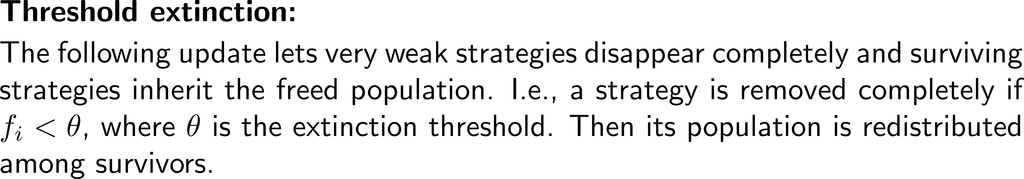
Phase 2 (2nd Evolutionary Replacement): Simulation set-up
2nd Evolutionary Replacement
weakest loses, strongest gains
over several generations
Purpose: see selection effects.

Slide 29
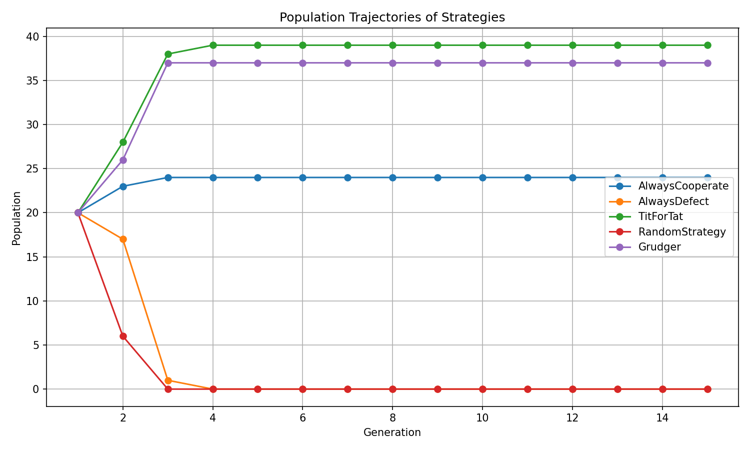
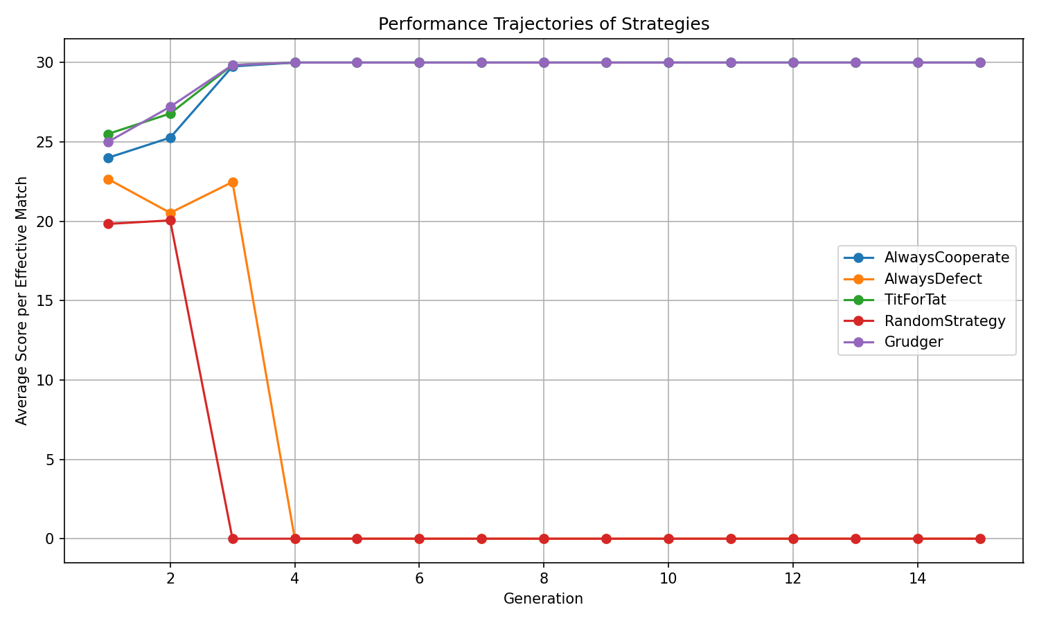
Phase 2 (2nd Evolutionary Replacement): Simulation set-up

Slide 30
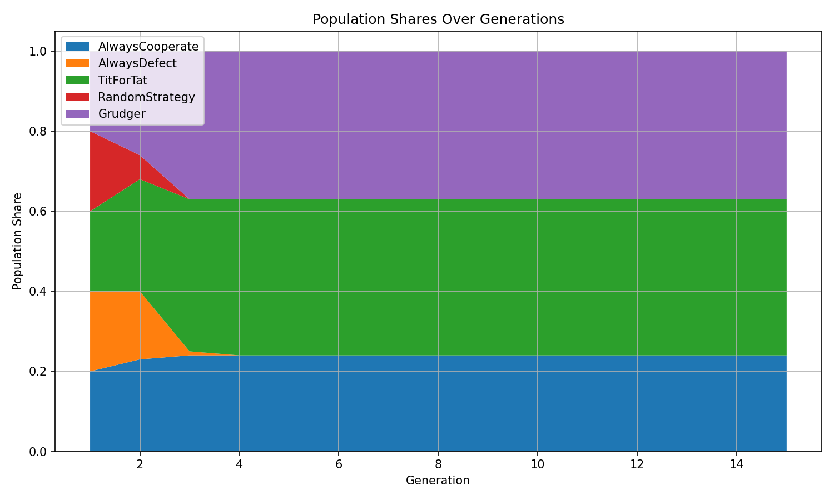
Phase 2 (2nd Evolutionary Replacement): Simulation set-up

Slide 31
Topics
Setting-up the Computerized Model
Phase 1: Baseline Tournament
Phase 2: Evolution
Phase 3: Environments

Slide 32
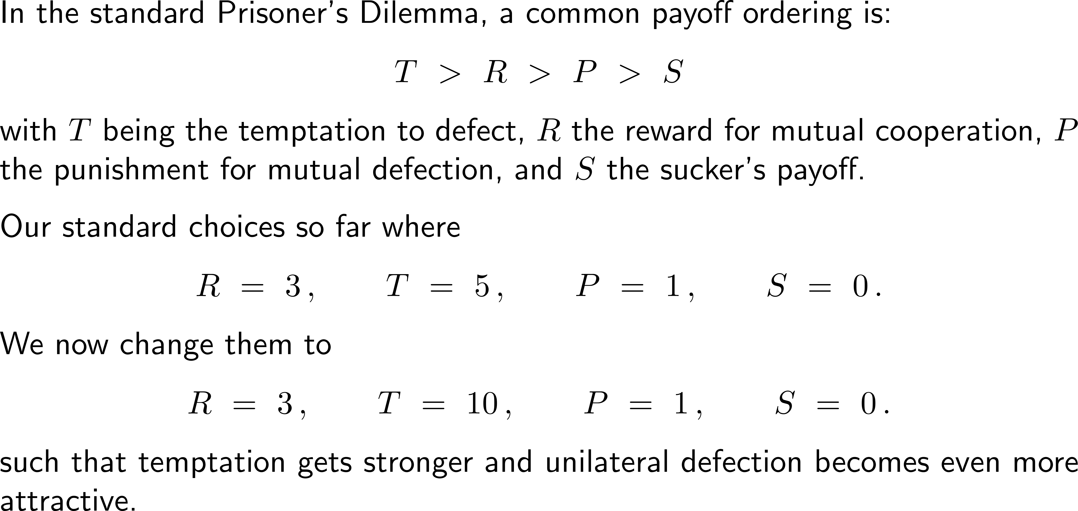
Phase 3a (Harsh Environments): Simulation set-up
Harsh Environments
change payoff matrix so temptation to defect is high
Purpose: show how environmental incentives shape cooperation.

Slide 33
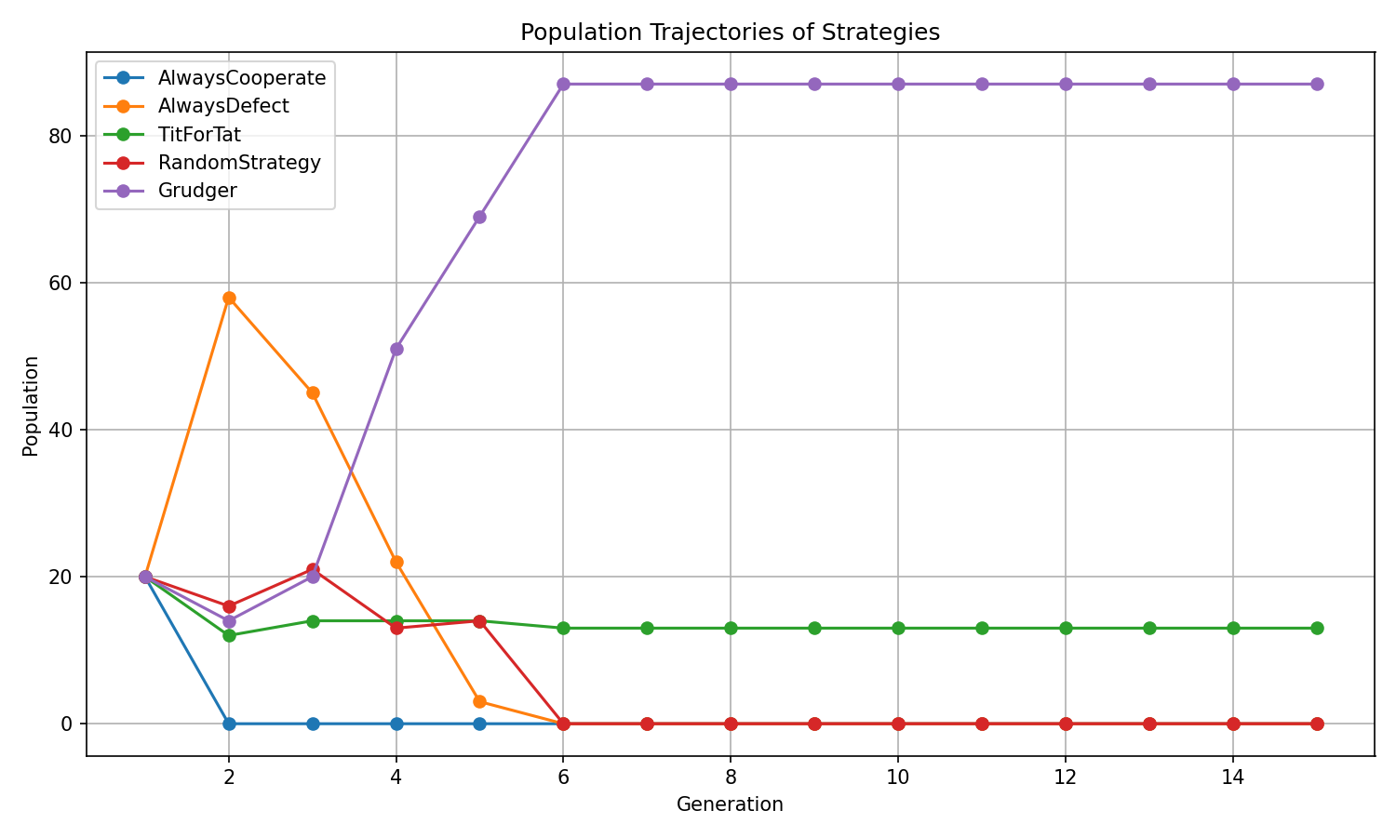
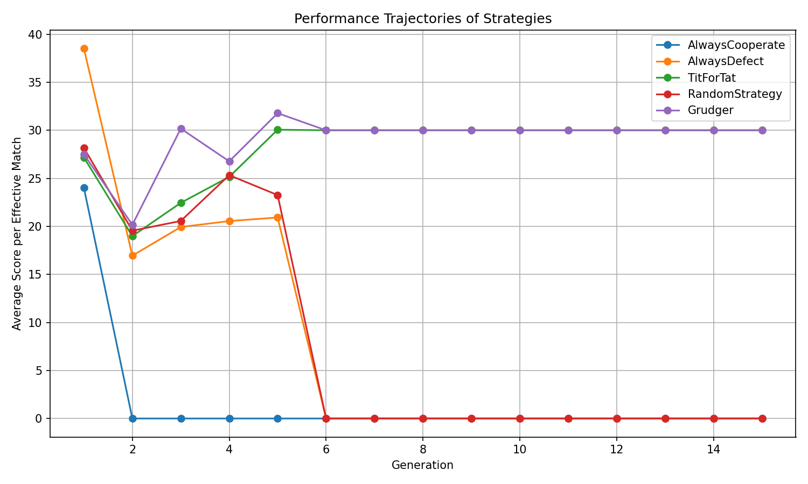
Phase 3a (Harsh Environments): Simulation results

Slide 34
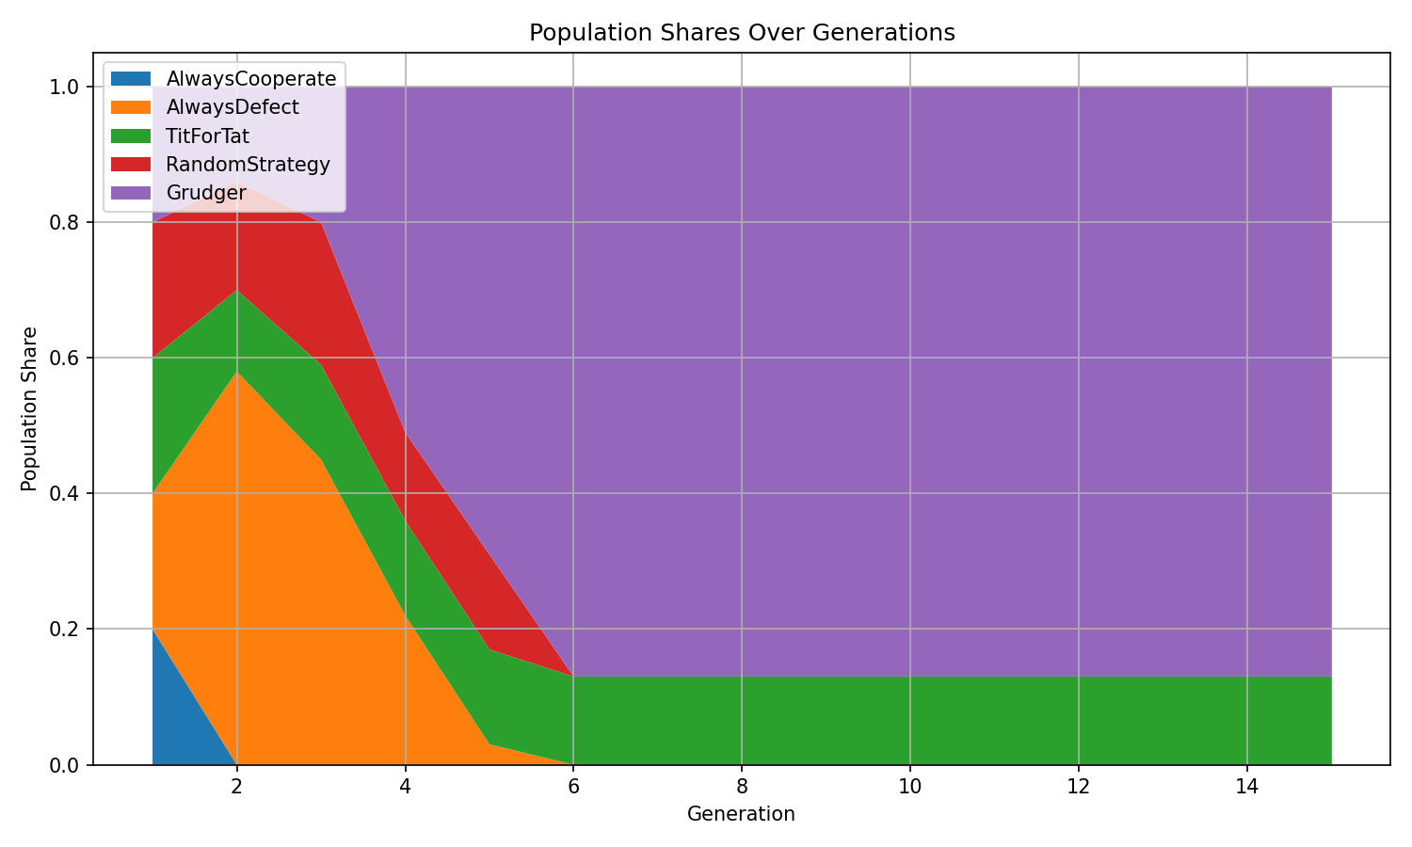
Phase 3a (Harsh Environments): Simulation results

Slide 35
Phase 3b (Noisy Interactions): Simulation set-up
By distinguishing between intended and indeed executed action, noise is introduced at the game-mechanics layer, not inside each strategy.
The main idea is:
a strategy chooses an intended action,
but with small probability that action is flipped by accident:
intended C may become actual D
intended D may become actual C
Noisy Interactions
occasional accidental defections
Purpose: show fragility and robustness of cooperation.
Expected results:
cooperation can be fragile
retaliation-based strategies can suffer under noise
forgiving or robust strategies may do better than expected

Slide 36
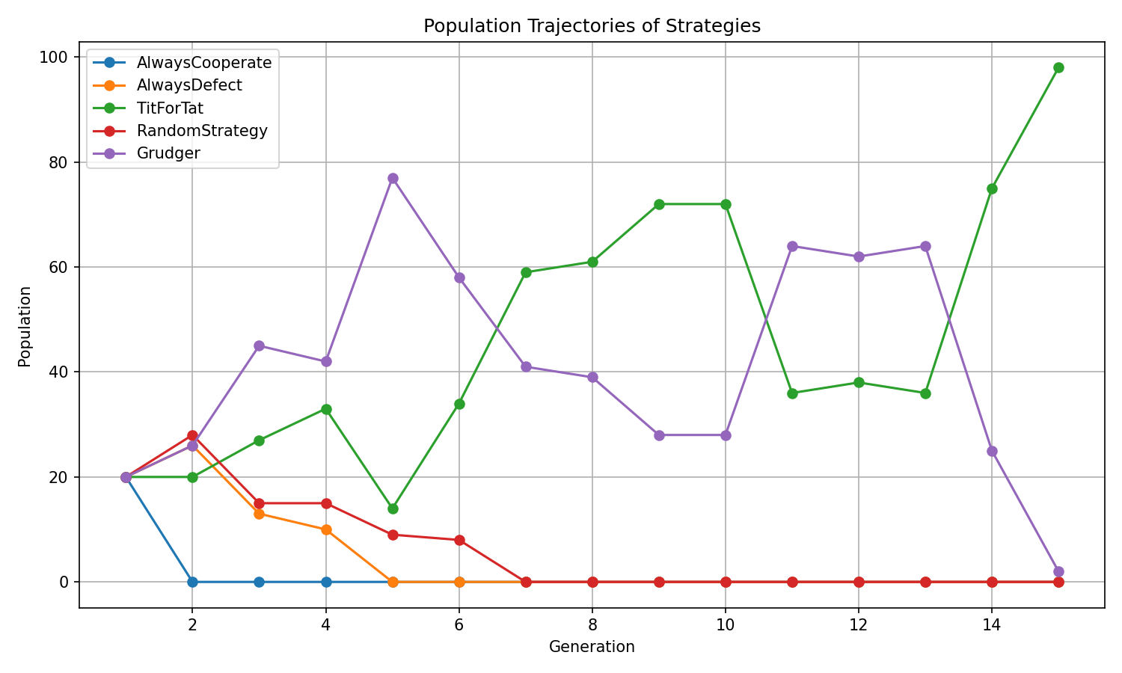
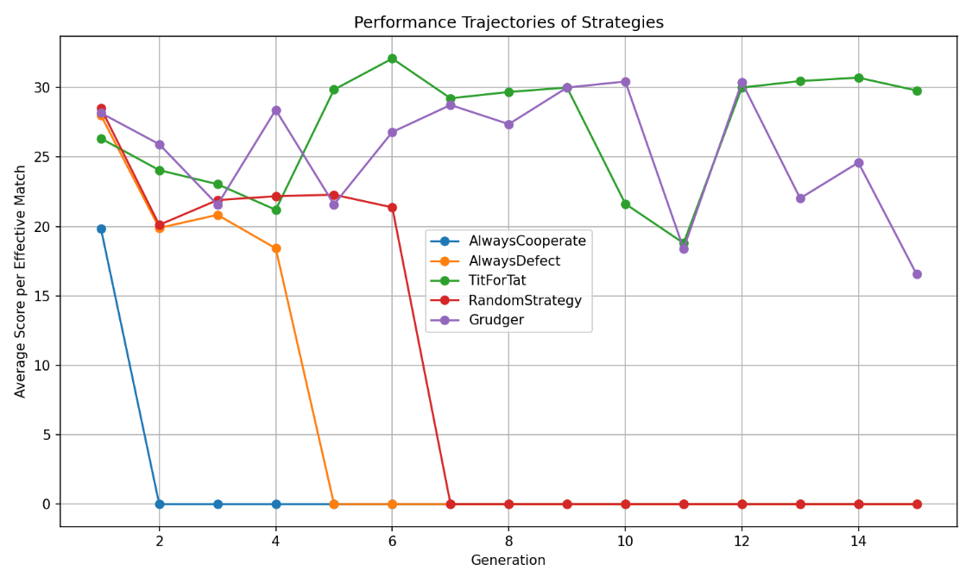
Phase 3b (Noisy Interactions): Simulation results
high temptation with noise
R = 3, T = 7, P = 1, S = 0

Slide 37
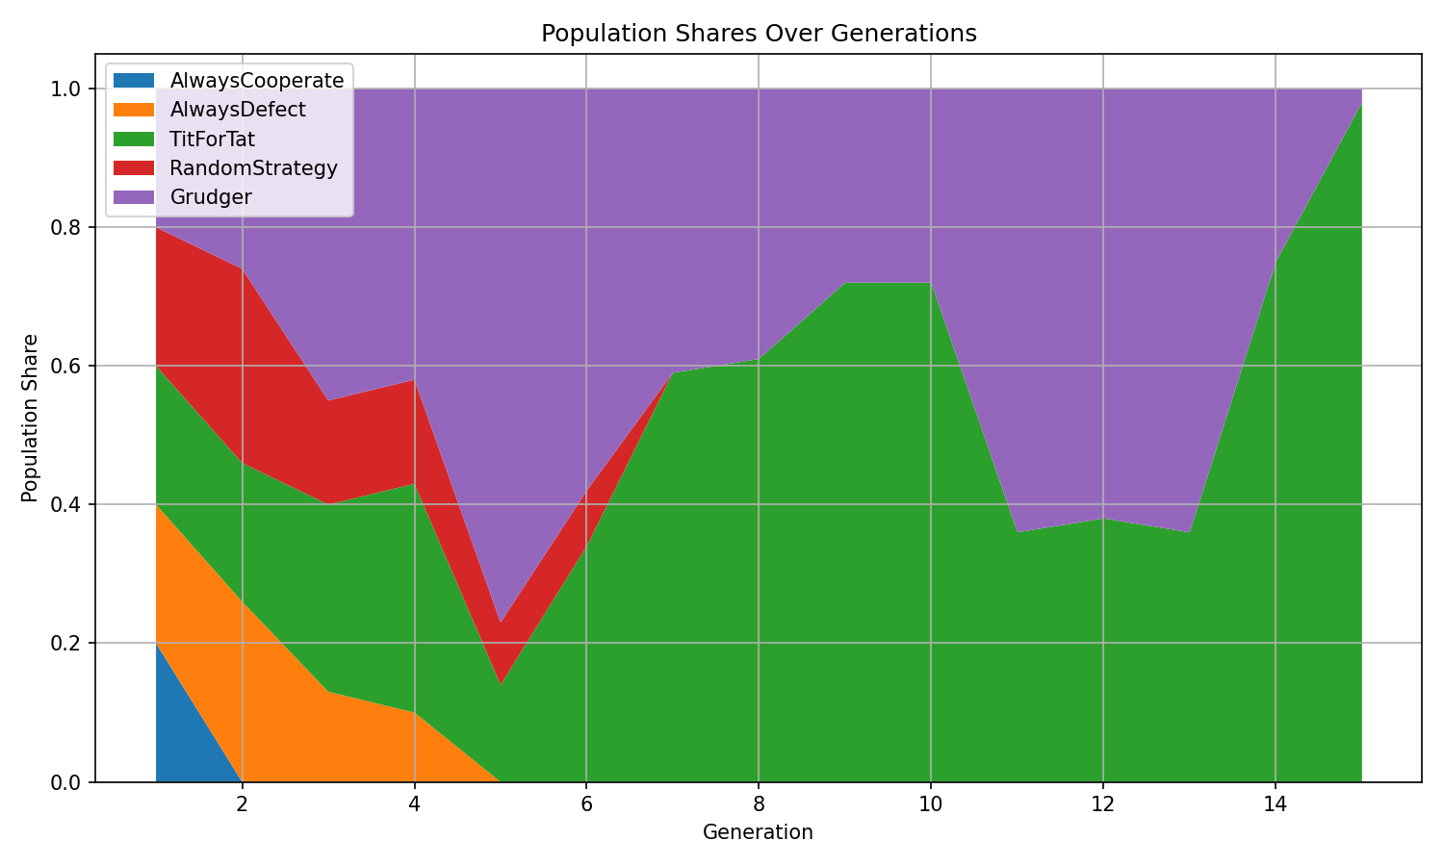
Phase 3b (Noisy Interactions): Simulation results
high temptation with noise
R = 3, T = 7, P = 1, S = 0

Slide 38
Phase 3c (Noisy Interactions with Additional Strategies): Simulation set-up
Addition of forgiving strategies:
Generous Tit for Tat avoid endless retaliation after accidental mistakes. I.e., usually behaves like Tit for Tat, but sometimes forgives a defection and cooperates anyway.
Tit for Two Tats does not punish immediately after one isolated accident. I.e., defects only if the opponent defected in the last two rounds.
Forgiver punishes but then rebuilds cooperation. I.e., defects after an opponent defected, but returns to cooperation after a short punishment phase.
Noisy Interactions
occasional accidental defections
additional forgiving strategies
Purpose: show effect of non-strictness.

Slide 39
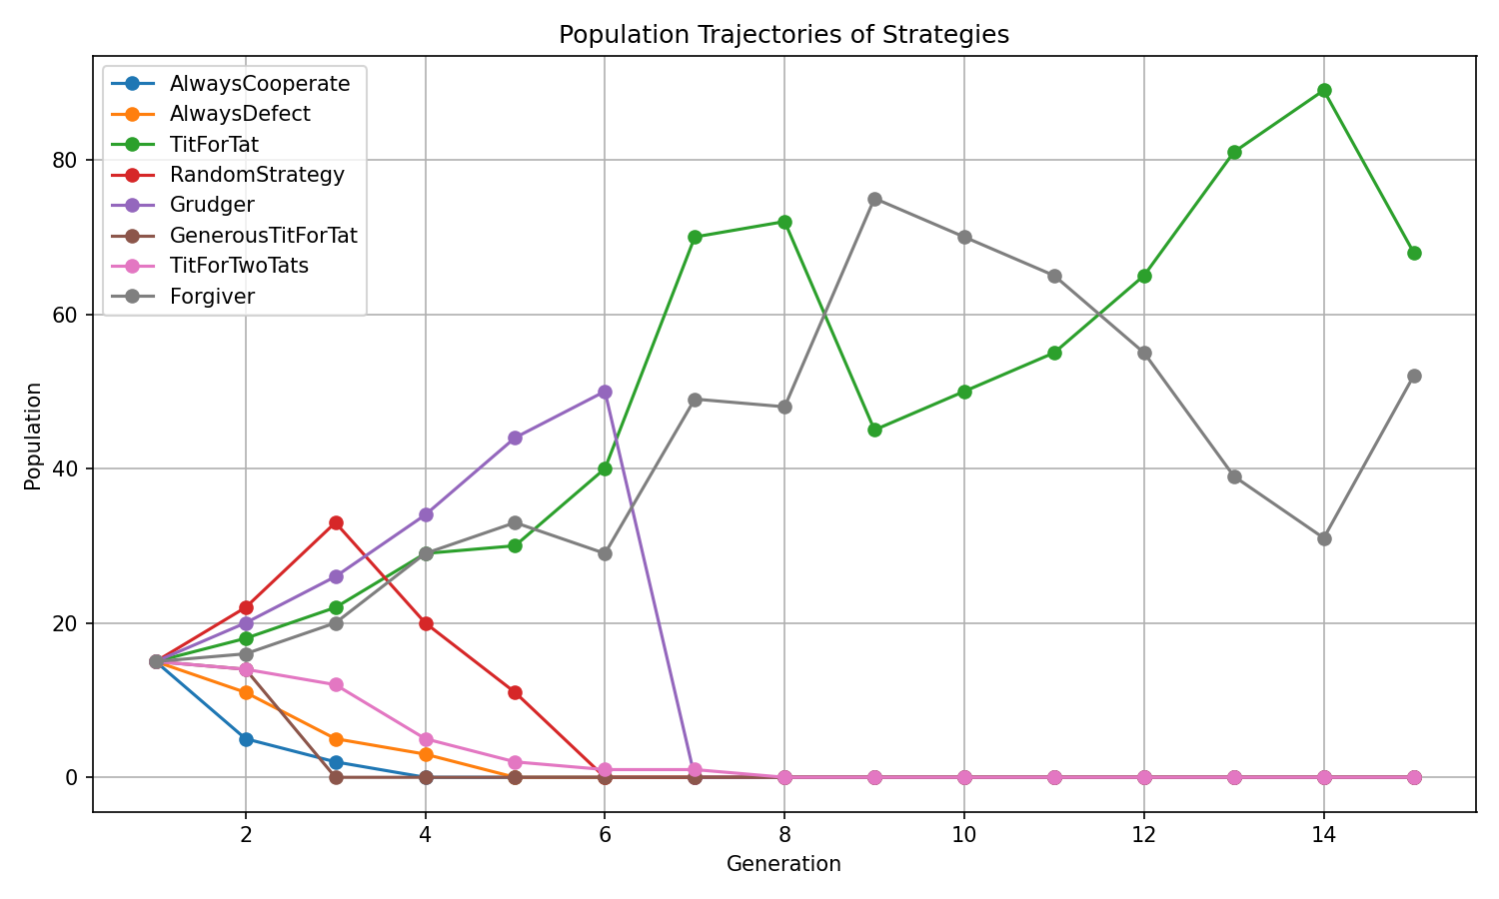
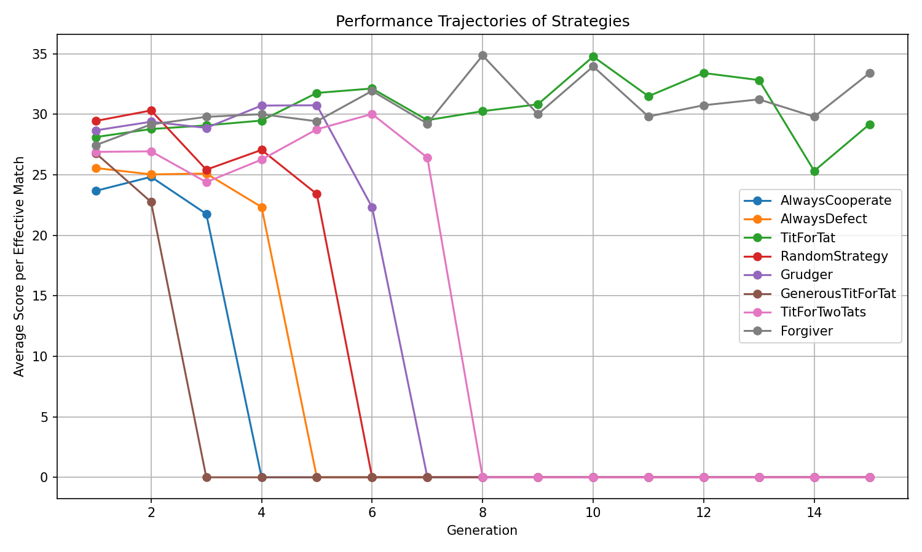
Phase 3c (Noisy Interactions with Additional Strategies): Simulation results
high temptation with noise
R = 3, T = 7, P = 1, S = 0

Slide 40
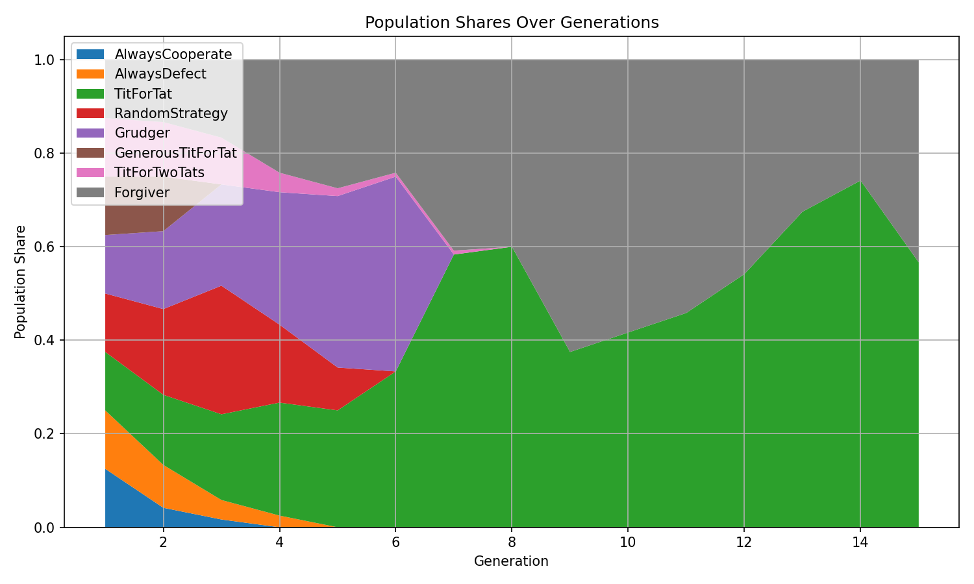
Phase 3c (Noisy Interactions with Additional Strategies): Simulation results
high temptation with noise
R = 3, T = 7, P = 1, S = 0

Slide 41
Computational Biomathematics
florian.rupp@kiu.edu.ge

