Slide 1
Computational Biomathematics
Ritualistic Battles
Lesson 8
Lecture
Mathematical formulation: The Hawk-Dove game
Discrete evolutionary dynamics
The Hawk-Dove-Bourgeois extension

Slide 2

Topics
Mathematical Formulation: The Hawk-Dove Game
Discrete Evolutionary Dynamics
The Hawk-Dove-Bourgeois Extension

Slide 3
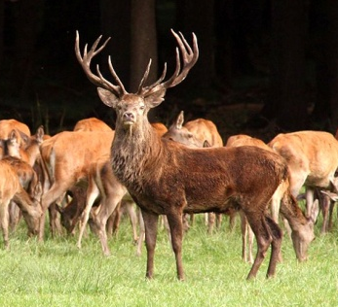
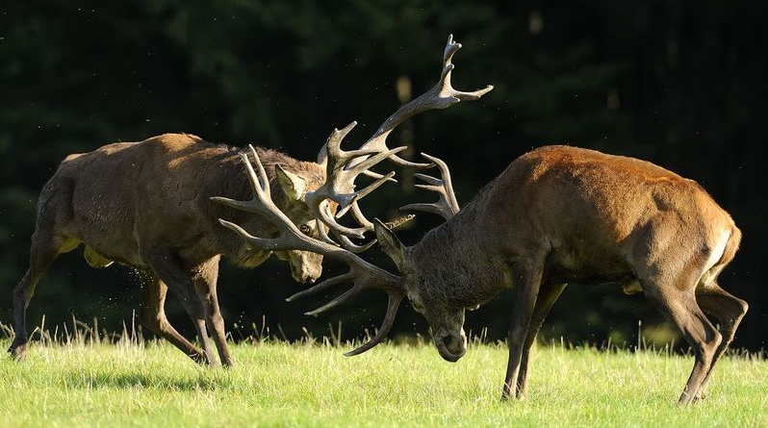


We have two identical players with the same strategies and who choose their strategy simultaneously and without cooperation
General
Assumptions
General Modeling Assumptions:
Two ‘identical’ players (player A and player B), i.e.
identical size, strength, and other attributes,
identical set of available behavioral strategies.
Each player has two strategies, either to behave like a hawk or like a dove.
The players choose their strategies simultaneously and without knowing which strategy the other player will use (no cooperation/ binding agreements).
Player A
Player B
Players
Strategies
Outcomes
Payoffs
Information

Slide 4
This leads to four different strategy pairs or outcomes …
General
Assumptions
I.e., there are four strategy pairs:
player A chooses hawk and player B chooses hawk
player A chooses hawk and player B chooses dove
player A chooses dove and player B chooses hawk
player A chooses dove and player B chooses dove
An outcome is associated to each strategy pair.
Player A
Player B
Players
Strategies
Outcomes
Payoffs
Information
Note: players can only influence their choice of a strategy and not an outcome (as this depends on the other’s players choice of their strategy)

Slide 5


… that can be ordered in a 2x2-matrix (the strategy matrix of the game)
General
Assumptions
Finally, each player evaluates what the outcome means to them individually and assigns a payoff to the outcome (= strategy pair). Players want to maximize their payoffs.
Both players have complete information (e.g. about strategies, outcomes, payoffs, etc.)
Player B (Column-Player)
strategy pair or outcome
(hawk, dove)
This is an ordered pair, the 1st element is for the row player (player A) and the 2nd element for the column player (player B).
This is the best outcome for player A and thus has the highest payoff for them.
Hawk
Dove
Players
Strategies
Outcomes
Payoffs
Information
Hawk
Player A (Row-Player)
Dove

Slide 6


Finally, each player evaluates what the outcome means to them individually and assigns a payoff to the outcome
V = value of winning resources, D = costs of injury, T = costs of wasting time
The (symmetric) payoff matrix:
Hawk
Dove
Hawk
Hawk wins 50% of fights but is injured in 50% fights as well:
( (V–D)/2 , (V–D)/2 )
Hawk always wins, is never injured, and doves always flees:
(V, 0)
Dove
Hawk always wins, is never injured, and doves always flees:
(0, V)
Doves wins/ flees 50%, never injured but looses time:
( V/2 – T , V/2 – T )

Slide 7
Depending on the cost of injury, we obtain two different payoff sets with rather different game settings
High Cost of Injury (typical setting)
Low Cost of Injury (Prisoner’s Dilemma)
player A B | Hawk | Dove
Hawk | ( (V–D)/2, (V–D)/2) = (-1, -1) | (V, 0) = (6, 0)
Dove | (0, V) = (0, 6) | ( V/2–T, V/2–T ) = (2, 2)
player A B | Hawk | Dove
Hawk | ( (V–D)/2, (V–D)/2) = (1, 1) | (V, 0) = (6, 0)
Dove | (0, V) = (0, 6) | ( V/2–T, V/2–T ) = (2, 2)
with
V = 6, D = 8, and T = 1
For animals, even small injuries may lead to severe infections and death. This fate is certainly worse than backing down from the contest.
with
V = 6, D = 4, and T = 1
The reason why this is a Prisoner’s Dilemma situation and why the Prisoner’s Dilemma is very interesting is beyond the scope of today's lecture.

Slide 8

We already have seen, that the Prisoner’s Dilemma has one Nash-equilibrium in dominant strategies …
player A B | Hawk | Dove
Hawk | (1, 1) | (6, 0)
Dove | (0, 6) | (2, 2)
In the Prisoner’s Dilemma the outcome (hawk, hawk) is such that
no player has an incentive to change their strategy,
given the (equilibrium-)strategy “hawk” of the other player
On the other hand:
at the outcome (hawk, dove), given player A chooses “hawk”, then player B is better of with “hawk” (payoff 1) instead of “dove” (payoff 0)
at the outcome (dove, hawk), given player B chooses “hawk”, then player A is better of with “hawk” (payoff 1) instead of “dove” (payoff 0)
at the outcome (dove, dove),
given player A chooses “dove”, then player B is better of with “hawk” (payoff 6) instead of “dove” (payoff 2)
given player B chooses “dove”, then player A is better of with “hawk” (payoff 6) instead of “dove” (payoff 2)
Nash-equilibrium in pure strategies
Prisoner’s Dilemma payoff matrix

Slide 9


… and that the Hawk-Dove game has two Nash equilibria in pure strategies
player A B | Hawk | Dove
Hawk | (-1, -1) | (6, 0)
Dove | (0, 6) | (2, 2)
It is easy to see that the Hawk-Dove game (on the left-hand side) has
no equilibrium in strictly dominant strategies, and
two Nash-equilibria in pure strategies (hawk, dove) and (dove, hawk)
Moreover, one can show – and we will do so in a way in the next sections – that it has a third Nash-equilibrium in mixed strategies. I.e., when the players choose their strategies with a certain probability p for “hawk” and 1-p for “dove”.
From this short piece of information, you already see that is a delicate issue of finding the “right” equilibrium concept when there is more than one equilibrium to choose from. Therefore, we next introduce evolutionary fitness as the test an equilibrium must stand.
One can also show that the Prisoner’s Dilemma has no Nash equilibrium in mixed strategies.
Nash-equilibrium in pure strategies
Hawk-Dove
payoff matrix

Slide 10
Finally, we switch from payoffs to utilities. Utilities indicate the usefulness of the outcome on an ordinal basis
Hawk-Dove
payoff matrix
Hawk-Dove
utility matrix
player A B | Hawk | Dove
Hawk | (-1, -1) | (6, 0)
Dove | (0, 6) | (2, 2)
The numbers are the utilities each
player assigns individually
to the outcomes,
i.e., the numbers represent an
ordinal preference structure.
Only the ordinal structure counts, the exact numbers do not matter.
player A B | Hawk | Dove
Hawk | (0, 0) | (3, 1)
Dove | (1, 3) | (2, 2)
Here, ‘0’ means no gain
(no payoff)
Here, ‘0’ means the least preferred outcome, as
0 < 1 < 2 < 3

Slide 11
Topics
Mathematical Formulation: The Hawk-Dove Game
Discrete Evolutionary Dynamics
The Hawk-Dove-Bourgeois Extension

Slide 12



Next, let us assume a large population of stag. Some of them play “hawk” and the others “dove” during a contest, …
Let
N(t) be the population, i.e., the total amount of stag, at generation or time t
p(t) ∈ [0, 1] be the frequency of stag at generation t that play “hawk”, then these are N_{H}(t) = p(t)·N(t) individuals
1 – p(t) is the frequency of stag at generation t that play “dove” and there are N_{D}(t) = (1-p(t))·N(t) of such individuals
Now it’s time for quite a simplification to focus on the essential ideas:
Suppose that the population has asexual reproduction and discrete generations that are non-overlapping (i.e. all adults die before the new generation, as happens in many insect species).
stag
= male deer

Slide 13
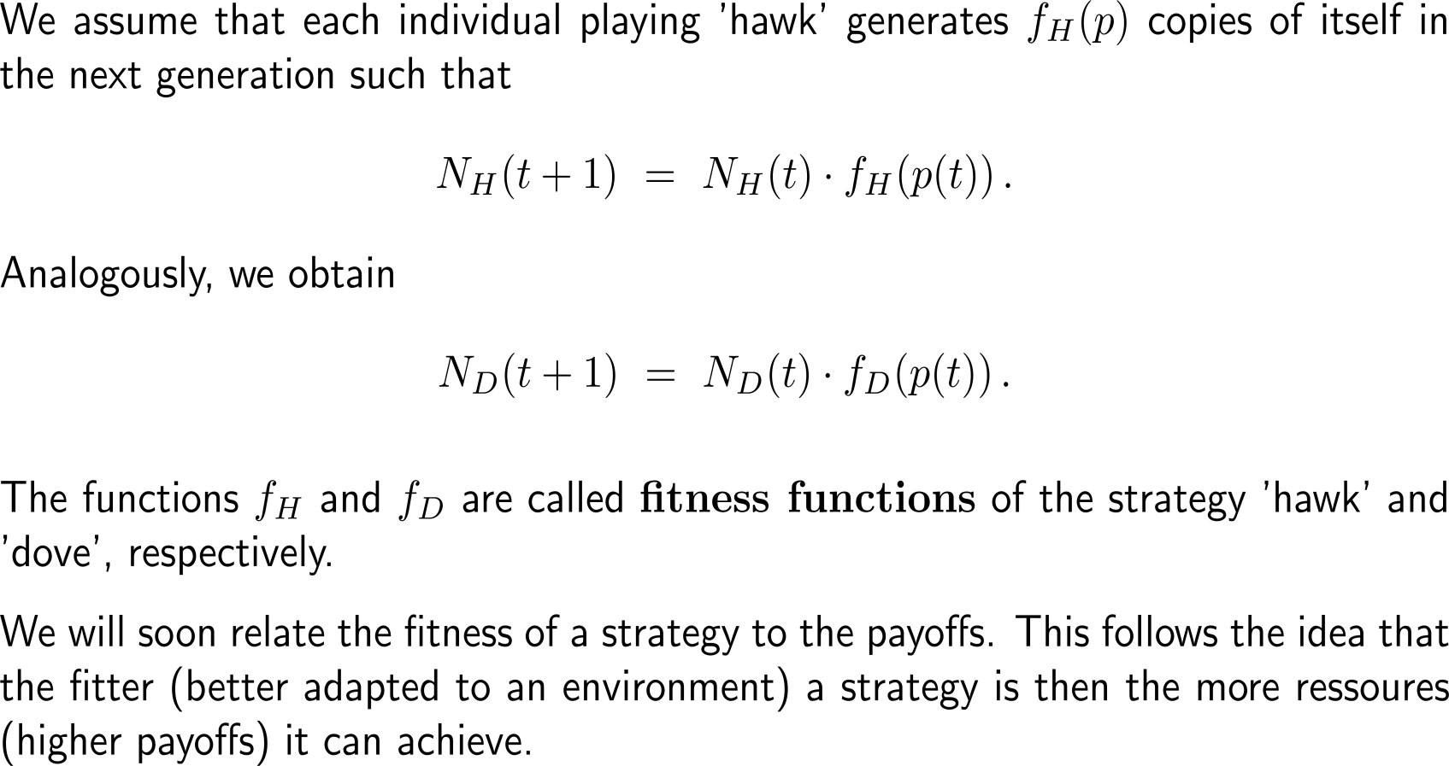


… such that the populations in the next generation are obtained with the aid of fitness functions

Slide 14
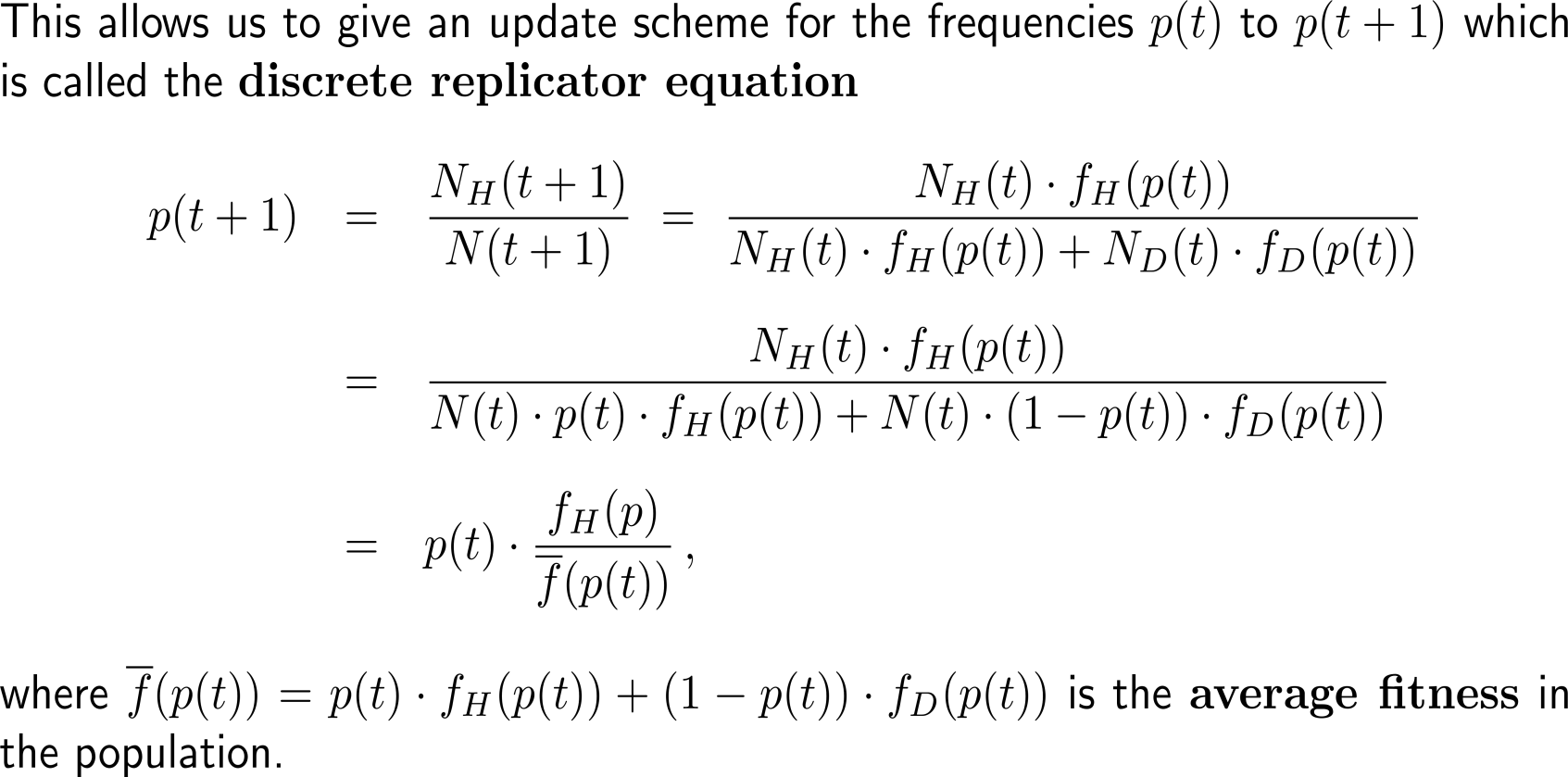
The discrete replicator equation provides the update scheme from one generation to the next (1/ 2)
t+1

Slide 15
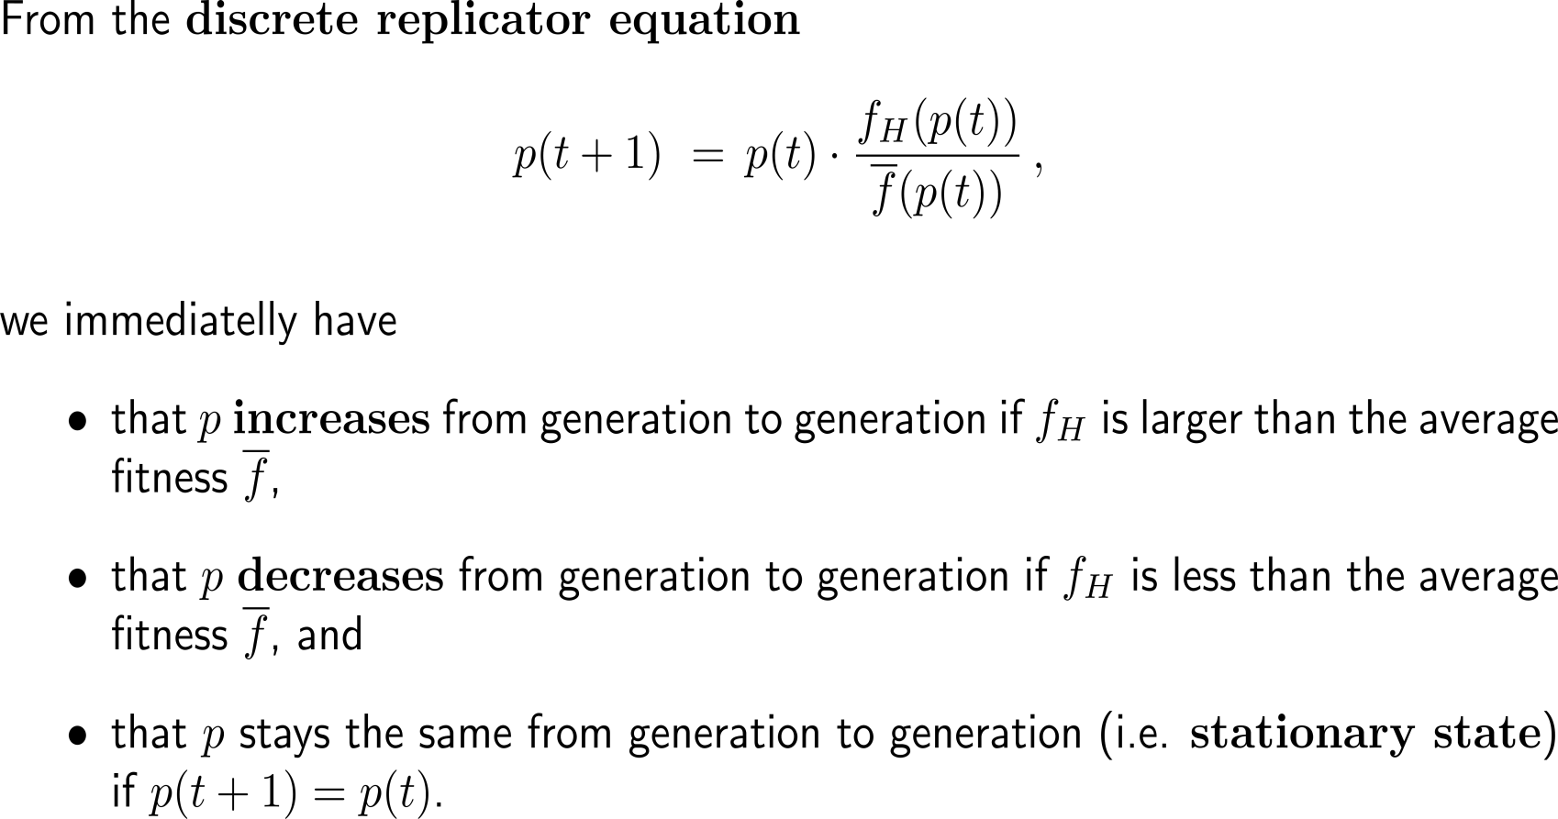
The discrete replicator equation provides the update scheme from one generation to the next (2/ 2)
t+1

Slide 16
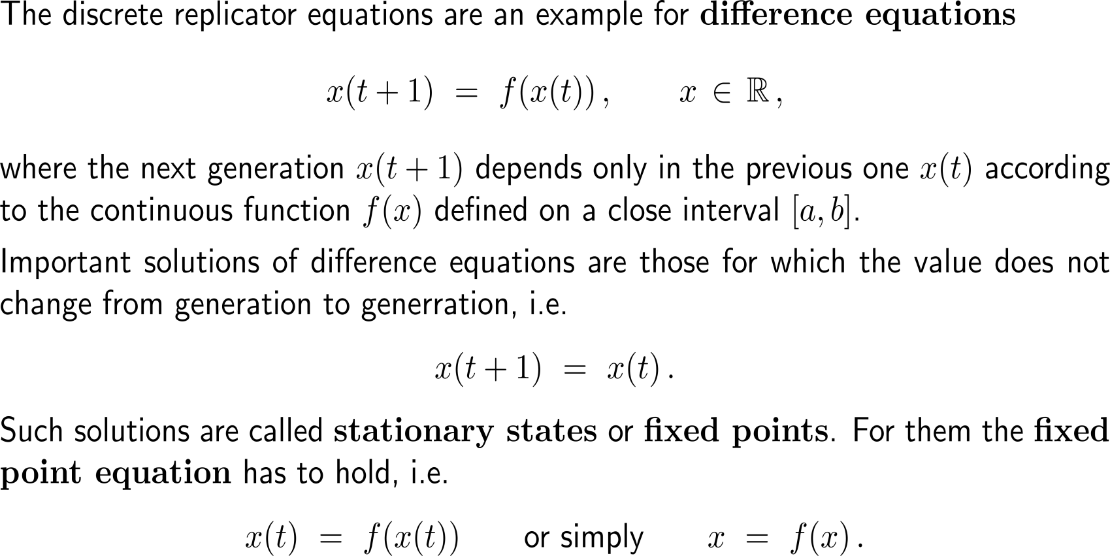
The discrete replicator equation is an example for a type of equations that are called difference equations
** General Theory *** General Theory *** General Theory *** General Theory *** General Theory **

Slide 17
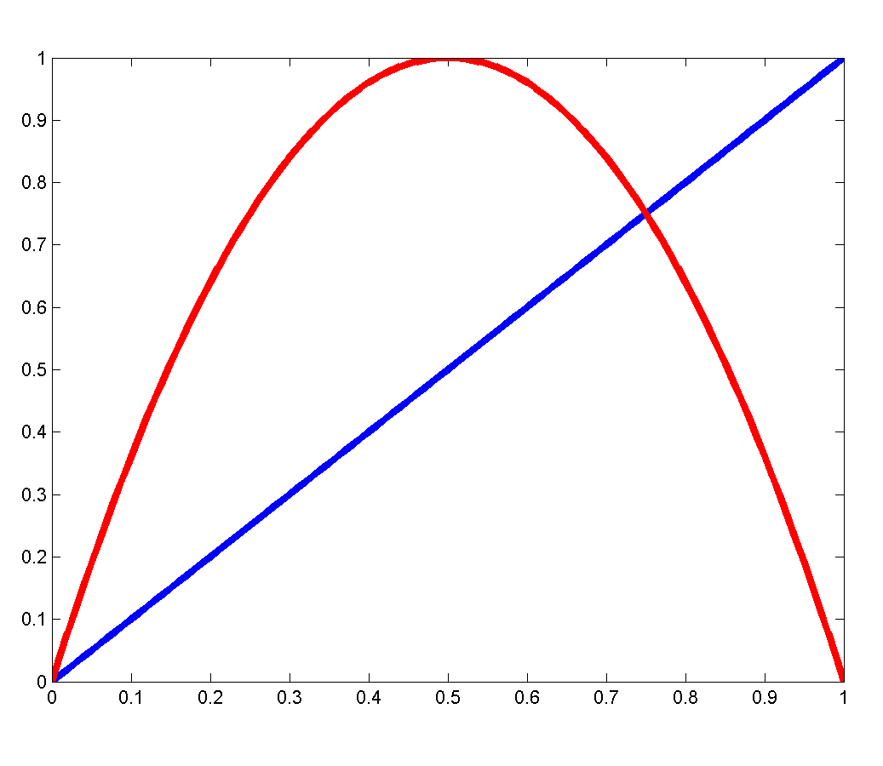
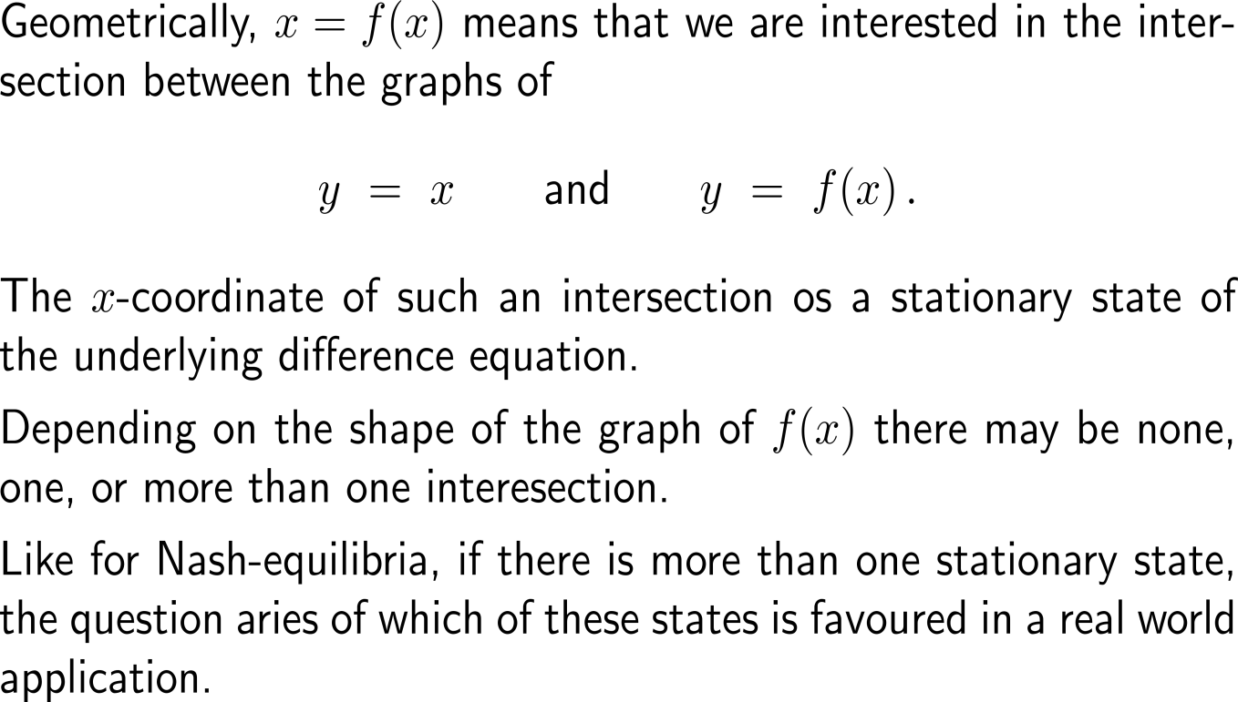
Their stationary states are computed via the fixed point equation that geometrically is interpreted as an intersection of graphs
** General Theory *** General Theory *** General Theory *** General Theory *** General Theory **
y = x
y = f(x) = -4 (x-0.5)² + 1

Slide 18
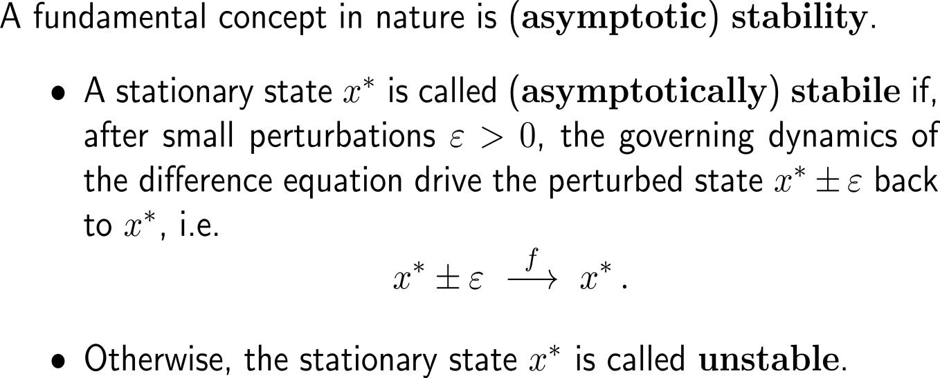
(Asymptotic) stability of a system means that the system, after experiencing being perturbed, returns to the previous stationary state
(asymptotically)
stable
x*
** General Theory *** General Theory *** General Theory *** General Theory *** General Theory **
unstable
x*

Slide 19
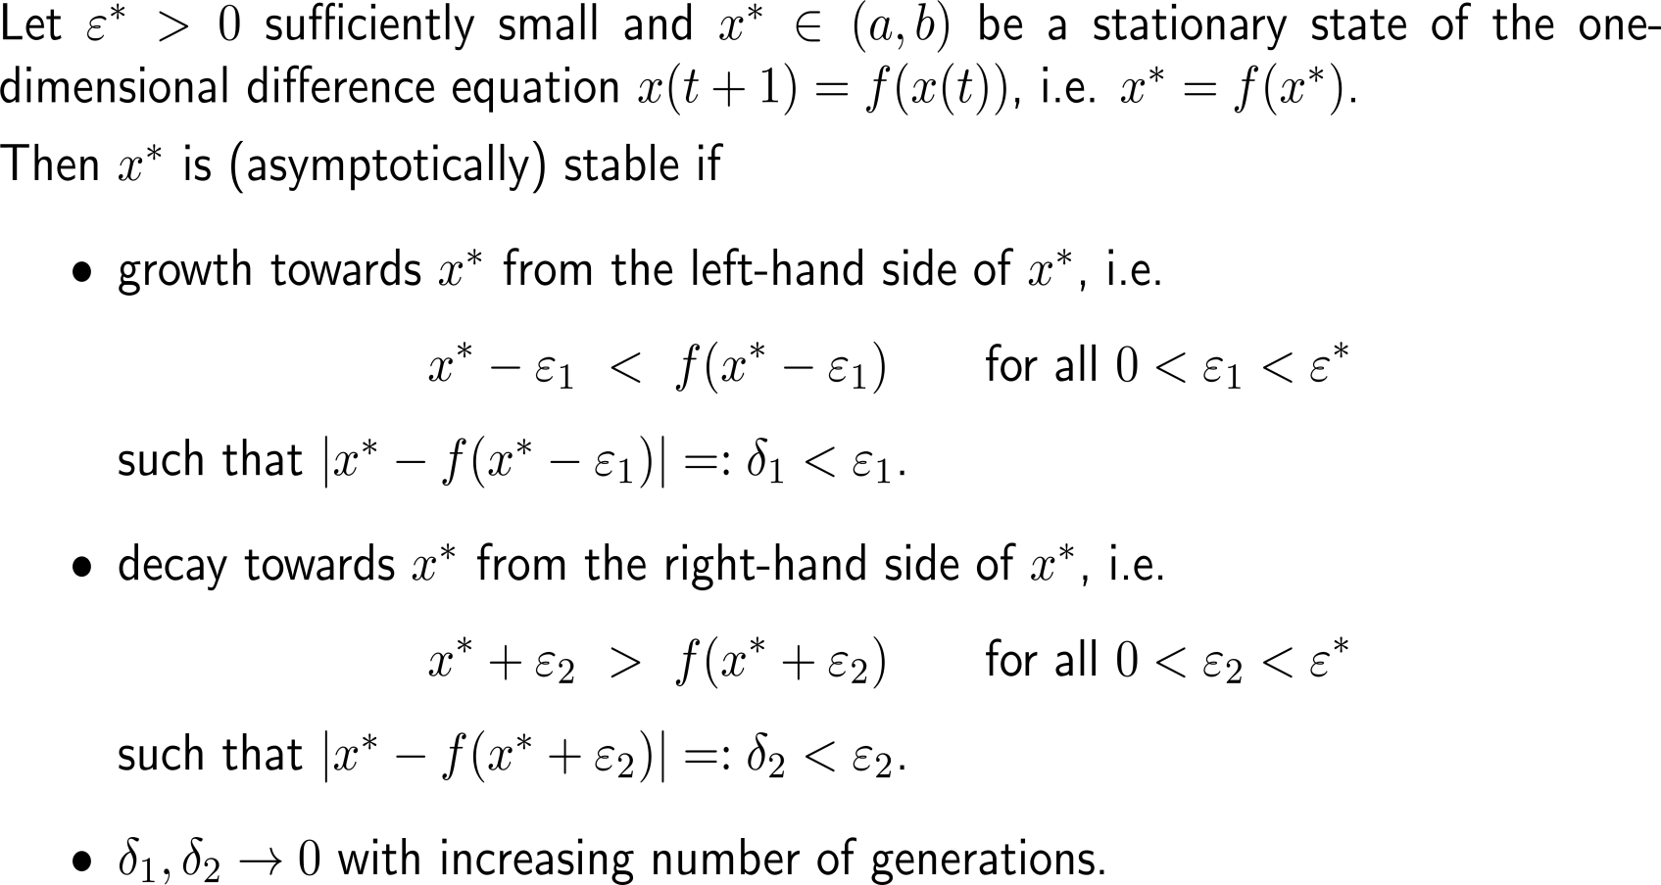
For difference equations, there are quite straightforward criteria to test a stationary state for (asymptotic) stability (1/ 2)
** General Theory *** General Theory *** General Theory *** General Theory *** General Theory **

Slide 20
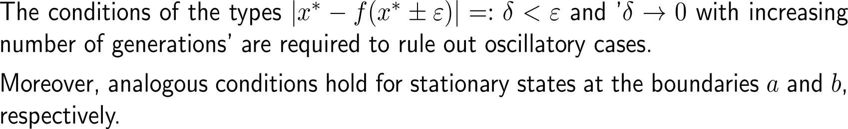
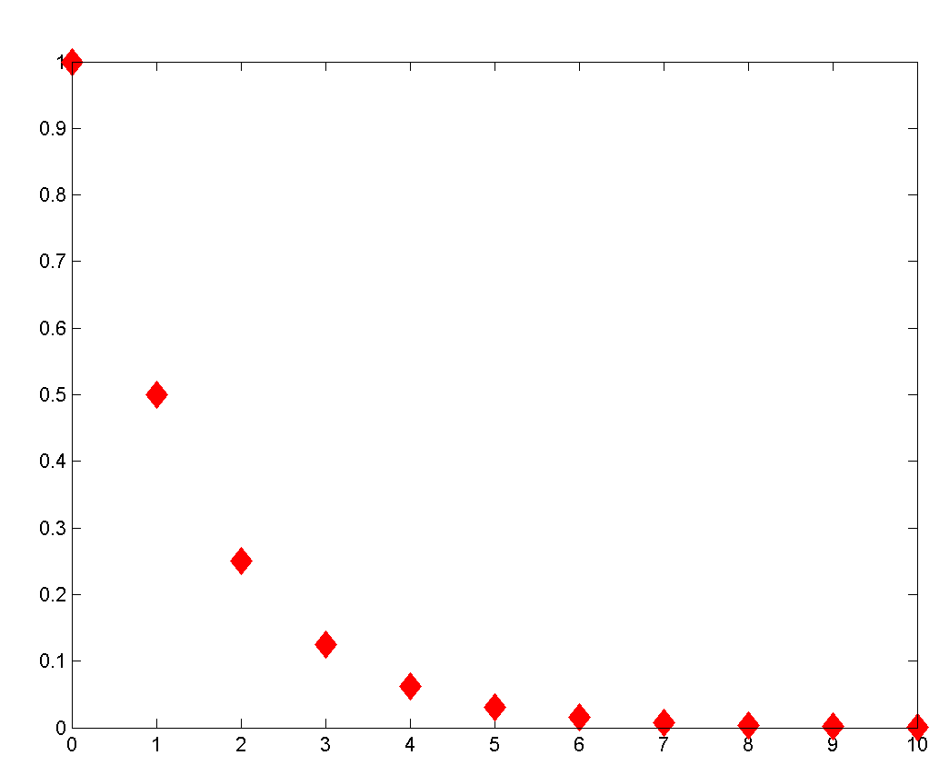
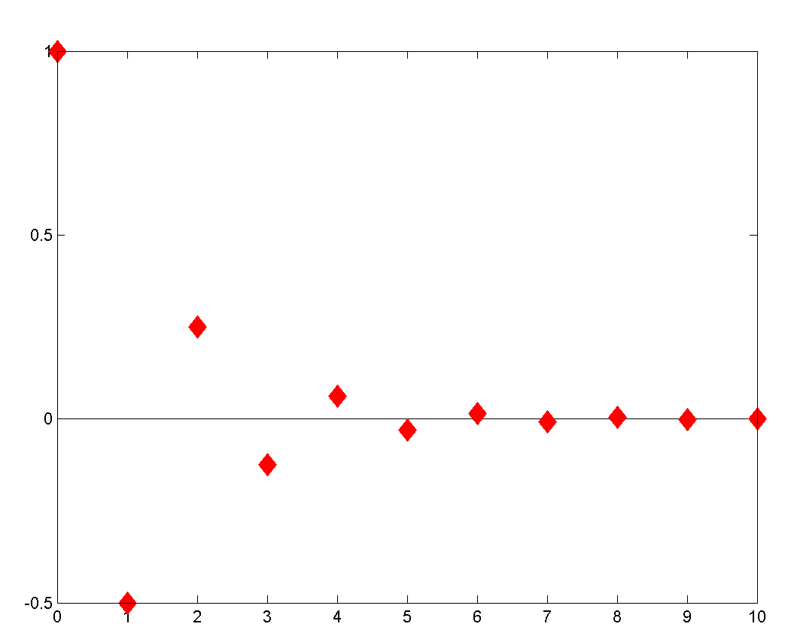
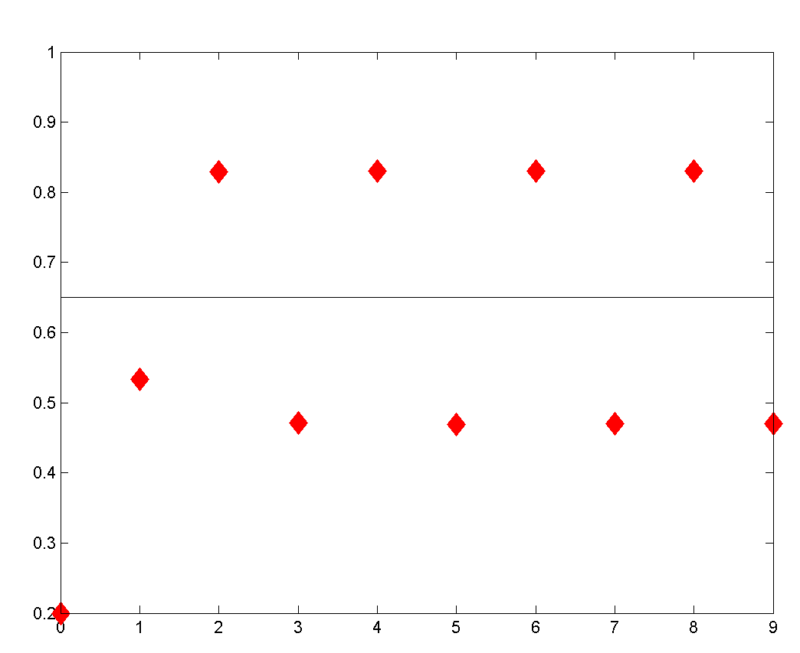



For difference equations, there are quite straightforward criteria to test a stationary state for (asymptotic) stability (2/ 2)
One-sided approach towards x*:
Alternating approach towards x*:
Oscillations about x*:
** General Theory *** General Theory *** General Theory *** General Theory *** General Theory **

Slide 21
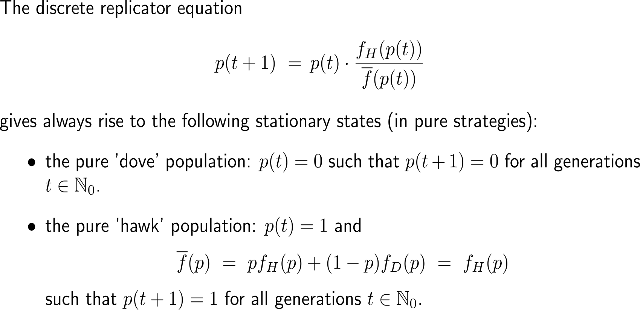
Our discrete replicator equation of the Hawk-Dove game always has the two pure strategies as stationary states …

Slide 22
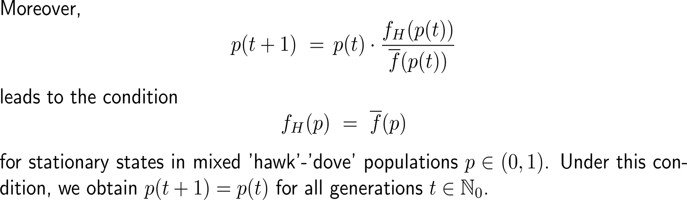
… as well as a third stationary state in mixed strategies provided a further condition on the fitness function is satisfied

Slide 23
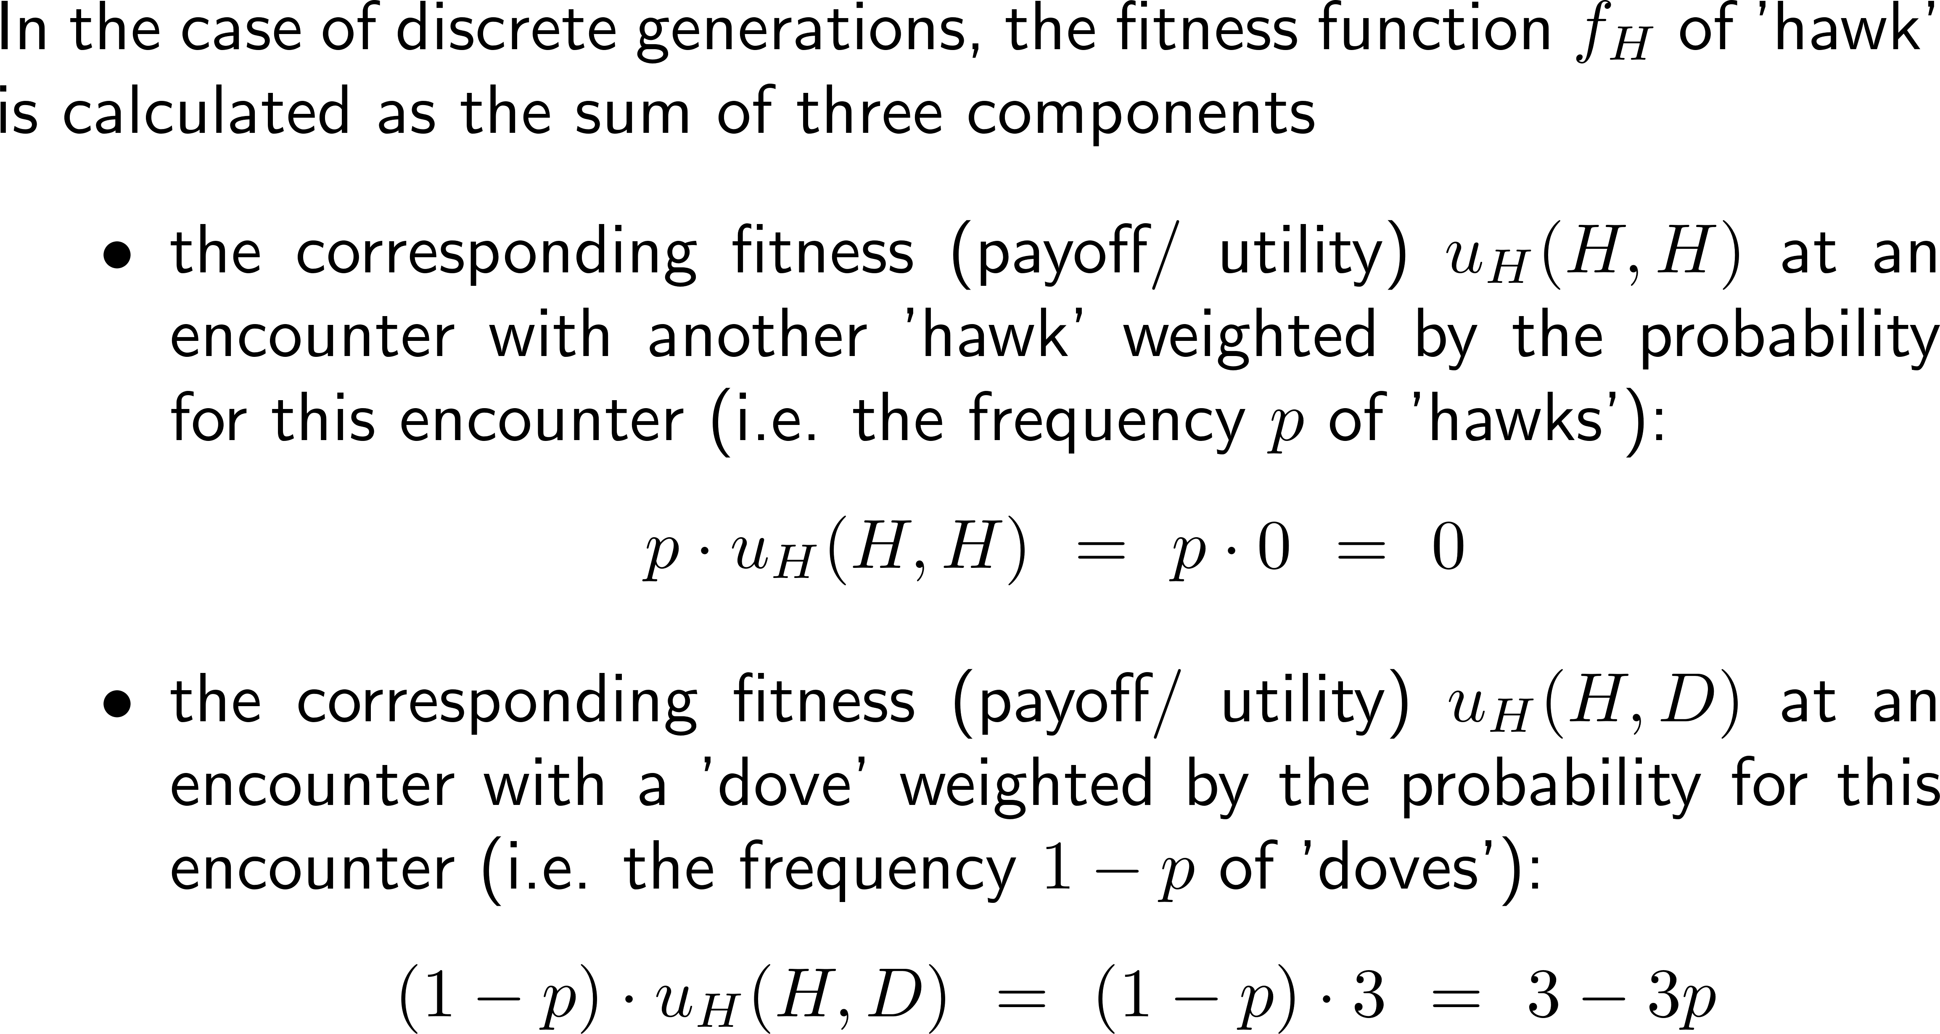
The fitness function of the ‘hawk’ strategy consist of the payoffs/ utilities at encounters weighted by the probability of the encounter …
Hawk-Dove
utility matrix
player A B | Hawk | Dove
Hawk | (0, 0) | (3, 1)
Dove | (1, 3) | (2, 2)
utility u_{H}(H,H) = 0 for the hawk at an encounter with another hawk

Slide 24
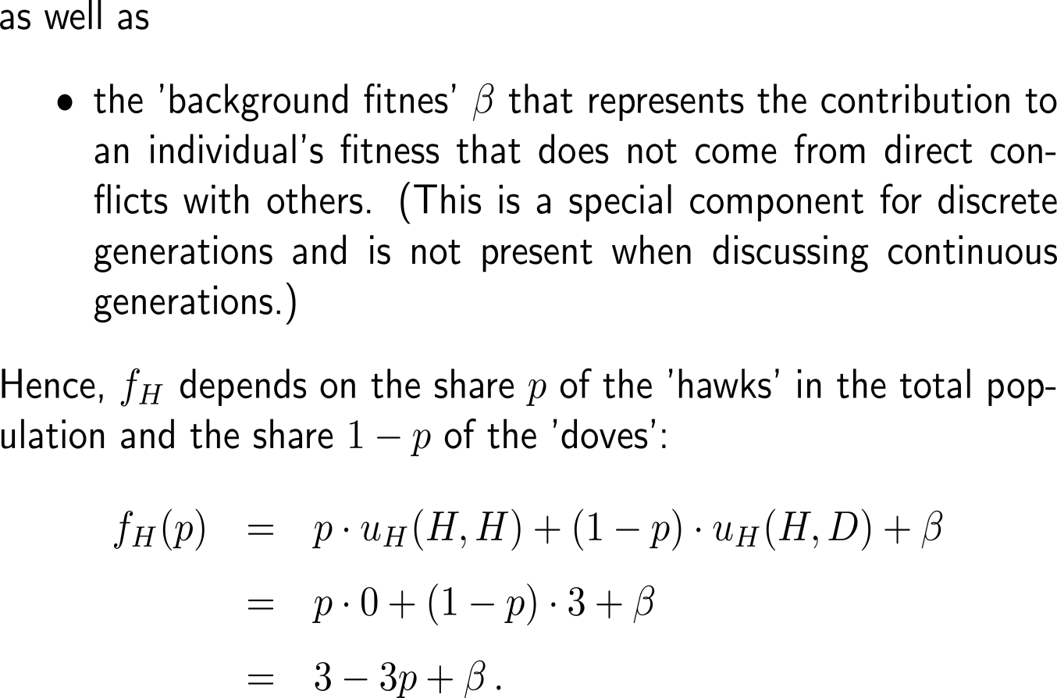
… and the background fitness
Hawk-Dove
utility matrix
player A B | Hawk | Dove
Hawk | (0, 0) | (3, 1)
Dove | (1, 3) | (2, 2)
utility u_{H}(H,H) = 0 for the hawk at an encounter with another hawk

Slide 25
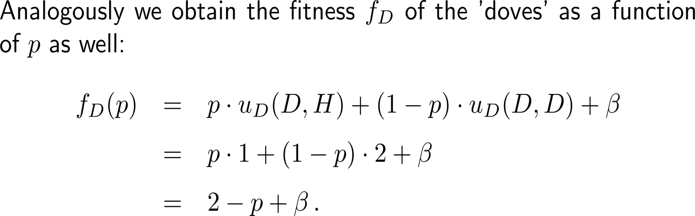
Analogously, the fitness function of the ‘dove’ strategy is obtained.
Hawk-Dove
utility matrix
player A B | Hawk | Dove
Hawk | (0, 0) | (3, 1)
Dove | (1, 3) | (2, 2)

Slide 26
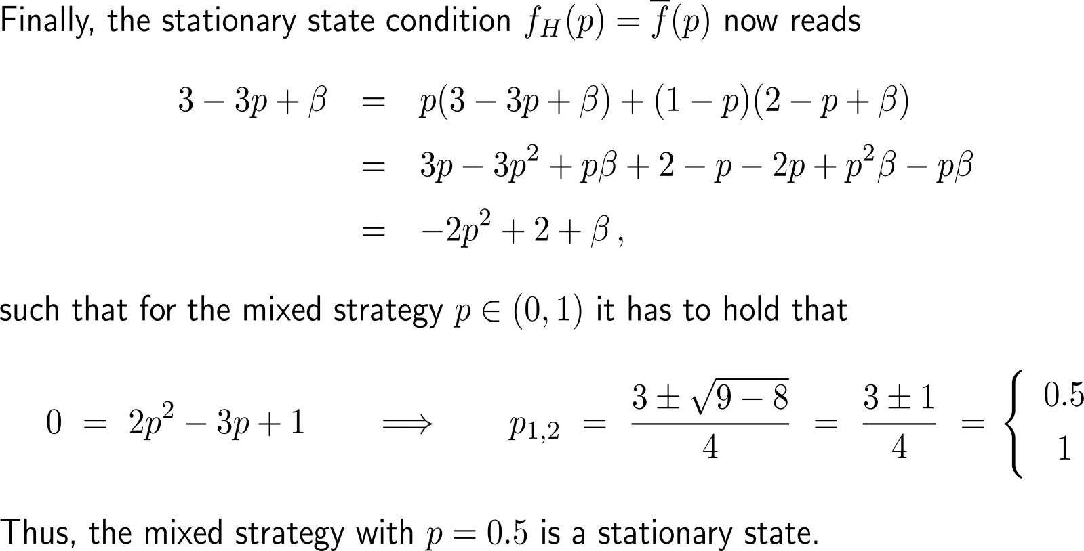
The fitness functions of the ‘hawk’ and ‘dove’ strategies allow the computation of the stationary state in mixed strategies

Slide 27
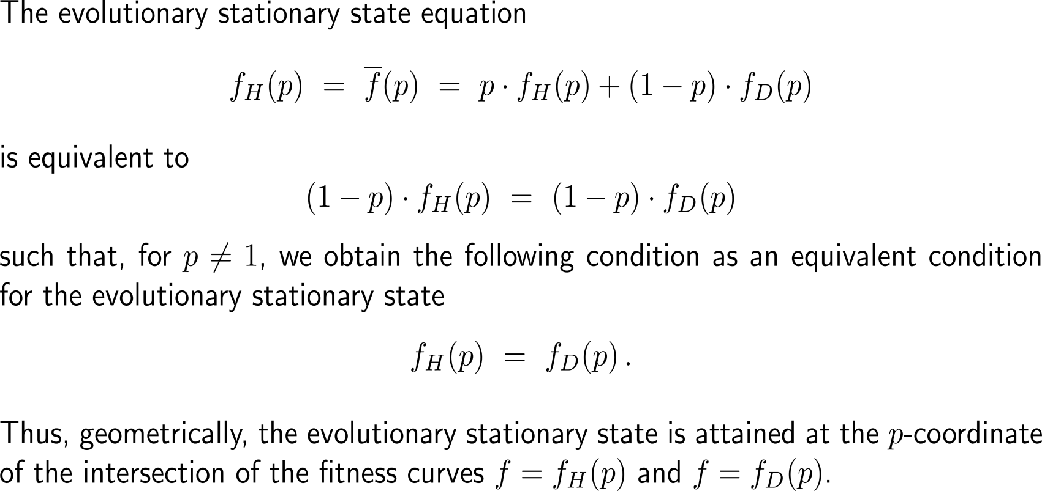
Alternatively, the stationary state in mixed strategies is obtained with the intersection of the graphs of the fitness functions f_{H} and f_{D}

Slide 28
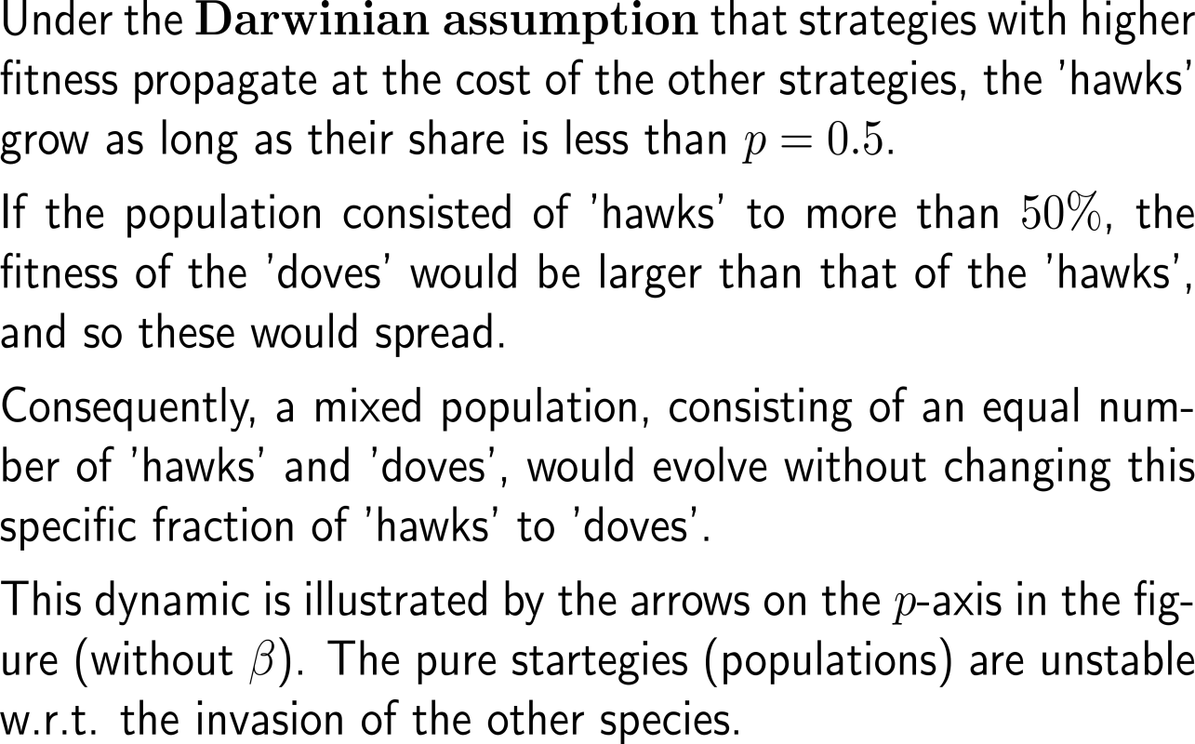
Under the Darwinian assumption, strategies with higher fitness propagate at the cost of the other strategies (1/ 2)
f_{i}(p)
3
f_{H}(p)
2
f_{D}(p)
1
p
0
0.5
1
average fitness -2p² + 2
pure strategy (100% of one type)

Slide 29
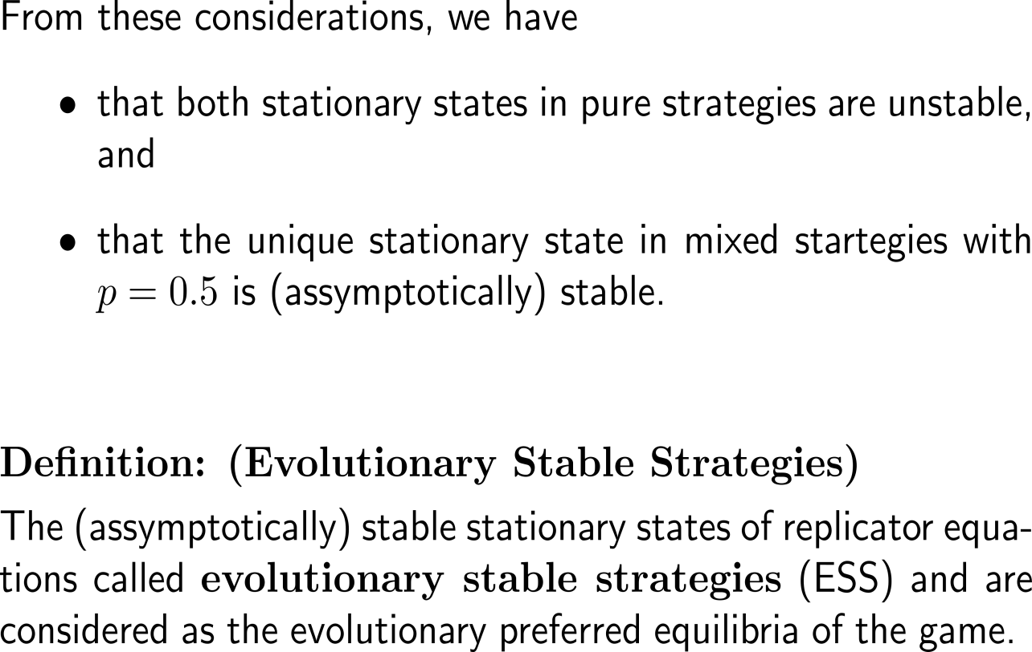
Under the Darwinian assumption, strategies with higher fitness propagate at the cost of the other strategies (2/ 2)
f_{i}(p)
3
f_{H}(p)
2
f_{D}(p)
1
p
0
0.5
1
average fitness -2p² + 2
pure strategy (100% of one type)

Slide 30
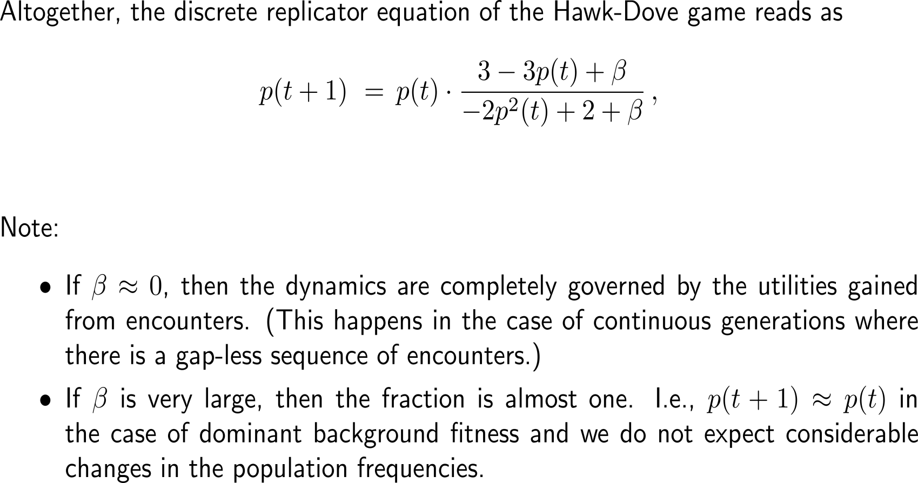
Summary: Discrete replicator equation of the Hawk-Dove game (1/ 2)

Slide 31
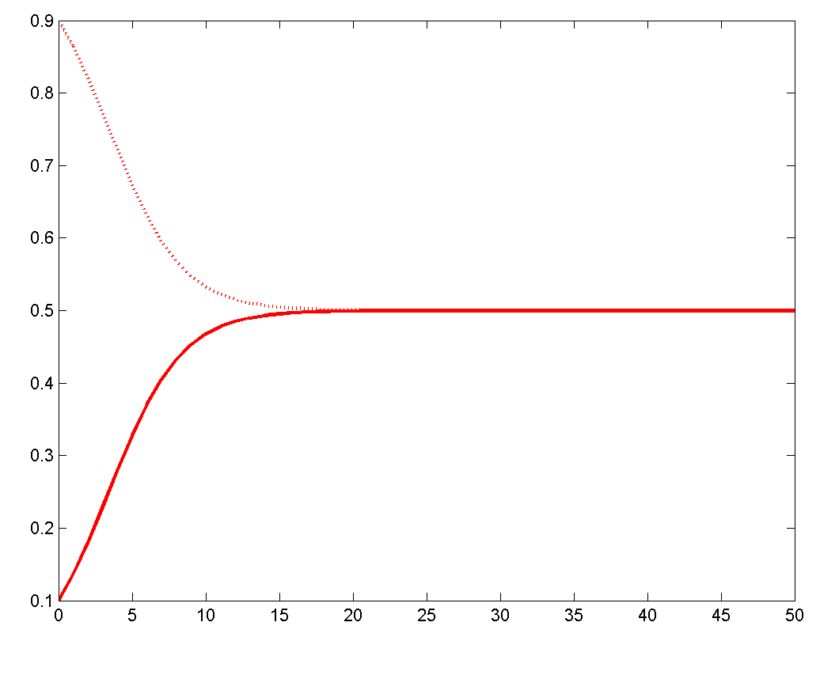
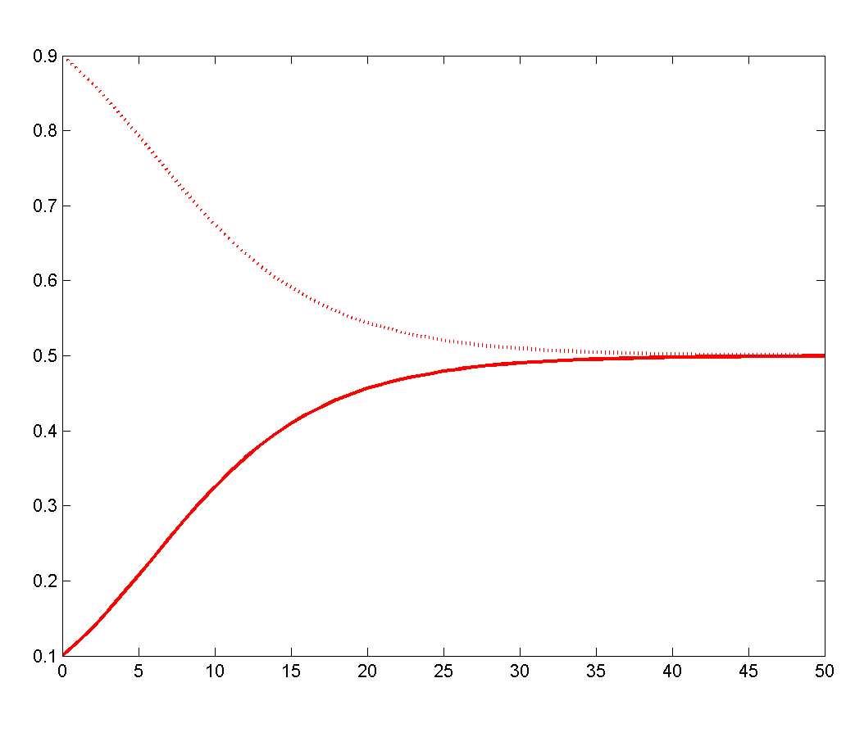
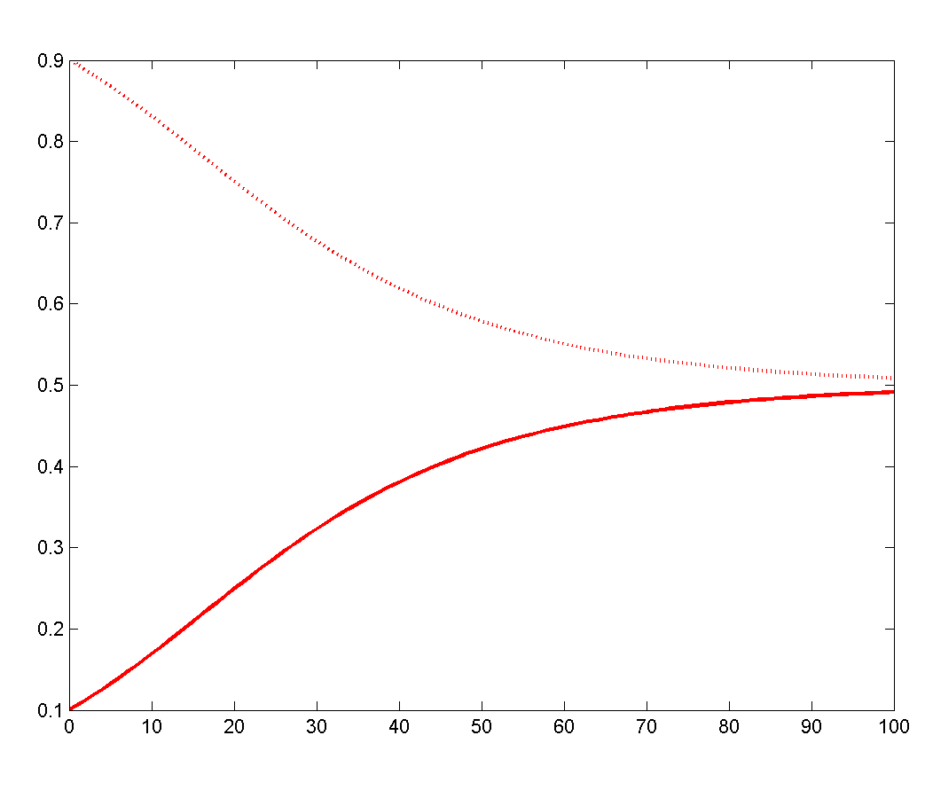
Summary: Discrete replicator equation of the Hawk-Dove game (2/ 2)
Discrete Hawk-Dove dynamics
with β = 0
Discrete Hawk-Dove dynamics
with β = 2
Discrete Hawk-Dove dynamics
with β = 10
‘hawk’
‘hawk’
‘hawk’
‘dove’
‘dove’
‘dove’
The larger the influence of the background fitness the longer it takes to reach the ESS

Slide 32
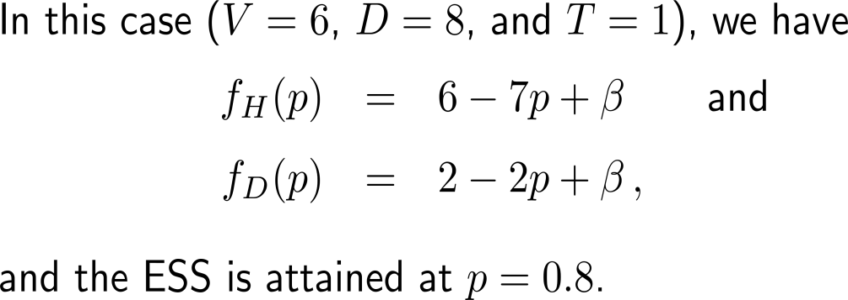
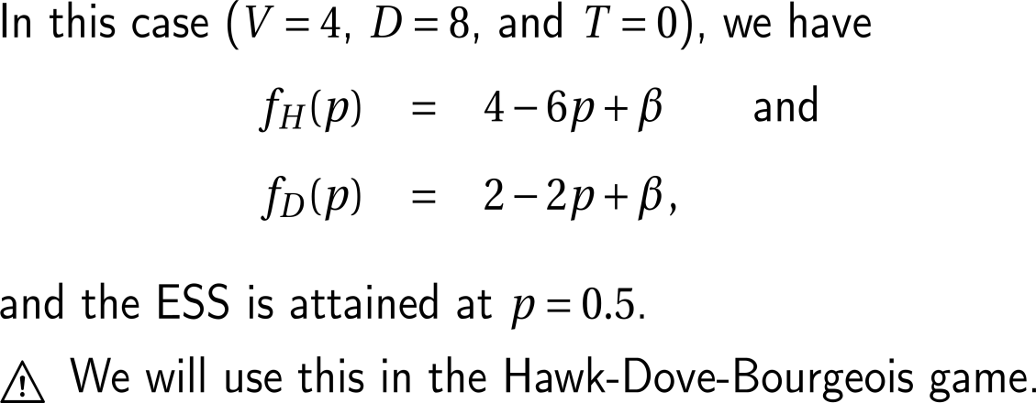
Note, the actual values of the payoffs/ utilities determine the location of the ESS
player A B | Hawk | Dove
Hawk | (-1, -1) | (6, 0)
Dove | (0, 6) | (2, 2)
player A B | Hawk | Dove
Hawk | (-2, -2) | (4, 0)
Dove | (0, 4) | (2, 2)

Slide 33
Topics
Mathematical Formulation: The Hawk-Dove Game
Discrete Evolutionary Dynamics
The Hawk-Dove-Bourgeois Extension
if time permits

Slide 34




We extend the Hawk-Dove game by introducing a third strategy that models territorial ownership
D
territory owner
B
H
intruder
Dove Strategy
Bourgeois Strategy:
We assume that there are two essential roles: 'territory owner' and 'intruder'. The individuals know in which role they are. (The role does not affect the probability to win a fight nor the payoff of a victory.)
This asymmetry allows the introduction of the 'bourgeois‘ strategy with the following behavior:
'as a territory owner, play hawk' an
'as an intruder, play dove'.
Hawk Strategy

Slide 35
The Hawk-Dove-Bourgeois game has (bourgeois, bourgeois) as a Nash-equilibrium in pure strategies which turns out to be an ESS as well
player 1 2 | Hawk | Dove | Bourgeois
Hawk | (-2, -2) | (4, 0) | (1, -1)
Dove | (0, 4) | (2, 2) | (1, 3)
Bourgeois | (-1, 1) | (3, 1) | (2, 2)
Theorem:
The Hawk-Dove-Bourgeois game has exactly four Nash-equilibria:
The strategy pairs (H, D), (D, H), and (B, B) are Nash-equilibria in pure strategies.
There is also an equilibrium in mixed strategies in which the players choose, independently of each other, the strategies ‘hawk’ and ‘dove’, each with frequency 0.5, and the strategy ‘bourgeois’ with zero frequency.
Proof (with some omissions):
We will use the dynamics induced by the replicator equation to verify the equilibrium in mixed strategies, that this is unstable, and that (B, B) is an evolutionary stable strategy (ESS).
ESS
Previous Hawk-Dove game
Nash-equilibrium in pure strategies
ESS
Evolutionary stable strategy

Slide 36
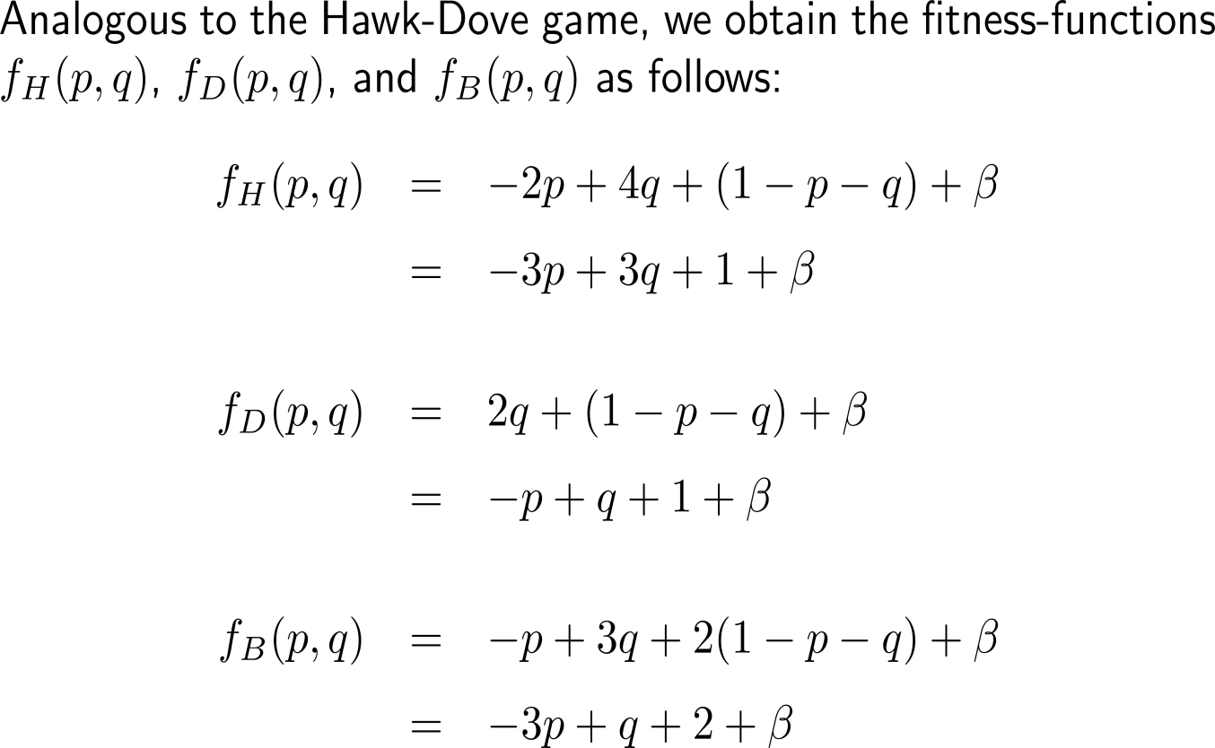
Proof: 1) fitness functions of the ‘hawk’, ‘dove’, and ‘bourgeois’ strategies
player 1 2 | Hawk | Dove | Bourgeois
Hawk | (-2, -2) | (4, 0) | (1, -1)
Dove | (0, 4) | (2, 2) | (1, 3)
Bourgeois | (-1, 1) | (3, 1) | (2, 2)
‘hawk’ frequency: p
‘dove’ frequency: q
‘bourgeois’ frequency: 1 – p – q

Slide 37
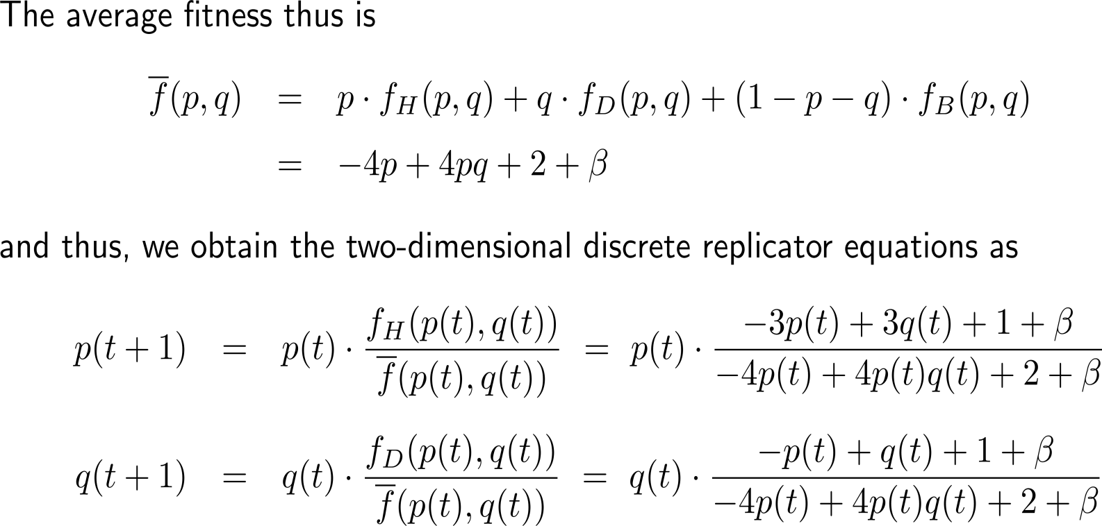
Proof: 2) average fitness and discrete replicator equations

Slide 38
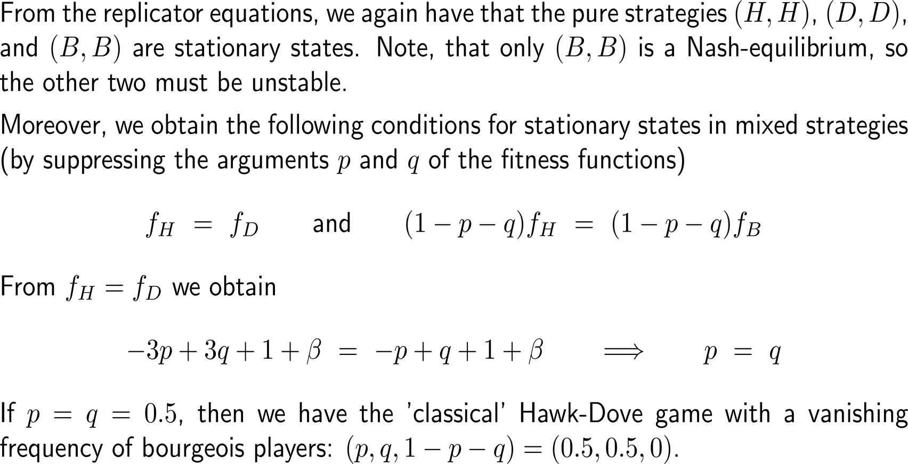
Proof: 3) stationary states and their conditions (1/ 2)

Slide 39
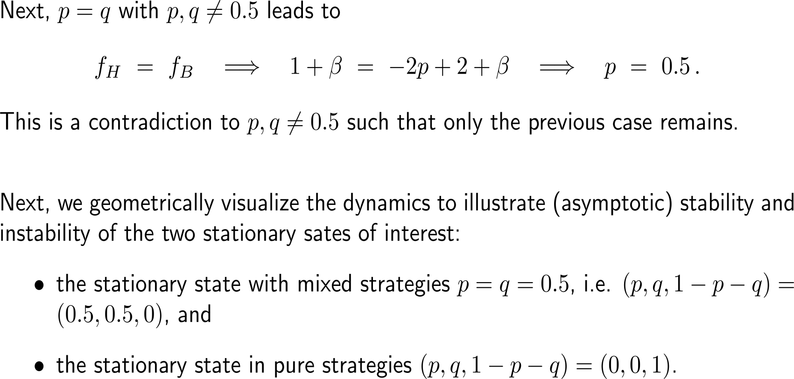
Proof: 3) stationary states and their conditions (2/ 2)

Slide 40
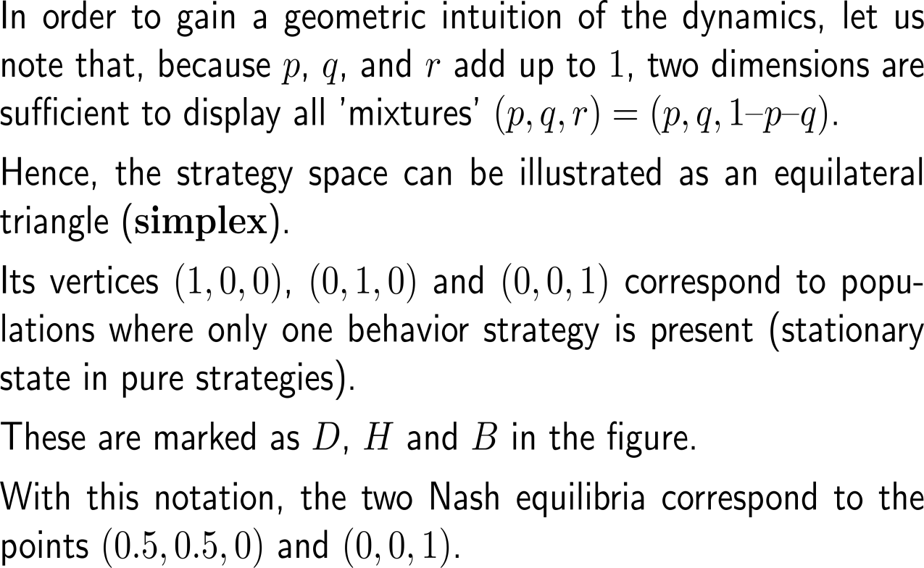
Proof: 4) geometric illustration of the dynamics within the strategy simplex
r
B
H
p
D
q
B = (0,0,1)
D
= (0,1,0)
H
= (1,0,0)

Slide 41
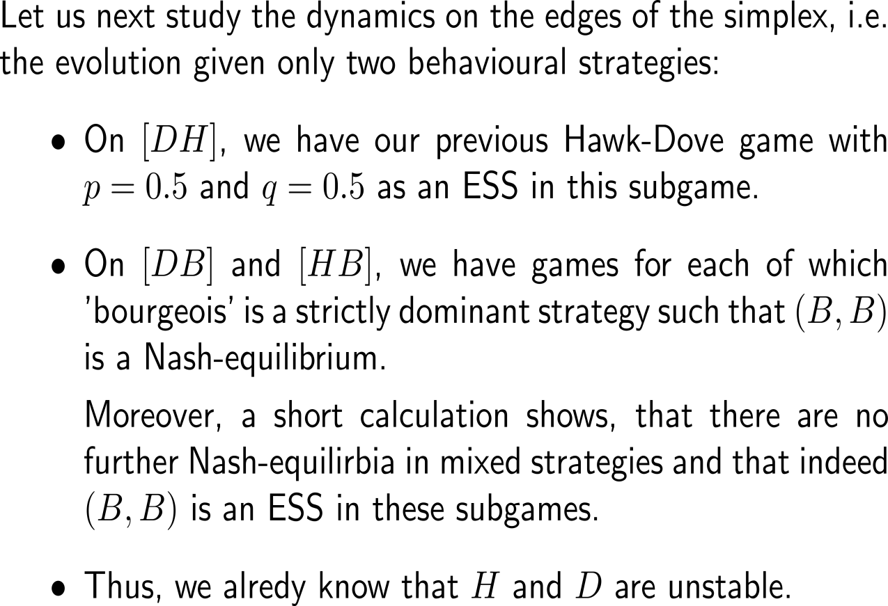
Proof: 5) dynamics on the edges of the simplex
player 1 2 | Dove | Bourgeois
Dove | (2, 2) | (1, 3)
Bourgeois | (3, 1) | (2, 2)
player 1 2 | Hawk | Bourgeois
Hawk | (-2, -2) | (1, -1)
Bourgeois | (-1, 1) | (2, 2)
B = (0,0,1)
D
= (0,1,0)
H
= (1,0,0)
player 1 2 | Hawk | Dove
Hawk | (-2, -2) | (4, 0)
Dove | (0, 4) | (2, 2)

Slide 42
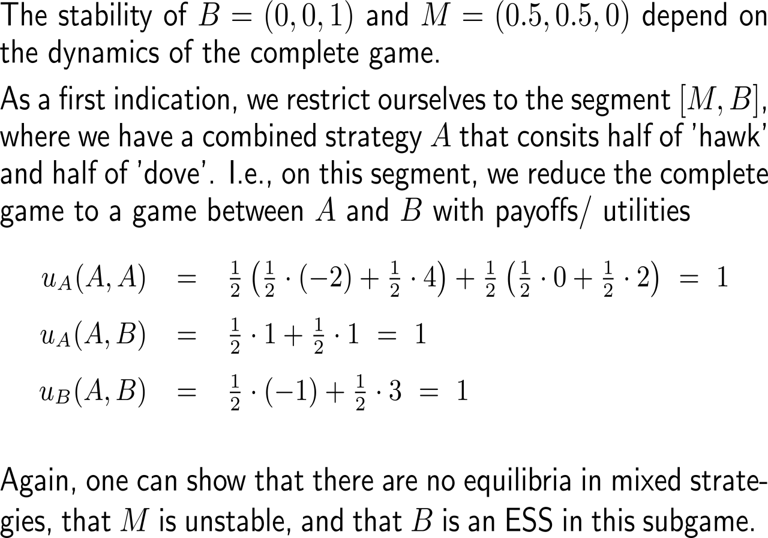
Proof: 6) dynamics on the connecting segment between B and M
player 1 2 | Hawk | Dove | Bourgeois
Hawk | (-2, -2) | (4, 0) | (1, -1)
Dove | (0, 4) | (2, 2) | (1, 3)
Bourgeois | (-1, 1) | (3, 1) | (2, 2)
* Nash-equilibrium
*
*
*
player 1 2 | A | Bourgeois
A | (1, 1) | (1, 1)
Bourgeois | (1, 1) | (2, 2)
*
B = (0,0,1)
*
D
= (0,1,0)
H
= (1,0,0)
M

Slide 43
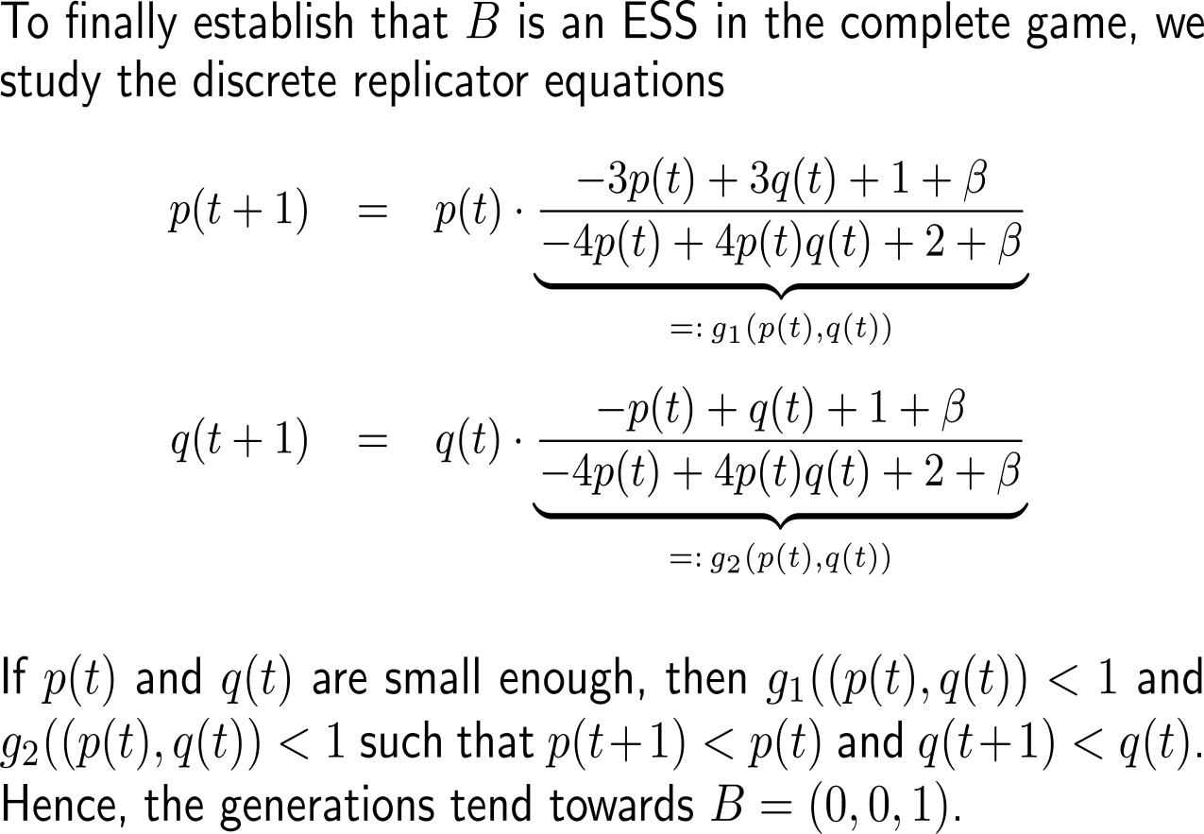
Proof: 7) dynamics near B justify that B is an ESS
r
B
H
p
D
q
B = (0,0,1)
D
= (0,1,0)
H
= (1,0,0)

Slide 44
Computational Biomathematics
florian.rupp@kiu.edu.ge

