Slide 1
Computational Biomathematics
The Secret Life of Slime Molds: Aggregation
Lesson 9
Lecture
Chemotaxis & the Keller-Segel model
A first mathematical stability analysis
Simulation of the Keller-Segel model

Slide 2
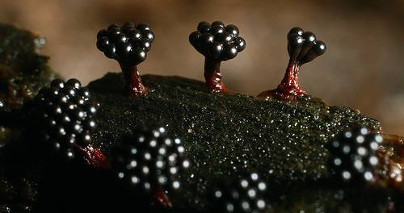
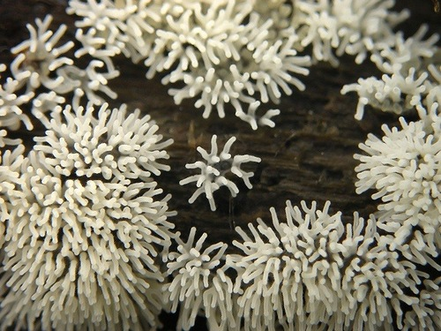
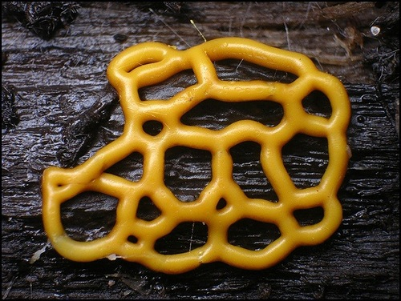
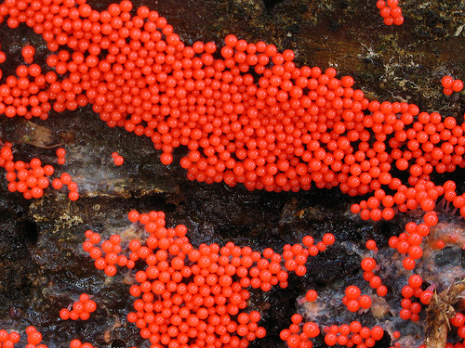
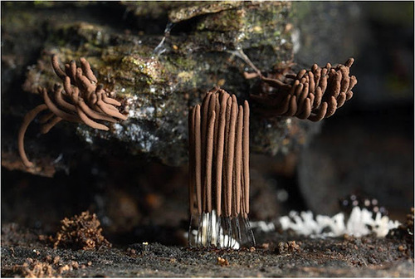
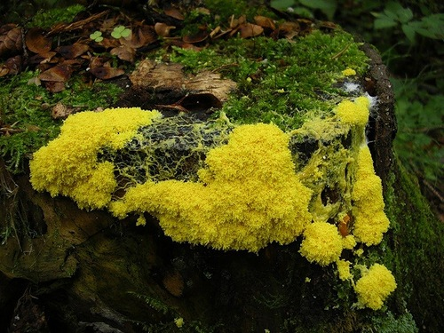

With over 700 sub-species slime molds form a variety-rich life-form that exhibits very interesting life phases
Some Facets of the
Life Cycle of Slime Molds

Slide 3
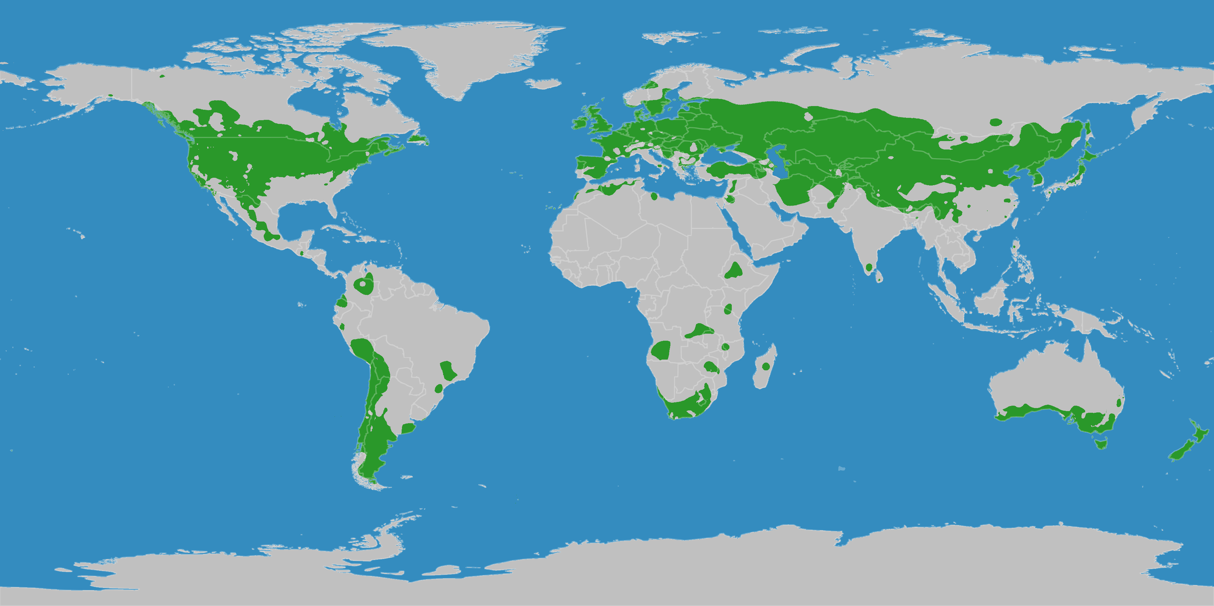
Slime molds are globally widespread with a preference to the temperate climate zone (1/ 2)
Slime molds with the huge variety of their sub-species are globally widespread.
Optimal growth conditions are provided in the temperate zones. These include
sufficient light for phototaxis (i.e. movement towards or away from stimulus of light) to reach new food supplies (like dead wood or rotting plant material)
sufficient wind power to carry and spread spores
sufficient humidity
not too strong rainfalls that wash away the amoebae
not too acid soil
temperate zones
S.L. Stevenson, H. Stempen (2000): Myxomycetes. A Handbook of Slime Molds. Portland: Timber Press
University of Arkansas, Fayetteville. "Slime molds discovered in southern African desert." ScienceDaily. ScienceDaily, 21 April 2015.

Slide 4
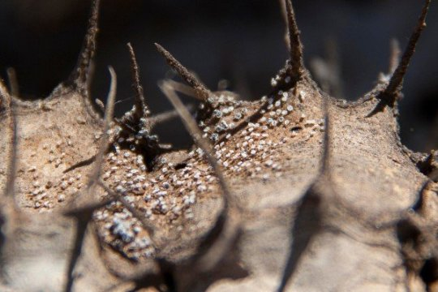
Slime molds are globally widespread with a preference to the temperate climate zone (2/ 2)
Though, this does not exclude that slime molds find niches in not so favorable habitats, like the sub-tropics, tropics or dessert regions.
temperate zones
at the Sonoran desert about 33 sub-species of slime molds are proven
in 2015 the first specimen (myxomycete) of slime molds were discovered in the Namib dessert
fruiting bodies of a myxomycete (small round white structures) on the decaying remains of a cactus-like plant.
S.L. Stevenson, H. Stempen (2000): Myxomycetes. A Handbook of Slime Molds. Portland: Timber Press
University of Arkansas, Fayetteville. "Slime molds discovered in southern African desert." ScienceDaily. ScienceDaily, 21 April 2015.

Slide 5
Plasmodial slime mold amoebae generate geodesic-path minimizing networks, other may form aggregations that act as a single organism (1/ 2)
Plasmodium moving over tree bark
Slime mold solving maze
Tokyo rail network designed by Physarum plasmodium

Slide 6
Plasmodial slime mold amoebae generate geodesic-path minimizing networks, other may form aggregations that act as a single organism (1/ 2)
from the movement of (undifferentiated) single slime mold amoebae
towards
the movement of complete cell clusters (with a certain degree of differentiation)

Slide 7
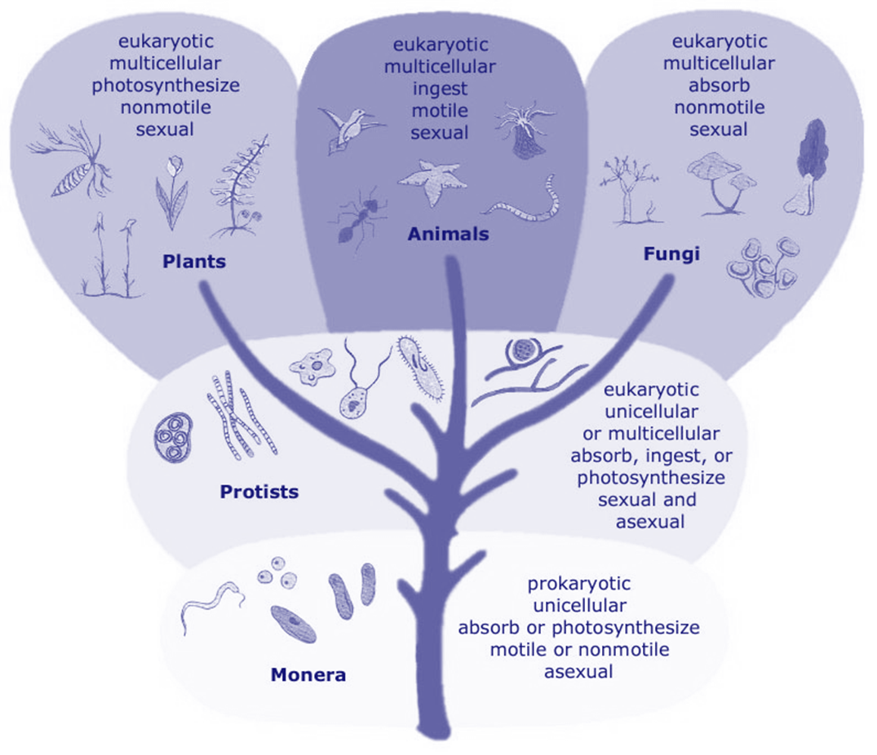
From the taxiomatic point of view slime molds belong to the kingdom of Protists and can be separated into plasmodial and cellular types
http://botanystudies.com/classification-of-plant-kingdoms-with-diagrams/five-kingdom-classification-system/
Slime Molds (SM)
Plasmodial SM
Cellular SM
One large “supercell” (a syncytium) where the cytoplasm contains thousands of individual nuclei.
Two distinct forms during life cycle:
individual unicellular protists amoebae
cluster of differentiated cells that acts as one organism

Slide 8
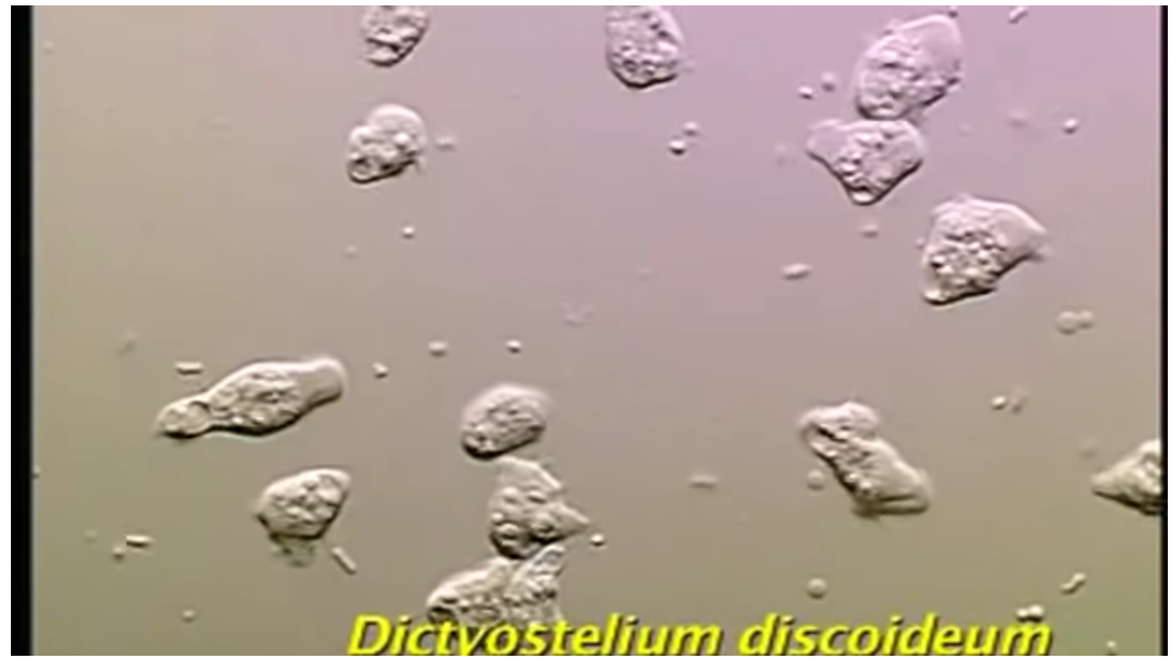
Our key protagonist is the cellular slime mold dictyostelium discoideum that exhibits very interesting social life phases (1/ 3)
https://www.youtube.com/watch?v=5h8WOWEqP6o
Dictyostelium - a Cellular Slime Mold (3:39 min)

Slide 9
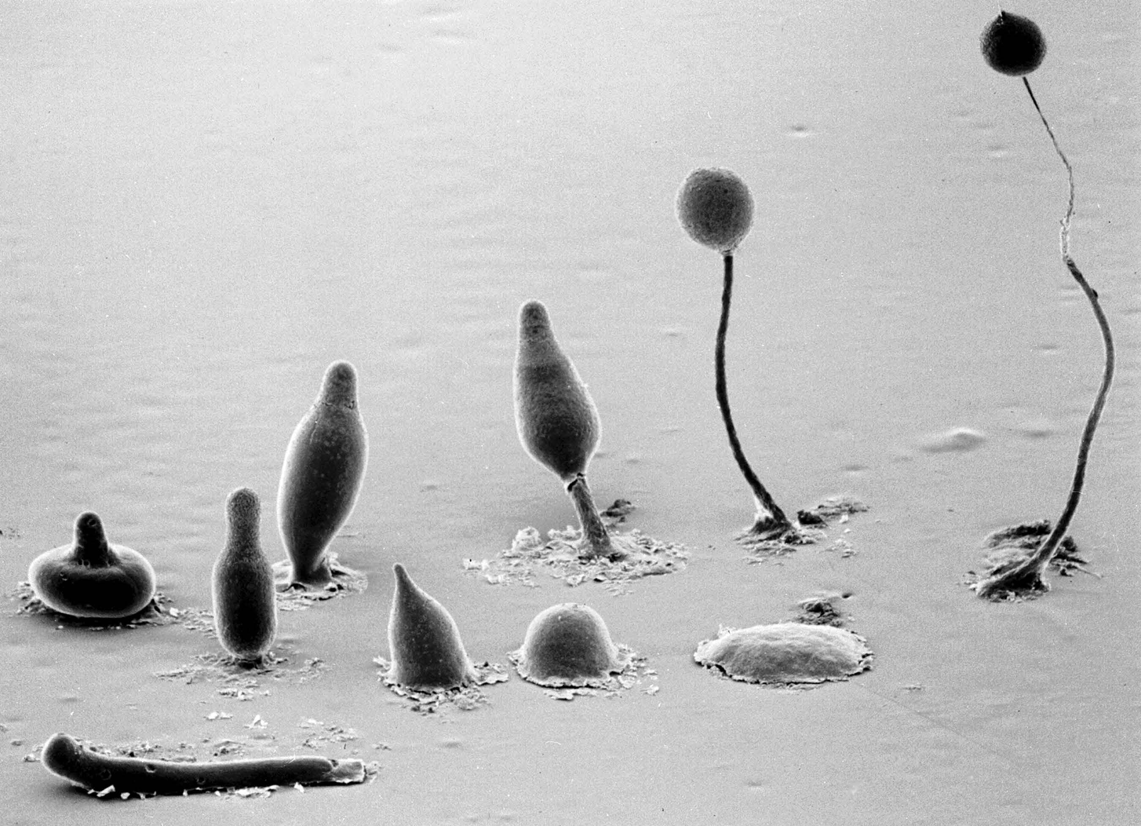

Our key protagonist is the cellular slime mold dictyostelium discoideum that exhibits very interesting social life phases (2/ 3)
Copyright, M.J. Grimson & R.L. Blanton, Biological Sciences Electron Microscopy Laboratory, Texas Tech University

Slide 10
Our key protagonist is the cellular slime mold dictyostelium discoideum that exhibits very interesting social life phases (3/ 3)
fruiting body
sufficient food supply
vegetative
cycle
scarcity in food supply
Mexican hat
several life-stages involve cAMP signaling
social cycle
based on Fig. 1 from the review article Si.I. Li & M.D. Purugganan (2011): The cooperative amoeba: Dictyostelium as a model for social evolution, Trends in Genetics, 27 (2), pp. 48-54
habloid cells
slug
sexual cycle
zygote
cAMP
cAMP
germination
finger
cannibalism
cAMP
sreaming
tight aggregate
macrocyst

Slide 11
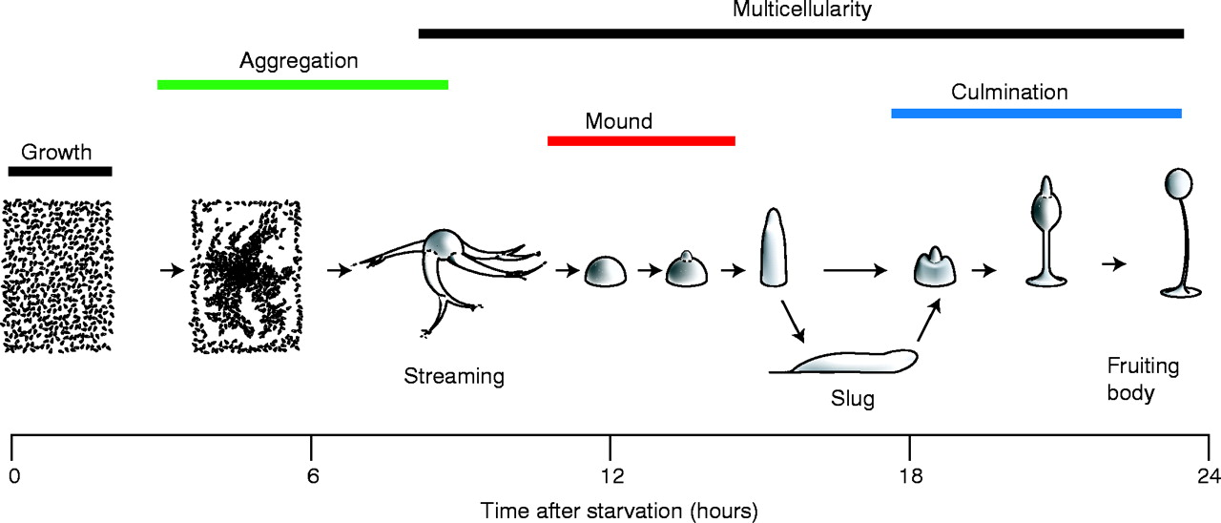
We start by discussing the cell communication (in particular cell aggregation) in dictyostelium discoideum …
J.C. Coates & A.J. Harwood (2001): Cell-cell adhesion and signal transduction during Dictyostelium development, Journal of Cell Science 114, pp. 4349-4358.
http://jcs.biologists.org/content/114/24/4349
Martiel & Goldbeter
Keller &
Segel

Slide 12
… and then continue with cell differentiation
J.C. Coates & A.J. Harwood (2001): Cell-cell adhesion and signal transduction during Dictyostelium development, Journal of Cell Science 114, pp. 4349-4358.
http://jcs.biologists.org/content/114/24/4349
Weijer, Pineda & Eftimie
Odell & Bonner

Slide 13

dictyBase: dictyostelium discoideum online
www.dictybase.org

Slide 14
Topics
Chemotaxis & the Keller-Segel Model
A First Mathematical Stability Analysis
Simulation of the Keller-Segel Model
Martiel & Goldbeter
Keller &
Segel

Slide 15
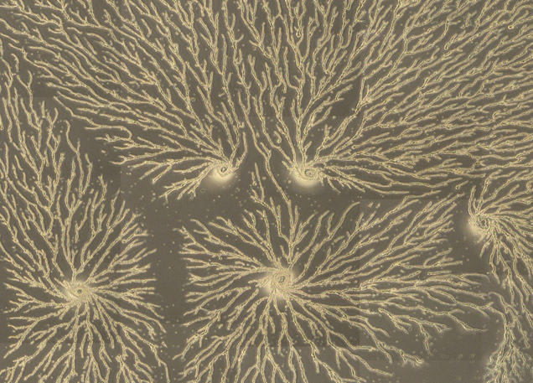
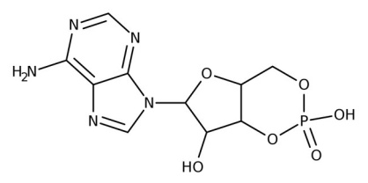
Chemotaxis: the dictyostelium discoideum amoebae aggregate following increasing concentrations of cAMP
cAMP
the dictyostelium discoideum amoebae move in response to a chemical signal sent by other amoebae
the chemical signal they use is cyclic adenosine 3’,5’-monophosphate (cAMP)
https://www.formedium.com/product-category/formedium-media/dictyostelium-discoideum/

Slide 16
Biochemically, this chemotaxis is activated by cAMP and regulated by Phosphodiesterase
The amoebae secrete cAMP
Other amoebae receive the cAMP signal with specific receptors and move towards the cAMP source
cAMP stimulates the organization of actin filaments in the membrane cortex
later (approx. 3 min.), the receiving amoebae secrete cAMP themselves
This process results in the movement of amoebae towards a central location
But with all amoebae secreting and receiving cAMP, how do they know which way to travel? Hence a biochemical mechanism is required to reset the system
The enzyme Phosphodiesterase breaks down cAMP and shuts the chemotaxis down
Phosphodiesterase clears the receptors for the next round of binding, movement and cAMP production
the receiving receptors are stimulated again where the cAMP concentration is highest and where the binding thus occurs fastest
the movement is in the direction of the highest cAMP concentration
cAMP-Phosphodiesterase regulated chemotaxis

Slide 17

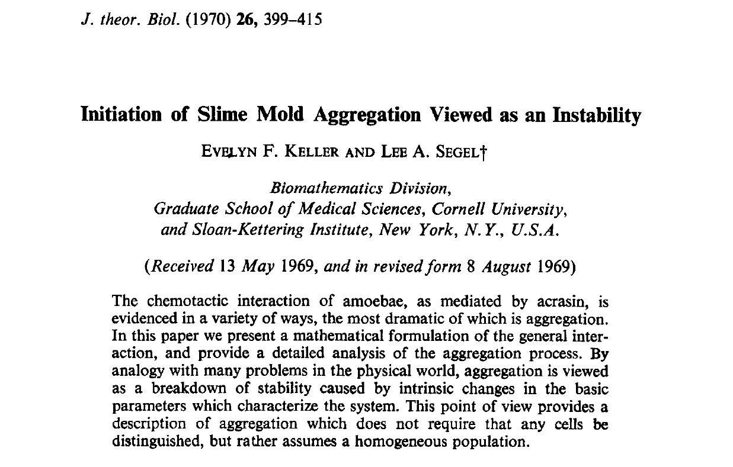
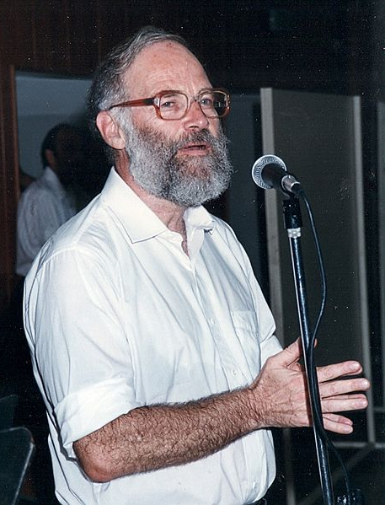
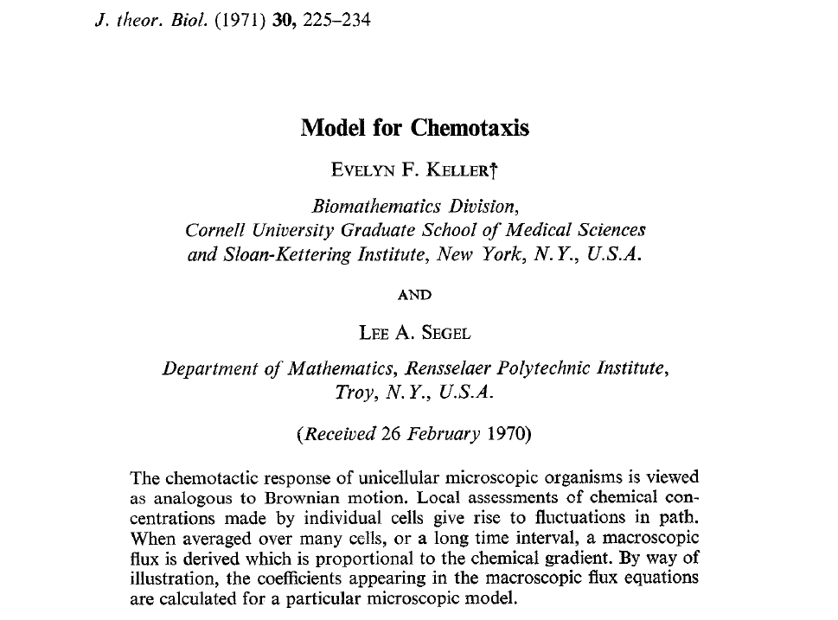
The best known mathematical models for cell aggregation and chemotaxis were proposed with dictyostelium discoideum in mind
Evelyn Fox Keller (*1936)
Lee Aaron Segel
(1932–2005)

Slide 18
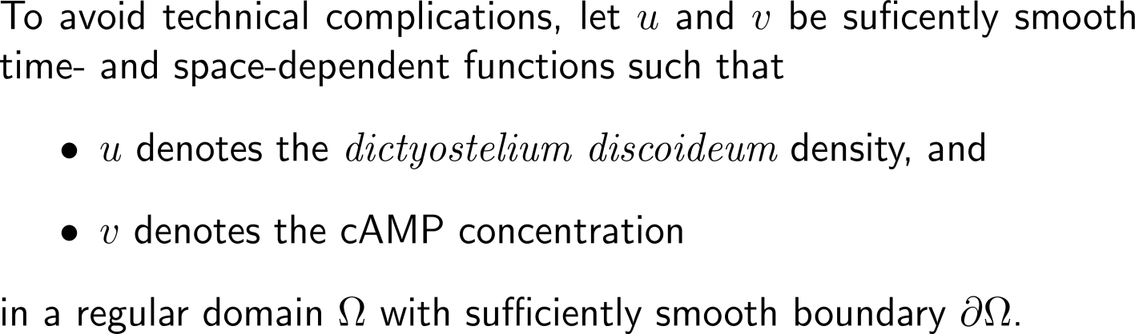


Derivation of the Keller-Segel chemotaxis model’s key building blocks
Step 1
Step 2
Step 3
Step 4
Step 5

Slide 19
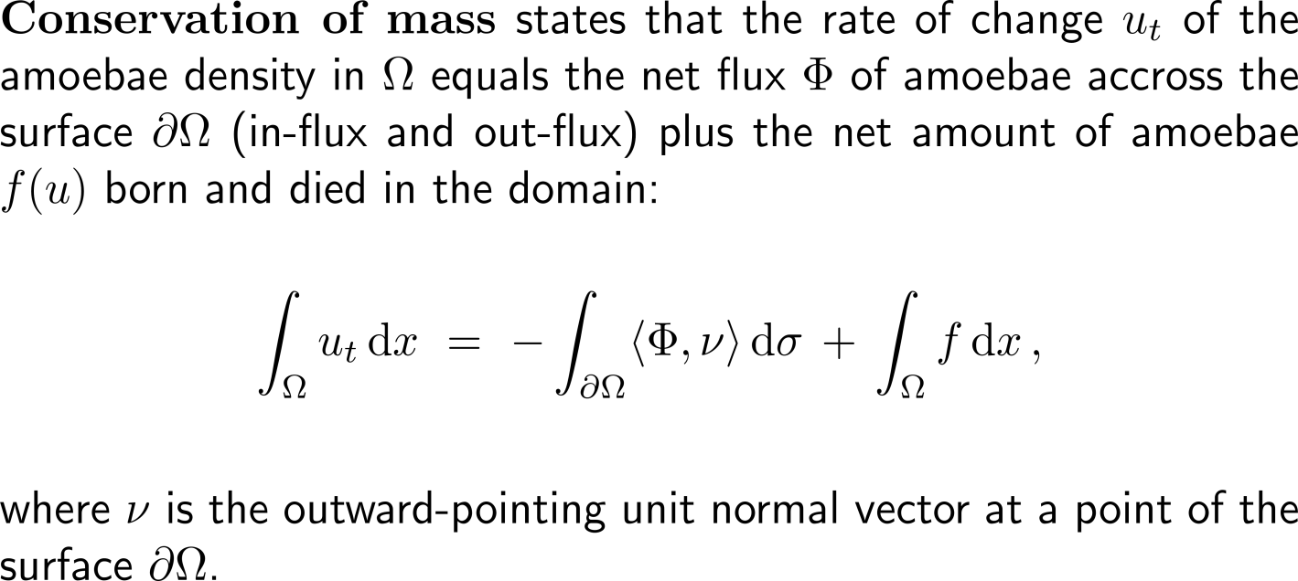
Derivation of the Keller-Segel chemotaxis model’s key building blocks
Step 1
Step 2
Step 3
Step 4
Step 5

Slide 20
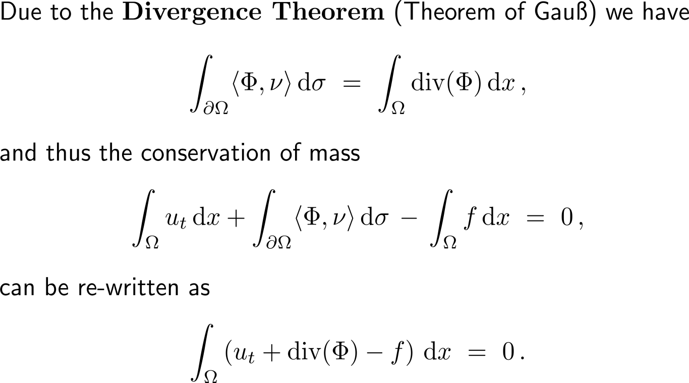
Derivation of the Keller-Segel chemotaxis model’s key building blocks
Step 1
Step 2
Step 3
Step 4
Step 5

Slide 21
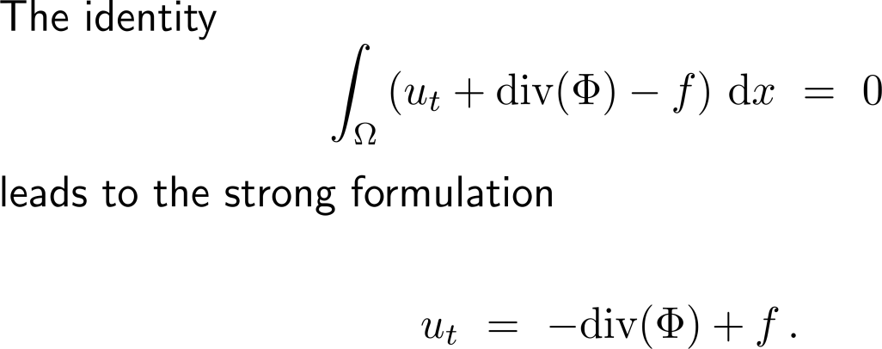
Derivation of the Keller-Segel chemotaxis model’s key building blocks
Step 1
Step 2
Step 3
Step 4
Step 5

Slide 22
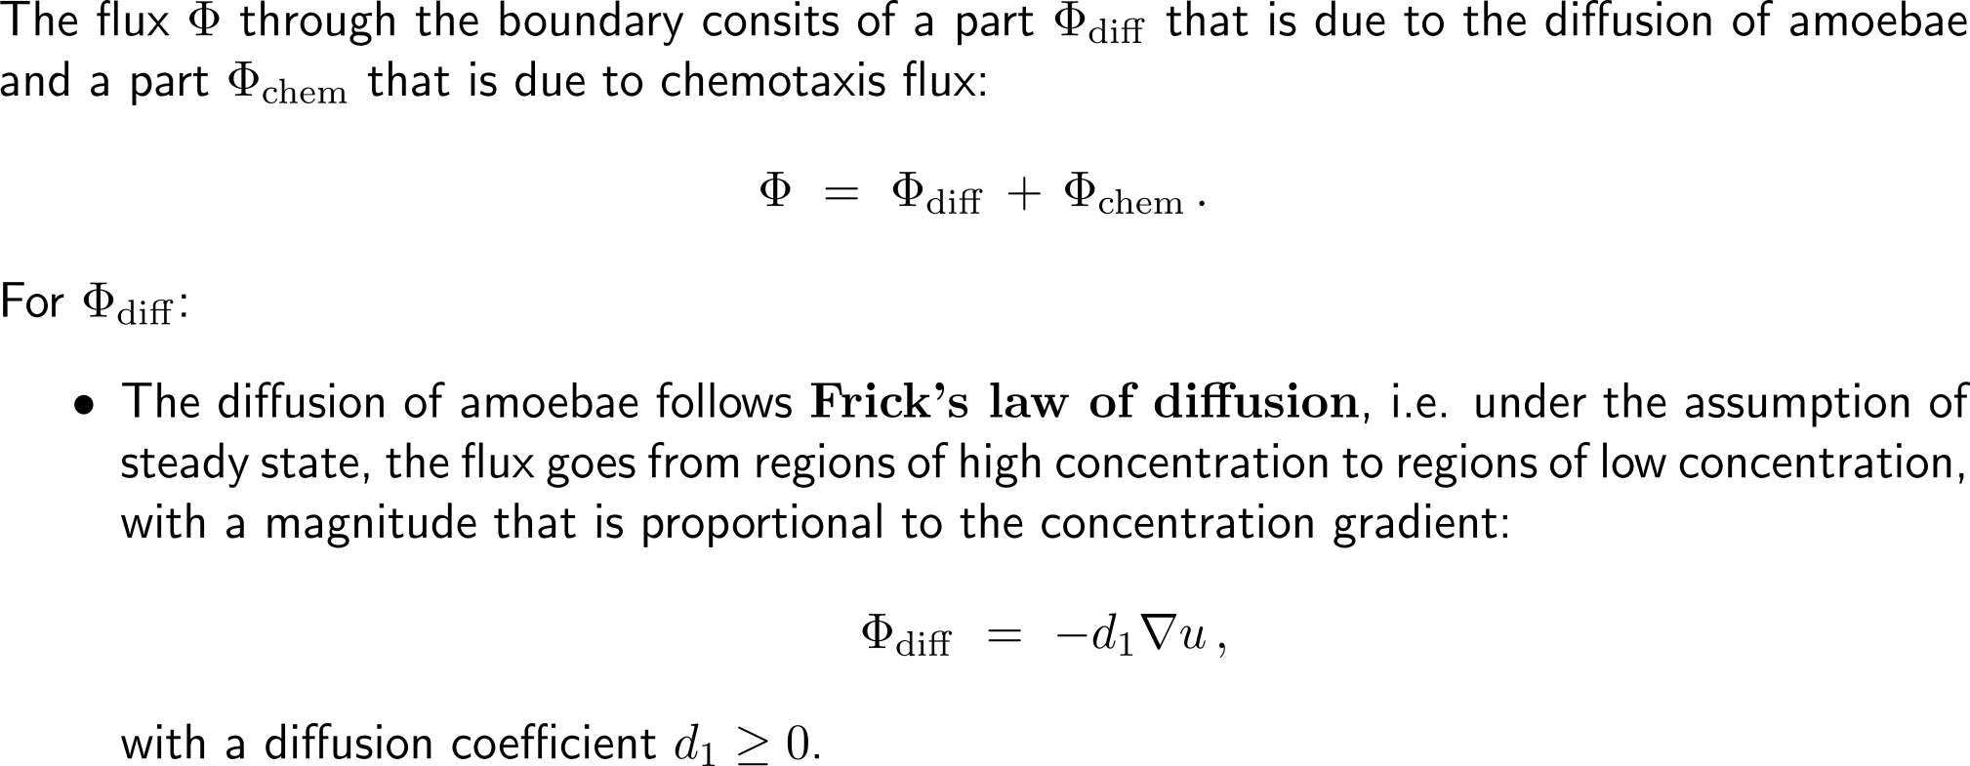
Derivation of the Keller-Segel chemotaxis model’s key building blocks
Step 1
Step 2
Step 3
Step 4
Step 5

Slide 23
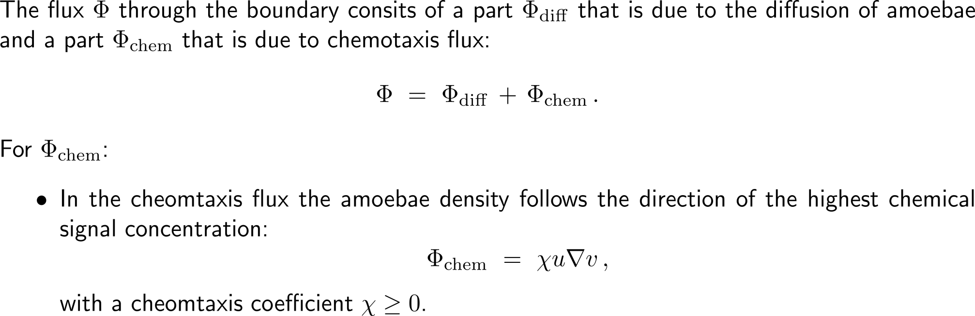
Derivation of the Keller-Segel chemotaxis model’s key building blocks
Step 1
Step 2
Step 3
Step 4
Step 5

Slide 24
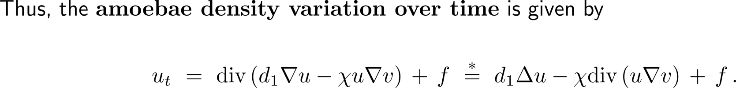
Derivation of the Keller-Segel chemotaxis model’s key building blocks
Step 1
Step 2
Step 3
Step 4
Step 5
diffusion
chemotaxis
aggregation
source
* under the assumption that the coefficients are constant

Slide 25
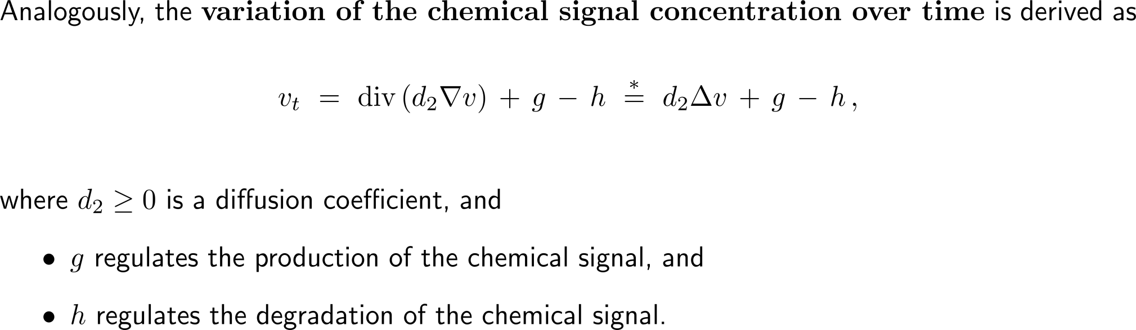
Derivation of the Keller-Segel chemotaxis model’s key building blocks
Step 1
Step 2
Step 3
Step 4
Step 5
* under the assumption that the coefficients are constant

Slide 26
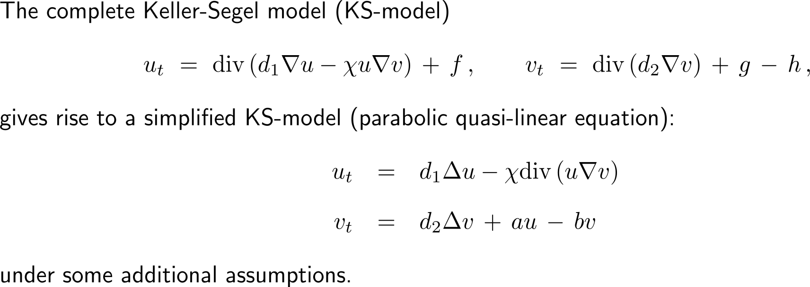
Derivation of the Keller-Segel chemotaxis model’s key building blocks
Step 1
Step 2
Step 3
Step 4
Step 5
competition between diffusion and aggregation

Slide 27
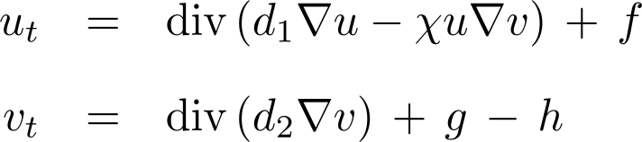
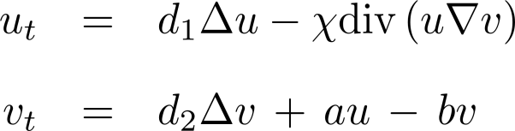
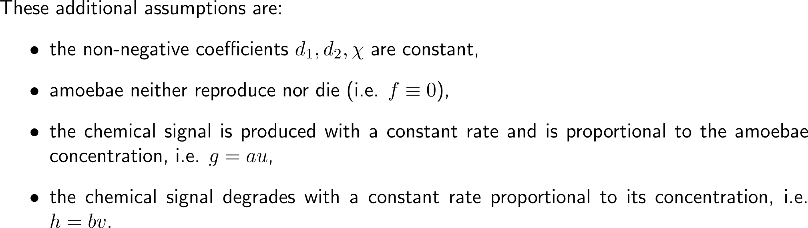
Derivation of the Keller-Segel chemotaxis model’s key building blocks
Step 1
Step 2
Step 3
Step 4
Step 5

Slide 28
Topics
Chemotaxis & the Keller-Segel Model
A First Mathematical Stability Analysis
Simulation of the Keller-Segel Model
We are interested in explaining biological phenomena by means of mathematical models that capture the essence of the problem (here the competition between diffusion and aggregation).
Thus, although not capturing the whole life-cycle of dictyostelium discoideum the simplified KS-model (or Keller-Segel‘s minimal chemotaxis model) has a lot of value.

Slide 29
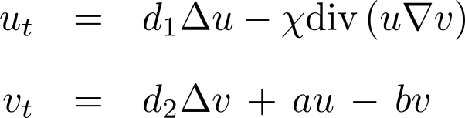
The mathematical analysis of the simplified KS-model can follow a somewhat straight-forward approach
together with initial and boundary conditions
Well-Posedness, Existence and Uniqueness of Solutions
For some classes of PDEs general results exist
Besides these and depending on the problem, proving existence and uniqueness can become rather tricky
Steady-State Solutions/
Equilibria and their Stability
Steady-state solutions/ equilibria (periodic orbits)
Linearized/ spectral/ Lyapunov stability
Parameter dependence and bifurcations

Slide 30
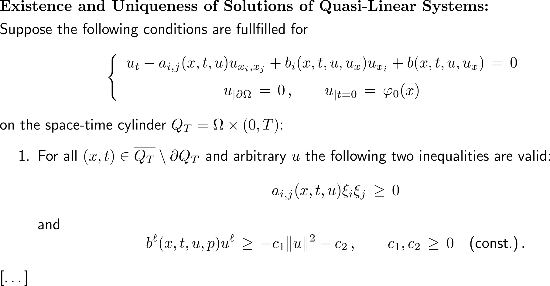
First to the unique existence of solutions of systems of quasi-linear systems (Ladyzenskaja, Solonnikov & Uralceva, Theorem 7.1, pp. 596) – 1/ 3

Slide 31
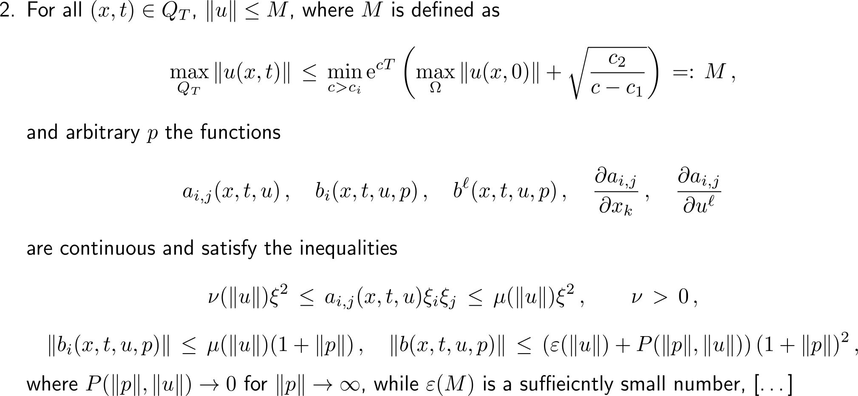
First to the unique existence of solutions of systems of quasi-linear systems (Ladyzenskaja, Solonnikov & Uralceva, Theorem 7.1, pp. 596) – 2a/ 3

Slide 32
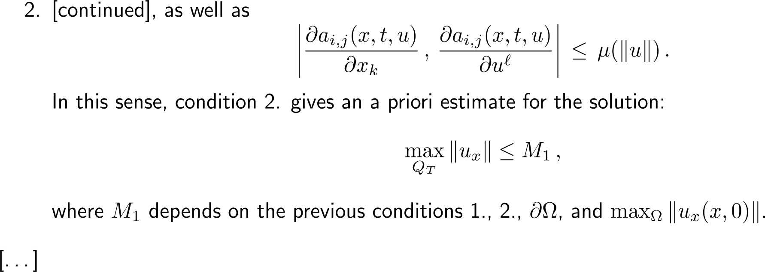
First to the unique existence of solutions of systems of quasi-linear systems (Ladyzenskaja, Solonnikov & Uralceva, Theorem 7.1, pp. 596) – 2b/ 3

Slide 33
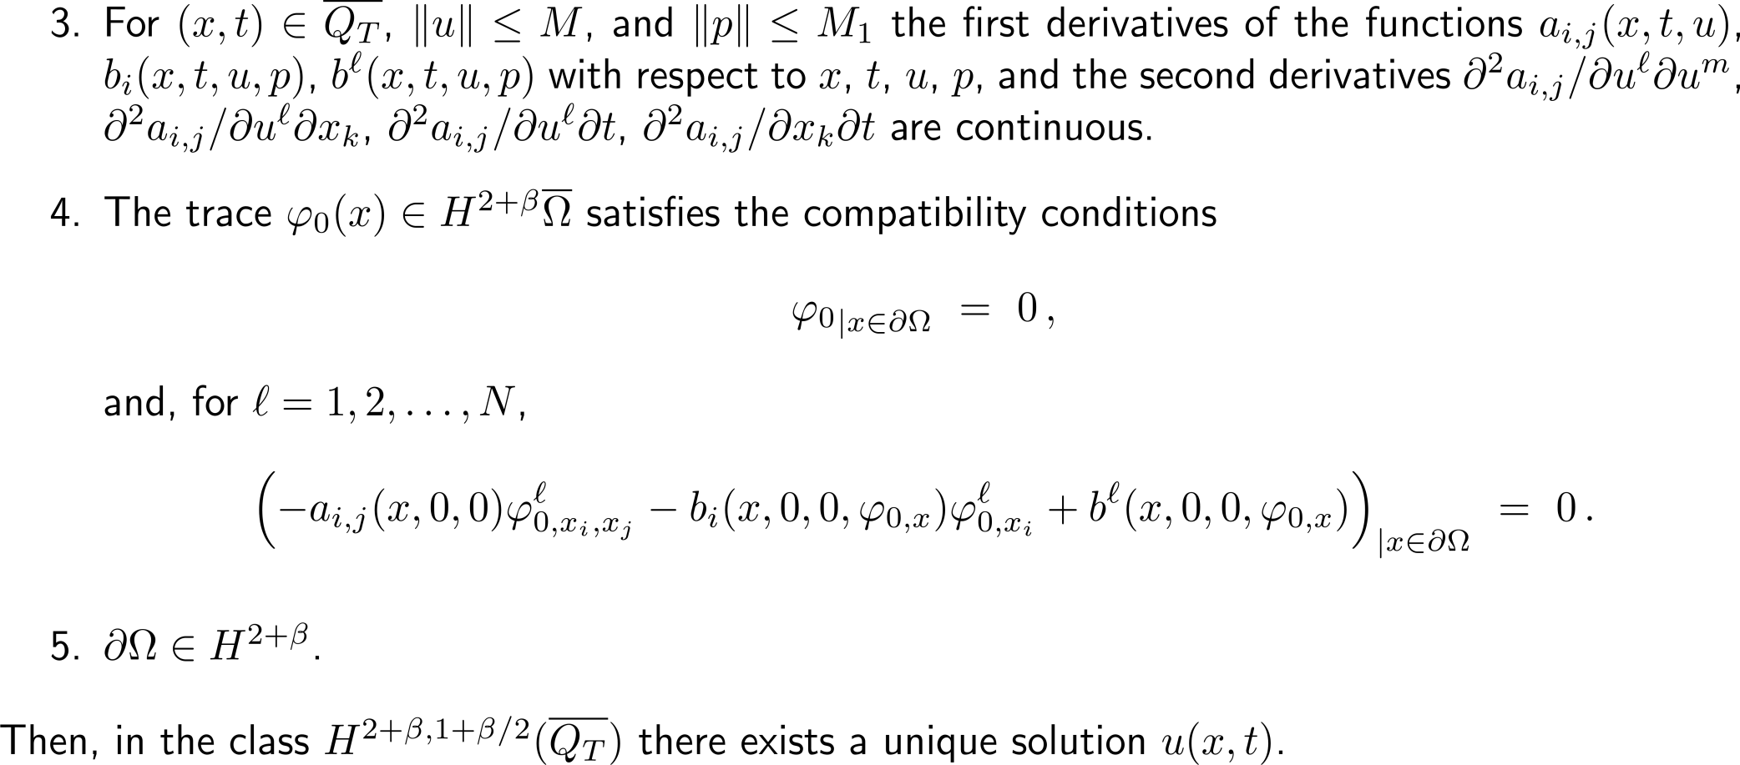
First to the unique existence of solutions of systems of quasi-linear systems (Ladyzenskaja, Solonnikov & Uralceva, Theorem 7.1, pp. 596) – 3/ 3

Slide 34

What remains is to verify that this Existence-and-Uniqueness Theorem applies for the simplified KS-model
Well-Posedness, Existence and Uniqueness of Solutions
Re-write the simplified KS-model in terms of the Theorem
Check that the conditions of the Theorem are satisfied (by choosing the constants in the Theorem appropriately)
an a bit time consuming homework assignment
With this Existence-and-Uniqueness Theorem we only have solutions on a time-interval (0, T), and hence the following analytical questions remain open:
formal justification that the non-negative solutions stay non-negative as long as they exist, i.e. the model makes biologically sense,
blow-up of solutions (depending on the parameters), i.e. aggregation outcompetes diffusion, and
existence of parameter regimes for which solutions persist for all times, i.e. diffusion outcompetes aggregation.

Slide 35
The mathematical analysis of the simplified KS-model can follow a somewhat straight-forward approach
together with initial and boundary conditions
Well-Posedness, Existence and Uniqueness of Solutions
For some classes of PDEs general results exist
Besides these and depending on the problem, proving existence and uniqueness can become rather tricky
Steady-State Solutions/
Equilibria and their Stability
Steady-state solutions/ equilibria (periodic orbits)
Linearized/ spectral/ Lyapunov stability
Parameter dependence and bifurcations

Slide 36
Stability or instability of equilibrium solutions in PDE systems can be studied via different approaches (1/ 2) …
Stability/ instability in infinite-dimensional function spaces:
δ-ball
ε-ball
t
functions
Any perturbation of the equilibrium
stays in a given environment about the equilibrium (stability) or even
tends back towards the equilibrium (asymptotic stability).

Slide 37
Stability or instability of equilibrium solutions in PDE systems can be studied via different approaches (2/ 2) …
Stability/ instability in infinite-dimensional function spaces:
δ-ball
ε-ball
t
functions
Some remarks:
The choice of the Banach-space and the corresponding metric is essential
A steady state solution may be stable in one Banach-space but unstable in another one

Slide 38
… like spectral properties, linearization, …
Spectral stability
Let σ(L) denote the spectrum of a (typically) unbounded operator L in infinite dimensions. For stability we require: sup Re( σ(L) ) ≤ 0
The spectrum decomposes into the essential spectrum (which is often easy to compute) and the point spectrum (eigenvalues, that may be quite difficult to locate)
Methods to compute the spectrum: Sturm-Liouville Theory (1d), Eavens function, …
Linear/ Linearized Stability
Let L be a linear operator that generates a semi-group e^{Lt}. The decay of solutions is determined by || e^{Lt} ||.
Spectral mapping theorem (SMT): σ( e^{L} )\ {0} = e^{σ(L)} (for special operators L only)
Without SMT: spectral stability does not necessarily imply linear stability
Methods to compute linear stability: Green’s function, …

Slide 39
… and the discussion of the non-linear system
Non-Linear Stability
It is in general non-trivial to prove non-linear stability (even if linear stability is proved)
If linear stability could be achieved, then the decay of perturbations may be extended to the non-linear setting via variation of constants (i.e. Duhamel’s formula), semi-group theory or Green’s function
A solution may be linearly unstable, but non-linearly stable (and vice versa)
A detailed discussion of these topics requires its time and is non-trivial, we thus continue with a hands-on approach that in general allows some good first stability/ instability results.

Slide 40
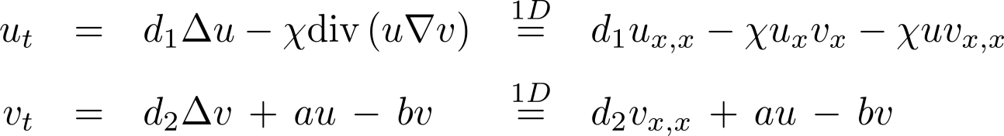
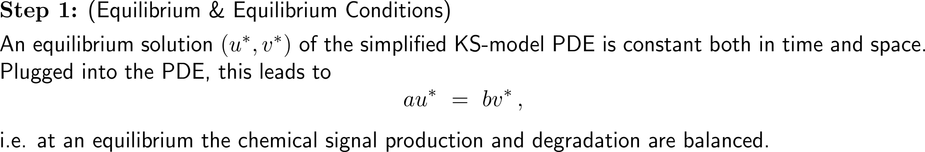
Let us consider the simplified KS-model in one spatial dimension and discuss small perturbations of an equilibrium (1/ 2)
together with initial and boundary conditions

Slide 41
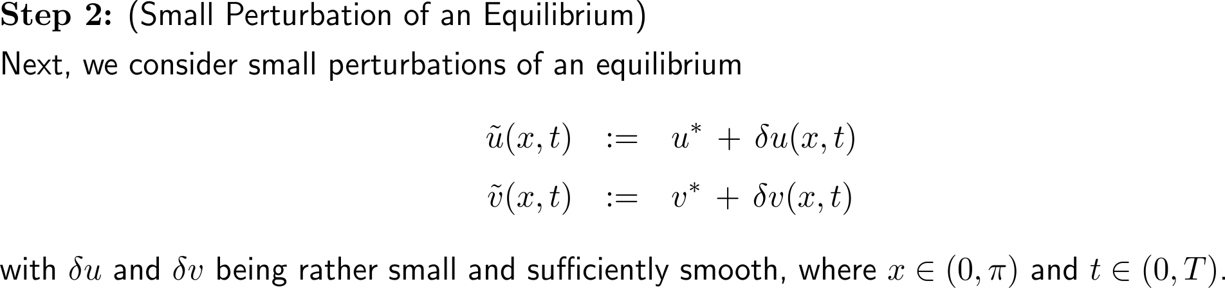
Let us consider the simplified KS-model in one spatial dimension and discuss small perturbations of an equilibrium (2/ 2)
together with initial and boundary conditions

Slide 42
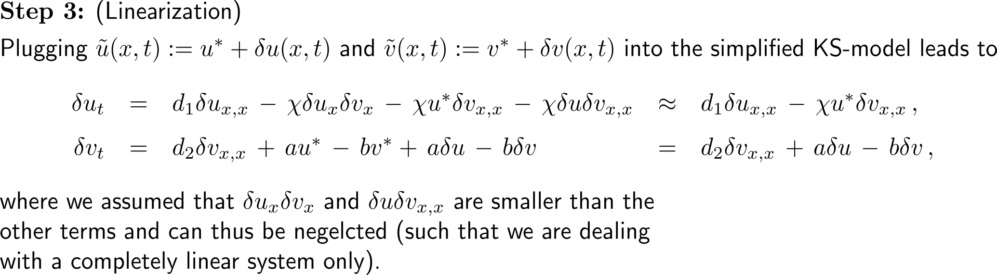
Therefore, we plug the small perturbation into the governing equations …
together with initial and boundary conditions
linear system

Slide 43
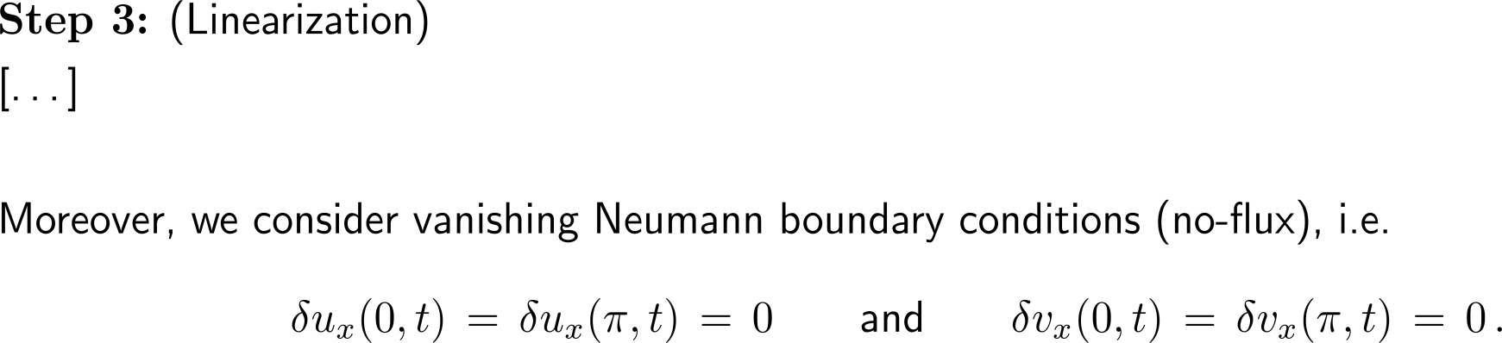
… with Neumann boundary conditions, …
together with initial and boundary conditions

Slide 44
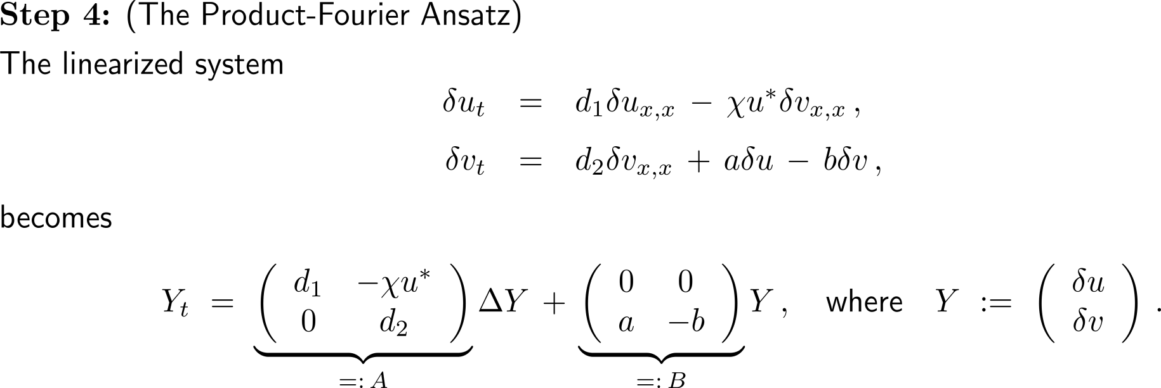
… and assume that the perturbations can be represented by a time- and space-product Fourier ansatz (1/ 2)
defining equations for the perturbations, i.e. δu and δv must fulfill these

Slide 45
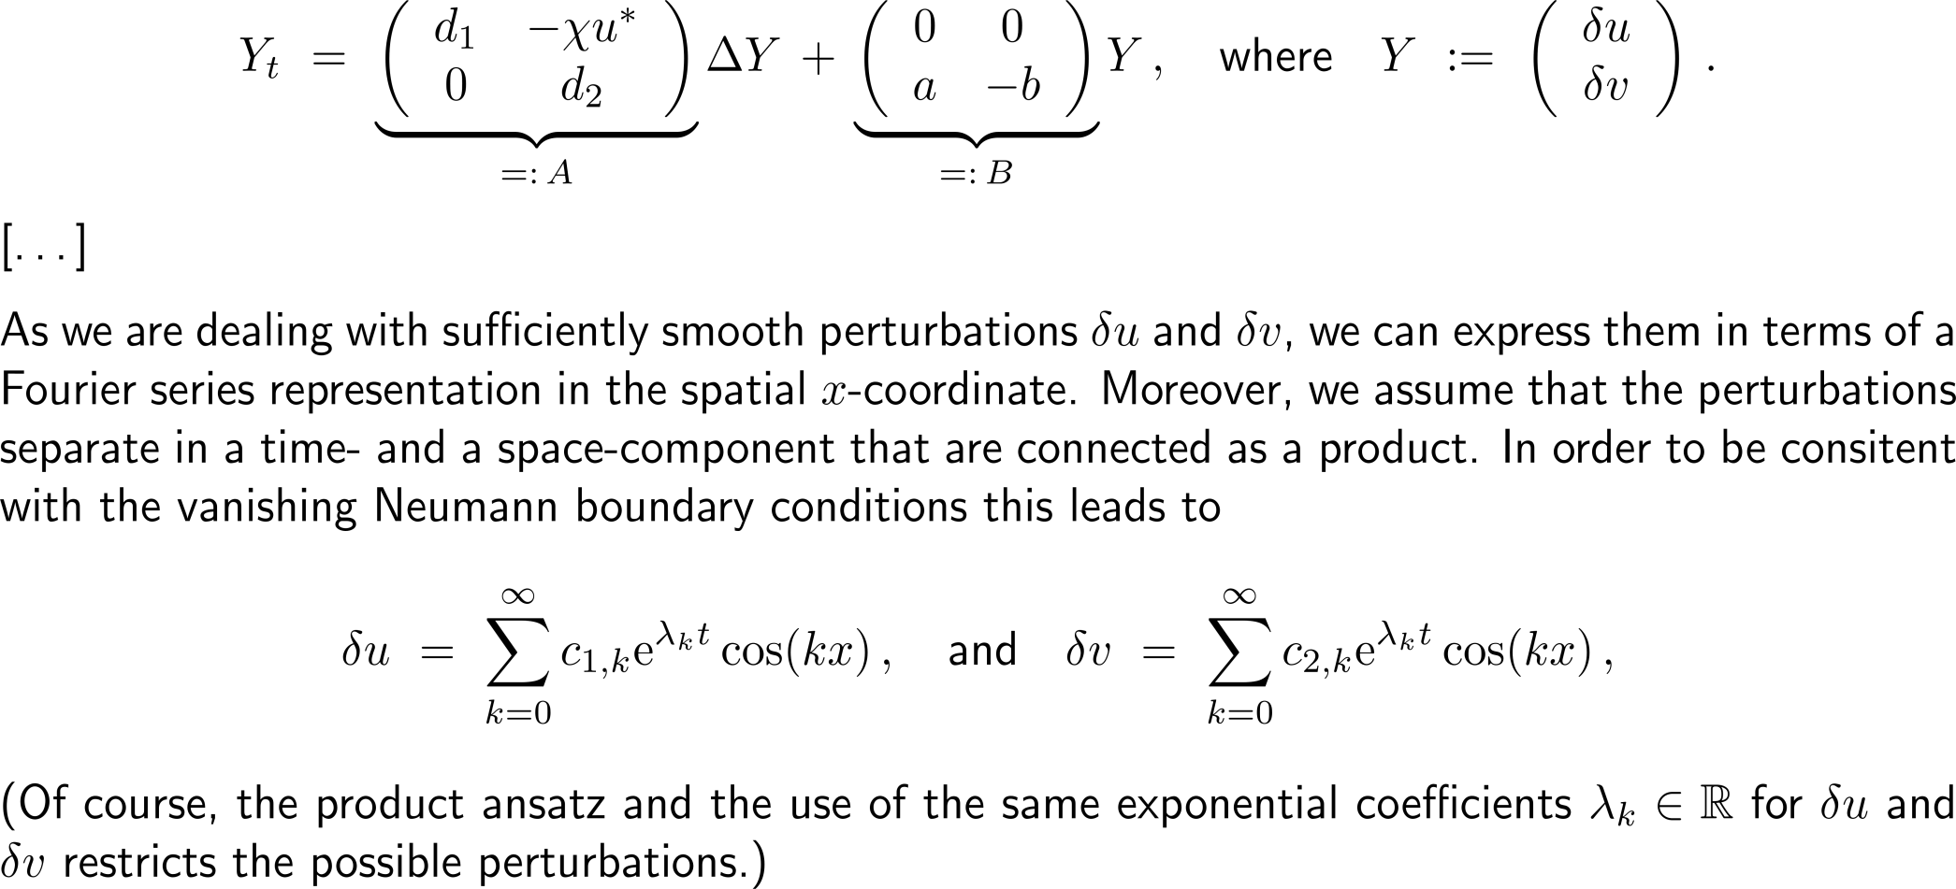
… and assume that the perturbations can be represented by a time- and space-product Fourier ansatz (2/ 2)
instability if
λ > 0

Slide 46
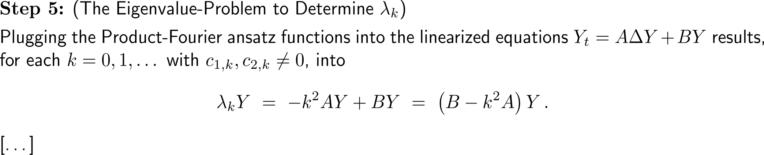
Provided that the chemotaxis coefficient is large enough there are unstable modes (values of k) in each perturbation representation

Slide 47
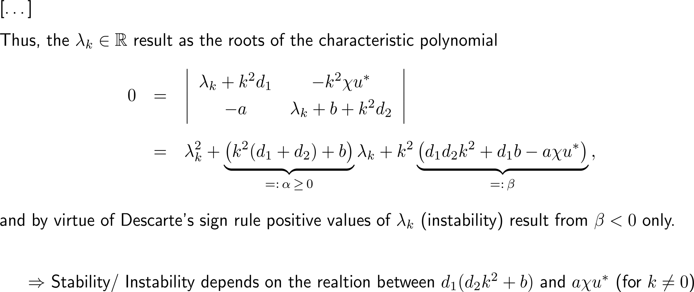
Provided that the chemotaxis coefficient is large enough there are unstable modes (values of k) in each perturbation representation (2/ 2)

Slide 48
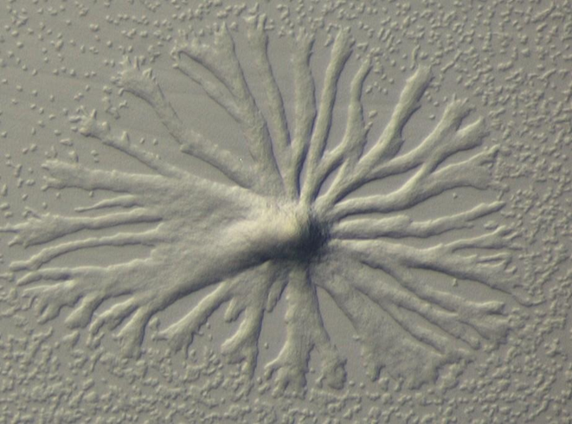
Topics
Chemotaxis & the Keller-Segel Model
A First Mathematical Stability Analysis
Simulation of the Keller-Segel Model

Slide 49
The mathematical analysis of the simplified Keller-Segel model can follow a somewhat straight-forward approach [continued]
together with initial and boundary conditions
Relevant Properties for the Connection of the Model to Reality
Here, e.g., blow-up of solutions (= aggregation)
Invariance of the non-negative orthant, travelling waves, pattern formation, etc.
Further Interesting Solution Properties
Asymptotics, Parameter-Regimes and Attractors
Asymptotic regimes, simplifications of the model
Differentiation of relevant parameter-regimes
Attractors and dimension reduction (ODE models)
Numerical Simulations
Numerical simulations to find interesting properties and gain clues for analytic discussions
Accurate numerical methods

Slide 50
A finite-difference discretization lays the ground for numerical simulations (1/ 2) …
together with initial conditions and vanishing Neumann boundary conditions (no-flux conditions)
time t
initial conditions
boundary conditions
n+1
fictitious layer
fictitious layer
n
i-1
i
i+1
space x

Slide 51
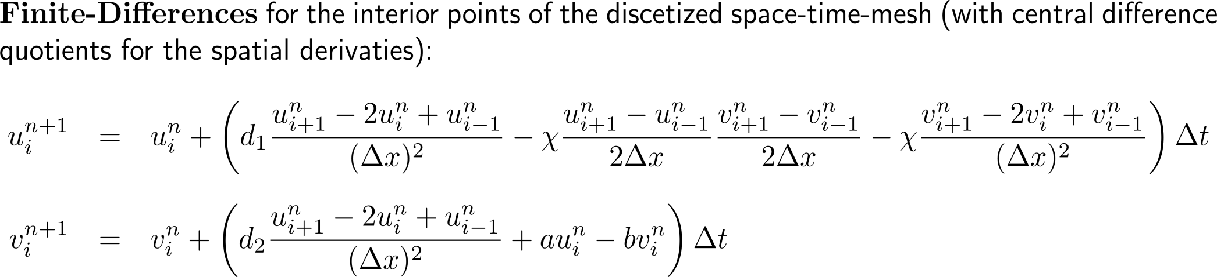
A finite-difference discretization lays the ground for numerical simulations (2/ 2) …
time t
initial conditions
boundary conditions
n+1
fictitious layer
fictitious layer
n
i-1
i
i+1
space x

Slide 52
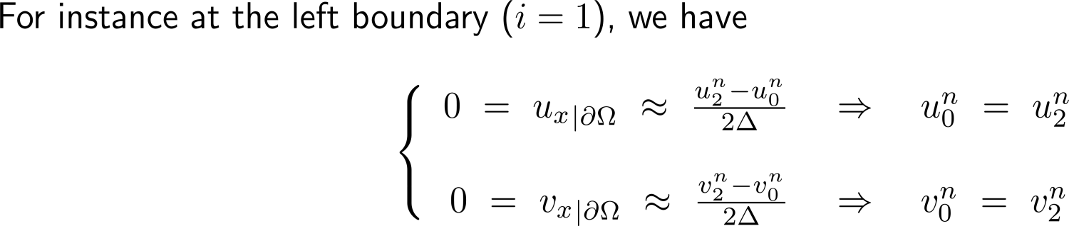
… where we use fictitious layers to include the vanishing Neumann boundary conditions (1/ 2)
fictitious layer
time t
initial conditions
boundary conditions
n+1
fictitious layer
n
application of Neumann conditions
i-1
i
i+1
space x

Slide 53
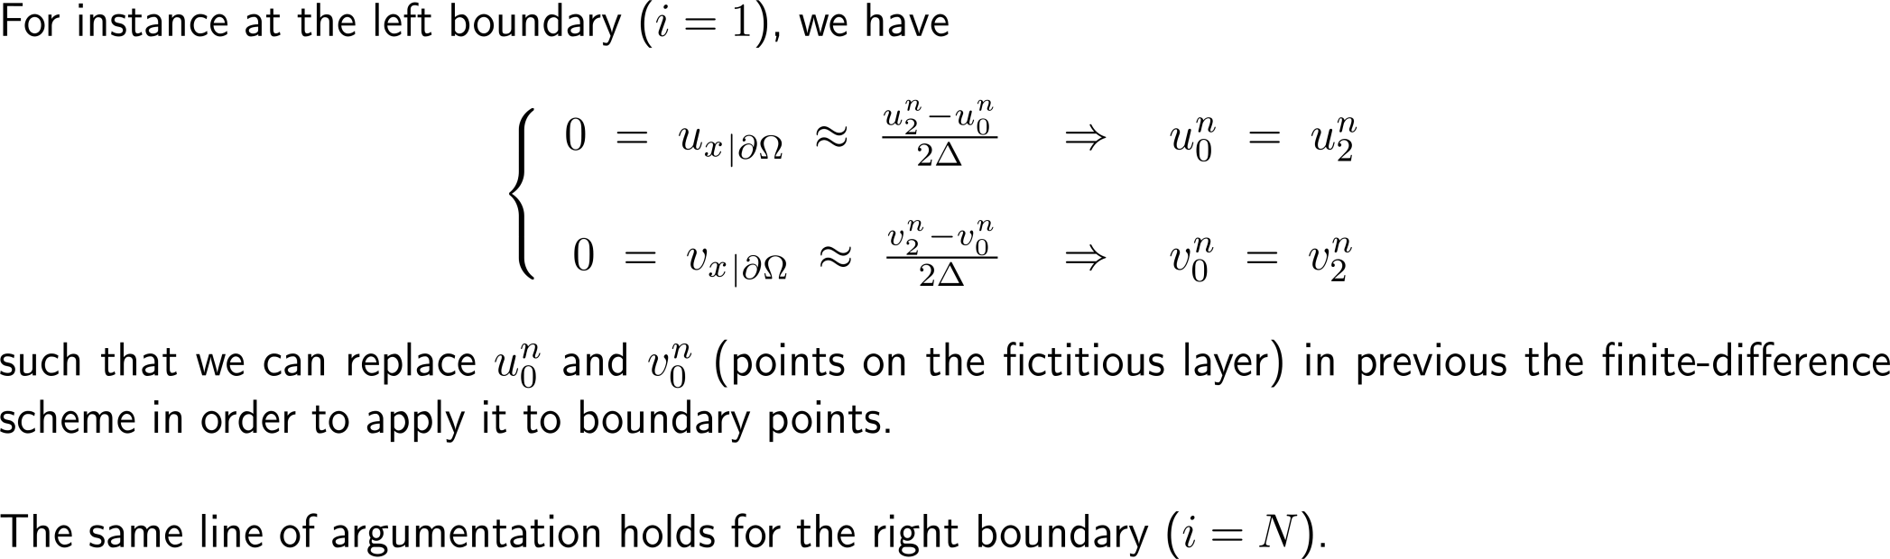
… where we use fictitious layers to include the vanishing Neumann boundary conditions (2/ 2)

Slide 54
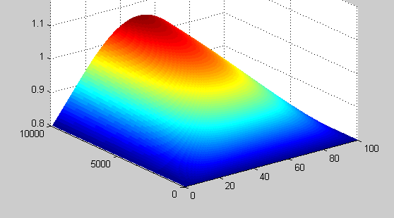
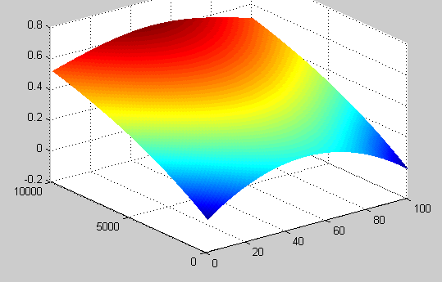
A corresponding code in MATLAB is easily written and executed to illustrate cell aggregation due to a high chemotaxis coefficient …
%-------------------------------------------------------------------
function[] = SKS1Dmod
%-------------------------------------------------------------------
% finite-difference approximation of the simplified
% KS-model (see lecture)
%-------------------------------------------------------------------
k = 100; dx = pi/(k-1); x = [0:dx:pi];
n = 10000; dt = 0.0001; t = [0:dt:((n-1)*dt)];
d1 = 1; d2 = 1; a = 1; b = 1; c = 3;
u = zeros(length(t),length(x));
v = zeros(length(t),length(x));
% initial conditions (uniform distribution of amoebae and
% parabolic chemotaxis concentration)
for i=1:k
u(1,i) = 0.8;
v(1,i) = 0.1*(i*dx)*(pi-(i*dx));
end
% update according to the finite-difference scheme
for j=2:n
% interior points
for i=2:(k-1)
uxx = (u(j-1,i+1)-2*u(j-1,i)+u(j-1,i-1))/(dx^2);
vxx = (v(j-1,i+1)-2*v(j-1,i)+v(j-1,i-1))/(dx^2);
ux = (u(j-1,i+1)-u(j-1,i-1))/(2*dx);
vx = (v(j-1,i+1)-v(j-1,i-1))/(2*dx);
%
u(j,i) = u(j-1,i) + dt*( d1*uxx - c*ux*vx - c*vxx );
v(j,i) = v(j-1,i) + dt*( d2*vxx + a*u(j-1,i) - b*v(j-1,i) );
end
% boundary points
uxx = 0; ux = 0; vxx = 0; vx = 0;
u(j,1) = u(j-1,1) + dt*( d1*uxx - c*ux*vx - c*vxx );
v(j,1) = v(j-1,1) + dt*( d2*vxx + a*u(j-1,1) - b*v(j-1,1) );
u(j,k) = u(j-1,k) + dt*( d1*uxx - c*ux*vx - c*vxx );
v(j,k) = v(j-1,k) + dt*( d2*vxx + a*u(j-1,k) - b*v(j-1,k) );
end
mesh(u)
% eof
%-------------------------------------------------------------------
Increase in amoebae concentration over time
Increase in chemotaxis signal over time

Slide 55
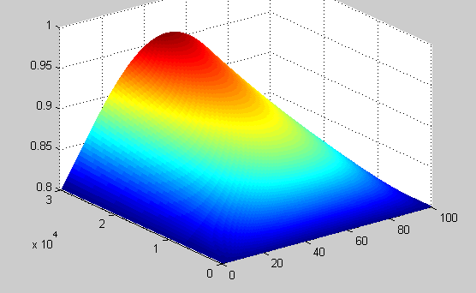



… aggregation due to an increase of chemical signal production, and diffusion
amoebae concentration
amoebae concentration
n = 30000; d1 = 2; d2 = 1; a = 3; b = 1; c = 1;
n = 30000; d₁ = 2; d₂ = 1; a = 1; b = 1; c = 0.1;
chemotaxis signal
chemotaxis signal

Slide 56
Another use of chemotaxis in nature is through ants and the pheromones they secret in order to mark paths
https://github.com/reaxis/ants
Ants walk around randomly until they find a food source, then retrace their steps and drop pheromones on the way back.
Pheromones are visualized by colored trails.

Slide 57
Computational Biomathematics
florian.rupp@kiu.edu.ge

