Slide 1
Computational Biomathematics
The Secret Life of Slime Molds: Pattern Formation
Lesson 10
Lecture
Turing’s model
Spiral waves & pattern formation

Slide 2
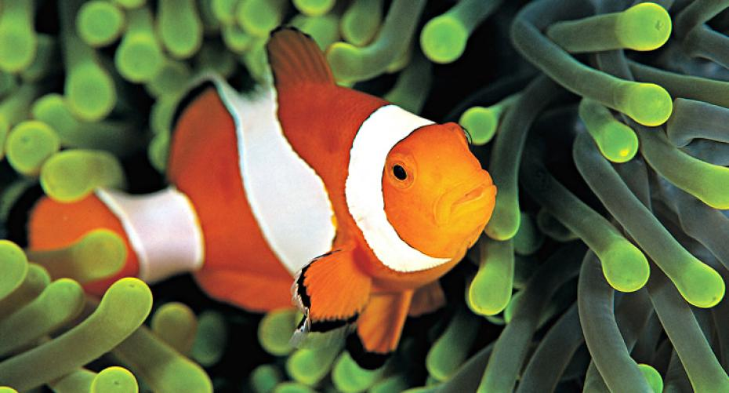
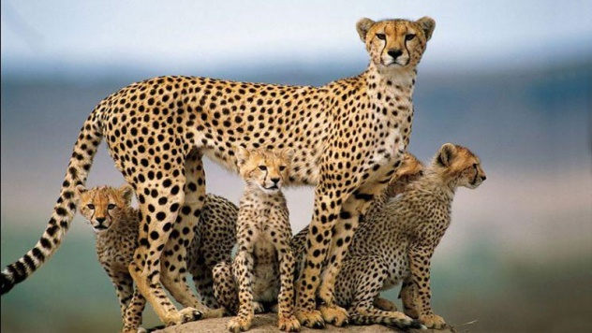
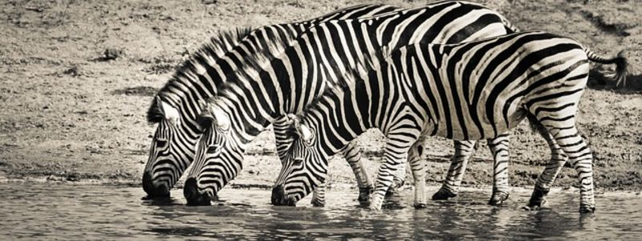
Topics
Turing’s Model
Spiral Waves & Pattern Formation

Slide 3
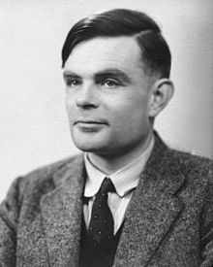
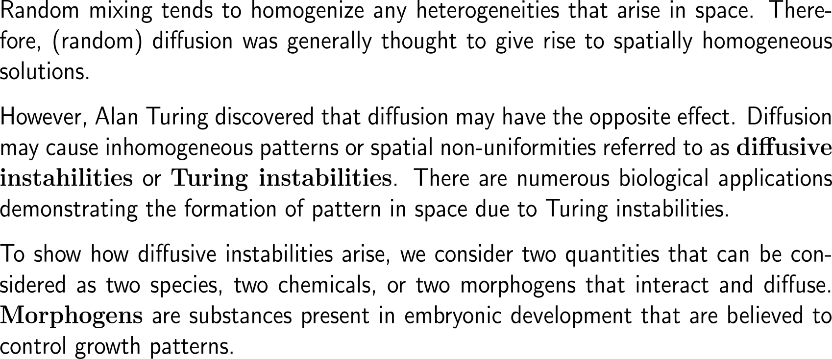
Diffusion may cause inhomogeneous patterns or spatial non-uniformities referred to as Turing instabilities
Alan M. Turing
(1912 - 1954)

Slide 4
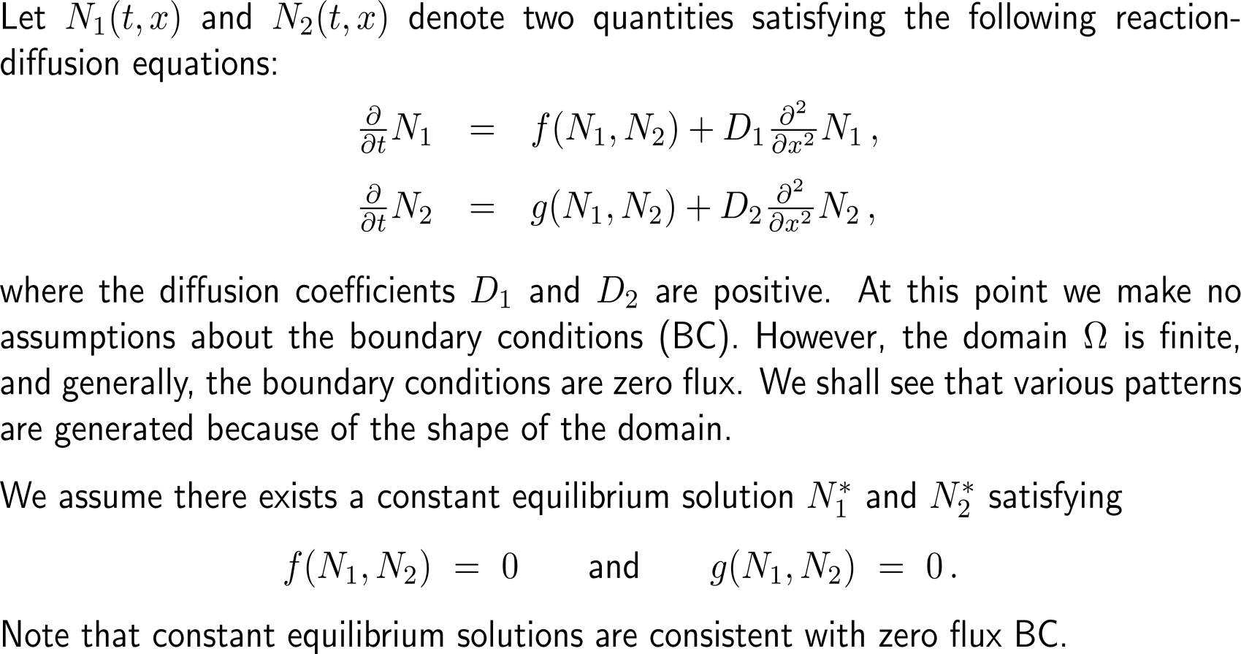
The starting point of our considerations is two-dimensional reaction diffusion system on a finite domain with zero flux boundary conditions

Slide 5
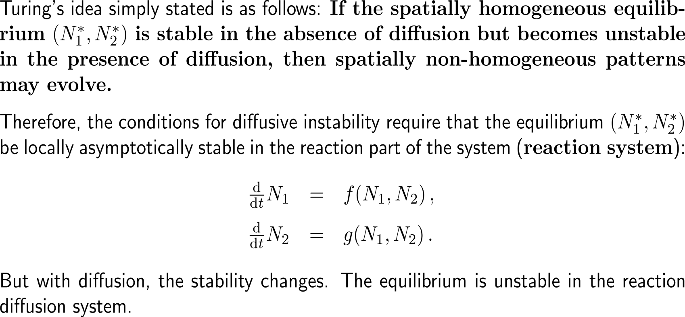
Step 1: There is an asymptotically stable equilibrium in the reaction system (1/ 2)

Slide 6
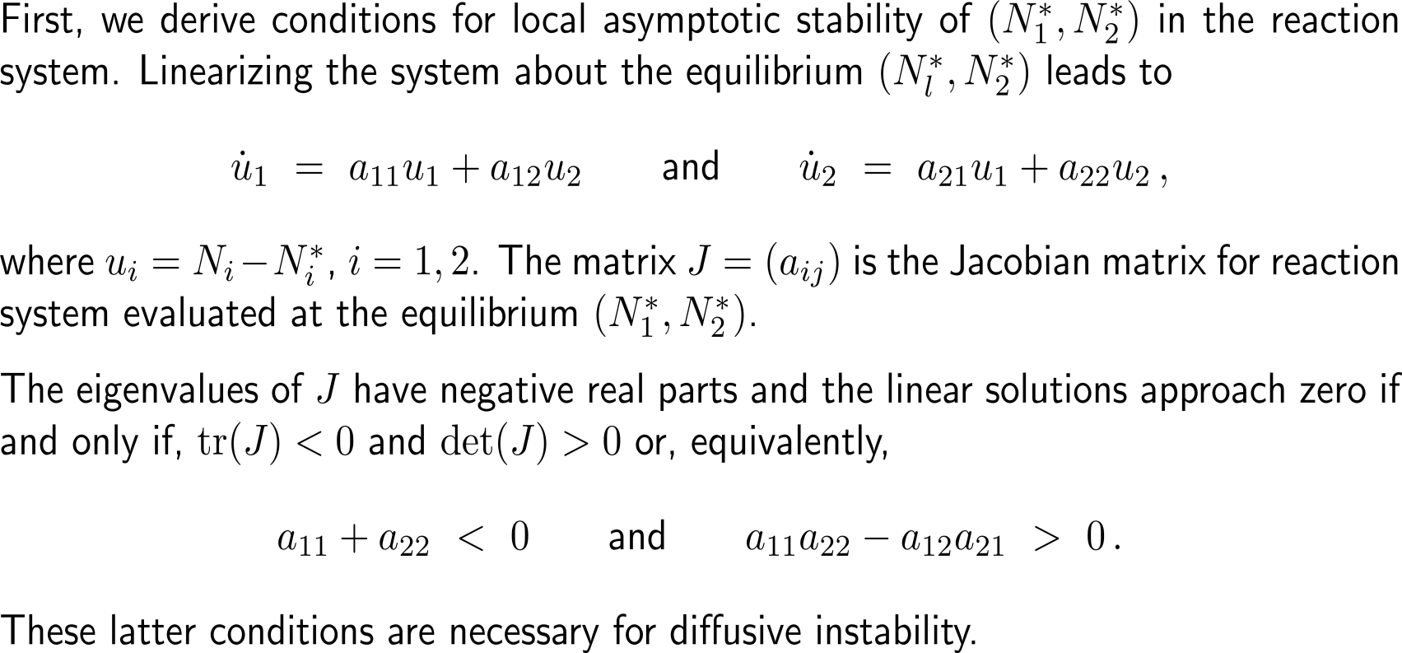
Step 1: There is an asymptotically stable equilibrium in the reaction system (2/ 2)

Slide 7
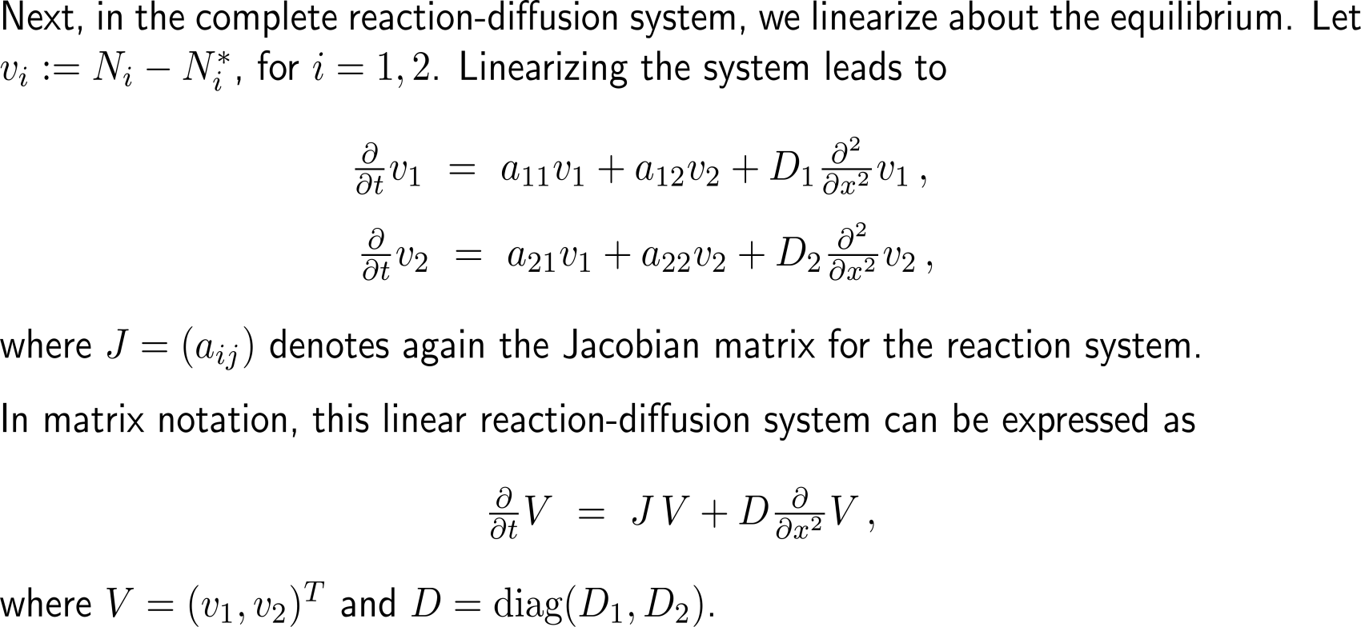
Step 2: This equilibrium is unstable when diffusion is present (1/ 7)

Slide 8
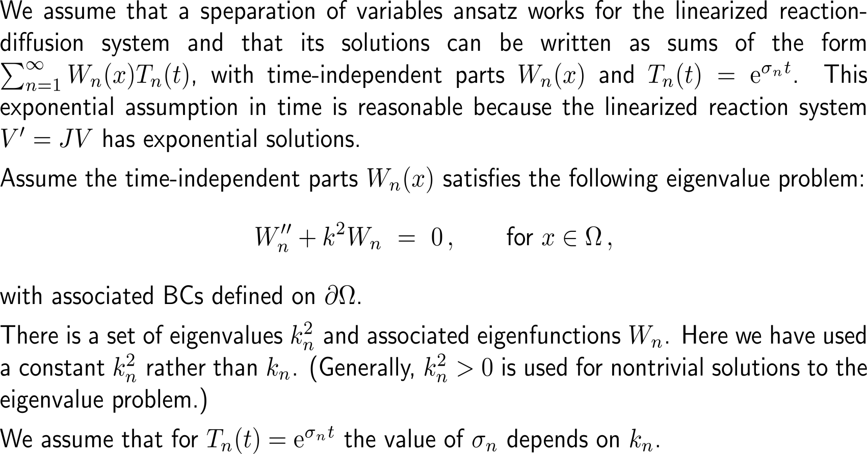
Step 2: This equilibrium is unstable when diffusion is present (2/ 7)

Slide 9
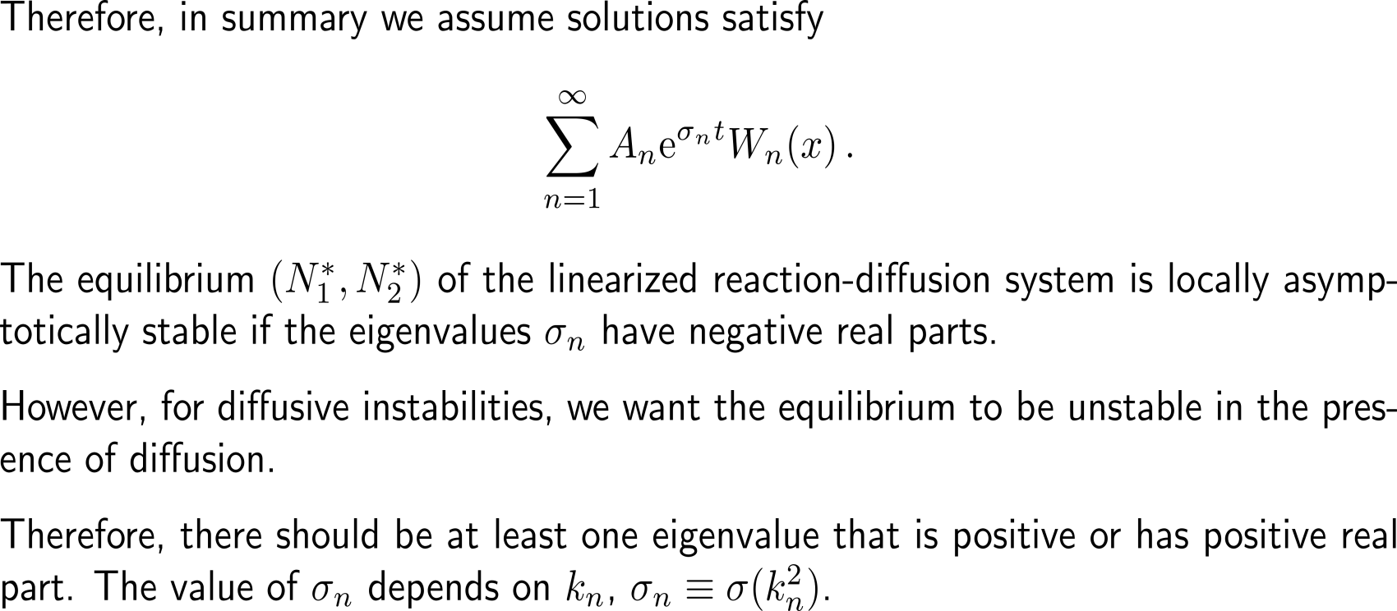
Step 2: This equilibrium is unstable when diffusion is present (3/ 7)

Slide 10
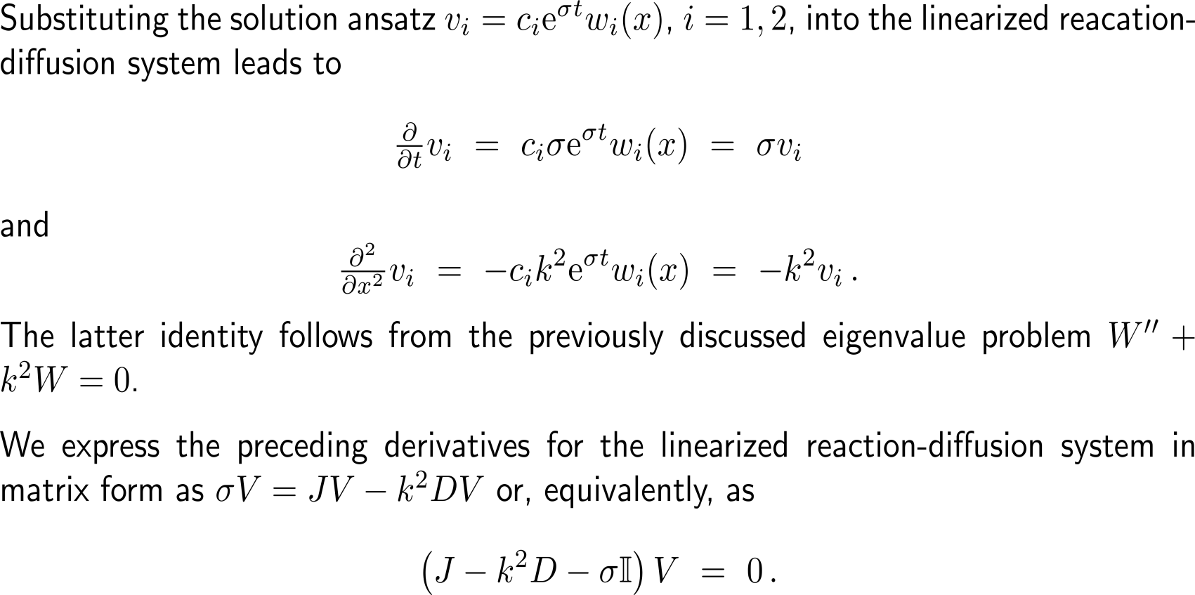
Step 2: This equilibrium is unstable when diffusion is present (4/ 7)

Slide 11
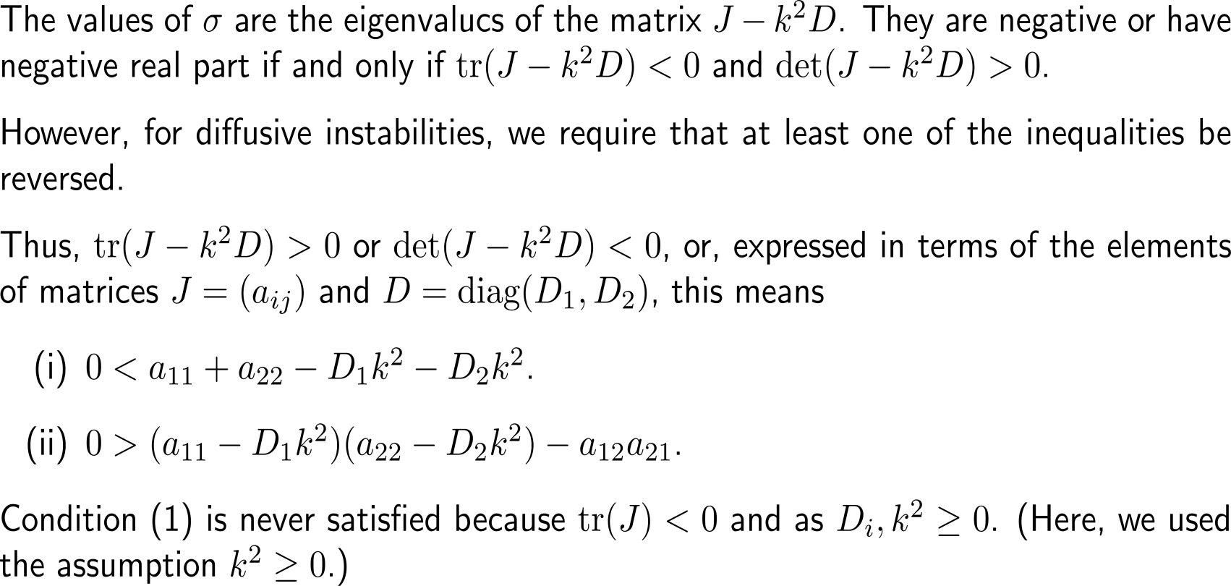
Step 2: This equilibrium is unstable when diffusion is present (5/ 7)

Slide 12
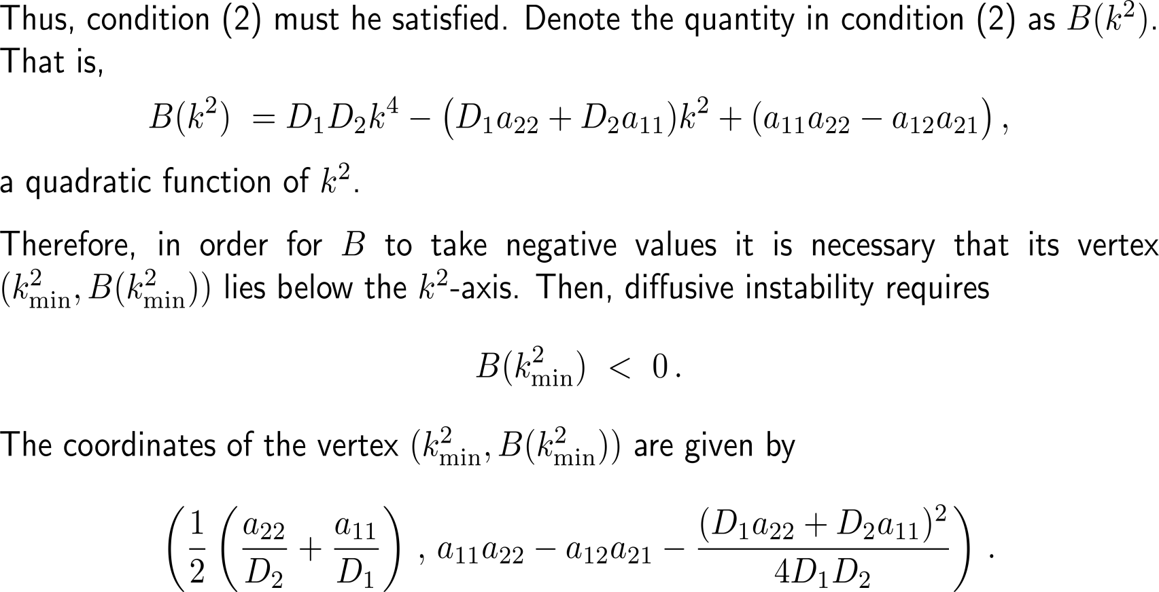
Step 2: This equilibrium is unstable when diffusion is present (6/ 7)

Slide 13
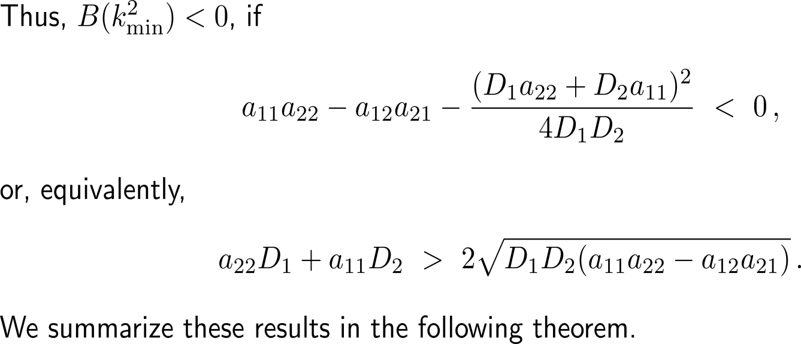
Step 2: This equilibrium is unstable when diffusion is present (7/ 7)

Slide 14
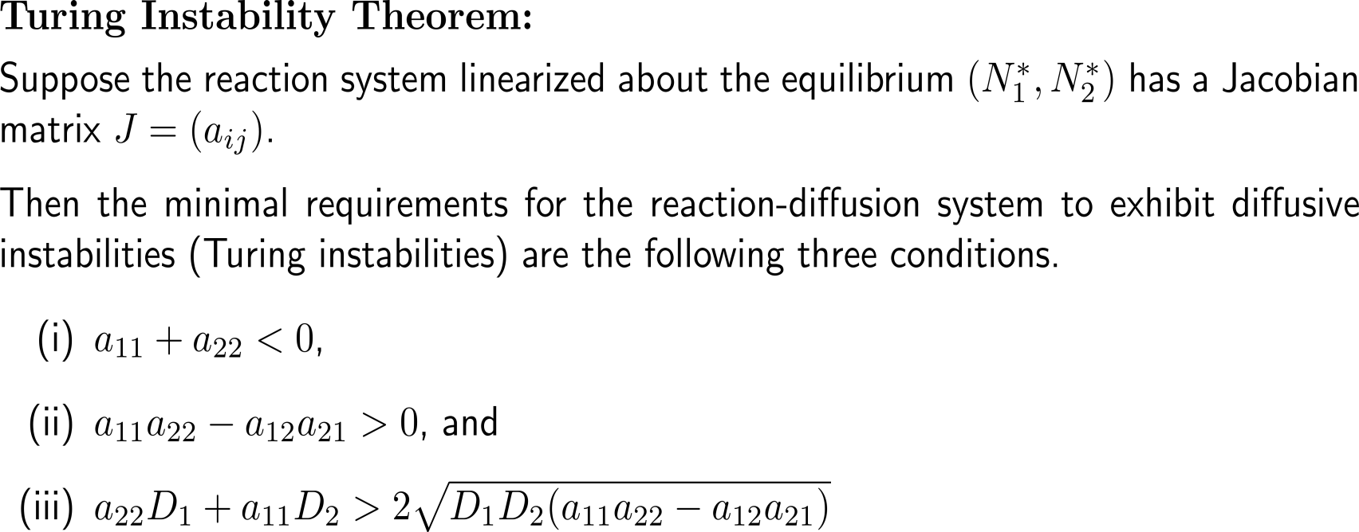
Theorem: Turing Instability Theorem

Slide 15
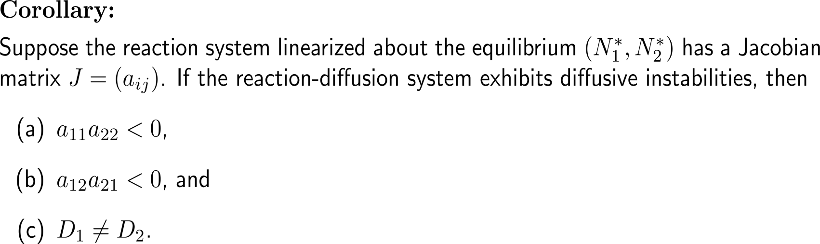
Corollary: Necessary conditions for Turing instability

Slide 16
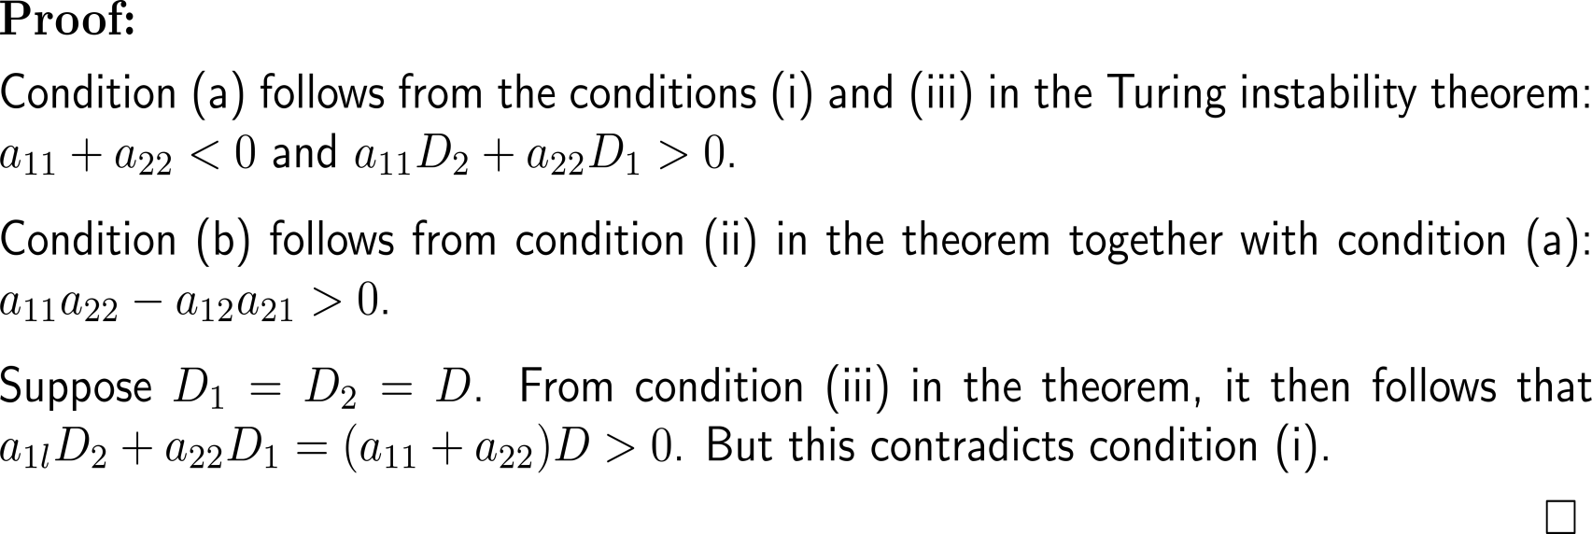
Proof: Corollary to Turing’s Instability Theorem

Slide 17
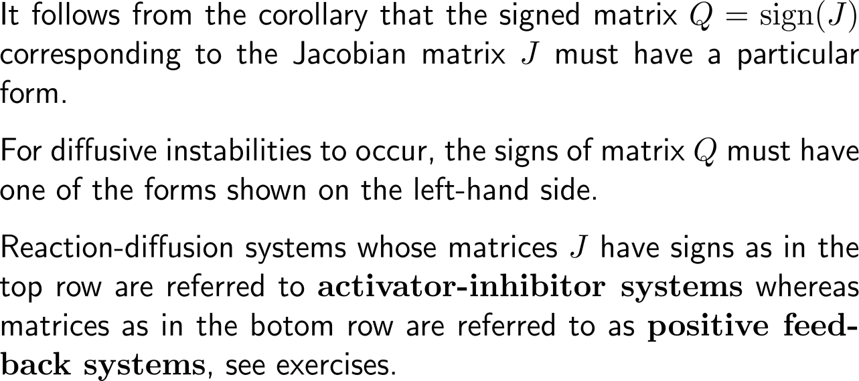
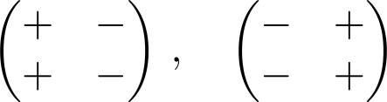
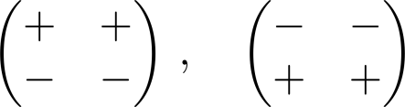
For diffusive instabilities to occur the signs of the Jacobian must follow a certain rule
Activator-Inhibitor Systems
Positive Feedback Systems

Slide 18
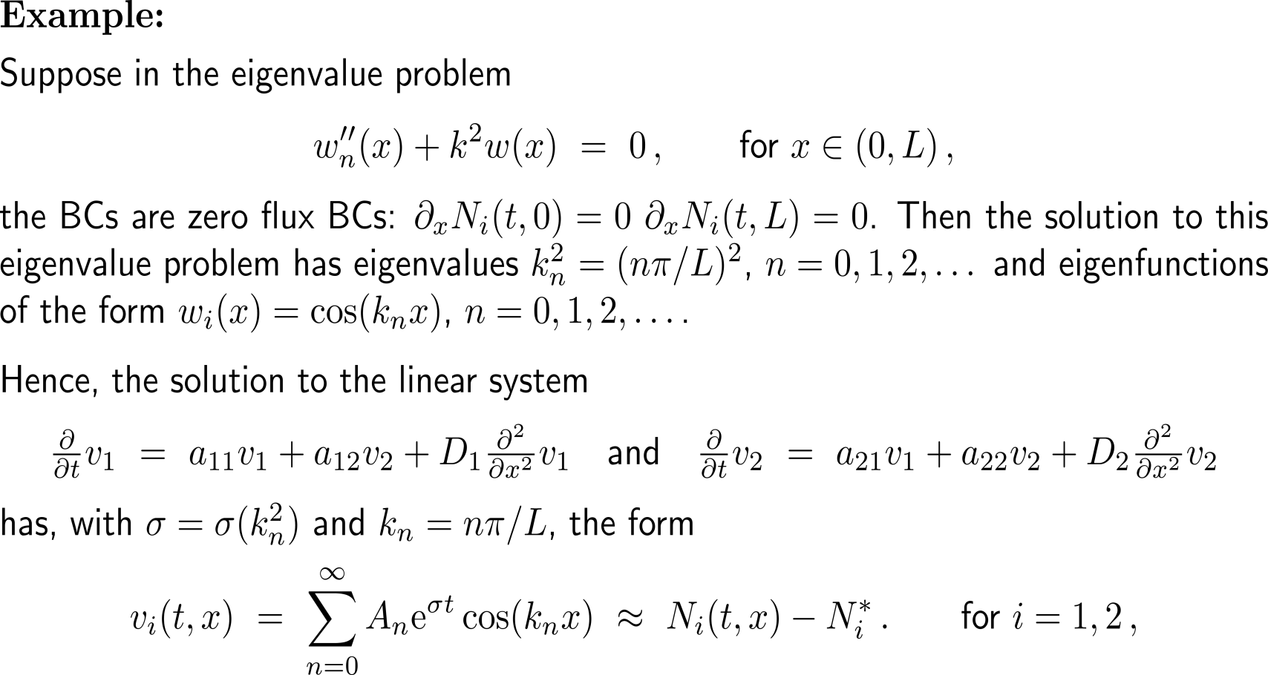
Example: Applying Turing’s Instability Theorem in 1D

Slide 19
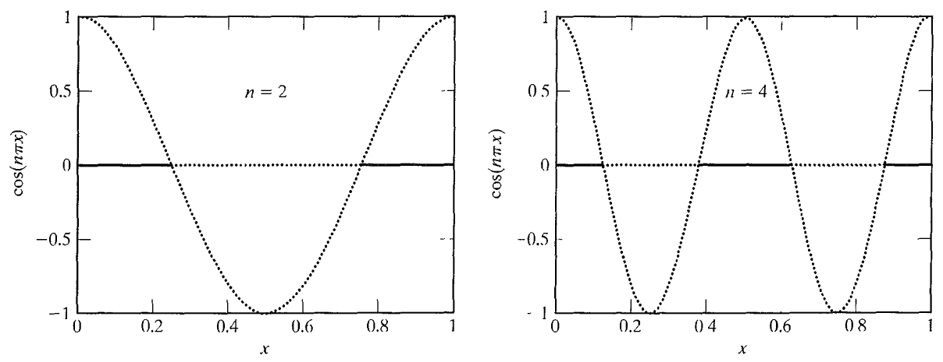
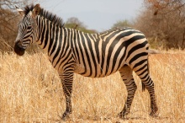
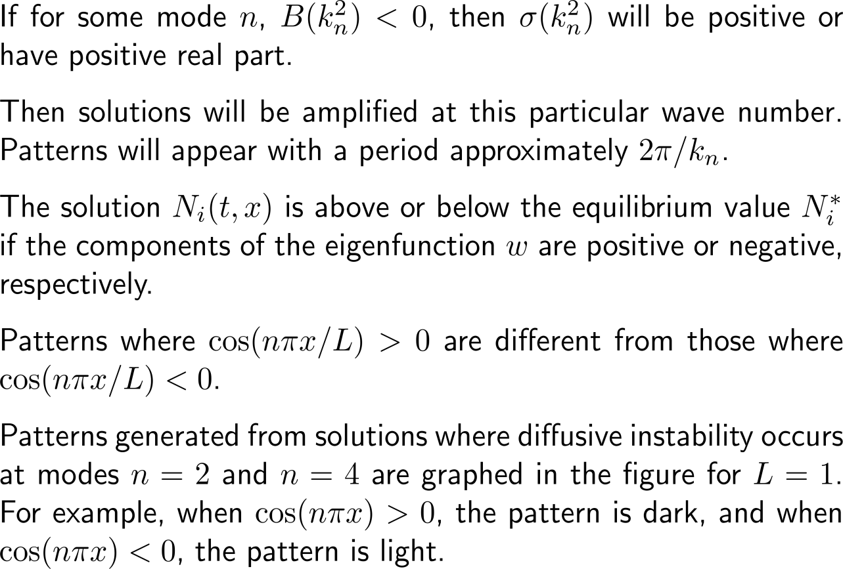
Example: Applying Turing’s Instability Theorem in 1D
Zebra patterns generated along the line segment [0, 1], L = 1, when the instability occurs at modes n = 2 and n = 4.

Slide 20
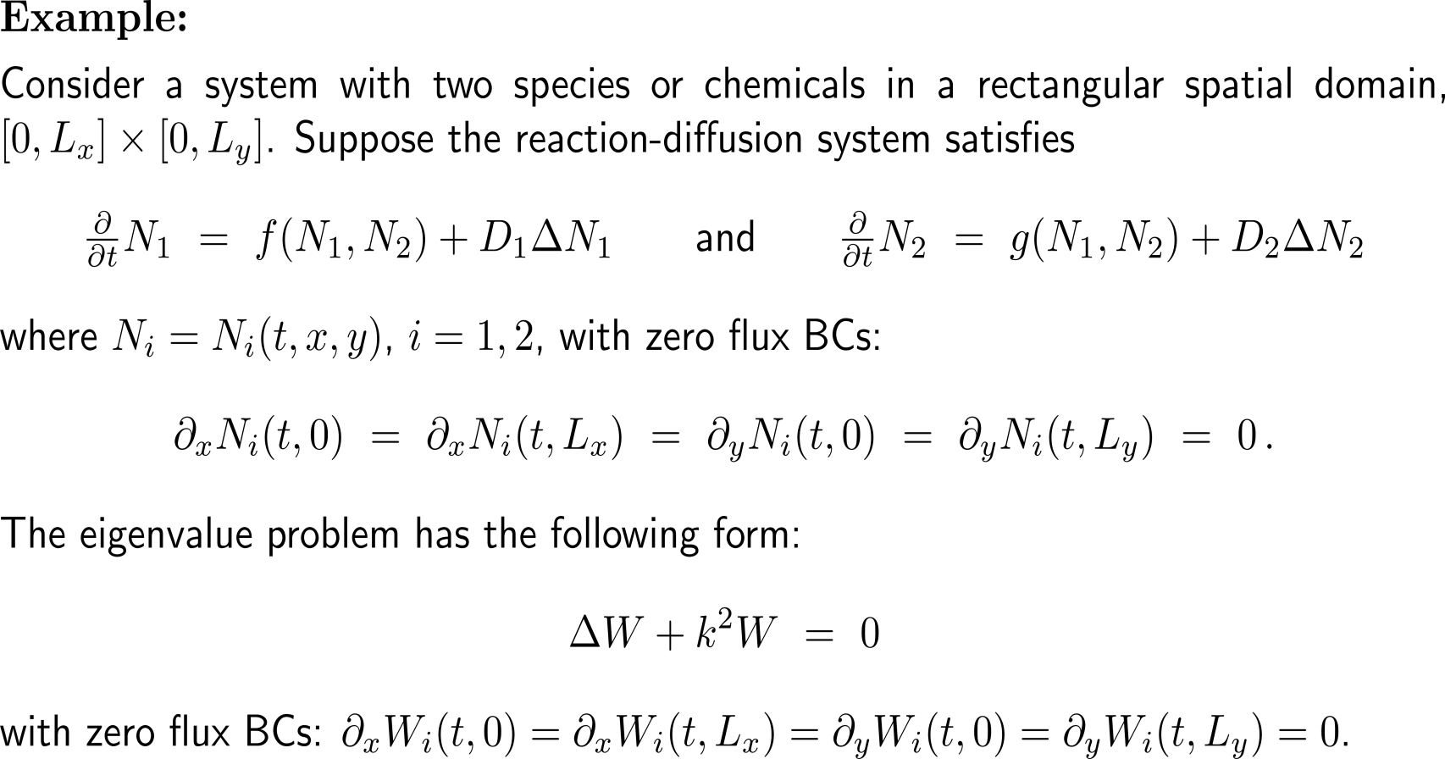
Example: Applying Turing’s Instability Theorem in 2D

Slide 21

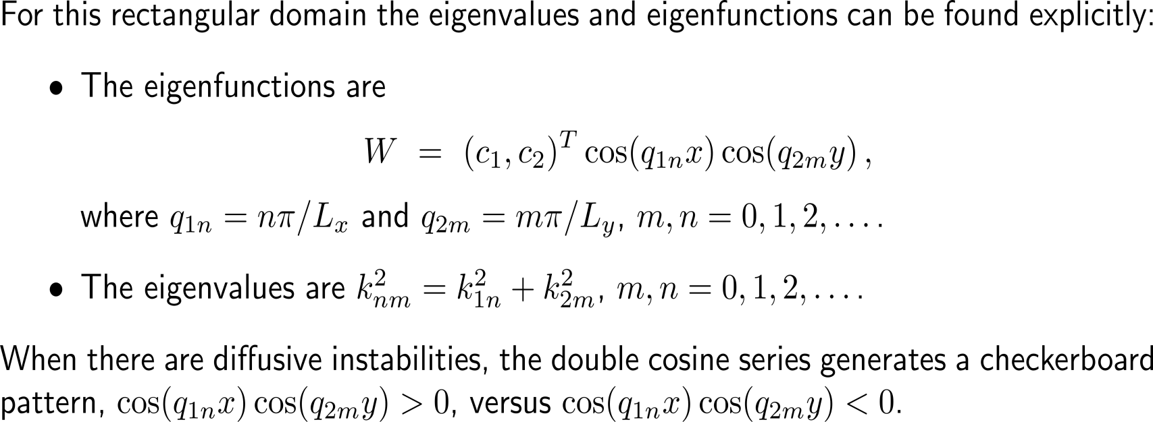
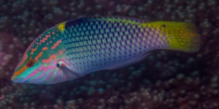
Example: Applying Turing’s Instability Theorem in 2D
checkerboard wrasse (Halichoeres hortulanus)

Slide 22
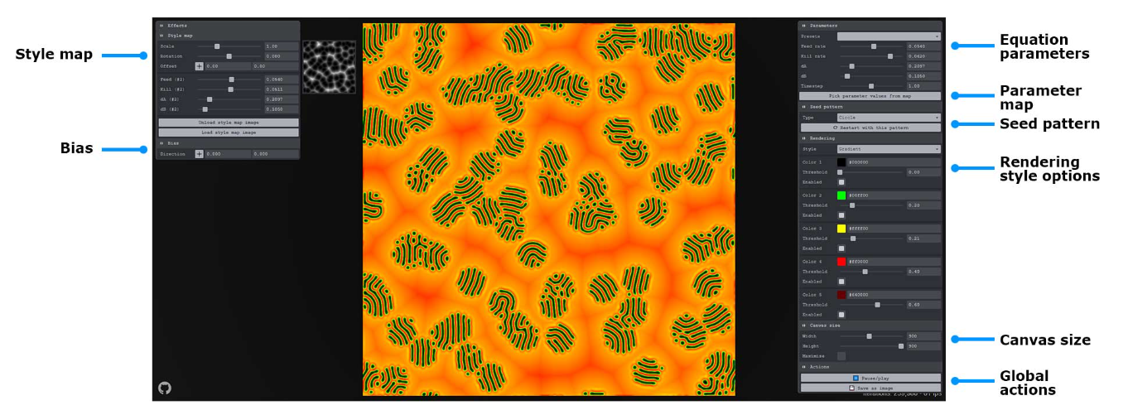
There are several applets available to illustrate pattern formation in two-dimensional reaction-diffusion systems
https://jasonwebb.github.io/reaction-diffusion-playground/

Slide 23
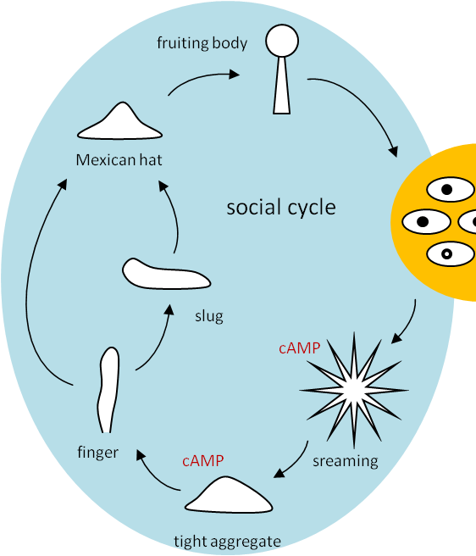
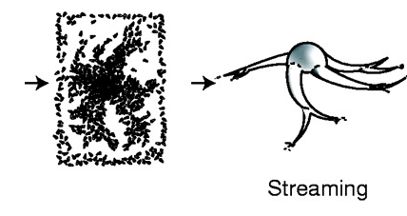
Topics
Turing’s Model
Spiral Waves & Pattern Formation
Martiel & Goldbeter
Keller &
Segel

Slide 24
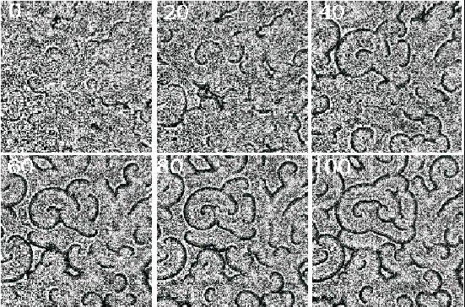
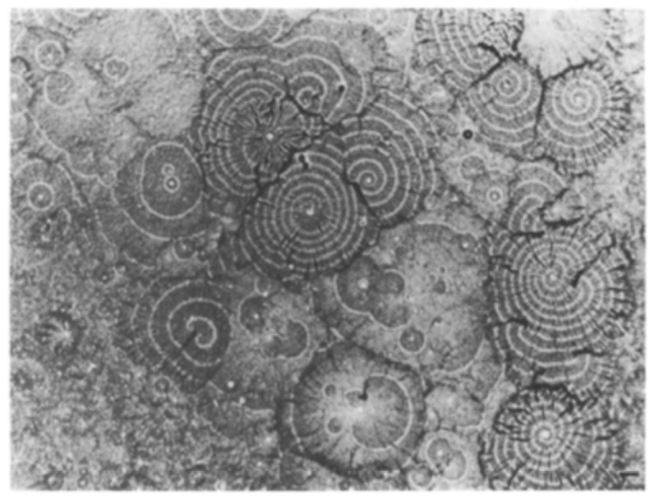
Spiral and concentric waves in a dictyostelium discoideum aggregation field (dark bands correspond to amoebaes) – 1/ 2
Time lapse (min.) data of dictyostelium amoebae aggregating on a thin layer of agar under dark field optics. Dark bands correspond to moving cells and indicate high cAMP concentrations. Field is 18x18 mm. Cells plated at a density 2x10⁶ cells cm². (http://www.math.utah.edu/~epalsson/research.html)
A.J. Durston (2013): Dictyostelium: The Mathematician’s Organism, Current Genomics, 14 (6), pp. 355-60, DOI:10.2174/13892029113149990010

Slide 25
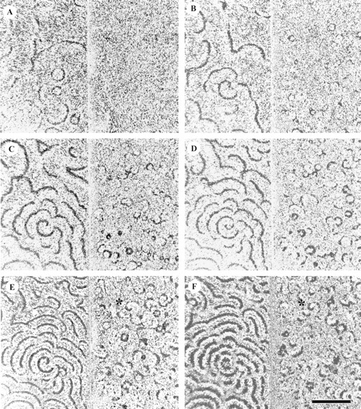
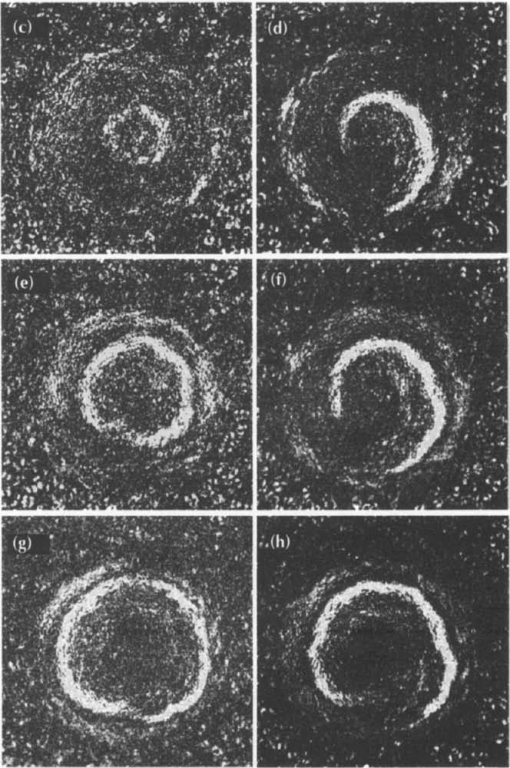
Spiral and concentric waves in a dictyostelium discoideum aggregation field (dark bands correspond to amoebaes) – 2/ 2
F. Siegert & C.J. Weijer (1995): Spiral and concentric waves organize multicellular Dictyostelium mounds, Current Biology, 5 (8), pp. 937-943.
Fig. 2 c, e, g,: Concentric-wave propagation after 25, 50, and 75 sec.
Fig. 2 d, f, h,: Spiral wave propagation after 25, 50, and 75 sec.
E. Palsson, K.J. Lee, R.E. Goldstein, J. Franke, R.H. Kessin & E.C. Cox (1997): Selection for spiral waves in the social amoebae Dictyostelium, PNAS, 94 (25), pp. 13719-13723, https://doi.org/10.1073/pnas.94.25.13719

Slide 26
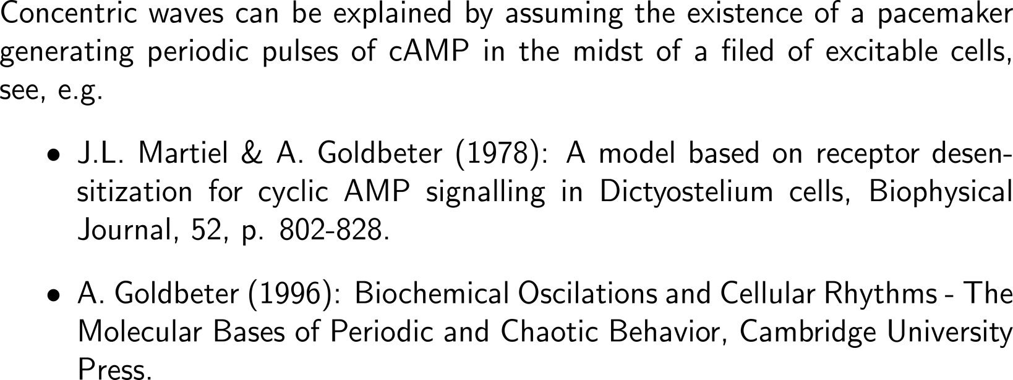
The dynamics of cAMP receptors are key to explain concentric and spiral waves in dictyostelium discoideum (1/ 2)
Concentric Waves
F. Siegert & C.J. Weijer (1995): Spiral and concentric waves organize multicellular Dictyostelium mounds, Current Biology, 5 (8), pp. 937-943.
Fig. 2 c, e, g,: Concentric-wave propagation after 25, 50, and 75 sec.

Slide 27
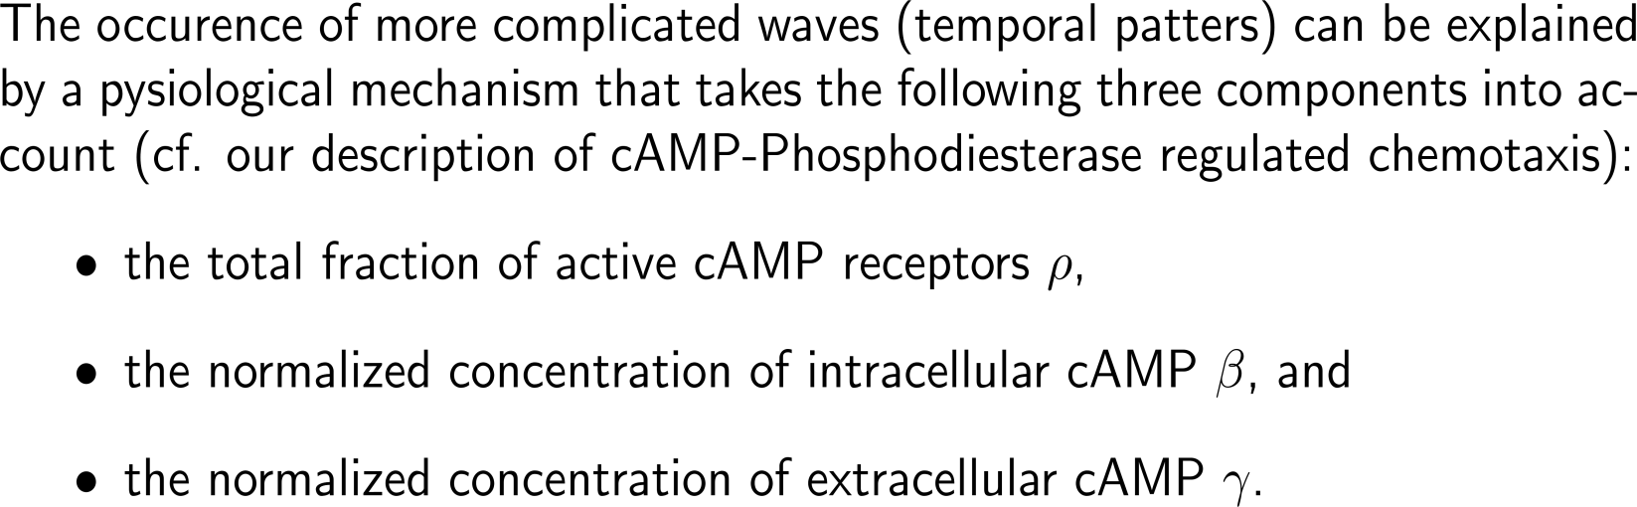
The dynamics of cAMP receptors are key to explain concentric and spiral waves in dictyostelium discoideum (2a/ 2)
Spiral Waves
F. Siegert & C.J. Weijer (1995): Spiral and concentric waves organize multicellular Dictyostelium mounds, Current Biology, 5 (8), pp. 937-943.
Fig. 2 d, f, h,: Spiral wave propagation after 25, 50, and 75 sec.

Slide 28
The dynamics of cAMP receptors are key to explain concentric and spiral waves in dictyostelium discoideum (2b/ 2)
Spiral Waves
transport
extracellular cAMP
active
cAMP receptor
intracellular cAMP

Slide 29
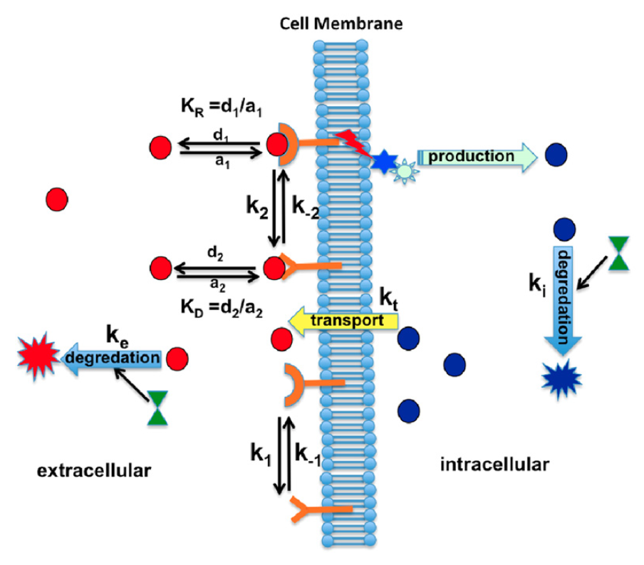
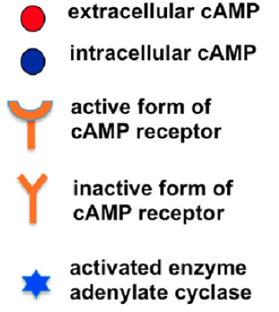
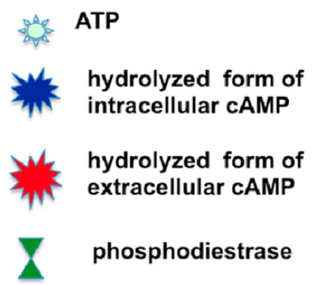
Starting from “first principles” the cAMP dynamics are governed by several main bio-chemical equations (1a/ 3) …
A. Gholami, O. Steinbock, V, Zykov & E. Bodenschatz (2015): Flow-driven instabilities during pattern formation of Dictyostelium discodideum, New Journal of Physics, 17, 063007.

Slide 30

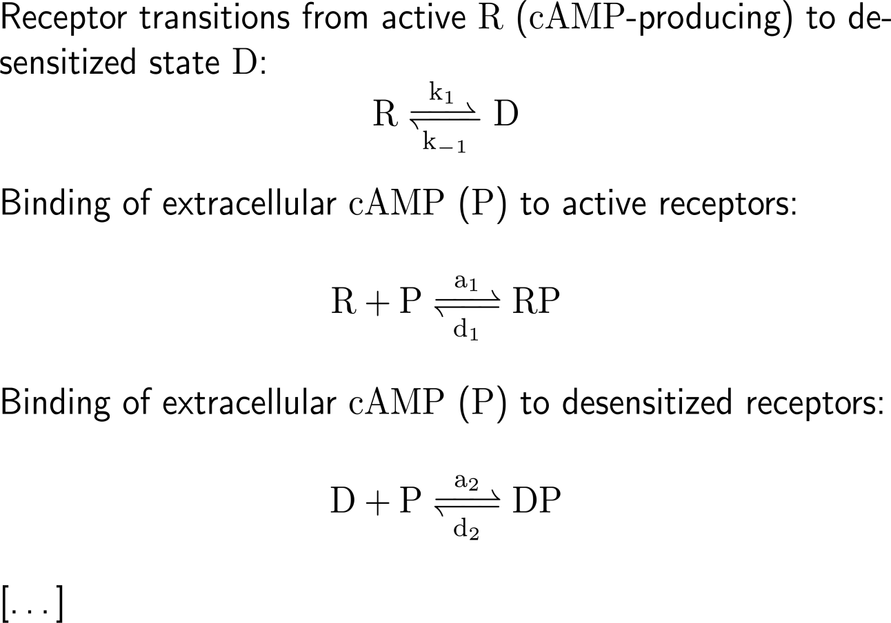
Starting from “first principles” the cAMP dynamics are governed by several main bio-chemical equations (1b/ 3) …

Slide 31
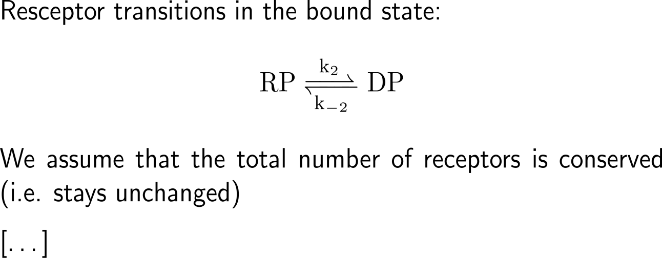
Starting from “first principles” the cAMP dynamics are governed by several main bio-chemical equations (1c/ 3) …

Slide 32
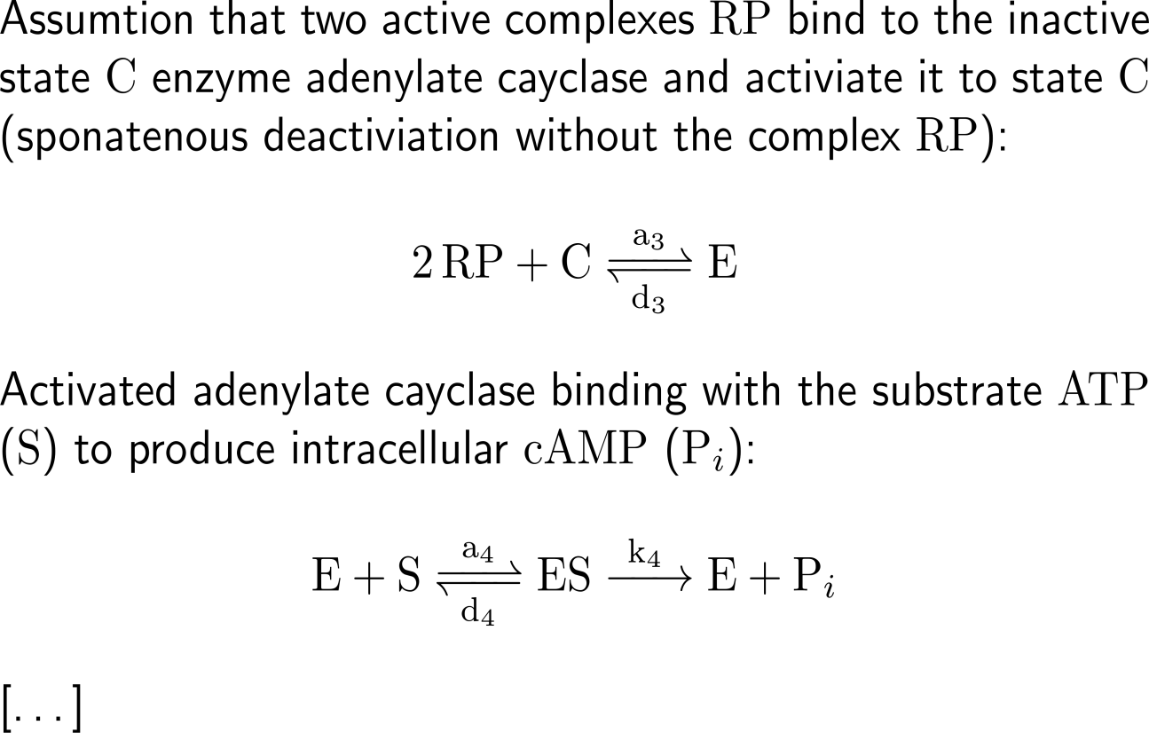
Starting from “first principles” the cAMP dynamics are governed by several main bio-chemical equations (2a/ 3) …

Slide 33
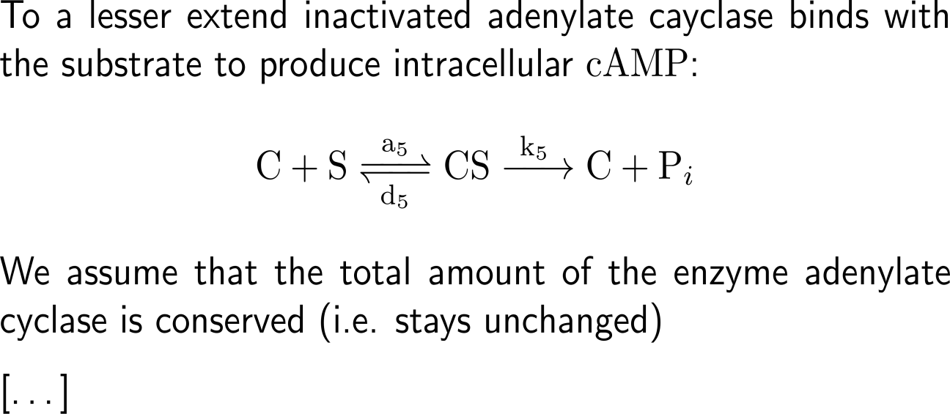
Starting from “first principles” the cAMP dynamics are governed by several main bio-chemical equations (2b/ 3) …

Slide 34
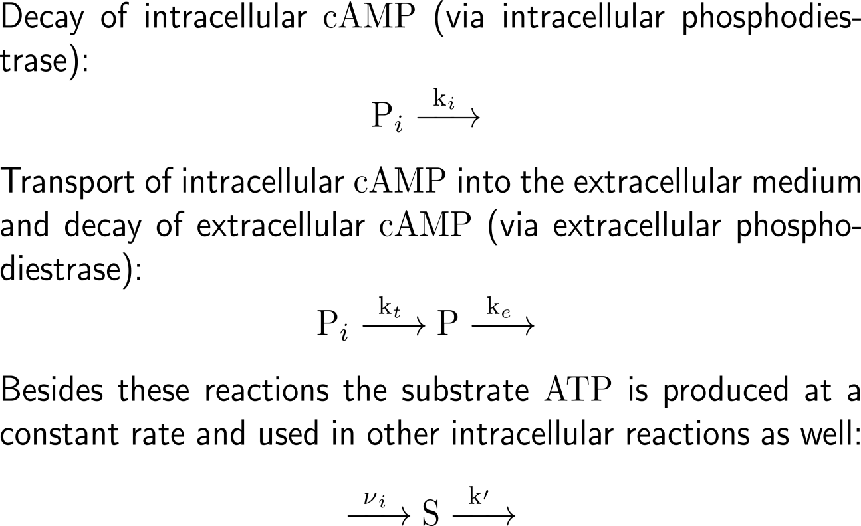
Starting from “first principles” the cAMP dynamics are governed by several main bio-chemical equations (3/ 3) …

Slide 35
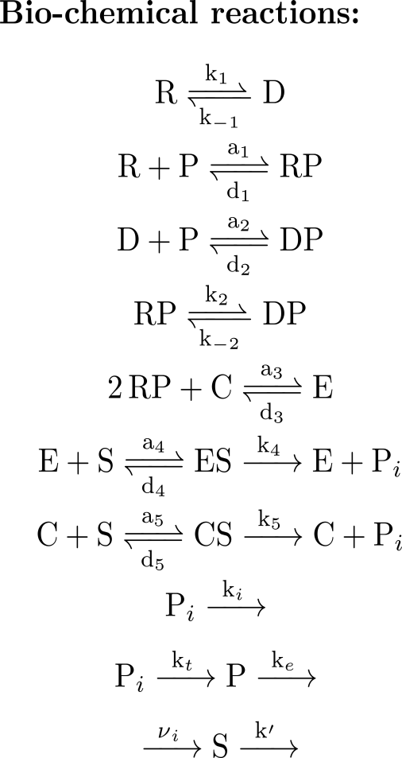
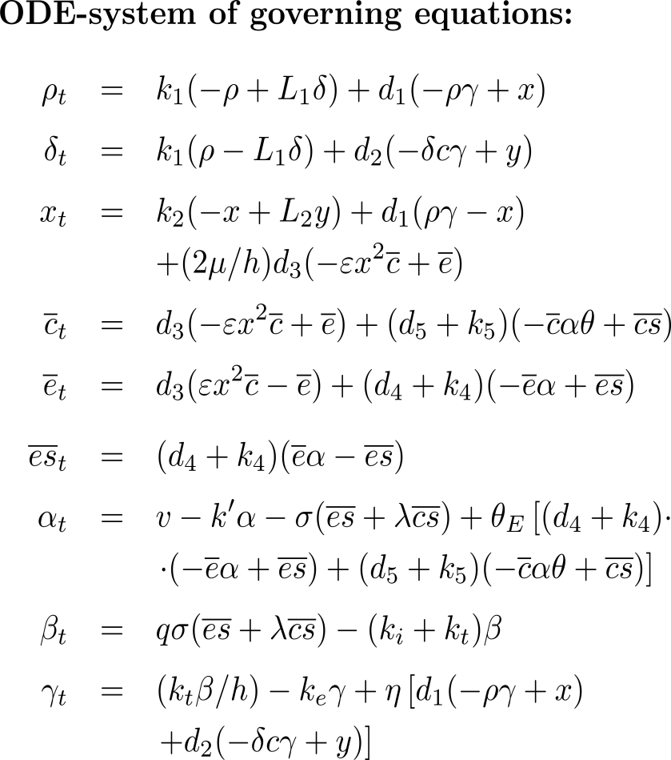
… resulting in a system of ordinary differential equations (see Martiel & Goldbeter (1987) for details)
Decay of R (- k₁ ρ)
Decay of D (+ k₁ L₁ δ)
Formation of the complex RP (- d₁ ρ γ)
Decay of the complex PR (+ d₁ x)
re-naming of constants

Slide 36
… resulting in a system of ordinary differential equations (see Martiel & Goldbeter (1987) for details)

Slide 37
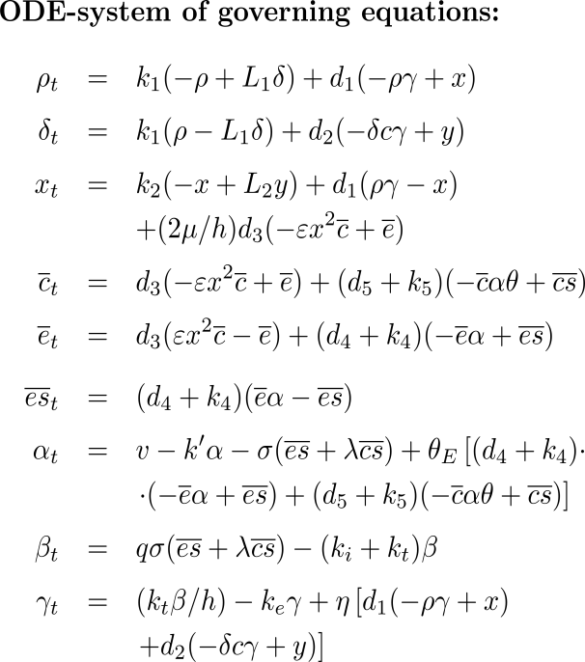
Next, certain simplifying assumptions are made in order to reduce this 9-dimensional system
The reactions contain fast binding and slow inter-conversion ones, such that we can separate the set of governing equations into two sets (fast and slow time scales)
After an initial transient phase the differential equations become algebraic equations (quasi-steady-state assumption)
Thus, the four equations for the slow time scale variables ρ, α, β, and γ remain. The other variables are expressed by means of the algebraic equations that are plugged into the remaining equations.
Terms are neglected that contain parameters/ constants that are rather small
Experiments show that the concentration α of ATP can be considered constant, such that this differential equation can be neglected as well
system of three coupled differential equations

Slide 38
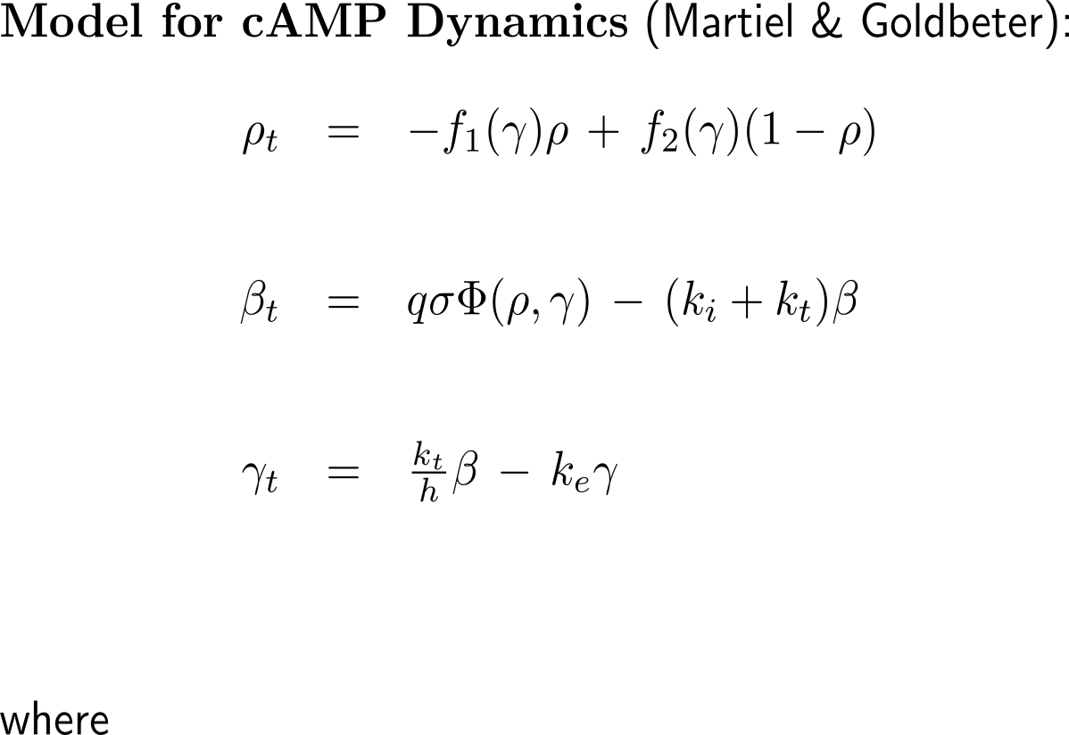
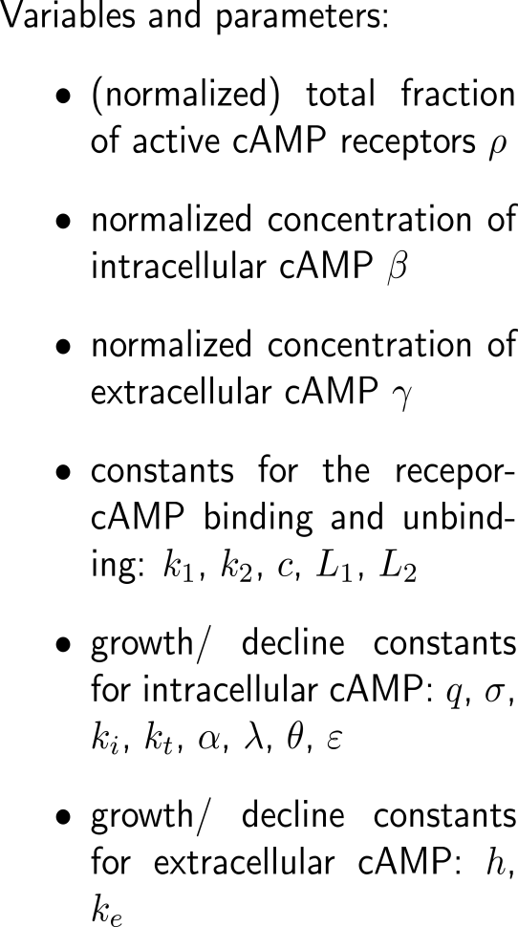
This leads to a three dimensional differential equation model for the cAMP dynamics in starving dictyostelium discoideum
binding to receptor
unbinding
“production”
decay & transport
transport of intra-
cellular cAMP
decay

Slide 39


In order to compare the model with reality, we require experimentally justified values for the parameters and constants …
J.L. Martiel & A. Goldbeter (1987): A model based on receptor desensitization for cyclic AMO signalling in Dictyostelium cells, Biophysical Journal, 52, p. 802-828.

Slide 40

… as well as assumptions for numerical simulations
J.L. Martiel & A. Goldbeter (1987): A model based on receptor desensitization for cyclic AMO signalling in Dictyostelium cells, Biophysical Journal, 52, p. 802-828.

Slide 41


Finally, the ODE model for cAMP dynamics can easily be extended to a PDE model that includes spatial effects
binding to receptor
unbinding
“production”
decay & transport
transport of intra-
cellular cAMP
decay
diffusion

Slide 42

The stability diagram in the space of two essential parameters allows the determination of specific stability/ instability regions
Domains in the parameter space:
S: one non-excitable stable steady states
excitability is the capability of the system to propagate/ sustain without attenuation a wave of cAMP initated by a suprathreshold extracellular cAMP pulse applied at the center of the spatially distributed system – this can be imagined as trigger waves
a Hopf-bifurcation occurs at the boundary from S to O
E: coexistence of three steady states, one of which is excitable (spiral waves)
B: bistability – coexistence of two stable steady states and one unstable steady state
O: one unstable steady state surrounded by a limit cycle, i.e. sustained autonomous oscillations of cAMP
maximum activity σ of adenylate cyclase
rate constant k_{e} of extracellular phosphodiesterase
J. Lauzeral, J. Halloy & A. Goldbeter (1997): Desynchronization of cells on the developmental path triggers the formation of spiral waves of cAMP during Dictyostelium aggregation, Developmental Biology, Proc. Natl. Acad. Sci. USA, 94, pp. 9153-9158.

Slide 43

Simulation of the spatial distribution of cAMP at the indicated times resulting from the progression of cells along a developmental path
Example 1
Example 2
Example 3
Lauzeral, Halloy & Goldbeter (1997), Figure 3A

Slide 44

Simulation of the spatial distribution of cAMP at the indicated times resulting from the progression of cells along a developmental path
Example 1
Example 2
Example 3
Lauzeral, Halloy & Goldbeter (1997), Figure 3A
Developmental paths and wavelike patterns of cAMP. Shown is the two-dimensional spatial distribution of cAMP (Upper) at indicated times (in min) resulting from the progression of cells along the developmental path 1 (Lower), for a desynchronization factor of 50.
For the cell distribution along the developmental path, each circle represents a 5% fraction of the total amount of cells considered.
The spatiotemporal evolution of the system is obtained by integrating the governing equations by means of an explicit Euler method with finite differences for the spatial term.
The resulting desynchronization of cells on the developmental path creates a spatial heterogeneity in the parameter(s) that vary on this path.

Slide 45

Example 1
Example 2
Example 3
Lauzeral, Halloy & Goldbeter (1997), Figure 3B

Slide 46

Simulation of the spatial distribution of cAMP at the indicated times resulting from the progression of cells along a developmental path
Example 1
Example 2
Example 3
Lauzeral, Halloy & Goldbeter (1997), Figure 3B
Developmental paths and wavelike patterns of cAMP. Shown is the two-dimensional spatial distribution of cAMP (Upper) at indicated times (in min) resulting from the progression of cells along the developmental path 1 (Lower), for a desynchronization factor of 100.
For the cell distribution along the developmental path, each circle represents a 5% fraction of the total amount of cells considered.
The spatiotemporal evolution of the system is obtained by integrating the governing equations by means of an explicit Euler method with finite differences for the spatial term.
The resulting desynchronization of cells on the developmental path creates a spatial heterogeneity in the parameter(s) that vary on this path.

Slide 47

Simulation of the spatial distribution of cAMP at the indicated times resulting from the progression of cells along a developmental path
Example 1
Example 2
Example 3
Lauzeral, Halloy & Goldbeter (1997), Figure 6

Slide 48

Simulation of the spatial distribution of cAMP at the indicated times resulting from the progression of cells along a developmental path
Example 1
Example 2
Example 3
Lauzeral, Halloy & Goldbeter (1997), Figure 6
Fully developed spiral waves of cAMP triggered by the desynchronized progression of cells along the developmental path. Shown is the two-dimensional spatial distribution of cAMP (Upper) at indicated times (in min) resulting from the evolution of cells along the developmental path 3.
Here again each circle represents a 5% fraction of the total amount of cells considered. The desynchronization factor is equal to 25. The color scale indicates the level of the normalized concentration of extracellular cAMP
For comparison: photograph of dictyostelium discoideum aggregation

Slide 49
Computational Biomathematics
florian.rupp@kiu.edu.ge

