Slide 1
Computational Biomathematics
Coding Lab 2 (2x 90 min)
Lesson 12 & 13
Lecture
Overview
Structure of the lab

Slide 2
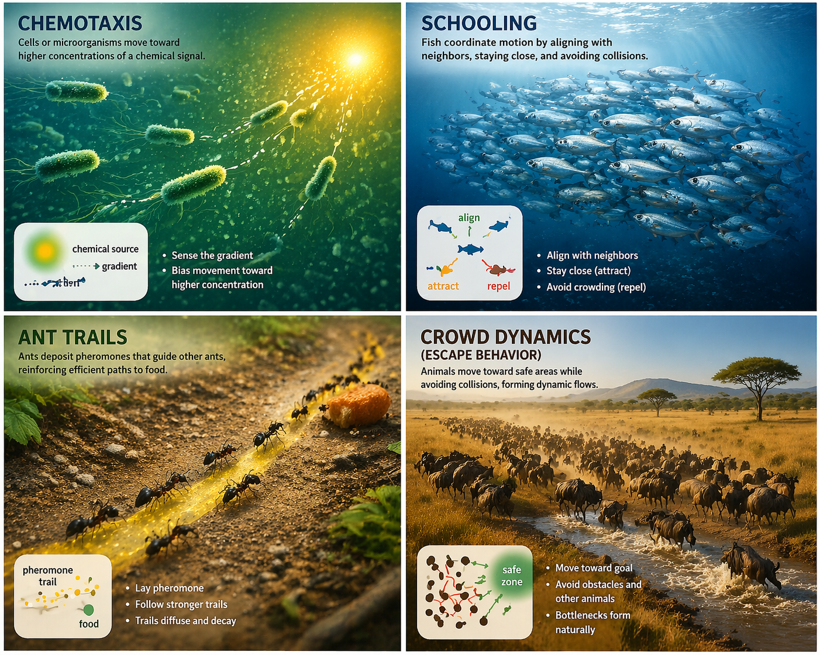
Complex collective behavior in biology often emerges from simple local interaction rules; no central control is needed.
Take home messages:
Modeling: very easy local rules lead to complex global behavior
AI usage: prompt design for code and tests
Scientific computing mindset:
“what should be true?”
not just “Does it run?”
image generated
with ChatGPT

Slide 3
Topics
Overview
Structure of the Lab

Slide 4
Group A: Chemotaxis
Quick summary:
Idea: movement toward higher concentration of a chemical signal
Rule: random movement and bias toward gradient
Outcome: clustering at source
Extensions:
moving source
noise level
Details:
chemical signal diffuses from the source throughout the simulation plane
Reference:
Recall the lectures on slime molds and adapt the concepts discussed there. Use word descriptions to design the program.
image generated
with ChatGPT

Slide 5
Group B: Schooling with Repulsion, Alignment & Attraction
Quick summary:
Idea: staying together but maintaining distance; i.e., coordination via neighbors
Rules: alignment, attraction, repulsion
Outcome: coherent motion
Extensions:
zone radii
weight of forces
Details (3 zones):
short distance: repulsion
medium: alignment
long: attraction
Reference:
Recall the lectures on the Vicsek model and adapt the concepts discussed there. Use word descriptions to design the program.
image generated
with ChatGPT

Slide 6
Group C: Ant Trail Formation (Environment-Agent Coupling)
Quick summary:
Idea: indirect communication via environment
Rule: follow pheromone
Outcome: trail formation
Extensions:
pheromone decay rate
food source location
Details:
random walk and bias toward pheromone
pheromone field diffuses and decays
Reference:
Recall the lectures on slime molds and adapt the concepts discussed there. Use word descriptions to design the program.
image generated
with ChatGPT

Slide 7
Group D: Crowd Dynamics/ Escape Behavior
Quick summary:
Idea: reaching a goal (e.g., exit) while avoiding collisions/ obstacles
Rule: move to goal and avoid nearby specimen/ obstacles
Outcome: bottlenecks
Extensions:
Bottlenecks
panic (noise)
Reference:
Recall the lectures on the Vicsek model and adapt the concepts discussed there. Use word descriptions to design the program.
image generated
with ChatGPT

Slide 8
Note, all models have a very similar internal structure
Component | Meaning
agents | points in space
local rule | individual behavior
interaction | neighbors or environment
iteration | time evolution
emergence | global structure

Slide 9
Topics
Overview
Structure of the Lab

Slide 10
Roadmap A) Session 1: “Build & Understand” – 1/ 2
Session 1: “build & understand” (architecture & first AI interaction)
Time | Topic
0 – 15 min | Introduction
15 – 45 min | Phase 1: Model understanding (no coding) Groups define How does space look like and what are the agents? What are the rules? (initialization, movement, interaction, dynamics, …) What is expected to happen qualitatively? What should happen after many steps?
45 – 65 min | Phase 2: Architecture & AI prompt design (code) Groups design program architecture (which routines are needed) write and refine prompts take care of modular code, simple structure, visualization

Slide 11
Roadmap A) Session 1: “Build & Understand” – 2/ 2
Time | Topic
65 – 90 min | Phase 3: First implementation Groups (focus on thinking, not fixing everything) generate code run simulation debug basic issues

Slide 12
Roadmap B) Session 2: “Test, Explore & Present” – 1/ 2
Session 2: “test, explore & present” (texting, improvement & reflection)
Time | Topic
0 – 10 min | Quick Recap “What worked?” “What didn’t?”
10 – 30 min | Phase 4: Testing (AI + pytest) Groups think “What must always be true?” write prompt for AI to generate tests (not just code sanity tests) run pytest
30 – 55 min | Phase 5: Model improvement Groups refine rules, fix bugs, and improve behavior

Slide 13
Roadmap B) Session 2: “Test, Explore & Present” – 2/ 2
Time | Topic
55 – 70 min | Phase 6: Exploration Groups vary parameters and observe behavior Examples: noise level interaction radius strength of forces
70 – 90 min | Phase 7: Presentations Each group (approx. 4–5 min): Model ideas Local rules - Which rule had the biggest effect on behavior? Test they designed Results and insights

Slide 14
Computational Biomathematics
florian.rupp@kiu.edu.ge

