Slide 1
Computational Biomathematics
Swarms of Locusts & Introduction to Chase & Escape
Lesson 14a
Lecture
Swarms of locusts
Avoiding predators
The basic model of chase & escape

Slide 2
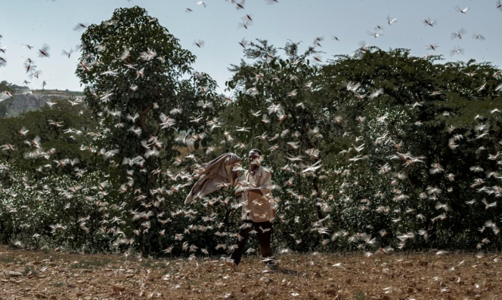
Agenda
Swarms of Locusts
Avoiding Predators
The Basic Model of Chase & Escape
Swarming generally refers to a dense aggregation of individuals focused on a spatial position, often with less order in their individual directions.

Slide 3
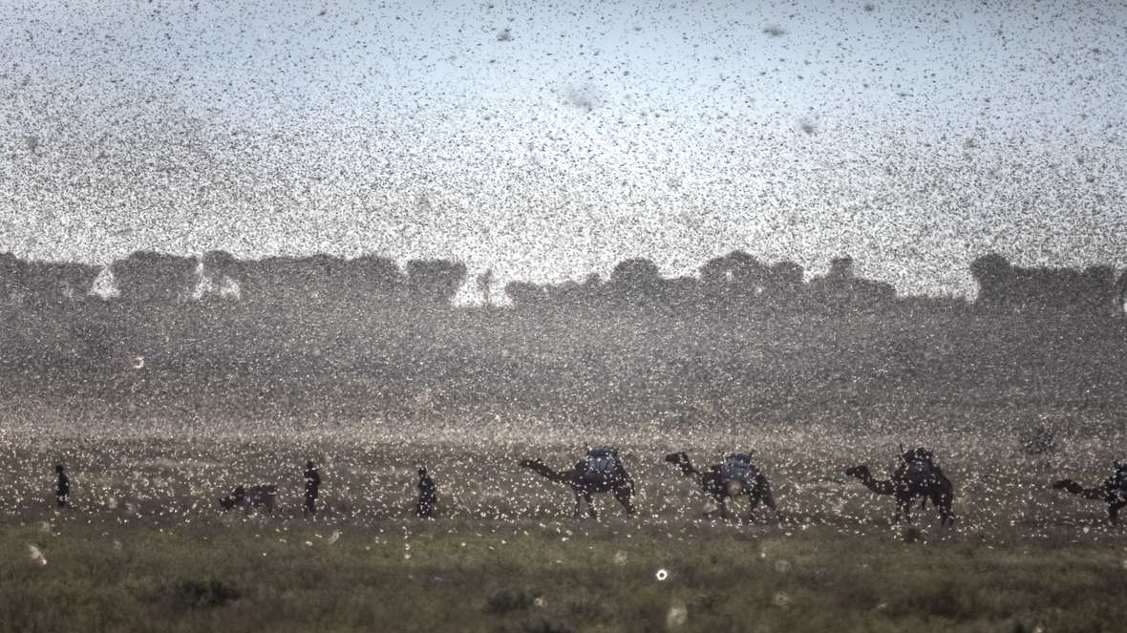
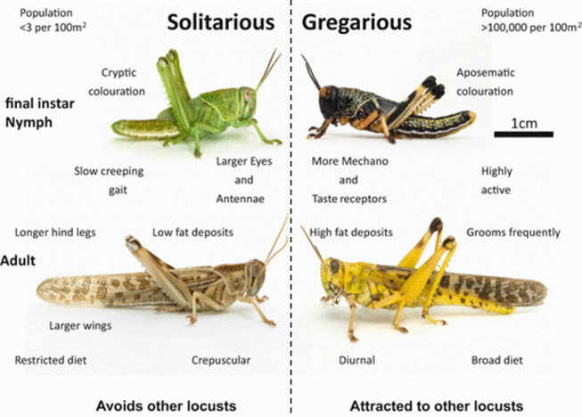
Let us start with the biological/ phenomenological description of the locust swarm formation (1a/ 2)
https://idc.icrisat.org/idc/index.php/locust-swarm-and-its-management/
C.M. Topaz, A.J. Bernoff, S. Logan & W. Toolson (2008): A Model for Rolling Swarms of Locusts, The European Physical Journal, Special Topics, 157, pp. 93-109, DOI: 10.1140/epjst/e2008-00633-y.

Slide 4
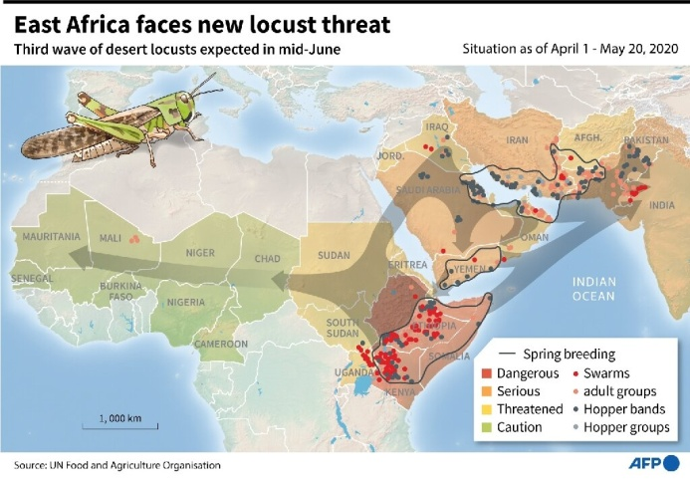
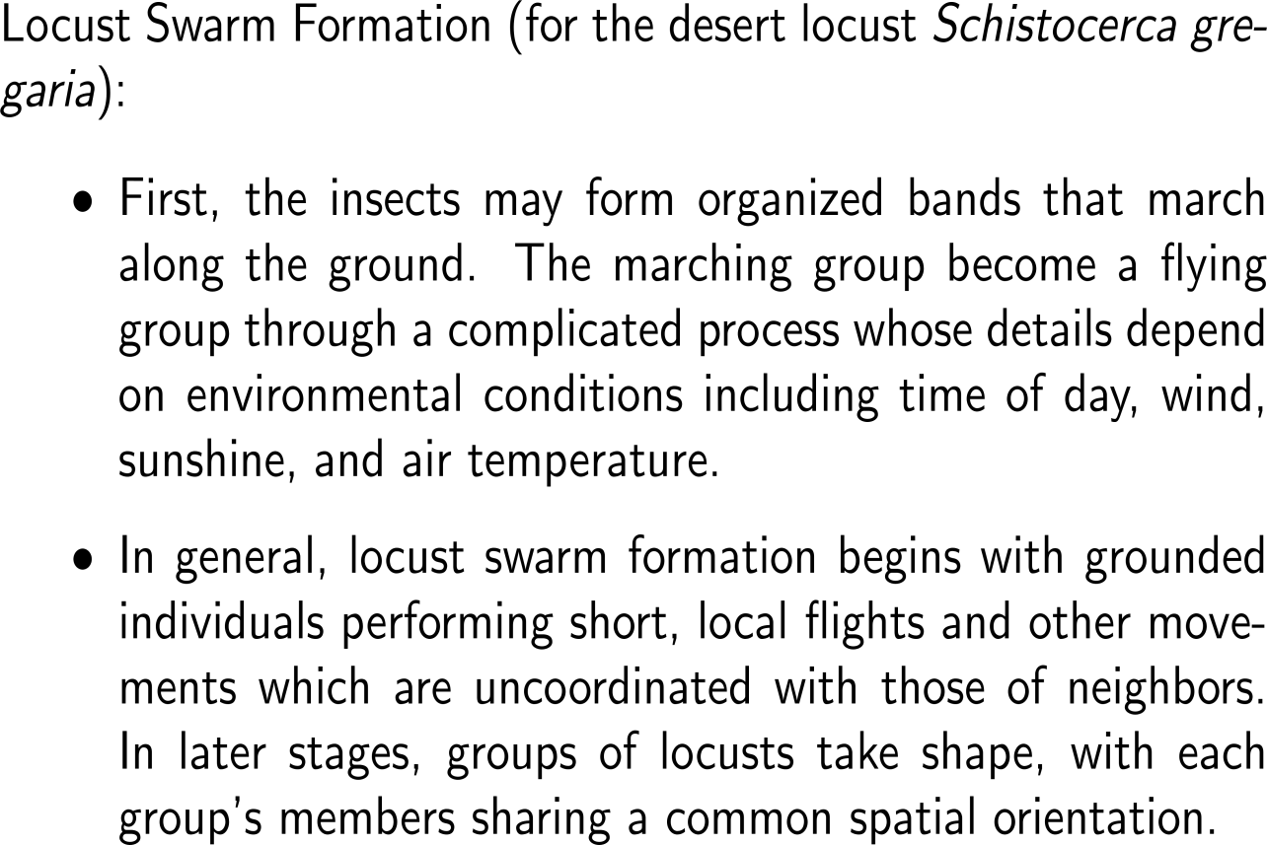
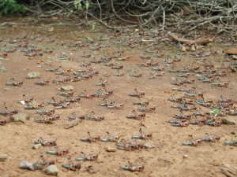
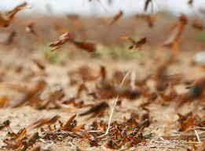
Let us start with the biological/ phenomenological description of the locust swarm formation (1b/ 2)

Slide 5
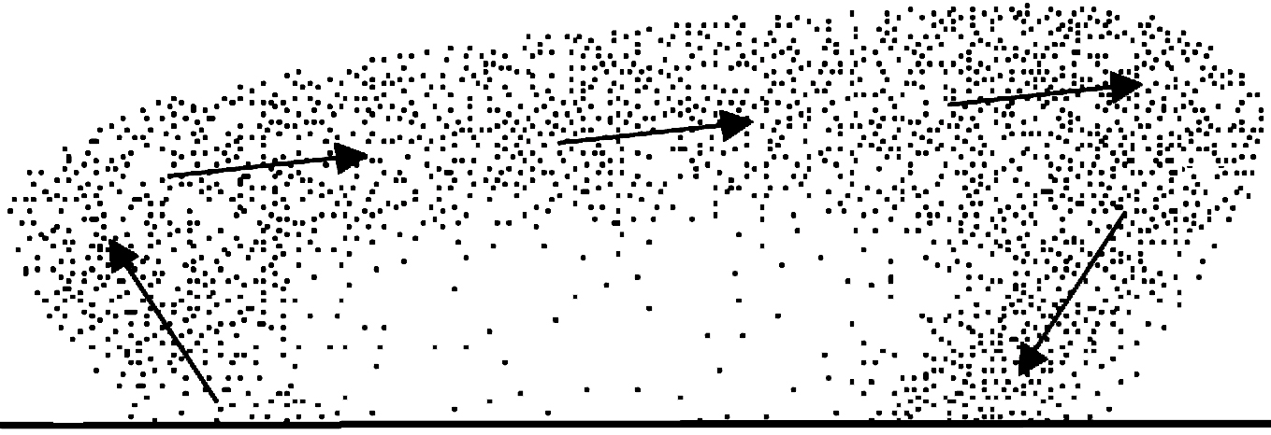
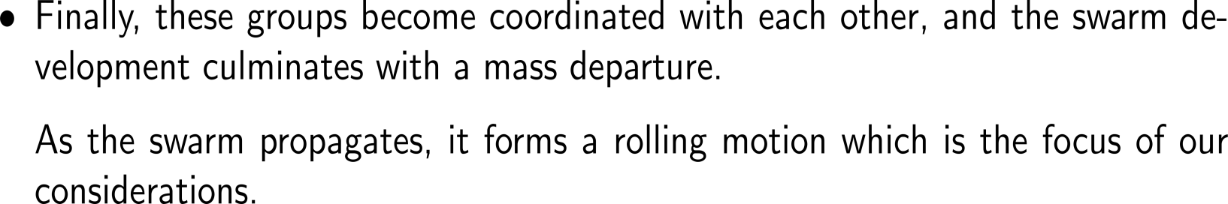
Let us start with the biological/ phenomenological description of the locust swarm formation (2/ 2)
Schematic depiction of a rolling locust swarm. The downwind direction is to the right.
rolling of the swarm
resting zone
landing zone
takeoff zone

Slide 6
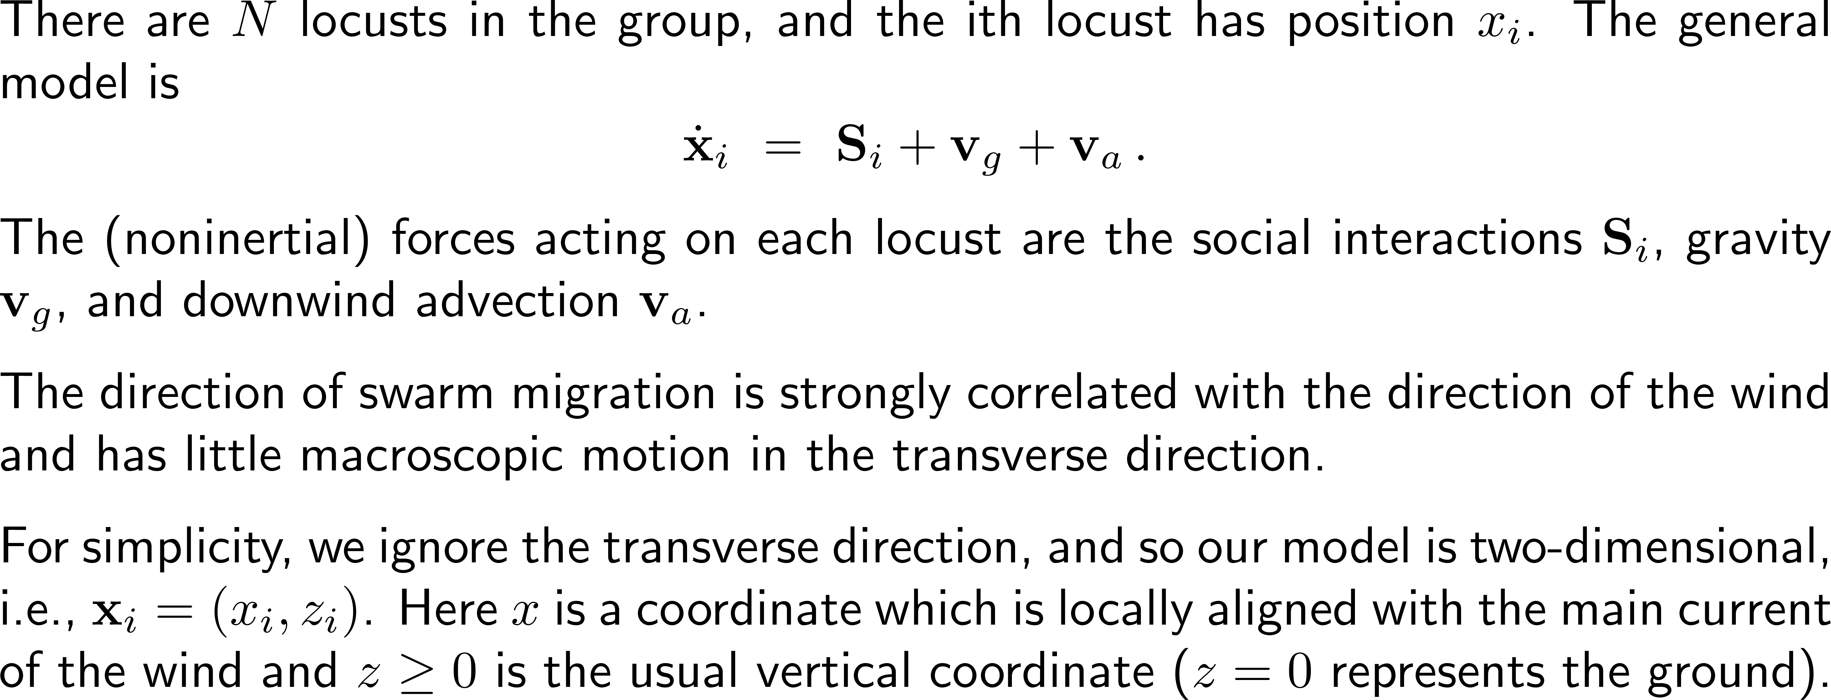
The mathematical model for the swarm’s rolling motion consist of the impact of social interactions, gravity, and downwind advection

Slide 7
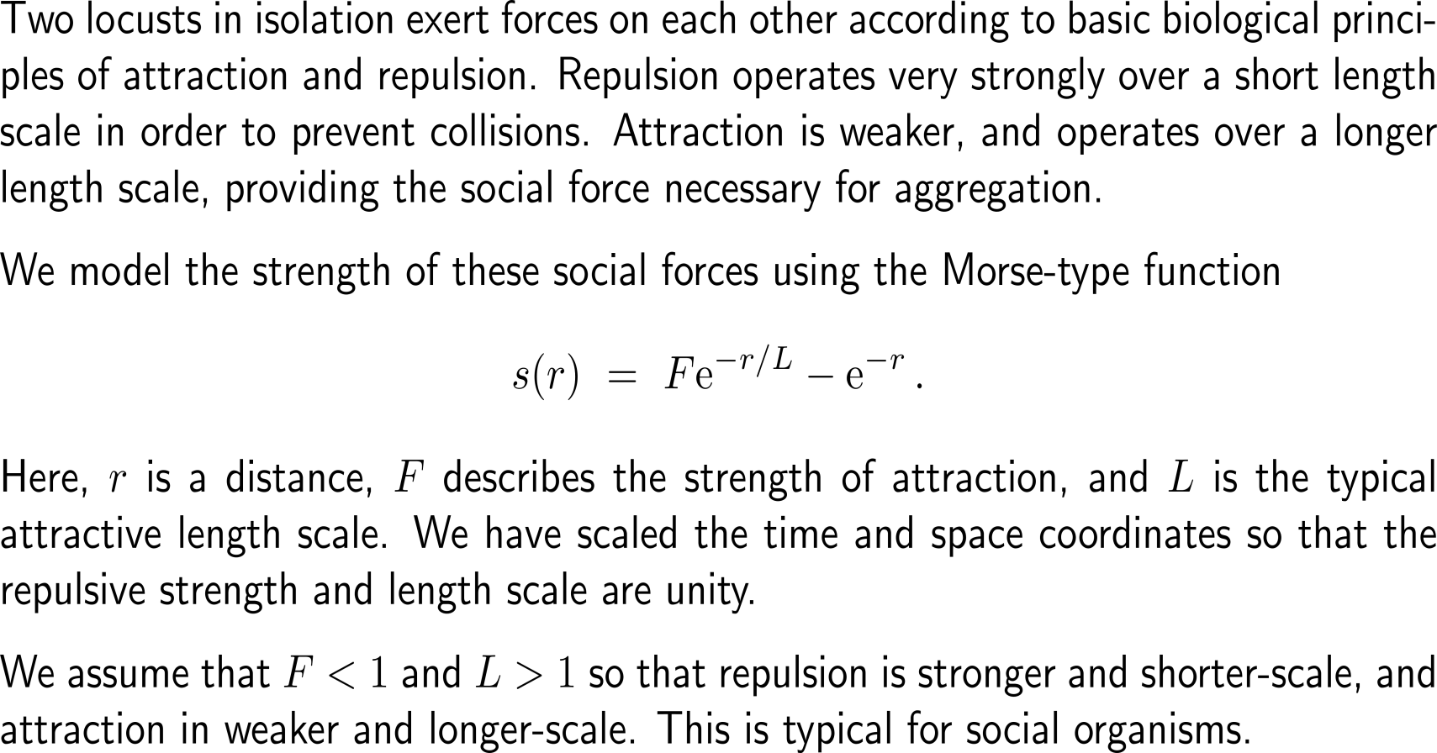
Set-up of the model: 1) social interaction
Social Interaction
Gravity
Downwind Advection
Ground Motion

Slide 8
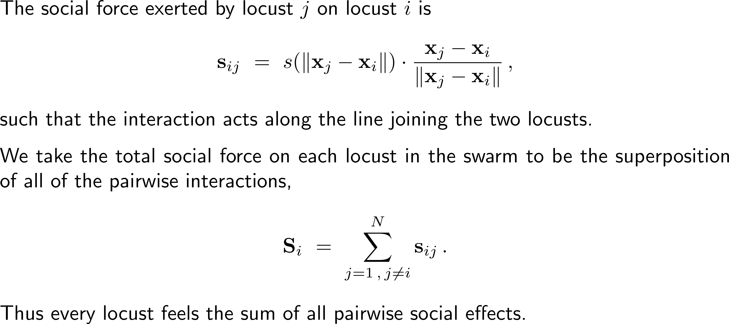
Set-up of the model: 1) social interaction
Social Interaction
Gravity
Downwind Advection
Ground Motion

Slide 9
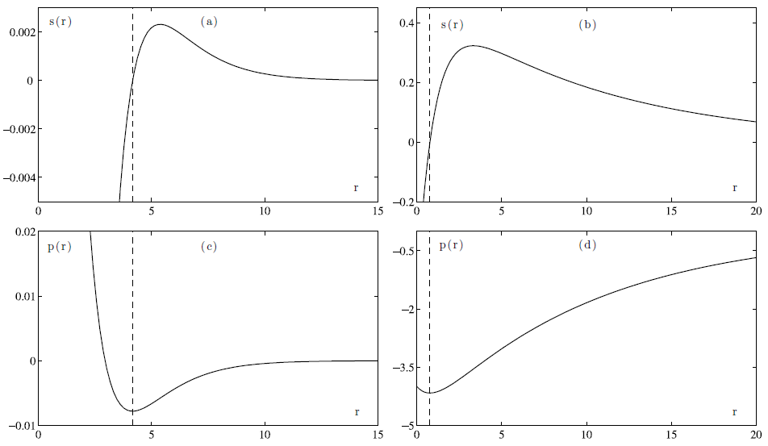
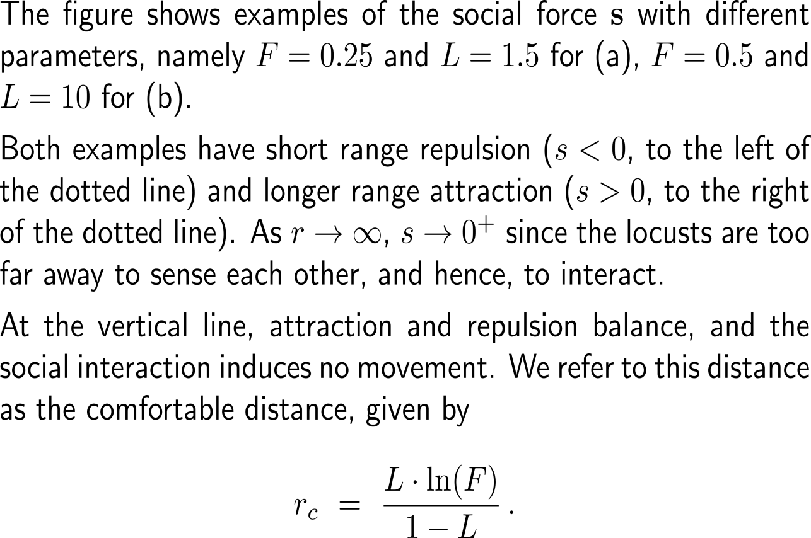
Set-up of the model: 1) social interaction

Slide 10
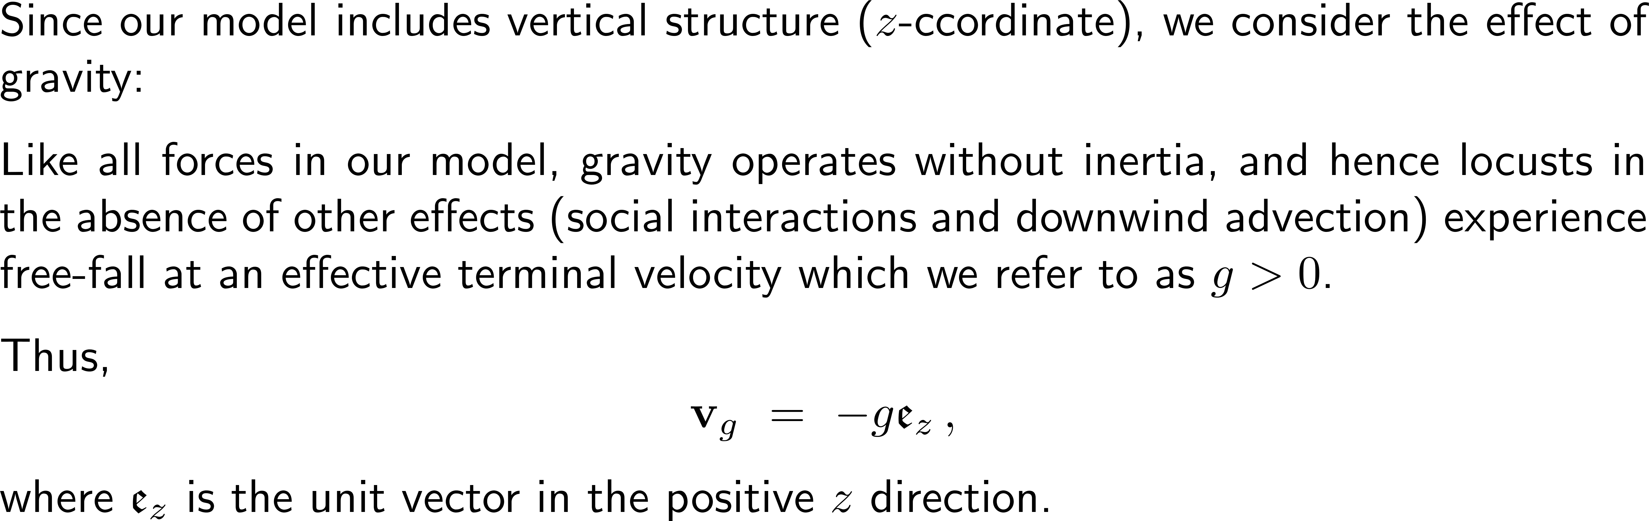
Set-up of the model: 2) gravity influence
Social Interaction
Gravity
Downwind Advection
Ground Motion

Slide 11
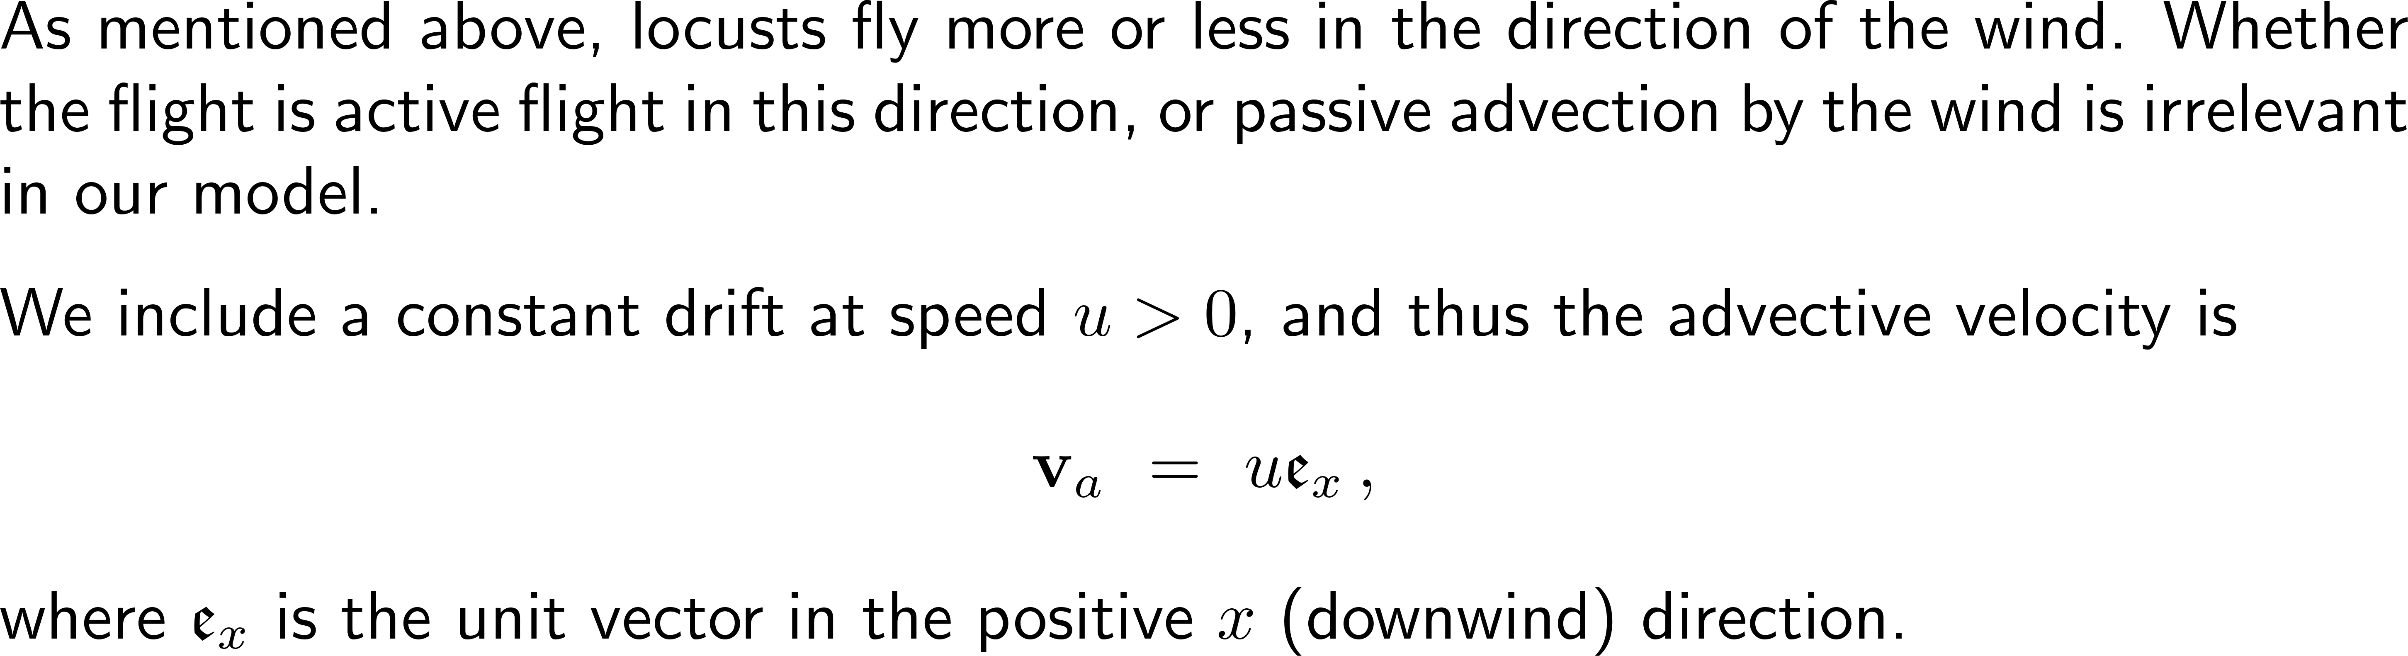
Set-up of the model: 3) downwind advection
Social Interaction
Gravity
Downwind Advection
Ground Motion

Slide 12
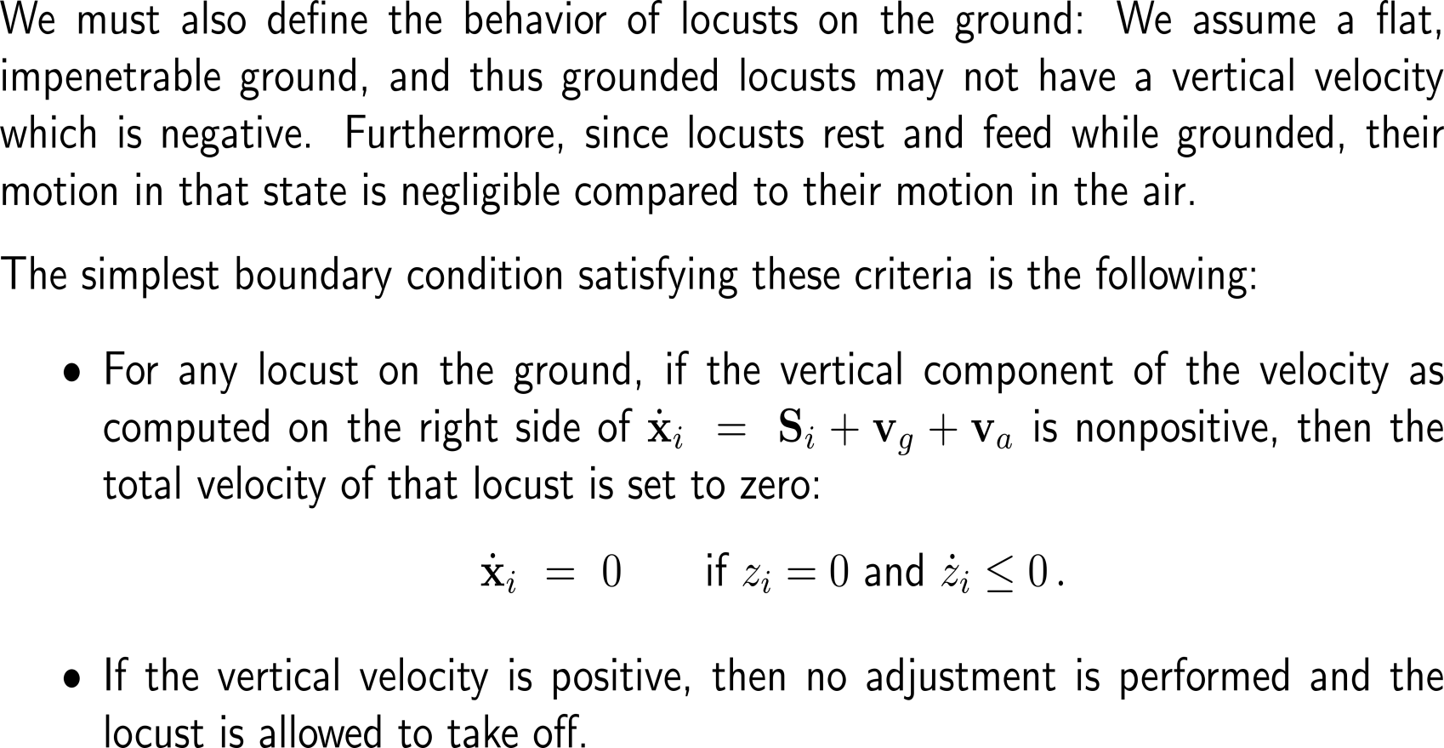
Set-up of the model: 4) ground motion
Social Interaction
Gravity
Downwind Advection
Ground Motion

Slide 13
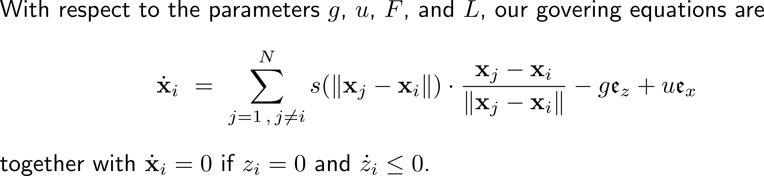
Summary: The governing equations for rolling motion
Schematic depiction of a rolling locust swarm. The downwind direction is to the right.

Slide 14
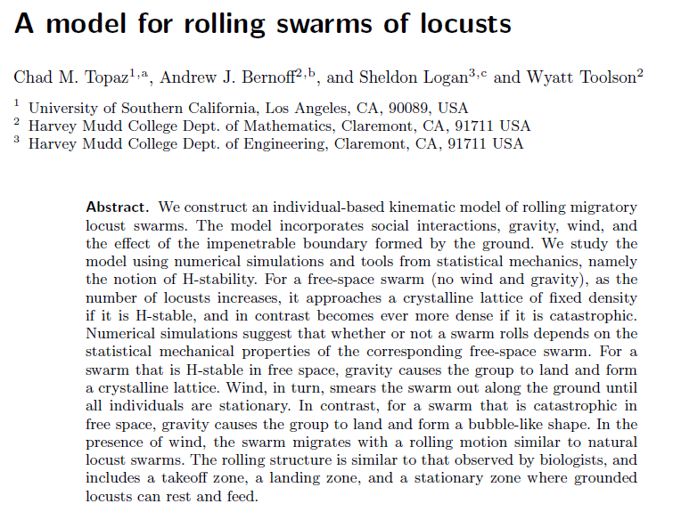
Sub-Agenda: Swarms of Locusts
The Computerized Model
Simulations

Slide 15
The modular program structure follows our previous architectures
1. Understand the Problem
setup.py
locust_swarm/
script that automatically creates all the folders and files (correct names, but empty)
main.py
config/
2. Plan
output/
parameters.py
model/
3. Execute
plots.py
simulation/
state.py
animation.py
dynamics.py
interaction.py
4. Look Back
snapshots.py
integrator.py
initializer.py
forces.py
runner.py
boundary.py
tests/
diagnostics.py

Slide 16
Here, the single files contain the information necessary to simulate the swarm of locusts according to our mathematical model (1/ 2)
main.py
config/parameters.py
model/state.py
model/interactions.py
model/forces.py
Main file
supported by
README.md
requirenments.txt
Stores:
number of locusts N,
F, L, G, U,
timestep dt,
total simulation time,
domain size,
random seed,
plotting options
Defines the swarm state:
positions array of shape (N, 2),
optional grounded mask,
helper functions for copying/updating state.
Implements:
pairwise distances,
Morse interaction s(r),
social velocity computation.
Implements:
gravity contribution,
wind contribution,
combined unconstrained velocity.
model/boundary.py
model/dynamics.py
model/integrator.py
simulation/initializer.py
simulation/runner.py
Implements:
clipping to z ≥ 0,
sticky-ground take-off/ landing rule.
High-level function:
input current positions,
compute social & gravity & wind,
apply boundary rule,
return final velocity.
Numerical stepping:
explicit Euler is enough for a first version,
later one can compare with RK45.
Creates initial states:
random cloud,
disk-shaped swarm,
already airborne group.
Runs the loop over time:
update state,
store history,
call diagnostics.

Slide 17
Here, the single files contain the information necessary to simulate the swarm of locusts according to our mathematical model (2/ 2)
sim…/diagnostics.py
output/plots.py
Core Data Structure
Computes:
mean height,
grounded count,
swarm center,
width/ height,
pair distance statistics.
Create:
scatter plots,
trajectory plots,
time series.
positions: NumPy array of shape (N, 2)
velocities: NumPy array of shape (N, 2)
grounded: boolean array of shape (N,)
history_positions: list of arrays
history_grounded: list of masks
Pseudo Code for the Simulation Loop
positions = initialize_swarm(...) for step in range(num_steps): social = compute_social_velocities(positions, F, L) gravity = compute_gravity(N, G) wind = compute_wind(N, U) raw_velocity = social + gravity + wind velocity = apply_ground_rule(positions, raw_velocity) positions = positions + dt * velocity positions[:, 1] = np.maximum(positions[:, 1], 0.0) save_history(...) compute_diagnostics(...)
output/animation.py
Create:
animation frames/ GIF.

Slide 18

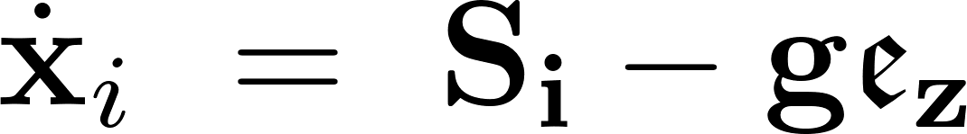
We build the computational model in three stages (Be careful, AI may overwrite previous setps)
Stage 1: Free-space social swarm
Additionally, to stage 1: diagnostics & experiments
Only use social interaction:
Goal:
understand aggregation, and
inspect spacing and cluster formation.
Graphics & measurements:
airborne fraction,
grounded fraction,
mean height,
swarm width,
number of take-off/ landing events,
whether motion is rolling or dissipative.
Stage 2: Add gravity
Stage 3: Add wind
plus the ground rule.
Goal:
observe landing, and
compare final shapes.
Goal: see whether the swarm
smears out or
rolls.
Note to tell AI to only update the code with new segments such that previous segments are not overwritten.

Slide 19
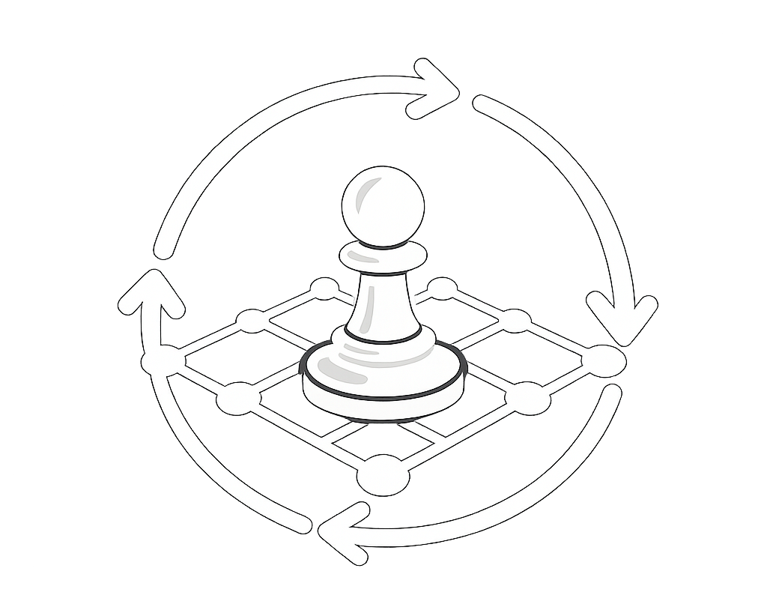
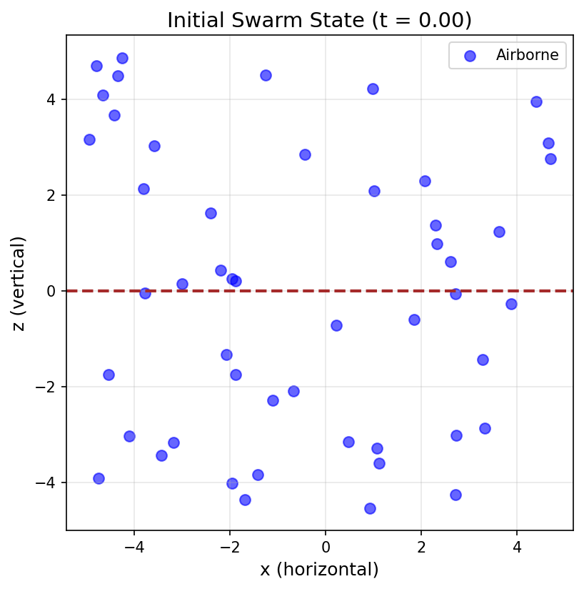
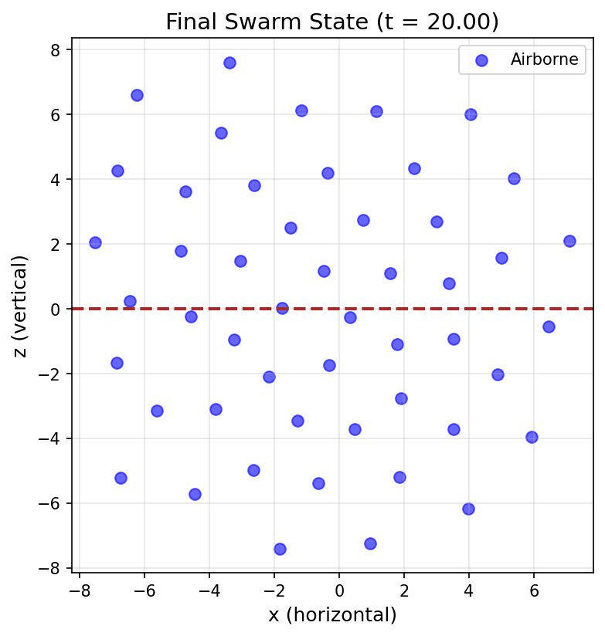
Building the computational model 1. Free-space social swarm
============================================================
LOCUST SWARM SIMULATION - STAGE 1
Free-space social swarm (no gravity, no wind)
============================================================
Number of locusts: 50
Social interaction: F = 0.25, L = 1.5
Time step: 0.01, Total time: 20.0
============================================================
no ground rule
Free-Space Social Swarm
social interaction only
Rectangular window with x ∈ [x_{min}​, x_{max}​] with a very large horizontal range

Slide 20
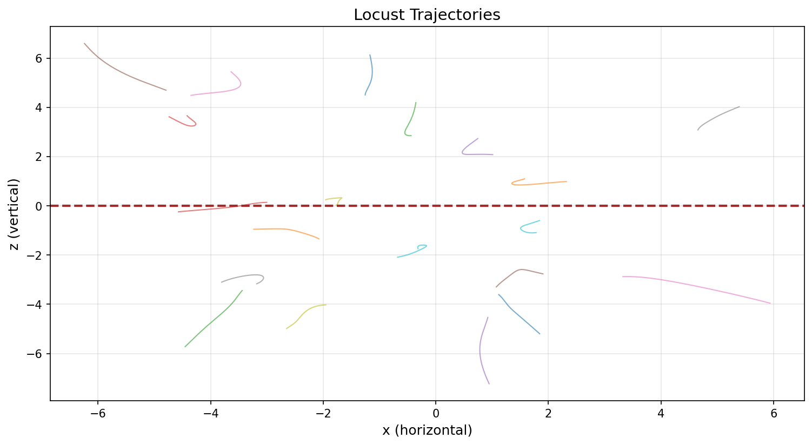
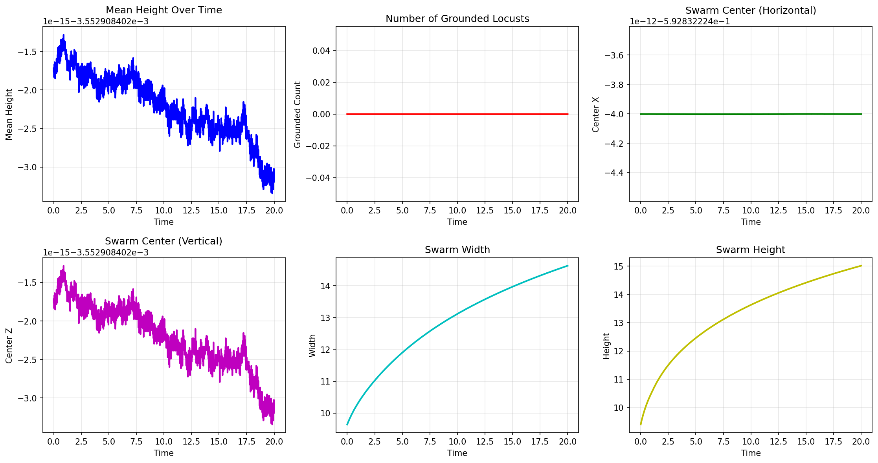
Building the computational model 1. Free-space social swarm

Slide 21
Building the computational model 1. Free-space social swarm

Slide 22
Building the computational model 2. Add gravity – What do we expect?
Depending on the values of the parameters, we expect to see two regimes:
Catastrophic Regime (Bubble Structure): the locusts form a “bubble” such that some land on ground, others hover above.
E.g.: F = 0.5 and L > F^{1/3} ≈ 1.26.
H-Stable Regime (Crystalline Structure): all locusts eventually land and form a crystalline pattern on ground.
E.g.: F = 0.25 and L < F^{1/3} ≈ 1.59.
Add Gravity
social interaction & gravitation
Additionally,
ground rule
z ∈ [0, z_{max}] with a very large upper boundary
enforcement of z non-negative

Slide 23
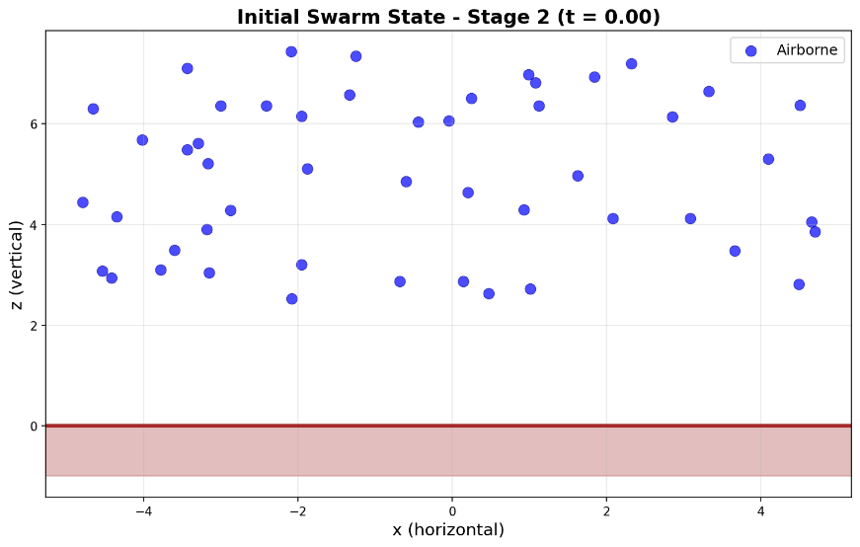
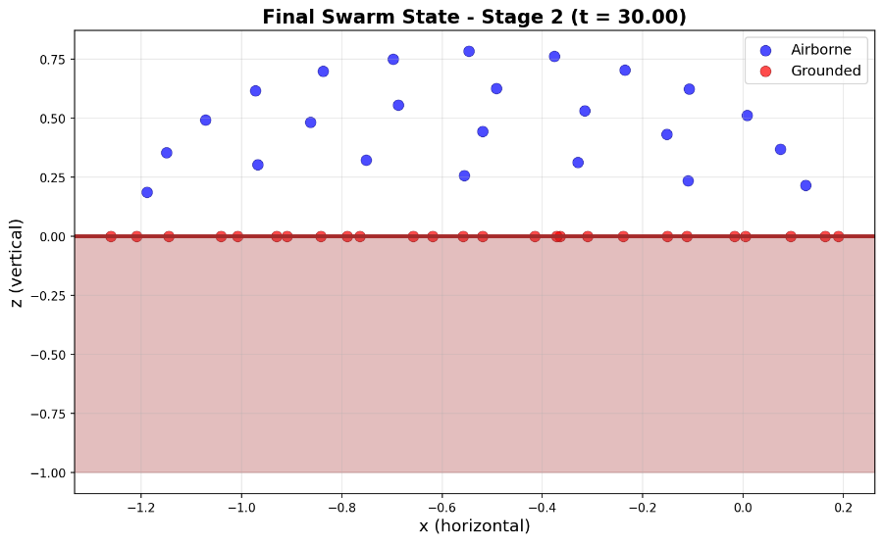
Building the computational model 2a. Add gravity – bubble structure
============================================================
LOCUST SWARM SIMULATION - STAGE 2
Social swarm with gravity and ground boundary
============================================================
Number of locusts: 50
Social interaction: F = 0.5, L = 10.0; Gravity: g = 1.0
Time step: 0.01, Total time: 30.0
============================================================
parameters such that bubble structure forms
Add Gravity
social interaction & gravitation
Additionally,
ground rule
z ∈ [0, z_{max}] with a very large upper boundary
enforcement of z non-negative

Slide 24
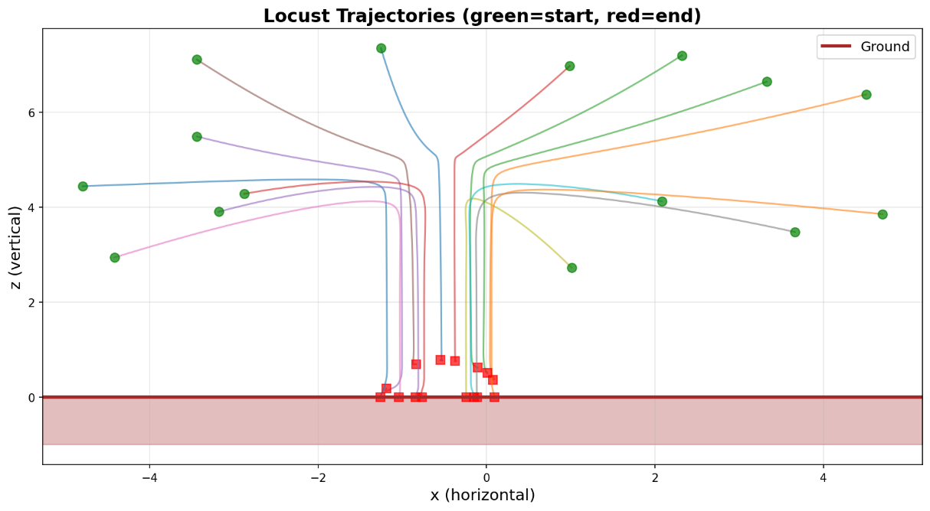
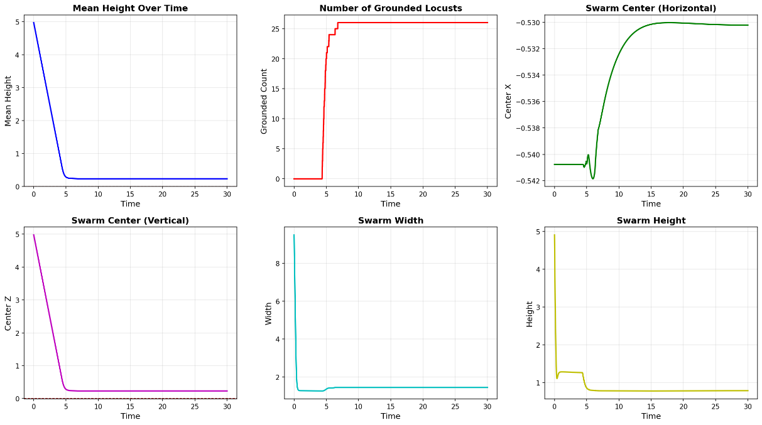
Building the computational model 2a. Add gravity – bubble structure

Slide 25
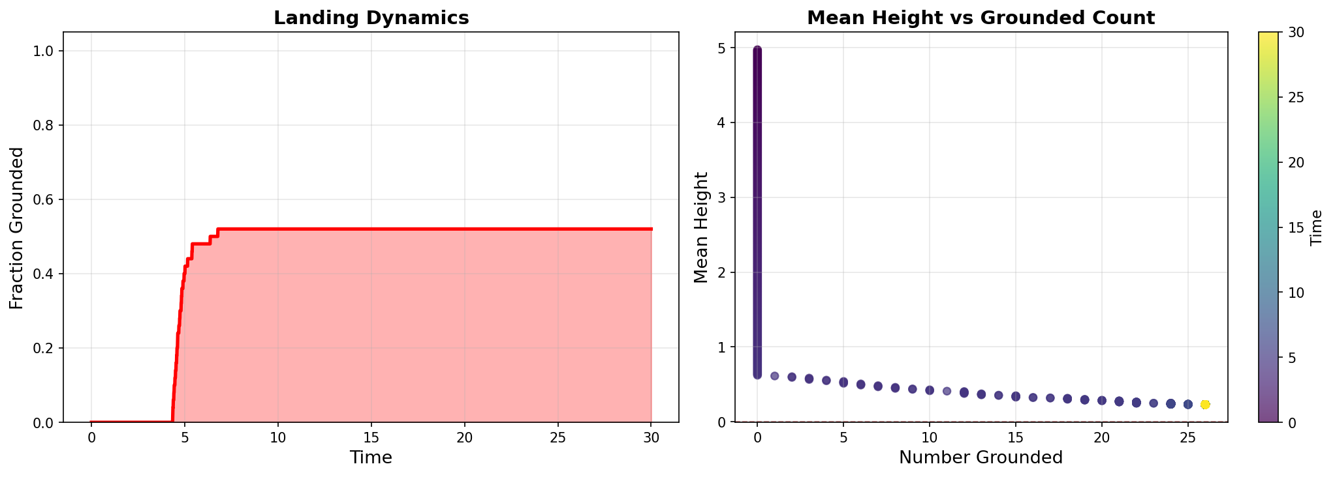
Building the computational model 2a. Add gravity – bubble structure

Slide 26
Building the computational model 2a. Add gravity – bubble structure

Slide 27
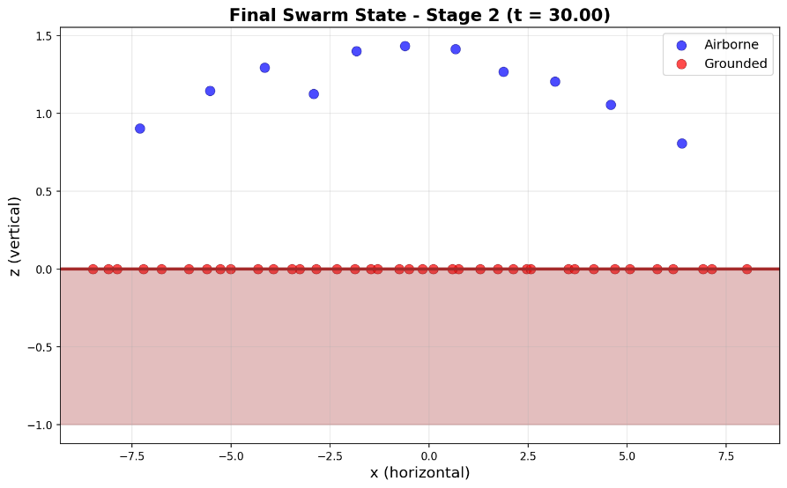
Building the computational model 2b. Add gravity – crystalline structure
============================================================
LOCUST SWARM SIMULATION - STAGE 2
Social swarm with gravity and ground boundary
============================================================
Number of locusts: 50
Social interaction: F = 0.25, L = 1.5; Gravity: g = 1.0
Time step: 0.01, Total time: 30.0
============================================================
parameters such that crystalline structure forms
Add Gravity
social interaction & gravitation
Additionally
ground rule
enforcement of z non-negative

Slide 28
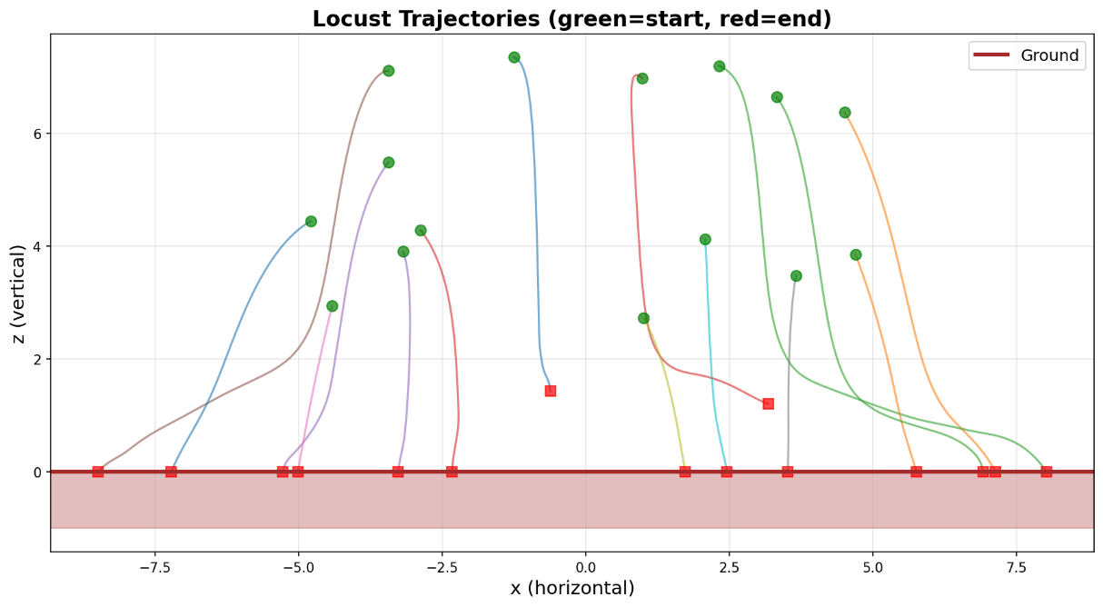
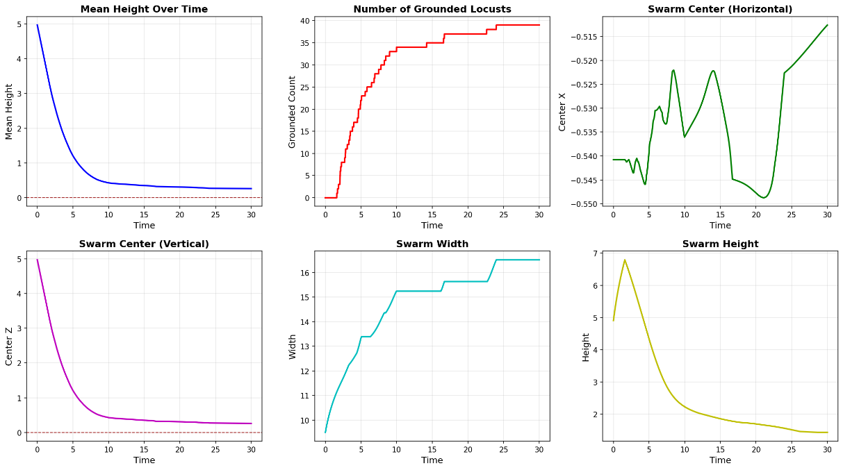
Building the computational model 2b. Add gravity – crystalline structure

Slide 29
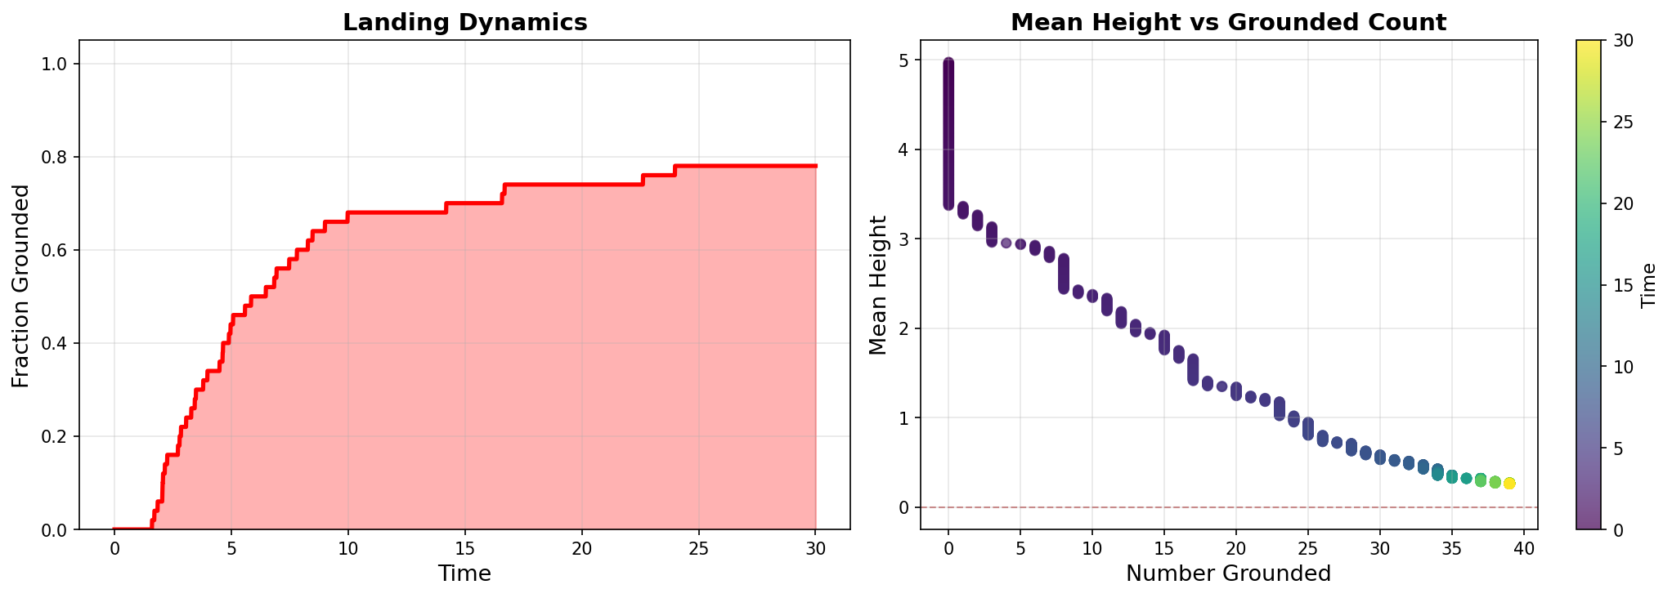
Building the computational model 2b. Add gravity – crystalline structure

Slide 30
Building the computational model 2b. Add gravity – crystalline structure

Slide 31
Other parameter values to try: Understanding the regime boundary
Value of F | Value of L | Description
0.8 | 2.0 | strong attraction, short range (tight cluster)
0.1 | 20.0 | weak attraction, long range (loose swarm)
0.4 | 5.0 | moderate values
Value of F | Value of L_{critical} = F^{1/3} | Regime if L < L_{critical} | Regime if L > L_{critical}
0.1 | ≈ 2.15 | H-stable | catastrophic
0.25 | ≈ 1.59 | H-stable | catastrophic
0.5 | ≈ 1.26 | H-stable | catastrophic
0.8 | ≈ 1.08 | H-stable | catastrophic

Slide 32

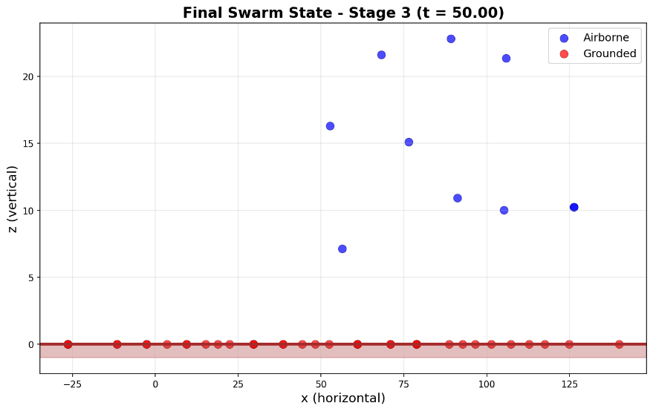
Building the computational model 3a. Complete model – bubble structure
============================================================
LOCUST SWARM SIMULATION - STAGE 3
Social swarm with gravity, ground, and wind (rolling)
============================================================
Number of locusts: 50
Parameters: F = 0.5, L = 10.0, g = 1.0, u = 2.0
Time step: 0.01, Total time: 50.0
============================================================
parameters such that bubble structure forms
Add Wind
social interaction & gravitation & wind
Goal: see whether the swarm smears out or rolls.

Slide 33
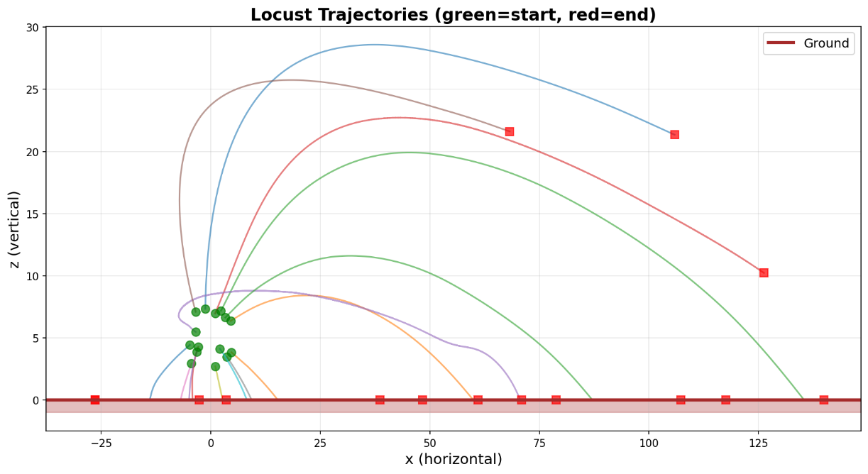
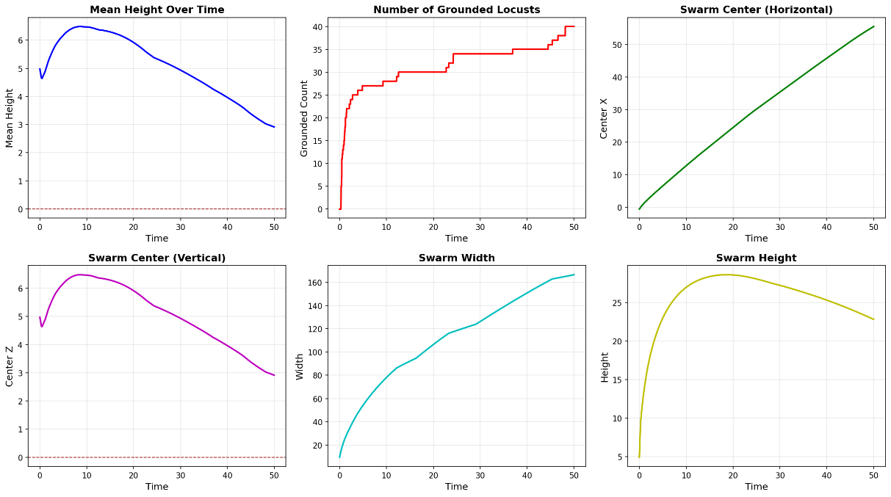
Building the computational model 3a. Complete model – bubble structure

Slide 34
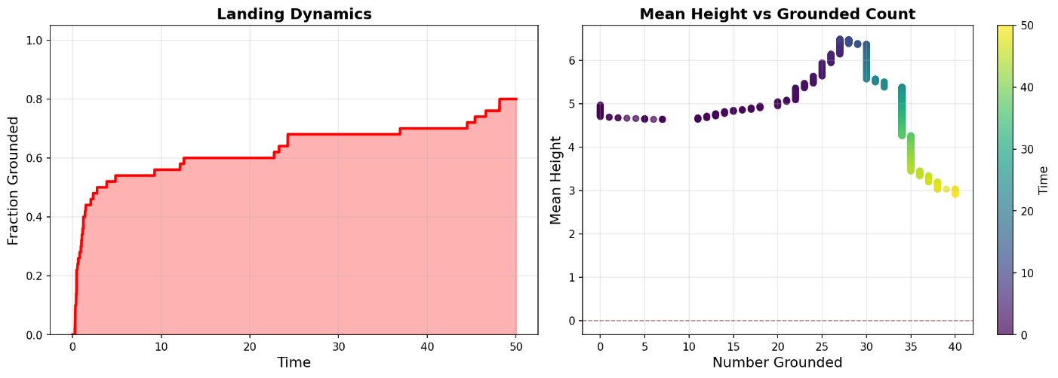
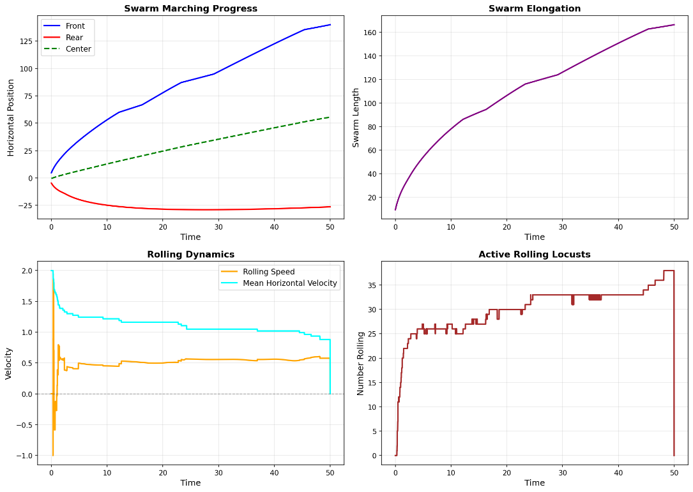
Building the computational model 3a. Complete model – bubble structure

Slide 35
Building the computational model 3a. Complete model – bubble structure

Slide 36
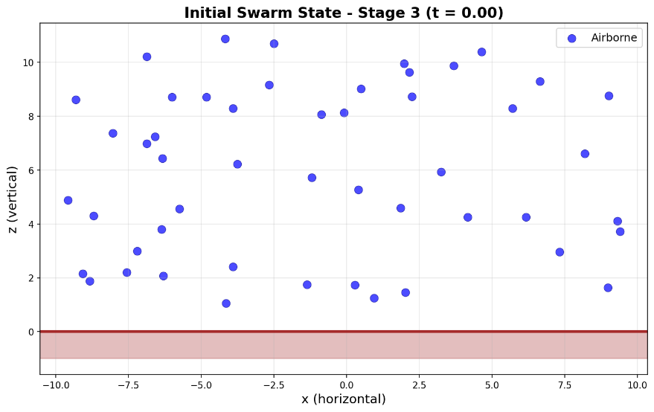
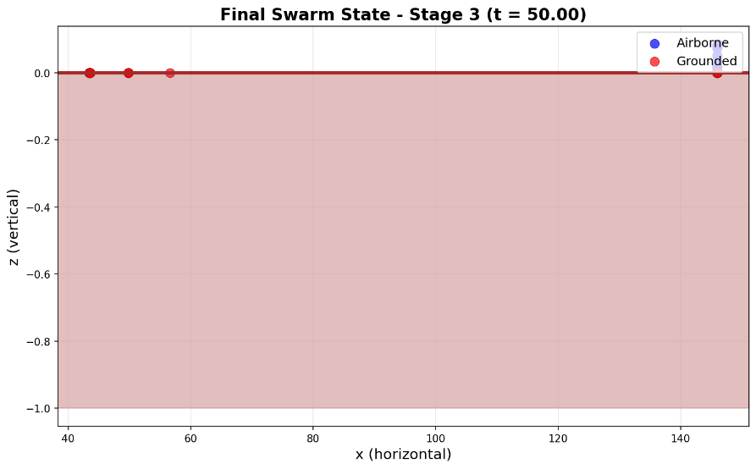
Building the computational model 3b. Complete model – crystalline structure
============================================================
LOCUST SWARM SIMULATION - STAGE 3
Social swarm with gravity, ground, and wind (rolling)
============================================================
Number of locusts: 50
Parameters: F = 0.25, L = 1.5, g = 1.0, u = 3.0
Time step: 0.01, Total time: 50.0
============================================================
parameters such that crystalline structure forms
Add Wind
social interaction & gravitation & wind
Goal: see whether the swarm smears out or rolls.

Slide 37
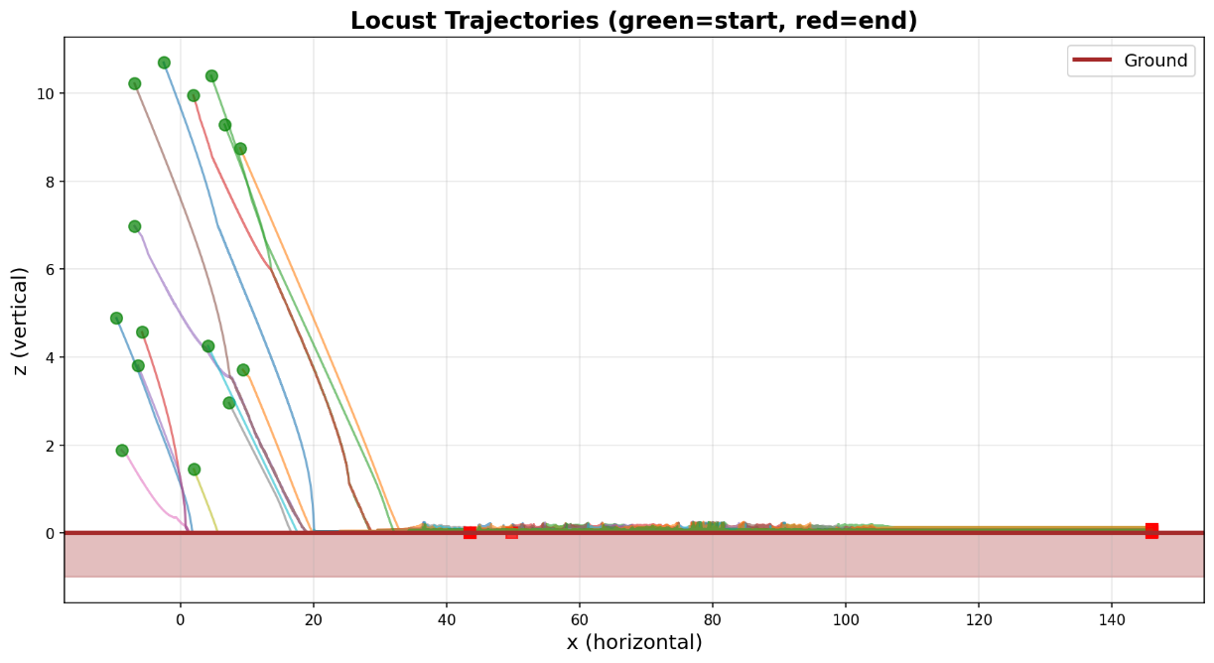
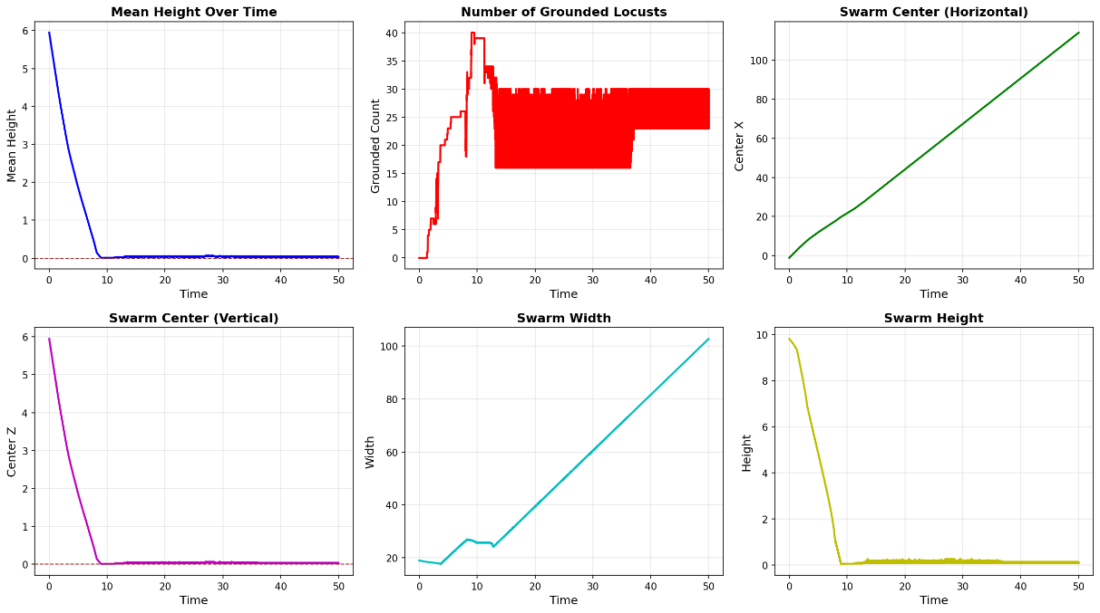
Building the computational model 3b. Complete model – crystalline structure

Slide 38
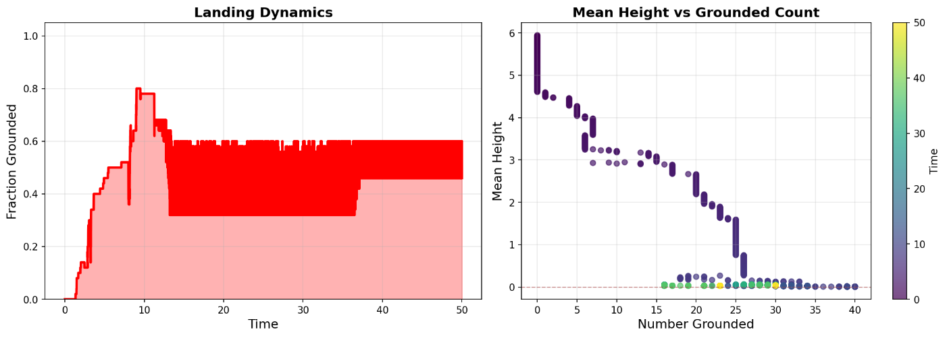
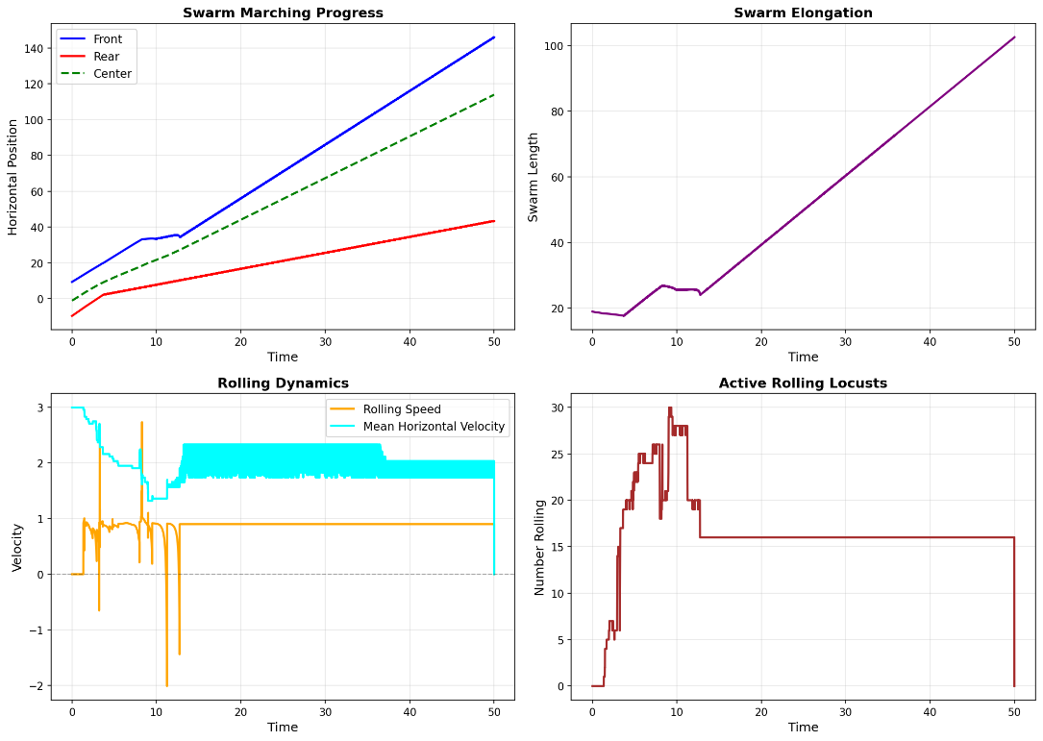
Building the computational model 3b. Complete model – crystalline structure

Slide 39
Building the computational model 3b. Complete model – crystalline structure

Slide 40
Sub-Agenda: Swarms of Locusts
The Computerized Model
Simulations

Slide 41
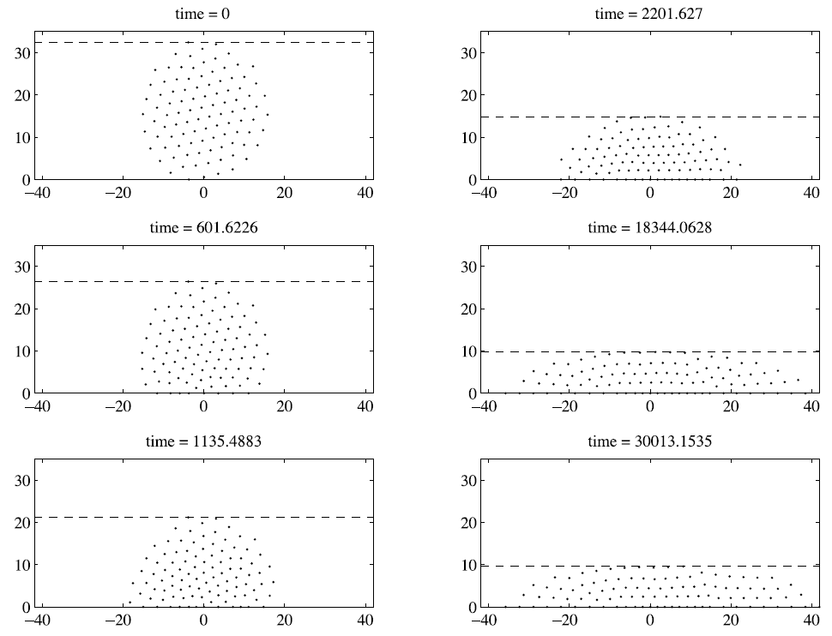
Results: 1) Simulation of a swarm landing on the ground
Snapshots of a swarm in landing on the ground under the influence of gravity.
The broken line guides the eye to the top of the swarm.
As the swarm lands, the macroscopic behavior is to (approximately) maintain a crystalline structure.
Here, N = 100, the social interaction rule is with F = 0.25 and L = 1.5, and the gravity parameter is G = 0.01.
For larger values of G, the swarm becomes even more spread out on the ground.

Slide 42
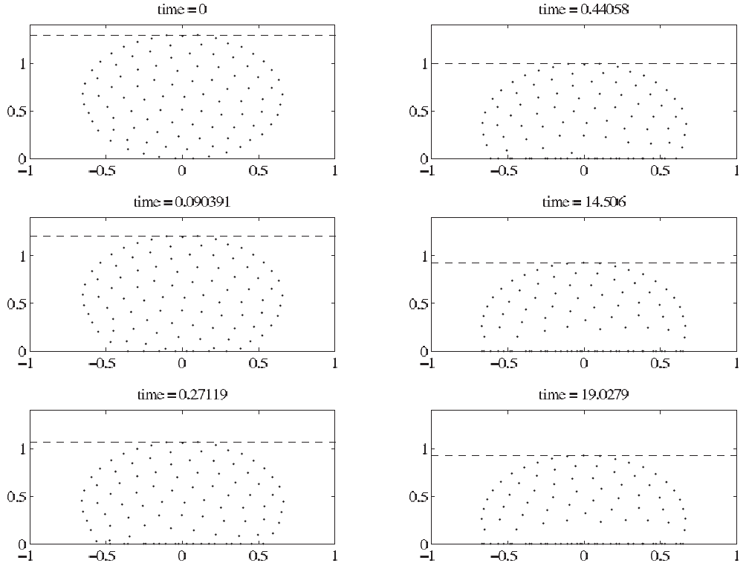
Results: 2) Simulation of a swarm landing on the ground
Snapshots of a swarm in landing on the ground under the influence of gravity.
The broken line guides the eye to the top of the swarm.
The equilibrium state consists of a group of locusts in the air, a dense group of locusts on the ground, and a void separating them.
Here, N = 100, the social interaction rule is with F = 0.5 and L = 10, and the gravity parameter is G = 1.
We observe similar bubbles over a wide range of G.

Slide 43
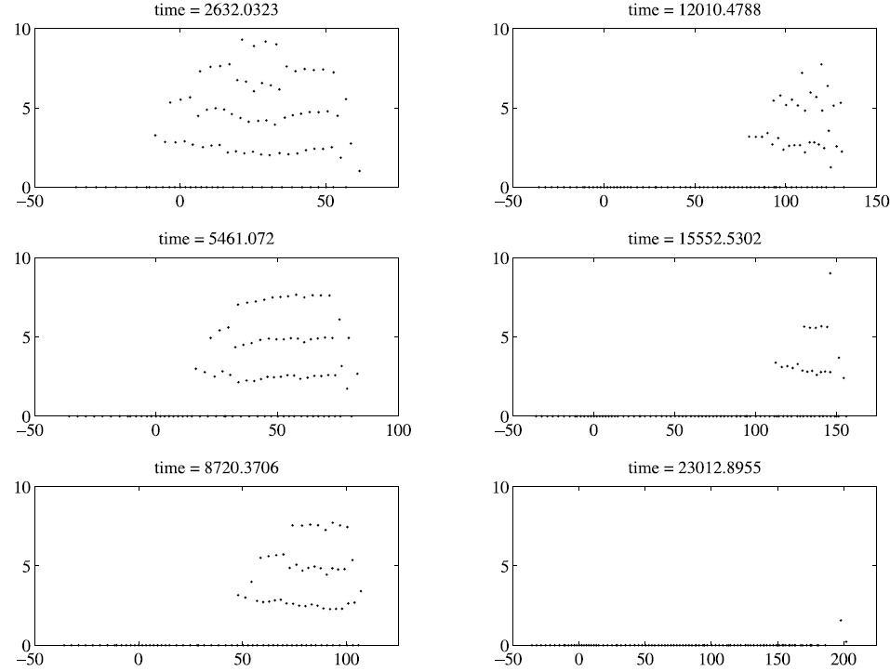
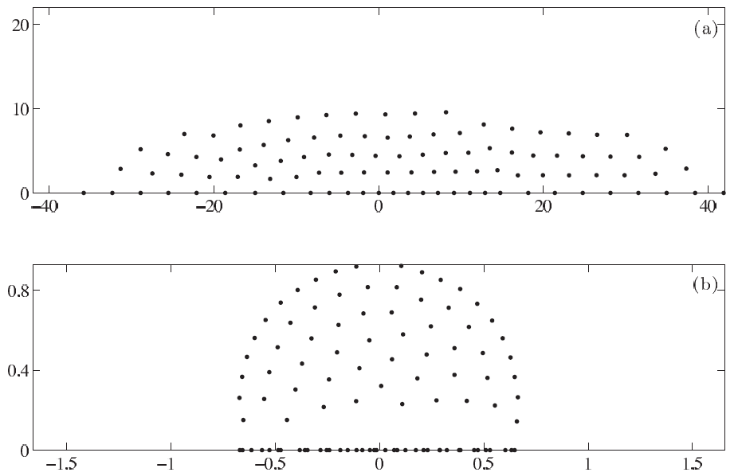
Results: 3) Comparison of the two settings 1) and 2)
The locusts land on the ground due to gravity, but the qualitative character of the final state depends on the regime in which the parameters F and L lie. In (a) the group has an oblong crystalline structure, while in case (b) it has a bubble-like structure with a void above the ground.

Slide 44
Computational Biomathematics
florian.rupp@kiu.edu.ge

