Slide 1
Computational Biomathematics
Swarms of Locusts & Introduction to Chase & Escape
Lesson 14c
Lecture
Swarms of locusts
Avoiding predators
The basic model of chase & escape

Slide 2
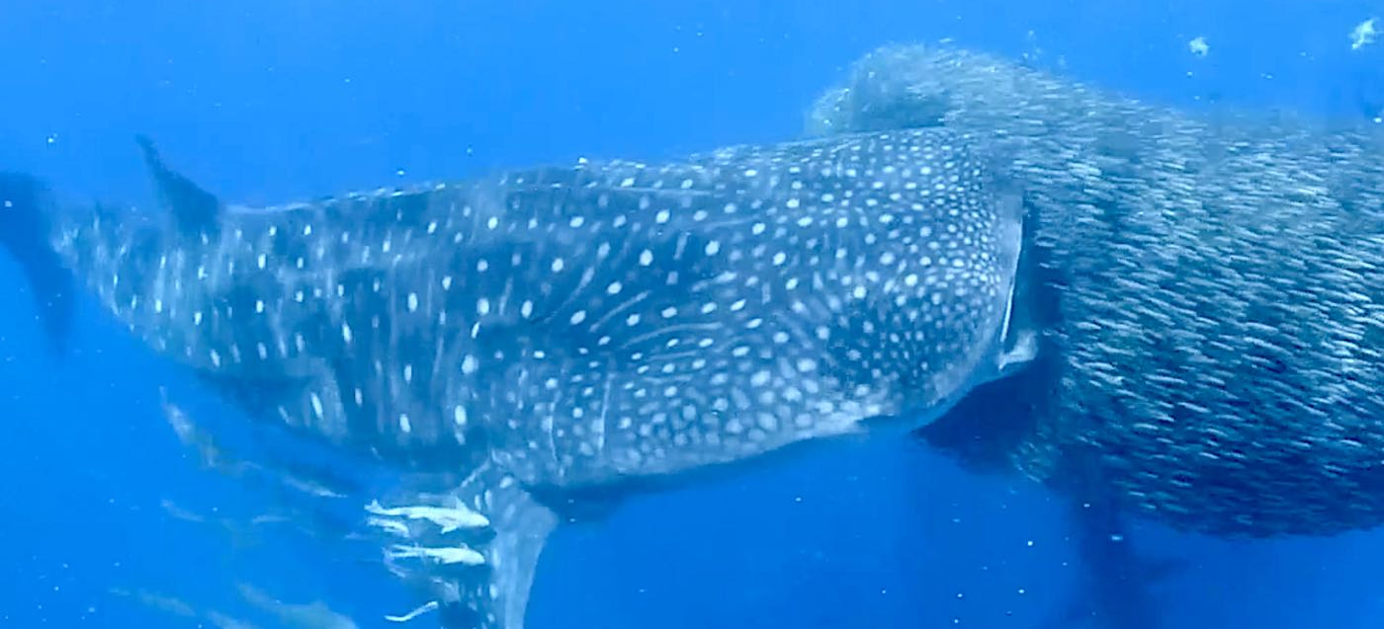
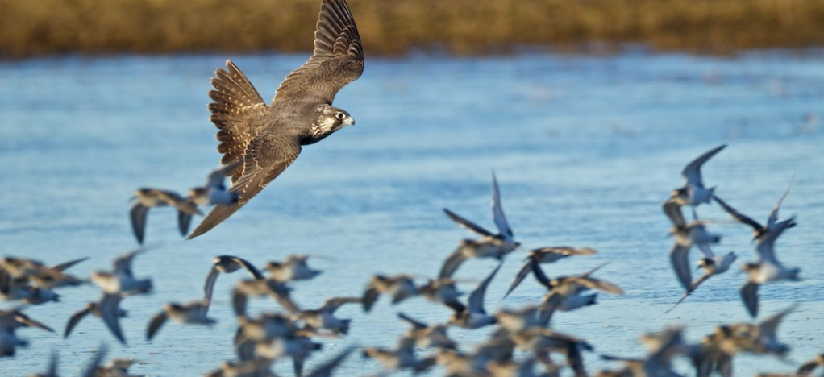
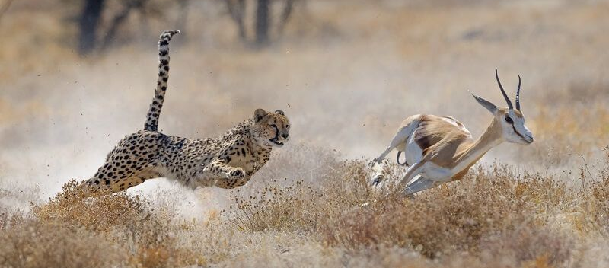
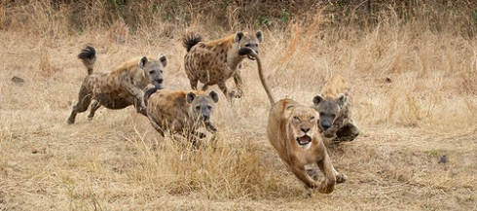
Some illustrations of chase and escape dynamics

Slide 3
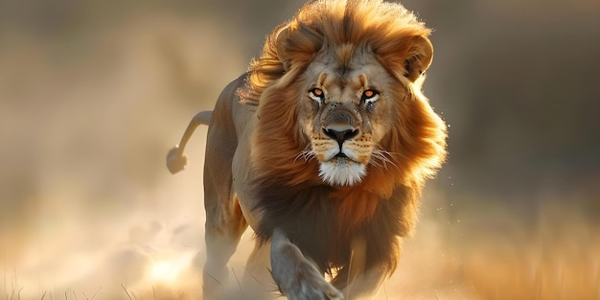
Agenda
Swarms of Locusts
Avoiding Predators
The Basic Model of Chase & Escape

Slide 4
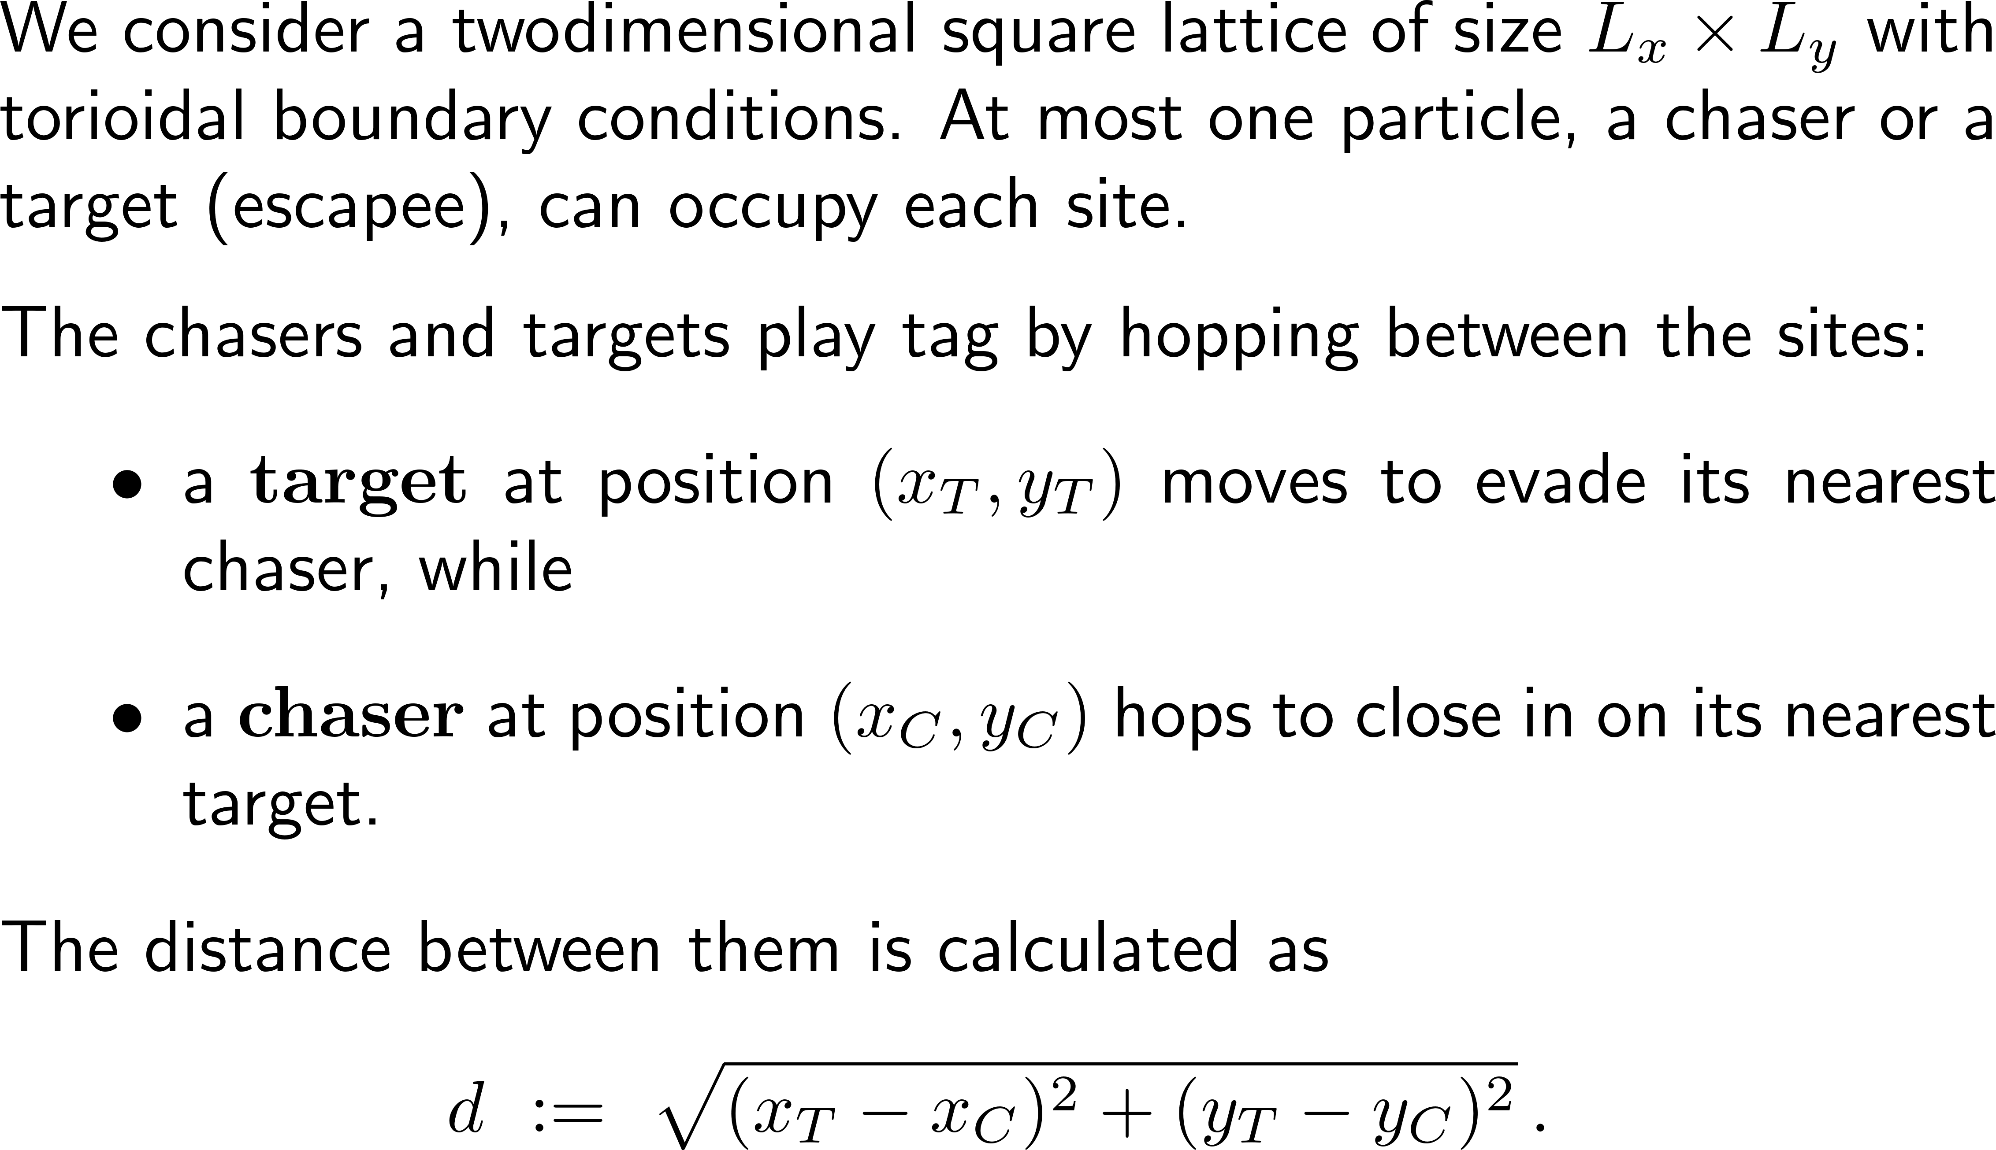


The basic model of group chase and escape (1/ 4)
L_{Y}
L_{X}

Slide 5
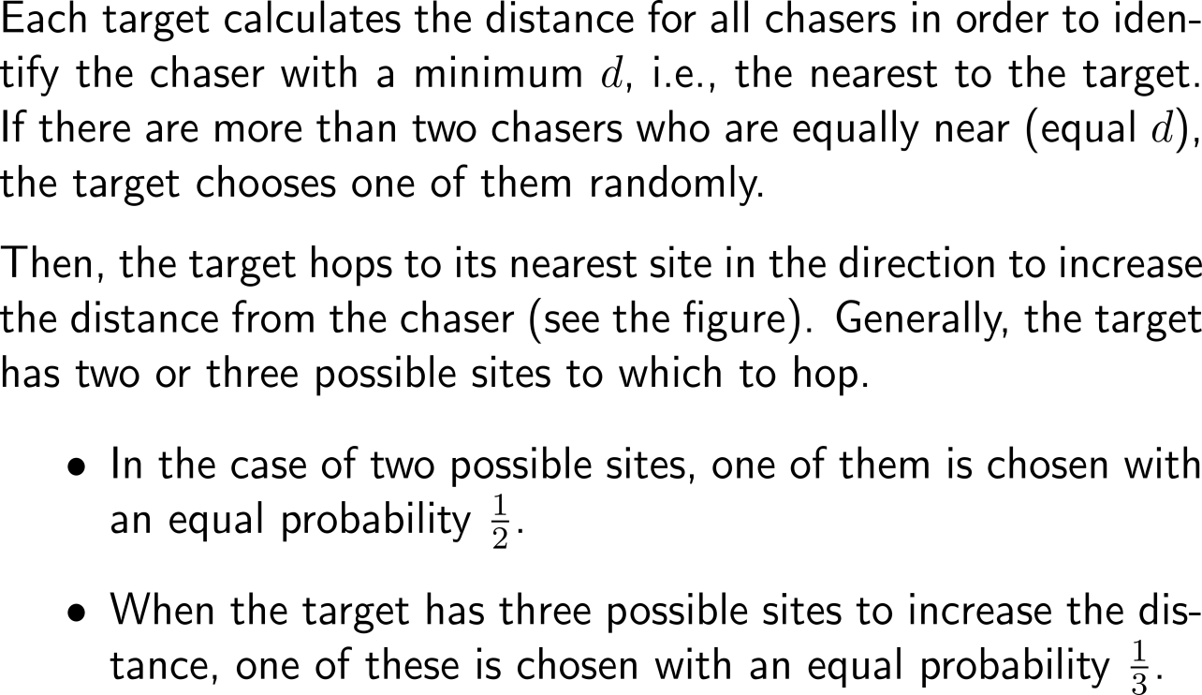
The basic model of group chase and escape (2/ 4)
¹/₂
¹/₃
T
T
¹/₂
¹/₃
¹/₃
C
C
Movement rules for targets: hop to evade the nearest chaser.

Slide 6
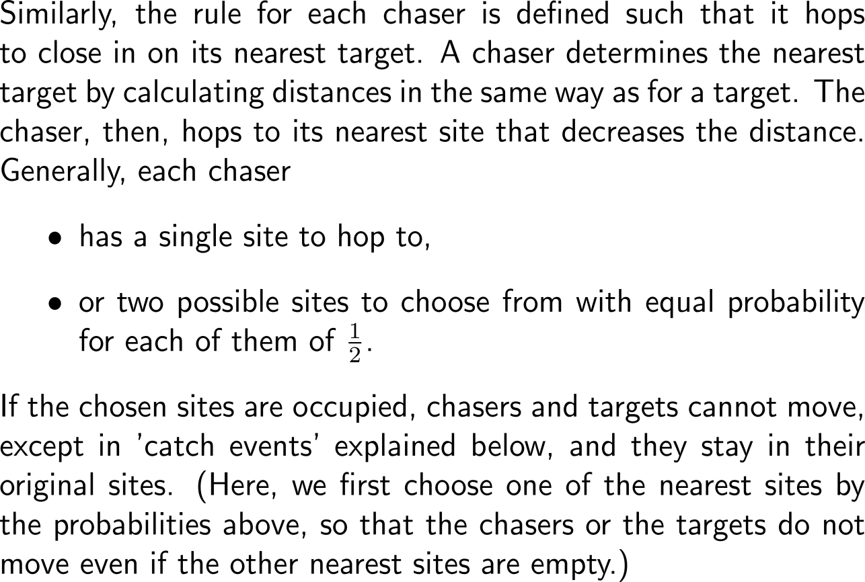
The basic model of group chase and escape (3/ 4)
T
T
¹/₂
1
¹/₂
C
C
Movement rules for chasers: hop to evade the nearest chaser.

Slide 7
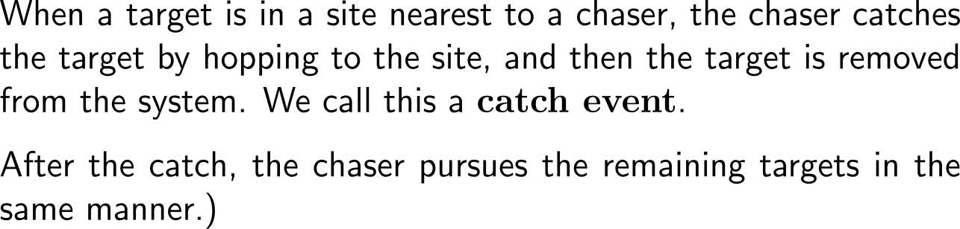
The basic model of group chase and escape (4/ 4)
T
C
C
The catch event

Slide 8
Sub-Agenda: The Basic Model of Chase & Escape
The Computerized Model
Simulations
The implemented model is a toroidal lattice pursuit-evasion system with random tie-breaking, sequential within-species updates, blocked-motion handling, and capture realized only by explicit chaser hops onto target cells.

Slide 9
The modular program structure follows our previous architectures
setup.py
chase_escape/
script that automatically creates all the folders and files (correct names, but empty)
main.py
config/
README.md
__initi__.py
requirenments.txt
visualization/
config.py
core/
__init__.py
snapshots.py
analysis/
movement.py
plotters.py
__init__.py
capture.py
animation.py
__init__.py
lattice.py
simulation.py
observables.py
agents.py
tests/
utils.py
reporter.py
distance.py

Slide 10
Here, the single files contain the information necessary to simulate the basic chase and escape model (1/ 2)
main.py
config/config.py
core/lattice.py
core/agents.py
core/distance.py
Main file
supported by
README.md
requirenments.txt
Stores:
lattice size
numbers of chasers and targets
number of time steps
random seed
visualization settings
debug flag
Responsible for:
creating the lattice
toroidal wrapping
occupancy checks
placing and removing agents
querying whether a site is empty or occupied
Defines classes such as
target and
chaser
Each agent should minimally have
unique id,
position (x, y),
active/ alive status for targets
Implements:
Euclidean distance on a torus
nearest chaser to a target
nearest target to a chaser
tie handling support
core/movement.py
core/capture.py
core/simulation.py
analysis/observables.py
Contains the local movement rules:
candidate neighboring sites
target evasion rule
chaser pursuit rule
random tie resolution for equally good moves
blocked move handling
Handles the catch event:
detect whether a target is on a nearest site to a chaser
move chaser onto target site
remove target from the system
The central engine:
initialize state
iterate time steps
update targets
update chasers
resolve captures
record observables
Computes quantities such as:
number of surviving targets over time
number of captures per step
mean nearest chaser-target distance
time to extinction of all targets
spatial clustering measures, if wanted later

Slide 11
Here, the single files contain the information necessary to simulate the basic chase and escape model (2/ 2)
vis…/plotters.py
vis…/animation.py
INITIALIZE lattice, targets, chasers
FOR each time step:
shuffle targets
FOR each alive target:
find nearest chaser(s)
choose one nearest chaser at random
evaluate the 4 neighboring sites
keep those maximizing distance from that chaser
choose one best site at random
move there if empty, otherwise stay
shuffle chasers
FOR each chaser:
find nearest alive target(s)
evaluate the 4 neighboring sites
keep those minimizing distance to the nearest targets
choose one best site at random
if chosen site is empty:
move there
else if chosen site contains a live nearest target:
move onto that site and remove the target
else:
stay
record alive target count and grid snapshot
if no targets remain:
stop
Pseudo-Code Algorithm
Produces:
lattice snapshots
time series plots of targets and chasers
optional trajectories of selected individuals
Produces:
animations
tests/
Test for:
toroidal wrap-around
nearest-agent identification
target move choices
chaser move choices
capture removal
occupancy consistency

Slide 12
Starter prompt
Please help me implement a modular Python simulation of the 2D chase-and-escape model on a square lattice with toroidal boundary conditions.
Important requirements:
Keep the code beginner-friendly.
Separate configuration, lattice logic, distance calculations, movement rules, capture logic, simulation loop, visualization, and tests into different files.
Use only Python, NumPy, matplotlib, and pytest.
At most one particle per site.
Targets move away from their nearest chaser.
Chasers move toward their nearest target.
If several equally good nearest moves exist, choose randomly with equal probability.
If a selected destination is occupied, the agent stays in place.
A chaser catches a target by hopping onto its site when allowed by the model.
Add comments, docstrings, and simple debug printouts.
Avoid overly advanced abstractions.
Make everything easy to test.
AI

Slide 13
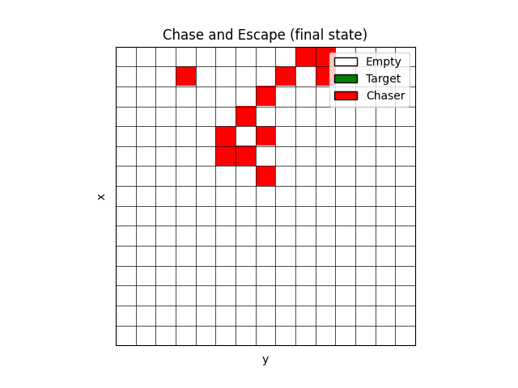
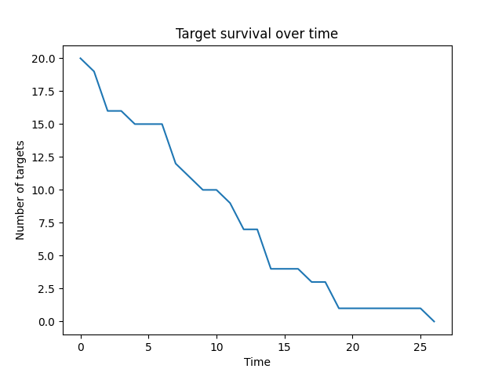
First simulations: Group chase and (unsuccessful) escape
Simulation parameter:
# chaser: 12
# targets: 20
# time steps: 200

Slide 14
Sub-Agenda: The Basic Model of Chase & Escape
The Computerized Model
Simulations

Slide 15
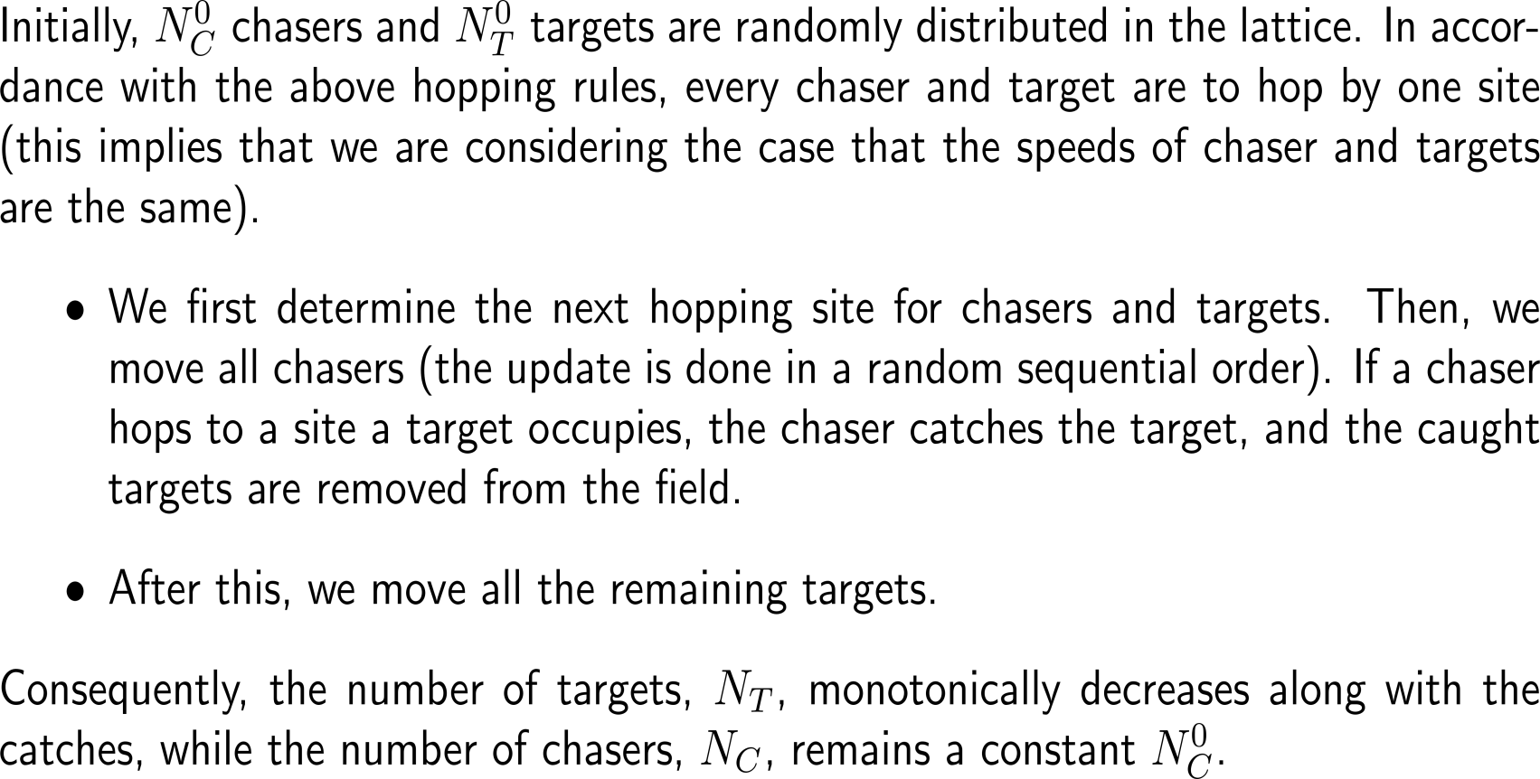
Simulation of the basic model

Slide 16
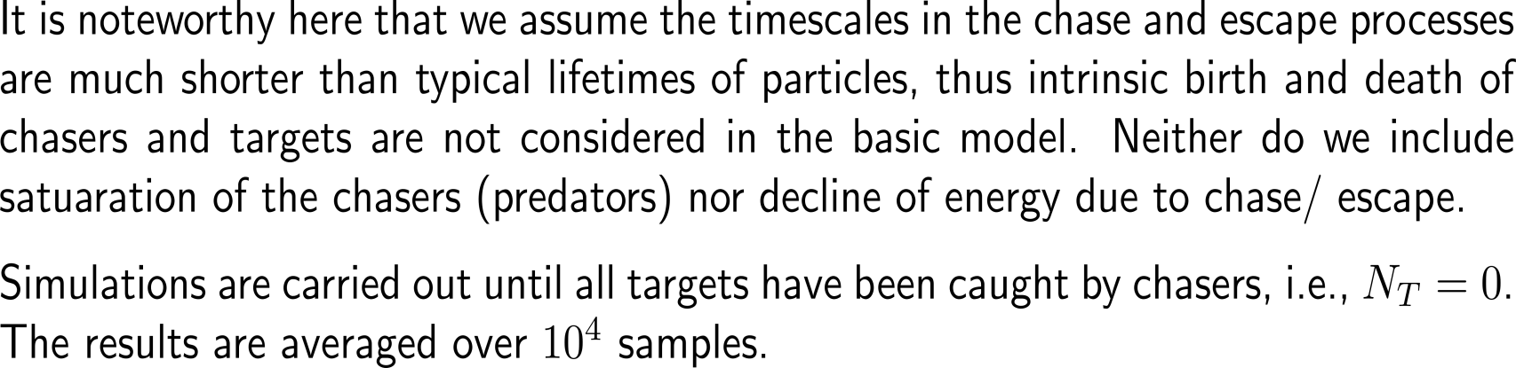
Simulation of the basic model

Slide 17
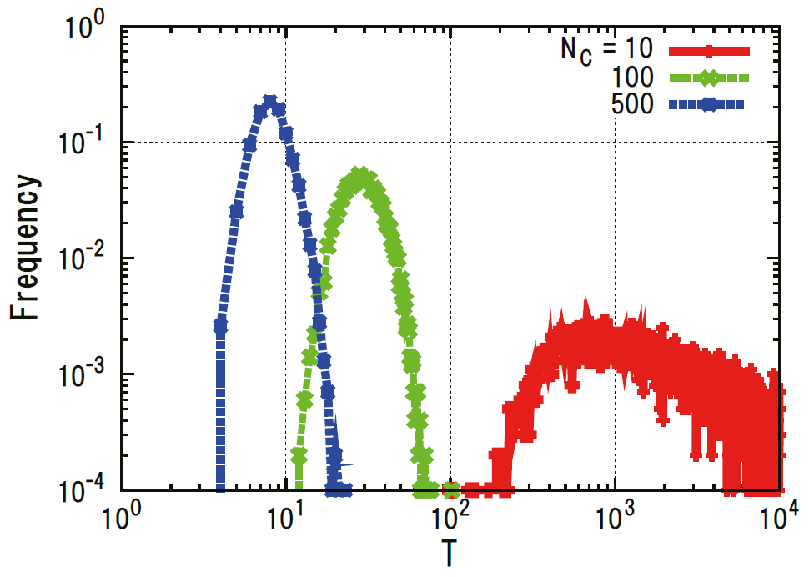
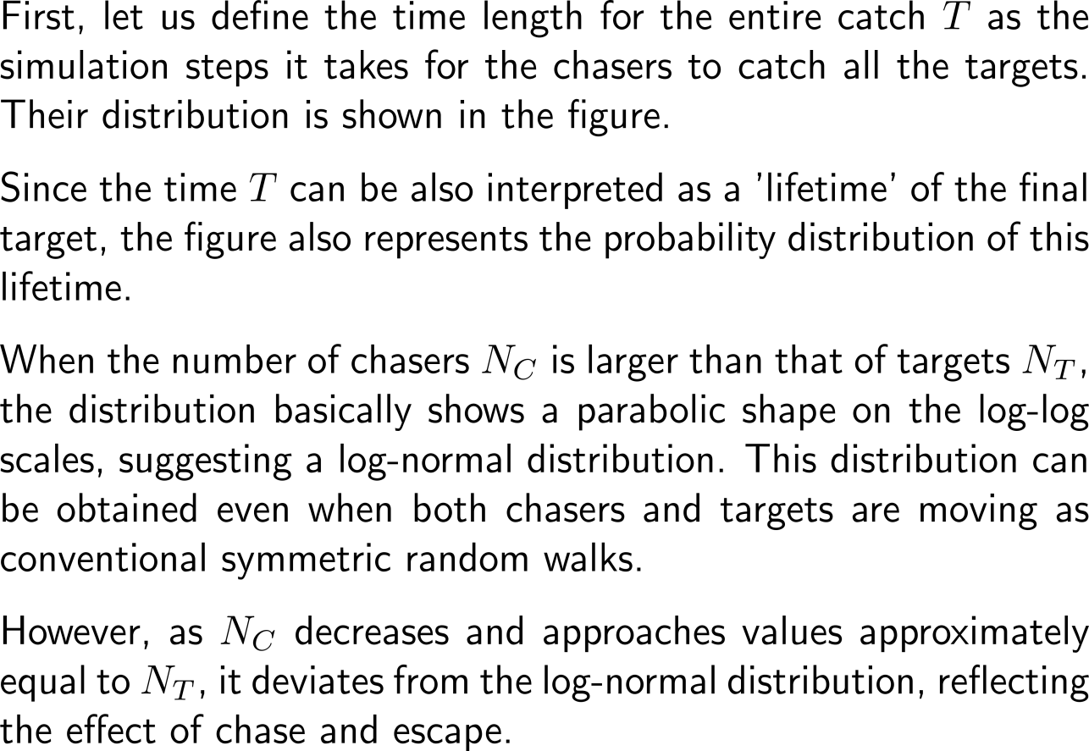
Simulation results: 1) Time until all chasers are caught
Distribution of time for the entire catch T for different numbers of chasers N_{C} = 10, 100, 500.
The grid parameters are L_{X} = L_{Y} = 100 and the initial number of targets is N⁰_{T} = 10.

Slide 18
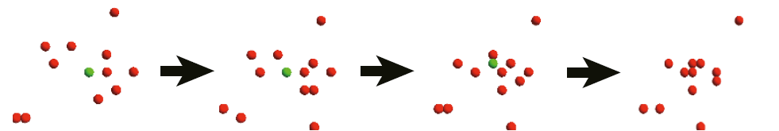
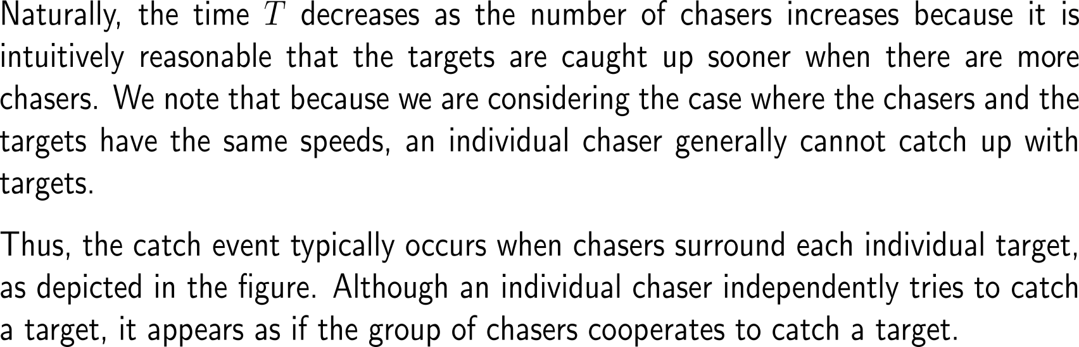
Simulation results: 2) Cooperative chase?
Snapshots of a catch event with time evolution from left to right. Red and green circles denote chasers and target, respectively.

Slide 19
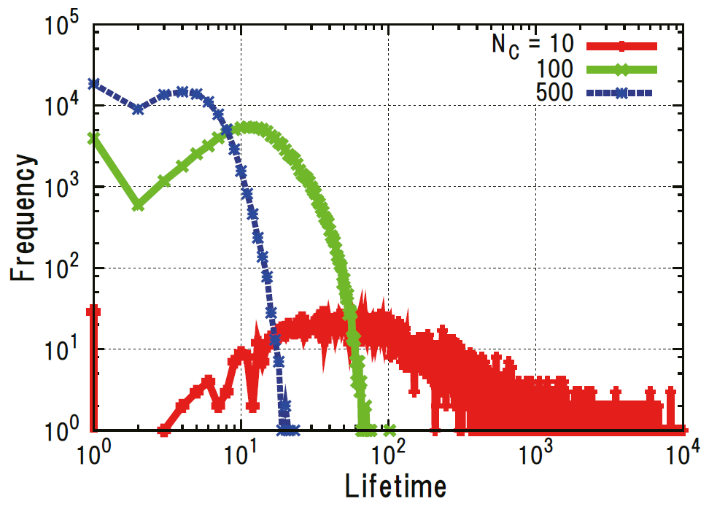
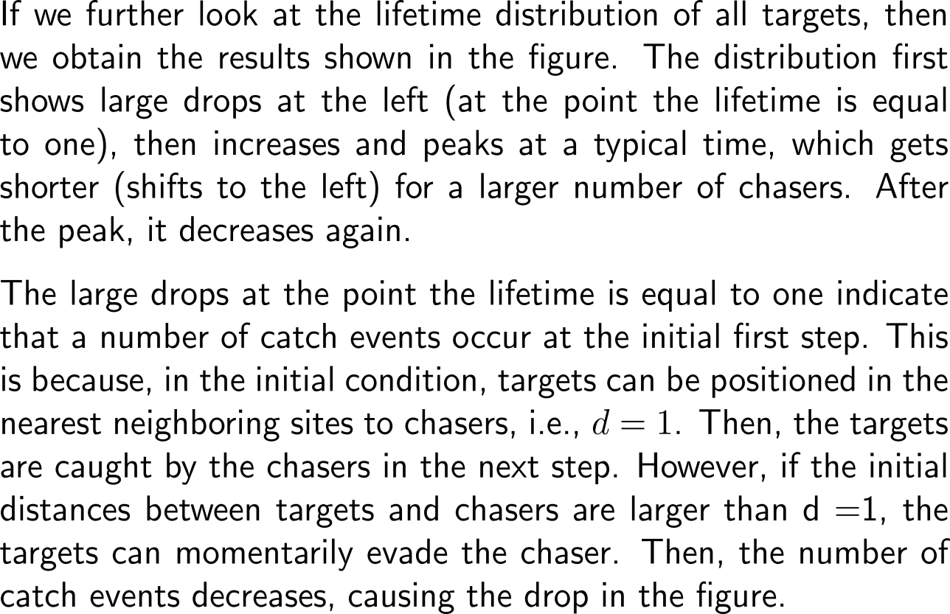
Simulation results: 3) Lifetime distributions of targets
Lifetime distribution of targets for N_{C} = 10, 100, and 500.
Parameters are identical with those of the previous figure.

Slide 20
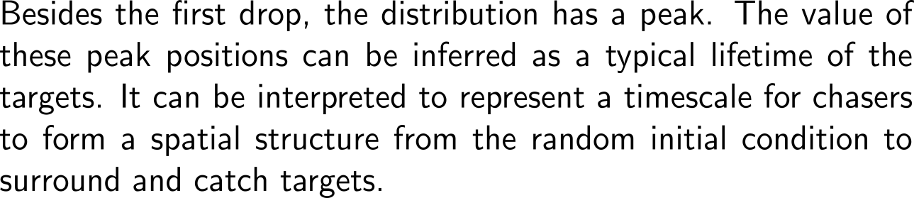
Simulation results: 3) Lifetime distributions of targets
Lifetime distribution of targets for N_{C} = 10, 100, and 500.
Parameters are identical with those of the previous figure.

Slide 21
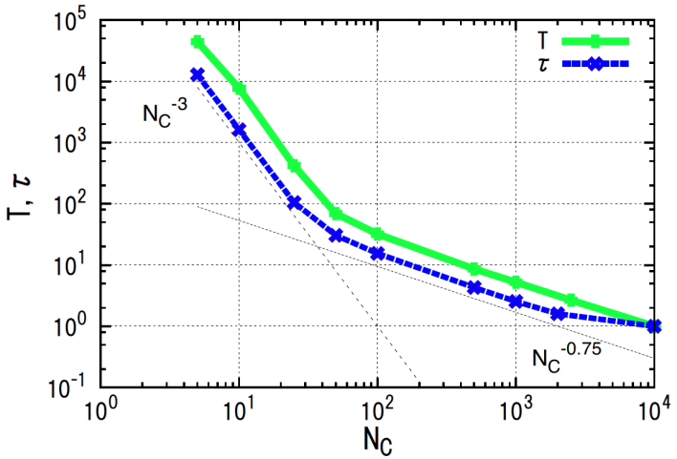
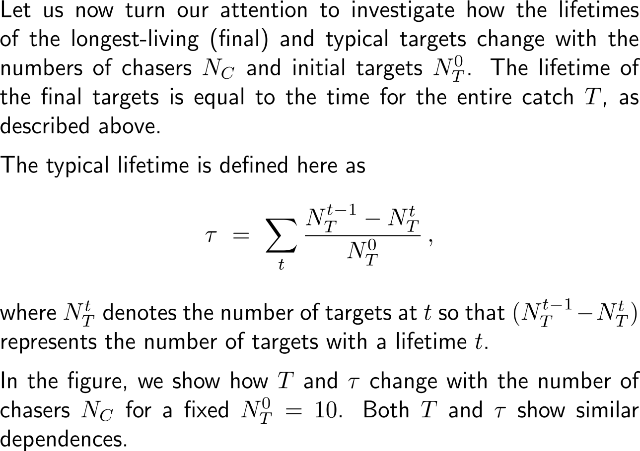
Simulation results: 4) Lifetime distributions of the final targets
Lifetime of final (T) and typical (τ) targets as a function of N_{C} for fixed N_{T} = 10.
The power-law dependences of N⁻³_{C} and N^{-0.75}_{C} are also shown as dotted lines.

Slide 22
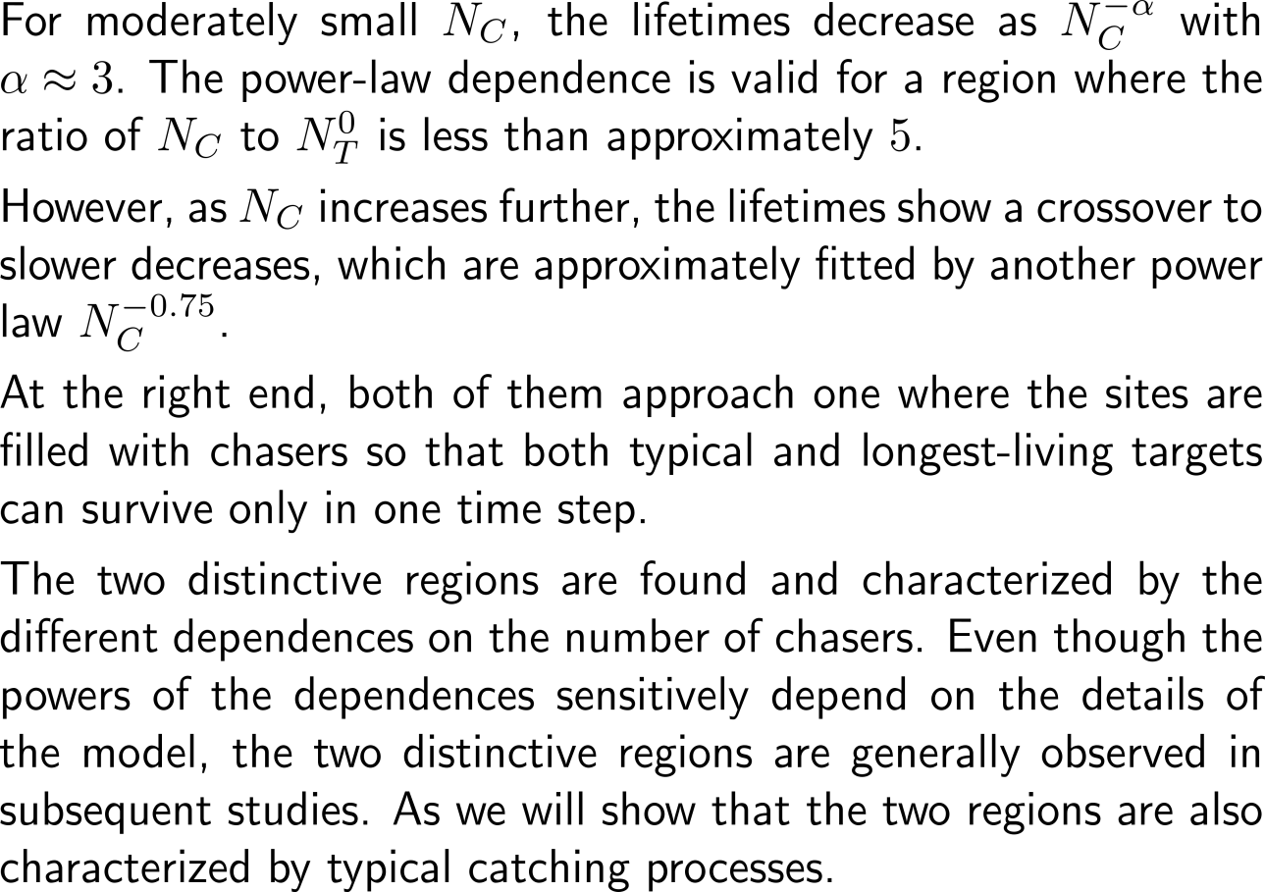
Simulation results: 4) Lifetime distributions of the final targets
Lifetime of final (T) and typical (τ) targets as a function of N_{C} for fixed N_{T} = 10.
The power-law dependences of N⁻³_{C} and N^{-0.75}_{C} are also shown as dotted lines.

Slide 23
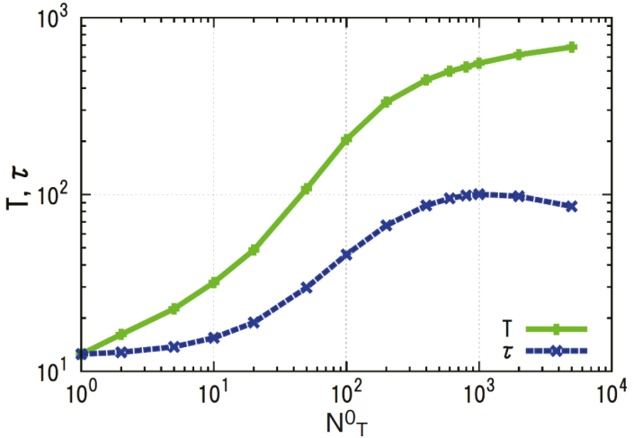
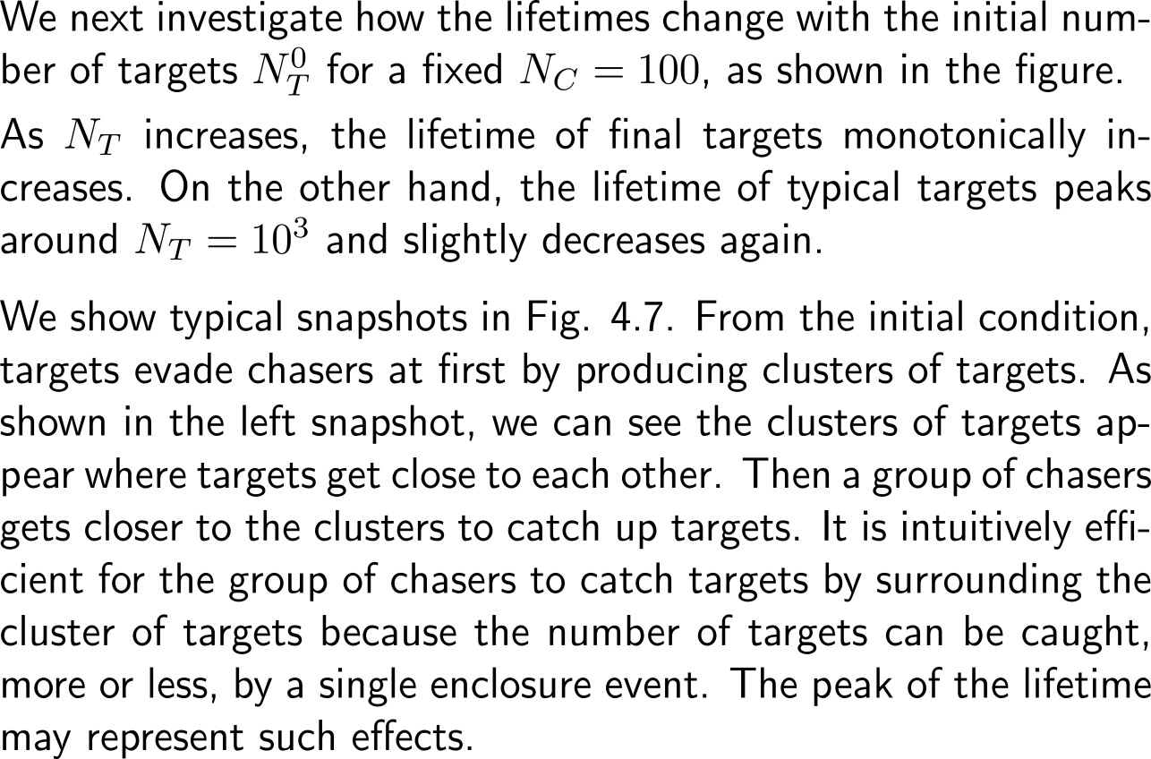
Simulation results: 5) Lifetime compared to the initial number of targets
Lifetime of final (T) and typical (τ) targets as a function of N_{T} for fixed N_{C} = 100.

Slide 24
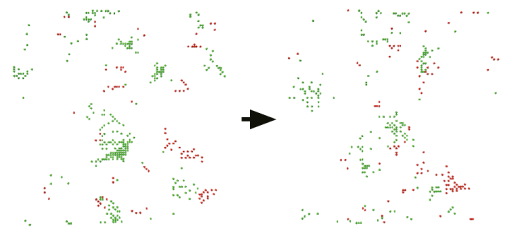
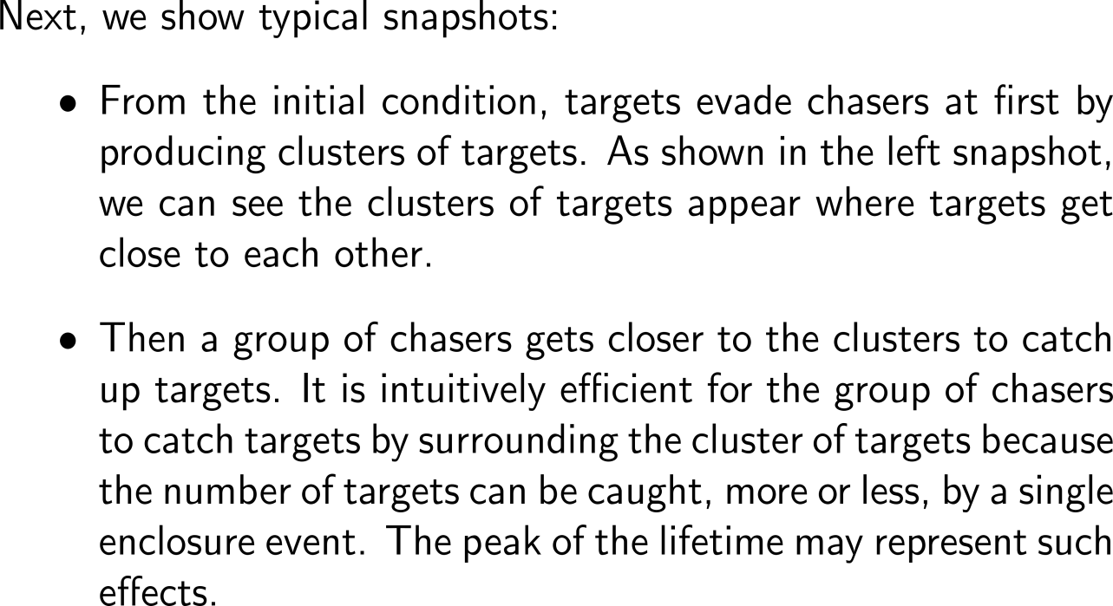
Simulation results: 6) Cluster emergence during the chasing and escaping process
Snapshots of the system for N_{C} = 100 and N⁰_{T} = 1000.
Red and green points represent chasers and targets, respectively.
Clusters of targets are typically observed during the chasing and escaping processes.

Slide 25
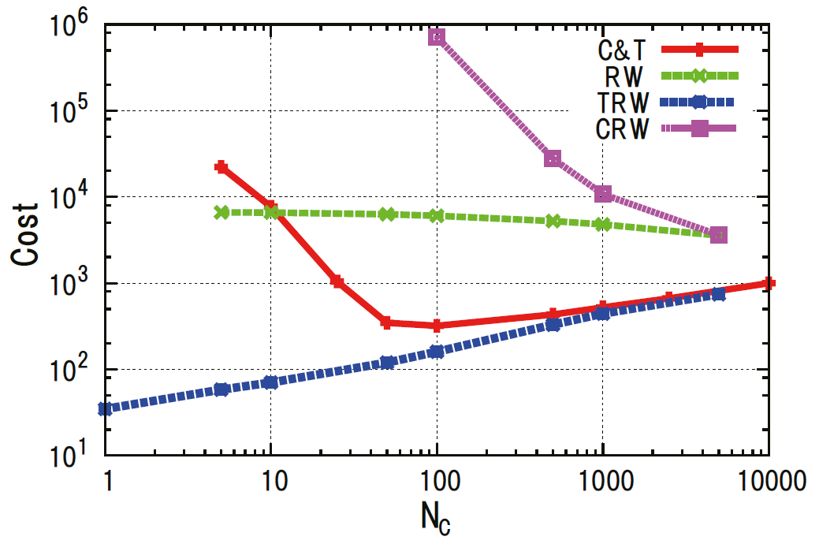
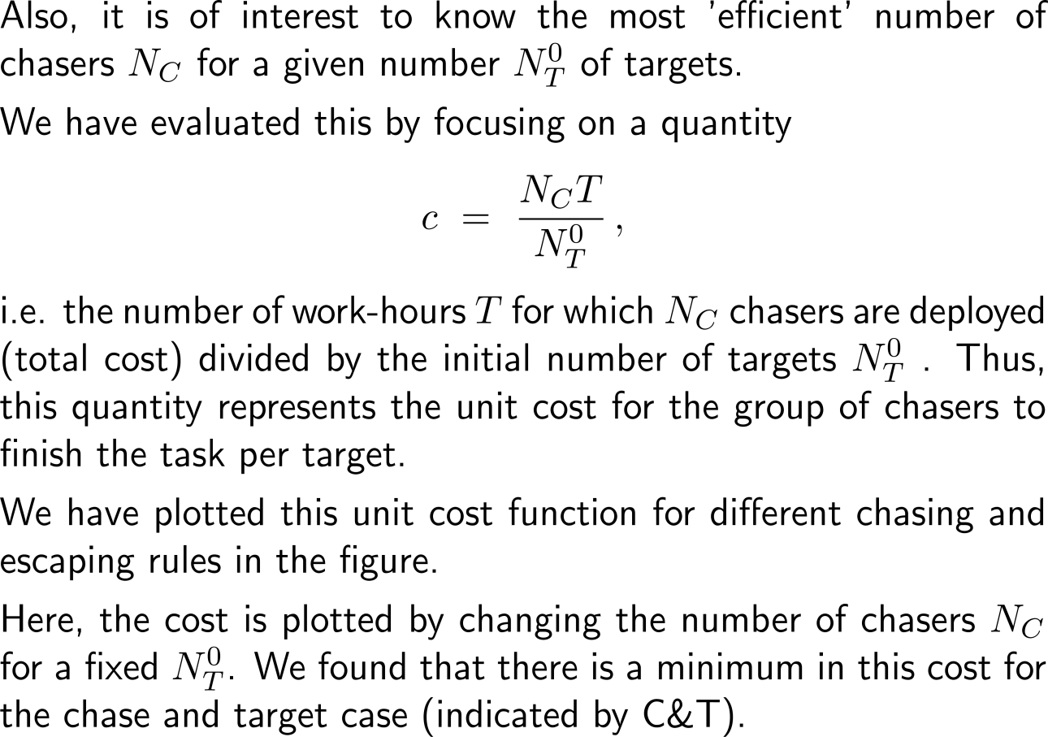
Simulation results: 7) Cost efficiency of chasing
Cost c = N_{C}T/N⁰_{T} vs. the number of chasers N_{C} for N⁰_{T} = 10 in following four cases:
the original chasers and targets (C&T),
both chasers and targets are random walkers (RW),
targets are random walkers (TRW), and
chasers are random walkers (CRW).

Slide 26
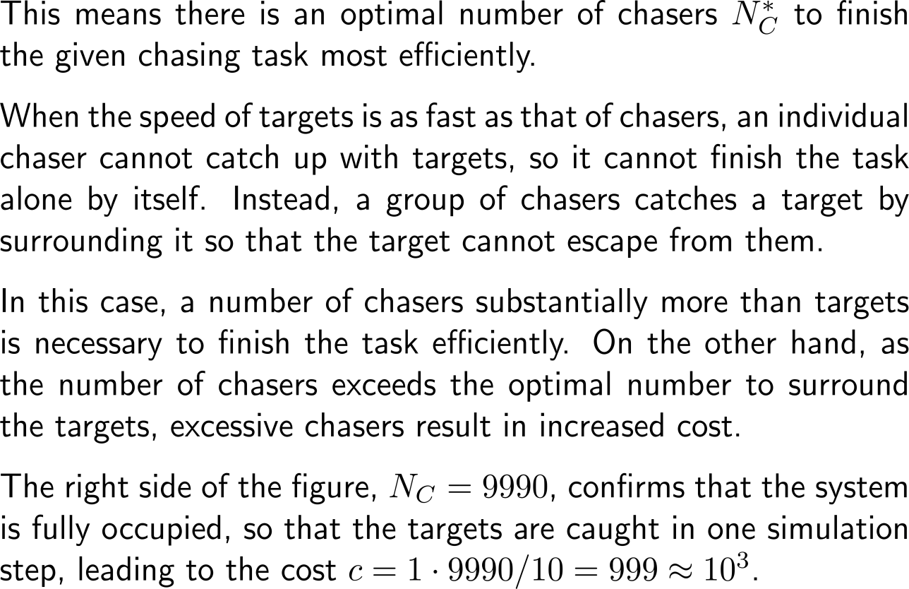
Simulation results: 7) Cost efficiency of chasing
Cost c = N_{C}T/N⁰_{T} vs. the number of chasers N_{C} for N⁰_{T} = 10 in following four cases:
the original chasers and targets (C&T),
both chasers and targets are random walkers (RW),
targets are random walkers (TRW), and
chasers are random walkers (CRW).

Slide 27
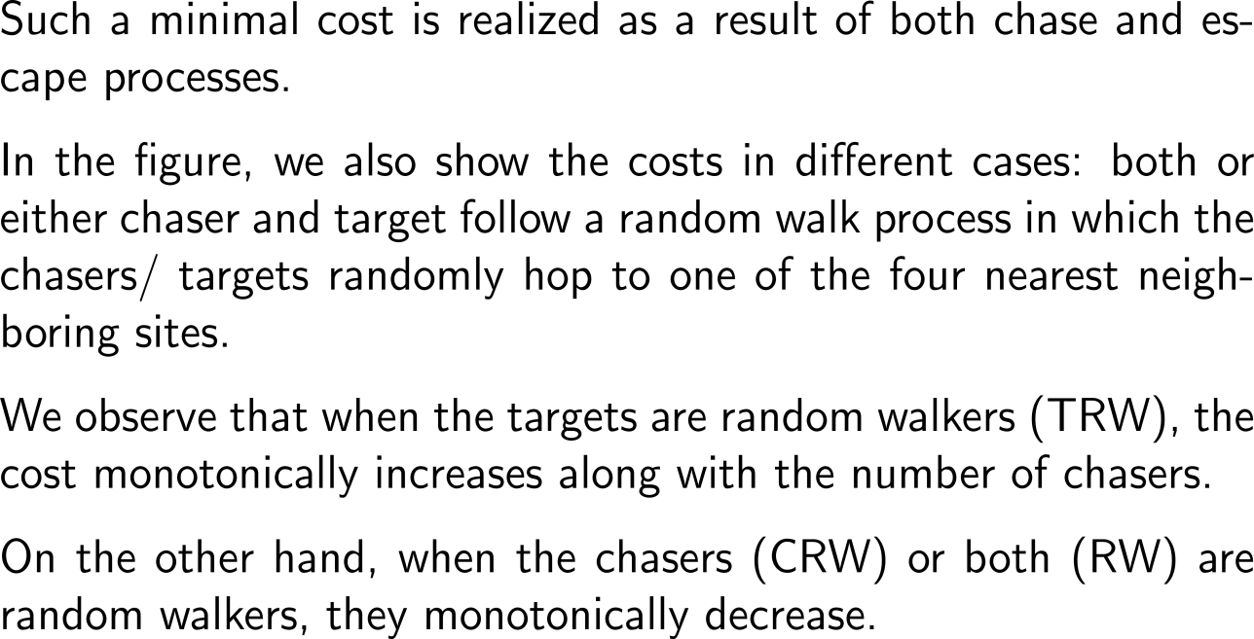
Simulation results: 7) Cost efficiency of chasing
Cost c = N_{C}T/N⁰_{T} vs. the number of chasers N_{C} for N⁰_{T} = 10 in following four cases:
the original chasers and targets (C&T),
both chasers and targets are random walkers (RW),
targets are random walkers (TRW), and
chasers are random walkers (CRW).

Slide 28
Computational Biomathematics
florian.rupp@kiu.edu.ge

