Slide 1


Fourier Growth of Parity Decision Trees
Kewen Wu (UC Berkeley)
Joint with Uma Girish (Princeton) and Avishay Tal (UC Berkeley)

Slide 2






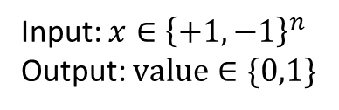


































Decision Trees and Parity Decision Trees
$$x_{1}$$
$$x_{1}x_{2}$$
Input: $x∈{\left\{+1,−1\right\}}^{n}$
Output: $value∈\{0,1\}$
$$−1$$
$$+1$$
$$−1$$
$$+1$$
$$x_{2}$$
$$x_{3}$$
$$x_{2}$$
$$x_{3}$$
$$−1$$
$$+1$$
$$−1$$
$$+1$$
$$−1$$
$$+1$$
$$−1$$
$$+1$$
$$x_{3}$$
$$x_{4}$$
$$x_{5}$$
$$x_{3}x_{5}$$
$$x_{4}$$
$$x_{1}x_{5}$$
$$1$$
$$1$$
$$−1$$
$$+1$$
$$−1$$
$$+1$$
$$−1$$
$$+1$$
$$−1$$
$$+1$$
$$−1$$
$$+1$$
$$−1$$
$$+1$$
$$x_{2}$$
$$x_{2}x_{3}x_{6}$$
$$1$$
$$0$$
$$1$$
$$1$$
$$1$$
$$1$$
$$0$$
$$1$$
$$1$$
$$1$$
$$−1$$
$$+1$$
$$−1$$
$$+1$$
$$0$$
$$1$$
$$0$$
$$1$$
Decision tree
Parity decision tree

Slide 3
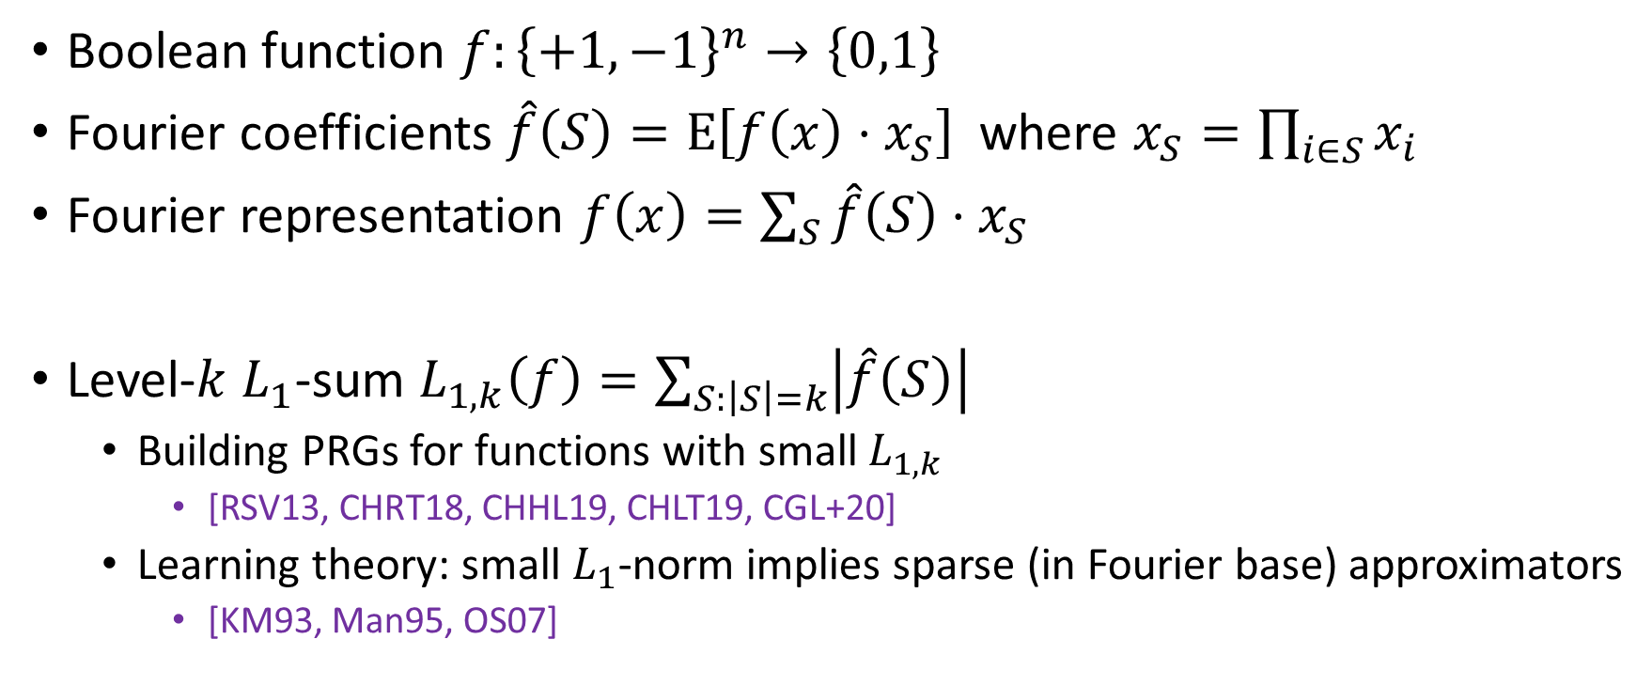
Fourier Basics
Boolean function $f:{\left\{+1,−1\right\}}^{n}→\left\{0,1\right\}$
Fourier coefficients $\hat{f}\left(S\right)=E\left[f\left(x\right)⋅x_{S}\right]$ where $x_{S}=\prod_{i∈S}{x_{i}}$
Fourier representation $f\left(x\right)=\sum_{S}{\hat{f}\left(S\right)⋅x_{S}}$
Level-$k$ $L_{1}$-sum $L_{1,k}\left(f\right)=\sum_{S:\left|S\right|=k}{\left|\hat{f}\left(S\right)\right|}$
Building PRGs for functions with small $L_{1,k}$
[RSV13, CHRT18, CHHL19, CHLT19, CGL+20]
Learning theory: small $L_{1}$-norm implies sparse (in Fourier base) approximators
[KM93, Man95, OS07]

Slide 4
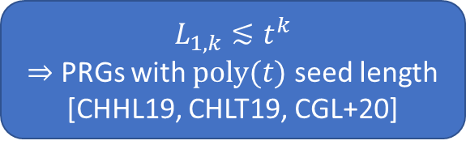
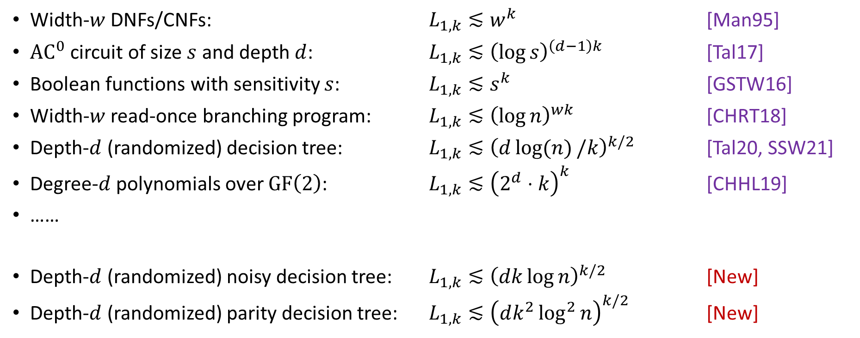

Known Bounds
$L_{1,k}≲t^{k}$
$⇒$ PRGs with $poly(t)$ seed length [CHHL19, CHLT19, CGL+20]
Width-$w$ DNFs/CNFs: $L_{1,k}≲w^{k}$ [Man95]
$AC^{0}$ circuit of size $s$ and depth $d$: $L_{1,k}≲{\left(\log{s}\right)}^{\left(d−1\right)k}$ [Tal17]
Boolean functions with sensitivity $s$: $L_{1,k}≲s^{k}$ [GSTW16]
Width-$w$ read-once branching program: $L_{1,k}≲{\left(\log{n}\right)}^{wk}$ [CHRT18]
Depth-$d$ (randomized) decision tree: $L_{1,k}≲{\left(d\log{(n)}/k\right)}^{k/2}$ [Tal20, SSW21]
Degree-$d$ polynomials over $GF\left(2\right)$: $L_{1,k}≲{\left(2^{d}⋅k\right)}^{k}$ [CHHL19]
……
Depth-$d$ (randomized) noisy decision tree: $L_{1,k}≲{\left(dk\log{n}\right)}^{k/2}$ [New]
Depth-$d$ (randomized) parity decision tree: $L_{1,k}≲{\left(dk^{2}\log^{2}{n}\right)}^{k/2}$ [New]
The dependence on $d$ is optimal

Slide 5
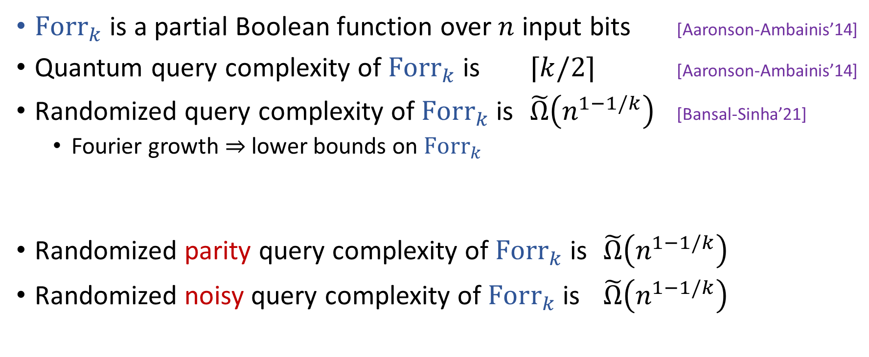
Quantum vs Parity Query Complexity
$Fo{rr}_{k}$ is a partial Boolean function over $n$ input bits [Aaronson-Ambainis’14]
Quantum query complexity of ${Forr}_{k}$ is $⌈k/2⌉$ [Aaronson-Ambainis’14]
Randomized query complexity of $Forr_{k}$ is $\tilde{Ω}\left(n^{1−1/k}\right)$ [Bansal-Sinha’21]
Fourier growth $⇒$ lower bounds on $Forr_{k}$
Randomized parity query complexity of $Forr_{k}$ is $\tilde{Ω}\left(n^{1−1/k}\right)$
Randomized noisy query complexity of $Forr_{k}$ is $\tilde{Ω}\left(n^{1−1/k}\right)$
Optimal separation

Slide 6
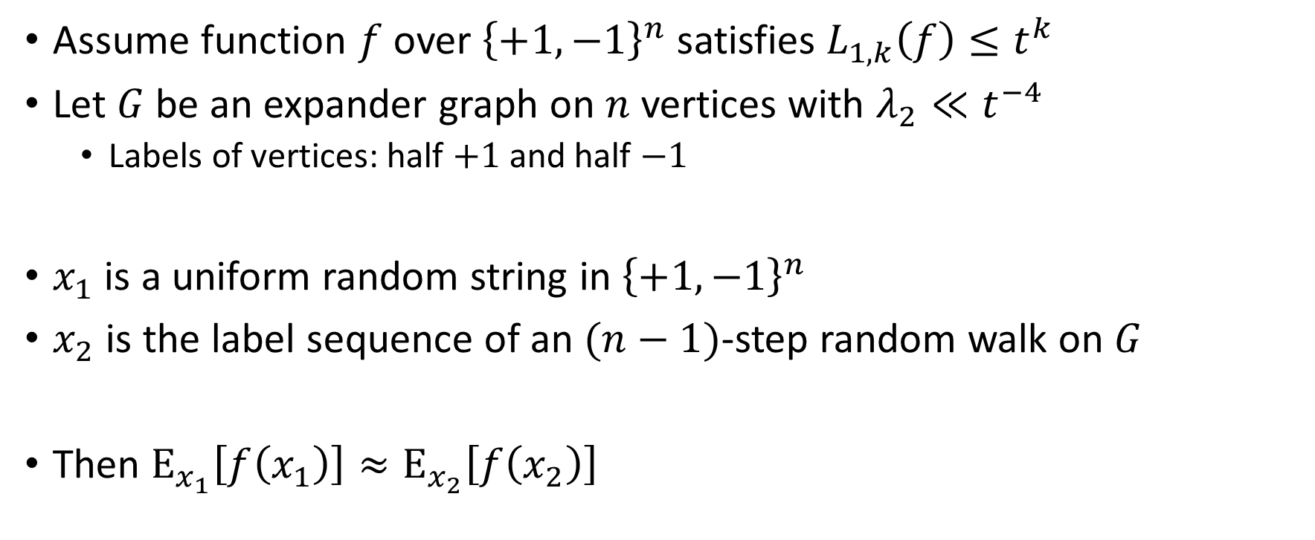
Expander Random Walks [Cohen, Peri, Ta-Shma’21]
Fourier growth of PDTs and NDTs
Assume function $f$ over ${\left\{+1,−1\right\}}^{n}$ satisfies $L_{1,k}\left(f\right)≤t^{k}$
Let $G$ be an expander graph on $n$ vertices with $λ_{2}≪t^{−4}$
Labels of vertices: half $+1$ and half $−1$
$x_{1}$ is a uniform random string in ${\left\{+1,−1\right\}}^{n}$
$x_{2}$ is the label sequence of an $(n−1)$-step random walk on $G$
Then $E_{x_{1}}\left[f\left(x_{1}\right)\right]≈E_{x_{2}}\left[f\left(x_{2}\right)\right]$

Slide 7
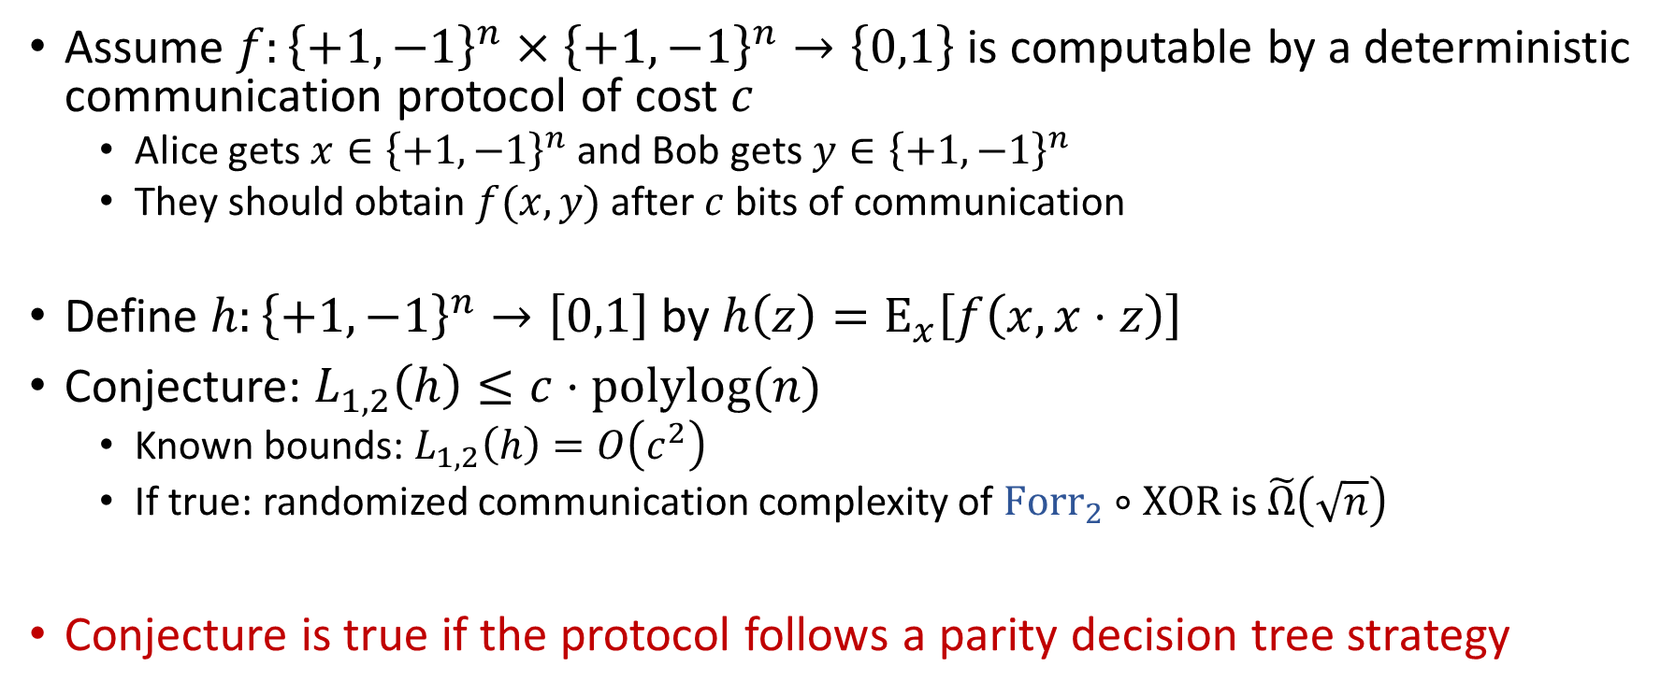
XOR-lifting in Communication Protocols [Girish-Raz-Tal’21]
Assume $f:{\left\{+1,−1\right\}}^{n}×{\left\{+1,−1\right\}}^{n}→\left\{0,1\right\}$ is computable by a deterministic communication protocol of cost $c$
Alice gets $x∈{\left\{+1,−1\right\}}^{n}$ and Bob gets $y∈{\left\{+1,−1\right\}}^{n}$
They should obtain $f(x,y)$ after $c$ bits of communication
Define $h:{\left\{+1,−1\right\}}^{n}→\left[0,1\right]$ by $h\left(z\right)=E_{x}\left[f\left(x,x⋅z\right)\right]$
Conjecture: $L_{1,2}\left(h\right)≤c⋅polylog(n)$
Known bounds: $L_{1,2}\left(h\right)=O\left(c^{2}\right)$
If true: randomized communication complexity of $Forr_{2}∘XOR$ is $\tilde{Ω}\left(\sqrt{n}\right)$
Conjecture is true if the protocol follows a parity decision tree strategy

Slide 8

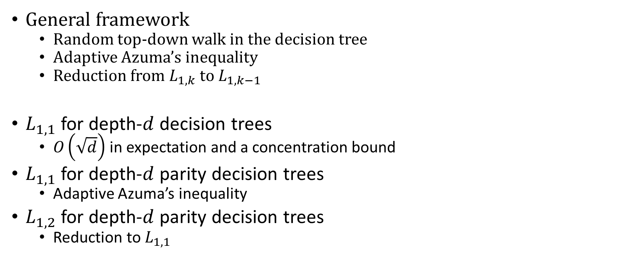
Technical Overview
General framework
Random top-down walk in the decision tree
Adaptive Azuma’s inequality
Reduction from $L_{1,k}$ to $L_{1,k−1}$
$L_{1,1}$ for depth-$d$ decision trees
$O\left(\sqrt{d}\right)$ in expectation and a concentration bound
$L_{1,1}$ for depth-$d$ parity decision trees
Adaptive Azuma’s inequality
$L_{1,2}$ for depth-$d$ parity decision trees
Reduction to $L_{1,1}$
$$L_{1,k}\left(f\right)=\sum_{S:\left|S\right|=k}{\left|\hat{f}\left(S\right)\right|}$$

Slide 9




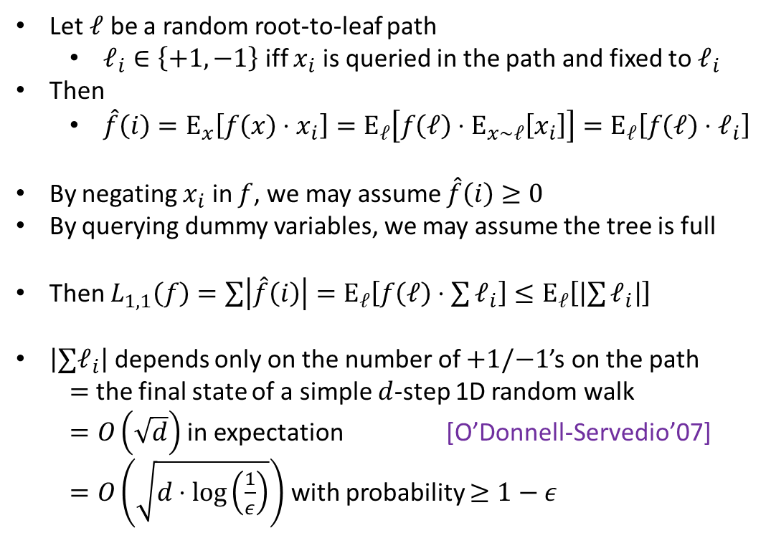
Proof Overview - $L_{1,1}\text{≲}\sqrt{d}$ for decision trees
$$x_{1}$$
Let $ℓ$ be a random root-to-leaf path
$ℓ_{i}∈\left\{+1,−1\right\}$ iff $x_{i}$ is queried in the path and fixed to $ℓ_{i}$
Then
$\hat{f}\left(i\right)=E_{x}\left[f\left(x\right)⋅x_{i}\right]=E_{ℓ}\left[f\left(ℓ\right)⋅E_{x∼ℓ}\left[x_{i}\right]\right]=E_{ℓ}\left[f\left(ℓ\right)⋅ℓ_{i}\right]$
By negating $x_{i}$ in $f$, we may assume $\hat{f}\left(i\right)≥0$
By querying dummy variables, we may assume the tree is full
Then $L_{1,1}\left(f\right)=\sum{\left|\hat{f}\left(i\right)\right|}=E_{ℓ}\left[f\left(ℓ\right)⋅\sum{ℓ_{i}}\right]≤E_{ℓ}\left[\left|\sum{ℓ_{i}}\right|\right]$
$\left|∑ℓ_{i}\right|$ depends only on the number of $+1/−1$’s on the path
$=$ the final state of a simple $d$-step 1D random walk
$=O\left(\sqrt{d}\right)$ in expectation [O’Donnell-Servedio’07]
$=O\left(\sqrt{d⋅\log\left(\frac{1}{ε}\right)}\right)$ with probability $≥1−ε$
$$−1$$
$$+1$$
$$x_{2}$$
$$x_{3}$$
$$−1$$
$$+1$$
$$−1$$
$$+1$$
$$x_{3}$$
$$x_{5}$$
$$x_{4}$$
$$−1$$
$$+1$$
$$−1$$
$$+1$$
$$−1$$
$$+1$$
$$−1$$
$$+1$$
$$ℓ_{1}=ℓ_{3}=+1, ℓ_{4}=−1$$

Slide 10
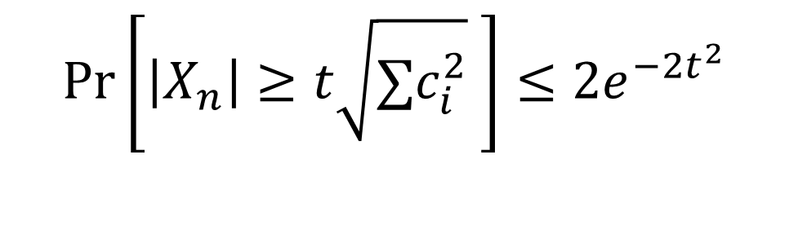

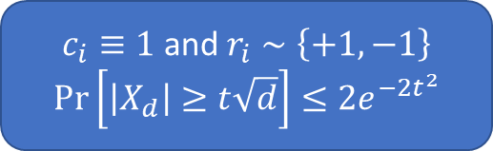
Standard Azuma’s Inequality
$X_{0}=0$ and $X_{i}=X_{i−1}+δ_{i}⋅r_{i}$ for $i=1,2,…$
$δ_{i}$ is a fixed value given $r_{1},r_{2},…, r_{i−1}$
$r_{i}$’s are independent random variable with $\left|r_{i}\right|≤1$ and $E\left[r_{i}\right]=0$
Standard Azuma’s inequality:
If $\left|δ_{i}\right|≤c_{i}$ almost surely for all $i$, then
$c_{i}≡1$ and $r_{i}∼\left\{+1,−1\right\}$
$$\operatorname{Pr}\left[\left|X_{d}\right|≥t\sqrt{d}\right]≤2e^{−2t^{2}}$$
$$\operatorname{Pr}\left[\left|X_{n}\right|≥t\sqrt{∑c_{i}^{2}} \right]≤{2e}^{−2t^{2}}$$

Slide 11




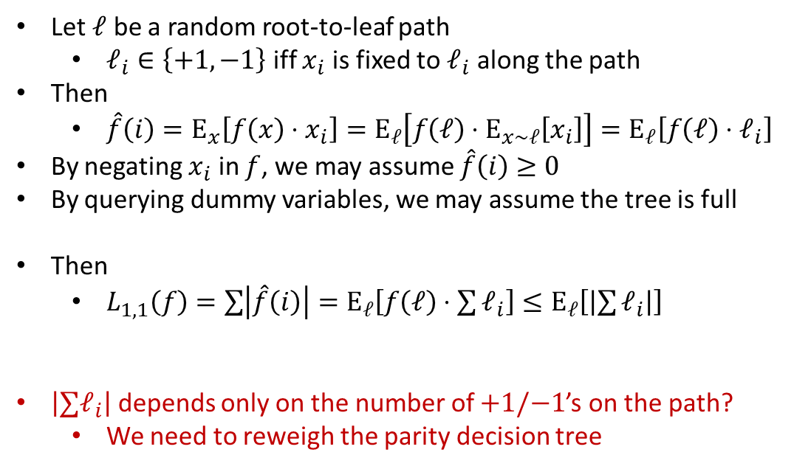


Proof Overview - $L_{1,1}\text{≲}\sqrt{d}$ for parity decision trees
$$x_{1}x_{2}x_{5}$$
Let $ℓ$ be a random root-to-leaf path
$ℓ_{i}∈\left\{+1,−1\right\}$ iff $x_{i}$ is fixed to $ℓ_{i}$ along the path
Then
$\hat{f}\left(i\right)=E_{x}\left[f\left(x\right)⋅x_{i}\right]=E_{ℓ}\left[f\left(ℓ\right)⋅E_{x∼ℓ}\left[x_{i}\right]\right]=E_{ℓ}\left[f\left(ℓ\right)⋅ℓ_{i}\right]$
By negating $x_{i}$ in $f$, we may assume $\hat{f}\left(i\right)≥0$
By querying dummy variables, we may assume the tree is full
Then
$L_{1,1}\left(f\right)=\sum{\left|\hat{f}\left(i\right)\right|}=E_{ℓ}\left[f\left(ℓ\right)⋅\sum{ℓ_{i}}\right]≤E_{ℓ}\left[\left|\sum{ℓ_{i}}\right|\right]$
$\left|∑ℓ_{i}\right|$ depends only on the number of $+1/−1$’s on the path?
We need to reweigh the parity decision tree
$$−1$$
$$+1$$
$$x_{2}$$
$$x_{3}x_{4}$$
$$−1$$
$$+1$$
$$−1$$
$$+1$$
$$x_{5}$$
$$x_{5}$$
$$x_{4}$$
$$−1$$
$$−1$$
$$+1$$
$$−1$$
$$+1$$
$$−1$$
$$+1$$
$$+1$$
$$ℓ_{2}=−1,ℓ_{5}=ℓ_{1}=+1$$
$$ℓ_{5}=+1$$

Slide 12




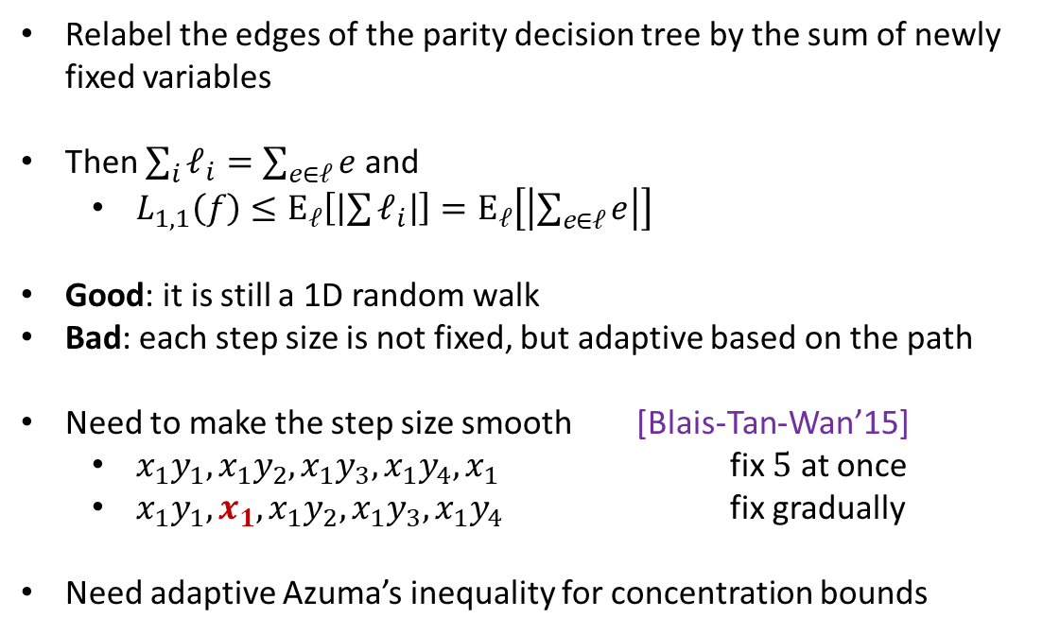





Proof Overview - $L_{1,1}\text{≲}\sqrt{d}$ for parity decision trees
$$x_{1}x_{2}x_{5}$$
Relabel the edges of the parity decision tree by the sum of newly fixed variables
Then $\sum_{i}{ℓ_{i}}=\sum_{e∈ℓ}{e}$ and
$L_{1,1}\left(f\right)≤E_{ℓ}\left[\left|\sum{ℓ_{i}}\right|\right]=E_{ℓ}\left[\left|\sum_{e∈ℓ}{e}\right|\right]$
Good: it is still a 1D random walk
Bad: each step size is not fixed, but adaptive based on the path
Need to make the step size smooth [Blais-Tan-Wan’15]
$x_{1}y_{1}, x_{1}y_{2}, x_{1}y_{3}, x_{1}y_{4}, x_{1}$ fix $5$ at once
$x_{1}y_{1}, x_{1}, x_{1}y_{2}, x_{1}y_{3}, x_{1}y_{4}$ fix gradually
Need adaptive Azuma’s inequality for concentration bounds
$$x_{2}=−1$$
$$0$$
$$0$$
$$x_{2}$$
$$x_{3}x_{4}$$
$$−1$$
$$+1$$
$$0$$
$$0$$
$$x_{5}$$
$$x_{5}$$
$$x_{4}$$
$$−2$$
$$−1$$
$$+1$$
$$−1$$
$$+1$$
$$−2$$
$$+2$$
$$+2$$
$$x_{1}=x_{5}=+1$$

Slide 13




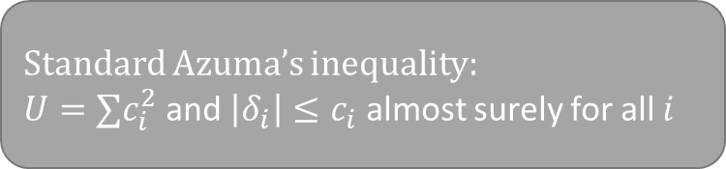
Adaptive Azuma’s Inequality [new]
$X_{0}=0$ and $X_{i}=X_{i−1}+δ_{i}⋅r_{i}$ for $i=1,2,…$
$δ_{i}$ is a fixed value given $r_{1},r_{2},…, r_{i−1}$
$r_{i}$’s are independent random variable with $\left|r_{i}\right|≤1$ and $E\left[r_{i}\right]=0$
Adaptive Azuma’s inequality:
If $\sum_{i=1}^{n}{{\left|δ_{i}\right|}^{2}}≤U$ almost surely, then
Standard Azuma’s inequality:
$U=∑c_{i}^{2}$ and $\left|δ_{i}\right|≤c_{i}$ almost surely for all $i$
w.p at least $1−ε$
$$\operatorname{Pr}\left[\left|X_{n}\right|≥t\sqrt{U} \right]≤{2e}^{−2t^{2}}$$
$$+ε$$

Slide 14



















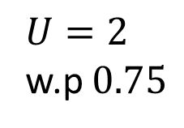
$U=2$
w.p $0.75$
$$0$$
$$0$$
$$c_{1}=0$$
$$−1$$
$$+1$$
$$0$$
$$0$$
$$c_{2}=1$$
$$∑c_{i}^{2}=5$$
$$+1$$
$$−2$$
$$+2$$
$$c_{3}=2$$
$$−1$$
$$−1$$
$$+1$$
$$−1$$
$$+1$$
$$U=4$$

Slide 15
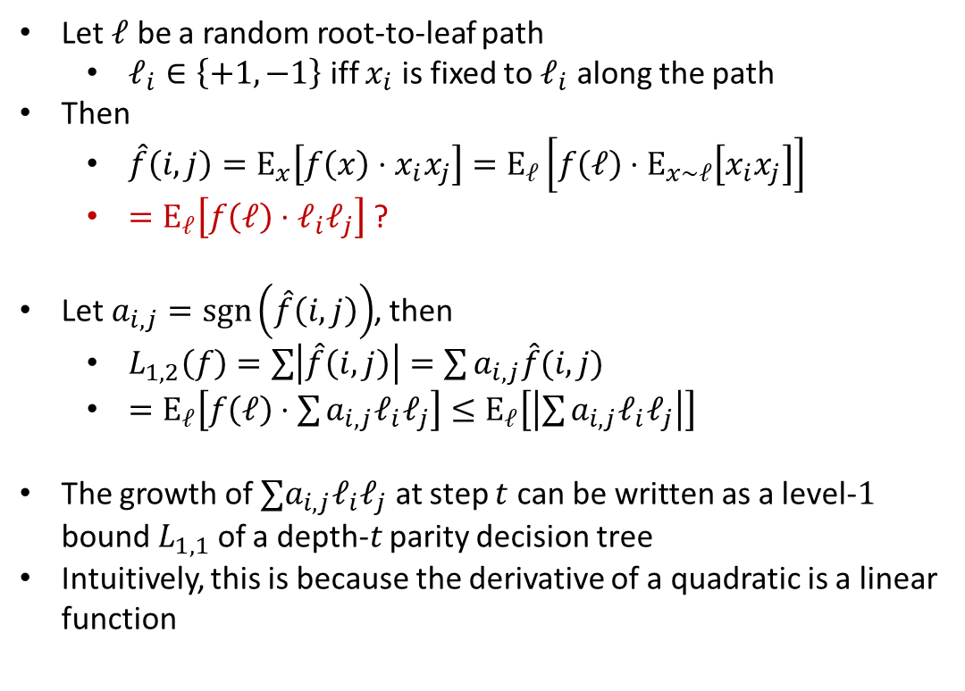





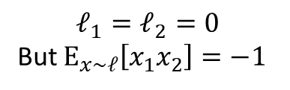


Proof Overview - $L_{1,2}$ for parity decision trees
$${x_{1}x}_{2}$$
Let $ℓ$ be a random root-to-leaf path
$ℓ_{i}∈\left\{+1,−1\right\}$ iff $x_{i}$ is fixed to $ℓ_{i}$ along the path
Then
$\hat{f}\left(i,j\right)=E_{x}\left[f\left(x\right)⋅x_{i}x_{j}\right]=E_{ℓ}\left[f\left(ℓ\right)⋅E_{x∼ℓ}\left[x_{i}x_{j}\right]\right]$
$=E_{ℓ}\left[f\left(ℓ\right)⋅ℓ_{i}ℓ_{j}\right]$ ?
Let $a_{i,j}=\operatorname{sgn}\left(\hat{f}\left(i,j\right)\right)$, then
$L_{1,2}\left(f\right)=\sum{\left|\hat{f}\left(i,j\right)\right|}=\sum{a_{i,j}\hat{f}(i,j)}$
$=E_{ℓ}\left[f\left(ℓ\right)⋅\sum{{a_{i,j}ℓ}_{i}ℓ_{j}}\right]≤E_{ℓ}\left[\left|\sum{a_{i,j}ℓ_{i}ℓ_{j}}\right|\right]$
The growth of $∑a_{i,j}ℓ_{i}ℓ_{j}$ at step $t$ can be written as a level-$1$ bound $L_{1,1}$ of a depth-$t$ parity decision tree
Intuitively, this is because the derivative of a quadratic is a linear function
$${x_{1}x}_{2}$$
$$+1$$
$$−1$$
$$+1$$
$$−1$$
$$x_{1}$$
$$−1$$
$$+1$$
Clean Up
$$x_{1}$$
$$x_{1}$$
$$+1$$
$$−1$$
$$+1$$
$$−1$$
$$−1$$
$$+1$$
$$+1$$
$$ℓ_{1}=ℓ_{2}=0$$
But $E_{x∼ℓ}\left[x_{1}x_{2}\right]=−1$
Now $E_{x∼ℓ}\left[x_{1}x_{2}\right]=ℓ_{1}ℓ_{2}$

Slide 16
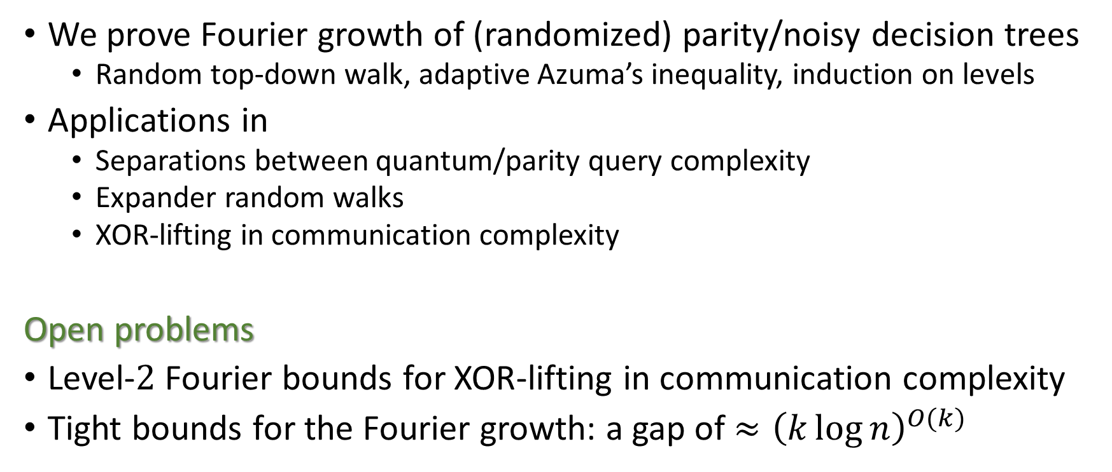
Summary
We prove Fourier growth of (randomized) parity/noisy decision trees
Random top-down walk, adaptive Azuma’s inequality, induction on levels
Applications in
Separations between quantum/parity query complexity
Expander random walks
XOR-lifting in communication complexity
Open problems
Level-$2$ Fourier bounds for XOR-lifting in communication complexity
Tight bounds for the Fourier growth: a gap of ${≈\left(k\log{n}\right)}^{O(k)}$

Slide 17
Thank you!

