Slide 1
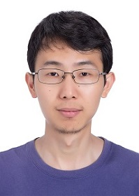
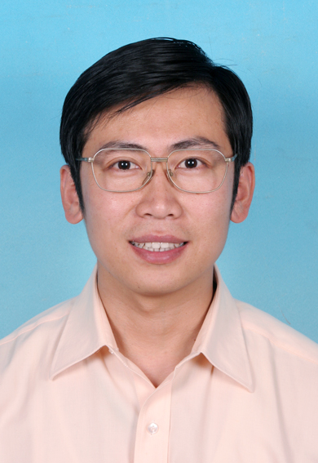
Perfect Sampling for (Atomic) Lovász Local Lemma
Kewen Wu (UC Berkeley)
Joint with Kun He (ICT, CAS) and Xiaoming Sun (ICT, CAS)

Slide 2
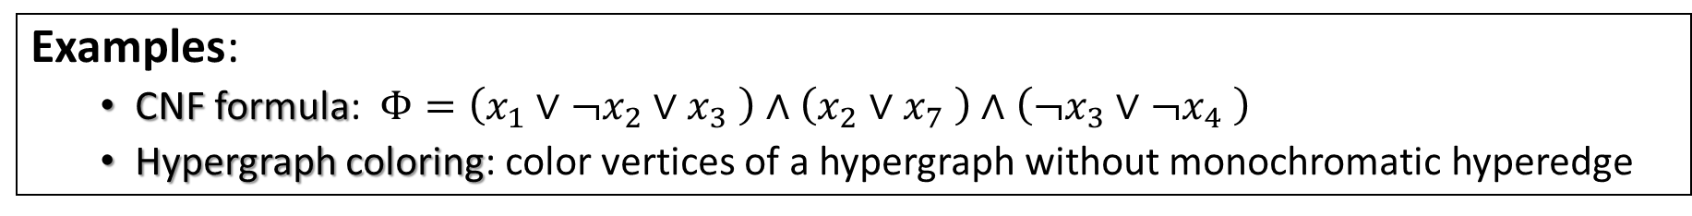
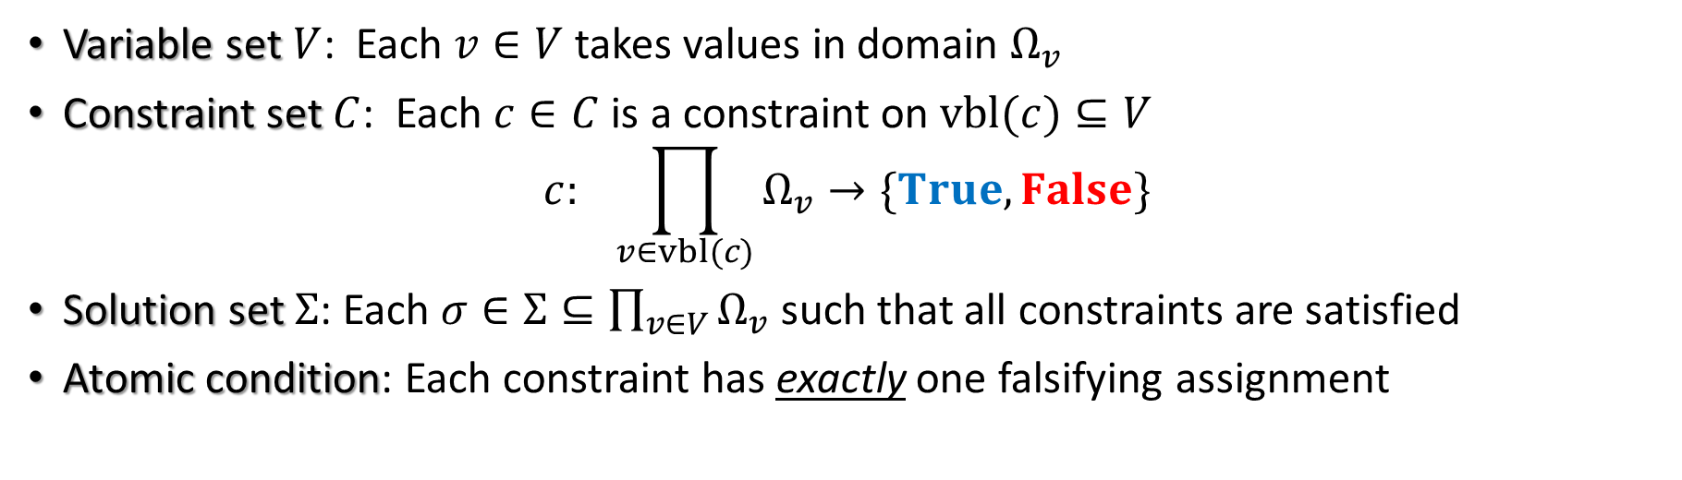
Constraint Satisfaction Problem (CSP)
Variable set $V$: Each $v∈V$takes values in domain $Ω_{v}$
Constraint set $C$: Each $c∈C$is a constraint on $vbl(c)⊆V$
$$c: \prod_{v∈vbl(c)}{Ω_{v}}→\{True,False\}$$
Solution set $Σ$: Each $σ∈Σ⊆\prod_{v∈V}{Ω_{v}}$such that all constraints are satisfied
Atomic condition: Each constraint has exactly one falsifying assignment
Examples:
CNF formula: $Φ=\left(x_{1}∨¬x_{2}∨x_{3} \right)∧\left(x_{2}∨x_{7} \right)∧\left(¬x_{3}∨¬x_{4} \right)$
Hypergraph coloring: color vertices of a hypergraph without monochromatic hyperedge

Slide 3
General Questions for CSP Instances
Decision: Can we efficiently determine if the instance has a solution?
NP-hard for general 3-CNF formula
Lovász local lemma
Search: If the CSP instance is satisfiable, can we find a solution efficiently?
Constructive Lovász local lemma
Sampling: If we can efficiently find a solution, can we efficiently sample a uniform random solution from the whole solution space?
Sampling Lovász local lemma
Our focus

Slide 4
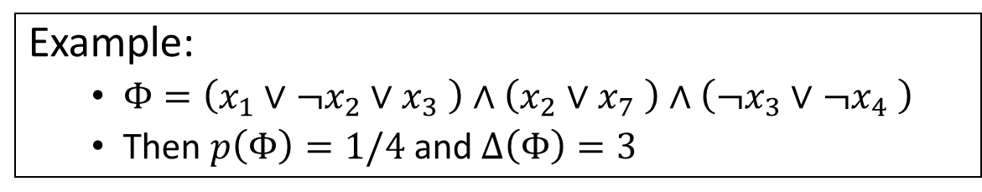
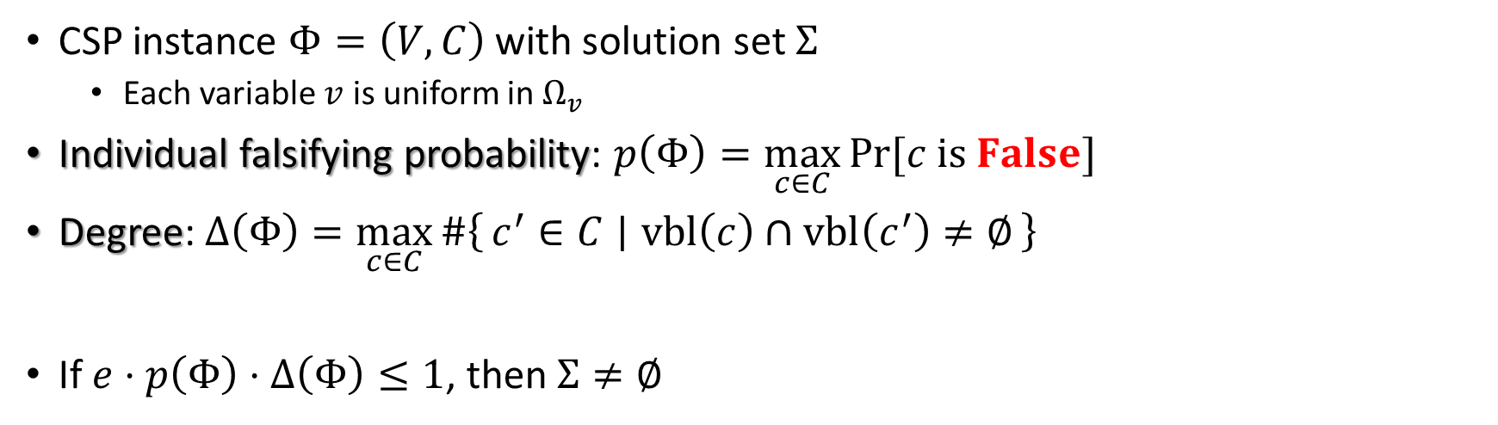
Lovász Local Lemma [Erdős and Lovász’75]
CSP instance $Φ=\left(V,C\right)$ with solution set $Σ$
Each variable $v$ is uniform in $Ω_{v}$
Individual falsifying probability: $p\left(Φ\right)=\max_{c∈C}{\operatorname{Pr}{[c is False]}}$
Degree: $Δ\left(Φ\right)=\max_{c∈C}{\#\left\{c^{′}∈C ∣ vbl\left(c\right)∩vbl\left(c^{′}\right)≠∅\right\}}$
If $e⋅p\left(Φ\right)⋅Δ\left(Φ\right)≤1$, then $Σ≠∅$
Example:
$Φ=\left(x_{1}∨¬x_{2}∨x_{3} \right)∧\left(x_{2}∨x_{7} \right)∧\left(¬x_{3}∨¬x_{4} \right)$
Then $p\left(Φ\right)=1/4$ and $Δ\left(Φ\right)=3$

Slide 5
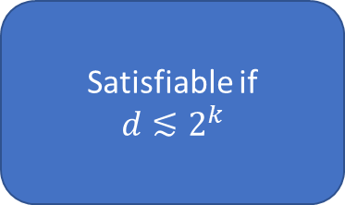
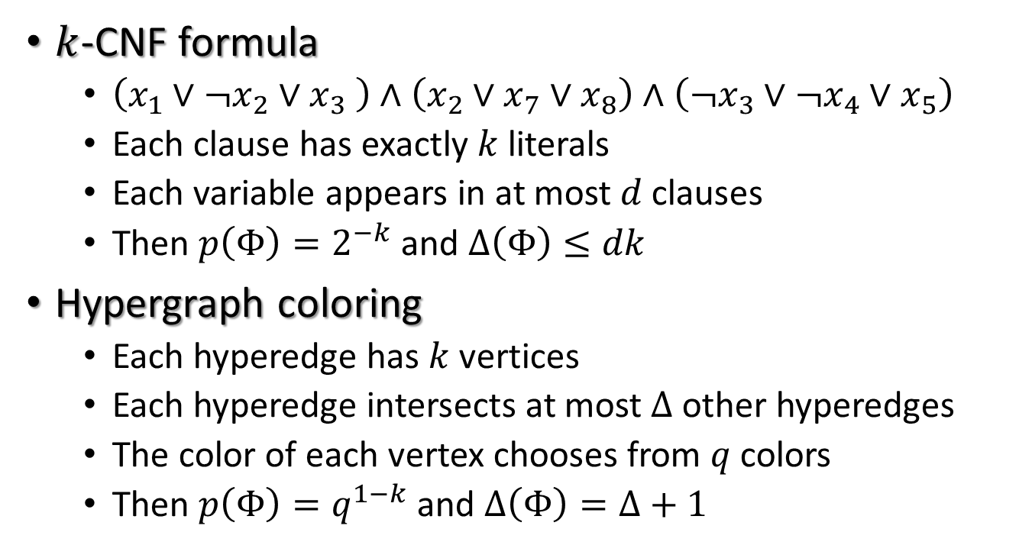
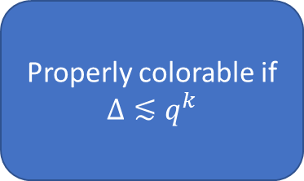
Examples
$k$-CNF formula
$\left(x_{1}∨¬x_{2}∨x_{3} \right)∧\left(x_{2}∨x_{7}∨x_{8}\right)∧\left(¬x_{3}∨¬x_{4}∨x_{5}\right)$
Each clause has exactly $k$ literals
Each variable appears in at most $d$ clauses
Then $p\left(Φ\right)=2^{−k}$ and $Δ\left(Φ\right)≤dk$
Hypergraph coloring
Each hyperedge has $k$ vertices
Each hyperedge intersects at most $Δ$ other hyperedges
The color of each vertex chooses from $q$ colors
Then $p\left(Φ\right)=q^{1−k}$ and $Δ\left(Φ\right)=Δ+1$
Satisfiable if
$$d≲2^{k}$$
Properly colorable if $Δ≲q^{k}$

Slide 6
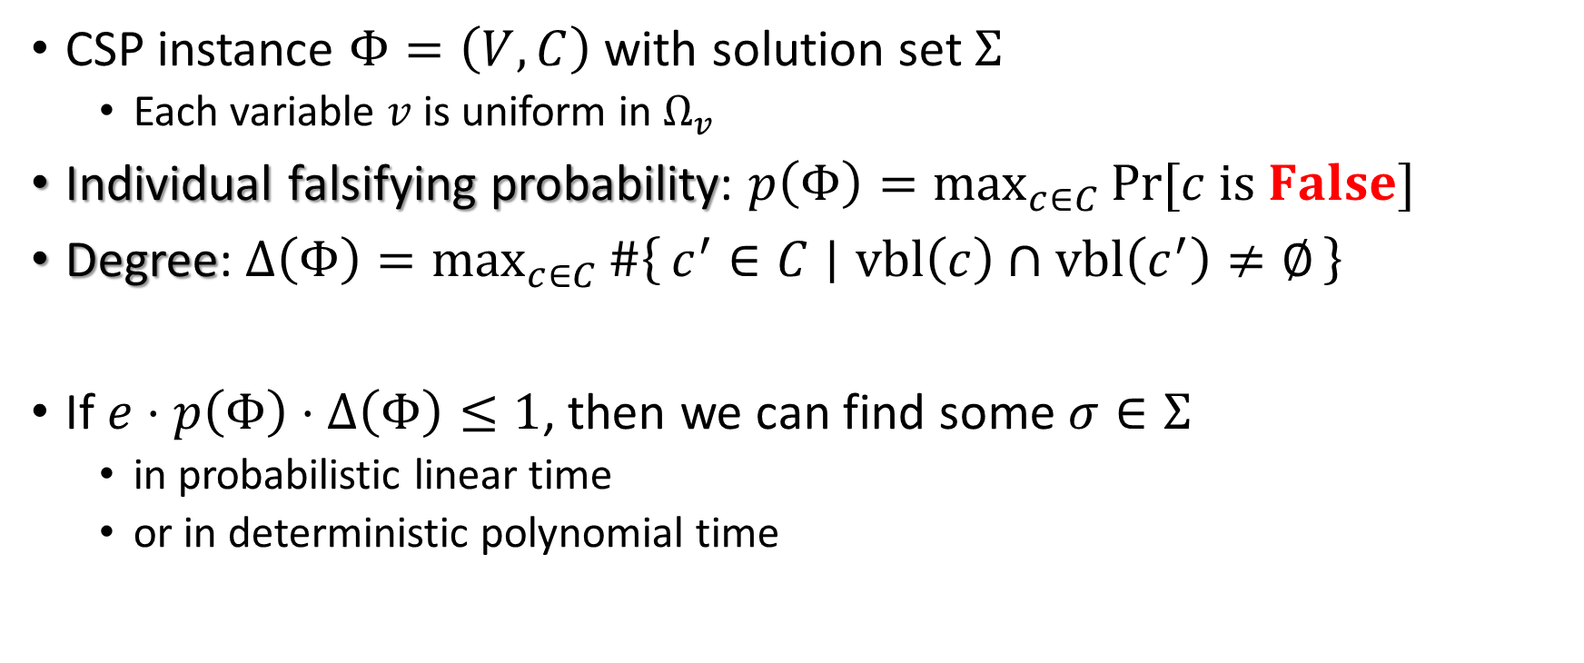
Constructive Lovász Local Lemma [Bec’91, Alo’91, MR’98, CS’00, Mos’09, MT’10, KM’11, HSS’11, HS’17, HS’19]
CSP instance $Φ=\left(V,C\right)$ with solution set $Σ$
Each variable $v$ is uniform in $Ω_{v}$
Individual falsifying probability: $p\left(Φ\right)=\max_{c∈C}{\operatorname{Pr}{[c is False]}}$
Degree: $Δ\left(Φ\right)=\max_{c∈C}{\#\left\{c^{′}∈C ∣ vbl\left(c\right)∩vbl\left(c^{′}\right)≠∅\right\}}$
If $e⋅p\left(Φ\right)⋅Δ\left(Φ\right)≤1$, then we can find some $σ∈Σ$
in probabilistic linear time
or in deterministic polynomial time

Slide 7
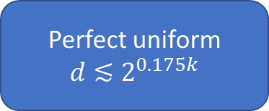
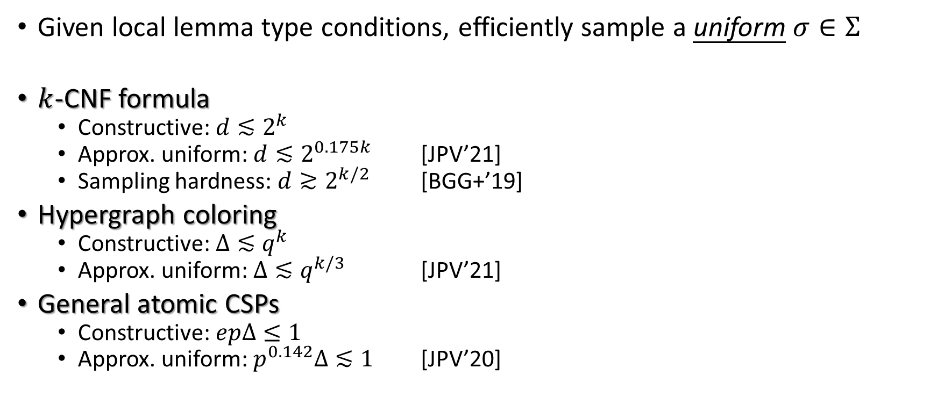

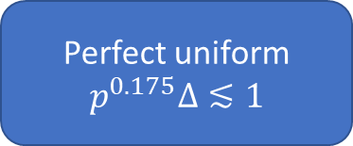
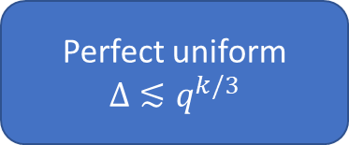
Sampling Lovász Local Lemma [Moi’19, GLLZ’19, FGYZ’20, FHY’20, JPV’20, JPV’21]
Given local lemma type conditions, efficiently sample a uniform $σ∈Σ$
$k$-CNF formula
Constructive: $d≲2^{k}$
Approx. uniform: $d≲2^{0.175k}$ [JPV’21]
Sampling hardness: $d≳2^{k/2}$ [BGG+’19]
Hypergraph coloring
Constructive: $Δ≲q^{k}$
Approx. uniform: $Δ≲q^{k/3}$ [JPV’21]
General atomic CSPs
Constructive: $epΔ≤1$
Approx. uniform: $p^{0.142}Δ≲1$ [JPV’20]
Perfect uniform
$$d≲2^{0.175k}$$
Simple algorithm
Simple analysis
Expected running time: $O(n\log{n})$
Perfect uniform
$$Δ≲q^{k/3}$$
Perfect uniform
$$p^{0.175}Δ≲1$$

Slide 8
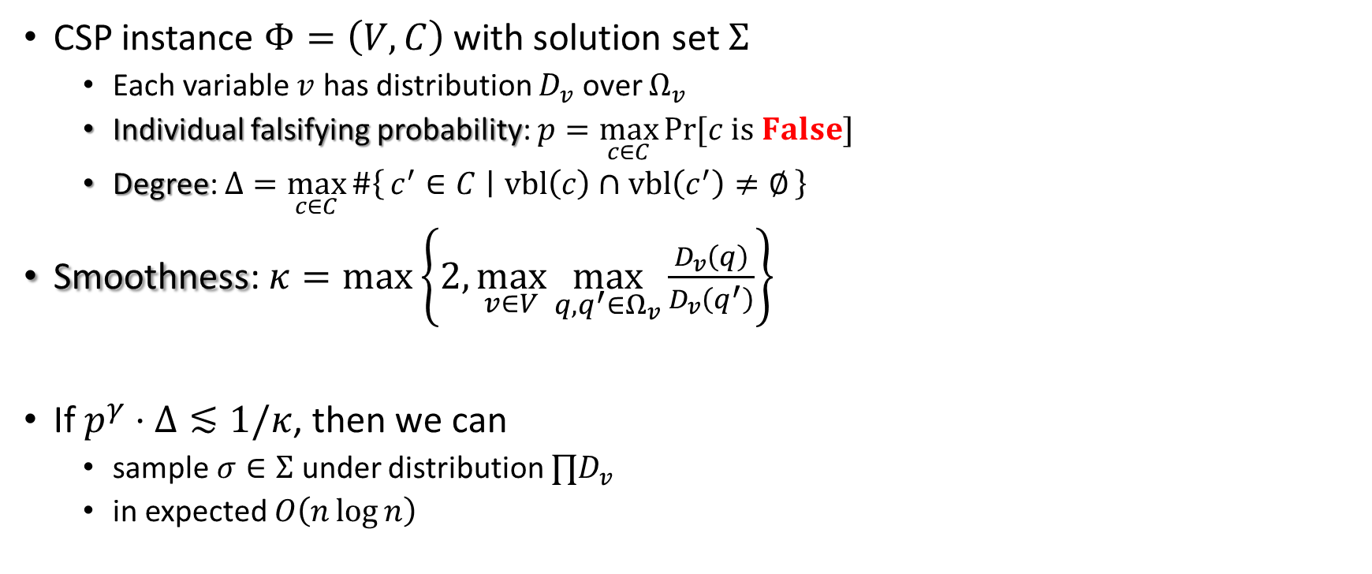
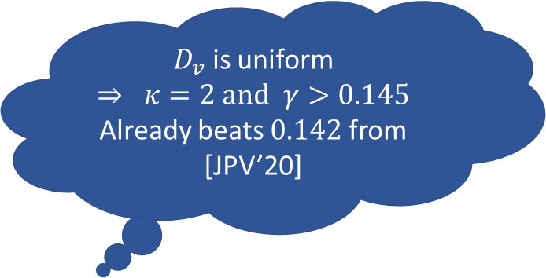

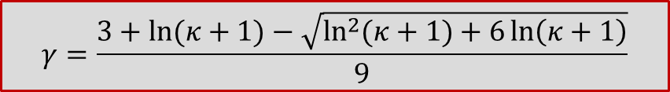
Our Results: Arbitrary Distribution
CSP instance $Φ=\left(V,C\right)$ with solution set $Σ$
Each variable $v$ has distribution $D_{v}$ over $Ω_{v}$
Individual falsifying probability: $p=\max_{c∈C}{\operatorname{Pr}{[c is False]}}$
Degree: $Δ=\max_{c∈C}{\#\left\{c^{′}∈C ∣ vbl\left(c\right)∩vbl\left(c^{′}\right)≠∅\right\}}$
Smoothness: $κ=\max\left\{2,\max_{v∈V}{\max_{q,q^{′}∈Ω_{v}}{\frac{D_{v}\left(q\right)}{D_{v}\left(q^{′}\right)}}}\right\}$
If $p^{γ}⋅Δ≲1/κ$, then we can
sample $σ∈Σ$ under distribution $∏D_{v}$
in expected $O\left(n\log{n}\right)$
$D_{v}$ is uniform
$⇒ κ=2$ and $γ>0.145$
Already beats $0.142$ from [JPV’20]
$$γ=\frac{3+\ln{(κ+1)}−\sqrt{\ln^{2}{(κ+1)}+6\ln\left(κ+1\right)}}{9}$$
$$\underset{σ∼∏D_{v}}{Pr}{[⋅∣σ is a solution]}$$

Slide 9
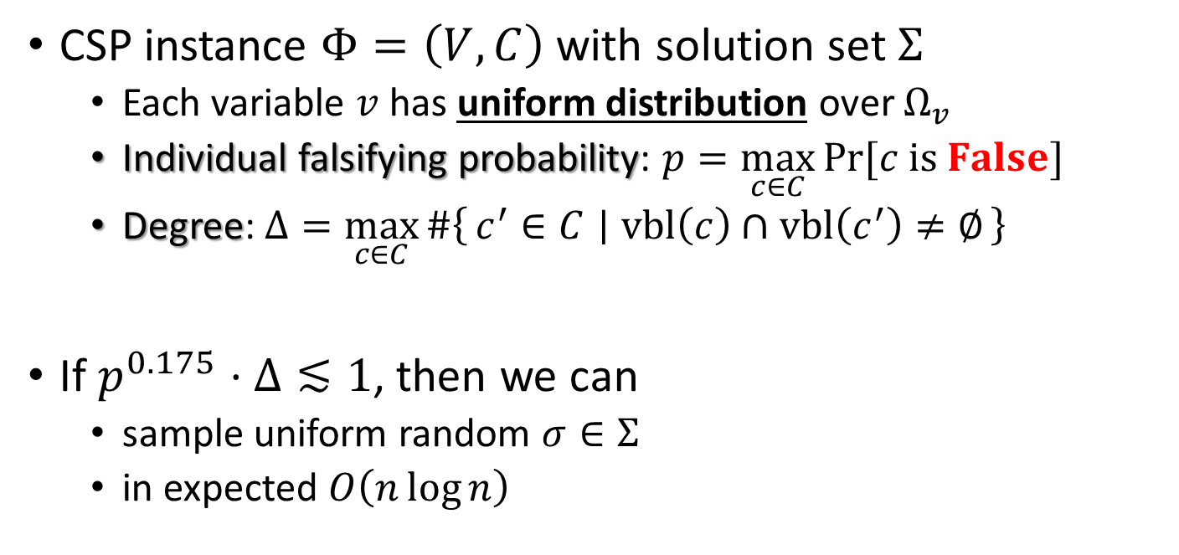
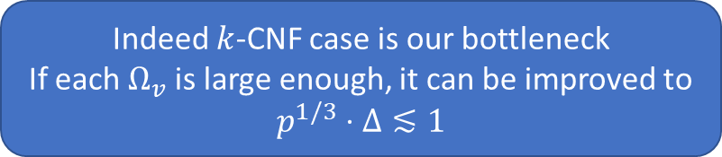

Our Results: Uniform Distribution
CSP instance $Φ=\left(V,C\right)$ with solution set $Σ$
Each variable $v$ has uniform distribution over $Ω_{v}$
Individual falsifying probability: $p=\max_{c∈C}{\operatorname{Pr}{[c is False]}}$
Degree: $Δ=\max_{c∈C}{\#\left\{c^{′}∈C ∣ vbl\left(c\right)∩vbl\left(c^{′}\right)≠∅\right\}}$
If $p^{0.175}⋅Δ≲1$, then we can
sample uniform random $σ∈Σ$
in expected $O\left(n\log{n}\right)$
Beats $0.142$ from [JPV’20]
Matches $0.175$ for $k$-CNF formula from [JPV’21]
Indeed $k$-CNF case is our bottleneck
If each $Ω_{v}$ is large enough, it can be improved to
$$p^{1/3}⋅Δ≲1$$
Hypergraph coloring

Slide 10
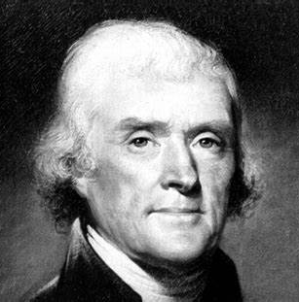
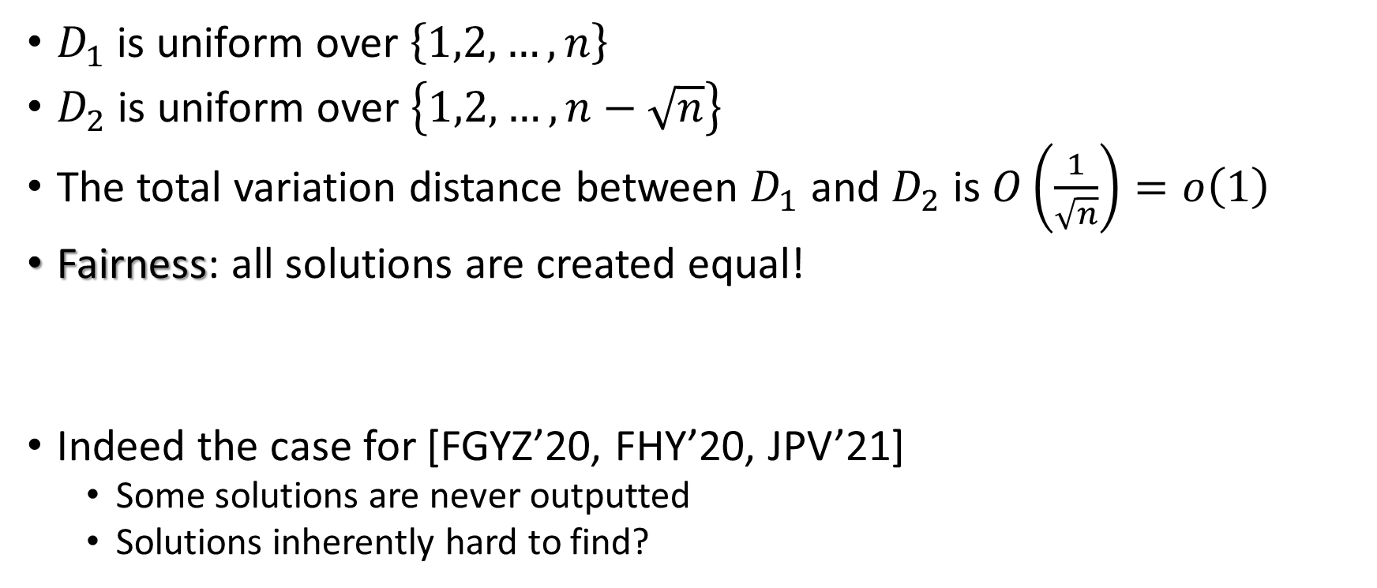
Perfect Sampling vs Approximate Sampling
$D_{1}$ is uniform over $\left\{1,2,…,n\right\}$
$D_{2}$ is uniform over $\left\{1,2,…,n−\sqrt{n}\right\}$
The total variation distance between $D_{1}$ and $D_{2}$ is $O\left(\frac{1}{\sqrt{n}}\right)=o\left(1\right)$
Fairness: all solutions are created equal!
Indeed the case for [FGYZ’20, FHY’20, JPV’21]
Some solutions are never outputted
Solutions inherently hard to find?

Slide 11
Practical Issue of Approximate Sampling
Usually an approx. sampler runs some Markov chain
Easy to show mixing
Connected, aperiodic, stationary/reversible distribution
Convergence theorem of Markov chains
Hard to prove bounds on mixing time
Path coupling, canonical path, spectral independence, information percolation, Cheeger’s constant, (modified) log-Sobolev inequality, …
How to stop the chain when bounds on mixing time is bad/unknown?

Slide 12
Practical Advantage of Perfect Sampling
Easy to design given a Markov chain based approx. sampler
Coupling from the past [PW’96]
Easy to show it halts almost surely
When it stops, the output distribution is always correct
Hard to implement efficiently
Bounding chain [Hub’98, HN’99]
Hard to prove bounds on stopping time
Martingale, information percolation, …

Slide 13
Proof Overview
Reduce general cases to binary domains
State tensorization, a generalization of state compression in [FHY’21]
Develop an algorithm for binary domains (arbitrary distribution)
Coupling from the past and bounding chain
Information percolation

Slide 14
State Tensorization

Slide 15

















Shrink Domain Size
Assume variable $v$ has distribution $D_{v}$ over domain $Ω_{v}$
$Ω_{v}=\left\{1,2,3,4,5\right\}$
$D_{v}\left(1\right)=D_{v}\left(2\right)=0.1$, $D_{v}\left(3\right)=0.3$, $D_{v}\left(4\right)=1/3$, $D_{v}\left(5\right)=1/6$
$$0.5$$
$$z_{1}$$
$$0.5$$
$$v$$
$$z_{2}$$
$$z_{3}$$
$$0.4$$
$$0.6$$
$$2/3$$
1/3
$$z_{4}$$
3
4
5
1
2
3
4
5
$$0.5$$
$$0.5$$
$$0.1$$
$$0.1$$
$$0.3$$
$$1/3$$
1/6
1
2

Slide 16

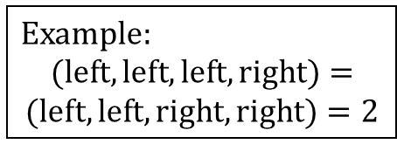
Preserve Distribution
Sample $v∼D_{v}$ is equivalent to
Sample ${(z}_{1},z_{2},z_{3},z_{4})∼D_{z_{1}}×D_{z_{2}}×D_{z_{3}}×D_{z_{4}}$
Then interpret $v$ from ${(z}_{1},z_{2},z_{3},z_{4})$
Example:
$$(left, left, left, right)=$$
$$(left, left, right, right)=2$$
$$0.5$$
$$z_{1}$$
$$0.5$$
$$v$$
$$z_{2}$$
$$z_{3}$$
$$0.4$$
$$0.6$$
$$2/3$$
1/3
$$z_{4}$$
3
4
5
1
2
3
4
5
$$0.5$$
$$0.5$$
$$0.1$$
$$0.1$$
$$0.3$$
$$1/3$$
1/6
1
2

Slide 17



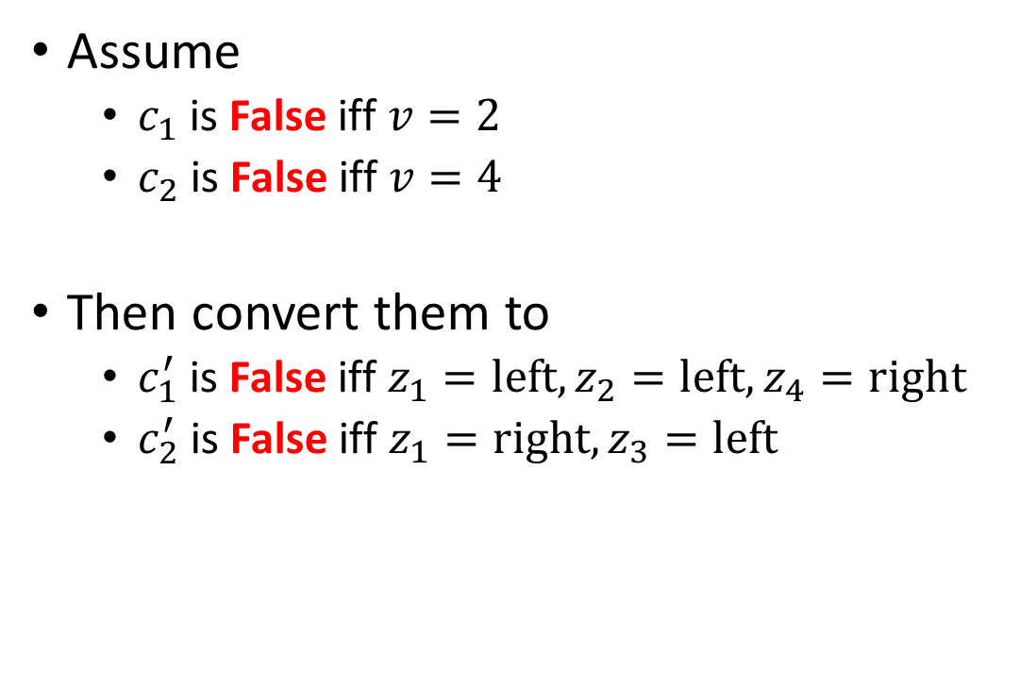
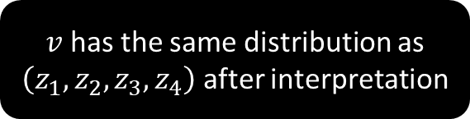




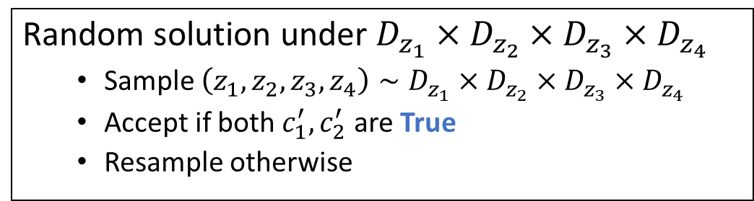





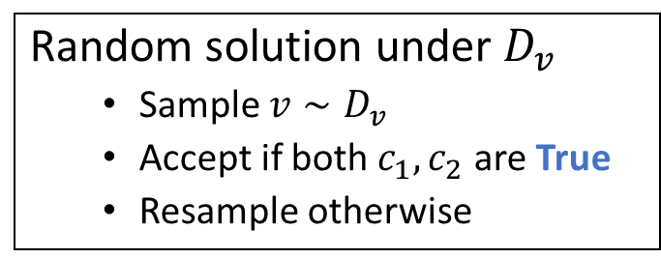



Sample Solutions
$$v$$
Random solution under $D_{v}$
Sample $v∼D_{v}$
Accept if both $c_{1},c_{2}$ are True
Resample otherwise
Assume
$c_{1}$ is False iff $v=2$
$c_{2}$ is False iff $v=4$
Then convert them to
$c_{1}^{′}$ is False iff $z_{1}=left,z_{2}=left,z_{4}=right$
$c_{2}^{′}$ is False iff $z_{1}=right,z_{3}=left$
1
2
3
4
5
$$0.1$$
$$0.1$$
$$0.3$$
$$1/3$$
1/6
$v$ has the same distribution as $\left(z_{1},z_{2},z_{3},z_{4}\right)$ after interpretation
$$0.5$$
$$z_{1}$$
$$0.5$$
Random solution under $D_{z_{1}}×D_{z_{2}}×D_{z_{3}}×D_{z_{4}}$
Sample $\left(z_{1},z_{2},z_{3},z_{4}\right)∼D_{z_{1}}×D_{z_{2}}×D_{z_{3}}×D_{z_{4}}$
Accept if both $c_{1}^{′},c_{2}^{′}$ are True
Resample otherwise
$$z_{2}$$
$$z_{3}$$
$$0.4$$
$$0.6$$
1/3
$$2/3$$
$$0.5$$
$$z_{4}$$
3
4
5
$$0.5$$
1
2

Slide 18
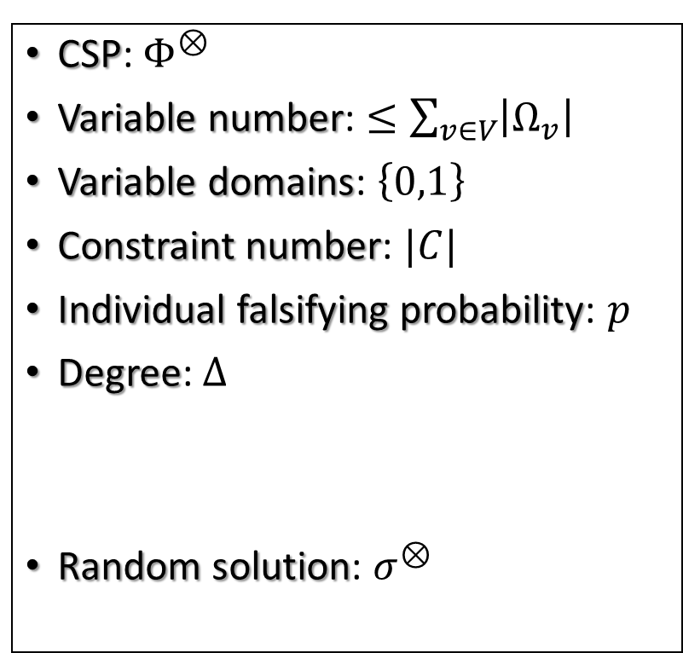
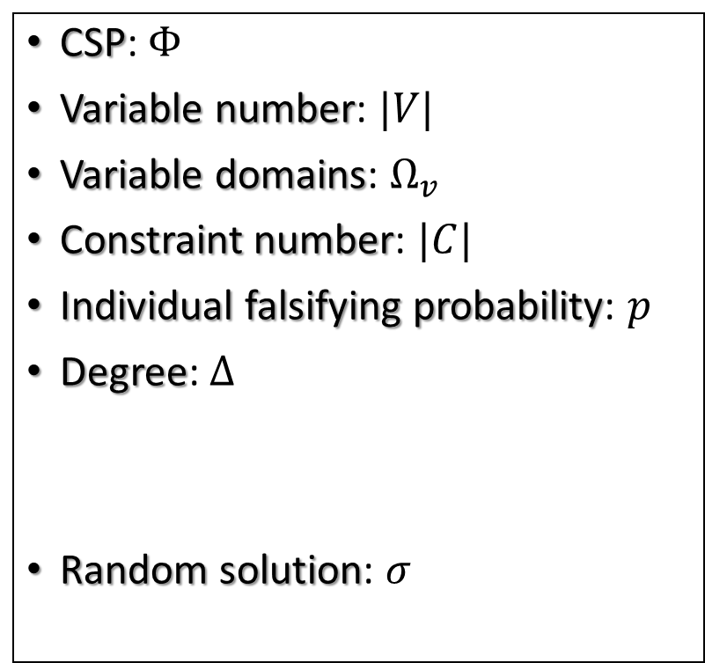
Comparison
CSP: $Φ$
Variable number: $|V|$
Variable domains: $Ω_{v}$
Constraint number: $|C|$
Individual falsifying probability: $p$
Degree: $Δ$
Random solution: $σ$
CSP: $Φ^{⊗}$
Variable number: $≤\sum_{v∈V}{\left|Ω_{v}\right|}$
Variable domains: $\left\{0,1\right\}$
Constraint number: $|C|$
Individual falsifying probability: $p$
Degree: $Δ$
Random solution: $σ^{⊗}$
State tensorization
Interpretation

Slide 19
The Algorithm for Binary Domains

Slide 20

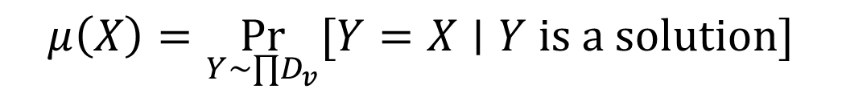
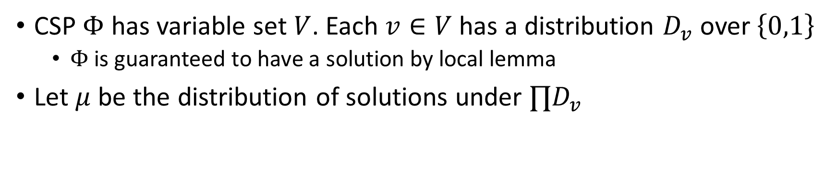

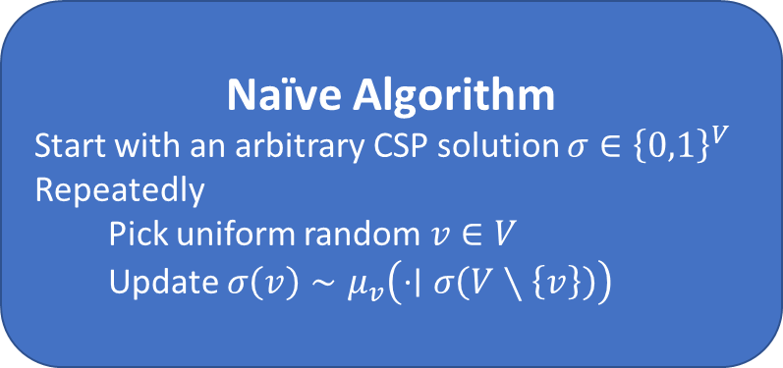
The Naïve Algorithm
CSP $Φ$ has variable set $V$. Each $v∈V$ has a distribution $D_{v}$ over $\left\{0,1\right\}$
$Φ$ is guaranteed to have a solution by local lemma
Let $μ$ be the distribution of solutions under $∏D_{v}$
$$μ\left(X\right)=\underset{Y∼∏D_{v}}{Pr}{[Y=X∣Y is a solution]}$$
Naïve Algorithm
Start with an arbitrary CSP solution $σ∈{\left\{0,1\right\}}^{V}$
Repeatedly
Pick uniform random $v∈V$
Update $σ\left(v\right)∼μ_{v}\left(⋅∣σ\left(V∖\left\{v\right\}\right)\right)$
Rapid Mixing
Disconnected
Slow Mixing
We’re here [Wig’19]

Slide 21
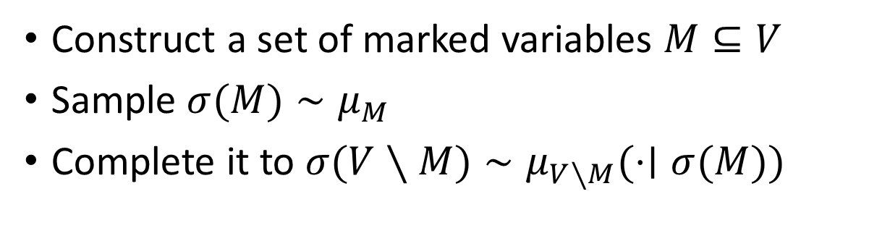
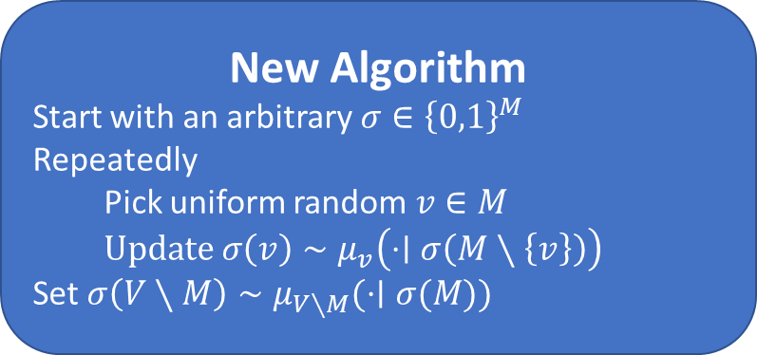
Mark/Unmark Framework [Moi’17, GLLZ’18, JPV’20]
Construct a set of marked variables $M⊆V$
Sample $σ(M)∼μ_{M}$
Complete it to $σ(V∖M)∼μ_{V∖M}(⋅∣σ(M))$
01001
10010
11011
00111
01***
10***
11***
00***
New Algorithm
Start with an arbitrary $σ∈{\left\{0,1\right\}}^{M}$
Repeatedly
Pick uniform random $v∈M$
Update $σ\left(v\right)∼μ_{v}\left(⋅∣σ\left(M∖\left\{v\right\}\right)\right)$
Set $σ\left(V∖M\right)∼μ_{V∖M}(⋅∣σ(M))$
Rapid mixing if each constraint has certain amount of marked variables
Update efficient if each constraint has certain amount of unmarked variables

Slide 22
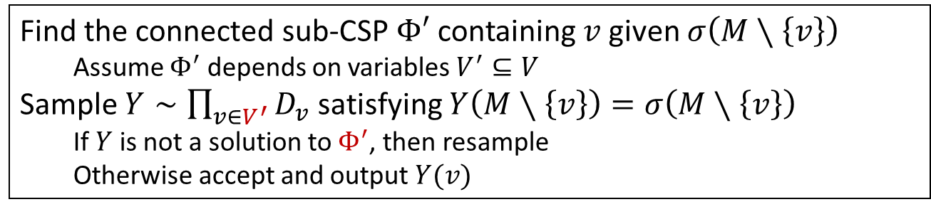
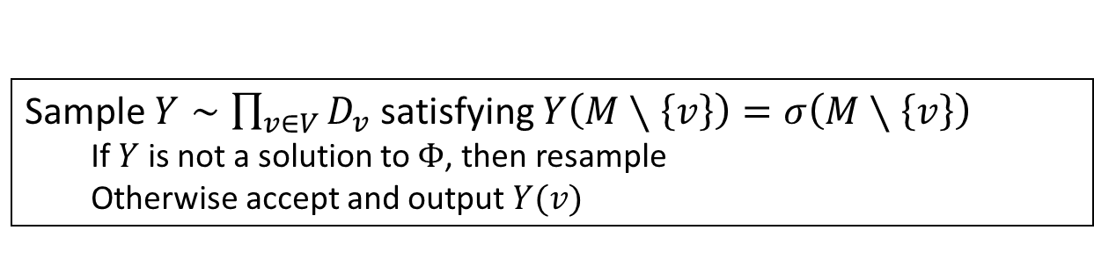



One-step Update
$$Φ′$$
How to obtain sample from $μ_{v}\left(⋅∣σ\left(M∖\left\{v\right\}\right)\right)$?
$$v$$
Sample $Y∼\prod_{v∈V}{D_{v}}$ satisfying $Y\left(M∖\left\{v\right\}\right)=σ\left(M∖\left\{v\right\}\right)$
If $Y$ is not a solution to $Φ$, then resample
Otherwise accept and output $Y(v)$
More efficient if $Φ′$ is smaller
Find the connected sub-CSP $Φ′$ containing $v$ given $σ\left(M∖\left\{v\right\}\right)$
Assume $Φ^{′}$ depends on variables $V^{′}⊆V$
Sample $Y∼\prod_{v∈V^{′}}{D_{v}}$ satisfying $Y\left(M∖\left\{v\right\}\right)=σ\left(M∖\left\{v\right\}\right)$
If $Y$ is not a solution to $Φ^{′}$, then resample
Otherwise accept and output $Y(v)$

Slide 23
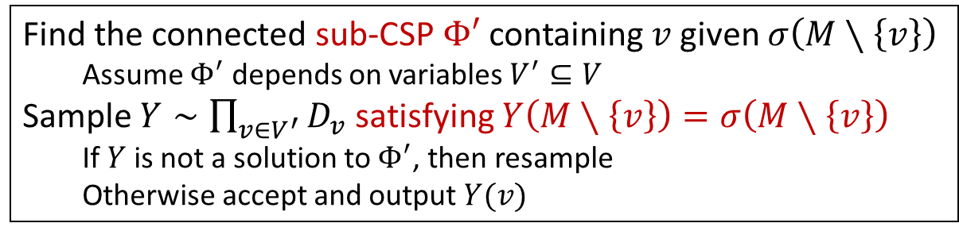
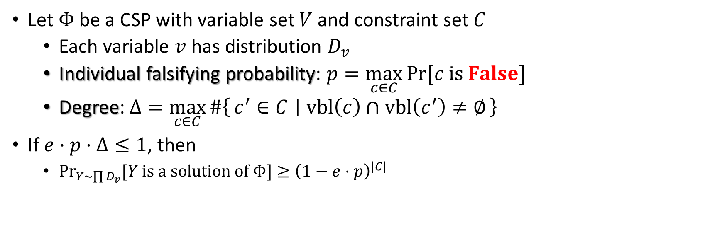
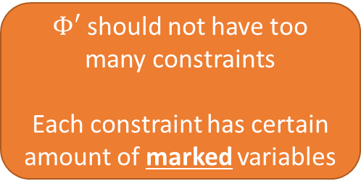

Rejection Sampling Efficiency
Let $Φ$ be a CSP with variable set $V$ and constraint set $C$
Each variable $v$ has distribution $D_{v}$
Individual falsifying probability: $p=\max_{c∈C}{\operatorname{Pr}{[c is False]}}$
Degree: $Δ=\max_{c∈C}{\#\left\{c^{′}∈C ∣ vbl\left(c\right)∩vbl\left(c^{′}\right)≠∅\right\}}$
If $e⋅p⋅Δ≤1$, then
$\underset{Y∼\prod{D_{v}}}{Pr}{[Y is a solution of Φ]}≥{\left(1−e⋅p\right)}^{|C|}$
Fixing values of $M∖\left\{v\right\}$ should not increase $p$ too much
Each constraint has certain amount of unmarked variables
Find the connected sub-CSP $Φ′$ containing $v$ given $σ\left(M∖\left\{v\right\}\right)$
Assume $Φ^{′}$ depends on variables $V^{′}⊆V$
Sample $Y∼\prod_{v∈V^{′}}{D_{v}}$ satisfying $Y\left(M∖\left\{v\right\}\right)=σ\left(M∖\left\{v\right\}\right)$
If $Y$ is not a solution to $Φ^{′}$, then resample
Otherwise accept and output $Y(v)$
$Φ′$ should not have too many constraints
Each constraint has certain amount of marked variables

Slide 24
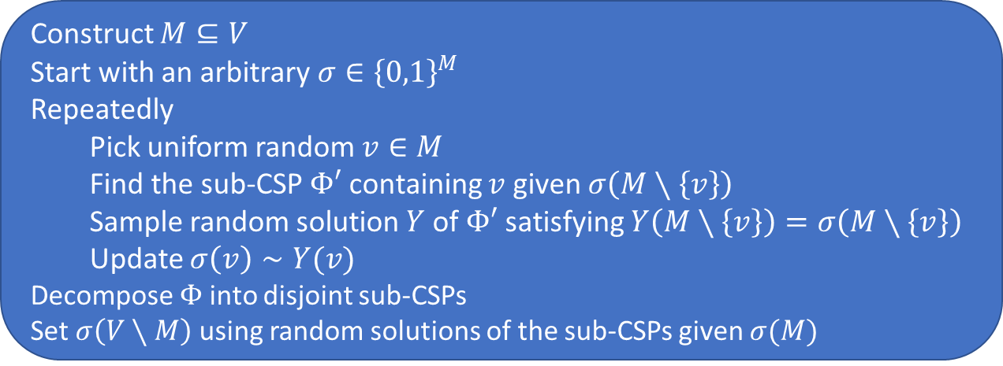
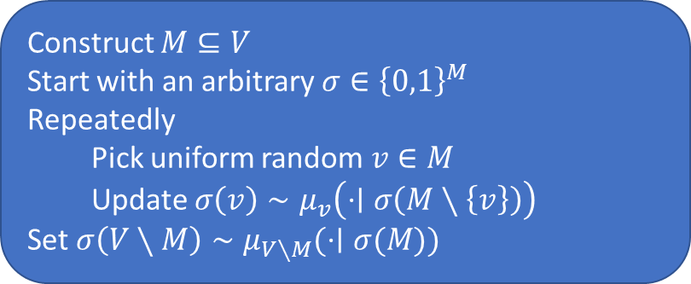
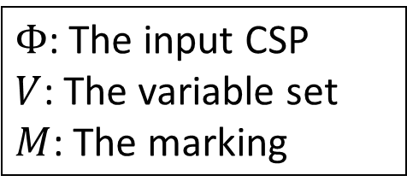
The Approximate Sampler
Construct $M⊆V$
Start with an arbitrary $σ∈{\left\{0,1\right\}}^{M}$
Repeatedly
Pick uniform random $v∈M$
Update $σ\left(v\right)∼μ_{v}\left(⋅∣σ\left(M∖\left\{v\right\}\right)\right)$
Set $σ\left(V∖M\right)∼μ_{V∖M}(⋅∣σ(M))$
Information theoretic
$Φ$: The input CSP
$V$: The variable set
$M$: The marking
Algorithmic
Construct $M⊆V$
Start with an arbitrary $σ∈{\left\{0,1\right\}}^{M}$
Repeatedly
Pick uniform random $v∈M$
Find the sub-CSP $Φ′$ containing $v$ given $σ\left(M∖\left\{v\right\}\right)$
Sample random solution $Y$ of $Φ′$ satisfying $Y\left(M∖\left\{v\right\}\right)=σ\left(M∖\left\{v\right\}\right)$
Update $σ\left(v\right)∼Y(v)$
Decompose $Φ$ into disjoint sub-CSPs
Set $σ\left(V∖M\right)$ using random solutions of the sub-CSPs given $σ(M)$

Slide 25
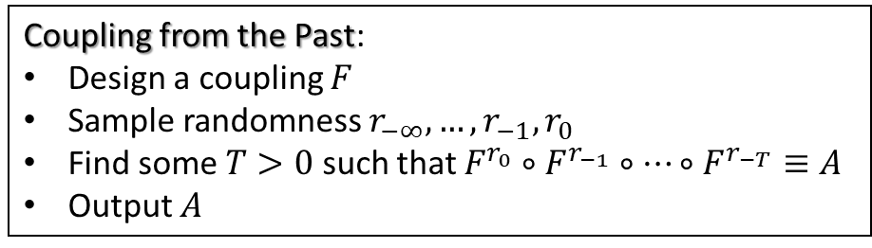



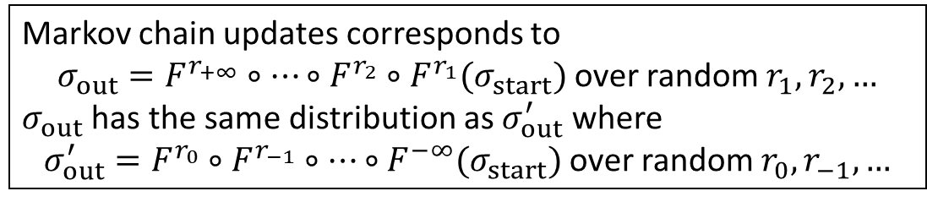
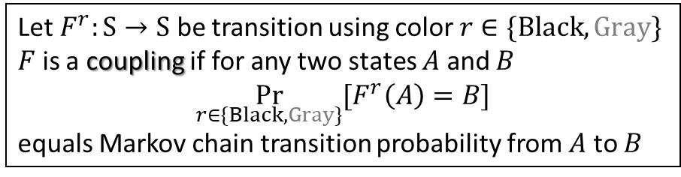
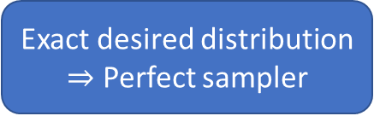
Coupling from the Past [Propp and Wilson’96]
Let $F^{r}:S→S$ be transition using color $r∈\{Black,Gray\}$
$F$ is a coupling if for any two states $A$ and $B$
$$\underset{r∈\{Black,Gray\}}{Pr}{[F^{r}\left(A\right)=B]}$$
equals Markov chain transition probability from $A$ to $B$
$$⋯⋯$$
Coupling from the Past:
Design a coupling $F$
Sample randomness $r_{−∞},…,r_{−1},r_{0}$
Find some $T>0$ such that $F^{r_{0}}∘F^{r_{−1}}∘⋯∘F^{r_{−T}}≡A$
Output $A$
Markov chain states $S$
Coupling $F$ of
Markov chain transition
Markov chain updates corresponds to
$σ_{out}=F^{r_{+∞}}∘⋯∘F^{r_{2}}∘F^{r_{1}}(σ_{start})$ over random $r_{1},r_{2},…$
$σ_{out}$ has the same distribution as $σ_{out}^{′}$ where
$σ_{out}^{′}=F^{r_{0}}∘F^{r_{−1}}∘⋯∘F^{−∞}(σ_{start})$ over random $r_{0},r_{−1},…$
Exact desired distribution
$⇒$ Perfect sampler
If $F^{r_{0}}∘F^{r_{−1}}∘⋯∘F^{r_{−T}}$ is a constant function, then $σ_{out}^{′}$ equals this constant

Slide 26




















The Coupling
Local Uniformity [HSS’11]
If the marking $M$ is “balanced”, then
$$Y^{σ}\left(v\right)≈D_{v}$$
for any $σ$. E.g.,
$$\operatorname{Pr}\left[Y^{σ}\left(v\right)=0\right]≥0.9 D_{v}(0)$$
$$\operatorname{Pr}\left[Y^{σ}\left(v\right)=1\right]≥0.9 D_{v}(1)$$
Algorithmic
One-step Update on $v$ given $σ$
Find the sub-CSP $Φ′$ containing $v$ given $σ\left(M∖\left\{v\right\}\right)$
Sample random solution $Y^{σ}$ of $Φ′$ satisfying $Y^{σ}\left(M∖\left\{v\right\}\right)=σ\left(M∖\left\{v\right\}\right)$
Update $σ\left(v\right)←Y^{σ}(v)$
$$\operatorname{Pr}\left[X=0\right]=0.4,\operatorname{Pr}\left[X=1\right]=0.6$$
$$\operatorname{Pr}\left[Z=0\right]=0.45,\operatorname{Pr}\left[Z=1\right]=0.55$$
A Coupling given $σ$ and Randomness $r$
Split $r$ into independent parts $r_{all}$ and $r_{σ}$
Sample $c_{all}∈\{0,1,⋆\}$ using $r_{all}$ such that
$$\operatorname{Pr}\left[c_{all}=b\right]=\left\{\begin{aligned}0.9 D_{v}\left(b\right) if b∈\{0,1\} \\ 0.1 if b=⋆\end{aligned}\right.$$
If $c_{all}≠⋆$, update $σ\left(v\right)←c_{all}$
Otherwise sample $c_{σ}∈\{0,1\}$ using $r_{σ}$ such that
$$\operatorname{Pr}\left[c_{σ}=b\right]=\frac{\operatorname{Pr}\left[Y^{σ}\left(v\right)=b\right]−0.9 D_{v}(b)}{0.1} for b∈\left\{0,1\right\}$$
and update $σ\left(v\right)←c_{σ}$
$$0.4$$
$$c_{all}$$
$$0.5$$
$$X=Z=0$$
$$0.1$$
$$X=Z=1$$
Information theoretic
$$c_{X}$$
$$c_{Z}$$
$$0$$
$$1$$
$$0.5$$
$$0.5$$
$$X=0$$
$$X=1$$
$$Z=0$$
$$Z=1$$

Slide 27




Bounding Chains [Hub’98, HN’99]
How to efficiently check if
$F^{r_{0}}∘F^{r_{−1}}∘⋯∘F^{r_{−T}}$
is a constant function?
Coupling from the Past:
Design a coupling $F$
Sample randomness $r_{−∞},…,r_{−1},r_{0}$
Find some $T>0$ such that $F^{r_{0}}∘F^{r_{−1}}∘⋯∘F^{r_{−T}}≡A$
Output $A$
Use $⋆$ to represent uncertainty
$$0⋆⋆1=\{0001,0011,0101,0111\}$$
Then
$$F^{r_{0}}∘F^{r_{−1}}∘⋯∘F^{r_{−T}}≡A$$
equals
$$F^{r_{0}}∘F^{r_{−1}}∘⋯∘F^{r_{−T}}\left(⋆^{M}\right)=A$$
What is $F^{r}$ when assignment has $⋆$?
A Coupling given $σ$ and Randomness $r$
Split $r$ into independent parts $r_{all}$ and $r_{σ}$
Sample $c_{all}∈\{0,1,⋆\}$ using $r_{all}$ such that
$$\operatorname{Pr}\left[c_{all}=b\right]=\left\{\begin{aligned}0.9 D_{v}\left(b\right) if b∈\{0,1\} \\ 0.1 if b=⋆\end{aligned}\right.$$
If $c_{all}≠⋆$, update $σ\left(v\right)←c_{all}$ and return
Otherwise sample $c_{σ}∈\{0,1\}$ using $r_{σ}$ such that
$$\operatorname{Pr}\left[c_{σ}=b\right]=\frac{\operatorname{Pr}\left[Y^{σ}\left(v\right)=b\right]−0.9 D_{v}(b)}{0.1} for b∈\left\{0,1\right\}$$
and update $σ\left(v\right)←c_{σ}$

Slide 28









One-step Update, Revisited
Find sub-CSP $Φ′$ containing $v$ given $σ\left(M∖\left\{v\right\}\right)$
Assume $Φ^{′}$ depends on variables $V^{′}⊆V$
Sample $Y∼\prod_{v∈V^{′}}{D_{v}}$ given $Y\left(M∖\left\{v\right\}\right)=σ\left(M∖\left\{v\right\}\right)$
If $Y$ is not a solution to $Φ^{′}$, then resample
Otherwise accept and output $Y(v)$
$σ∈{\left\{0,1,⋆\right\}}^{M}$ where $⋆$ represents uncertainty
Then $μ_{v}\left(⋅∣σ\left(M∖\left\{v\right\}\right)\right)$ has all possible marginal distributions of $v$ given $σ$
Two cases:
Unique marginal even though $σ$ has uncertainty
Multiple possible marginals since $σ$ has uncertainty
$$v$$
No $u∈V^{′}∩M$ is $⋆$
$⇒$ $Φ′$ is fixed $⇒$ unique marginal
$$Φ′$$
Rejection sampling
Local uniformity
$$Φ′$$
Some $u∈V^{′}∩M$ is $⋆$
$⇒$ $Φ′$ may change based on $u=0/1$
$⇒$ multiple possible marginals
Local Uniformity
If the marking $M$ is “balanced”, then
$$\operatorname{Pr}\left[Y^{σ}\left(v\right)=0\right]≥0.9 D_{v}(0)$$
$$\operatorname{Pr}\left[Y^{σ}\left(v\right)=1\right]≥0.9 D_{v}(1)$$
for any $σ$
$$v$$
$$v$$
$$u$$

Slide 29




One-step Update, Revisited
Markov chain
Given $σ∈{\left\{0,1\right\}}^{M}$
Find the sub-CSP $Φ′$ containing $v$ given $σ\left(M∖\left\{v\right\}\right)$
Sample random solution $Y^{σ}$ of $Φ′$ satisfying $Y^{σ}\left(M∖\left\{v\right\}\right)=σ\left(M∖\left\{v\right\}\right)$
Update $σ\left(v\right)←Y^{σ}(v)$
$$Φ′$$
$$v$$
Bounding chain
Given $σ∈{\left\{0,1,⋆\right\}}^{M}$
Pick uniform random $v∈M$
Find the sub-CSP $Φ′$ containing $v$ given $σ\left(M∖\left\{v\right\}\right)$
If $Φ′$ contains some variable $u∈M$ with $σ\left(u\right)=⋆$ /* Multiple marginals */
Update $σ(v)$ using local uniformity, i.e.,
$$\operatorname{Pr}\left[σ\left(v\right)=b\right]=\left\{\begin{aligned}0.9 D_{v}\left(b\right) if b∈\left\{0,1\right\} \\ 0.1 if b=⋆\end{aligned}\right.$$
Otherwise /* Unique marginal */
Sample random solution $Y^{σ}$ of $Φ′$ satisfying $Y^{σ}\left(M∖\left\{v\right\}\right)=σ\left(M∖\left\{v\right\}\right)$
Update $σ\left(v\right)←Y^{σ}(v)$

Slide 30


The Coupling, revisited
The Coupling given $σ∈{\left\{0,1,⋆\right\}}^{M}$ and Randomness $r$
Split $r$ into independent parts $r_{all}$ and $r_{σ}$
Sample $c_{all}∈\{0,1,⋆\}$ using $r_{all}$ such that
$$\operatorname{Pr}\left[c_{all}=b\right]=\left\{\begin{aligned}0.9 D_{v}\left(b\right) if b∈\{0,1\} \\ 0.1 if b=⋆\end{aligned}\right.$$
If $c_{all}≠⋆$, update $σ\left(v\right)←c_{all}$ and return
Find the sub-CSP $Φ′$ containing $v$ given $σ\left(M∖\left\{v\right\}\right)$
If $Φ′$ contains some variable $u∈M$ with $σ\left(u\right)=⋆$ /* Multiple marginals */
Update $σ\left(v\right)←⋆$
Otherwise /* Unique marginal */
$Y^{σ}$ is unique and well-defined
Sample $c_{σ}∈\{0,1\}$ using $r_{σ}$ such that
$$\operatorname{Pr}\left[c_{σ}=b\right]=\frac{\operatorname{Pr}\left[Y^{σ}\left(v\right)=b\right]−0.9 D_{v}(b)}{0.1} for b∈\left\{0,1\right\}$$
and update $σ\left(v\right)←c_{σ}$
For any fixed $σ∈{\left\{0,1,⋆\right\}}^{M}$ and random $r$, the marginal of the coupling is exactly the one-step update in the bounding chain
Information theoretic

Slide 31


The Perfect Sampler
Construct $M⊆V$
Initialize randomness $r_{−∞},…,r_{−1},r_{0}$
For each $T=1,2,…$
Initialize $σ=⋆^{M}$
Iterate from $t=−T$ to $0$
Pick uniform random $v∈M$
Find the sub-CSP $Φ′$ containing $v$ given $σ\left(M∖\left\{v\right\}\right)$
If $Φ′$ contains some variable $u∈M$ with $σ\left(u\right)=⋆$
Update $σ(v)$ using local uniformity, i.e.,
$$\operatorname{Pr}\left[σ\left(v\right)=b\right]=\left\{\begin{aligned}0.9 D_{v}\left(b\right) if b∈\left\{0,1\right\} \\ 0.1 if b=⋆\end{aligned}\right.$$
Otherwise
Sample random solution $Y^{σ}$ of $Φ′$ satisfying $Y^{σ}\left(M∖\left\{v\right\}\right)=σ\left(M∖\left\{v\right\}\right)$
Update $σ\left(v\right)←Y^{σ}(v)$
If $σ(M)$ has no $⋆$, then break
Decompose $Φ$ into disjoint sub-CSPs
Set $σ\left(V∖M\right)$ using random solutions of the sub-CSPs given $σ(M)$
Bounding chain
Coupling from the past
Local uniformity
Rejection sampling
$F^{r_{0}}∘F^{r_{−1}}∘⋯∘F^{r_{−T}}$ is constant

Slide 32






Systematic Scan
Construct $M⊆V$
Let $V=\{v_{0},v_{1},…,v_{n−1}\}$
Initialize randomness $r_{−∞},…,r_{−1},r_{0}$
For each $T=1,2,…$
Initialize $σ=⋆^{M}$
Iterate from $t=−T$ to $0$
Pick $v_{i_{t}}$ with $i_{t}=t mod n$
If $v_{i_{t}}∉M$, skip it
Otherwise, update $σ(v_{i_{t}})$ using bounding chain one-step update
If $σ(M)$ has no $⋆$, then break
Decompose $Φ$ into disjoint sub-CSPs
Set $σ\left(V∖M\right)$ using random solutions of the sub-CSPs given $σ(M)$
$σ(v_{i_{t}})$ will be update to some value in $\{0,1,⋆\}$
$Φ′$ has $⋆$
Local uniformity
Rejection sampling
$Φ′$ has no $⋆$
When do we break?
$⇔$ What’s the probability that some $⋆$ remains in $σ(M)$ after $T+1$ updates
$σ(v_{i_{t}})$ will be update to some value in $\{0,1\}$

Slide 33

























Information Percolation [LS’16, HSZ’19, JPV’21]
$$\underset{r_{−T},…, r_{−1},r_{0}}{Pr}\left[σ\left(M\right) has⋆after T+1 updates\right]≤n⋅2^{−T/n}$$
Stop after $O\left(n\log{n}\right)$ updates in expectation
Variable set: $V=\left\{v_{0},v_{1},v_{2},v_{3}\right\}$
Variable number: $n=|V|=4$
The marking: $M=\left\{v_{0},v_{1},v_{2}\right\}$
Starting time: $T=13$
Variable to update at time $t$ is
$v_{i_{t}}$ where $i_{t}=t mod 4$
$$v_{3}$$
$$v_{0}$$
$$v_{1}$$
$$v_{2}$$
$$v_{3}$$
$$v_{0}$$
$$v_{1}$$
$$v_{2}$$
$$v_{3}$$
$$v_{0}$$
$$v_{1}$$
$$v_{2}$$
$$v_{3}$$
$$v_{0}$$
Time increases
$$−13$$
$$⋯⋯$$
$$⋯⋯$$
$$⋯⋯$$
$$⋯⋯$$
$$⋯⋯$$
$$−1$$
$$0$$

Slide 34































Backtracking Failed Constraints
Connected by constraints that are not satisfied by $σ(M)$ at that time
$$σ\left(\left\{v_{0},v_{1},v_{2}\right\}\right) has⋆after 14 updates$$
$⇒$ some $v_{b}, b∈\{0,1,2\}$ is updated to $⋆$ in the final update
$⇒$ at $t=−2$, we used local uniformity
$⇒$ at $t=−2$, $v_{2}$ is connected to some $v_{b}, b∈\{0,1\}$ that is $⋆$
$⇒$ at $t=−4$, we used local uniformity
$⇒$ at $t=−4$, $v_{0}$ is connected to some $v_{b},b∈\left\{1,2\right\}$ that is $⋆$
$⇒$ at $t=−7$, we used local uniformity
......
Until starting time $t=−T=−13$
Say it is $v_{2}$
Last update of $v_{2}$ is $t=−2$
Say it is $v_{0}$
Last update of $v_{0}$ is $t=−4$
Say it is $v_{1}$
Last update of $v_{1}$ is $t=−7$
……
$$v_{3}$$
$$v_{0}$$
$$v_{1}$$
$$v_{2}$$
$$v_{3}$$
$$v_{0}$$
$$v_{1}$$
$$v_{2}$$
$$v_{3}$$
$$v_{0}$$
$$v_{1}$$
$$v_{2}$$
$$v_{3}$$
$$v_{0}$$
Time increases
$$−13$$
$$⋯⋯$$
$$⋯⋯$$
$$⋯⋯$$
$$⋯⋯$$
$$⋯⋯$$
$$−1$$
$$0$$

Slide 35



























Individual Survival Probability
$$v_{3}$$
$$v_{0}$$
$$v_{1}$$
$$v_{2}$$
$$v_{3}$$
$$v_{0}$$
$$v_{1}$$
$$v_{2}$$
$$v_{3}$$
$$v_{0}$$
$$v_{1}$$
$$v_{2}$$
$$v_{3}$$
$$v_{0}$$
Time increases
$$−13$$
$$⋯⋯$$
$$⋯⋯$$
$$⋯⋯$$
$$⋯⋯$$
$$⋯⋯$$
$$−1$$
$$0$$
A connected hypergraph over time points
Each hyperedge spans over time period at mot $n$
A path of length $T/n$
Each fixed long path survives with probability $P^{T/(2n)}$
Each hyperedge represents a constraint that is not satisfied by assignments over $M$
Each fixed hyperedge survives with small probability $P$
CSP is atomic
Local uniformity
Balanced marking

Slide 36

















































The Union Bound
$$v_{3}$$
$$v_{0}$$
$$v_{1}$$
$$v_{2}$$
$$v_{3}$$
$$v_{0}$$
$$v_{1}$$
$$v_{2}$$
$$v_{3}$$
$$v_{0}$$
$$v_{1}$$
$$v_{2}$$
$$v_{3}$$
$$v_{0}$$
$$≤n⋅2^{−T/n}$$
If $Δk\sqrt{P}≤1/2$
Time increases
$$−13$$
$$⋯⋯$$
$$⋯⋯$$
$$⋯⋯$$
$$⋯⋯$$
$$⋯⋯$$
$$−1$$
$$0$$
The starting point is some $⋆$ in the output assignment
At most $n$ starting points
$$≤n⋅{\left(Δk\right)}^{T/n}$$
paths of length $T/n$
Each hyperedge intersects
$≤Δk$ hyperedges
Each hyperedge represents a constraint
Each survives with probability ${≤P}^{T/(2n)}$
Depends on $≤k$ variables
Correlates with $≤Δ$ constraints
A constraint depends on $\{v_{1},v_{2},v_{3}\}$
$$v_{3}$$
$$v_{0}$$
$$v_{1}$$
$$v_{2}$$
$$v_{3}$$
$$v_{0}$$
$$v_{1}$$
$$v_{2}$$
$$v_{3}$$
$$v_{0}$$
$$v_{1}$$
$$v_{2}$$
$$v_{3}$$
$$v_{0}$$

Slide 37

Summary
We provide efficient perfect sampler for (atomic) constraint satisfaction problems under local lemma conditions
Simple algorithm and simple analysis
General atomic CSPs: $p^{0.175}Δ≲1$
$k$-CNF formula: $d≲2^{0.175k}$ $d≲2^{k/3}$?
Hypergraph coloring: $Δ≲q^{k/3}$ $Δ≲q^{k/2}$?
Hardness?

Slide 38
Thank you!

