Slide 1
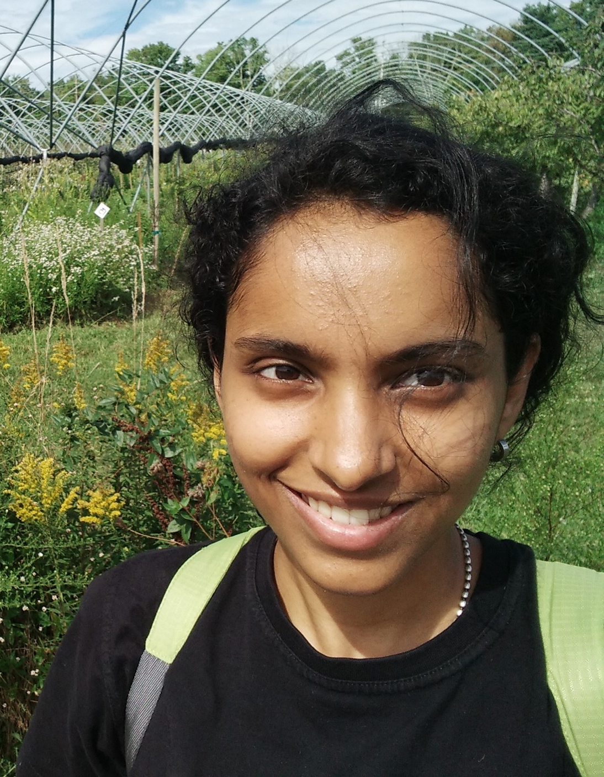
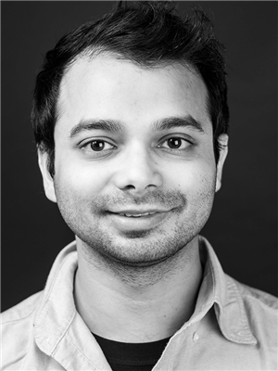
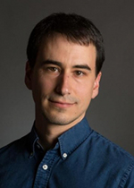
The Power of Adaptivity in Quantum Query Algorithms
Kewen Wu (UC Berkeley)
Uma Girish
Makrand Sinha
Avishay Tal
Princeton
UIUC
UC Berkeley

Slide 2


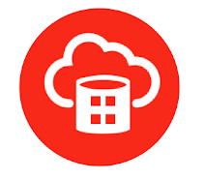
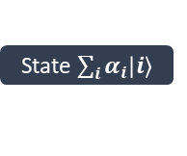


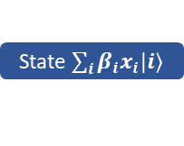

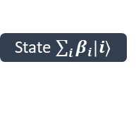

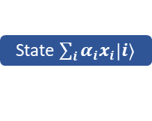
Quantum Query Model
Phase oracle
State $\sum_{i}{α_{i}\left|i\right\rangle }$
Black-box (oracle) access to the input
Computation cost:
Charged for quantum queries to the input
Free intermediate computation
Successful test bed for quantum algorithms
Grover’s search, Bernstein-Vazirani algorithm, Simon’s algorithm, Shor’s period-finding algorithm ……
Provable quantum advantages over classical algorithms
State $\sum_{i}{α_{i}x_{i}\left|i\right\rangle }$
State $\sum_{i}{β_{i}\left|i\right\rangle }$
State $\sum_{i}{β_{i}x_{i}\left|i\right\rangle }$
$$⋯⋯$$
$f\left(x\right)$ ?
$f\left(x\right)$ !
$$x∈{\left\{±1\right\}}^{N}$$

Slide 3
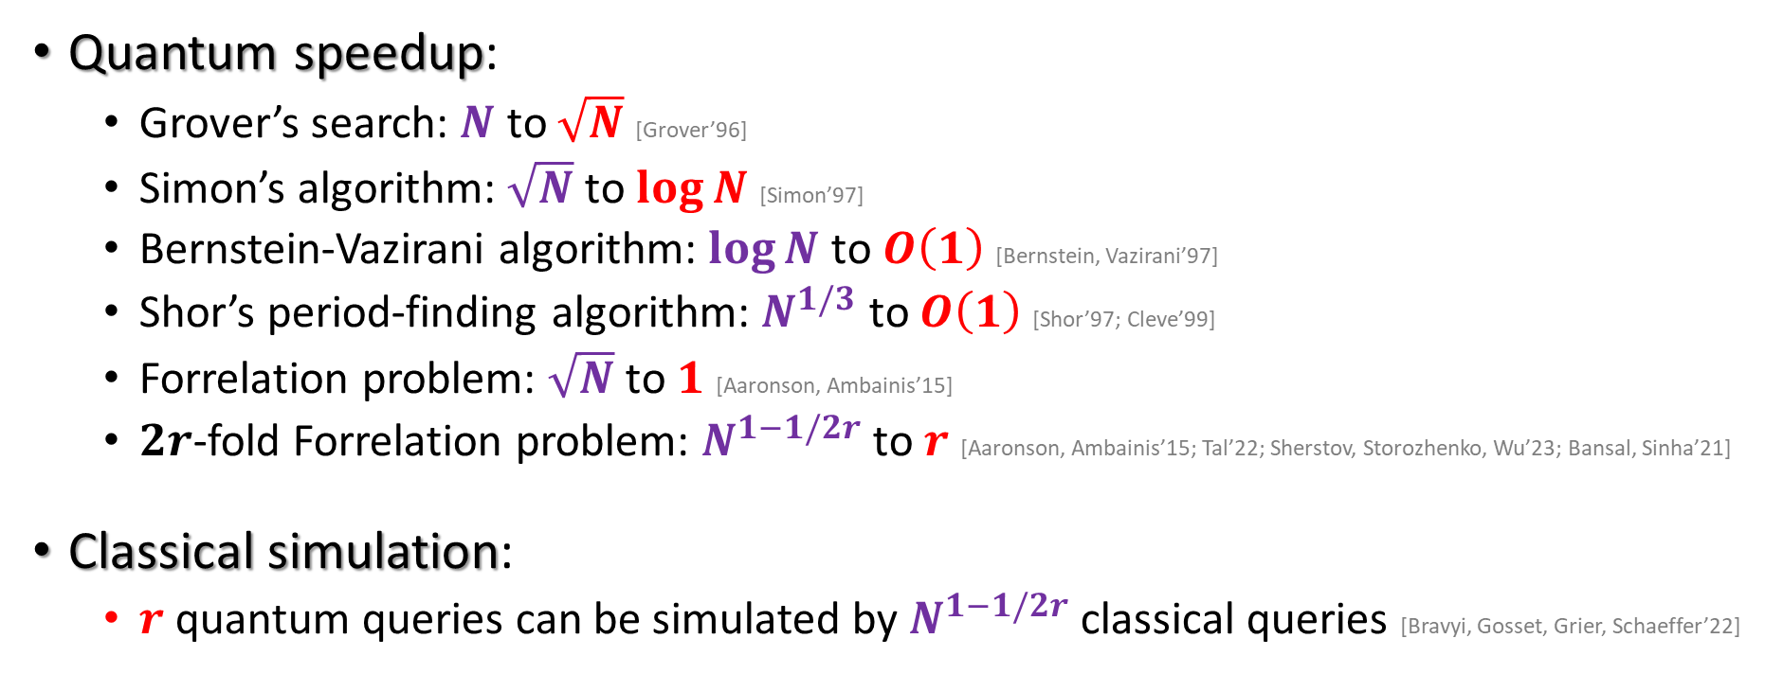

Quantum Speedup over Classical Query
Randomized
Boolean function $f:{\left\{±1\right\}}^{N}→\left\{±1,⋆\right\}$
Quantum speedup:
Grover’s search: $N$ to $\sqrt{N}$ [Grover’96]
Simon’s algorithm: $\sqrt{N}$ to $\log{N}$ [Simon’97]
Bernstein-Vazirani algorithm: $\log{N}$ to $O\left(1\right)$ [Bernstein, Vazirani’97]
Shor’s period-finding algorithm: $N^{1/3}$ to $O\left(1\right)$ [Shor’97; Cleve’99]
Forrelation problem: $\sqrt{N}$ to $1$ [Aaronson, Ambainis’15]
$2r$-fold Forrelation problem: $N^{1−1/2r}$ to $r$ [Aaronson, Ambainis’15; Tal’22; Sherstov, Storozhenko, Wu’23; Bansal, Sinha’21]
Classical simulation:
$r$ quantum queries can be simulated by $N^{1−1/2r}$ classical queries [Bravyi, Gosset, Grier, Schaeffer’22]
Tight separation
Unbounded speedup!

Slide 4
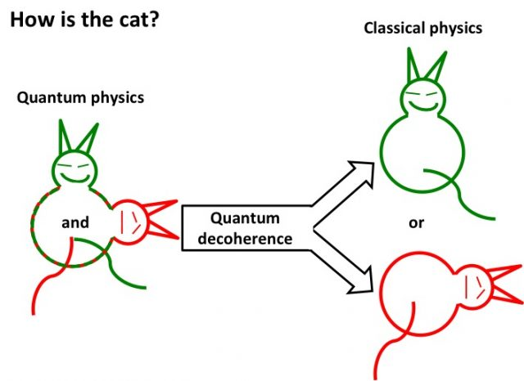
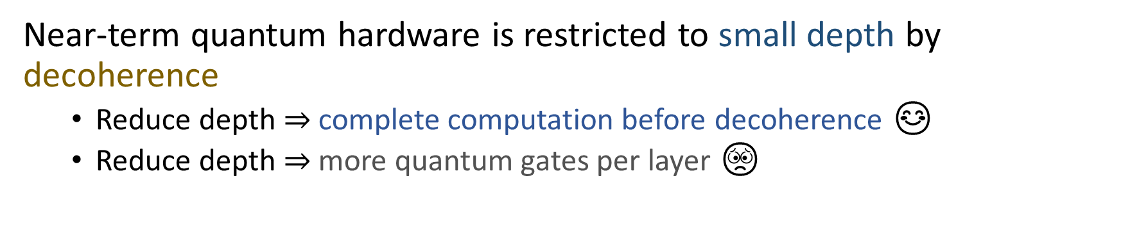
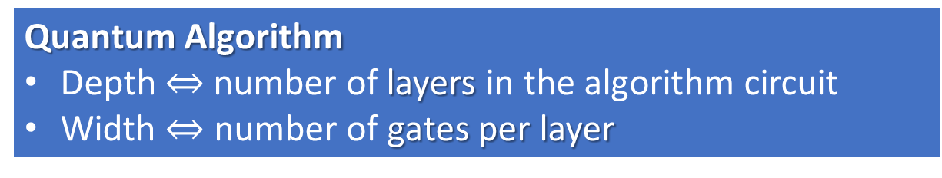
Depth-Width Trade-Off
Decoherence
Near-term quantum hardware is restricted to small depth by decoherence
Reduce depth $⇒$ complete computation before decoherence 😊
Reduce depth $⇒$ more quantum gates per layer 😟
Quantum Algorithm
Depth $⇔$ number of layers in the algorithm circuit
Width $⇔$ number of gates per layer
Size
Parallelizing quantum Fourier transform [Cleve, Watrous’00]
Parallelizing Shor’s factoring algorithm [Cleve, Watrous’00; Regev’23]
Certain staircase quantum circuit may not be efficiently parallelized [Moore, Nilsson’01]

Slide 5
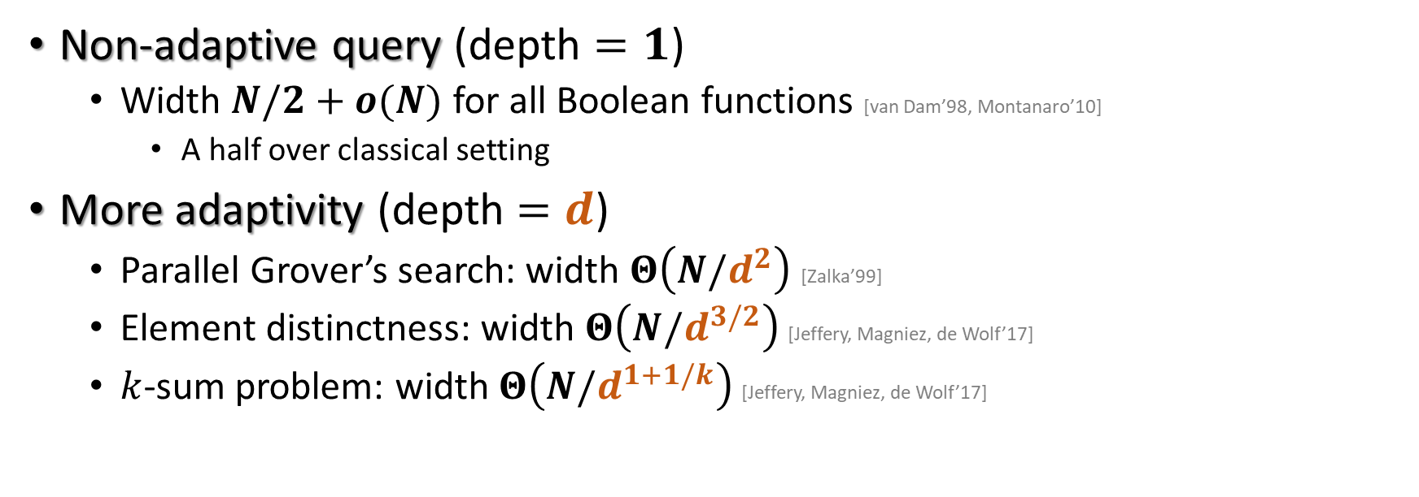
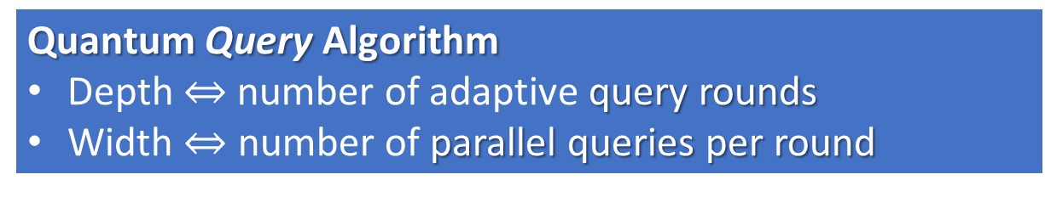
Depth-Width Trade-Off in Quantum Queries
Quantum Query Algorithm
Depth $⇔$ number of adaptive query rounds
Width $⇔$ number of parallel queries per round
Total query
Non-adaptive query (depth $=1$)
Width $N/2+o(N)$ for all Boolean functions [van Dam’98, Montanaro’10]
A half over classical setting
More adaptivity (depth $=d$)
Parallel Grover’s search: width $Θ\left(N/d^{2}\right)$ [Zalka’99]
Element distinctness: width $Θ\left(N/d^{3/2}\right)$ [Jeffery, Magniez, de Wolf’17]
$k$-sum problem: width $Θ\left(N/d^{1+1/k}\right)$ [Jeffery, Magniez, de Wolf’17]
Even if the depth is doubled,
the saving is only a constant
Largest saving from more quantum query adaptivity?

Slide 6
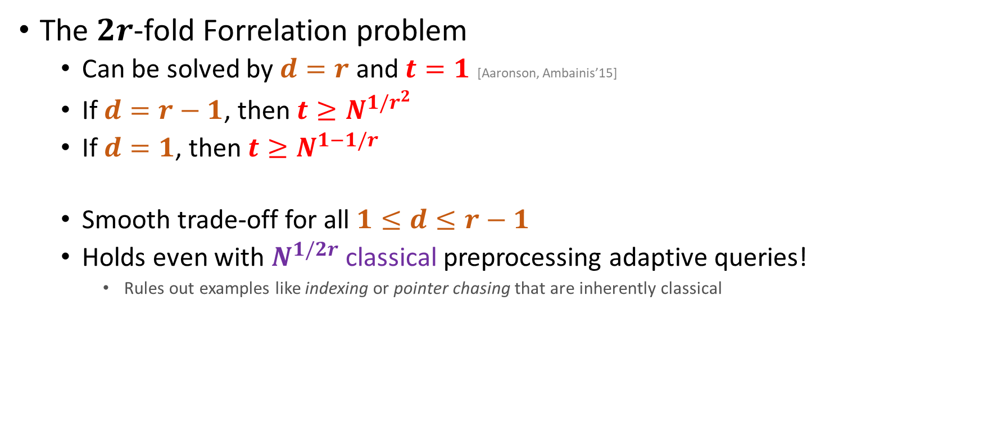
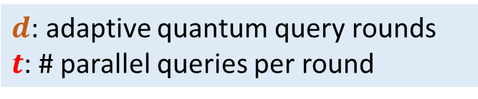
Our Results
$d$: adaptive quantum query rounds
$t$: # parallel queries per round
Provided maximal
quantum-classical separation
Also witness separation for quantum-less quantum
The $2r$-fold Forrelation problem
Can be solved by $d=r$ and $t=1$ [Aaronson, Ambainis’15]
If $d=r−1$, then ${t≥N}^{1/r^{2}}$
If $d=1$, then ${t≥N}^{1−1/r}$
Smooth trade-off for all $1≤d≤r−1$
Holds even with $N^{1/2r}$ classical preprocessing adaptive queries!
Rules out examples like indexing or pointer chasing that are inherently classical
One more adaptive round already gives more power
Non-adaptive quantum queries barely outperform brute force
In the quantum query model, being more adaptive can be unboundedly more powerful!

Slide 7
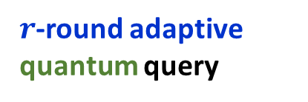
Progress on Quantum Query Advantages
Non-adaptive quantum query
3-round adaptive quantum query
Our work
Computational Power
Previous works
Classical query
2-round adaptive quantum query
$r$-round adaptive quantum query

Slide 8
Proof Overview
Fourier-sparse functions cannot approximately compute Forrelation and its variants [Raz, Tal’22; Tal’22; Bansal, Sinha’21]
Led to many quantum-classical separations: circuit [Raz, Tal’22], query [Tal’22; Bansal, Sinha’21; Sherstov, Storozhenko, Wu’23; Girish, Tal, Wu’21], communication [Girish, Raz, Tal’22; Girish, Sinha, Tal, Wu’23]
We extend the framework to study quantum vs less quantum algorithms
Suffices to show: quantum query algorithms with small depth and limited width are Fourier-sparse
Matrix analysis instead of polynomial analysis [Iyer, Rao, Reis, Rothvoss, Yehudayoff’21; Eskenazis, Ivanisvili’22]

Slide 9
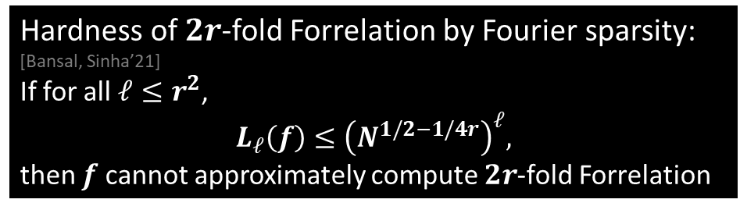
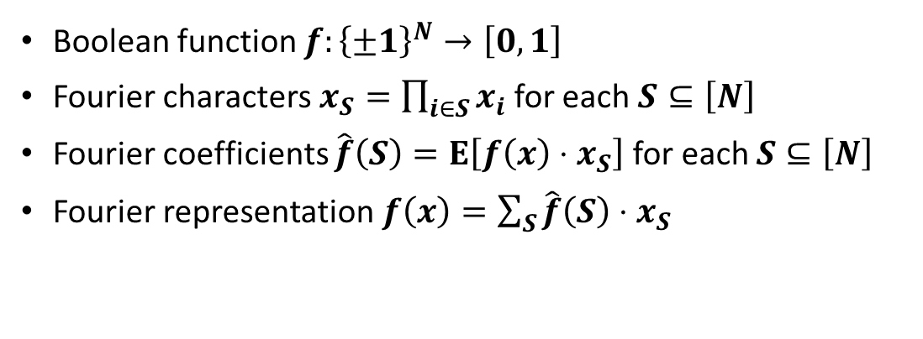



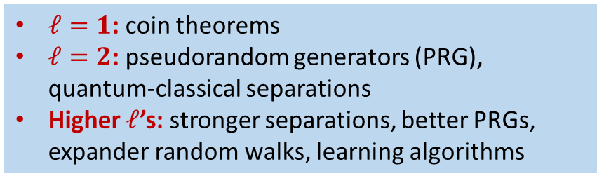
Boolean Functions and Fourier Growth
Level-$ℓ$ Fourier growth
$$L_{ℓ}\left(f\right)=\sum_{S:\left|S\right|=ℓ}{\left|\hat{f}\left(S\right)\right|}$$
Boolean function $f:{\left\{±1\right\}}^{N}→\left[0,1\right]$
Fourier characters $x_{S}=\prod_{i∈S}{x_{i}}$ for each $S⊆\left[N\right]$
Fourier coefficients $\hat{f}\left(S\right)=E\left[f\left(x\right)⋅x_{S}\right]$ for each $S⊆\left[N\right]$
Fourier representation $f\left(x\right)=\sum_{S}{\hat{f}\left(S\right)⋅x_{S}}$
Fourier-sparse: $L_{ℓ}\left(f\right)$ is small for a range of $ℓ$
Established for DNFs/CNFs, ${AC}^{0}$ circuits, (parity) decision trees, read-once branching programs, …
Hardness of $2r$-fold Forrelation by Fourier sparsity: [Bansal, Sinha’21]
If for all $ℓ≤r^{2}$,
$$L_{ℓ}\left(f\right)≤{\left(N^{1/2−1/4r}\right)}^{ℓ},$$
then $f$ cannot approximately compute $2r$-fold Forrelation
$ℓ=1$: coin theorems
$ℓ=2$: pseudorandom generators (PRG), quantum-classical separations
Higher $ℓ$’s: stronger separations, better PRGs, expander random walks, learning algorithms

Slide 10

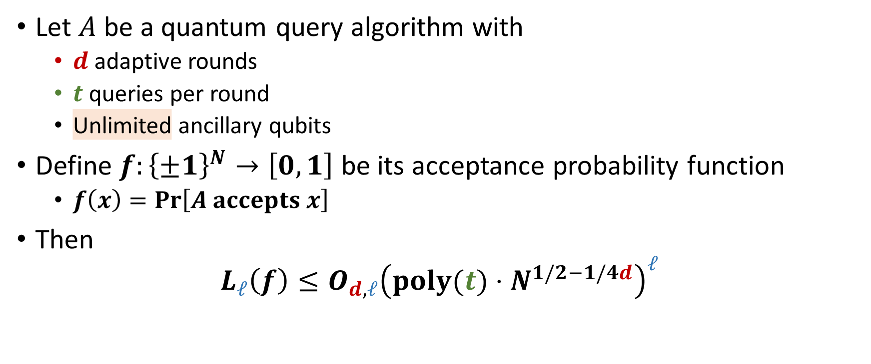
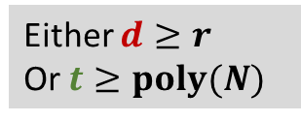
Our Results – Alternative Form
Let $A$ be a quantum query algorithm with
$d$ adaptive rounds
$t$ queries per round
Unlimited ancillary qubits
Define $f:{\left\{±1\right\}}^{N}→\left[0,1\right]$ be its acceptance probability function
$f\left(x\right)=\operatorname{Pr}\left[A accepts x\right]$
Then
$$L_{ℓ}\left(f\right)≤O_{d,ℓ}{\left(poly(t)⋅N^{1/2−1/4d}\right)}^{ℓ}$$
$A$ cannot approximately compute $2r$-fold Forrelation if
$$L_{ℓ}\left(f\right)≤{\left(N^{1/2−1/4r}\right)}^{ℓ}$$
Either $d≥r$
Or $t≥poly(N)$

Slide 11
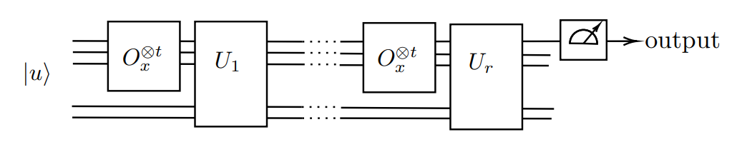
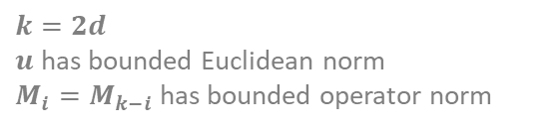

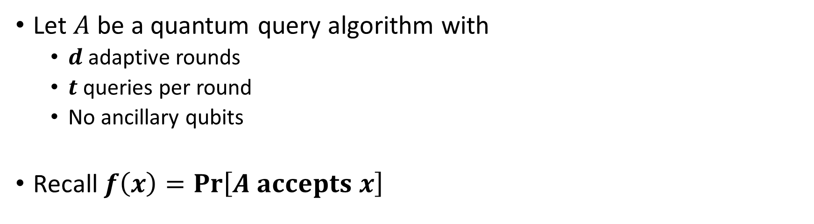



Formalizing $f$
Goal: $L_{ℓ}\left(f\right)≤O_{d,ℓ}{\left(poly(t)⋅N^{1/2−1/4d}\right)}^{ℓ}$
Let $A$ be a quantum query algorithm with
$d$ adaptive rounds
$t$ queries per round
No ancillary qubits
Recall $f\left(x\right)=\operatorname{Pr}\left[A accepts x\right]$
Intermediate unitary operations
Final measurement
Initial state
$$U_{1}$$
$$U_{d}$$
Parallel oracle access per round
$$f\left(x\right)=u^{⊤ }O_{x}^{⊗t}M_{1}O_{x}^{⊗t}M_{2}⋯M_{k−1}O_{x}^{⊗t}u$$
$k=2d$
$u$ has bounded Euclidean norm
$M_{i}=M_{k−i}$ has bounded operator norm
Assume for simplicity everything is real

Slide 12

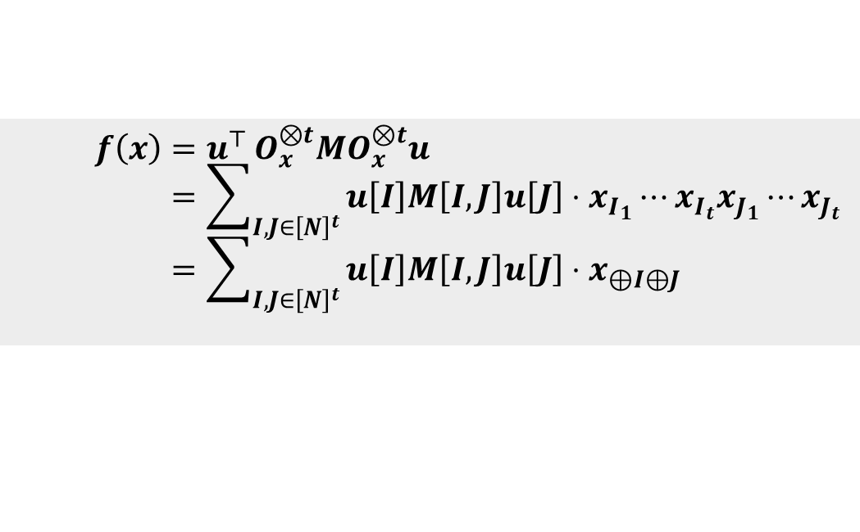
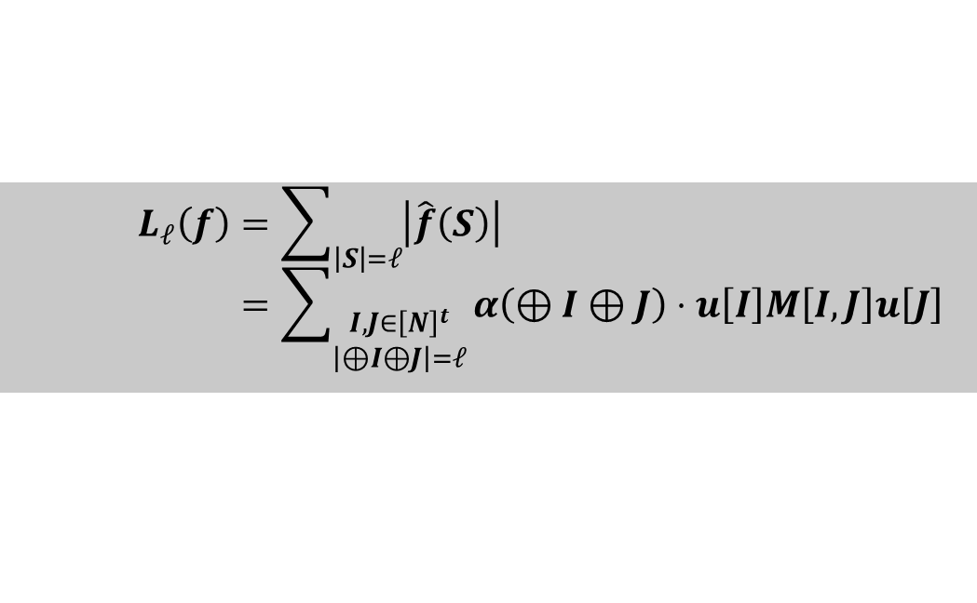


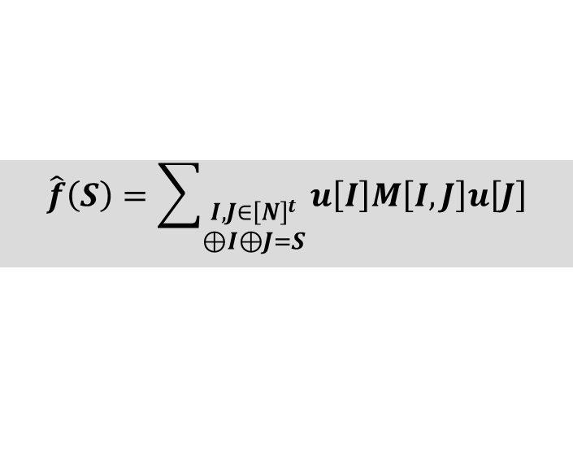
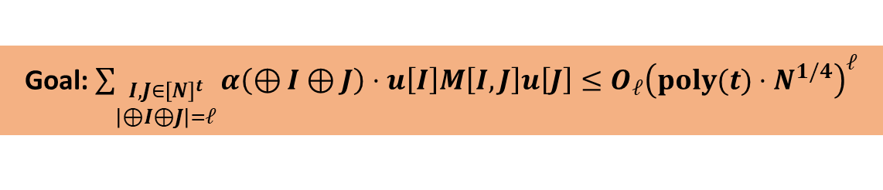


The $k=2$ Case
Goal: $L_{ℓ}\left(f\right)≤O_{ℓ}{\left(poly(t)⋅N^{1/4}\right)}^{ℓ}$
$$f\left(x\right)=u^{⊤ }O_{x}^{⊗t}MO_{x}^{⊗t}u \\ =\sum_{I,J∈{\left[N\right]}^{t}}{u\left[I\right]M\left[I,J\right]u\left[J\right]⋅x_{I_{1}}⋯x_{I_{t}}x_{J_{1}}⋯x_{J_{t}}} \\ =\sum_{I,J∈{\left[N\right]}^{t}}{u\left[I\right]M\left[I,J\right]u\left[J\right]⋅x_{⊕I⊕J}}$$
$$⊕I⊕J=\left\{i∈\left[N\right]:i appears odd times in I,J\right\}$$
$$x_{i}∈\left\{±1\right\}$$
Even appearances cancel out
$$\hat{f}\left(S\right)=\sum_{\begin{aligned}I,J∈{\left[N\right]}^{t} \\ ⊕I⊕J=S\end{aligned}}{u\left[I\right]M\left[I,J\right]u\left[J\right]}$$
$$L_{ℓ}\left(f\right)=\sum_{\left|S\right|=ℓ}{\left|\hat{f}\left(S\right)\right|} \\ =\sum_{\begin{aligned}I,J∈{\left[N\right]}^{t} \\ \left|⊕I⊕J\right|=ℓ\end{aligned}}{α\left(⊕I⊕J\right)⋅u\left[I\right]M\left[I,J\right]u\left[J\right]}$$
$$α\left(S\right)=\operatorname{sgn}\left(\hat{f}\left(S\right)\right)∈\left\{±1\right\}$$
Goal: $\sum_{\begin{aligned}I,J∈{\left[N\right]}^{t} \\ \left|⊕I⊕J\right|=ℓ\end{aligned}}{α\left(⊕I⊕J\right)⋅u\left[I\right]M\left[I,J\right]u\left[J\right]}≤O_{ℓ}{\left(poly(t)⋅N^{1/4}\right)}^{ℓ}$

Slide 13
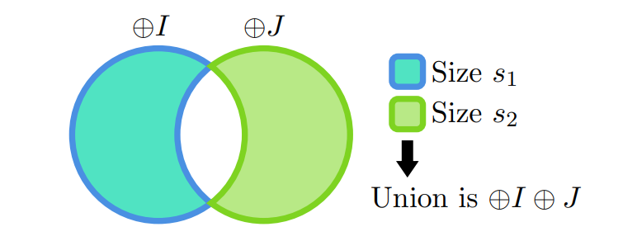
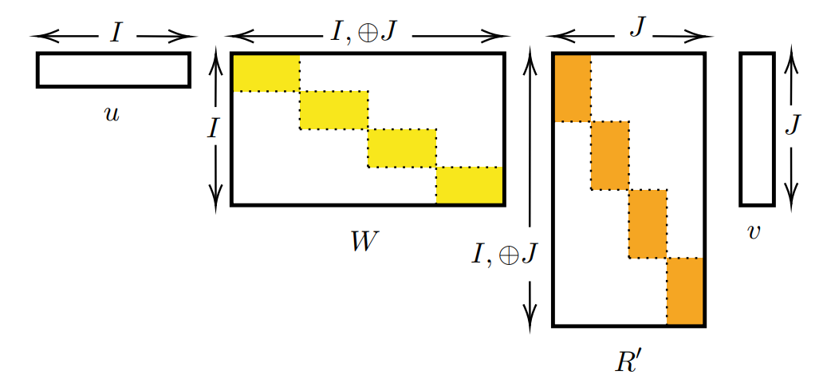
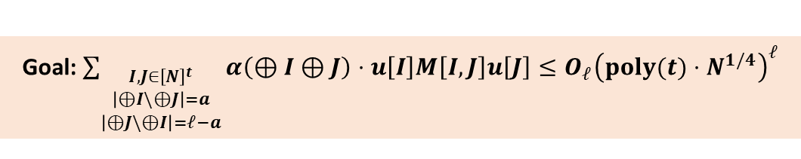

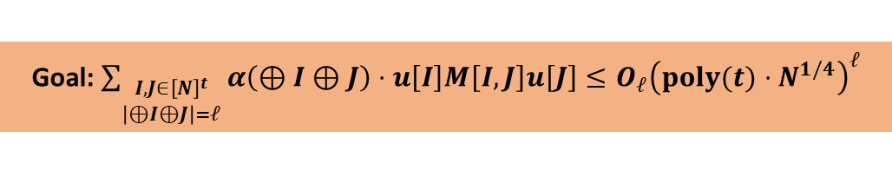
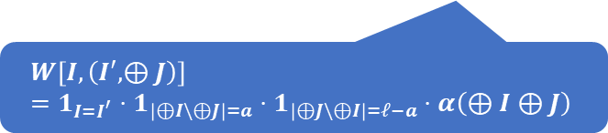
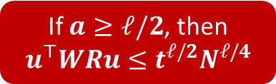





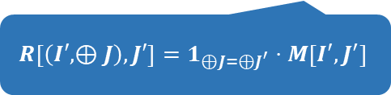
The $k=2$ Case
Goal: $\sum_{\begin{aligned}I,J∈{\left[N\right]}^{t} \\ \left|⊕I⊕J\right|=ℓ\end{aligned}}{α\left(⊕I⊕J\right)⋅u\left[I\right]M\left[I,J\right]u\left[J\right]}≤O_{ℓ}{\left(poly(t)⋅N^{1/4}\right)}^{ℓ}$
Goal: $\sum_{\begin{aligned}I,J∈{\left[N\right]}^{t} \\ \left|⊕I\backslash ⊕J\right|=a \\ \left|⊕J\backslash ⊕I\right|=ℓ−a\end{aligned}}{α\left(⊕I⊕J\right)⋅u\left[I\right]M\left[I,J\right]u\left[J\right]}≤O_{ℓ}{\left(poly(t)⋅N^{1/4}\right)}^{ℓ}$
$$a$$
$$ℓ−a$$
$$LHS=u^{⊤}WRu$$
$\left|u\right|=1$ and ${\left|M\right|}_{op}≤1$
${\left|R\right|}_{op}≤{\left|M\right|}_{op}$ by block-diagonality
${\left|W\right|}_{op}≤\sqrt{{\left|W\right|}_{1}{\left|W\right|}_{∞}}$ by Hölder's inequality
${\left|W\right|}_{1}=$ #non-zero entries per column
${\left|W\right|}_{∞}=$ #non-zero entries per row
If $\left(I,⊕J\right)$ is fixed, then $I$ is fixed
$⇒$ ${\left|W\right|}_{1}=1$
If $I$ is fixed, how many possible $⊕J$ ?
$N^{ℓ−a}$ for $⊕J \backslash ⊕I$ and $t^{a}≤t^{ℓ}$ for $⊕J∩⊕I$
$⇒$ ${\left|W\right|}_{∞}≤t^{ℓ}N^{ℓ−a}$
${\left|W\right|}_{op}≤t^{ℓ/2}N^{\left(ℓ−a\right)/2}$
$$u$$
Block diagonal
$$W\left[I,\left(I′,⊕J\right)\right]=1_{I=I^{′}}⋅1_{\left|⊕I\backslash ⊕J\right|=a}⋅1_{\left|⊕J\backslash ⊕I\right|=ℓ−a}⋅α\left(⊕I⊕J\right)$$
Block diagonal
$$R$$
$$R\left[\left(I′,⊕J\right),J′\right]=1_{⊕J=⊕J^{′}}⋅M\left[I′,J^{′}\right]$$
If $a≥ℓ/2$, then $u^{⊤}WRu≤t^{ℓ/2}N^{ℓ/4}$

Slide 14
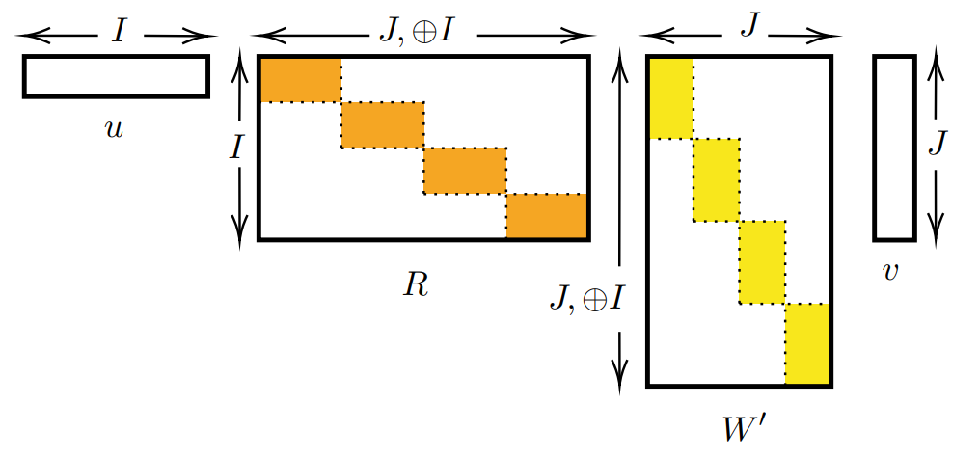


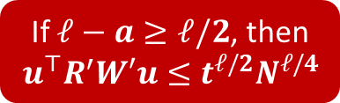






The $k=2$ Case
$$a$$
$$ℓ−a$$
Goal: $\sum_{\begin{aligned}I,J∈{\left[N\right]}^{t} \\ \left|⊕I\backslash ⊕J\right|=a \\ \left|⊕J\backslash ⊕I\right|=ℓ−a\end{aligned}}{α\left(⊕I⊕J\right)⋅u\left[I\right]M\left[I,J\right]u\left[J\right]}≤O_{ℓ}{\left(poly(t)⋅N^{1/4}\right)}^{ℓ}$
$$LHS=u^{⊤}WRu$$
$$LHS=u^{⊤}R′W′u$$
$$u$$
$$R^{′}$$
$$R$$
If $a≥ℓ/2$, then $u^{⊤}WRu≤t^{ℓ/2}N^{ℓ/4}$
If $ℓ−a≥ℓ/2$, then $u^{⊤}R^{′}W′u≤t^{ℓ/2}N^{ℓ/4}$

Slide 15
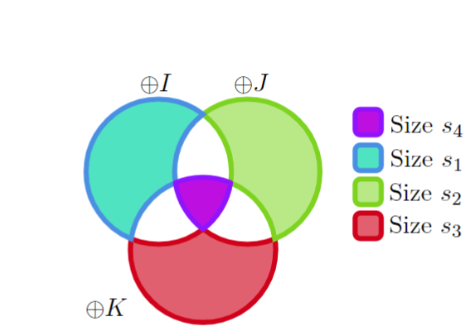
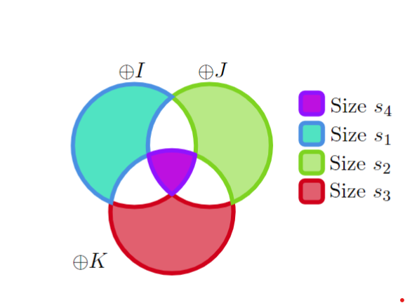
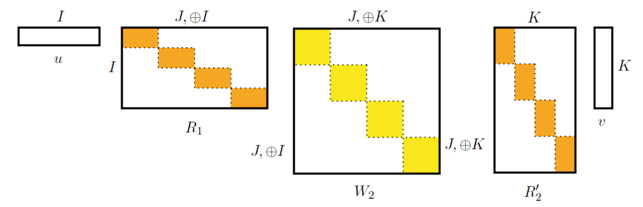
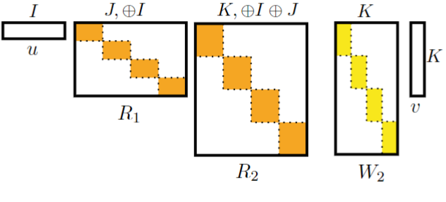
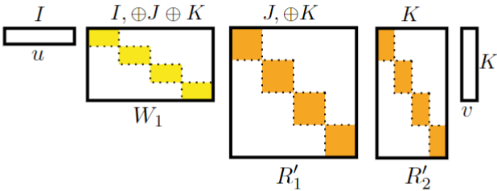


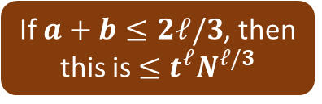
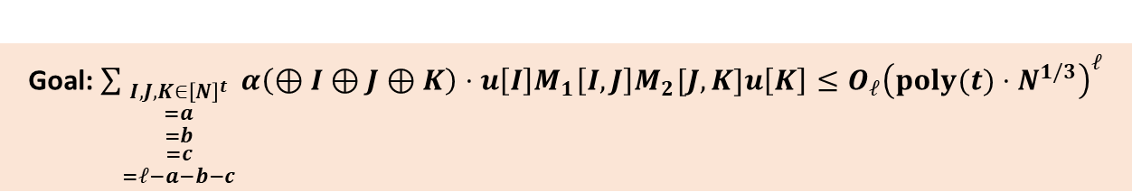



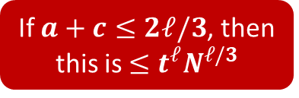




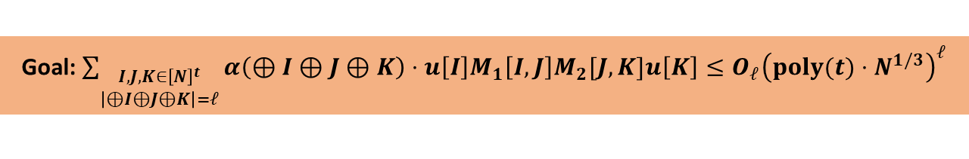

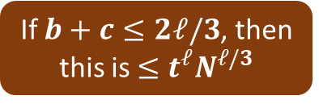
The $k=3$ Case
$ℓ−a−b−c$
$a$
$b$
$c$
Goal: $\sum_{\begin{aligned}I,J,K∈{\left[N\right]}^{t} \\ \left|⊕I⊕J⊕K\right|=ℓ\end{aligned}}{α\left(⊕I⊕J⊕K\right)⋅u\left[I\right]M_{1}\left[I,J\right]M_{2}[J,K]u\left[K\right]}≤O_{ℓ}{\left(poly(t)⋅N^{1/3}\right)}^{ℓ}$
Goal: $\sum_{\begin{aligned}I,J,K∈{\left[N\right]}^{t} \\ =a \\ =b \\ =c \\ =ℓ−a−b−c\end{aligned}}{α\left(⊕I⊕J⊕K\right)⋅u\left[I\right]M_{1}\left[I,J\right]M_{2}[J,K]u\left[K\right]}≤O_{ℓ}{\left(poly(t)⋅N^{1/3}\right)}^{ℓ}$
$$\left|u\right|=1$$
$$\left|u\right|=1$$
$$W′′$$
$${\left|R_{1}\right|}_{op}≤{\left|M_{1}\right|}_{op}≤1$$
$$W′$$
$$W$$
$${\left|W′\right|}_{op}≤\sqrt{{\left|W^{′}\right|}_{1}{\left|W^{′}\right|}_{∞}} \\ ≤\sqrt{t^{ℓ}N^{a}⋅t^{ℓ}N^{c}}$$
$${\left|R_{2}^{′}\right|}_{op}≤{\left|M_{2}\right|}_{op}≤1$$
If $a+b≤2ℓ/3$, then this is $≤t^{ℓ}N^{ℓ/3}$
If $b+c≤2ℓ/3$, then this is $≤t^{ℓ}N^{ℓ/3}$
Identification issue!
If $a+c≤2ℓ/3$, then this is $≤t^{ℓ}N^{ℓ/3}$
Identification issue!

Slide 16







The $k=3$ Case
Goal: $\sum_{\begin{aligned}I,J,K∈{\left[N\right]}^{t} \\ =a \\ =b \\ =c \\ =ℓ−a−b−c\end{aligned}}{α\left(⊕I⊕J⊕K\right)⋅u\left[I\right]M_{1}\left[I,J\right]M_{2}[J,K]u\left[K\right]}≤O_{ℓ}{\left(poly(t)⋅N^{1/3}\right)}^{ℓ}$
$$W′′$$
$⊕J⊕K$ and $I$ do not uniquely identify xxxxxxxx
Expanding $⊕J⊕K$ to $⊕J,⊕K$ fixes the issue
But each $I$ corresponds to too many $⊕J,⊕K$
$⇒$ each row of $W^{′′}$will have too many non-zeros entries
$⇒$ ${\left|W^{′′}\right|}_{op}$ is too large 😟
?
?
$$⊕I$$
$$⊕J⊕K$$
Give up exact identification!

Slide 17







The $k=3$ Case
Compute: $\sum_{\begin{aligned}I,J,K∈{\left[N\right]}^{t} \\ =a \\ =b \\ =c \\ =ℓ−a−b−c\end{aligned}}{α\left(⊕I⊕J⊕K\right)⋅u\left[I\right]M_{1}\left[I,J\right]M_{2}[J,K]u\left[K\right]}≤O_{ℓ}{\left(poly(t)⋅N^{1/3}\right)}^{ℓ}$
Relaxed partition
Similarly handle the other cases
$a+b≤2ℓ/3$
$a+c≤2ℓ/3$
Use inclusion-exclusion to get the correct $L_{ℓ}\left(f\right)$
$O_{ℓ}\left(1\right)$ many possible
$⇒$ $O_{ℓ}\left(1\right)$ blowup from the inversion
Norm $≤poly\left(t^{ℓ}\right)⋅N^{\left(b+c\right)/2}$
Norm $≤1$
Norm $≤poly\left(t^{ℓ}\right)$
If $b+c≤2ℓ/3$, then this is $≤{\left(poly\left(t\right)⋅N^{1/3}\right)}^{ℓ}$

Slide 18

Summary
Adaptivity can be extremely helpful in quantum query algorithms
Problem solvable by constant adaptive rounds of one quantum query per round
But not solvable by polynomial many quantum queries with one round fewer
Even given polynomial many classical preprocessing adaptive queries
Open problem: fine-grained simulation of quantum query algorithms
Let $A$ be an algorithm with $r$ rounds and $w$ quantum queries per round
Conjecture: $A$ can be simulated by $O_{w}\left(N^{1−1/2r}\right)$ classical queries
The special case $w=1$ has been proved [Bravyi, Gosset, Grier, Schaeffer’22]
Question: what about simulation by less adaptive quantum algorithms?
Thank you!

