Slide 1
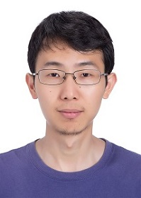
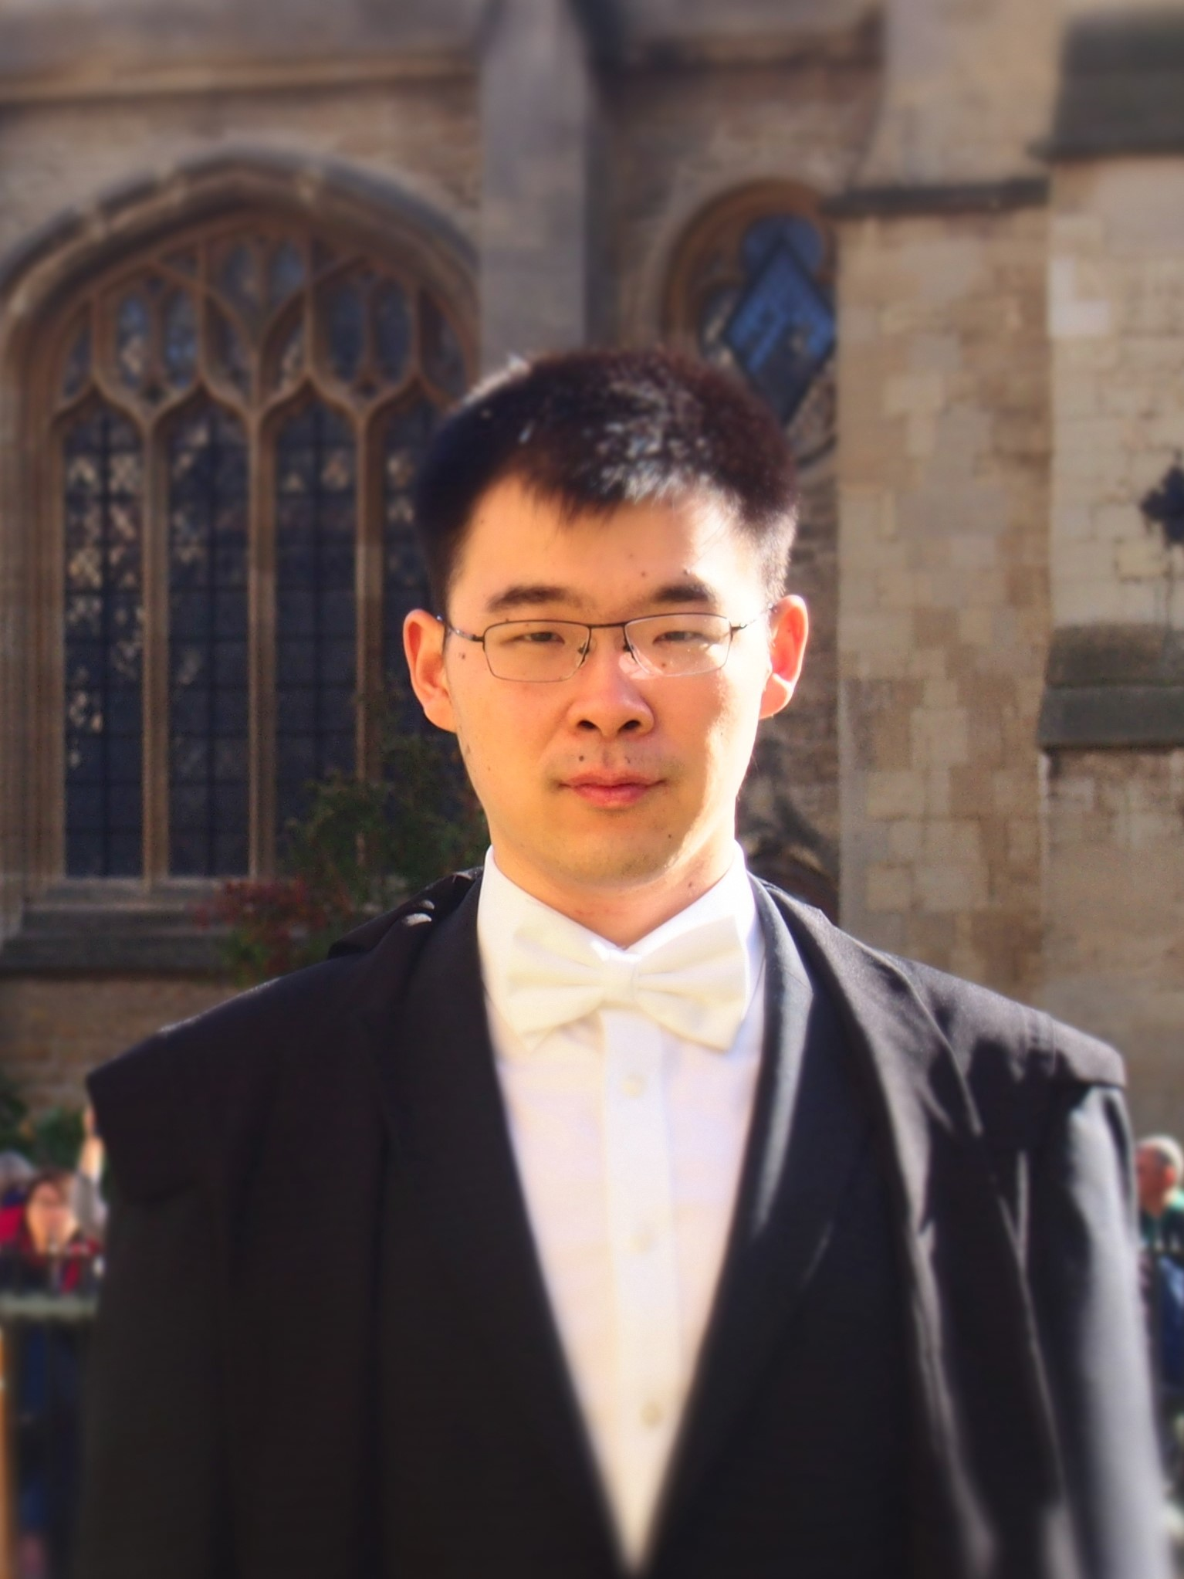
Improved Bounds for Sampling Solutions of Random CNF Formulas
Kewen Wu (UC Berkeley)
with Kun He (Inst of Computing Technology, Chinese Academy of Sciences)
and Kuan Yang (John Hopcroft Center, Shanghai Jiao Tong Univ)

Slide 2
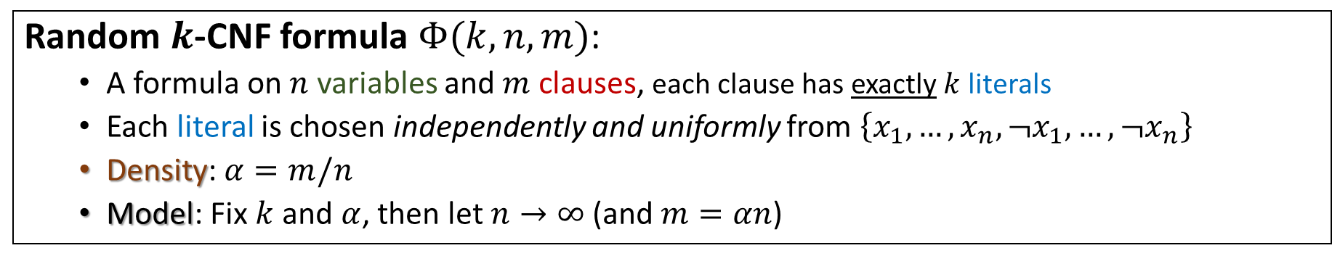
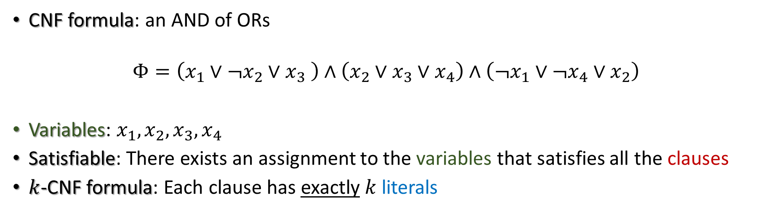
Conjunctive Normal Forms (CNFs)
CNF formula: an AND of ORs
$$Φ=\left(x_{1}∨¬x_{2}∨x_{3} \right)∧\left(x_{2}∨x_{3}∨x_{4}\right)∧\left(¬x_{1}∨¬x_{4}∨x_{2}\right)$$
Variables: $x_{1},x_{2},x_{3},x_{4}$
Satisfiable: There exists an assignment to the variables that satisfies all the clauses
$k$-CNF formula: Each clause has exactly $k$ literals
Clause
Literal
Random $k$-CNF formula $Φ(k,n,m)$:
A formula on $n$ variables and $m$ clauses, each clause has exactly $k$ literals
Each literal is chosen independently and uniformly from $\left\{x_{1},…,x_{n},¬x_{1},…,¬x_{n}\right\}$
Density: $α=m/n$
Model: Fix $k$ and $α$, then let $n→∞$ (and $m=αn$)

Slide 3
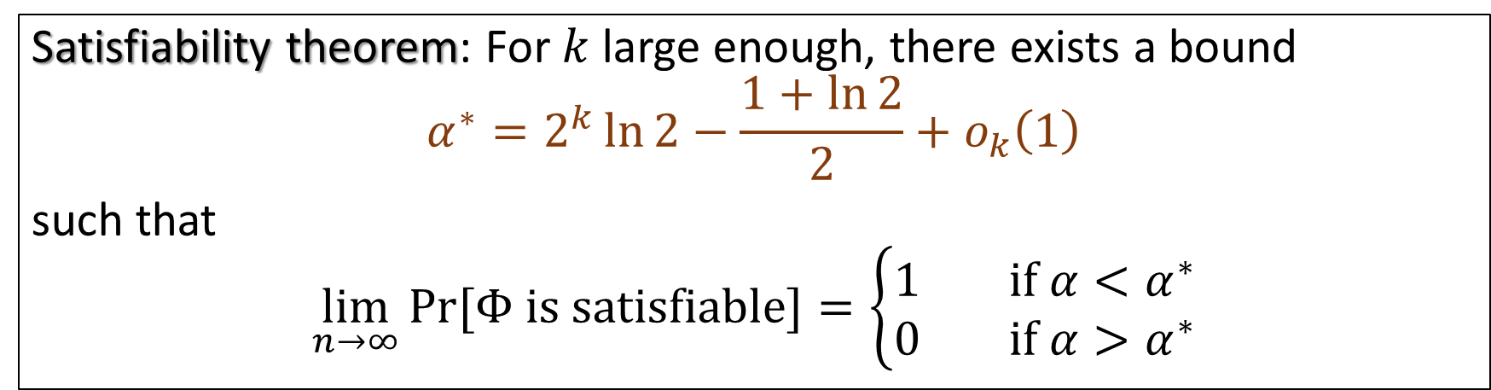
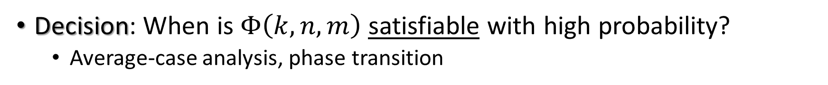
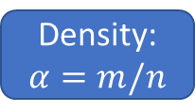
Questions for Random CNF Formulas
Density: $α=m/n$
Decision: When is $Φ\left(k,n,m\right)$ satisfiable with high probability?
Average-case analysis, phase transition
Satisfiability theorem: For $k$ large enough, there exists a bound
$$α^{∗}=2^{k}\ln{2}−\frac{1+\ln{2}}{2}+o_{k}\left(1\right)$$
such that
$$\lim_{n→∞}\operatorname{Pr}{[Φ is satisfiable]}=\left\{\begin{aligned}1 if α<α^{∗} \\ 0 if α>α^{∗}\end{aligned}\right.$$
[KKK’98,F’99,AM’02,AP’03,COP’16,DSS’22]

Slide 4
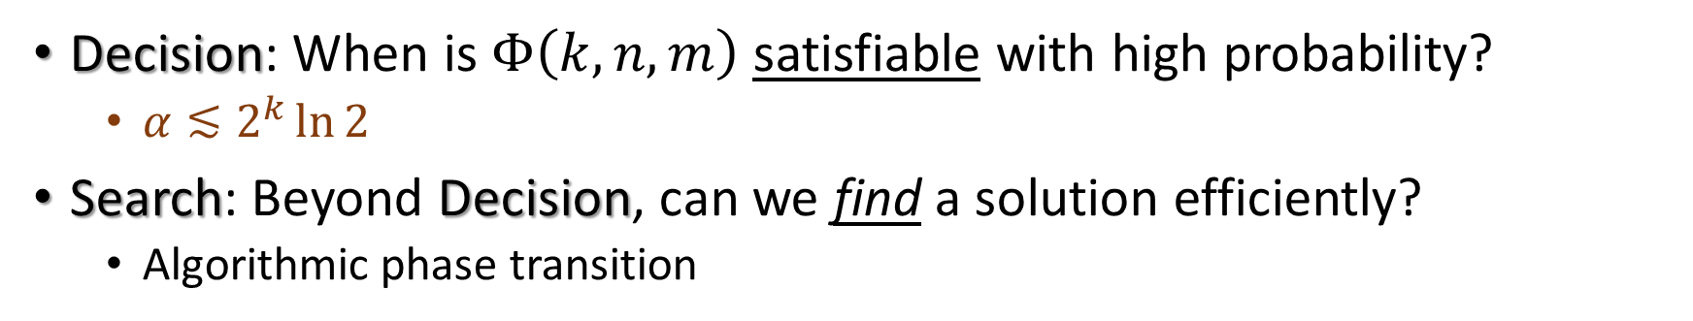
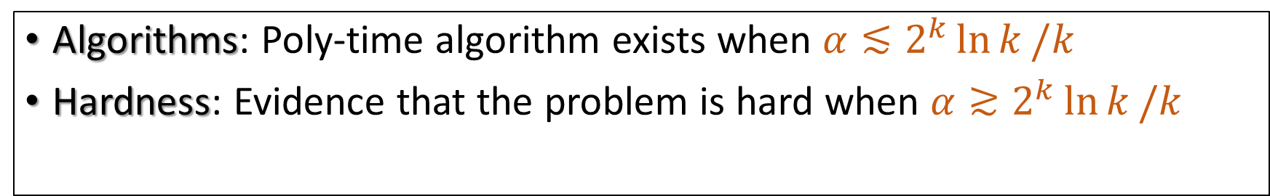
Questions for Random CNF Formulas
Density: $α=m/n$
Decision: When is $Φ\left(k,n,m\right)$ satisfiable with high probability?
$α≲2^{k}\ln{2}$
Search: Beyond Decision, can we find a solution efficiently?
Algorithmic phase transition
Algorithms: Poly-time algorithm exists when $α≲2^{k}\ln{k}/k$
Hardness: Evidence that the problem is hard when $α≳2^{k}\ln{k}/k$
[CO’10]
[ACO’08, H’16,COHH’17,BH’22]

Slide 5
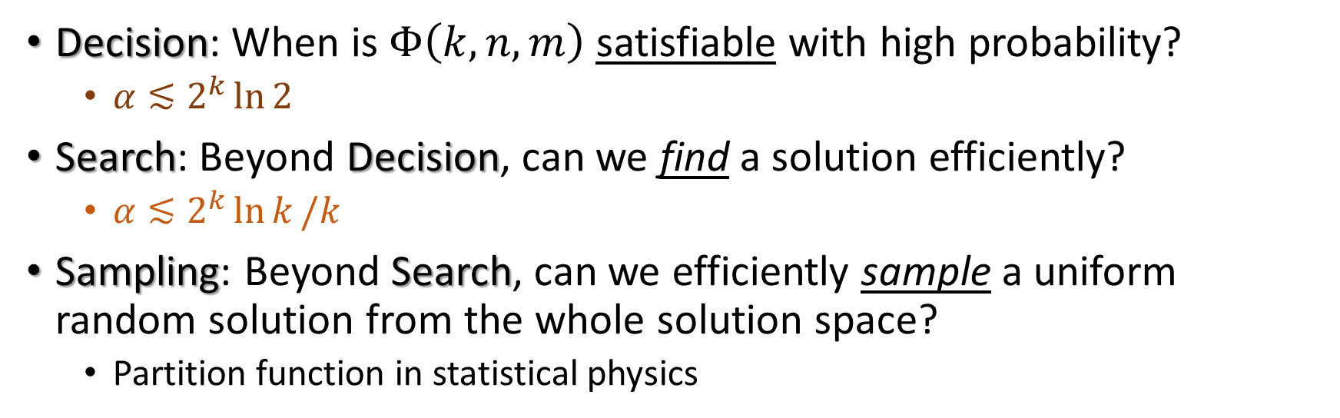
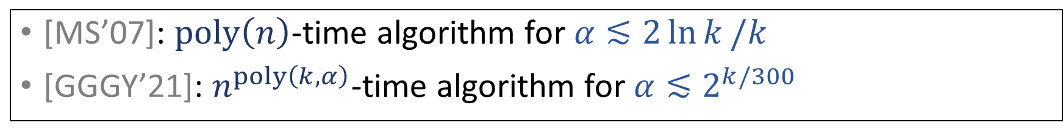
Questions for Random CNF Formulas
Density: $α=m/n$
Decision: When is $Φ\left(k,n,m\right)$ satisfiable with high probability?
$α≲2^{k}\ln{2}$
Search: Beyond Decision, can we find a solution efficiently?
$α≲2^{k}\ln{k}/k$
Sampling: Beyond Search, can we efficiently sample a uniform random solution from the whole solution space?
Partition function in statistical physics
[MS’07]: $poly\left(n\right)$-time algorithm for $α≲2\ln{k}/k$
[GGGY’21]: $n^{poly\left(k,α\right)}$-time algorithm for $α≲2^{k/300}$

Slide 6
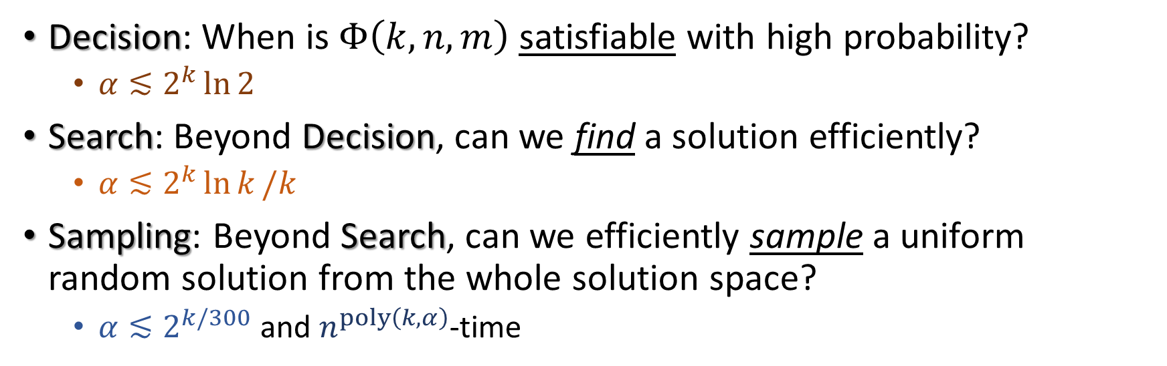
Questions for Random CNF Formulas
Density: $α=m/n$
Decision: When is $Φ\left(k,n,m\right)$ satisfiable with high probability?
$α≲2^{k}\ln{2}$
Search: Beyond Decision, can we find a solution efficiently?
$α≲2^{k}\ln{k}/k$
Sampling: Beyond Search, can we efficiently sample a uniform random solution from the whole solution space?
$α≲2^{k/300}$ and $n^{poly\left(k,α\right)}$-time
Our focus

Slide 7
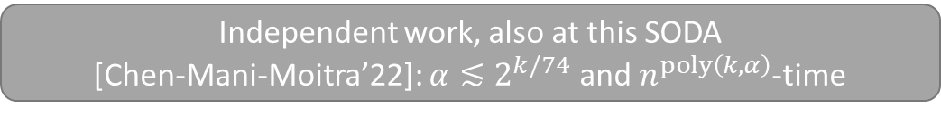
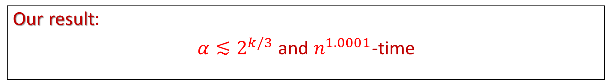
Questions for Random CNF Formulas
Density: $α=m/n$
Decision: When is $Φ\left(k,n,m\right)$ satisfiable with high probability?
$α≲2^{k}\ln{2}$
Search: Beyond Decision, can we find a solution efficiently?
$α≲2^{k}\ln{k}/k$
Sampling: Beyond Search, can we efficiently sample a uniform random solution from the whole solution space?
$α≲2^{k/300}$ and $n^{poly\left(k,α\right)}$-time
Independent work, also at this SODA
[Chen-Mani-Moitra’22]: $α≲2^{k/74}$ and $n^{poly\left(k,α\right)}$-time
Our result:
$α≲2^{k/3}$ and $n^{1.0001}$-time

Slide 8
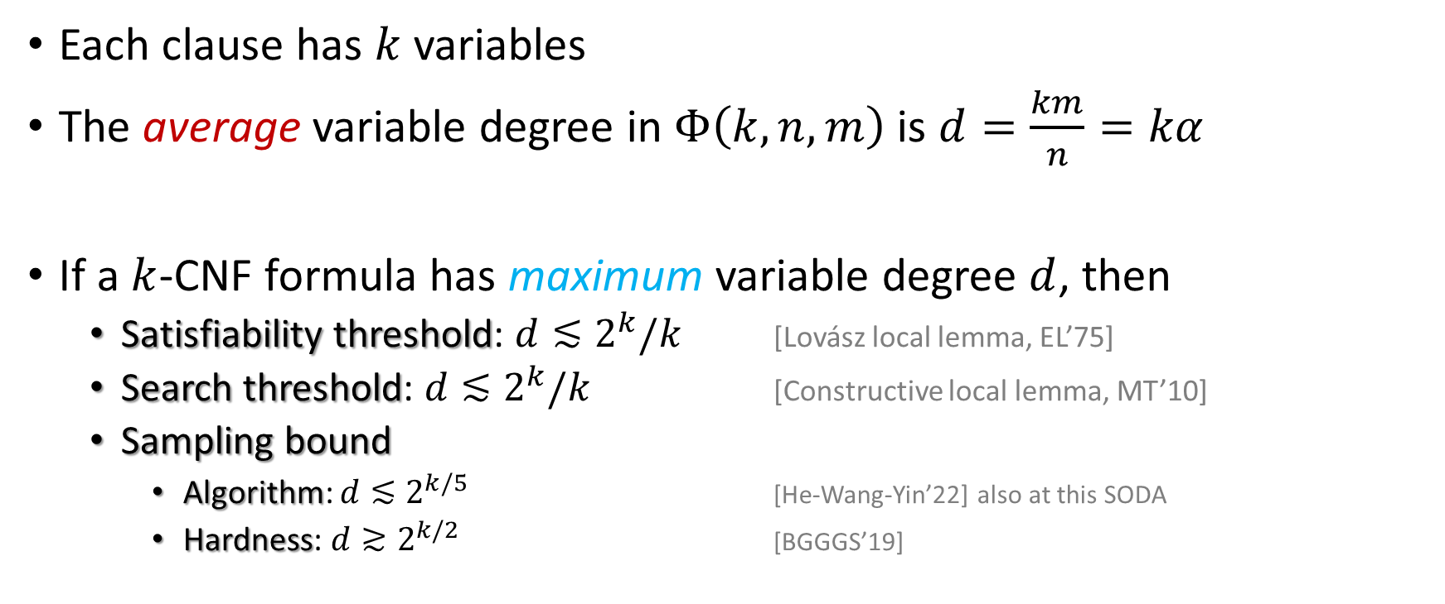

Random vs Standard $k$-CNF Formulas
Each clause has $k$ variables
The average variable degree in $Φ\left(k,n,m\right)$ is $d=\frac{km}{n}=kα$
If a $k$-CNF formula has maximum variable degree $d$, then
Satisfiability threshold: $d≲2^{k}/k$ [Lovász local lemma, EL’75]
Search threshold: $d≲2^{k}/k$ [Constructive local lemma, MT’10]
Sampling bound
Algorithm: $d≲2^{k/5}$ [He-Wang-Yin’22] also at this SODA
Hardness: $d≳2^{k/2}$ [BGGGS’19]

Slide 9
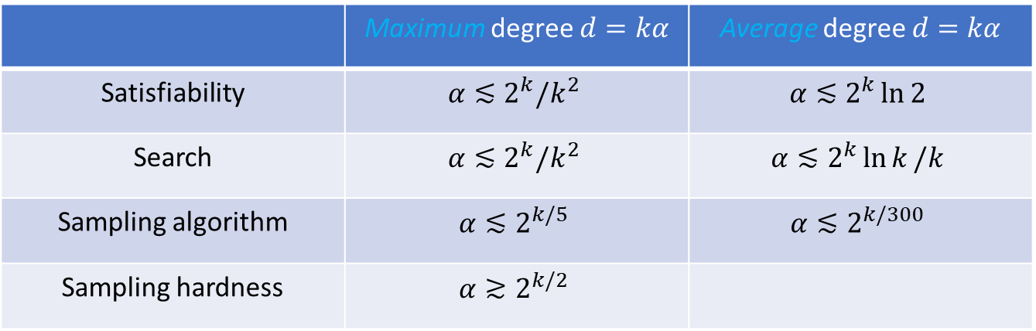
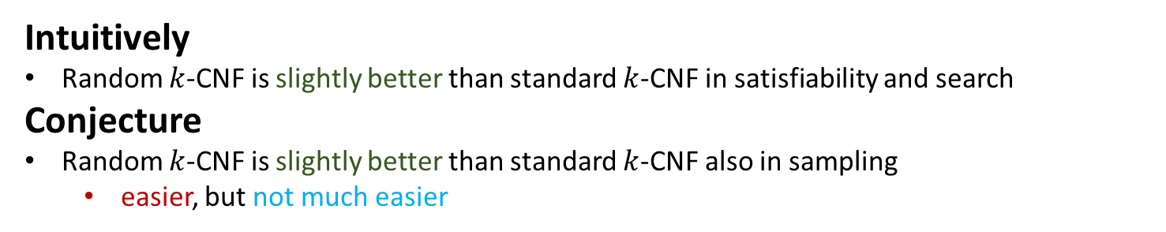
Random vs Standard $k$-CNF Formulas
 | Maximum degree $d=kα$ | Average degree $d=kα$
Satisfiability | $$α≲2^{k}/k^{2}$$ | $$α≲2^{k}\ln{2}$$
Search | $$α≲2^{k}/k^{2}$$ | $$α≲2^{k}\ln{k}/k$$
Sampling algorithm | $$α≲2^{k/5}$$ | $$α≲2^{k/300}$$
Sampling hardness | $$α≳2^{k/2}$$
Intuitively
Random $k$-CNF is slightly better than standard $k$-CNF in satisfiability and search
Conjecture
Random $k$-CNF is slightly better than standard $k$-CNF also in sampling
easier, but not much easier

Slide 10
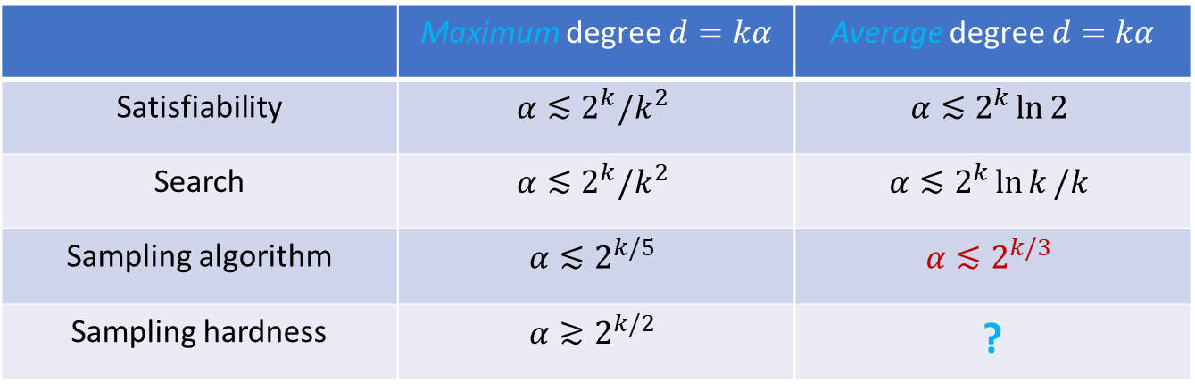
Random vs Standard $k$-CNF Formulas
 | Maximum degree $d=kα$ | Average degree $d=kα$
Satisfiability | $$α≲2^{k}/k^{2}$$ | $$α≲2^{k}\ln{2}$$
Search | $$α≲2^{k}/k^{2}$$ | $$α≲2^{k}\ln{k}/k$$
Sampling algorithm | $$α≲2^{k/5}$$ | $$α≲2^{k/3}$$
Sampling hardness | $$α≳2^{k/2}$$ | ?
Intuitively
Random $k$-CNF is slightly better than standard $k$-CNF in satisfiability and search
Conjecture
Random $k$-CNF is slightly better than standard $k$-CNF also in sampling
easier, but not much easier

Slide 11
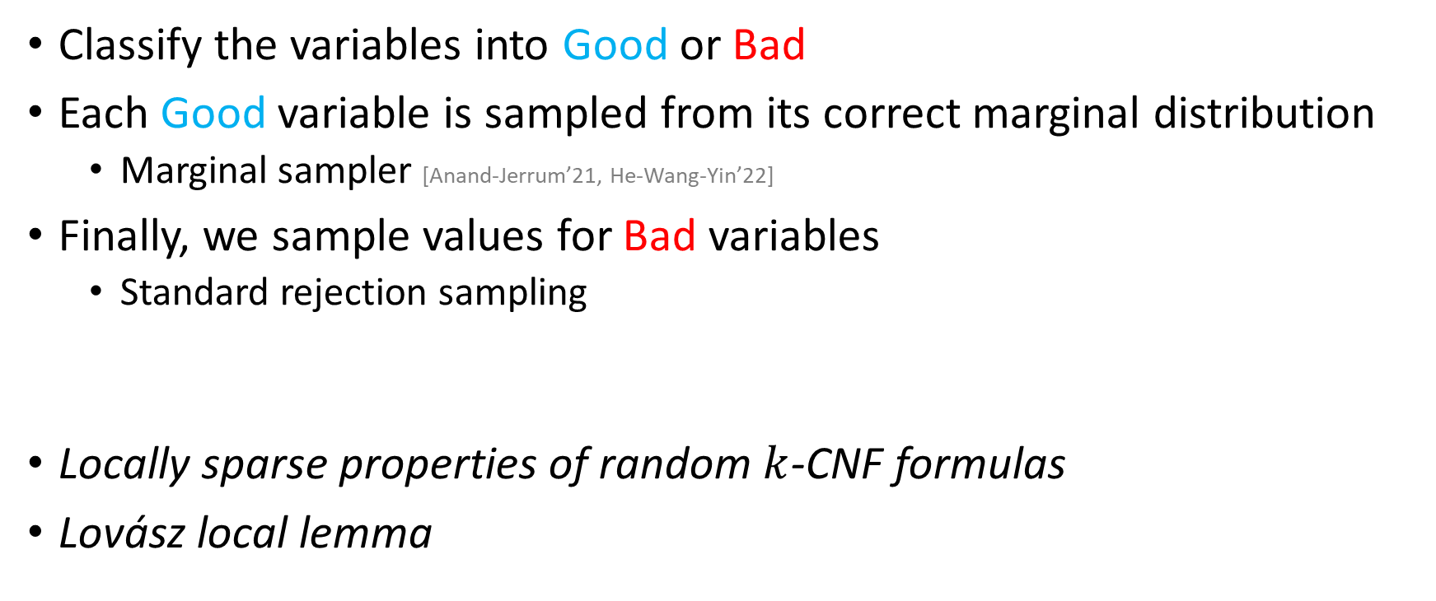
Proof Overview
Classify the variables into Good or Bad
Each Good variable is sampled from its correct marginal distribution
Marginal sampler [Anand-Jerrum’21, He-Wang-Yin’22]
Finally, we sample values for Bad variables
Standard rejection sampling
Locally sparse properties of random $k$-CNF formulas
Lovász local lemma

Slide 12
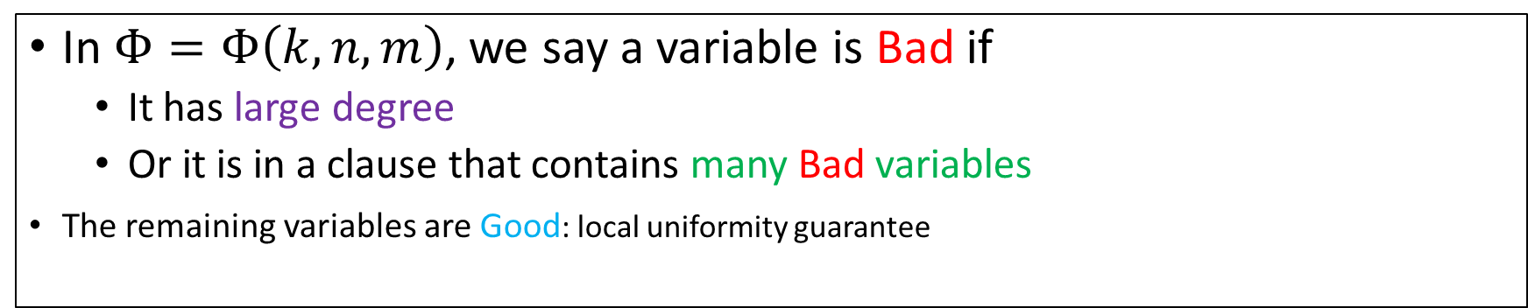
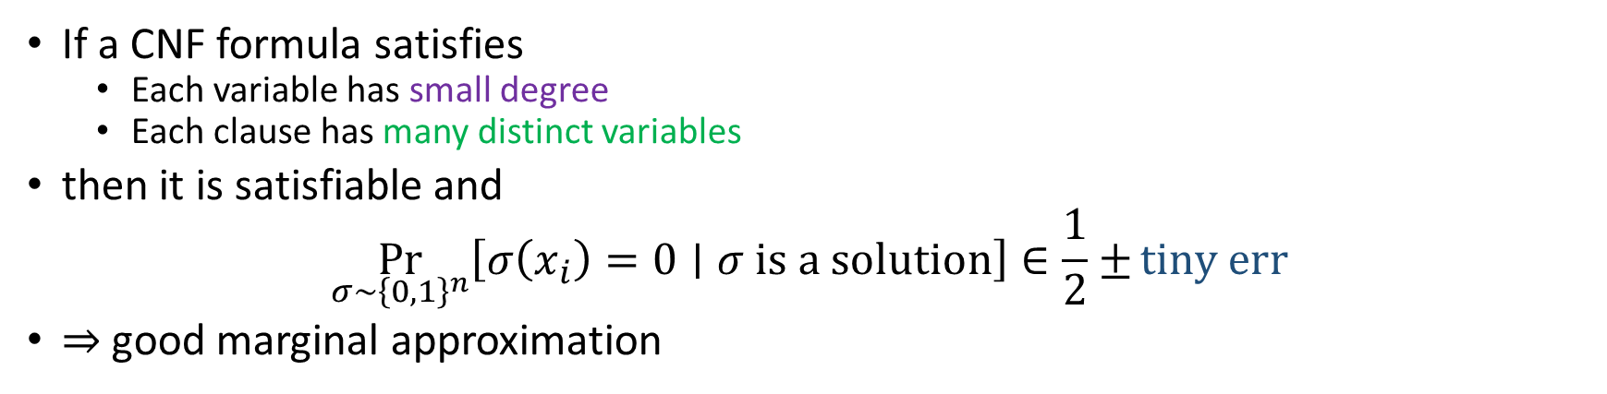
Local Uniformity [Lovász Local Lemma EL’75, HSS’11]
If a CNF formula satisfies
Each variable has small degree
Each clause has many distinct variables
then it is satisfiable and
$$\underset{σ∼{\left\{0,1\right\}}^{n}}{Pr}\left[σ\left(x_{i}\right)=0∣σ is a solution\right]∈\frac{1}{2}±tiny err$$
$⇒$ good marginal approximation
In $Φ=Φ\left(k,n,m\right)$, we say a variable is Bad if
It has large degree
Or it is in a clause that contains many Bad variables
The remaining variables are Good: local uniformity guarantee

Slide 13
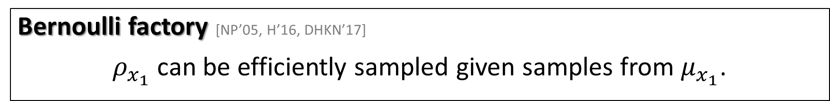
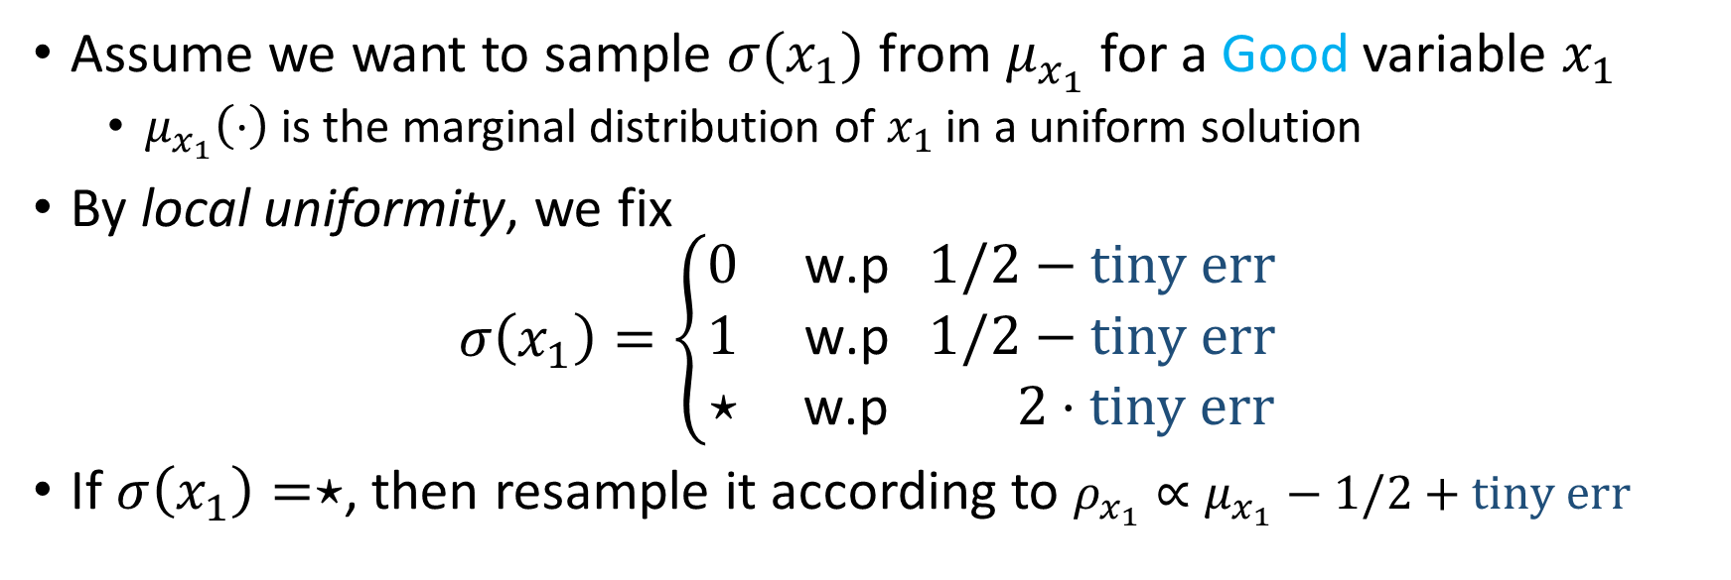
Marginal Sampler [AJ’21, HWY’22]
Assume we want to sample ${σ(x}_{1})$ from $μ_{x_{1}}$ for a Good variable $x_{1}$
$μ_{x_{1}}\left(⋅\right)$ is the marginal distribution of $x_{1}$ in a uniform solution
By local uniformity, we fix
$$σ\left(x_{1}\right)=\left\{\begin{aligned}0 \text{w}\text{.}\text{p} 1/2−tiny err \\ 1 \text{w}\text{.}\text{p} 1/2−tiny err \\ ⋆ \text{w}\text{.}\text{p} 2⋅tiny err \end{aligned}\right.$$
If $σ\left(x_{1}\right)=⋆$, then resample it according to $ρ_{x_{1}}∝μ_{x_{1}}−1/2+tiny err$
Bernoulli factory [NP’05, H’16, DHKN’17]
$ρ_{x_{1}}$ can be efficiently sampled given samples from $μ_{x_{1}}$.

Slide 14
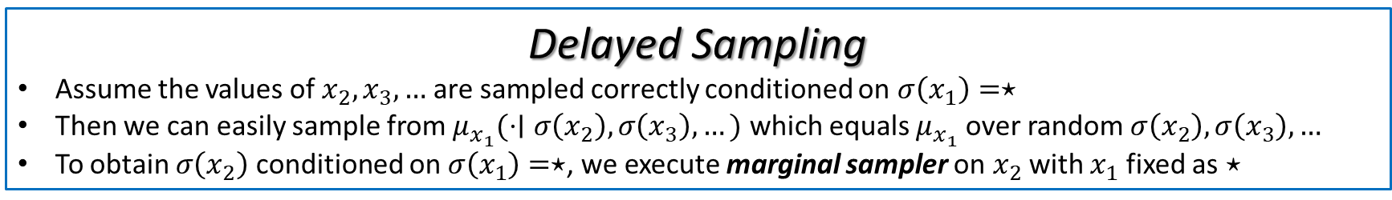
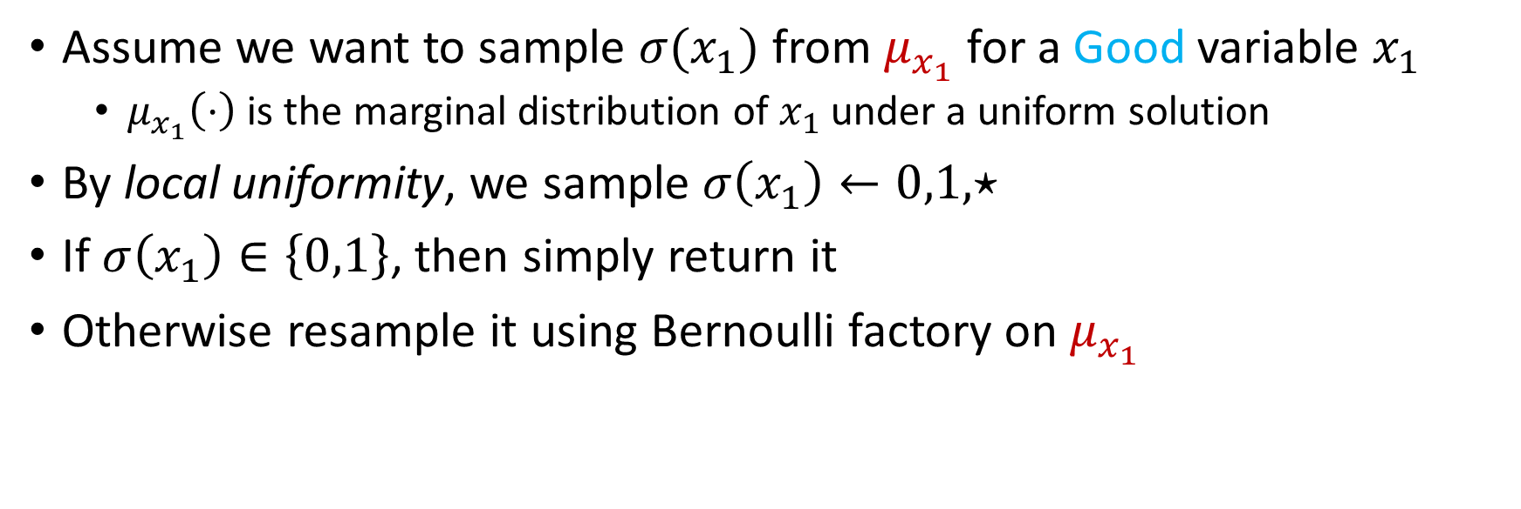
Marginal Sampler [AJ’21, HWY’22]
Assume we want to sample ${σ(x}_{1})$ from $μ_{x_{1}}$ for a Good variable $x_{1}$
$μ_{x_{1}}\left(⋅\right)$ is the marginal distribution of $x_{1}$ under a uniform solution
By local uniformity, we sample $σ\left(x_{1}\right)←0,1,⋆$
If $σ\left(x_{1}\right)∈\left\{0,1\right\}$, then simply return it
Otherwise resample it using Bernoulli factory on $μ_{x_{1}}$
Recursive
Delayed Sampling
Assume the values of $x_{2},x_{3},…$are sampled correctly conditioned on $σ\left(x_{1}\right)=⋆$
Then we can easily sample from $μ_{x_{1}}(⋅∣σ\left(x_{2}\right),σ\left(x_{3}\right),…)$ which equals $μ_{x_{1}}$ over random $σ\left(x_{2}\right),σ\left(x_{3}\right),…$
To obtain $σ\left(x_{2}\right)$ conditioned on $σ\left(x_{1}\right)=⋆$, we execute marginal sampler on $x_{2}$ with $x_{1}$ fixed as $⋆$

Slide 15
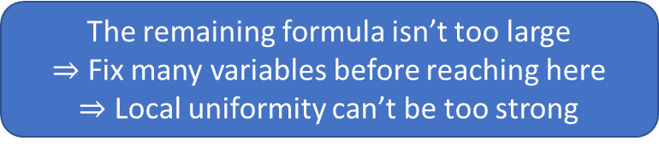
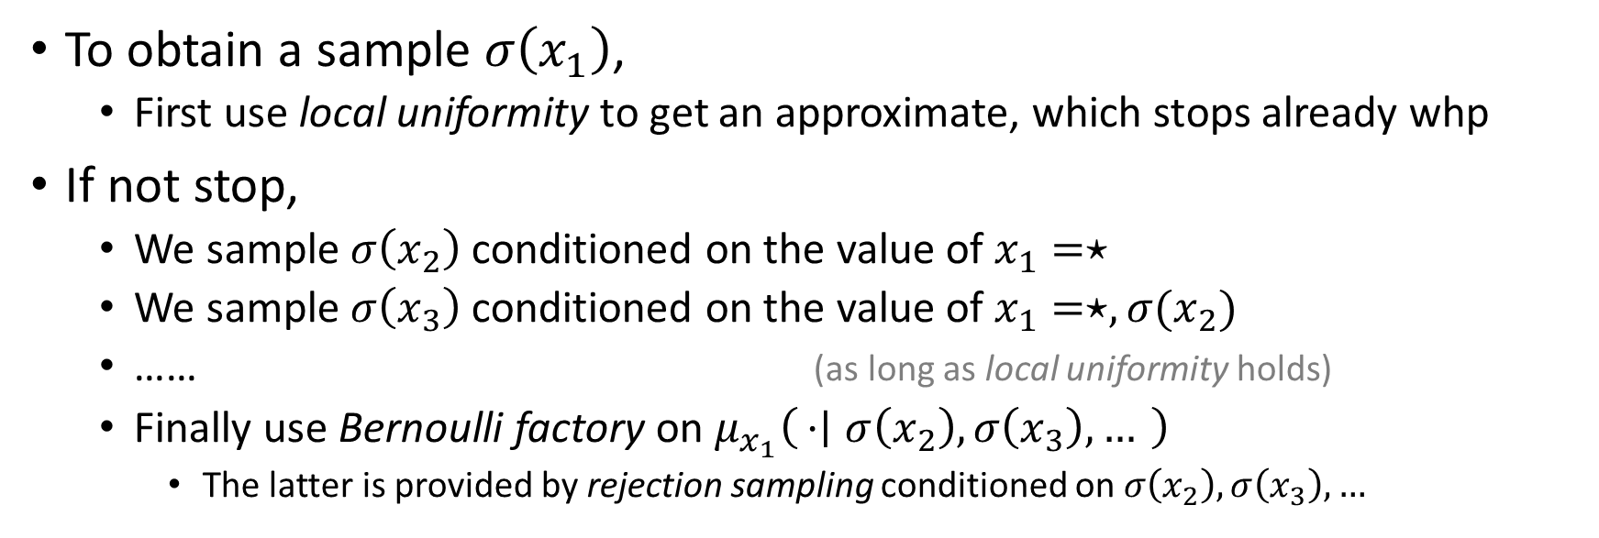
Marginal Sampler [AJ’21, HWY’22]
To obtain a sample $σ\left(x_{1}\right)$,
First use local uniformity to get an approximate, which stops already whp
If not stop,
We sample $σ\left(x_{2}\right)$ conditioned on the value of $x_{1}=⋆$
We sample $σ\left(x_{3}\right)$ conditioned on the value of $x_{1}=⋆,{σ(x}_{2})$
…… (as long as local uniformity holds)
Finally use Bernoulli factory on $μ_{x_{1}}\left(⋅ ∣ σ\left(x_{2}\right),σ\left(x_{3}\right),…\right)$
The latter is provided by rejection sampling conditioned on $σ\left(x_{2}\right),σ\left(x_{3}\right),…$
Strong local uniformity
Tradeoff
The remaining formula isn’t too large
$⇒$ Fix many variables before reaching here
$⇒$ Local uniformity can’t be too strong
Efficiency

Slide 16
Efficiency
The rejection sampling is efficient if the remaining formula is small
Bad variables are few
Good variables have many possible solutions
The recursion has small depth
Most variables of the visited clauses are in the recursion
The local uniformity sampling stops whp
Locally sparse properties
Local uniformity

Slide 17







Summary
Density: $α=m/n$
Efficient search
Satisfiability threshold
Our work
$$2^{k/300}$$
$$2^{k/3}$$
$$2^{k/2}$$
$$α=0$$
$$α=∞$$
$$2^{k}\ln{k}/k$$
$$2^{k}\ln{2}$$
Trivial formula
Efficient sampling
Efficient sampling
?

Slide 18
Thank you!

