Slide 1
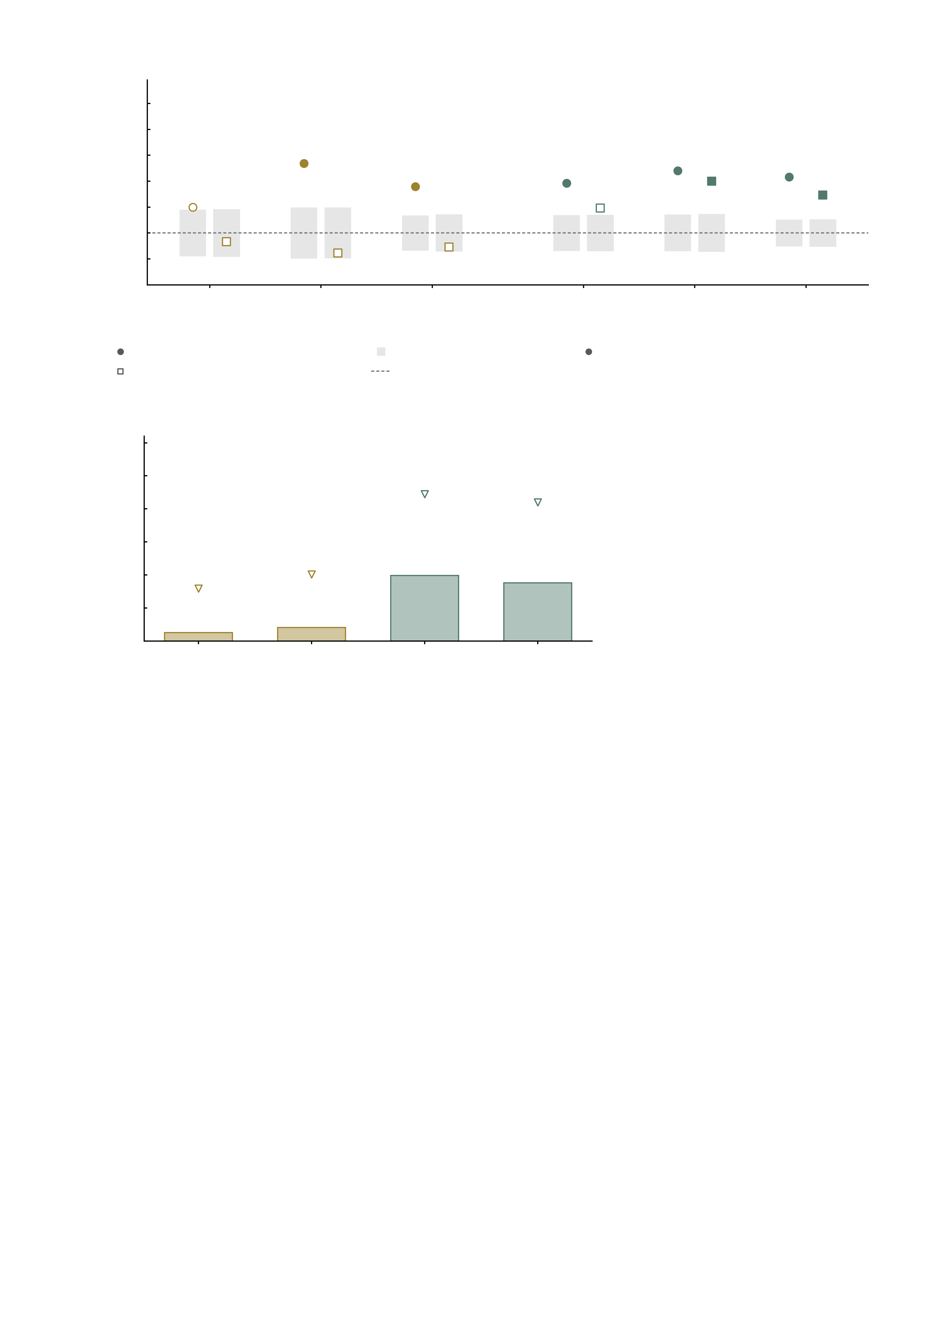
a
Pharmacologically matched pairings
100
Ketamine
Midazolam
90
20/26
80
37/50
73/102
Edges with matching
direction (%)
38/56
36/52
70
18/30
35/50
66/102
60
31/52
50
14/30
25/56
40
11/26
30
MID
anticipation
MID
feedback
pooled
MID
anticipation
MID
feedback
pooled
task-matched (MID) prediction
±1 s.d. of the sign-flip null
filled = P < 0.05 vs the sign-flip null
task-mismatched (SST) prediction
chance (50%)
b
0.7
Reliability of the empirical maps at n = 27
0.6
max attainable
r = 0.45
0.5
max attainable
r = 0.42
0.4
Split-half reliability of the
empirical drug-effect map
0.3
max attainable
r = 0.16
max attainable
r = 0.20
0.2
0.1
0.041
0.198
0.176
0.0
0.025
Ketamine
MID anticipation
Ketamine
MID feedback
Midazolam
MID anticipation
Midazolam
MID feedback

