Slide 1
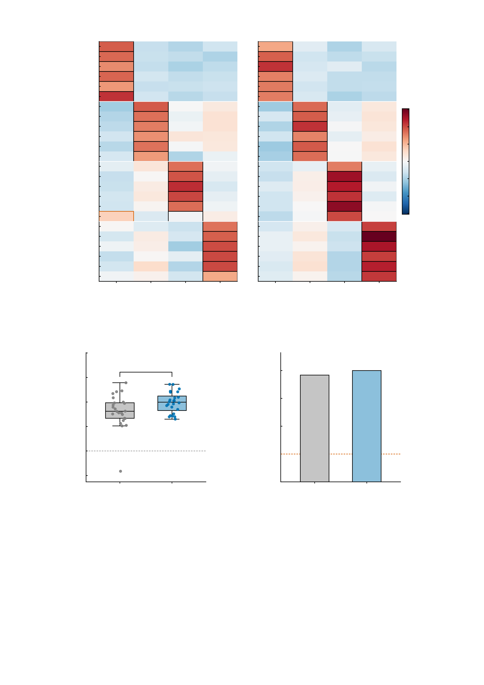
a
Empirical BOLD
23/24 correct = 95.8%
b
Digital twins, no re-assimilation
24/24 correct = 100.0%
sub1 angry 1
sub1 angry 2
sub1 neutral 1
sub1 neutral 2
sub1 happy 1
0.4
sub1 happy 2
sub2 angry 1
0.3
sub2 angry 2
sub2 neutral 1
0.2
sub2 neutral 2
0.1
sub2 happy 1
sub2 happy 2
Pattern correlation
sub3 angry 1
0.0
sub3 angry 2
-0.1
sub3 neutral 1
sub3 neutral 2
-0.2
sub3 happy 1
-0.3
sub3 happy 2
sub4 angry 1
-0.4
sub4 angry 2
sub4 neutral 1
sub4 neutral 2
sub4 happy 1
sub4 happy 2
sub1
sub2
sub3
sub4
sub1
sub2
sub3
sub4
Participant template
Participant template
c
0.5
d
0.4
exact binomial vs chance
*
100
95.8% ***
100.0% ***
0.3
0.2
75
Identification margin
(self − best other r)
Identification accuracy (%)
0.1
50
0.0
25
chance, 25%
-0.1
Empirical
Twins
0
Empirical
Twins
-0.2
SupplementaryFig.S16|Digitaltwinbrainspreserveparticipant-specificsignaturesonheld-outtrialswithoutre-assimilation.Fourparticipants(sub1andsub2,healthycontrols;sub3,alcoholusedisorder;sub4,majordepressivedisorder)x6held-outemotional-facetrials(n=24trials;unitofobservation,oneheld-outtrial;thelabelssub1-sub4arelocaltothisfigure).Hyperparameterswereestimatedfromthefirsthalfofthetaskandthesecondhalfwassimulatedforwardwithoutre-assimilation,soeverypaneltestsgeneralisationratherthanfit.a,Pearsoncorrelationbetweeneachheld-outtrial'sactivationpatternandeachparticipant'stemplate,fromempiricalBOLD;colourscalesymmetricat+/-0.30,blackoutlinemarksthecorrecttemplateandanorangeoutlinethetemplateactuallyselectedwhenidentificationfailed;noerrorindicatorandnoinferentialtest(descriptivesimilaritymatrix).b,Thesamematrixfromthedigitaltwins.c,Identificationmarginpertrial(selfminusbest-othercorrelation);boxesshowthemedianandinterquartilerangewithwhiskersat1.5xIQRandeverytrialplotted;empirical0.1628+/-0.0699versustwins0.1974+/-0.0426,two-sidedpairedttest,t(23)=2.293,*P=0.03134(theasteriskinthepanelmarksthistest;Wilcoxonsigned-rankP=0.01787),nomultiple-comparisoncorrection(onepre-specifiedcontrast).Withineachdatatypetheselfcorrelationexceedsthebestothercorrelation:empirical0.1662versus0.0034,t(23)=11.411,P=5.99e-11;twins0.2021versus0.0047,t(23)=22.725,P=2.94e-17.d,Identificationaccuracyagainstthe25%chancelevelofafour-waychoice;barsshowthepercentageoftrialsidentifiedcorrectly,withnoerrorbarbecausethequantityisacountoverall24trials:empirical23/24=95.8%(thesinglefailureisahappytrialofsub3,assignedtothesub1template)andtwins24/24=100.0%;one-sidedexactbinomialtestagainst0.25,P=2.59e-13andP=3.55e-15.

