Slide 1
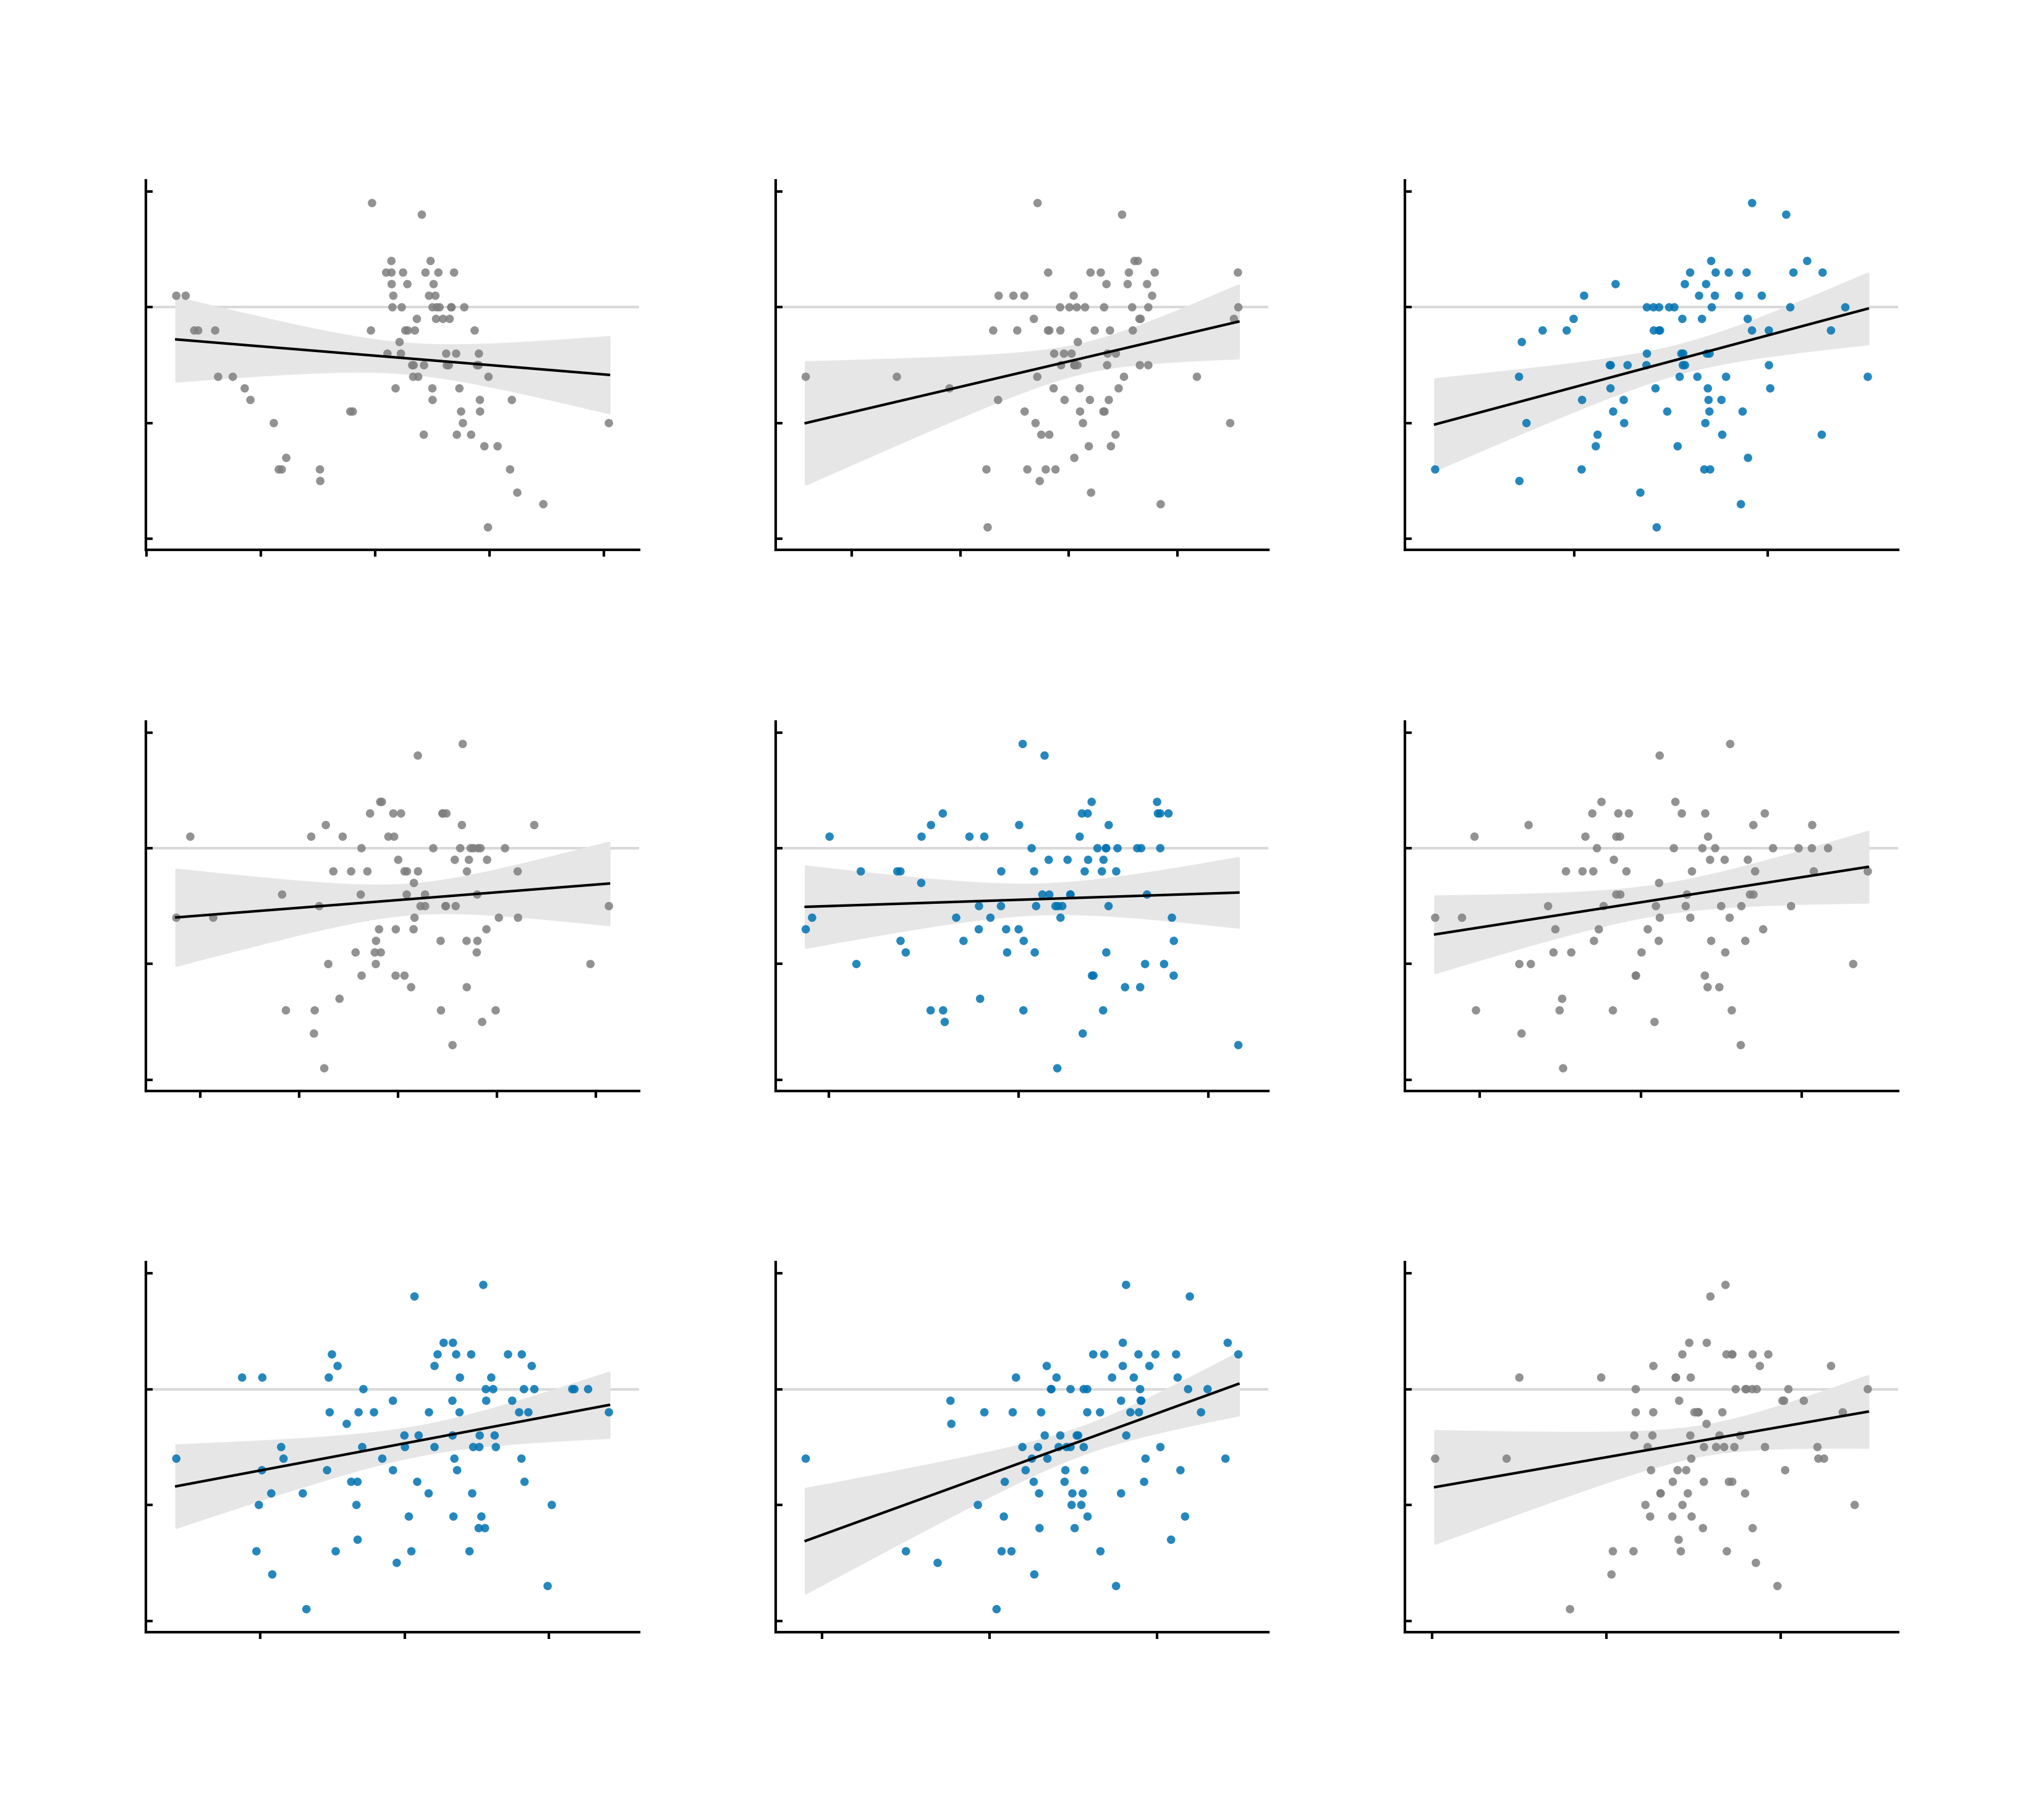
20
20
20
a
Covariates only
b
Age-19 symptoms
c
12 simulated edges
10
r = -0.10 n.s.
10
r = 0.23 *
10
r = 0.32 **
0
0
0
Observed Δ symptoms
-10
-10
-10
-20
-20
-20
-12.5
-10.0
-7.5
-5.0
-2.5
0.0
2.5
-20
-15
-10
-5
0
5
-20
-10
0
10
20
20
20
d
-30
e
-30
f
-30
12 empirical edges
Summed simulated NP
Summed empirical NP
10
r = 0.09 n.s.
10
r = 0.05 n.s.
10
r = 0.21 *
0
0
0
Observed Δ symptoms
-10
-10
-10
-20
-20
-20
-20
-15
-10
-5
0
5
-15
10
-10
-5
0
-15
5
-10
-5
0
5
20
20
20
g
-30
h
-30
i
-30
Both summed read-outs
Symptoms + simulated
Symptoms + empirical
10
r = 0.25 *
10
r = 0.40 ***
10
r = 0.19 n.s.
0
0
0
Observed Δ symptoms
-10
-10
-10
-20
-20
-20
-15
-10
-5
0
-30
5
-20
-10
0
-30
10
-20
-10
0
10
Predicted Δ symptoms
(leave-one-out)
Predicted Δ symptoms
(leave-one-out)
Predicted Δ symptoms
(leave-one-out)
-30
-30
-30

