Slide 1
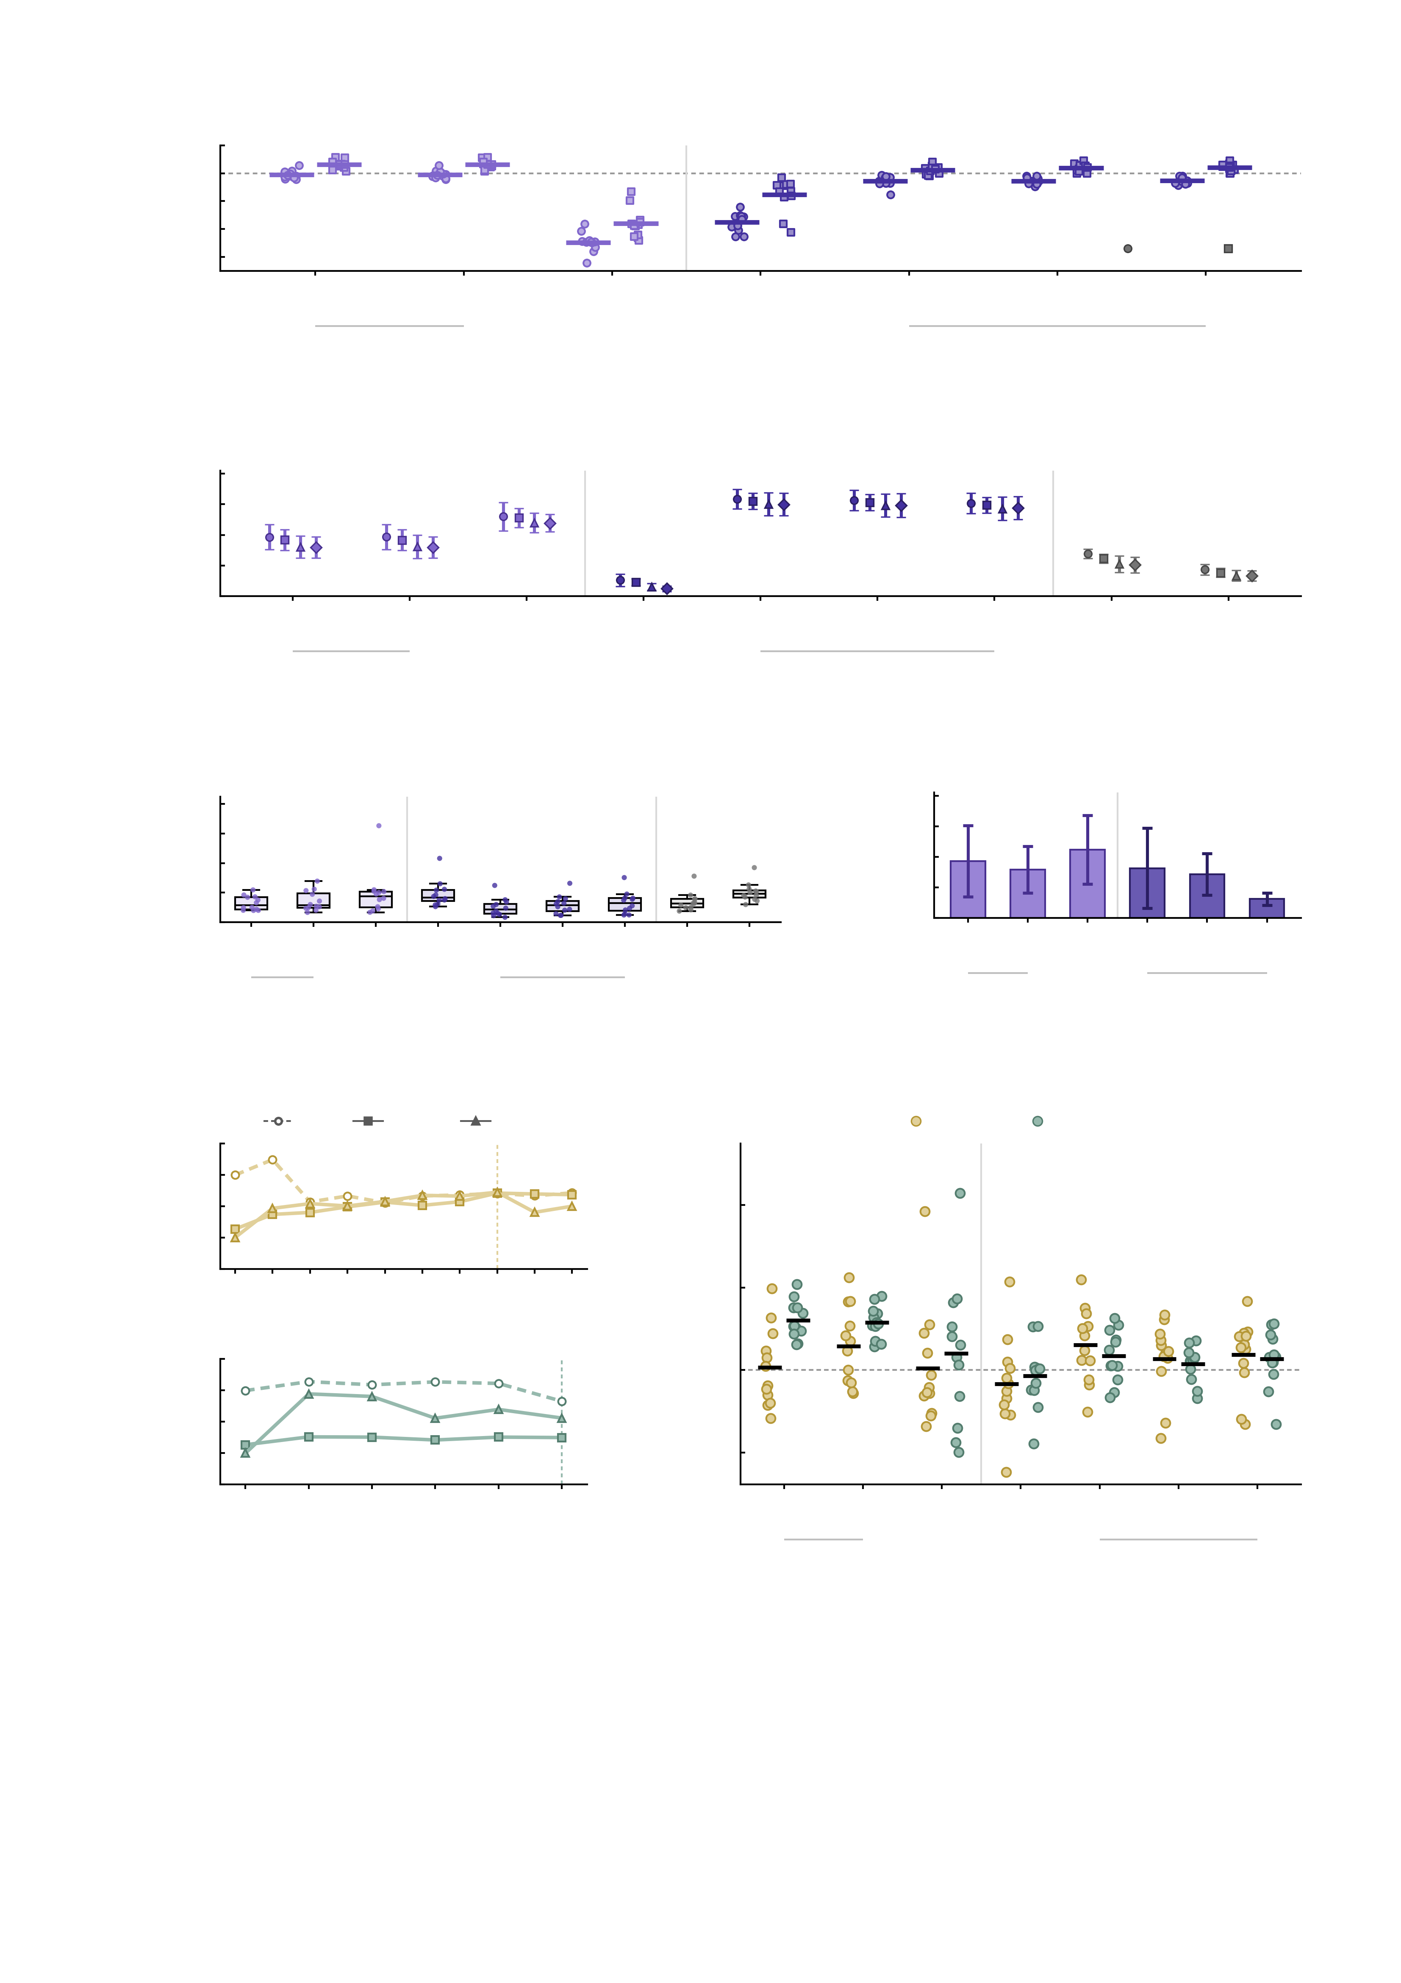
a
1.0
regional models
voxel models
0.9
Assimilated-region
BOLD (r)
0.8
0.7
MID
SST
0.6
3 M
268
10 M
268
10 M
1000
10 M
voxel
10 M
voxel
100 M
voxel
1 B
voxel
assimilated
hyperparameters
3 M
268
10 M
1000
10 M
voxel
100 M
voxel
b
1.0
0.8
regional models
voxel models
benchmarks
0.6
Whole-brain FC
similarity (r)
0.4
0.2
0.0
3 M
268
10 M
268
10 M
1000
10 M
voxel
10 M
voxel
100 M
voxel
1 B
voxel
SAR
rWW
assimilated
hyperparameters
3 M
268
10 M
1000
10 M
voxel
100 M
voxel
c
0.5
d
1.0
0.4
regional models
voxel models
benchmarks
0.8
regional models
voxel models
0.6
0.3
Run-to-run s.d.
of NP factor
Simulation error
of NP (MSE)
0.4
0.2
0.2
0.1
0.0
0.0
3 M
268
10 M
268
10 M
1000
10 M
voxel
10 M
voxel
100 M
voxel
1 B
voxel
SAR
rWW
3 M
268
10 M
268
10 M
1000
10 M
voxel
100 M
voxel
1 B
voxel
3 M
268
10 M
1000
10 M
voxel
100 M
voxel
3 M
268
10 M
1000
100 M
voxel
e
HC
MDD
AUD
f
6
AMPA
GABA-A
2
regional models
voxel models
1
Simulated
NP factor
4
0
-1
AMPA
-2
2
0.002
0.0024
0.0028
0.0032
0.0036
0.004
0.0044
0.0048
0.0052
Δ NP (perturbed
- baseline)
baseline
2
0
1
Simulated
NP factor
0
-2
-1
GABA-A
-2
0.002
0.0025
0.003
0.0035
0.004
3 M
268
10 M
268
10 M
1000
10 M
voxel
10 M
voxel
100 M
voxel
1 B
voxel
baseline
-4
3 M
268
10 M
1000
10 M
voxel
100 M
voxel
Conductance
Fig. 3 | Multiscale validation of the digital twin brain. Seven DTB builds are compared throughout; they differ in the number of simulated neurons, the neuron count of the assimilated hyperparameter set and the spatial resolution of the simulation target, so every panel carries a second tick row naming the hyperparameter set, labelled once per set with a rule spanning the builds that share it. Colour encodes model family (regional versus voxel) only; benchmarks (SAR, rWW) are grey. a, Pearson correlation between simulated and measured BOLD within the assimilated regions (MID, 51 Shen labels; SST, 47), averaged over assimilated voxels; one subject × task session, 24 points per build, bar, group mean; two-sided paired t tests, n = 24, uncorrected. b, whole-brain FC similarity, mean ± s.d. across the 12 twins of the correlation between simulated and measured FC (23,436 edges among 217 nodes), per task condition (marker shape); n = 12 per point; descriptive. c, simulation error of the 12-edge NP profile against one empirical reference (FC recomputed from the simulated voxels); median, 25th–75th percentiles, 1.5 × IQR whiskers, all 12 twins overplotted; paired t tests, df = 11, uncorrected. Benchmarks are scored against the Shen-268 task FC their coupling was fitted to and are not on the DTB scale. d, run-to-run variability: mean across twins of the within-subject s.d. of the NP factor over 5 repeats; error bars, s.d. across twins; the single-run 10 M voxel own-hyperparameter build is omitted; descriptive. e, NP factor across the AMPA (upper; 9 settings, 0.0020–0.0052) and GABA-A (lower; 5 settings, 0.0020–0.0040) conductance sweeps in three twins (HC, MDD, AUD), stacked. The first column of each segment is that twin's own unperturbed baseline, the same value in both segments; the GABA-A settings themselves are applied on top of the AMPA perturbation, as in f. Colour marks the perturbation, marker and dash pattern the twin; vertical dashed line and bold tick, AMPA 0.0044 and GABA-A 0.0040; descriptive only, no test at n = 3. f, change in summed NP after AMPA and after GABA-A perturbation in all seven builds; points, twins; bar, group mean; n = 12 per build × perturbation; two-sided one-sample t tests against zero, df = 11, Benjamini–Hochberg FDR across the 14 tests. Only the two 268-region builds survive correction, and only under GABA-A; GABA-A is applied on top of AMPA.

