Slide 1
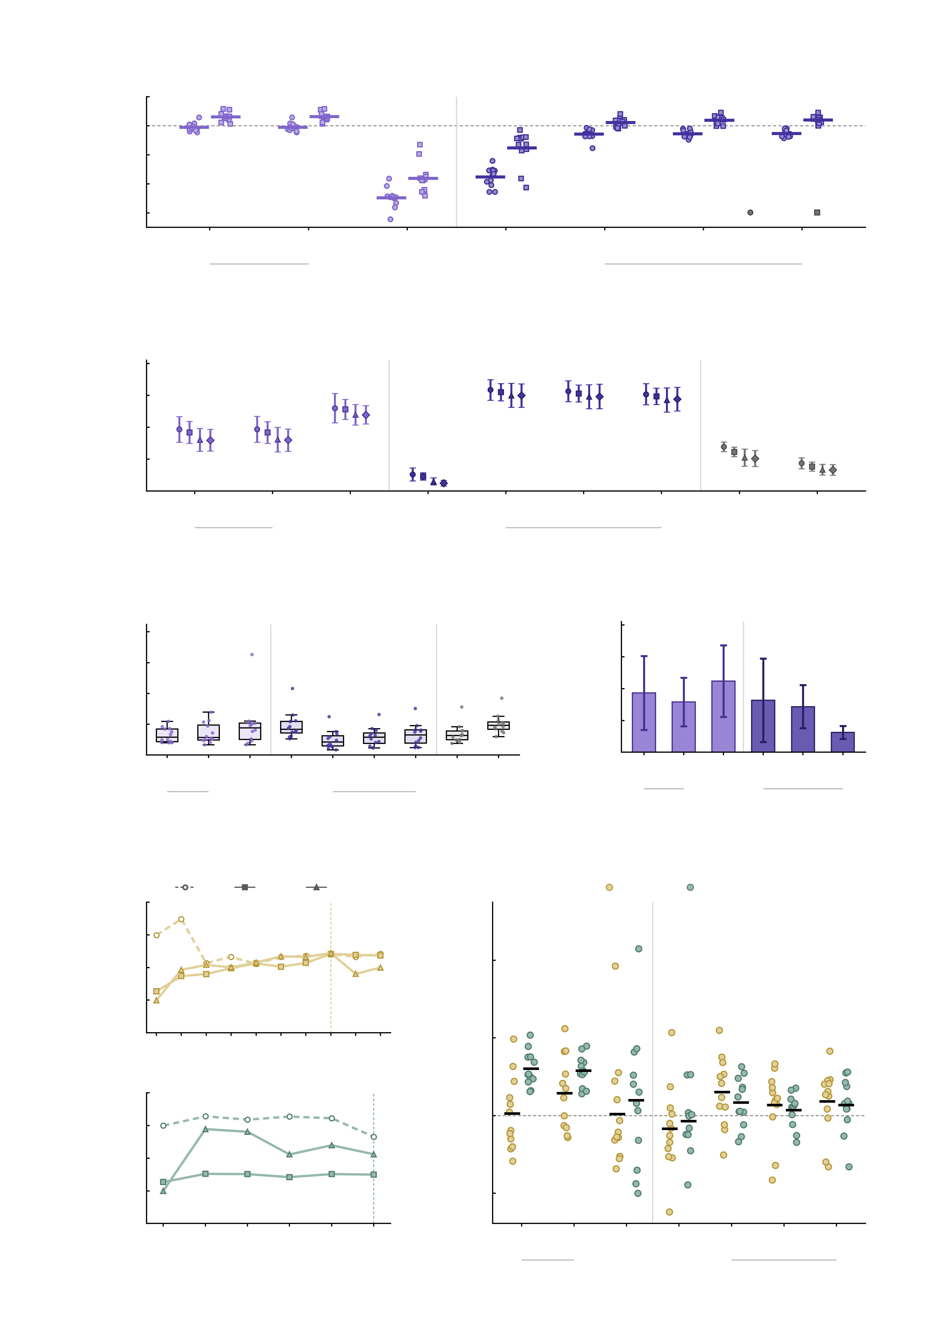
a
regional models
voxel models
1.0
0.9
Assimilated-region
BOLD (r)
0.8
0.7
0.6
MID
SST
3 M
268
10 M
268
10 M
1000
10 M
voxel
10 M
voxel
100 M
voxel
1 B
voxel
assimilated
hyperparameters
3 M
268
10 M
1000
10 M
voxel
100 M
voxel
b
1.0
0.8
regional models
voxel models
benchmarks
0.6
Whole-brain FC
similarity (r)
0.4
0.2
0.0
3 M
268
10 M
268
10 M
1000
10 M
voxel
10 M
voxel
100 M
voxel
1 B
voxel
SAR
rWW
assimilated
hyperparameters
3 M
268
10 M
1000
10 M
voxel
100 M
voxel
c
0.5
d
1.0
0.4
regional models
voxel models
benchmarks
0.8
regional models
voxel models
0.3
0.6
Simulation error
of NP (MSE)
Run-to-run s.d.
of NP factor
0.2
0.4
0.1
0.2
0.0
3 M
268
10 M
268
10 M
1000
10 M
voxel
10 M
voxel
100 M
voxel
1 B
voxel
SAR
rWW
0.0
3 M
268
10 M
268
10 M
1000
10 M
voxel
100 M
voxel
1 B
voxel
3 M
268
10 M
1000
10 M
voxel
100 M
voxel
3 M
268
10 M
1000
100 M
voxel
e
HC
MDD
AUD
f
6
AMPA
GABA-A
2
regional models
voxel models
1
Simulated
NP factor
4
0
-1
AMPA
-2
2
0.002
0.0024
0.0028
0.0032
0.0036
0.004
0.0044
0.0048
0.0052
Δ NP (perturbed
- baseline)
baseline
2
0
1
Simulated
NP factor
0
-1
GABA-A
-2
-2
0.002
0.0025
0.003
0.0035
0.004
3 M
268
10 M
268
10 M
1000
10 M
voxel
10 M
voxel
100 M
voxel
1 B
voxel
baseline
-4
3 M
268
10 M
1000
10 M
voxel
100 M
voxel
Conductance

