Slide 1
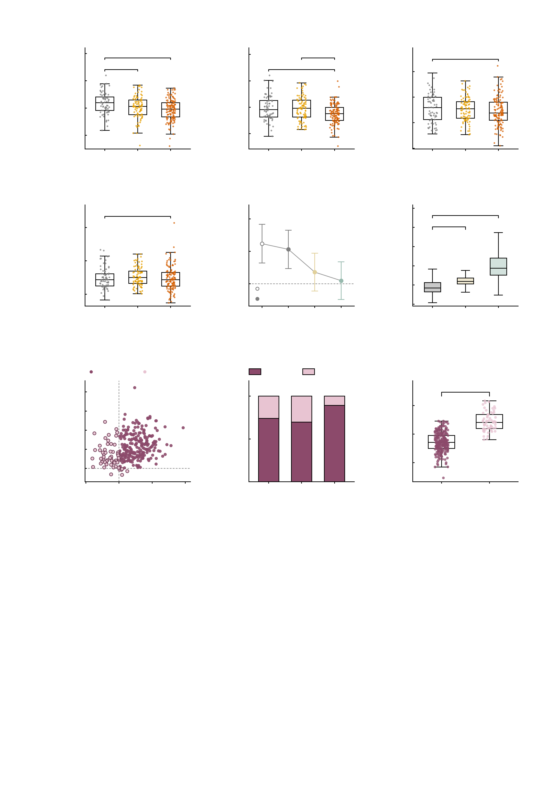
a
6
b
6
c
4
***
4
**
3
n.s.
*
**
2
2
2
Measured NP factor
Baseline NP factor
Perturbed AMPA NP
0
0
1
-2
-2
0
-4
HC
High-
symptom
Patient
-4
HC
High-
symptom
Patient
-1
HC
High-
symptom
Patient
1.5
-2
d
15
e
f
12.5
n.s.
1.0
***
**
group difference
not detectable
10.0
***
***
10
7.5
0.5
n.s.
n.s.
5.0
Perturbed GABA-A NP
Cohen's d (HC − patient)
NP factor
5
2.5
0
0.0
measured
0.0
HC
High-
symptom
Patient
simulated
-2.5
Baseline
+AMPA
+GABA-A
-0.5
Baseline
AMPA
GABA-A
-5.0
-5
Measured
g
12.5
both up
any down
h
both up
any down
i
Baseline by response
10.0
***
4
***
7.5
100
2
Δ NP after GABA-A
Twins (%)
Simulated baseline NP
5.0
50
0
2.5
-2
0.0
0
-4
-2.5
-2
0
2
4
6
HC
High-
symptom
Patient
-4
both
up
any
down
Δ NP after AMPA
Fig. 4 | Virtual perturbation stratifies individuals. Cohort: n = 288 digital twins (HC 69, high-symptom 89, patients 130) after excluding two subjects with mean framewise displacement > 0.5 mm. GABA-A perturbation is always applied on top of the AMPA perturbation. a–d, NP factor by group in four conditions — measured (a), simulated baseline (b), after AMPA (c), after AMPA + GABA-A (d); each panel is scaled to its own data, so the within-panel contrast is comparable, not the absolute level. NP is residualised on sex, site and mean head motion, refit on these 288. Box plots show the median, 25th–75th percentiles and 1.5 × IQR whiskers with all subjects overplotted; unit of observation, one subject. One-way ANOVA, F(2, 285): a F = 8.20, P = 0.00034; b F = 9.22, P = 0.00013; c F = 0.95, P = 0.39; d F = 0.85, P = 0.43. Brackets are pairwise two-sided Welch t tests corrected within each panel by Benjamini–Hochberg FDR. Asterisks: *q < 0.05, **q < 0.01, ***q < 0.001 in a–d (P in e–i); n.s., not significant. q for HC vs high-symptom / HC vs patient / high-symptom vs patient: a 0.024 / 0.0002 / 0.15; b 0.94 / 0.0016 / 0.001; c and d all q ≥ 0.44, so both are marked n.s. e, HC − patient separation across the same four conditions (baseline = simulated baseline; AMPA / GABA-A = after that perturbation): Cohen's d with 95% CI, n = 69 HC versus 130 patients (the high-symptom group is excluded from this contrast by design); two-sided independent t tests, df = 197, uncorrected. The separation present in the measured data and reproduced by the twins is no longer detectable after either perturbation: d = 0.62 (95% CI 0.32 to 0.92), t = 4.11, P < 0.0001 measured; 0.53 (0.23 to 0.83), t = 3.36, P = 0.001 at baseline; 0.18 (-0.11 to 0.47), t = 1.19, P = 0.23 after AMPA; 0.05 (-0.24 to 0.34), t = 0.33, P = 0.74 after GABA-A. f, within-subject effect of each perturbation on the simulated network: box plots (median, 25th–75th percentiles, 1.5 × IQR whiskers) of the 12-edge NP factor at baseline and after each perturbation; the axis is cropped to the whiskers and 7 of 864 values beyond them are not shown. Brackets are two-sided paired t tests against baseline (pairing on subject), n = 288, df = 287, uncorrected, with Cohen's dz and the share of twins that increase: AMPA +0.78 ± 0.93, t = 14.14, dz = 0.83, 234/288 up; GABA-A +2.74 ± 1.71, t = 27.11, dz = 1.60, 282/288 up; both P < 0.0001. g, each twin's change in NP factor under AMPA against the change under GABA-A; 229 of 288 (79.5%) increase under both, 59 have at least one decrease (234/288 increase under AMPA, 282/288 under GABA-A). Descriptive classification; no test is applied to this split, because the grouping is defined by the sign of the plotted quantity. h, the response pattern by clinical group (χ²(2) = 14.2, P = 0.00084); both up / total: HC 51/69, high-symptom 62/89, patients 116/130, i.e. 89% of patients versus 74% of HC. i, simulated baseline NP in the two response groups (both up n = 229, any down n = 59): -0.57 versus 0.88, two-sided Welch t = -14.7, P < 0.0001. The grouping is defined on the perturbation response and the plotted quantity is the unperturbed baseline, so this contrast is not circular.

