Slide 1
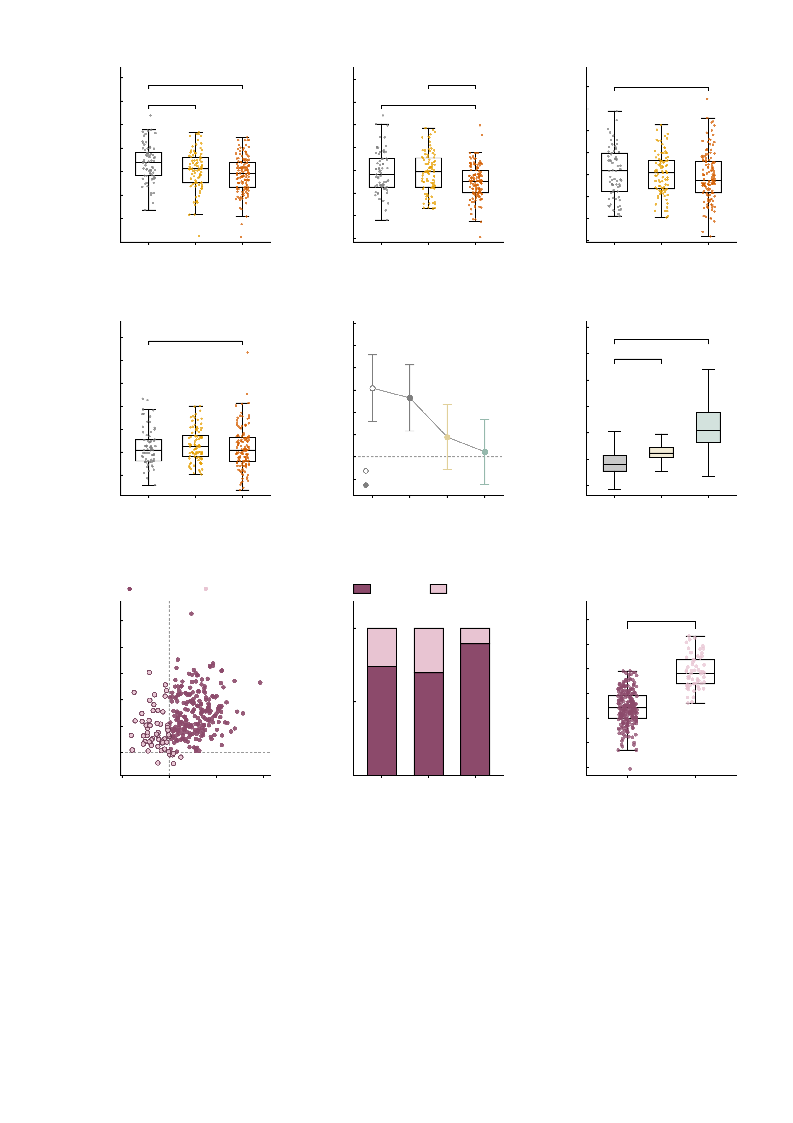
a
5
b
5
c
3.0
4
*
***
4
**
**
2.5
n.s.
3
3
2.0
2
2
1.5
1
1
Measured NP factor
Baseline NP factor
Perturbed AMPA NP
0
0
1.0
-1
-1
0.5
-2
-2
0.0
-3
-0.5
-3
HC
High-
symptom
Patient
-4
HC
High-
symptom
Patient
-1.0
HC
High-
symptom
Patient
-1.5
d
14
e
1.4
f
12
12
n.s.
1.2
***
group difference
not detectable
10
***
10
1.0
**
8
***
8
0.8
6
0.6
n.s.
Perturbed GABA-A NP
Cohen's d (HC − patient)
n.s.
NP factor
6
0.4
4
4
0.2
2
2
0.0
measured
0
0
-0.2
simulated
-2
-2
HC
High-
symptom
Patient
-0.4
Baseline
AMPA
GABA-A
-4
Baseline
+AMPA
+GABA-A
Measured
g
both up
any down
h
both up
any down
i
Baseline by response
12
***
4
***
10
100
3
8
2
6
1
Δ NP after GABA-A
Twins (%)
Simulated baseline NP
4
50
0
2
-1
0
-2
-4
-2
-2
0
2
4
6
0
HC
High-
symptom
Patient
-3
both
up
any
down
Δ NP after AMPA
-4

