Slide 1
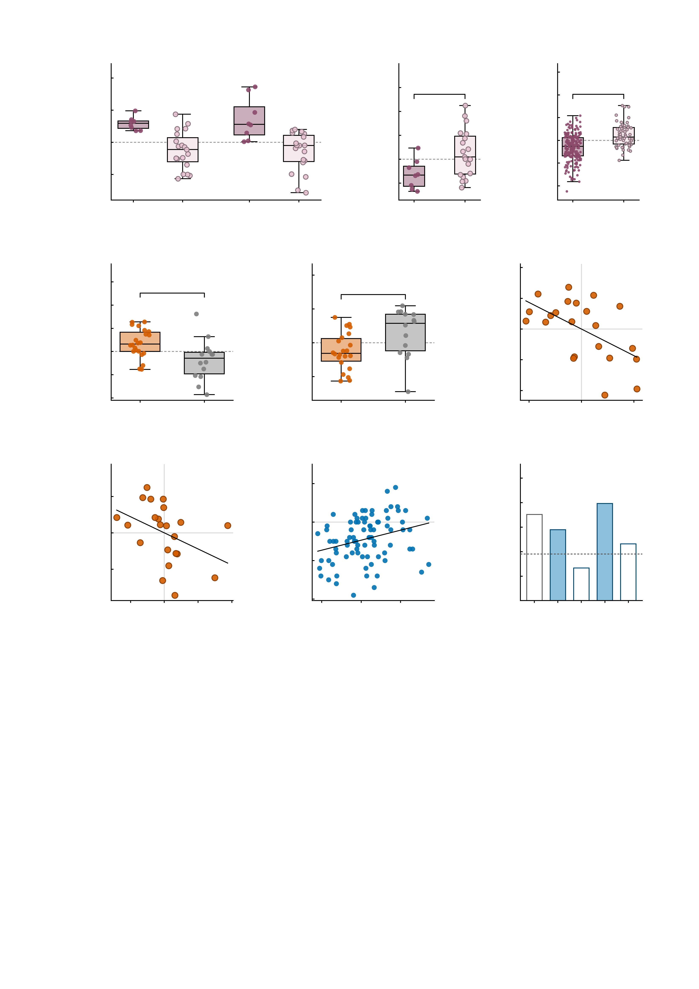
a
3
b
2.0
c
4
2
Ketamine
Midazolam
Placebo
3
Simulation
1.5
*
2
***
1
1.0
1
Δ summed MID FC
(drug - placebo)
Placebo summed MID FC
Simulated baseline MID FC
0
0.5
0
-1
0.0
-1
-0.5
-2
-2
both up
any down
both up
any down
-1.0
both up
any down
-3
both up
any down
d
e
6
f
3
10.0
Ketamine
4
Placebo
2
Ketamine
r = −0.56
7.5
**
**
1
5.0
*
2
Δ NP FC
(ketamine - placebo)
Δ symptom PC1
(residual)
2.5
Placebo NP FC
0
0.0
0
-1
-2.5
-2
-2
-5.0
MDD
HC
-4
MDD
HC
-4
-2
0
2
4
-7.5
-3
Δ NP FC (residual)
g
20
h
20
i
0.6
Ketamine
ρ = −0.56
10
Follow-up
r = 0.29
0.5
Follow-up
10
0.4
***
***
Δ MADRS
(residual)
**
0
Leave-one-out r
(predicted vs observed)
0
Observed Δ symptoms
0.3
*
-10
-10
0.2
null 95th
0.1
-20
-20
0.0
-0.050
-0.025
0.000
0.025
0.050
0.075
-15
-10
-5
0
5
Similarity to AMPA-perturbed
twin (residual)
Predicted Δ symptoms
(leave-one-out)
empirical
simulated
symptoms
sym + sim
-30
sym + emp
Fig. 5 | In vivo pharmacology and longitudinal association. Two cohorts test the perturbation account in vivo, one panel gives its model counterpart, and a third cohort tests it prospectively. Healthy volunteers (n = 27) received placebo, ketamine and midazolam; the clinical cohort (n = 36) received placebo and ketamine; the digital twins in c are the Fig. 4 cohort (n = 288); the longitudinal cohort is the IMAGEN follow-up (n = 85). Box plots show the median, 25th-75th percentiles and 1.5 x IQR whiskers with every participant overplotted; dashed line, no change. An asterisk above a single box (d) is a two-sided one-sample t test against zero; brackets are the between-group test named below. *P < 0.05, **P < 0.01, ***P < 0.001. The heading inside each panel names the condition or data source it shows. b, c and e make one statement in two independent drug datasets and in the model: the group whose connectivity rises under the drug is the group that starts from the lower drug-free level. In f, g and h both axes are residuals, so the grey cross marks zero on each and the coefficient in the heading band is the effect size itself (both axes being residuals, it is a partial coefficient); its P, confidence interval and n are given below. a, change in summed MID FC from placebo in the healthy cohort, split by the Fig. 4 response rule (both up n = 8, any down n = 19). Ketamine: +0.59 +/- 0.21 in both-up versus -0.25 +/- 0.58 in any-down; midazolam: +0.72 +/- 0.66 versus -0.30 +/- 0.61 (mean +/- s.d.). This panel is descriptive and carries no test: the two groups are defined by the sign of the very quantity plotted here, so any test of it would be circular. b, drug-free (placebo) level of the same two groups: -0.32 versus +0.13, two-sided Welch t = -2.83, P = 0.01. The grouping is defined on the drug-induced change and the plotted quantity is the drug-free level, so this contrast is not circular. c, the same comparison in the digital twins of the Fig. 4 cohort: simulated baseline MID FC under the both-up / any-down split defined on the NP sum (both up n = 229, any down n = 59): -0.31 +/- 0.58 versus +0.22 +/- 0.51, Welch t = -6.95, P < 0.0001 -- the model reproduces the direction seen in b on the same measure. d, ketamine-induced change in NP FC in the clinical cohort (MDD n = 22, HC n = 14): +0.87 versus -0.93. The bracket is the group coefficient of an OLS model adjusted for age, sex, infusion order and placebo-session mean framewise displacement (beta = 2.43, t = 3.43, df = 30, P = 0.0018), not a raw two-sample test. e, placebo NP FC in the same cohort, same adjusted model (beta = -1.34, t = -2.77, df = 30, P = 0.0096). f, change in NP FC against change in the symptom PC1 in the patients (n = 22); both axes are residuals on baseline severity, age, infusion order and placebo-session mean framewise displacement, so the residual df is 16: partial r = -0.56, P = 0.016. g, similarity of the ketamine state to the AMPA-perturbed digital twin against MADRS change (n = 22), both residualised on age, sex, infusion order and placebo-session mean framewise displacement: Spearman rho = -0.56, P = 0.0069; permutation P = 0.0068. h, leave-one-out predicted against observed four-year symptom change from the 12 NP edges of each participant's unperturbed digital twin (n = 85): r = 0.29, P = 0.0072; cross-validated R^2 = 0.012. Negative values on both axes are improvement; the line is a least-squares fit shown to indicate direction, not an additional test. i, leave-one-out correlation between predicted and observed symptom change for five model specifications in the same n = 85: age-19 symptoms alone r = 0.35, the 12 simulated edges r = 0.29, the 12 empirical edges r = 0.13, and symptoms combined with each edge set r = 0.40 and r = 0.23. Filled bars, simulated network; open bars, empirical network. The dashed line is the 95th percentile (0.19) of a permutation null for the 12-edge simulated model in which the outcome was shuffled and the whole leave-one-out procedure repeated 2,000 times (observed P = 0.0095). *P < 0.05, **P < 0.01, ***P < 0.001 on the leave-one-out correlation itself.

