Slide 1
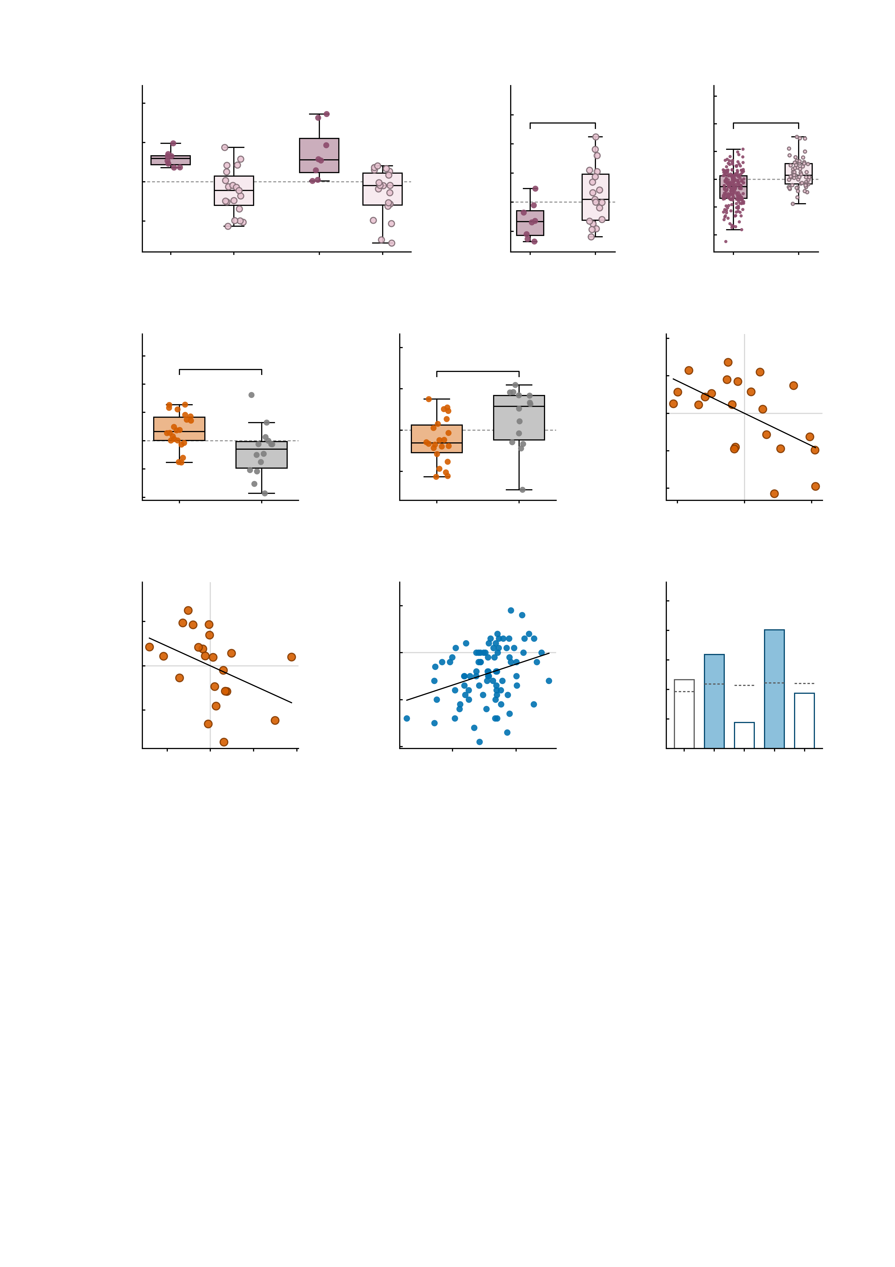
a
3
b
2.0
c
4
2
Ketamine
Midazolam
Placebo
3
Simulation
1.5
*
2
***
1
1.0
1
Δ summed MID FC
(drug - placebo)
Placebo summed MID FC
Simulated baseline MID FC
0
0.5
0
-1
0.0
-1
-0.5
-2
-2
both up
any down
both up
any down
-1.0
both up
any down
-3
both up
any down
d
e
6
f
3
10.0
Ketamine
4
Placebo
2
Ketamine
r = −0.56
7.5
**
**
1
5.0
*
2
Δ NP FC
(ketamine - placebo)
Δ symptom PC1
(residual)
2.5
Placebo NP FC
0
0.0
0
-1
-2.5
-2
-2
-5.0
MDD
HC
-4
MDD
HC
-4
-2
0
2
4
-7.5
-3
Δ NP FC (residual)
g
20
h
20
i
0.6
Ketamine
ρ = −0.56
10
Follow-up
r = 0.32
0.5
Follow-up
10
0.4
**
***
Δ MADRS
(residual)
0
Leave-one-out r
(predicted vs observed)
0
Observed Δ symptoms
0.3
*
null 95th
-10
-10
0.2
0.1
-20
-20
0.0
-0.050
-0.025
0.000
0.025
0.050
0.075
-20
-10
0
10
Similarity to AMPA-perturbed
twin (residual)
Predicted Δ symptoms
(leave-one-out)
empirical
simulated
symptoms
sym + sim
-30
sym + emp
Fig. 5 | In vivo pharmacology and longitudinal association. Two cohorts test the perturbation account in vivo, one panel gives its model counterpart, and a third cohort tests it prospectively. Healthy volunteers (n = 27) received placebo, ketamine and midazolam; the clinical cohort (n = 36) received placebo and ketamine; the digital twins in c are the Fig. 4 cohort (n = 288); the longitudinal cohort is the IMAGEN follow-up (n = 85). Box plots show the median, 25th-75th percentiles and 1.5 x IQR whiskers with every participant overplotted; dashed line, no change. An asterisk above a single box (d) is a two-sided one-sample t test against zero; brackets are the between-group test named below. *P < 0.05, **P < 0.01, ***P < 0.001. The heading inside each panel names the condition or data source it shows. b, c and e make one statement in two independent drug datasets and in the model: the group whose connectivity rises under the drug is the group that starts from the lower drug-free level. In f, g and h both axes are residuals, so the grey cross marks zero on each and the coefficient in the heading band is the effect size itself (both axes being residuals, it is a partial coefficient); its P, confidence interval and n are given below. a, change in summed MID FC from placebo in the healthy cohort, split by the Fig. 4 response rule (both up n = 8, any down n = 19). Ketamine: +0.59 +/- 0.21 in both-up versus -0.25 +/- 0.58 in any-down; midazolam: +0.72 +/- 0.66 versus -0.30 +/- 0.61 (mean +/- s.d.). This panel is descriptive and carries no test: the two groups are defined by the sign of the very quantity plotted here, so any test of it would be circular. b, drug-free (placebo) level of the same two groups: -0.32 versus +0.13, two-sided Welch t = -2.83, P = 0.01. The grouping is defined on the drug-induced change and the plotted quantity is the drug-free level, so this contrast is not circular. c, the same comparison in the digital twins of the Fig. 4 cohort: simulated baseline MID FC under the both-up / any-down split defined on the NP sum (both up n = 229, any down n = 59): -0.31 +/- 0.58 versus +0.22 +/- 0.51, Welch t = -6.95, P < 0.0001 -- the model reproduces the direction seen in b on the same measure. d, ketamine-induced change in NP FC in the clinical cohort (MDD n = 22, HC n = 14): +0.87 versus -0.93. The bracket is the group coefficient of an OLS model adjusted for age, sex, infusion order and placebo-session mean framewise displacement (beta = 2.43, t = 3.43, df = 30, P = 0.0018), not a raw two-sample test. e, placebo NP FC in the same cohort, same adjusted model (beta = -1.34, t = -2.77, df = 30, P = 0.0096). f, change in NP FC against change in the symptom PC1 in the patients (n = 22); both axes are residuals on baseline severity, age, infusion order and placebo-session mean framewise displacement, so the residual df is 16: partial r = -0.56, P = 0.016. g, similarity of the ketamine state to the AMPA-perturbed digital twin against MADRS change (n = 22), both residualised on age, sex, infusion order and placebo-session mean framewise displacement: Spearman rho = -0.56, permutation P = 0.0068, q = 0.027 after Benjamini-Hochberg correction across the four symptom measures. h, leave-one-out predicted against observed four-year symptom change from the 12 NP edges of each participant's unperturbed digital twin, with sex, recruitment site and mean framewise displacement included as covariates in every model (n = 85): r = 0.32, permutation P = 0.0088; in-sample R^2 = 0.42, F(21,63) = 2.15, P = 0.0103; cross-validated R^2 = -0.053. Negative values on both axes are improvement; the line is a least-squares fit shown to indicate direction, not an additional test. i, leave-one-out correlation between predicted and observed symptom change for five model specifications in the same n = 85, each including sex, recruitment site and mean framewise displacement as covariates: age-19 symptoms alone r = 0.23, the 12 simulated edges r = 0.32, the 12 empirical edges r = 0.09, and symptoms combined with each edge set r = 0.40 and r = 0.19. Filled bars, simulated network; open bars, empirical network. The dashed segment above each bar is the 95th percentile of that model's own permutation null (0.19 to 0.22), obtained by shuffling the outcome and repeating the whole leave-one-out procedure 5,000 times. *P < 0.05, **P < 0.01, ***P < 0.001 on the permutation P of the leave-one-out correlation.

