Slide 1
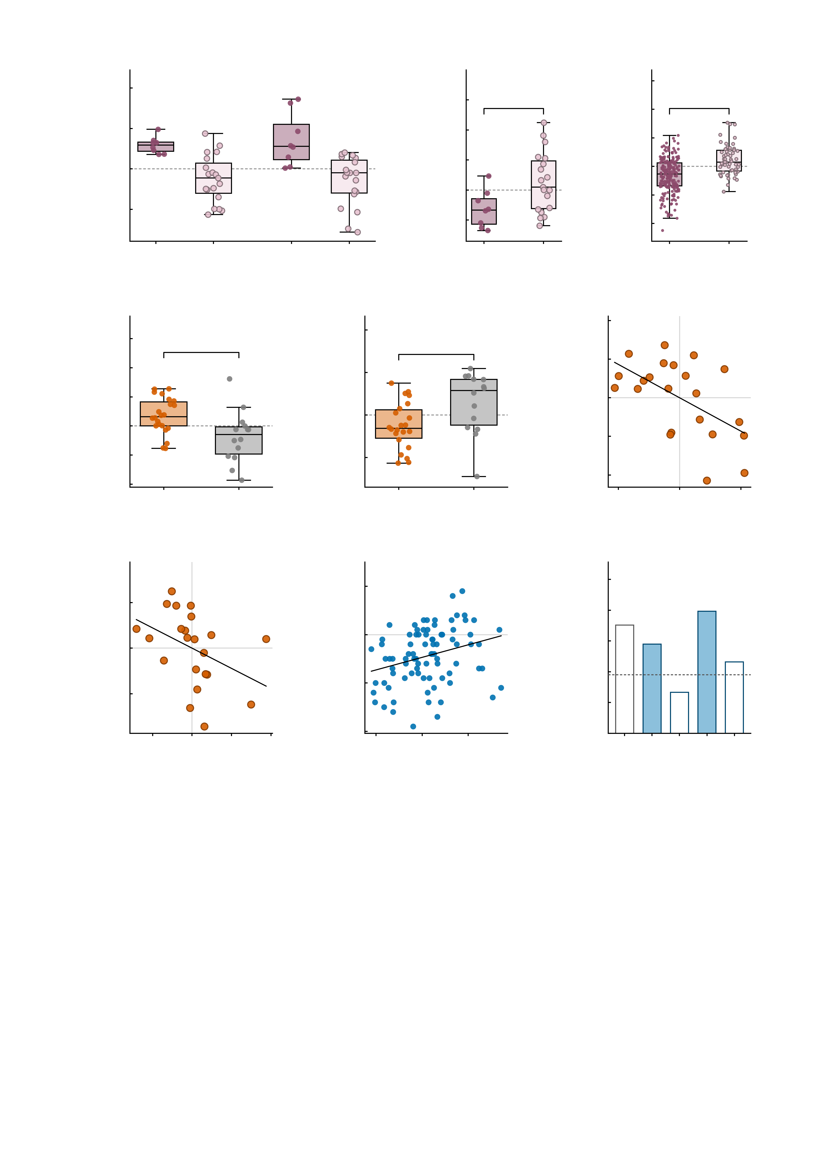
a
3
b
2.0
c
4
2
Ketamine
Midazolam
Placebo
3
Simulation
1.5
*
2
***
1
1.0
1
Δ summed MID FC
(drug - placebo)
Placebo summed MID FC
Simulated baseline MID FC
0
0.5
0
-1
0.0
-1
-0.5
-2
-2
both up
any down
both up
any down
-1.0
both up
any down
-3
both up
any down
d
e
6
f
3
10.0
Ketamine
4
Placebo
2
Ketamine
r = −0.56
7.5
**
**
1
5.0
*
2
Δ NP FC
(ketamine - placebo)
Δ symptom PC1
(residual)
2.5
Placebo NP FC
0
0.0
0
-1
-2.5
-2
-2
-5.0
MDD
HC
-4
MDD
HC
-4
-2
0
2
4
-7.5
-3
Δ NP FC (residual)
g
20
h
20
i
0.6
Ketamine
ρ = −0.56
10
Follow-up
r = 0.29
0.5
Follow-up
10
0.4
***
***
Δ MADRS
(residual)
**
0
Leave-one-out r
(predicted vs observed)
0
Observed Δ symptoms
0.3
*
-10
-10
0.2
null 95th
0.1
-20
-20
0.0
-0.050
-0.025
0.000
0.025
0.050
0.075
-15
-10
-5
0
5
Similarity to AMPA-perturbed
twin (residual)
Predicted Δ symptoms
(leave-one-out)
empirical
simulated
symptoms
sym + sim
-30
sym + emp

