Slide 1
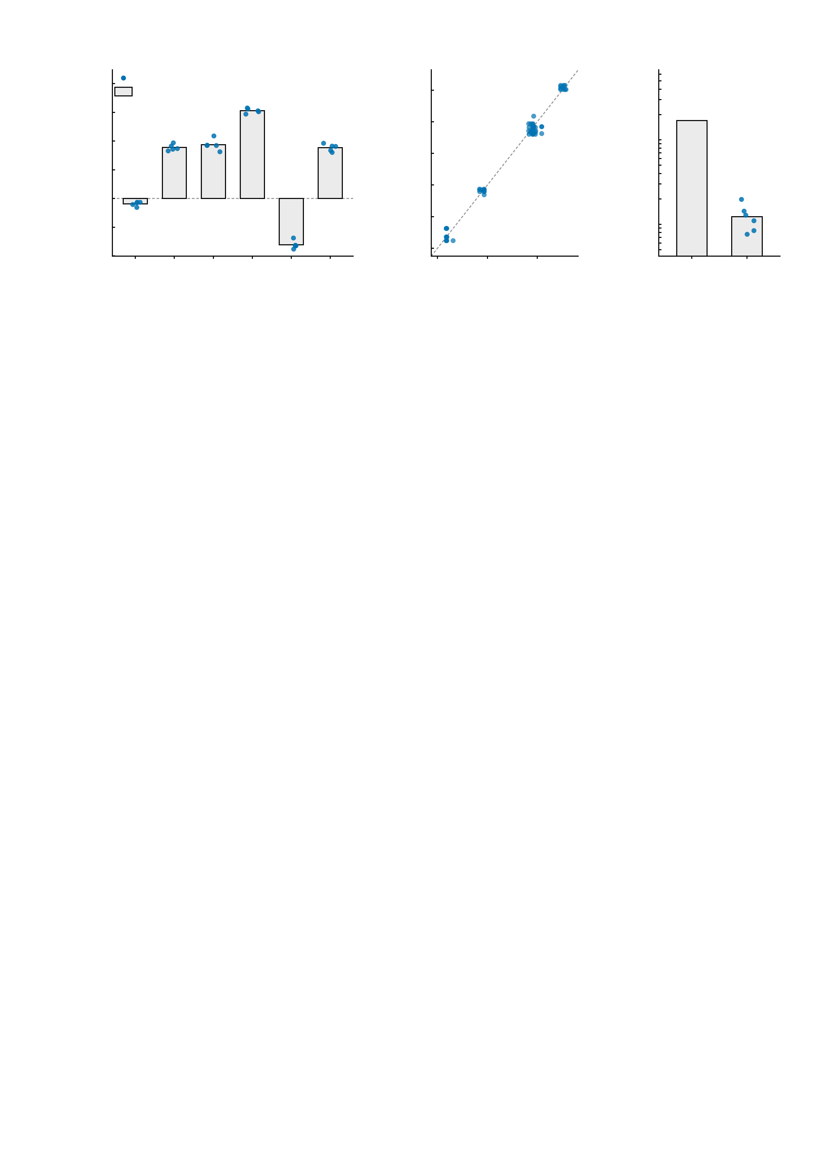
a
0.5
b
0.4
c
mathdefault{10^{0}}
Five independent runs, six reward-task NP edges
Runs agree edge by edge
Signal versus run noise
0.4
individual run (5)
0.3
ICC(3,1) = 0.995
13.8× in SD
(189× in variance)
0.3
across-run mean
0.2
0.2
mathdefault{10^{-1}}
0.1
Simulated FC
Run j (simulated FC)
SD of simulated FC (log scale)
0.1
0.0
0.0
-0.1
-0.1
mathdefault{10^{-2}}
-0.2
e7
e8
e9
e10
e11
e12
-0.4
-0.2
-0.2
0.0
0.2
0.4
between
edges
between
runs
-0.3
-0.3
Run i (simulated FC)
Supplementary Fig. S1 | Reproducibility of the assimilation procedure. Five independent HMDA assimilation runs (ensemble Kalman filter, 30 parallel realisations) on the reward-task (MID) BOLD of one representative healthy control at the 100-million-neuron scale. Each run repeated assimilation and forward simulation from scratch, so the spread shown includes both the filter and the Ornstein-Uhlenbeck forward noise. Unit of observation is one run × edge, n = 5 runs × 6 edges = 30 values. a, the six reward-task NP edges plotted run by run: bars are the across-run mean and points the 5 individual runs. The edges are, as parcel pairs in 217-region space, e7 p126-p5, e8 p16-p15, e9 p207-p15, e10 p66-p41, e11 p213-p94, e12 p207-p15. b, edge-wise agreement between runs: every one of the 10 run pairs is plotted against the identity line, 10 pairs × 6 edges = 60 points. Reliability of the edge profile across runs is ICC(3,1) = 0.9951 (two-way mixed, runs fixed, single measurement) and ICC(2,1) = 0.9942 (two-way random, absolute agreement); the mean between-run profile correlation is r = 0.996 (range 0.990-0.999). c, the same spread expressed as standard deviations on a logarithmic axis: between-edge s.d. 0.169 (the biological signal the model has to carry) against a mean between-run s.d. of 0.0123, a signal-to-noise ratio of 13.8-fold in s.d. and 189-fold in variance. Points are the six edges' individual between-run s.d. values. This is a descriptive reliability analysis; no null-hypothesis test is performed. Scope limitation: the repeats exist only for the MID edges and only for this one subject, so what is quantified here is the run-to-run stability of the assimilation procedure, not between-subject generalisability. Source values are in assim5_edges_mid.csv and assim5_stats.csv.
mathdefault{10^{-3}}

