Slide 1
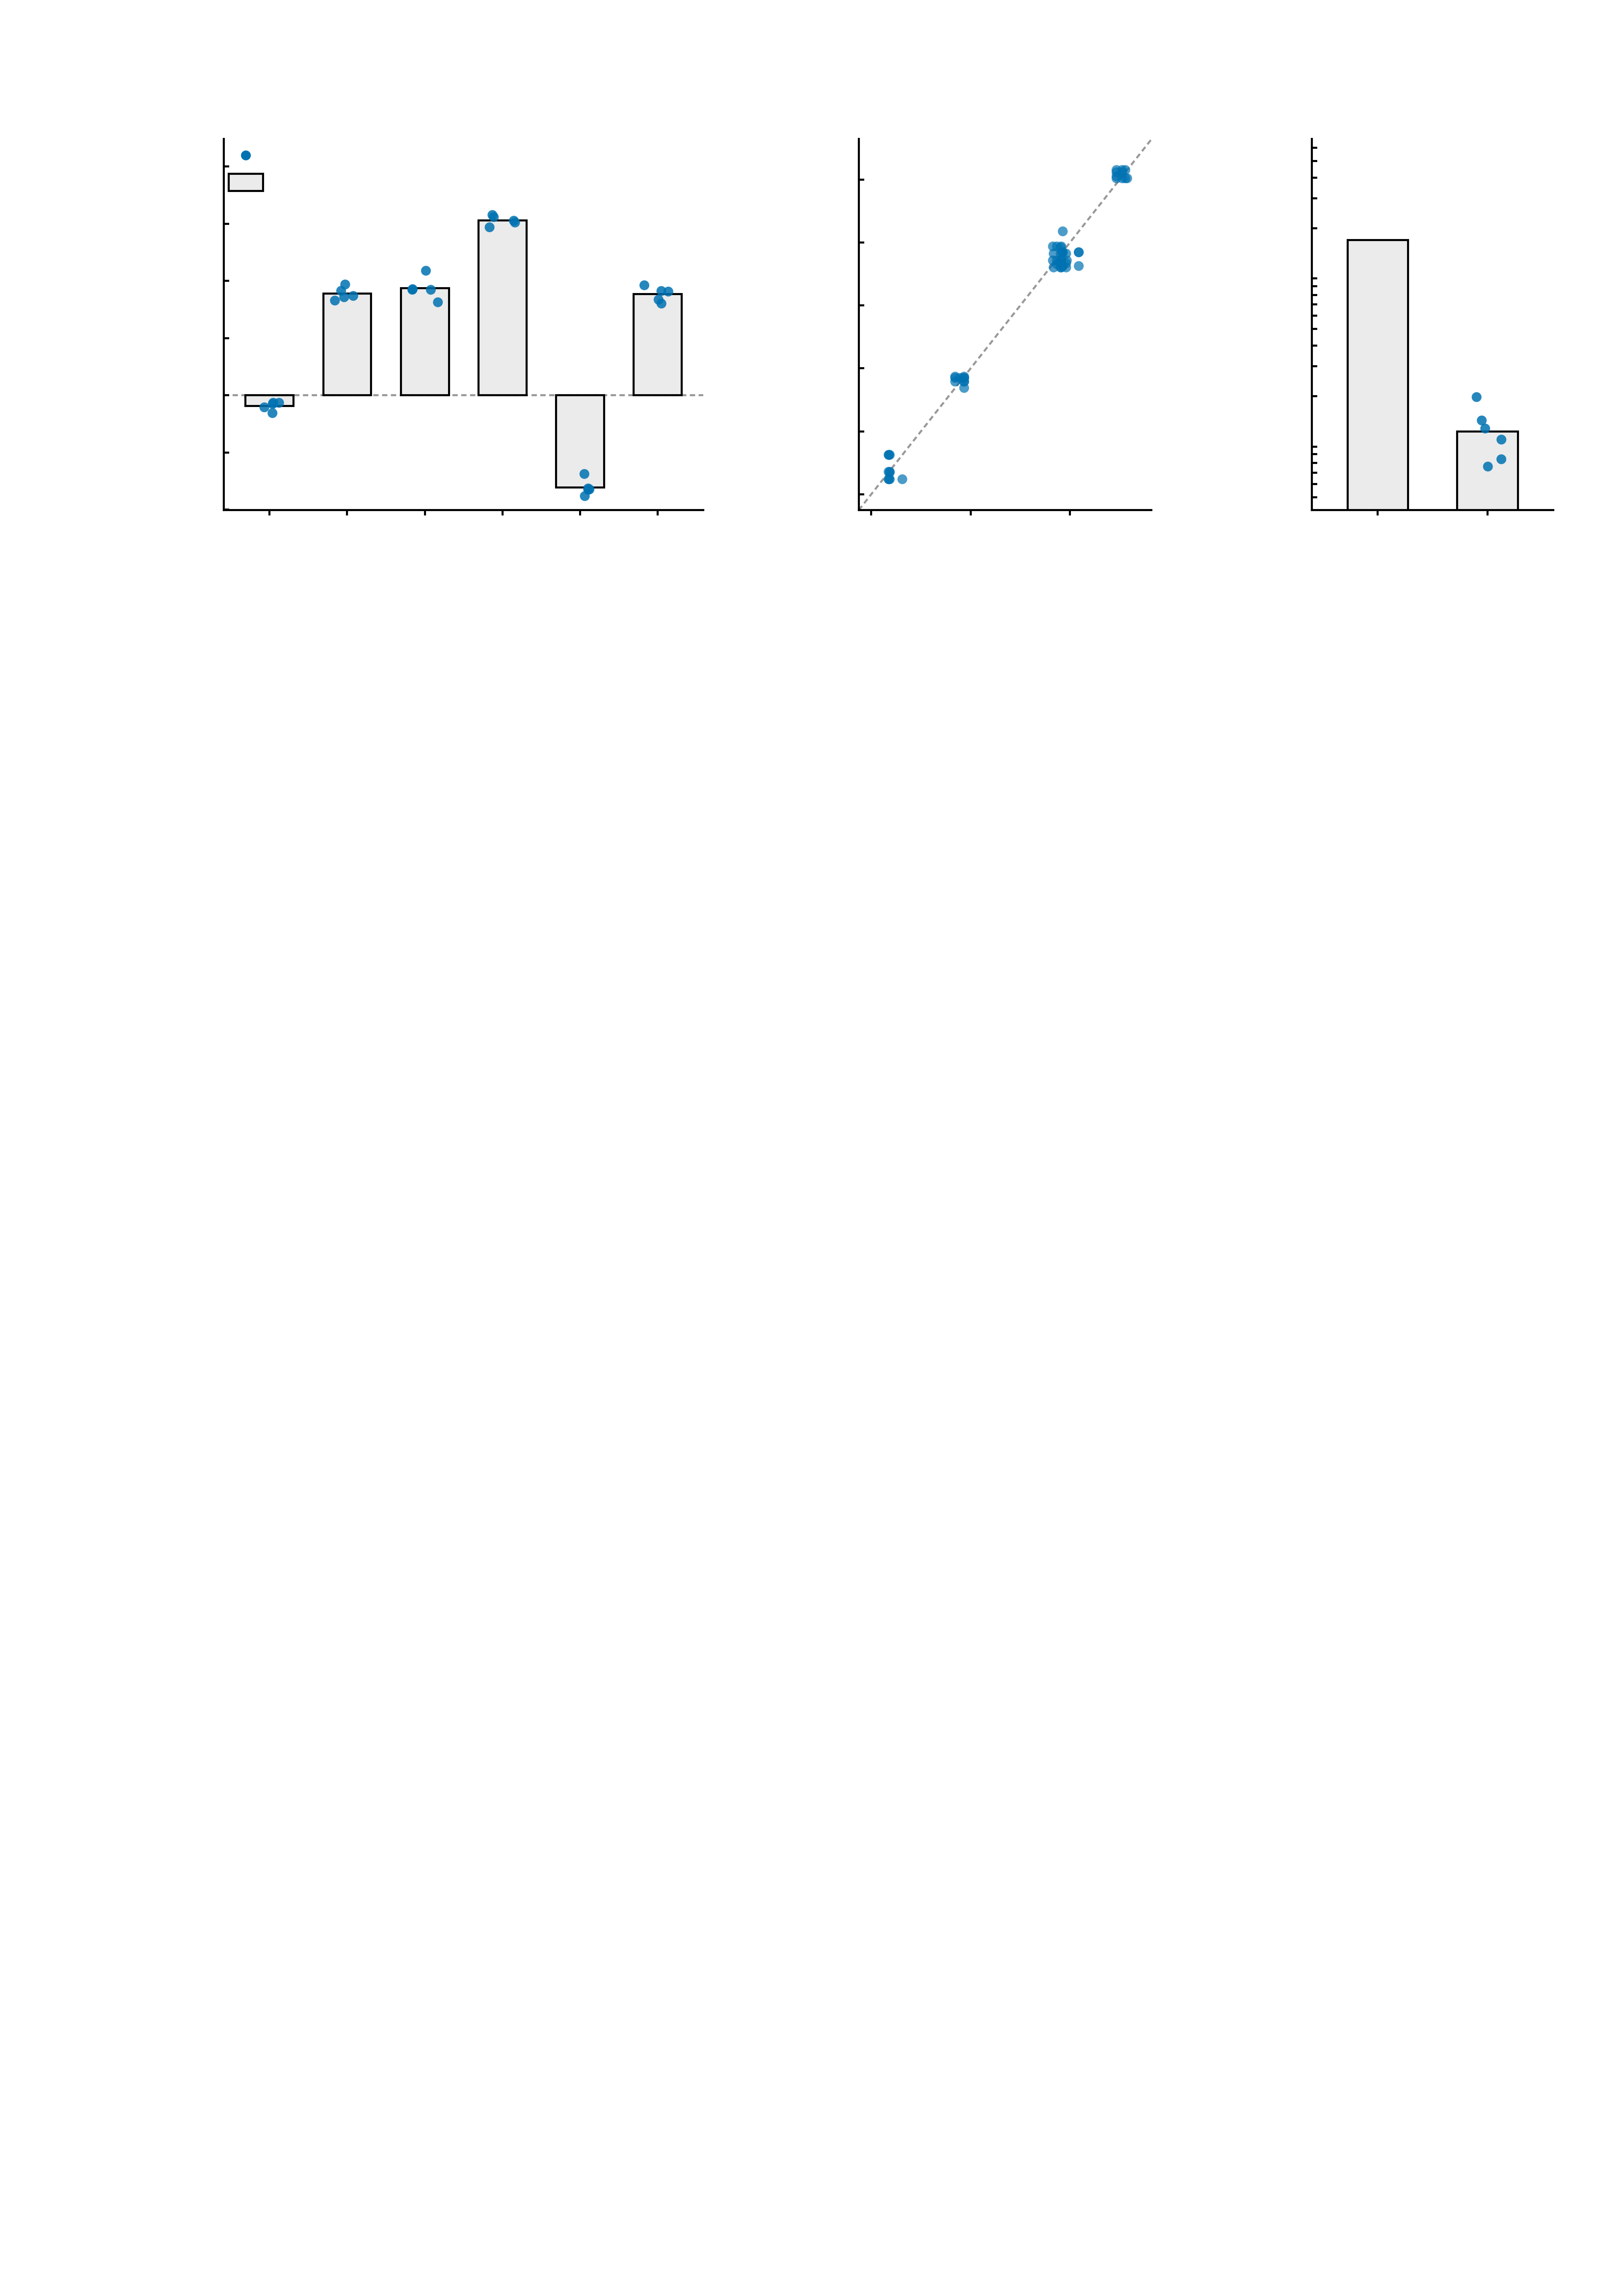
a
0.5
b
0.4
c
mathdefault{10^{0}}
Five independent runs, six reward-task NP edges
Runs agree edge by edge
Signal versus run noise
0.4
individual run (5)
0.3
ICC(3,1) = 0.995
13.8× in SD
(189× in variance)
0.3
across-run mean
0.2
0.2
mathdefault{10^{-1}}
0.1
Simulated FC
Run j (simulated FC)
SD of simulated FC (log scale)
0.1
0.0
0.0
-0.1
-0.1
mathdefault{10^{-2}}
-0.2
e7
e8
e9
e10
e11
e12
-0.4
-0.2
-0.2
0.0
0.2
0.4
between
edges
between
runs
-0.3
-0.3
Run i (simulated FC)
mathdefault{10^{-3}}

