Slide 1
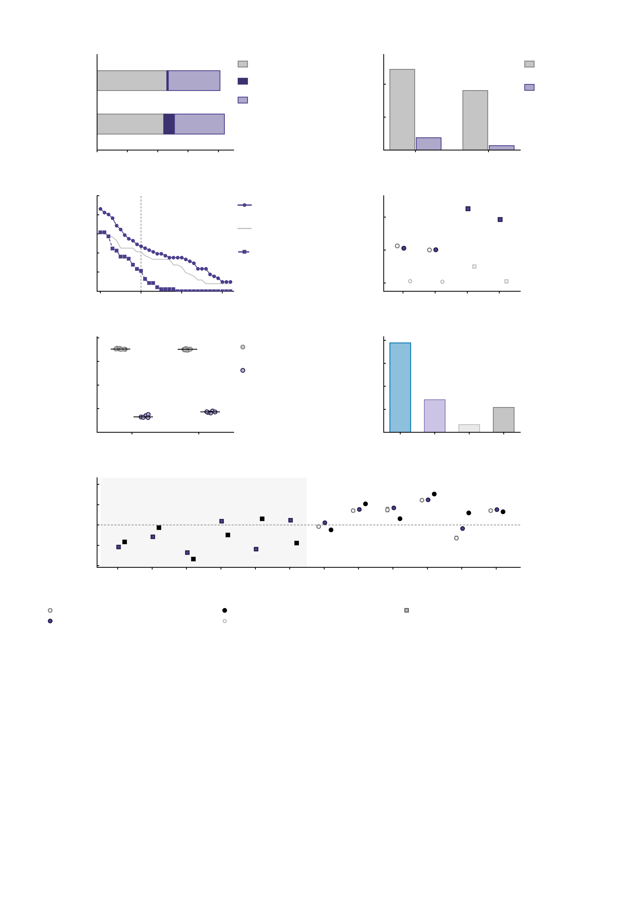
a
Meta-analytic
only
b
60
Meta-
analytic
Inhibition (SST)
Shared
40
Activation-
defined
Activation
only
Subcortical share (%)
Reward (MID)
20
0
20
40
60
80
100
0
Reward
(MID)
Inhibition
(SST)
Assimilated parcels
0.9
c
100
Reward
(MID)
d
80
Region-mean
threshold
0.8
Meta-analytic parcels
also activated (%)
Whole-brain accuracy
(Pearson r)
60
Inhibition
(SST)
0.7
40
20
0.6
0
0
5
10
15
Reward
feed.
Reward
antic.
Inhib.
succ.
Inhib.
fail.
1.01
Activation threshold (T)
0.5
e
f
1.25
1.00
Repeated
assimilation
1.00
0.99
Region
swap
0.75
Connectome agreement (r)
Simulated vs empirical r
0.98
0.50
0.97
0.25
0.96
Feedback
Anticip.
0.00
Both
One
Neither
All
0.75
Assimilated endpoints
g
0.50
Inhibition task
Reward task
0.25
Task FC of the edge
0.00
-0.25
-0.50
1
86-28
2
128-58
3
124-86
4
126-64
5
157-121
6
200-170
7
126-5
8
16-15
9
207-15
10
66-41
11
213-94
12
207-15
-0.75
NP edge (region pair, model indices)
meta-analytic, 5 runs (mean and range)
empirical
circle, reward task; square, inhibition task
activation-defined
meta-analytic, 10 M cohort model (d only)
SupplementaryFig.S22|Meta-analyticversusactivation-definedassimilationregions.Oneactivation-definedregionsetwasbuiltpertaskfromthecohort'sgroup-leveltaskTmapsandmatchedtothemeta-analyticsetonassimilatedvoxelcount(rewardset,2,013versus2,022voxels;inhibitionset,2,185versus1,959).Bothwerethenassimilatedandsimulatedinoneparticipant's100-million-neuronvoxel-wisedigitaltwinbrainandscoredagainstthatparticipant'sempiricaltaskfunctionalconnectivityoverall23,436edgesofthe217-regionmodel.Themeta-analyticsetwasassimilatedfiveindependenttimesontherewardtask,whichprovidestherun-to-runenvelopeagainstwhichtheregionswapisjudged;no100-million-neuronmeta-analyticassimilationoftheinhibitiontaskexistsforthisparticipant,soitsonlycomparatoristhe10-million-neuroncohortmodel,whichdiffersinscaleaswellasinregiondefinitionandisshownascontextratherthanasamatchedcomparison.Oneparticipantwithrepeatedassimilationsisasetofrepeatedmeasurementsratherthanasample,soeverypanelisdescriptive:noerrorindicatorotherthantheobservedrun-to-runrange,andnoinferentialtest.Panelscarrynonumbers;everyvalueisgivenbelow,andthemarkerkeyundergappliestodandg.a,Parcelcompositionofthetwosimulatedsetsintheparticipant'sownvoxelspace,asmeta-analyticonly/shared/activationonly:44/7/33parcelsontherewardtaskand46/1/34ontheinhibitiontask,sothesetsshare7of51meta-analyticparcelsontherewardtask(Dice15.4%,17.4%byvoxel)and1of47ontheinhibitiontask(2.4%,1.5%byvoxel).b,Subcorticalshareofeachsetinthe217-regionmodelspace(reward,25of51regionssubcorticalforthemeta-analyticsetversus3of40fortheactivation-definedset;inhibition,17of47versus1of36);theactivation-definedsetsloadontovisualandmotorcortexinstead.c,Percentageofmeta-analyticparcelsthatalsoshowpositivegroup-levelactivation,astheactivationthresholdisraised(solidlineandcircles,reward;dashed,inhibition;thepalelinesapplythethresholdtotheregionmeanratherthantoanyvoxel).Thedefinitionsagreeatliberalthresholds(86%ofrewardand62%ofinhibitionparcelsatT>0)anddivergeasthethresholdrises(47%and21%atT>=5).d,Whole-brainaccuracyforthefourtaskconditions.Replacingthemeta-analyticregionsdidnotimproveit:rewardfeedback-hitr=0.7059versus0.7129+/-0.0007(range0.7120-0.7138)overthefivemeta-analyticruns,achangeof-0.0070,abouttenbetween-runstandarddeviationsbut-1.0%ofr;rewardanticipation-hit0.7011versus0.7007+/-0.0006(+0.0004,+0.1%).Theinhibitionconditionsreach0.8255and0.7926withtheactivation-definedsetat100millionneuronsagainst0.6502and0.6050forthe10-million-neuronmeta-analyticcohortmodel,adifferencethatcannotbeattributedtotheregiondefinitionbecausethetworunsdifferinscale.e,Agreementbetweenpairsofsimulatedconnectomes,onepointperpairandthebaratthemedian:thefiverepeatsofthemeta-analyticsetreproduceeachotheratr=0.9949-0.9956(10pairspercondition)whereastheactivation-definedrunreproducesthematr=0.9663-0.9691(5pairspercondition),sotheregionswapperturbstheconnectomeabout6.8timesmorethanrerunningthesameassimilation-andaccuracystilldidnotimprove.f,Simulated-empiricalagreementforalledgesofthemeta-analytic100-millionneuronbaseline,groupedbyhowmanyoftheedge'stwoendpointswereassimilated(r=0.9729,n=1275,MSE=0.00671;r=0.3532,n=8466,MSE=0.07995;r=0.0832,n=13695,MSE=0.09875;r=0.2698,n=23436,MSE=0.08695).g,ThetwelveNPedges.Onlyedges7and11falloutsidethefive-runmeta-analyticrange(z=6.1and8.3inunitsofthebetween-runstandarddeviation),andbothareedgeswhoseendpointsthemeta-analyticsetassimilatedandtheactivation-definedsetdropped-thesamepatternasf.Edges1-6belongtotheinhibitiontaskandhavenometa-analytic100-million-neuroncomparator.

