Slide 1
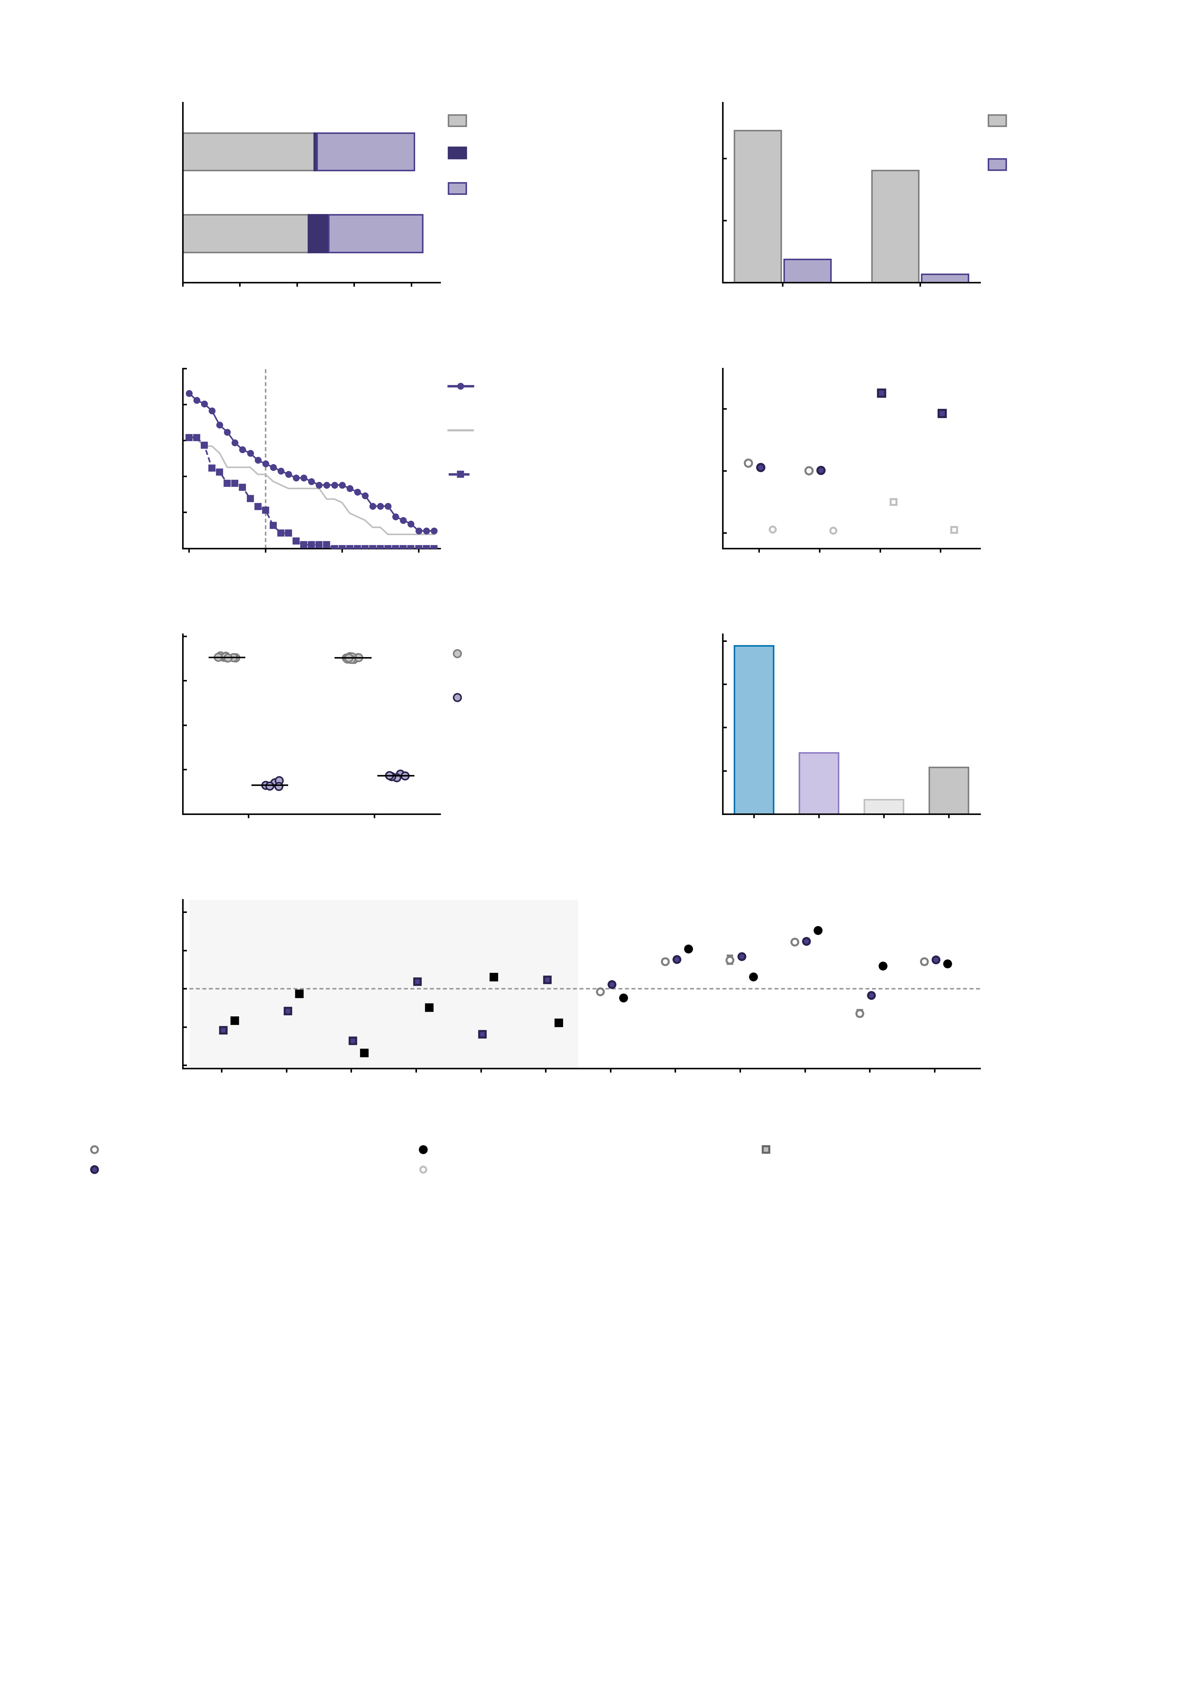
a
Meta-analytic
only
b
60
Meta-
analytic
Inhibition (SST)
Shared
40
Activation-
defined
Activation
only
Subcortical share (%)
Reward (MID)
20
0
20
40
60
80
100
0
Reward
(MID)
Inhibition
(SST)
Assimilated parcels
0.9
c
100
Reward
(MID)
d
80
Region-mean
threshold
0.8
Meta-analytic parcels
also activated (%)
Whole-brain accuracy
(Pearson r)
60
Inhibition
(SST)
0.7
40
20
0.6
0
0
5
10
15
Reward
feed.
Reward
antic.
Inhib.
succ.
Inhib.
fail.
1.01
Activation threshold (T)
0.5
e
f
1.25
1.00
Repeated
assimilation
1.00
0.99
Region
swap
0.75
Connectome agreement (r)
Simulated vs empirical r
0.98
0.50
0.97
0.25
0.96
Feedback
Anticip.
0.00
Both
One
Neither
All
0.75
Assimilated endpoints
g
0.50
Inhibition task
Reward task
0.25
Task FC of the edge
0.00
-0.25
-0.50
1
86-28
2
128-58
3
124-86
4
126-64
5
157-121
6
200-170
7
126-5
8
16-15
9
207-15
10
66-41
11
213-94
12
207-15
-0.75
NP edge (region pair, model indices)
meta-analytic, 5 runs (mean and range)
empirical
circle, reward task; square, inhibition task
activation-defined
meta-analytic, 10 M cohort model (d only)

