Slide 1
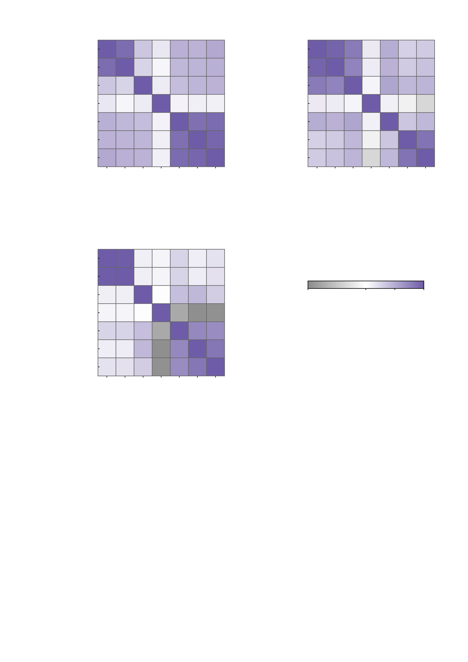
a
3 M | 268
hyper 3 M
b
3 M | 268
hyper 3 M
1.00
0.89
0.35
0.15
0.48
0.47
0.52
1.00
0.94
0.81
0.13
0.50
0.28
0.32
10 M | 268
hyper 3 M
0.89
1.00
0.26
0.06
0.43
0.45
0.48
10 M | 268
hyper 3 M
0.94
1.00
0.76
0.12
0.47
0.32
0.37
10 M | 1000
hyper 10 M/1000
0.35
0.26
1.00
0.12
0.40
0.44
0.46
10 M | 1000
hyper 10 M/1000
0.81
0.76
1.00
0.07
0.54
0.43
0.45
10 M | voxel
hyper 10 M vox
0.15
0.06
0.12
1.00
0.07
0.10
0.09
10 M | voxel
hyper 10 M vox
0.13
0.12
0.07
1.00
0.09
-0.02
-0.07
10 M | voxel
hyper 100 M
0.48
0.43
0.40
0.07
1.00
0.87
0.91
10 M | voxel
hyper 100 M
0.50
0.47
0.54
0.09
1.00
0.35
0.44
100 M | voxel
hyper 100 M
0.47
0.45
0.44
0.10
0.87
1.00
0.93
100 M | voxel
hyper 100 M
0.28
0.32
0.43
-0.02
0.35
1.00
0.86
1 B | voxel
hyper 100 M
0.52
0.48
0.46
0.09
0.91
0.93
1.00
1 B | voxel
hyper 100 M
0.32
0.37
0.45
-0.07
0.44
0.86
1.00
3 M | 268
hyper 3 M
10 M | 268
hyper 3 M
10 M | voxel
hyper 100 M
1 B | voxel
hyper 100 M
3 M | 268
hyper 3 M
10 M | 268
hyper 3 M
10 M | voxel
hyper 100 M
1 B | voxel
hyper 100 M
10 M | voxel
hyper 10 M vox
100 M | voxel
hyper 100 M
10 M | voxel
hyper 10 M vox
100 M | voxel
hyper 100 M
10 M | 1000
hyper 10 M/1000
10 M | 1000
hyper 10 M/1000
c
3 M | 268
hyper 3 M
1.00
0.99
0.10
0.07
0.26
0.11
0.18
10 M | 268
hyper 3 M
0.99
1.00
0.10
0.07
0.26
0.11
0.18
10 M | 1000
hyper 10 M/1000
0.10
0.10
1.00
0.00
0.39
0.44
0.30
-0.2
0.0
0.5
1.0
10 M | voxel
hyper 10 M vox
0.07
0.07
0.00
1.00
-0.15
-0.19
-0.19
Spearman ρ over the 12 subjects x 12 edges
(144 cells) of the raw NP profile
10 M | voxel
hyper 100 M
0.26
0.26
0.39
-0.15
1.00
0.72
0.70
100 M | voxel
hyper 100 M
0.11
0.11
0.44
-0.19
0.72
1.00
0.83
1 B | voxel
hyper 100 M
0.18
0.18
0.30
-0.19
0.70
0.83
1.00
3 M | 268
hyper 3 M
10 M | 268
hyper 3 M
10 M | voxel
hyper 100 M
1 B | voxel
hyper 100 M
10 M | voxel
hyper 10 M vox
100 M | voxel
hyper 100 M
10 M | 1000
hyper 10 M/1000
Supplementary Fig. S5 | Cross-build agreement of the 12-edge NP profile follows the assimilated hyperparameters, and loosens under perturbation. Each matrix is the agreement between every pair of the seven digital-twin-brain builds in the same quantity: one Spearman rho over all 12 subjects x 12 edges = 144 cells of the raw NP profile, with no per-subject averaging, no Fisher transform and no standardisation. Rows and columns give the build (simulated neurons | parcellation) above the hyperparameter set it was assimilated with; regional builds are printed in light purple and voxel builds in dark purple. The colour bar is shared by the three panels and is white at zero, so the negative entries that appear after perturbation are grey rather than clipped; the matrices are symmetric and the diagonal is 1 by construction. Rank correlation is used because the builds have very different tail behaviour: the 10 M voxel build assimilated with its own hyperparameters has excess kurtosis 10.6, and its Pearson agreement with the 100 M hyperparameter voxel builds falls from 0.21 to -0.04 when the five most extreme of the 144 cells are dropped, whereas Spearman moves only from 0.07 to -0.02; over the 21 off-diagonal pairs the two metrics rank almost identically (rho = 0.96, largest shift 0.14) and the Pearson matrix is kept in fig3c_cross_scale_similarity_pearson.csv. Repeat-averaged profiles are used wherever repeats exist (the 3 M, 10 M | 268 and archive voxel builds, five runs each); the 10 M voxel own-hyperparameter build is a single run. a, baseline. Agreement tracks the hyperparameter set, not the model scale: the two builds that share the 3 M hyperparameters agree at rho = 0.89 although one is a 3 M and the other a 10 M model, and the three voxel builds that share the 100 M hyperparameters agree at 0.87-0.93, while agreement across the two families is only 0.40-0.52. The 10 M voxel build assimilated with its own hyperparameters agrees with no other build (+0.06 to +0.15). b, after the AMPA perturbation. The regional block tightens (0.76-0.94 against 0.26-0.89 at baseline) while the voxel block loosens (0.35-0.86 against 0.87-0.93), and the first negative entries appear (minimum -0.07). c, after AMPA plus GABA-A. The two 268-region builds become nearly interchangeable (rho = 0.99), the voxel block stays together (0.70-0.83) but its agreement with the regional builds drops to 0.11-0.44, and the own-hyperparameter build turns negative against every voxel build (-0.19 to -0.15, against +0.07 to +0.10 at baseline). All entries in b and c use the full 144 cells; the counts are tabulated in fig3c_cross_scale_n_cells_ampa.csv and fig3c_cross_scale_n_cells_gaba.csv.

