Slide 1
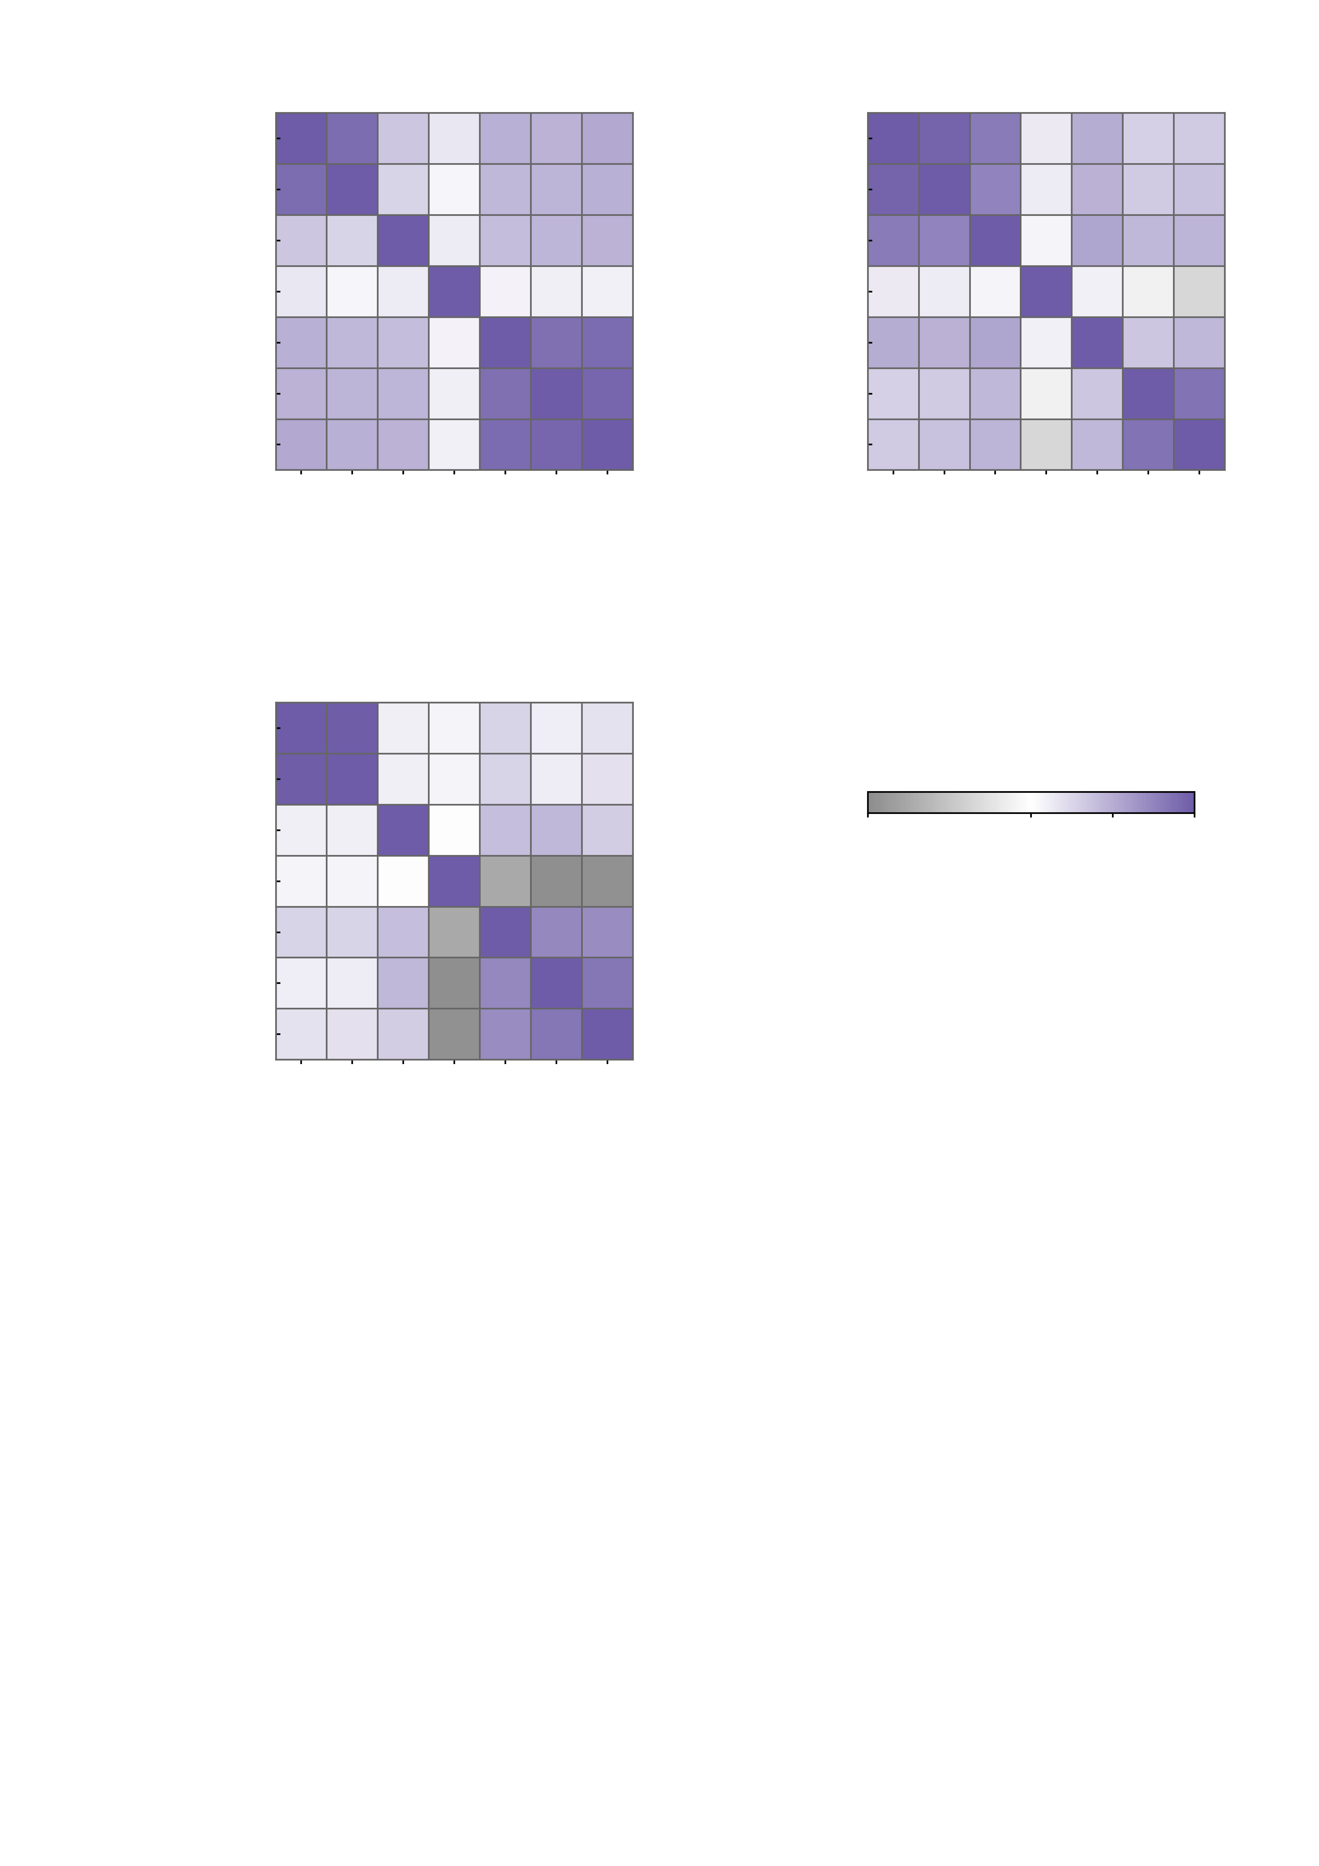
a
3 M | 268
hyper 3 M
b
3 M | 268
hyper 3 M
1.00
0.89
0.35
0.15
0.48
0.47
0.52
1.00
0.94
0.81
0.13
0.50
0.28
0.32
10 M | 268
hyper 3 M
0.89
1.00
0.26
0.06
0.43
0.45
0.48
10 M | 268
hyper 3 M
0.94
1.00
0.76
0.12
0.47
0.32
0.37
10 M | 1000
hyper 10 M/1000
0.35
0.26
1.00
0.12
0.40
0.44
0.46
10 M | 1000
hyper 10 M/1000
0.81
0.76
1.00
0.07
0.54
0.43
0.45
10 M | voxel
hyper 10 M vox
0.15
0.06
0.12
1.00
0.07
0.10
0.09
10 M | voxel
hyper 10 M vox
0.13
0.12
0.07
1.00
0.09
-0.02
-0.07
10 M | voxel
hyper 100 M
0.48
0.43
0.40
0.07
1.00
0.87
0.91
10 M | voxel
hyper 100 M
0.50
0.47
0.54
0.09
1.00
0.35
0.44
100 M | voxel
hyper 100 M
0.47
0.45
0.44
0.10
0.87
1.00
0.93
100 M | voxel
hyper 100 M
0.28
0.32
0.43
-0.02
0.35
1.00
0.86
1 B | voxel
hyper 100 M
0.52
0.48
0.46
0.09
0.91
0.93
1.00
1 B | voxel
hyper 100 M
0.32
0.37
0.45
-0.07
0.44
0.86
1.00
3 M | 268
hyper 3 M
10 M | 268
hyper 3 M
10 M | voxel
hyper 100 M
1 B | voxel
hyper 100 M
3 M | 268
hyper 3 M
10 M | 268
hyper 3 M
10 M | voxel
hyper 100 M
1 B | voxel
hyper 100 M
10 M | voxel
hyper 10 M vox
100 M | voxel
hyper 100 M
10 M | voxel
hyper 10 M vox
100 M | voxel
hyper 100 M
10 M | 1000
hyper 10 M/1000
10 M | 1000
hyper 10 M/1000
c
3 M | 268
hyper 3 M
1.00
0.99
0.10
0.07
0.26
0.11
0.18
10 M | 268
hyper 3 M
0.99
1.00
0.10
0.07
0.26
0.11
0.18
10 M | 1000
hyper 10 M/1000
0.10
0.10
1.00
0.00
0.39
0.44
0.30
-0.2
0.0
0.5
1.0
10 M | voxel
hyper 10 M vox
0.07
0.07
0.00
1.00
-0.15
-0.19
-0.19
Spearman ρ over the 12 subjects x 12 edges
(144 cells) of the raw NP profile
10 M | voxel
hyper 100 M
0.26
0.26
0.39
-0.15
1.00
0.72
0.70
100 M | voxel
hyper 100 M
0.11
0.11
0.44
-0.19
0.72
1.00
0.83
1 B | voxel
hyper 100 M
0.18
0.18
0.30
-0.19
0.70
0.83
1.00
3 M | 268
hyper 3 M
10 M | 268
hyper 3 M
10 M | voxel
hyper 100 M
1 B | voxel
hyper 100 M
10 M | voxel
hyper 10 M vox
100 M | voxel
hyper 100 M
10 M | 1000
hyper 10 M/1000

