Slide 1
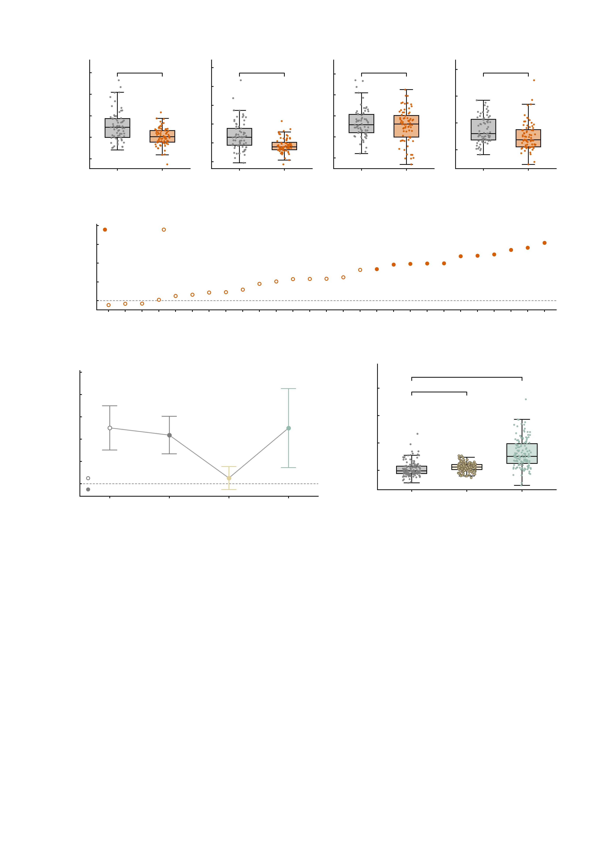
a
10.0
10
4
20
Empirical
***
Simulated baseline
After AMPA
After GABA-A
7.5
8
***
3
n.s.
15
**
5.0
6
2
10
Depression-network FC
4
2.5
2
1
5
0.0
0
0
0
-2.5
-2
-1
-5.0
HC
MDD
-4
HC
MDD
-2
HC
MDD
-5
HC
MDD
b
1.0
0.8
P < 0.05
n.s.
0.6
Adjusted Cohen's d
(HC − MDD)
0.4
0.2
0.0
-0.2
E10
E13
E12
E3
E11
E6
E20
E26
E21
E2
E24
E7
E15
E9
E5
E8
E1
E22
E23
E25
E4
E14
E19
E27
E17
E16
E18
c
3.0
d
20
2.5
**
15
*
***
2.0
***
***
1.5
10
Adjusted HC − MDD difference
Depression-network FC
1.0
5
0.5
n.s.
0
0.0
Empirical
Simulated
Simulated
baseline
After
AMPA
After
GABA-A
-5
Baseline
+AMPA
+GABA-A
-0.5
Empirical
Supplementary Fig. S6 | A depression-specific network: the AMPA perturbation abolishes the diagnostic difference, the GABA-A perturbation does not. The depression-specific network is the set of 27 edges selected against the diagnosis in the population-scale simulation subsample (SI Results 5); every panel is computed in that same sample, n = 141 (healthy controls n = 69, MDD n = 72), and the measure is the summed connectivity of those 27 edges. The network was defined here, so a and b are descriptive of that selection rather than an independent test of it; what is tested is whether a perturbation of the digital twins moves the measure and whether it removes the group difference. Four conditions are compared throughout: the empirical connectivity, the simulated baseline of the twins, and the twins after the AMPA and after the GABA-A perturbation (GABA-A is applied on top of AMPA, as everywhere else in this work). Group tests are linear models of the condition on diagnosis with sex, recruitment site and mean head motion as covariates (df = 136), uncorrected across the four pre-specified conditions; a and c display adjusted values, i.e. the residual of those covariates plus that condition's own mean, so the covariates are removed without moving a condition off its real scale. Box plots show the median, 25th-75th percentiles and 1.5 x IQR whiskers with every subject overplotted. *P < 0.05, **P < 0.01, ***P < 0.001; n.s., not significant. a, depression-network connectivity by diagnosis in each condition, each on its own scale: empirically 1.30 +/- 1.82 in controls versus 0.09 +/- 1.11 in MDD, adjusted difference 1.25 (95% CI 0.76 to 1.75, t = -4.98, df = 136, P = 1.9e-06, unadjusted Cohen's d = 0.81); in the simulated baseline 0.74 +/- 1.56 in controls versus -0.26 +/- 0.86 in MDD, adjusted difference 1.09 (95% CI 0.67 to 1.51, t = -5.13, df = 136, P = 9.9e-07, unadjusted Cohen's d = 0.80); after AMPA 0.68 +/- 0.76 in controls versus 0.51 +/- 0.80 in MDD, adjusted difference 0.13 (95% CI -0.13 to 0.39, t = -0.97, df = 136, P = 0.335, unadjusted Cohen's d = 0.22); after GABA-A 3.80 +/- 2.44 in controls versus 2.44 +/- 2.74 in MDD, adjusted difference 1.25 (95% CI 0.36 to 2.13, t = -2.78, df = 136, P = 0.00617, unadjusted Cohen's d = 0.52). The diagnostic difference survives in the simulated baseline, is abolished after AMPA and remains after GABA-A. b, the 27 edges of the network sorted by their adjusted effect size, oriented controls minus MDD and converted from the covariate model's t so that one convention holds across the figure (range -0.04 to 0.62). Filled symbols mark the 11 edges with an uncorrected P < 0.05 empirically; 12 of the 27 reach the same threshold in the simulated baseline. 1 of these edges are shared with the NP-factor profile of Fig. 2. This panel resolves the empirical contrast of a edge by edge. Per-edge values are in depnet_edge_source_data.csv and carry no correction across edges. c, the same four contrasts as adjusted differences with their 95% confidence intervals; open symbol, empirical; filled symbols, simulated. The interval excludes zero in every condition except after AMPA, where it spans -0.13 to 0.39. The tests are those of a and are not repeated. d, the within-subject effect of each perturbation on the same measure, all 141 subjects pooled across diagnosis. AMPA raises it by +0.36 +/- 1.40 (94/141 subjects, 66.7%, increase), paired t = 3.03, df = 140, P = 0.00287; with the same covariates t = 2.34, df = 137, P = 0.0208. GABA-A raises it by +2.87 +/- 2.64 (124/141, 87.9%), paired t = 12.92, df = 140, P = 1.2e-25; adjusted t = 5.24, df = 137, P = 6.1e-07. Both perturbations therefore raise depression-network connectivity, but only AMPA removes the diagnostic difference.

