Slide 1
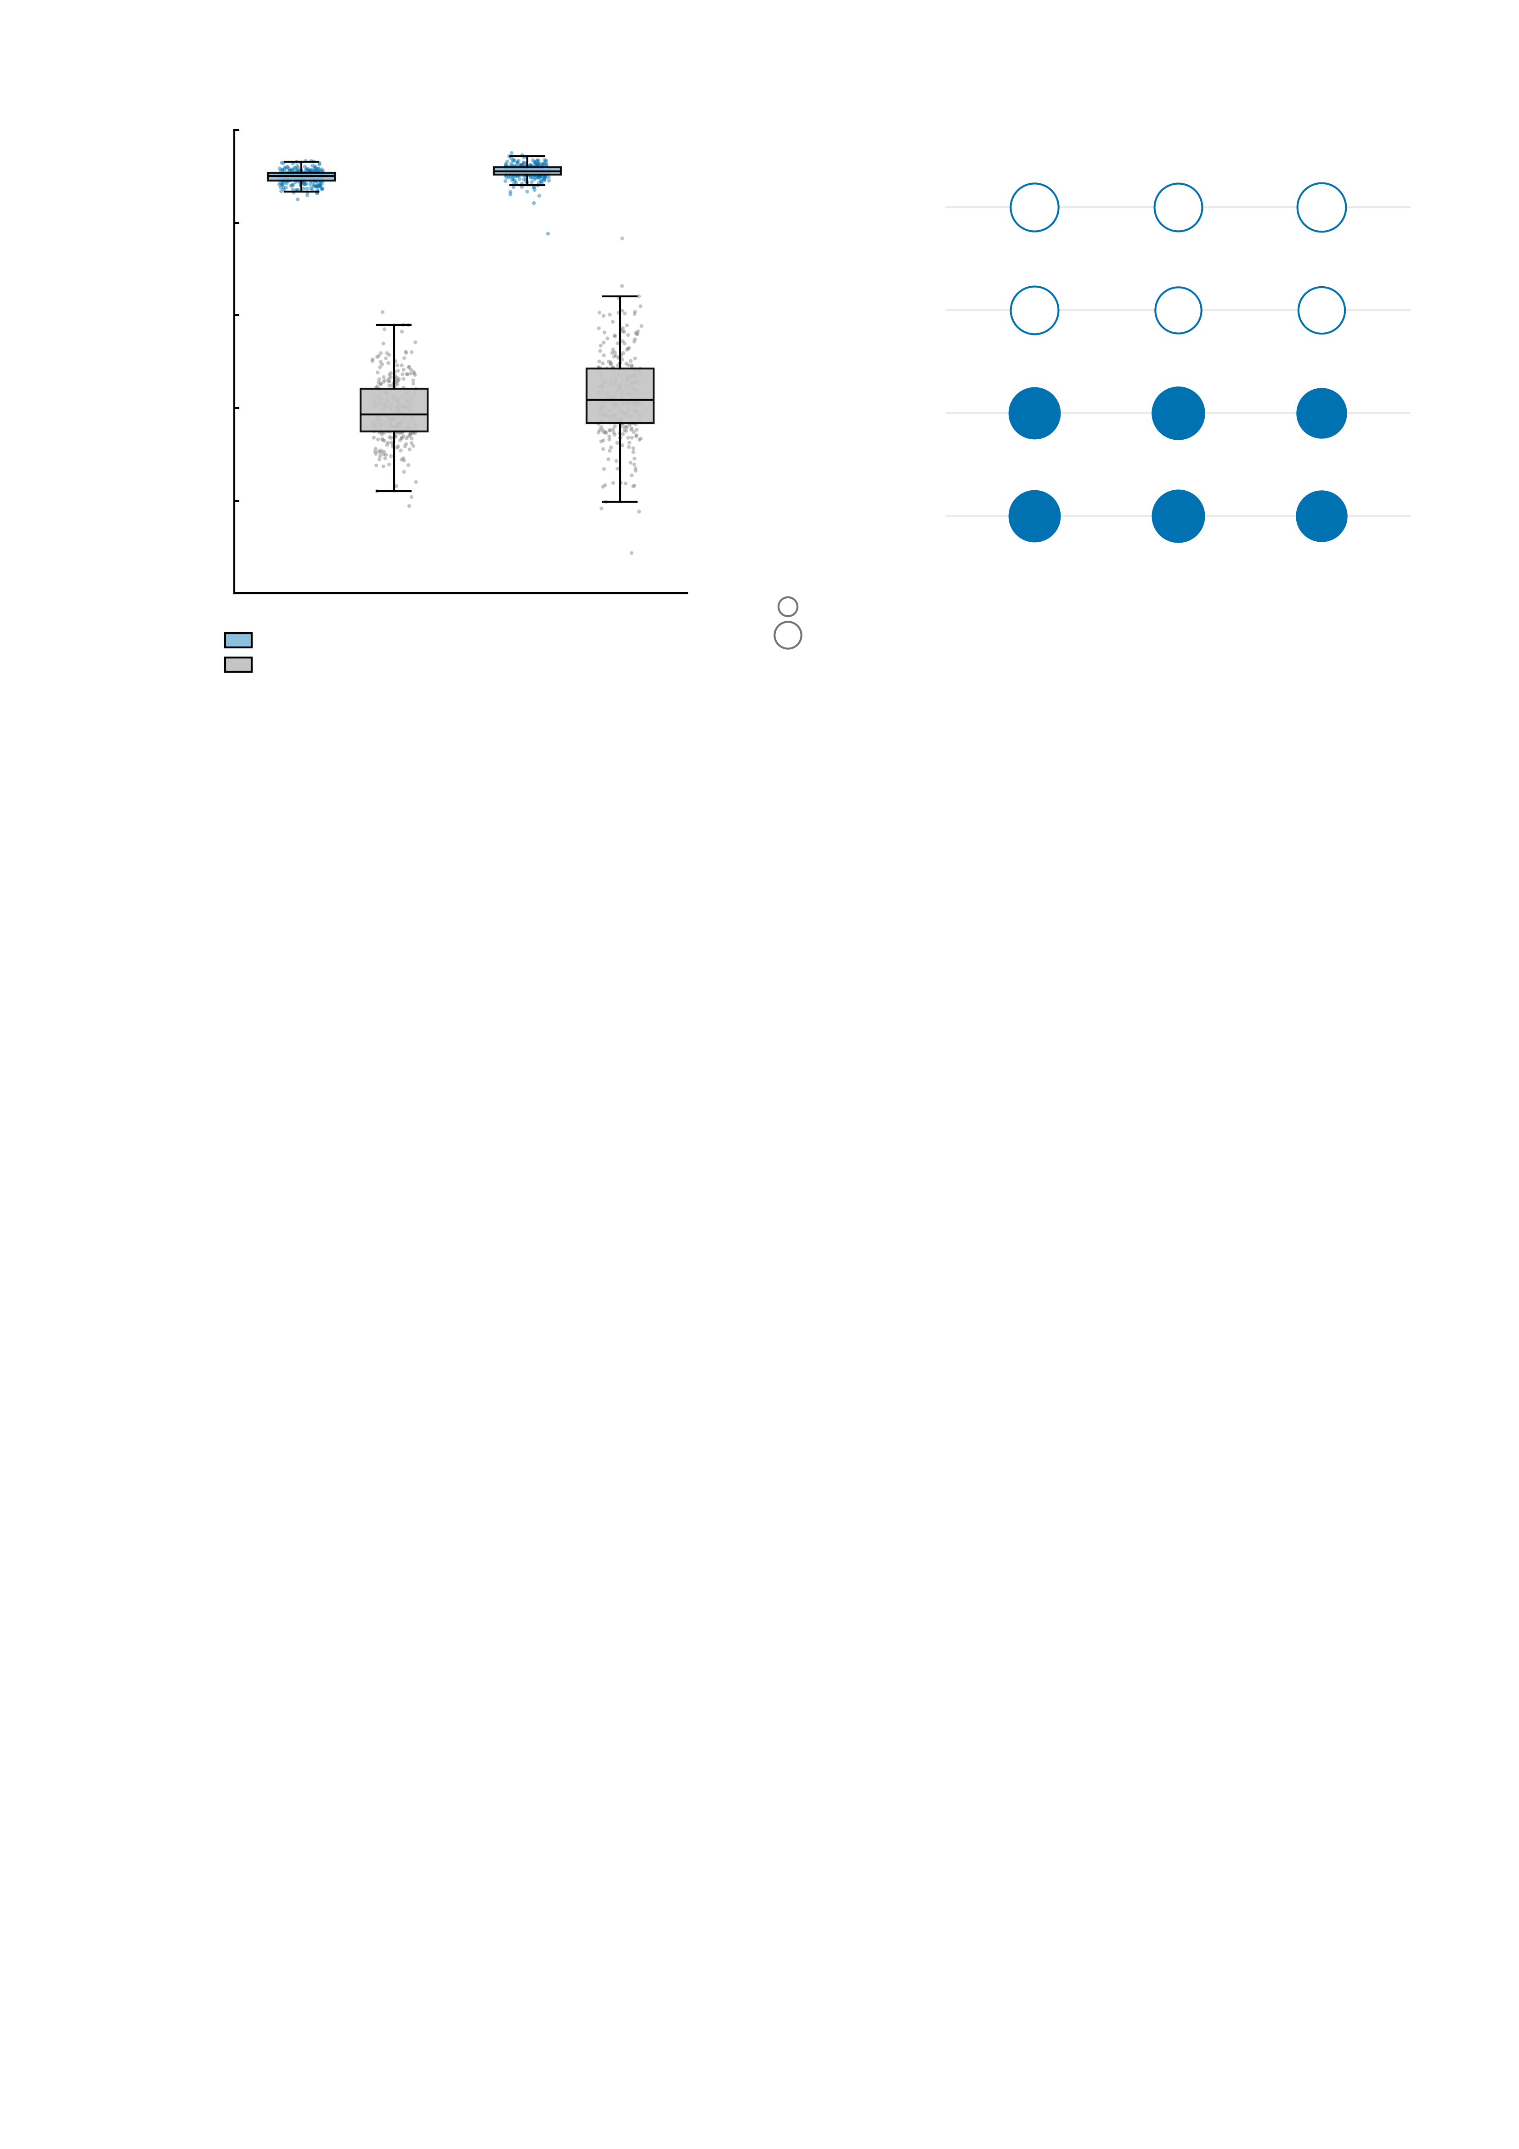
a
1.0
b
0.8
Empirical
anticipation
Empirical
feedback
***
***
***
0.6
Simulated-empirical BOLD
correlation
***
***
***
0.4
Simulated
anticipation
0.2
Simulated
feedback
***
***
***
0.0
r = 0.2
***
***
***
MID
SST
r = 0.4
Big win
Small win
No win
Assimilated regions
Whole brain
Supplementary Fig. S4 | Fidelity of the simulated regional BOLD signals and of the behaviour their connectivity predicts. Both panels are the same n = 288 participants, the sample retained after the mean framewise displacement < 0.5 mm criterion. Panel a is descriptive and carries no test; panel b carries only the significance symbol (*** P < 0.001, ** P < 0.01, * P < 0.05, n.s. not significant). The coefficients are given below, and the per-participant BOLD correlations and all 32 prediction models are in bold_cc_n288.csv and cpm_predict_perf_n288.csv. a, correlation between the simulated and the empirical regional BOLD time series in each participant, evaluated over the regions whose empirical signals entered the data assimilation and over all regions of the brain, for the monetary incentive delay task (MID) and the stop-signal task (SST). Boxes are the median and interquartile range with whiskers at 1.5 x IQR, one point per participant. MID assimilated regions 0.899 +/- 0.014 (median 0.901, range 0.850 to 0.934), MID whole brain 0.394 +/- 0.068 (median 0.386, range 0.189 to 0.607); SST assimilated regions 0.910 +/- 0.017 (median 0.911, range 0.776 to 0.951), SST whole brain 0.426 +/- 0.093 (median 0.418, range 0.087 to 0.766). Within participant the assimilated regions exceed the whole brain by 0.505 +/- 0.061 in MID and 0.485 +/- 0.086 in SST. No test is reported for this difference because the two quantities are not comparable in kind: the assimilated signals are the fitting target of the assimilation, whereas the whole-brain value is the out-of-sample agreement over regions the model was never fitted to. b, connectome-based predictive modelling (CPM) of MID response time, trained and tested by leave-one-out cross-validation on whole-brain task-state functional connectivity with an edge-selection threshold of P < 0.01; accuracy is Spearman's correlation between predicted and observed response time, averaged over the positive- and negative-edge models. Bubble area is proportional to r, open for empirical connectivity and filled for simulated. Empirical anticipation: big win r = 0.429 (P < 0.001), small win r = 0.427 (P < 0.001), no win r = 0.441 (P < 0.001). Empirical feedback: big win r = 0.426 (P < 0.001), small win r = 0.398 (P < 0.001), no win r = 0.405 (P < 0.001). Simulated anticipation: big win r = 0.474 (P < 0.001), small win r = 0.500 (P < 0.001), no win r = 0.446 (P < 0.001). Simulated feedback: big win r = 0.475 (P < 0.001), small win r = 0.495 (P < 0.001), no win r = 0.463 (P < 0.001). Response time is predicted well above chance from every one of the four connectivity sources and in all three conditions. The prediction tests in b are two-sided and uncorrected. The accuracy (hit-rate) targets and the two difference contrasts (big-win minus no-win, small-win minus no-win) were fitted with the same pipeline and are tabulated in the source file; they are predicted far less well than response time from either connectivity source.

