Slide 1
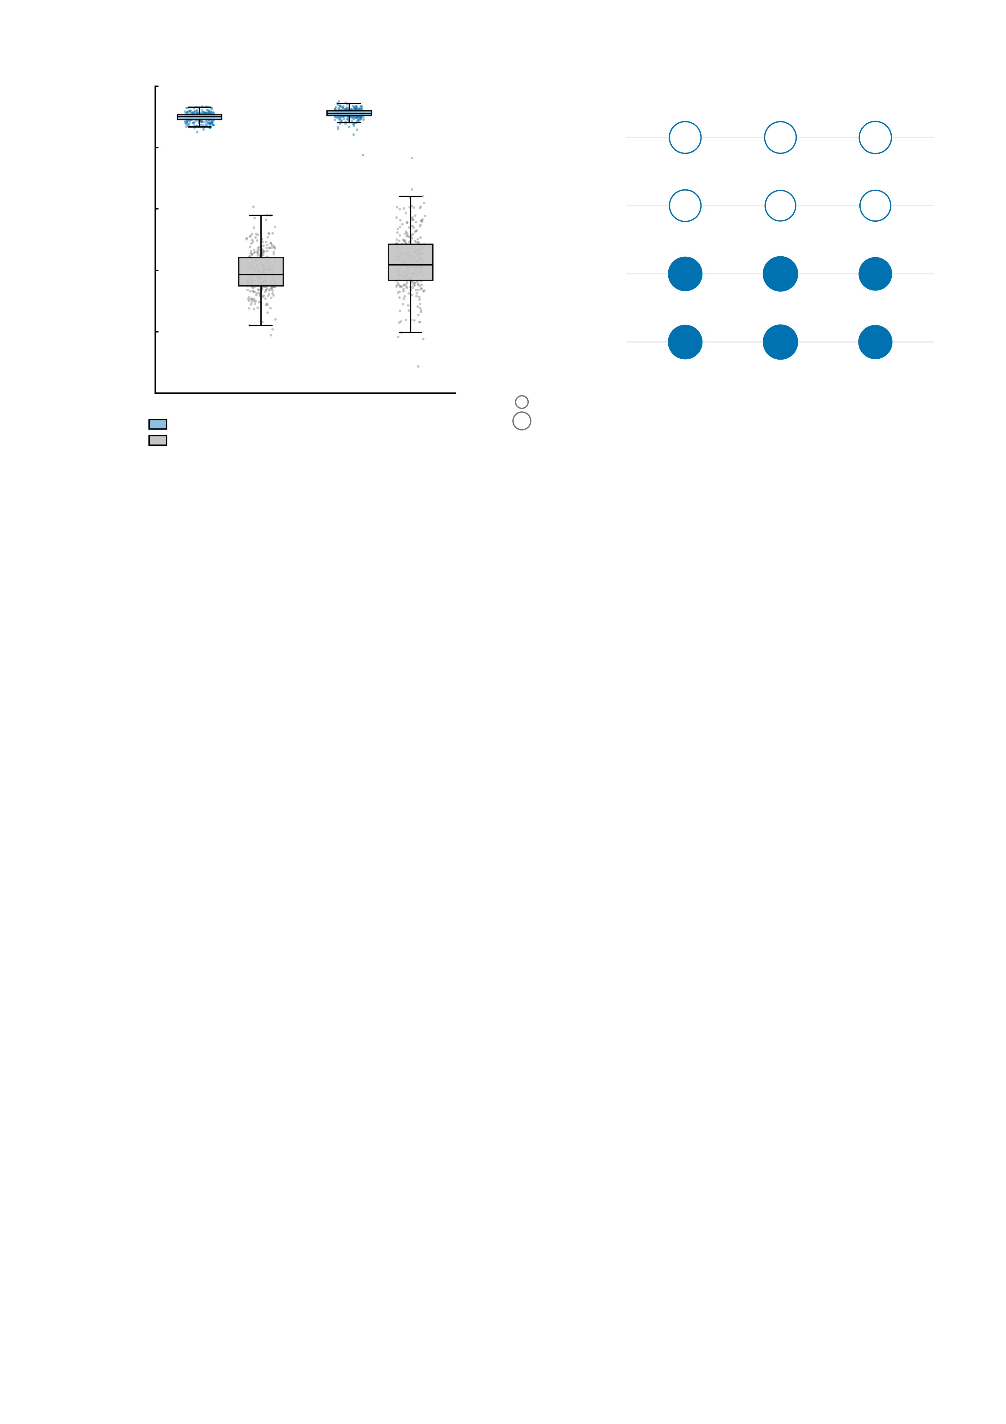
a
1.0
b
0.8
Empirical
anticipation
Empirical
feedback
***
***
***
0.6
Simulated-empirical BOLD
correlation
***
***
***
0.4
Simulated
anticipation
0.2
Simulated
feedback
***
***
***
0.0
r = 0.2
***
***
***
MID
SST
r = 0.4
Big win
Small win
No win
Assimilated regions
Whole brain

