Slide 1
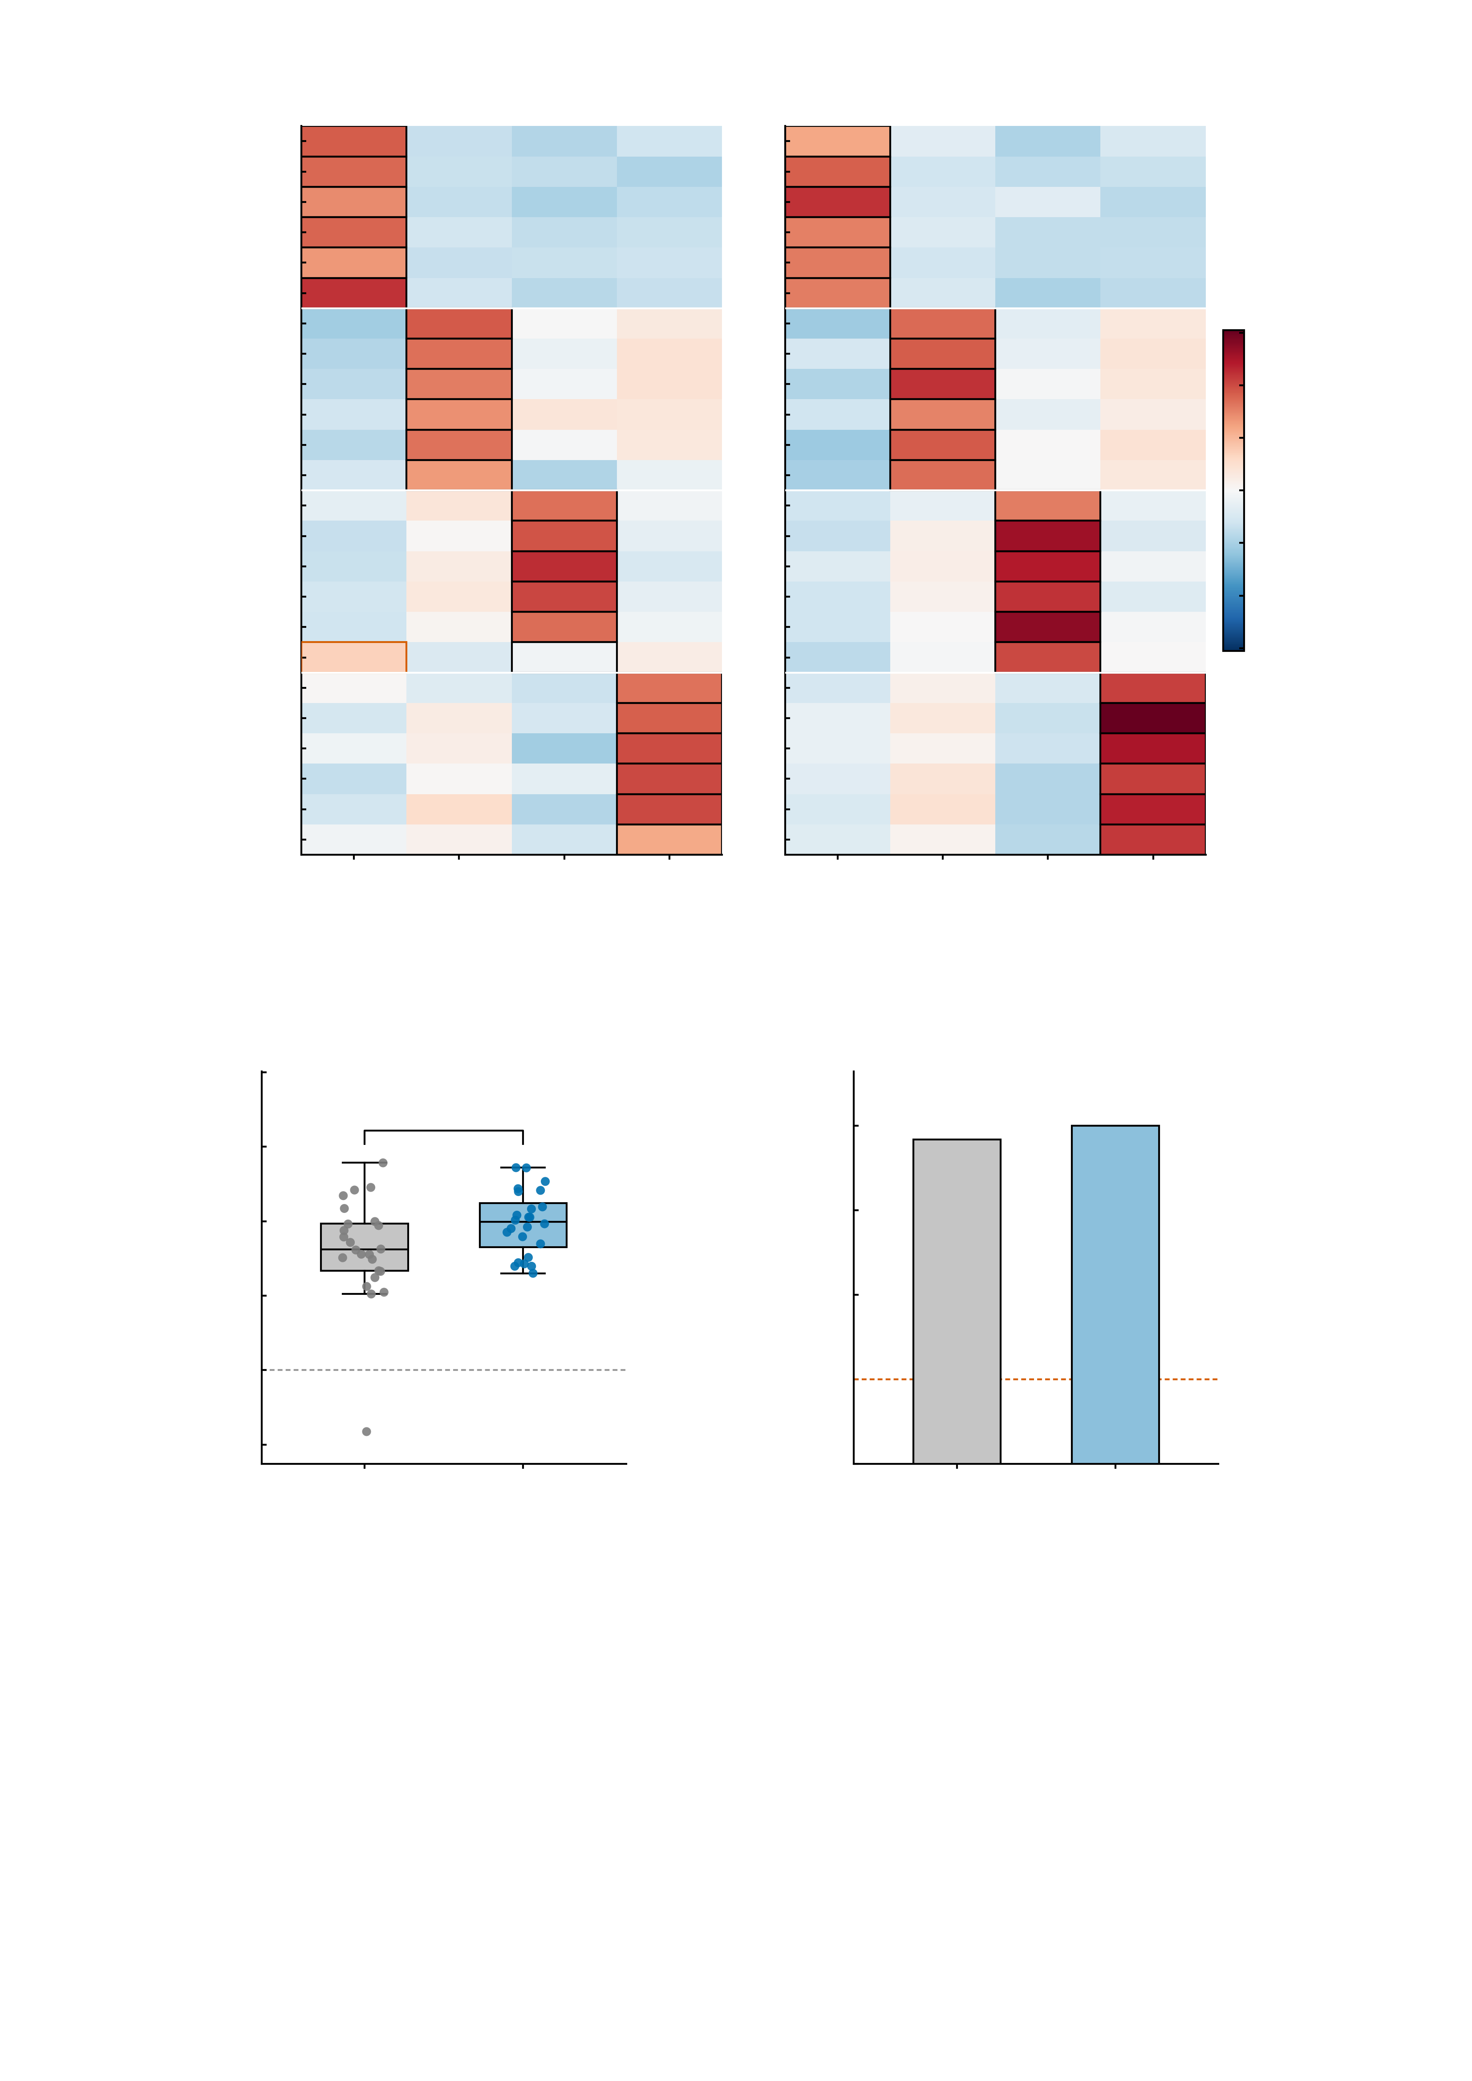
a
Empirical BOLD
23/24 correct = 95.8%
b
Digital twins, no re-assimilation
24/24 correct = 100.0%
sub1 angry 1
sub1 angry 2
sub1 neutral 1
sub1 neutral 2
sub1 happy 1
0.4
sub1 happy 2
sub2 angry 1
0.3
sub2 angry 2
sub2 neutral 1
0.2
sub2 neutral 2
0.1
sub2 happy 1
sub2 happy 2
Pattern correlation
sub3 angry 1
0.0
sub3 angry 2
-0.1
sub3 neutral 1
sub3 neutral 2
-0.2
sub3 happy 1
-0.3
sub3 happy 2
sub4 angry 1
-0.4
sub4 angry 2
sub4 neutral 1
sub4 neutral 2
sub4 happy 1
sub4 happy 2
sub1
sub2
sub3
sub4
sub1
sub2
sub3
sub4
Participant template
Participant template
c
0.5
d
exact binomial vs chance
P = 2.6e-13 and 3.6e-15
0.4
*
100.0%
0.3
100
95.8%
0.2
75
Identification margin
(self − best other r)
Identification accuracy (%)
0.1
50
0.0
25
chance, 25%
-0.1
Empirical
Twins
0
Empirical
Twins
-0.2

